Slide 1
Section A.2
The Fundamental Counting Principle and Permutations

Slide 2
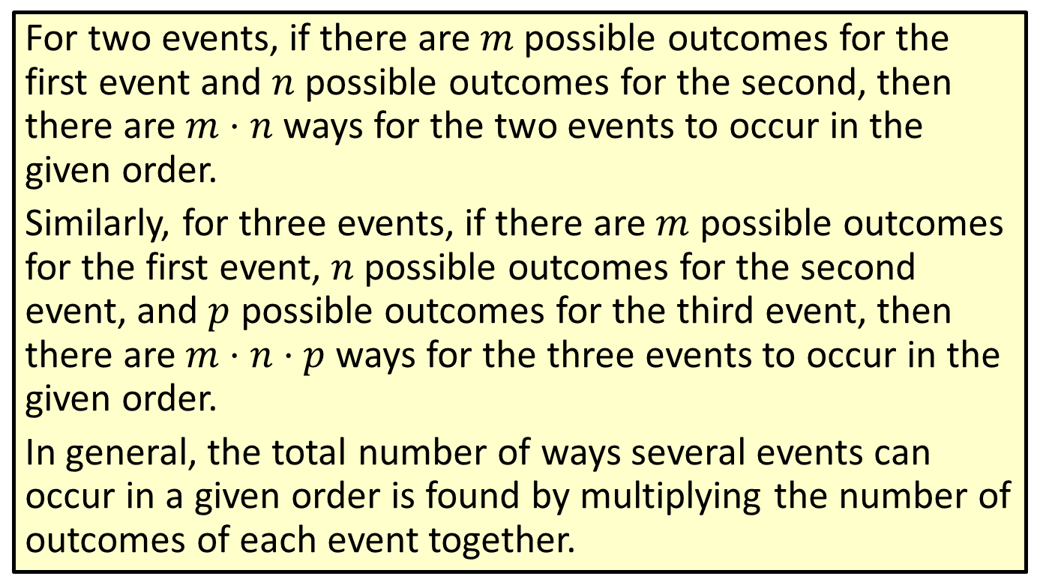
Definition: The Fundamental Counting Principle
For two events, if there are $m$ possible outcomes for the first event and $n$ possible outcomes for the second, then there are $m⋅n$ ways for the two events to occur in the given order.
Similarly, for three events, if there are $m$ possible outcomes for the first event, $n$ possible outcomes for the second event, and $p$ possible outcomes for the third event, then there are $m⋅n⋅p$ ways for the three events to occur in the given order.
In general, the total number of ways several events can occur in a given order is found by multiplying the number of outcomes of each event together.

Slide 3
Example 1: Using the Fundamental Counting Principle
A home contractor offers two basic floor plans, each with two possible arrangements for the garage, four color combinations, and three types of landscaping. How many different homes can the contractor build?
Solution
Each of the possible home design options can be considered an event.
Event 1: number of floor plans = 2
Event 2: number of garage options = 2
Event 3: number of color combinations = 4
Event 4: number of landscaping types = 3

Slide 4
Example 1: Using the Fundamental Counting Principle (cont.)
Now, using the fundamental counting principle, multiply the number of outcomes for each
event to find the total number of different homes the contractor can build.
2 · 2 · 4 · 3 = 48
The contractor can build 48 different homes.

Slide 5
Definition: Permutation
A permutation is an arrangement (or ordering) of the elements of a set where the order matters.

Slide 6
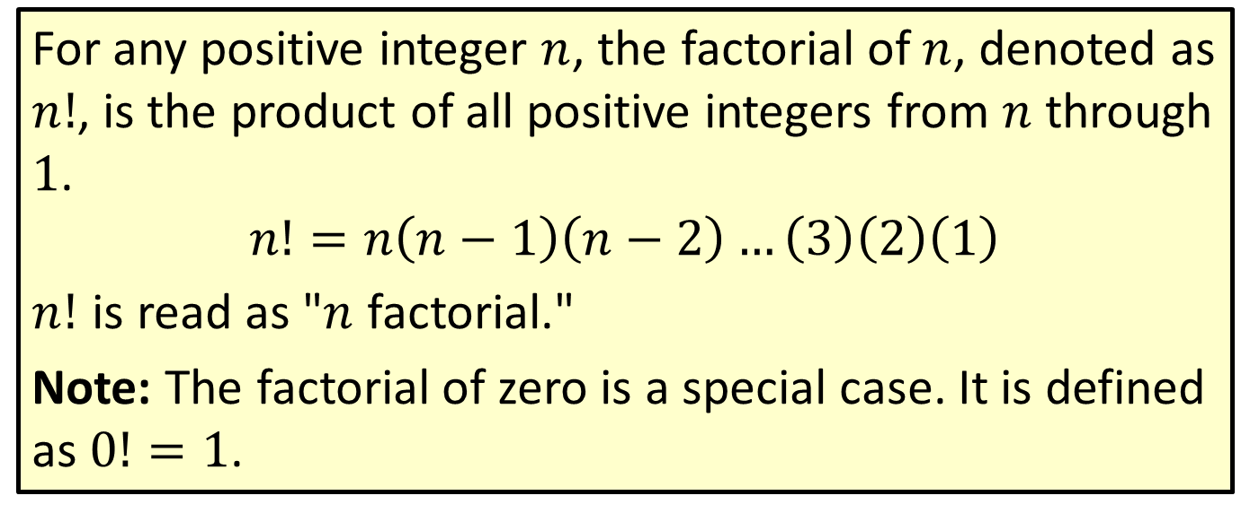

Definition: $n$ Factorial ($n!$)
For any positive integer $n$, the factorial of $n$, denoted as $n!$, is the product of all positive integers from $n$ through 1.
$$n!=n\left(n−1\right)\left(n−2\right)…\left(3\right)\left(2\right)\left(1\right)$$
$n!$ is read as "$n$ factorial."
Note: The factorial of zero is a special case. It is defined as $0!=1$.

Slide 7
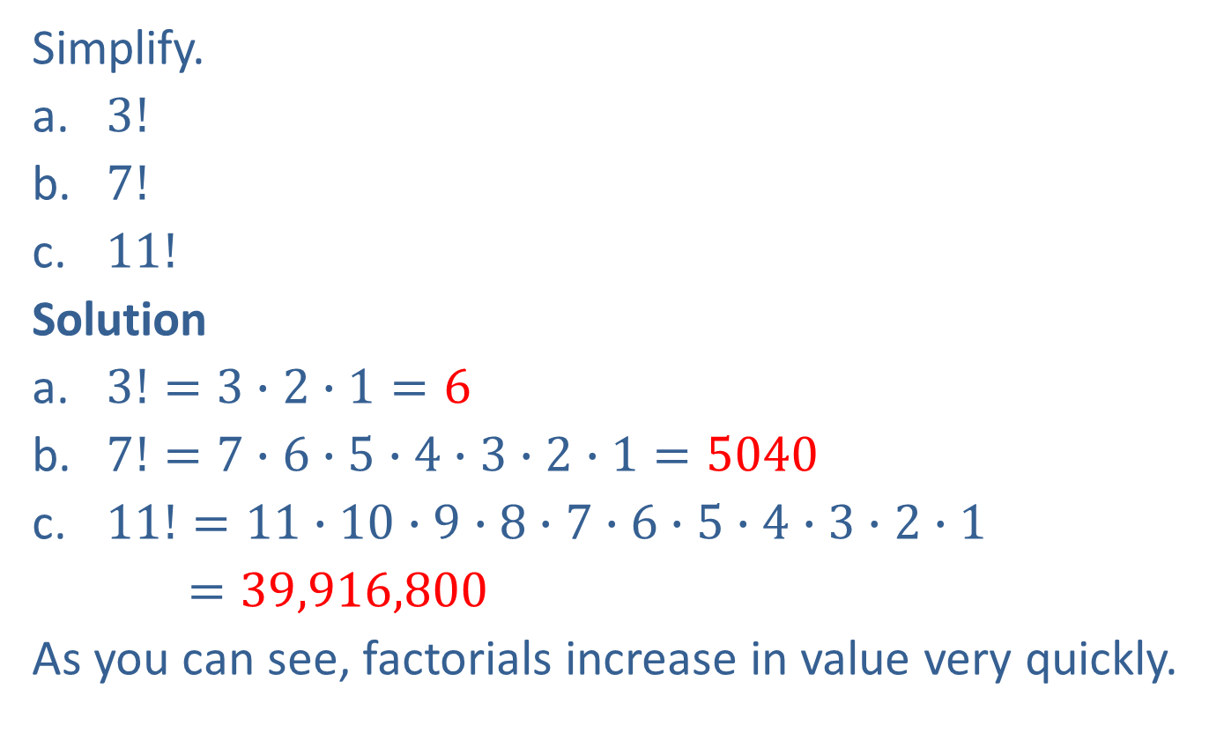
Example 2: Simplifying Factorials
Simplify.
​$3!$
​$7!$
​$11!$
Solution
​$3!=3∙2∙1=6$
​$7!=7∙6∙5∙4∙3∙2∙1=5040$
​$11!=11∙10∙9∙8∙7∙6∙5∙4∙3∙2∙1$
$=39,916,800$
As you can see, factorials increase in value very quickly.

Slide 8
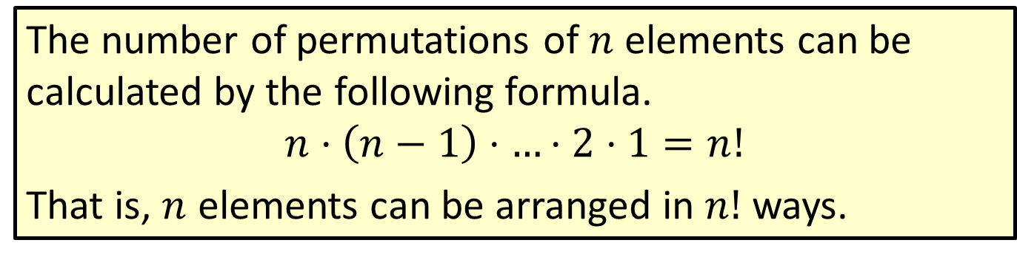

Formula: Number of Permutations of $n$ Elements
The number of permutations of $n$ elements can be calculated by the following formula.
$$n⋅\left(n−1\right)⋅…⋅2⋅1=n!$$
That is, $n$ elements can be arranged in $n!$ ways.

Slide 9
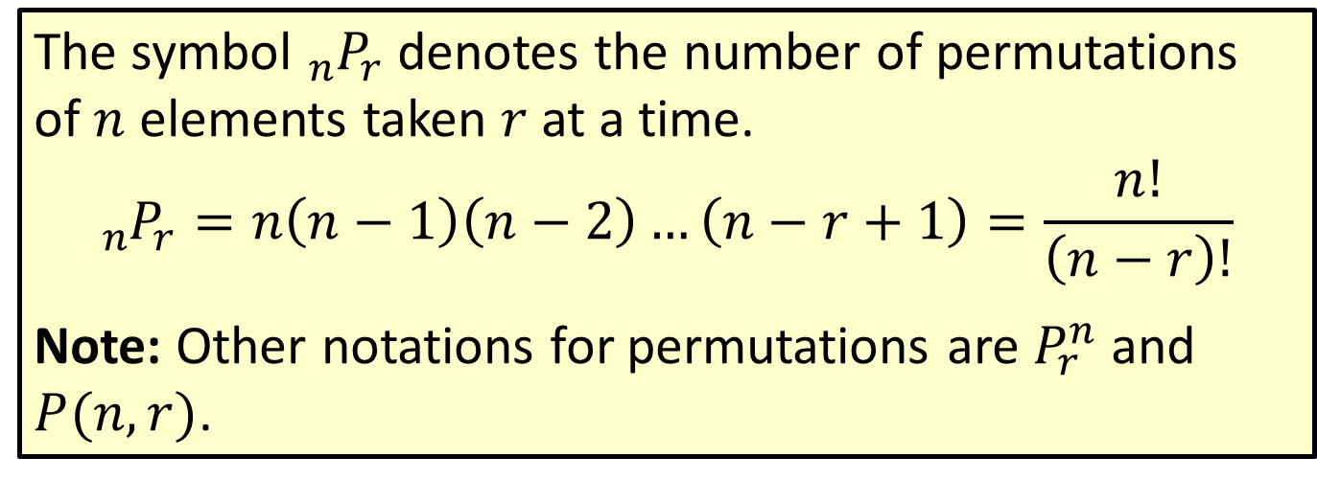

Formula: Number of Permutations of $n$ Elements Taken $r$ at a Time
The symbol ${}_{n}^{ }{P_{r}}$ denotes the number of permutations of $n$ elements taken $r$ at a time.
$${}_{n}^{ }{P_{r}}=n\left(n−1\right)\left(n−2\right)…\left(n−r+1\right)=\frac{n!}{\left(n−r\right)!}$$
Note: Other notations for permutations are $P_{r}^{n}$ and $P(n,r)$.

Slide 10
Example 3: Calculating the Number of Permutations of n Elements Taken r at a Time
If the digits 1, 2, 3, 4, 5, and 6 are used to form four-digit numbers, how many numbers can be formed
​if digits may not be repeated, and
​if digits may be repeated?
Solution
For both situations, we have a set of 6 elements (the numbers) and we are choosing 4 of them.
Since the numbers cannot be repeated, we have a permutation of 6 elements taken 4 at a time. We can substitute these values into the formula and simplify.

Slide 11
Example 3: Calculating the Number of Permutations of n Elements Taken r at a Time (cont.)
Since any of the digits can be used in more than one position, this part of the problem does not involve permutations. Instead we use the fundamental counting principle.
There are 360 four‑digit numbers if the digits may not be repeated and 1296 four‑digit numbers if digits may be repeated.

Slide 12
Example 4: Calculating the Number of Permutations of n Elements Taken r at a Time
A sailor has 7 different flags he can signal with. How many signals can he send using 3 flags at a time?
Solution
In this case, we have a set of 7 elements (the flags) and we are choosing 3 of them. This means n = 7 and r = 3. Now substitute these values into the formula and simplify.
Therefore, the sailor can send 210 different signals using 3 flags.

Slide 13
Formula: Permutations with Repetition
The number of permutations with repetition of n objects can be calculated by the formula
where k is the number of unique elements repeated x₁, x₂, x₃, …, x_{k} times, respectively.

Slide 14
Example 5: Calculating the Number of Permutations with Repetition
Use the formula for permutations with repetition to calculate each value.
How many ways can the letters in the word BOOKKEEPER be arranged?
How many six‑digit numbers can be created with the numbers 2, 2, 3, 3, 6, 8?

Slide 15
Example 5: Calculating the Number of Permutations with Repetition (cont.)
Solution
BOOKKEEPER is a word with 10 letters, so n = 10. There is a total of 6 unique letters: 3 Es, 2 Os, 2 Ks, 1 B, 1 P, and 1 R. Thus, we have x₁ = 3, x₂ = 2, x₃ = 2, x₄ = 1, x₅ = 1, and x₆ = 1. Using the formula, we get the following.
Therefore, there are 151,200 ways the letters in BOOKKEEPER can be arranged.

Slide 16
Example 5: Calculating the Number of Permutations with Repetition (cont.)
The set of numbers 2, 2, 3, 3, 6, 8 contains 6 digits, so n = 6. There are 4 unique elements in this set: two 2s, two 3s, one 6, and one 8. Thus, we have x₁ = 2, x₂ = 2, x₃ = 1, and x₄ = 1. Using the formula, we get the following.
Therefore, there are 180 six‑digit numbers that can be created.

