Slide 1
Section A.1
Decimal Numbers and Percents

Slide 2
Procedure: Reading or Writing a Decimal Number
​Read (or write) the whole number.
​Read (or write) the word "and" in place of the decimal point.
​Read (or write) the fraction part as a whole number. Then, name the fraction part with the name of the place of the last digit on the right.

Slide 3
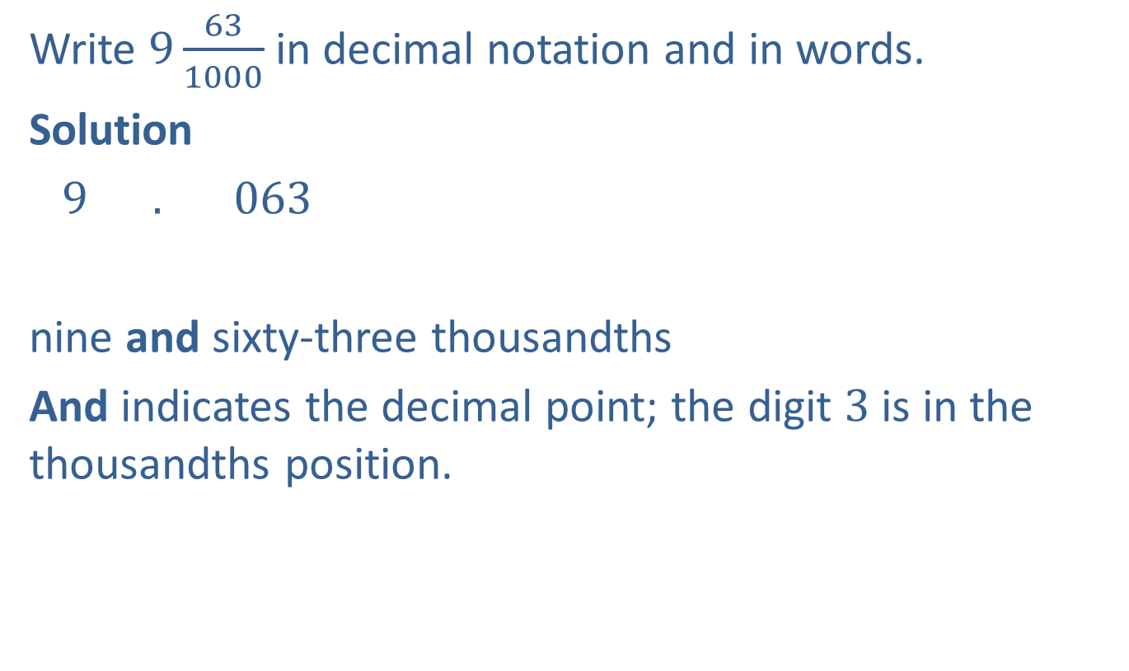
Example 1: Writing in Decimal Notation
Write $9\frac{63}{1000}$ in decimal notation and in words.
Solution
$9 . 063$
nine and sixty-three thousandths
And indicates the decimal point; the digit $3$ is in the thousandths position.
In decimal notation
In words

Slide 4
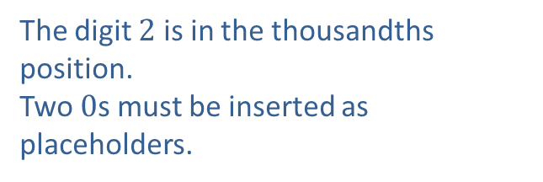
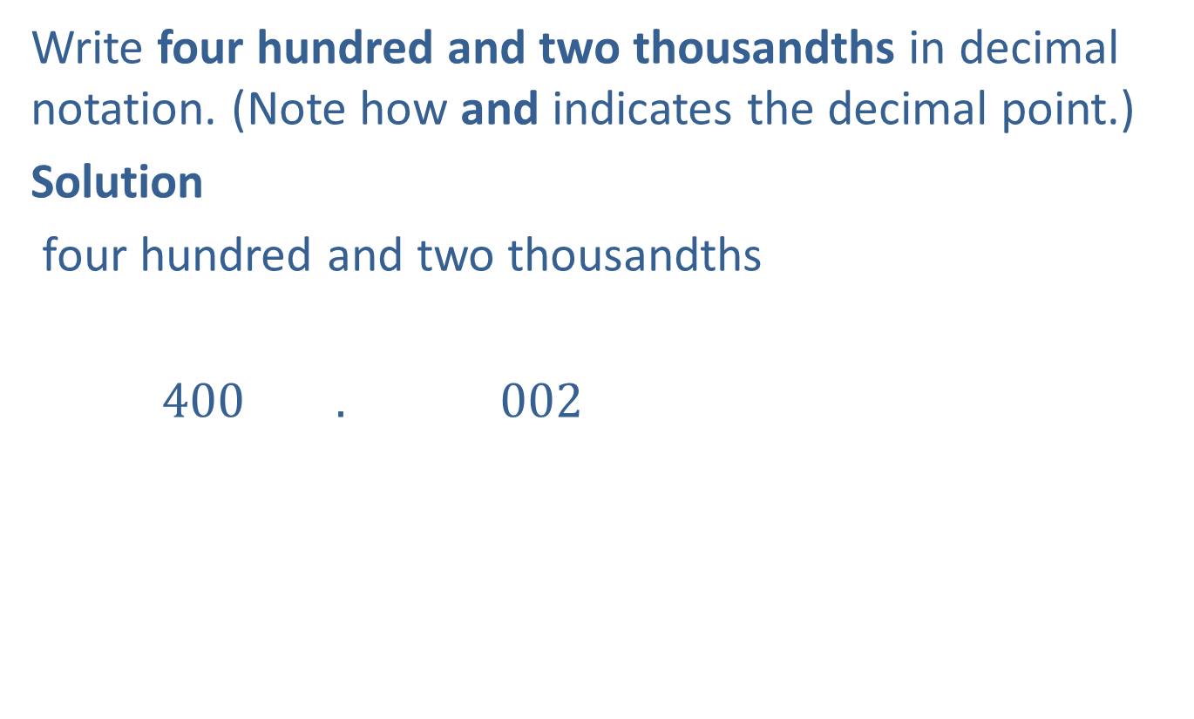
Example 2: Reading and Writing Decimal Numbers
Write four hundred and two thousandths in decimal notation. (Note how and indicates the decimal point.)
Solution
four hundred and two thousandths
$400 . 002$
The digit $2$ is in the thousandths position.
Two $0$s must be inserted as placeholders.

Slide 5

Example 3: Reading and Writing Decimal Numbers
Write four hundred two thousandths in decimal notation.
Solution
$0 . 402$
four hundred two thousandths

Slide 6
Procedure: Comparing Two Decimal Numbers
​Moving left to right, compare digits with the same place value. (Insert 0s to the right to continue comparison if necessary.)
​When one compared digit is larger, then the corresponding number is larger.

Slide 7
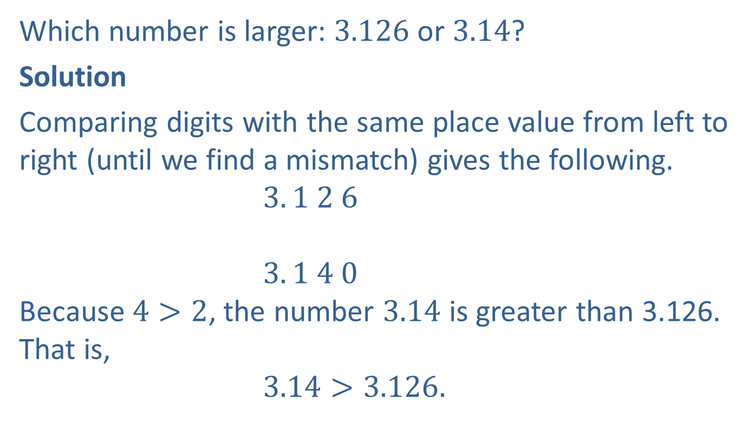
Example 4: Comparing Decimal Numbers
Which number is larger: 3.126 or 3.14?
Solution
Comparing digits with the same place value from left to right (until we find a mismatch) gives the following.
$3. 1 2 6$
$3. 1 4 0$
Because $4>2$, the number $3.14$ is greater than 3.126. That is,
$3.14>3.126.$
Mismatch

Slide 8


Example 4: Comparing Decimal Numbers (cont.)
Graphing these values on a number line, we have
$3.14>3.126$ and $3.14$ lies to the right of $3.126$.

Slide 9
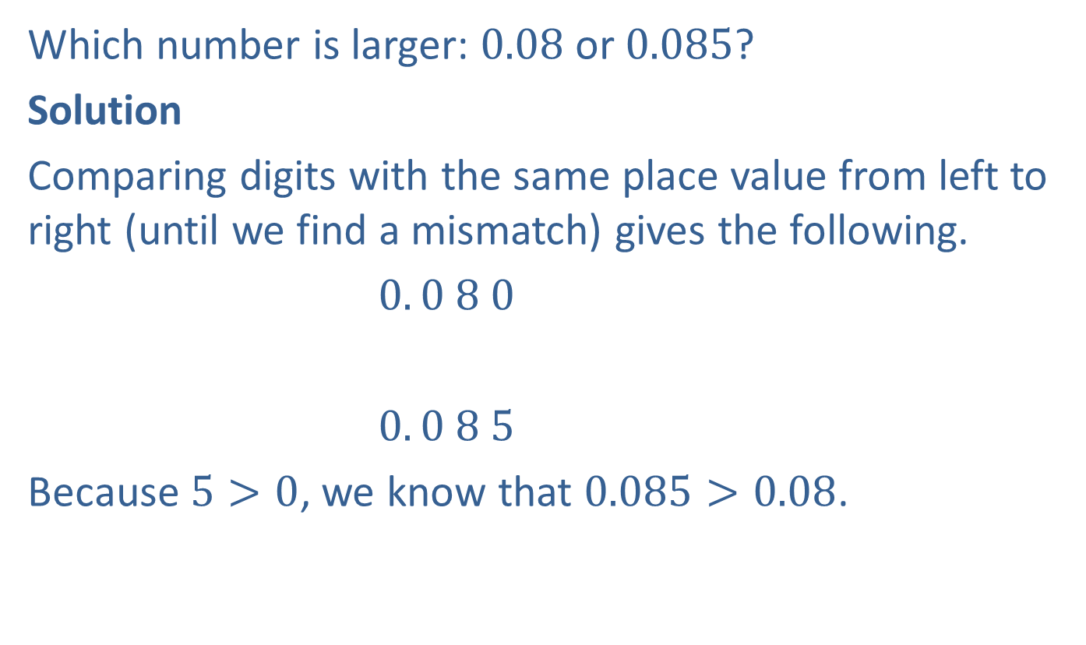
Example 5: Comparing Decimal Numbers
Which number is larger: 0.08 or 0.085?
Solution
Comparing digits with the same place value from left to right (until we find a mismatch) gives the following.
$0. 0 8 0$
$0. 0 8 5$
Because $5>0$, we know that $0.085>0.08$.
Mismatch

Slide 10


Example 5: Comparing Decimal Numbers (cont.)
Graphing these values on a number line, we have
$0.085>0.08$ and $0.085$ lies to the right of $0.08$.

Slide 11
Procedure: Adding Decimal Numbers
​Write the numbers vertically.
​Keep the decimal points aligned vertically.
​Keep digits with the same place values aligned. Zeros may be written in to help keep the digits aligned properly.
​Add, just as with whole numbers, keeping the decimal point in the sum aligned with the other decimal points.

Slide 12
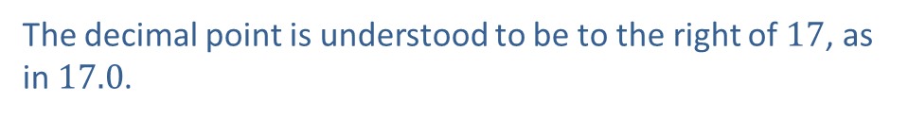


Example 6: Adding Decimal Numbers
Add: $17+4.88+50.033+0.6$
Solution
$$17.000$$
$4.880$
$50.033$
$$\underline{+ 0.600}$$
$72.513$
$$1 1 1$$
The decimal point is understood to be to the right of $17$, as in $17.0$.
$0$s are written in to help keep digits aligned.

Slide 13
Procedure: Subtracting Decimal Numbers
​Write the numbers vertically.
​Keep the decimal points aligned vertically.
​Keep digits with the same place values aligned. Zeros may be written in to help keep the digits aligned properly.
​Subtract, just as with whole numbers, keeping the decimal point in the difference aligned with the other decimal points.

Slide 14






Example 7: Subtracting Decimal Numbers
Subtract: $21.715−14.8$
Solution
$$2 1. 7 1 5$$
$$\underline{−1 4. 8 0 0}$$
$$6. 9 1 5$$
$$10$$
$$1$$
$$0$$
$$17$$
$0$s are written in to help keep digits aligned.

Slide 15

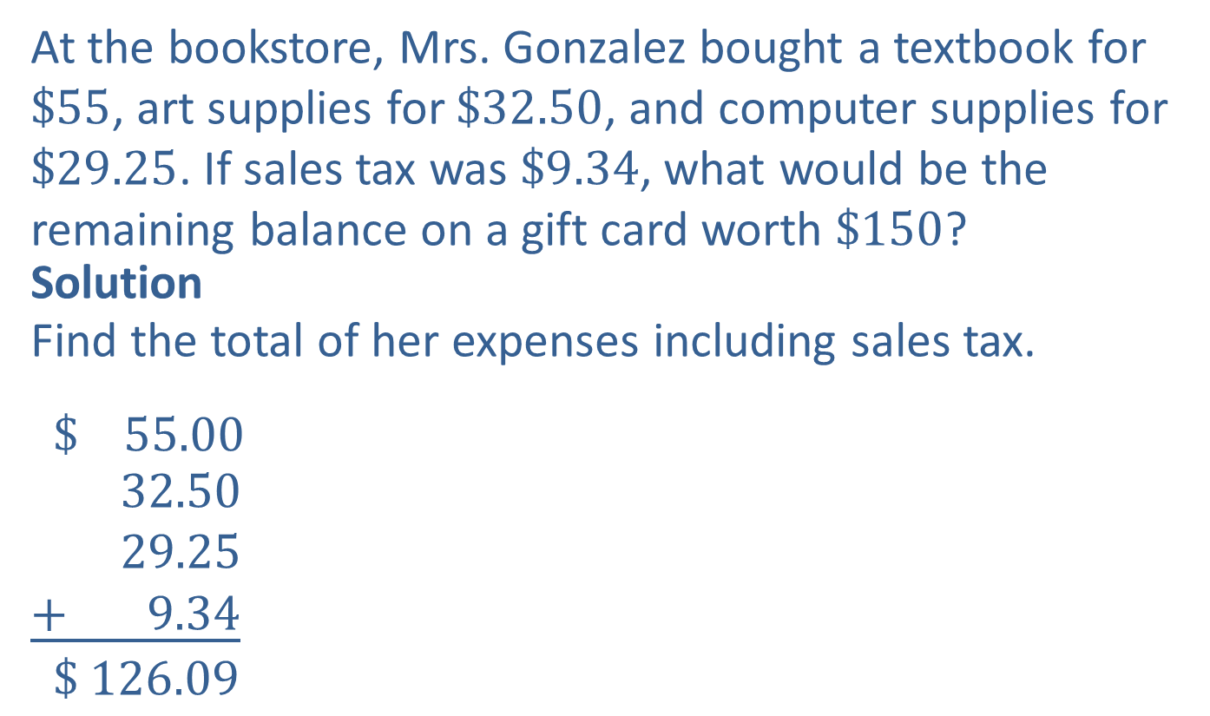

Example 8: Application: Adding and Subtracting Decimal Numbers
At the bookstore, Mrs. Gonzalez bought a textbook for $\$55$, art supplies for $\$32.50$, and computer supplies for $\$29.25$. If sales tax was $\$9.34$, what would be the remaining balance on a gift card worth $\$150$?
Solution
Find the total of her expenses including sales tax.
$$\$ 55.00$$
$$32.50$$
$$29.25$$
$$\underline{+ 9.34}$$
$$\$ 126.09$$
$$1$$
$$2$$
$$1$$
Total expenses

Slide 16



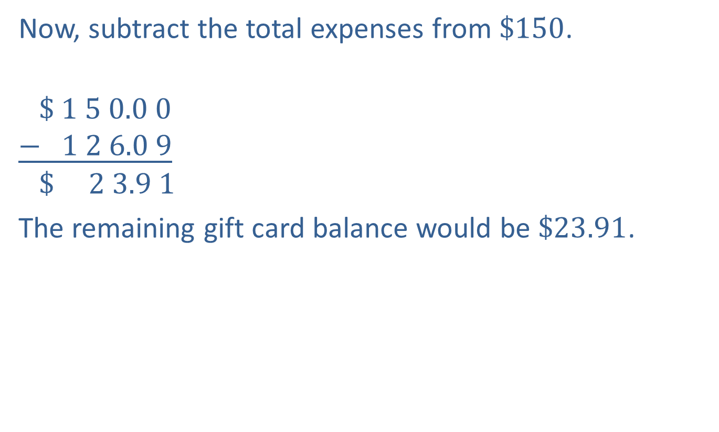



Example 8: Application: Adding and Subtracting Decimal Numbers (cont.)
Now, subtract the total expenses from $\$150$.
$$\$ 1 5 0.0 0$$
$$\underline{− 1 2 6.0 9}$$
$$\$ 2 3.9 1$$
The remaining gift card balance would be $\$23.91$.
$$9$$
$$9$$
$$4$$
$$10$$
$$10$$
$$10$$

Slide 17
Procedure: Multiplying Decimal Numbers
​Multiply the two numbers as if they were whole numbers.
​Count the total number of digits to the right of the decimal points in both numbers being multiplied.
​Place the decimal point in the product so that the number of digits to the right of the decimal point is the same as that found in Step 2. (Zeros may need to be inserted.)

Slide 18


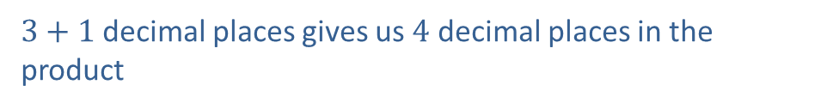

Example 9: Multiplying Decimal Numbers
Multiply: $2.435∙4.1$
Solution
$$2.4 3 5$$
$$\underline{× 4.1}$$
$$2 4 3 5$$
$$\underline{ 9 7 4 0 }$$
$$9.9 8 3 5$$
$3$ decimal places
$1$ decimal places
$3+1$decimal places gives us $4$ decimal places in the product

Slide 19
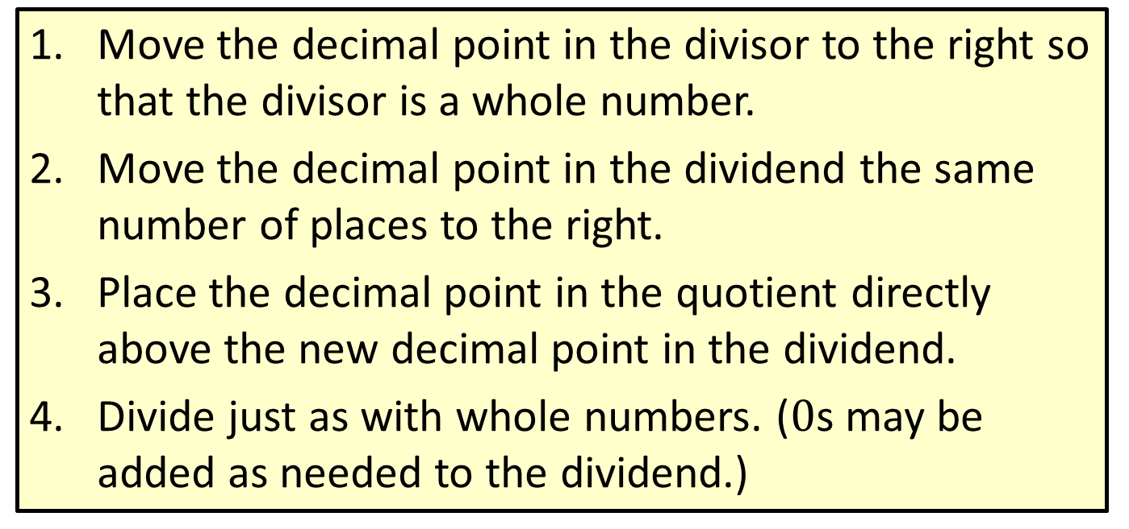
Procedure: Dividing Decimal Numbers
​Move the decimal point in the divisor to the right so that the divisor is a whole number.
​Move the decimal point in the dividend the same number of places to the right.
​Place the decimal point in the quotient directly above the new decimal point in the dividend.
​Divide just as with whole numbers. ($0$s may be added as needed to the dividend.)

Slide 20

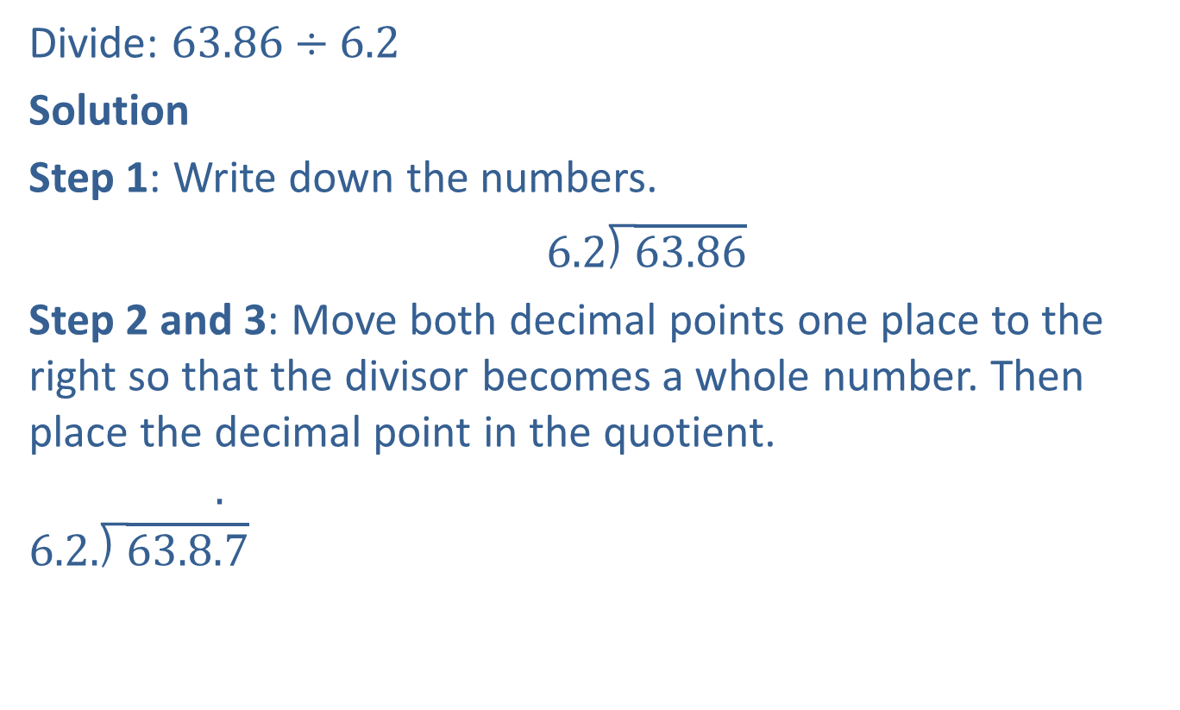
Example 10: Dividing Decimal Numbers
Divide: $63.86÷6.2$
Solution
Step 1: Write down the numbers.
$6.2\text{⟌}\overline{63.86}$
Step 2 and 3: Move both decimal points one place to the right so that the divisor becomes a whole number. Then place the decimal point in the quotient.
.
$$\text{6}\text{.}\text{2}\text{.}\text{⟌}\overline{63.8.7}$$
Decimal point in quotient

Slide 21

Example 10: Dividing Decimal Numbers (cont.)
Step 4: Proceed to divide as with whole numbers.
$1 0.3$
$\text{6} \text{2.}\text{⟌}\overline{6 3 8.6}$
$\underline{−6 2}$
$1 8$
$\underline{ −0}$
$1 8 6$
$\underline{−1 8 6}$
$0$
Quotient
Divisor
Dividend
Remainder

Slide 22
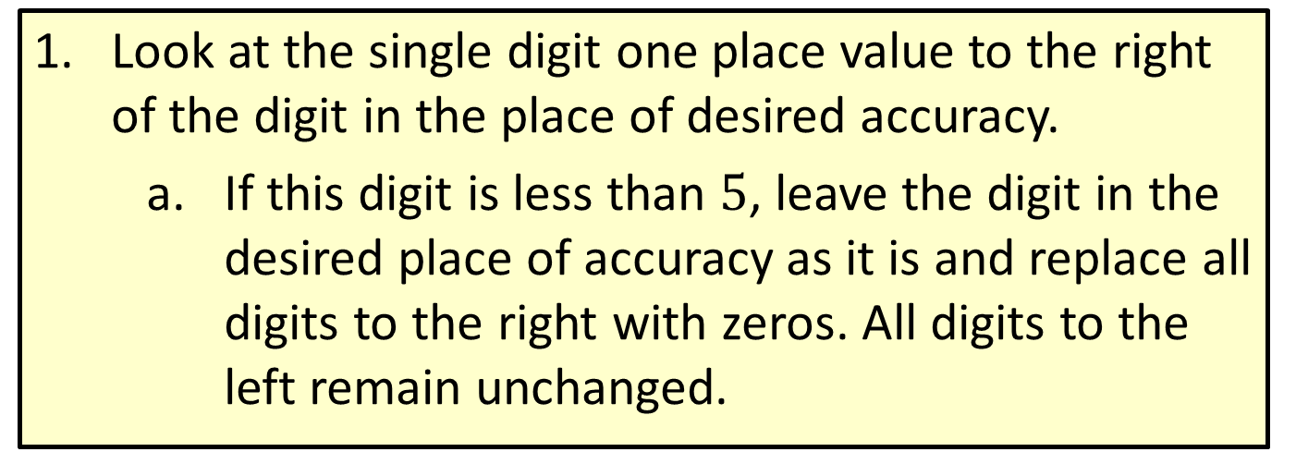
Procedure: Rounding Rule for Decimal Numbers
​Look at the single digit one place value to the right of the digit in the place of desired accuracy.
  If this digit is less than $5$, leave the digit in the desired place of accuracy as it is and replace all digits to the right with zeros. All digits to the left remain unchanged.

Slide 23
Procedure: Rounding Rule for Decimal Numbers (cont.)
  ​If this digit is 5 or greater, increase the digit in the desired place of accuracy by one and replace all digits to the right with zeros. All digits to the left remain unchanged unless a 9 is made one larger. Then, the 9 is replaced by 0 and the next digit to the left is increased by 1.
​Zeros to the right of the place of accuracy that are also to the right of the decimal point must be dropped. In this way, the place of accuracy is clearly understood. If a rounded number has a 0 in the desired place of accuracy, then that 0 remains.

Slide 24
Procedure: Dividing When the Remainder is
Not 0
Decide how many decimal places are to be in the quotient.
Divide until the quotient has been calculated to one place to the right of the place of desired accuracy.
Using this last digit, round the quotient to the desired place of accuracy.

Slide 25

Example 11: Dividing Decimal Numbers
Find the quotient $82.3÷2.9$ to the nearest tenth.
Solution
Divide until the quotient has been calculated to the hundredths place (one place more than tenths), then round to the nearest tenth.

Slide 26


Example 11: Dividing Decimal Numbers (cont.)
$2 8.3 7≈2 8.4$
$$2.9.\text{⟌}\overline{8 2.3.0 0}$$
$$\underline{−5 8}$$
  $2 4 3$
  $$\underline{−2 3 2}$$
  $1 1 0$
  $\underline{ −8 7}$
  $2 3 0$
  $$\underline{−2 0 3}$$
  $2 7$
  Thus, $82.3 ÷2.9 ≈28.4.$
Hundredths
Read “approximately equals”
Round to the nearest tenth.
Add $0$s as needed.
Accurate to the nearest tenth

Slide 27
Procedure: Changing a Decimal Number to a Percent
​Move the decimal point two places to the right.
​Write the % symbol.

Slide 28


Example 12: Changing Decimal Numbers to Percents
Change each decimal to an equivalent percent.
​0.254 b. ​0.005 c. ​1.5 d. ​0.6
Solution
a. $0.25.4=25.4\%$
b. $0.00.5=0.5\%$
% symbol added.
Decimal point moved two places to the right
% symbol added. Note that this is less than $1\%$.
Decimal point moved two places to the right

Slide 29

Example 12: Changing Decimal Numbers to Percents (cont.)
c. $1.50. =150\%$
d. $0.60.=60\%$
% symbol added. Note that this is more than $100\%$.
Decimal point moved two places to the right (a $0$ is inserted)
% symbol added.
Decimal point moved two places to the right (a $0$ is inserted)

Slide 30
Procedure: Changing a Percent to a Decimal Number
​Move the decimal point two places to the left.
​Delete the % sign.

Slide 31
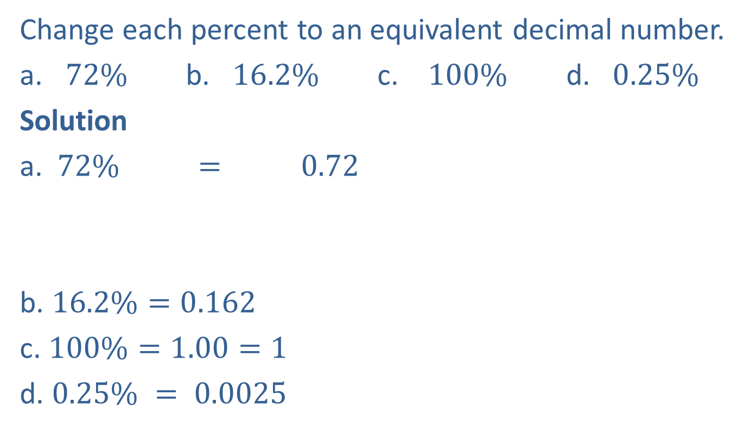
Example 13: Changing Percents to Decimal Numbers
Change each percent to an equivalent decimal number.
​$72\%$ b. $16.2\%$ c. ​$100\%$ d. ​$0.25\%$
Solution
a. $72\% = 0.72$
b. $16.2\%=0.162$
c. $100\%=1.00=1$
d. $0.25\% = 0.0025$
% symbol deleted
Understood decimal point
Decimal point moved two places to the left
Note that when moving the decimal point two places to the left,
two zeros were added as placeholders.

Slide 32
Procedure: Changing a Fraction to a Percent
Change the fraction to a decimal number. (Divide the numerator by the denominator.)
Change the decimal number to a percent.

Slide 33
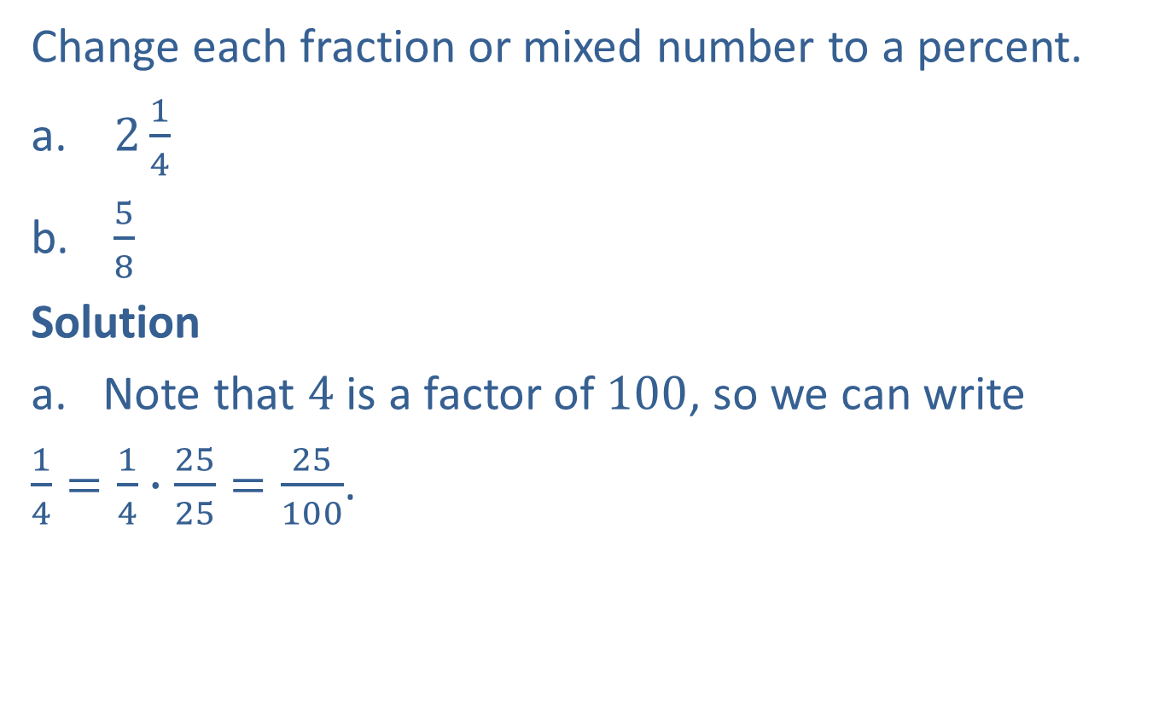
Example 14: Changing Fractions and Mixed Numbers to Percents
Change each fraction or mixed number to a percent.
$2\frac{1}{4}$
$\frac{5}{8}$
Solution
Note that $4$ is a factor of $100$, so we can write
$\frac{1}{4}=\frac{1}{4}∙\frac{25}{25}=\frac{25}{100}$.

Slide 34

Example 14: Changing Fractions and Mixed Numbers to Percents (cont.)
Using this equivalent fraction, we can change $2\frac{1}{4}$ to decimal form, then change to decimal form, then change the decimal number to a percent as follows.
$$2\frac{1}{4}=2\frac{25}{100}=2.25=225\%$$

Slide 35
Example 14: Changing Fractions and Mixed Numbers to Percents (cont.)
b. Note that 8 is not a factor of 100, so we divide using long division (or using a calculator).
This can be done with a calculator.
Now change 0.625 to a percent. Move the decimal point two places to the right
and write the % sign.

Slide 36
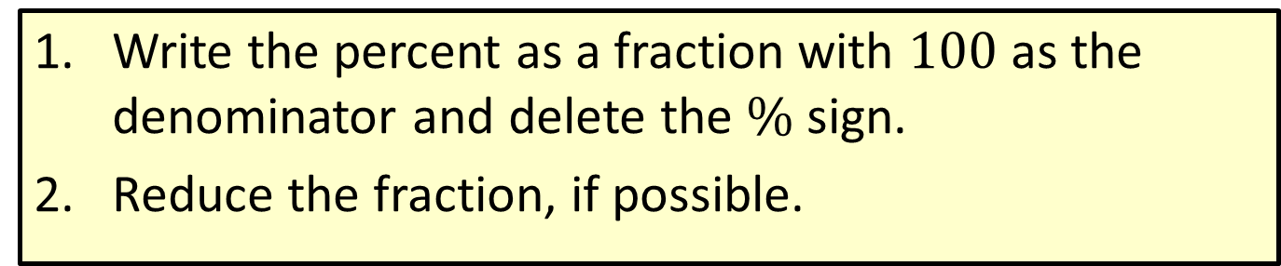
Procedure: Changing a Percent to a Fraction or a Mixed Number
Write the percent as a fraction with $100$ as the denominator and delete the $\%$ sign.
Reduce the fraction, if possible.

Slide 37
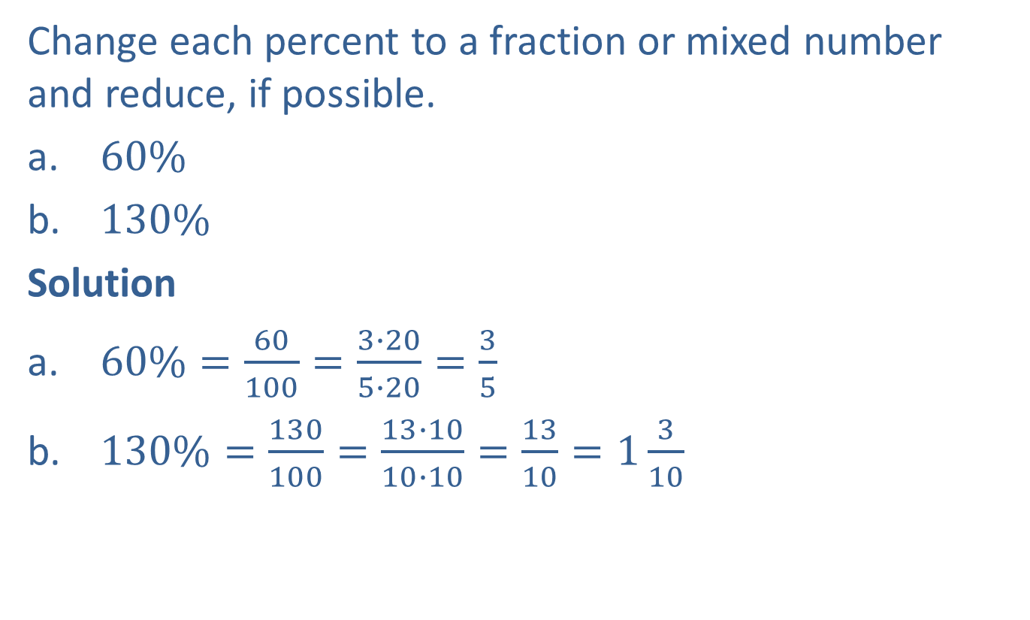
Example 15: Changing Percents to Fractions and Mixed Numbers
Change each percent to a fraction or mixed number and reduce, if possible.
$60\%$
$130\%$
Solution
$60\%=\frac{60}{100}=\frac{3∙20}{5∙20}=\frac{3}{5}$
$130\%=\frac{130}{100}=\frac{13∙10}{10∙10}=\frac{13}{10}=1\frac{3}{10}$

