Slide 1
Section 9.4
Basic Matrix Operations

Slide 2
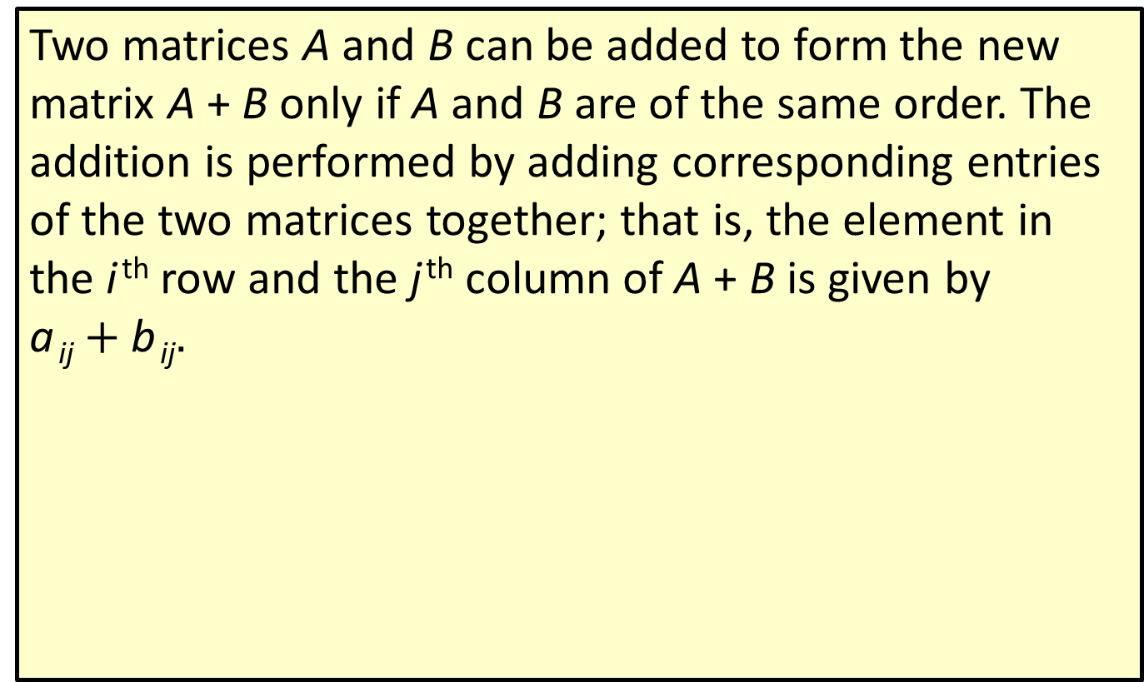
Definition: Matrix Addition
Two matrices A and B can be added to form the new matrix A + B only if A and B are of the same order. The addition is performed by adding corresponding entries of the two matrices together; that is, the element in the i ^{th} row and the j ^{th} column of A + B is given by
a _{ij}$+ \text{b} \text{ij}$.

Slide 3
CAUTION!₁
It is very important to note the restriction on the order of the two matrices in the definition; a matrix with m rows and n columns can only be added to another matrix with m rows and n columns. In all aspects of matrix algebra, the orders of the matrices involved must be considered.

Slide 4
Definition: Matrix Equality
Two matrices A and B are equal, denoted A = B, if they are of the same order and all corresponding entries of A and B are equal.

Slide 5
Example 1: Matrix Addition₁
Perform the indicated addition, if possible.

Slide 6
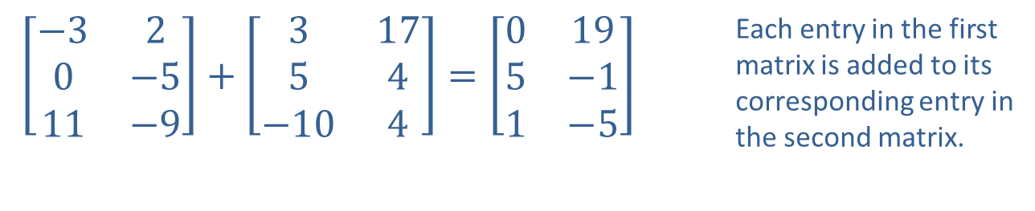
Example 1: Matrix Addition₂
Solution
​Both matrices are​
so the sum is defined.
$\left[\begin{matrix}−3 & 2 \\ 0 & −5 \\ 11 & −9\end{matrix}\right]+\left[\begin{matrix}3 & 17 \\ 5 & 4 \\ −10 & 4\end{matrix}\right]=\left[\begin{matrix}0 & 19 \\ 5 & −1 \\ 1 & −5\end{matrix}\right]$ | Each entry in the first matrix is added to its corresponding entry in the second matrix.

Slide 7
Example 1: Matrix Addition₃
​The first matrix is
and the second is
so the addition cannot be performed.

Slide 8
Example 2: Matrix Equations₁
Determine the values of the variables that will make each of the following statements true.

Slide 9
Example 2: Matrix Equations₂
Solution
​Solving for the four variables a, b, c, and d is just a matter of comparing the entries one-by-one.
​
​
  Comparing the top rows tells us that a = 3, b = 7, and
  c = −3.
  In the bottom rows, note the −2 in the left corner of each matrix and the 5 in each right corner. If these constants were not equal we would have a contradiction, and there would be no way to make the matrix equation true.

Slide 10
Example 2: Matrix Equations₃
​The only variable left to solve for is d, which we see is equal to a + b. So, d = 3 + 7 = 10.

Slide 11
Example 2: Matrix Equations₄
​Each matrix consists of only two entries, and after performing the matrix addition on the left and comparing corresponding entries, we arrive at the following system of equations.
​
​​

Slide 12
Example 2: Matrix Equations₅
​We know a number of ways of solving such a system. If we choose to use Cramer's Rule, we first rewrite the system as follows.
​
​
​
​From here we can determine

Slide 13
Definition: Scalar Multiplication
If A is an
matrix and c is a scalar, cA stands for
matrix for which each entry is c times the
corresponding entry of A. In other words, the entry in the i ^{th} row and j ^{th} column of cA is ca _{ij} .

Slide 14
Example 3: Scalar Multiplication₁
Given the matrices
write −3A + 2B as a single matrix.

Slide 15
Example 3: Scalar Multiplication₂
Solution
Before calculating, note that the operation can be performed since both matrices are of the same order,
This problem has two steps. First, multiply each entry of A and B by its corresponding scalar. Second, add the resulting matrices together.

Slide 16
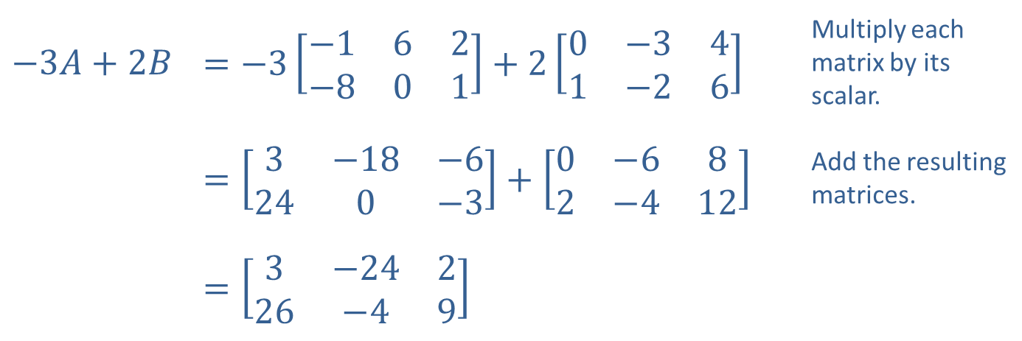
Example 3: Scalar Multiplication₃
​$−3A+2B$ | ​$=−3\left[\begin{matrix}−1 & 6 & 2 \\ −8 & 0 & 1\end{matrix}\right]+2\left[\begin{matrix}0 & −3 & 4 \\ 1 & −2 & 6\end{matrix}\right]$ | Multiply each matrix by its scalar.
 | ​$=\left[\begin{matrix}3 & −18 & −6 \\ 24 & 0 & −3\end{matrix}\right]+\left[\begin{matrix}0 & −6 & 8 \\ 2 & −4 & 12\end{matrix}\right]$ | Add the resulting matrices.
 | ​$=\left[\begin{matrix}3 & −24 & 2 \\ 26 & −4 & 9\end{matrix}\right]$

Slide 17
Definition: Matrix Subtraction
Let A and B be two matrices of the same order. The difference A − B is defined by

Slide 18
Example 4: Matrix Subtraction₁
Perform the indicated subtraction:

Slide 19
Example 4: Matrix Subtraction₂
Solution
Since both matrices are of order
we know the subtraction is possible. Subtract each entry in the second matrix from the corresponding entry in the first.

Slide 20
Definition: Matrix Multiplication
Two matrices A and B can be multiplied together, resulting in a new matrix denoted AB, only if the number of columns of A (the matrix on the left) is the same as the number of rows of B (the matrix on the right). Thus, if A is of order
the product AB is only defined if B is
If we let c _{ij} denote the entry in the i ^{th} row and j ^{th} column of AB, c _{ij} is obtained from the i ^{th} row of A and the j ^{th} column of B by the formula
In words, c _{ij} equals the product of the first element of row i of matrix A and the first element of column j of matrix B, plus the product of the second element of row i and the second element of column j, and so on.

Slide 21
CAUTION!₂
Unlike numerical multiplication, matrix multiplication is not commutative. That is, given two matrices A and B, AB in general is not equal to BA. As an illustration of this fact, suppose
matrix. Then AB is defined
but BA doesn't even exist. Even when both AB and BA are defined, they are generally not equal.

Slide 22
Example 5: Matrix Multiplication₁
Given the matrices
find AB.

Slide 23
Example 5: Matrix Multiplication₂
Solution
Since both matrices are
they can be multiplied,
and the result will also be a
matrix. For this
example, we will follow the procedure one entry at a time.

Slide 24
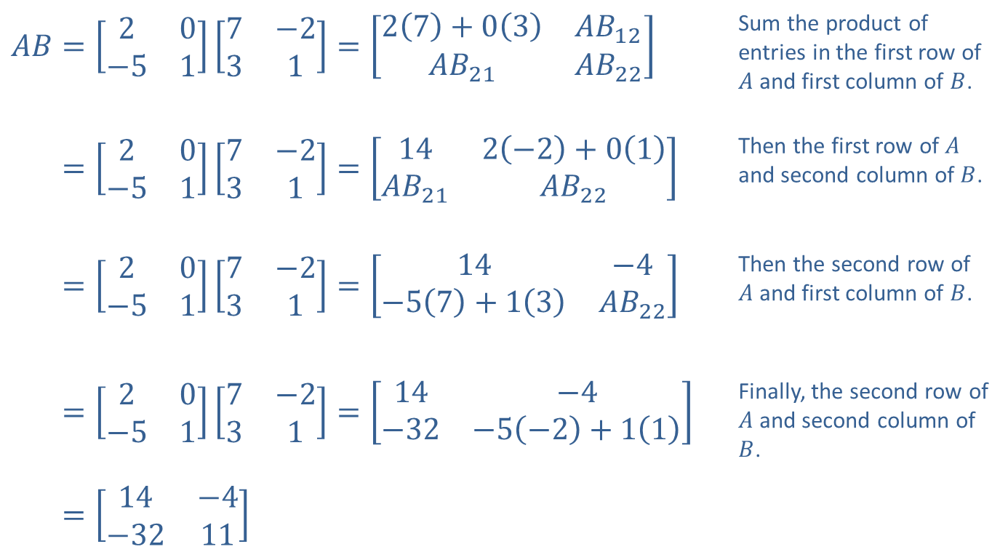
Example 5: Matrix Multiplication₃
​$AB=\left[\begin{matrix}2 & 0 \\ −5 & 1\end{matrix}\right]\left[\begin{matrix}7 & −2 \\ 3 & 1\end{matrix}\right]=\left[\begin{matrix}2\left(7\right)+0\left(3\right) & AB_{1⁣2} \\ AB_{2⁣1} & AB_{2⁣2}\end{matrix}\right]$ | Sum the product of entries in the first row of $A$ and first column of $B$.
​𝐴𝐵=20−517−231=142−2+01𝐴𝐵2⁣1𝐴𝐵2⁣2 | Then the first row of $A$ and second column of $B$.
​𝐴𝐵=20−517−231=14−4−57+13𝐴𝐵2⁣2 | Then the second row of $A$ and first column of $B$.
​𝐴𝐵=20−517−231=14−4−32−5−2+11 | Finally, the second row of $A$ and second column of $B$.
​𝐴𝐵=14−4−3211

Slide 25
Example 6: Matrix Multiplication₁
Given the matrices
find the following products.
​AB
​BA

Slide 26

Example 6: Matrix Multiplication₂
Solution
​$A$ is of order
so AB is defined and is of order
Each entry of
AB is formed from a row of A and a column of B.

Slide 27
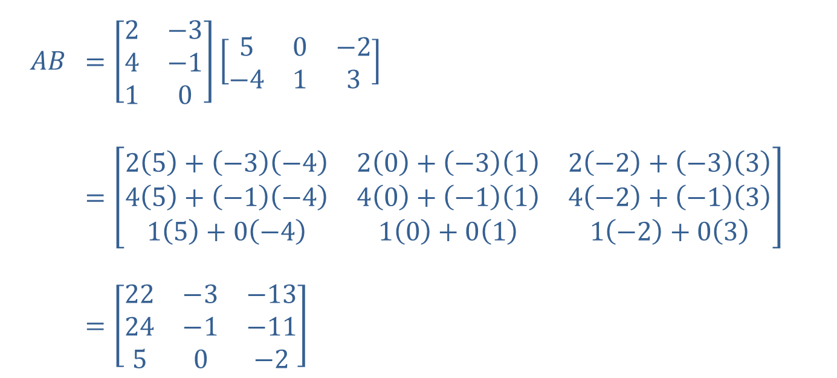
Example 6: Matrix Multiplication₃
$$AB$$ | ​$=\left[\begin{matrix}2 & −3 \\ 4 & −1 \\ 1 & 0\end{matrix}\right]\left[\begin{matrix}5 & 0 & −2 \\ −4 & 1 & 3\end{matrix}\right]$
 | ​$=\left[\begin{matrix}2\left(5\right)+\left(−3\right)\left(−4\right) & 2\left(0\right)+\left(−3\right)\left(1\right) & 2\left(−2\right)+\left(−3\right)\left(3\right) \\ 4\left(5\right)+\left(−1\right)\left(−4\right) & 4\left(0\right)+\left(−1\right)\left(1\right) & 4\left(−2\right)+\left(−1\right)\left(3\right) \\ 1\left(5\right)+0\left(−4\right) & 1\left(0\right)+0\left(1\right) & 1\left(−2\right)+0\left(3\right)\end{matrix}\right]$
 | ​$=\left[\begin{matrix}22 & −3 & −13 \\ 24 & −1 & −11 \\ 5 & 0 & −2\end{matrix}\right]$

Slide 28
Example 6: Matrix Multiplication₄
​From the orders of the two matrices, we know BA exists and will be a
matrix. Note that each
entry of BA is a sum of three products.

Slide 29
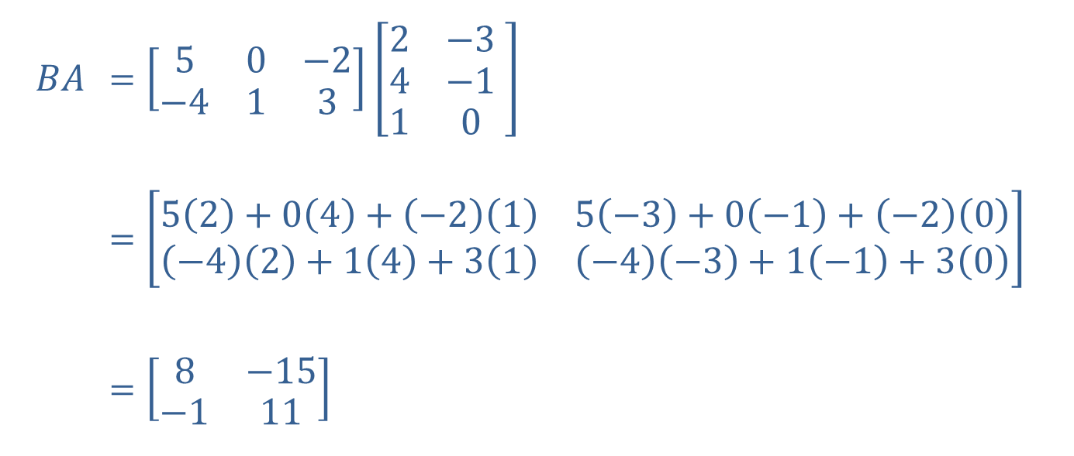
Example 6: Matrix Multiplication₅
$$BA$$ | ​$=\left[\begin{matrix}5 & 0 & −2 \\ −4 & 1 & 3\end{matrix}\right]\left[\begin{matrix}2 & −3 \\ 4 & −1 \\ 1 & 0\end{matrix} \right]$
 | ​$=\left[\begin{matrix}5\left(2\right)+0\left(4\right)+\left(−2\right)\left(1\right) & 5\left(−3\right)+0\left(−1\right)+\left(−2\right)\left(0\right) \\ \left(−4\right)\left(2\right)+1\left(4\right)+3\left(1\right) & \left(−4\right)\left(−3\right)+1\left(−1\right)+3\left(0\right)\end{matrix}\right]$
 | ​$=\left[\begin{matrix}8 & −15 \\ −1 & 11\end{matrix}\right]$

