Slide 1
Section 9.2
Matrix Notation and Gauss-Jordan Elimination

Slide 2
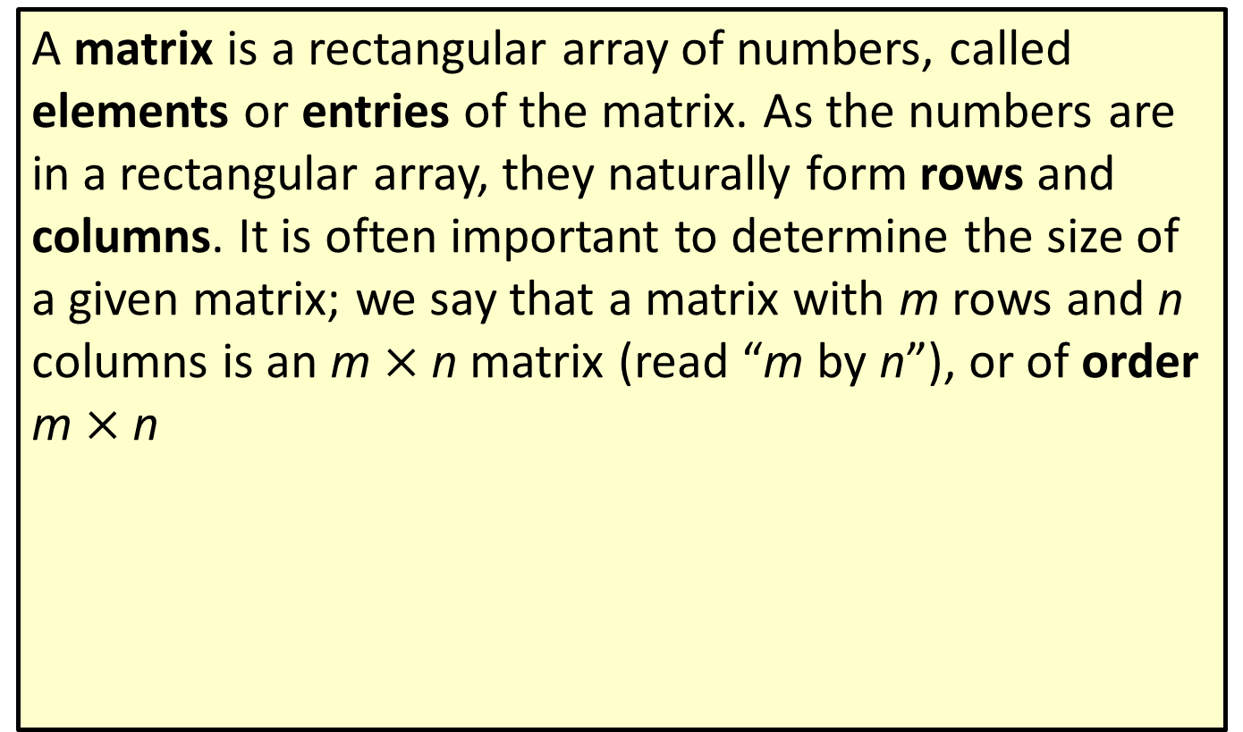
Definition: Matrices and Matrix Notation₁
A matrix is a rectangular array of numbers, called elements or entries of the matrix. As the numbers are in a rectangular array, they naturally form rows and columns. It is often important to determine the size of a given matrix; we say that a matrix with m rows and n columns is an m$×$ n matrix (read “m by n”), or of order m$×$ n

Slide 3
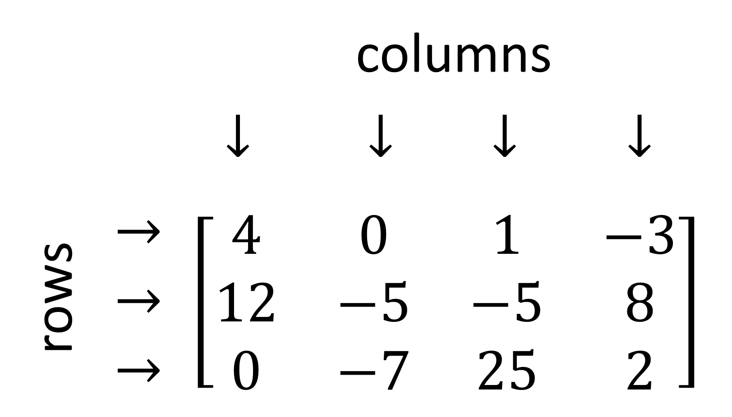
Definition: Matrices and Matrix Notation₂
By convention, the number of rows is always stated first.
This matrix has 3 rows and 4 columns, so it is a

Slide 4
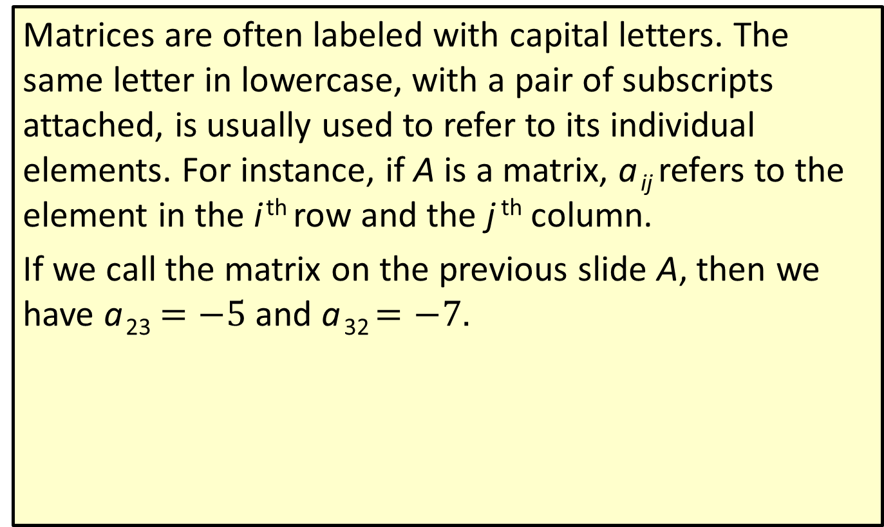
Definition: Matrices and Matrix Notation₃
Matrices are often labeled with capital letters. The same letter in lowercase, with a pair of subscripts attached, is usually used to refer to its individual elements. For instance, if A is a matrix, a _{ij} refers to the element in the i ^{th} row and the j ^{th} column.
If we call the matrix on the previous slide A, then we have a ₂₃$=−5$ and a ₃₂ $=−7$.

Slide 5
Example 1: Matrices and Matrix Notation₁
Given the matrix
determine
​the order of A,
the value of a ₁₃,
the value of a ₂₁.

Slide 6

Example 1: Matrices and Matrix Notation₂
Solution
​$A$ has 2 rows and 3 columns, and is thus a
​The value of the entry in the first row and third column is a₁₃ = 1.
​The value of the entry in the second row and first column is a ₂₁ = 5.

Slide 7
Definition: Standard Form of a System of Linear Equations
A system of linear equations is in standard form when each equation has been simplified with its variables on the left-hand side and its constant term on the right-hand side. Each equation should have its variable terms listed in the same order.
For example, the system
is written in standard form as

Slide 8
Definition: Augmented Matrices
The augmented matrix of a system of linear equations written in standard form is a matrix consisting of the coefficients of the variables listed in their relative positions with an adjoined column of the constants of the system. The matrix of coefficients and the column of constants are customarily separated by a vertical bar.
For example, the augmented matrix for the system
is
The augmented matrix will have as many rows as there are equations in the system, and one more column than there are variables.

Slide 9
Example 2: Augmented Matrices₁
Construct the augmented matrix for the following linear system.

Slide 10
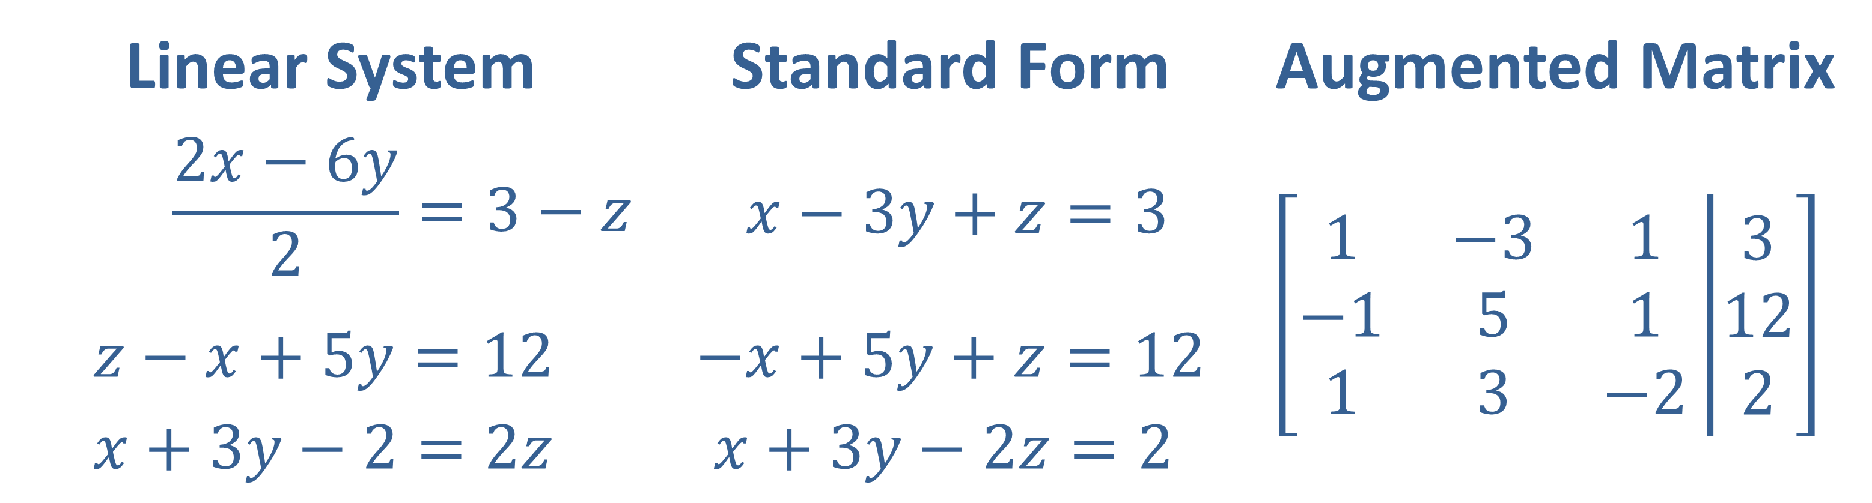
Example 2: Augmented Matrices₂
Solution
Write each equation in standard form, then read off the coefficients and constants to construct the augmented matrix.

Slide 11
Definition: Row Echelon Form
A matrix is in row echelon form if each of the following is true.
​The first nonzero entry in each row is 1. We call this a leading 1.
​Every entry below a leading 1 is 0, and each leading 1 appears farther to the right than the leading 1s in the rows above it.
​All rows consisting entirely of 0s (if there are any) appear at the bottom.

Slide 12
Example 3: Row Echelon Form₁
Determine if the following matrices are in row echelon form. If not, explain why not.

Slide 13
Example 3: Row Echelon Form₂
Solution
​This matrix fails the first condition, as the first nonzero entry is not always 1.
​
​This matrix meets each of the three conditions and is in row echelon form.
​This matrix fails the second condition, as nonzero values are present beneath a leading 1.
​
​This matrix fails the third condition, since there is a row of all zeros that lies above a row with nonzero entries.

Slide 14
Definition: Elementary Row Operations₁
Let A be an augmented matrix corresponding to a system of equations. Each of the following operations on A results in the augmented matrix of an equivalent system. In the notation, R _{i} refers to row i of the matrix A.
​Rows i and j can be interchanged.
​
​
Each entry in row i can be multiplied by a nonzero constant c.
Row j can be replaced with the sum of itself and a constant multiple of row i.

Slide 15
Definition: Elementary Row Operations₂
Typically, we write that an operation has been performed by connecting the original matrix to the new matrix with an arrow, writing the type of operation above it. For example, the matrix from Example 3d can be placed in row echelon form as follows.

Slide 16
Example 4: Elementary Row Operations₁
Perform the indicated elementary row operation.

Slide 17
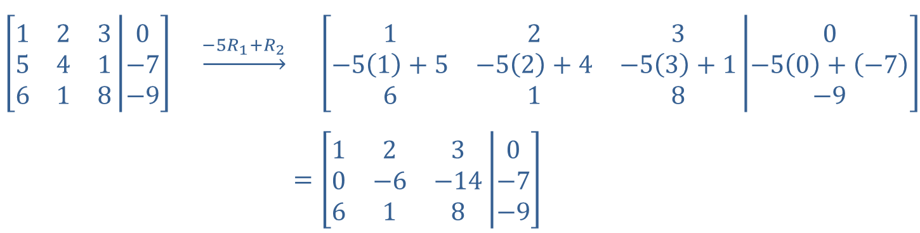
Example 4: Elementary Row Operations₂
Solution
The row operation indicates that we should add −5 times Row 1 to Row 2.
$$\left[\begin{matrix}1 & 2 & 3 \\ 5 & 4 & 1 \\ 6 & 1 & 8\end{matrix}\left|\begin{matrix}0 \\ −7 \\ −9\end{matrix}\right.\right] \underset{→}{{−5R}_{1}+R_{2}}$$ | $$\left[\begin{matrix}1 & 2 & 3 \\ −5\left(1\right)+5 & −5\left(2\right)+4 & −5\left(3\right)+1 \\ 6 & 1 & 8\end{matrix}\left|\begin{matrix}0 \\ −5\left(0\right)+\left(−7\right) \\ −9\end{matrix}\right.\right]$$
​$=$ | ​$\left[\begin{matrix}1 & 2 & 3 \\ 0 & −6 & −14 \\ 6 & 1 & 8\end{matrix}\left|\begin{matrix}0 \\ −7 \\ −9\end{matrix}\right.\right]$
Note that the first row now begins with 1 and the second row now begins with 0. The row operation has begun to change this matrix towards row echelon form.

Slide 18
Example 5: Gaussian Elimination₁
Use Gaussian elimination to solve the system

Slide 19
Example 5: Gaussian Elimination₂
Solution
First, we read off the augmented matrix corresponding to this system.
Now, we transform it into row echelon form. It is usually easiest to work one column at a time. After getting a leading 1 in the first row, use row operations to obtains 0s below it. Repeat this process with each successive column.

Slide 20
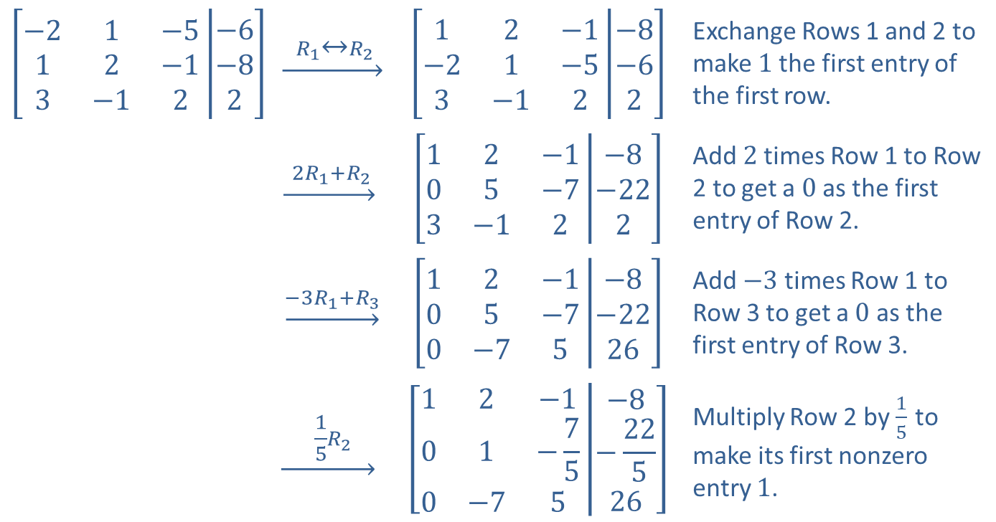
Example 5: Gaussian Elimination₃
$$\left[\begin{matrix}−2 & 1 & −5 \\ 1 & 2 & −1 \\ 3 & −1 & 2\end{matrix}\left|\begin{matrix}−6 \\ −8 \\ 2\end{matrix}\right.\right]$$ | ​$\underset{→}{ R_{1}↔R_{2} }$ | $$\left[\begin{matrix}1 & 2 & −1 \\ −2 & 1 & −5 \\ 3 & −1 & 2\end{matrix}\left|\begin{matrix}−8 \\ −6 \\ 2\end{matrix}\right.\right]$$ | Exchange Rows 1 and 2 to make 1 the first entry of the first row.
 | $$\underset{→}{ {2R}_{1}+R_{2} }$$ | $$\left[\begin{matrix}1 & 2 & −1 \\ 0 & 5 & −7 \\ 3 & −1 & 2\end{matrix}\left|\begin{matrix}−8 \\ −22 \\ 2\end{matrix}\right.\right]$$ | Add 2 times Row 1 to Row 2 to get a 0 as the first entry of Row 2.
 | ​$\underset{→}{{−3R}_{1}+R_{3}}$ | $$\left[\begin{matrix}1 & 2 & −1 \\ 0 & 5 & −7 \\ 0 & −7 & 5\end{matrix}\left|\begin{matrix}−8 \\ −22 \\ 26\end{matrix}\right.\right]$$ | Add $−3$ times Row 1 to Row 3 to get a 0 as the first entry of Row 3.
 | $$\underset{→}{ \frac{1}{5}R_{2} }$$ | $$\left[\begin{matrix}1 & 2 & −1 \\ 0 & 1 & −\frac{7}{5} \\ 0 & −7 & 5\end{matrix}\left|\begin{matrix}−8 \\ −\frac{22}{5} \\ 26\end{matrix}\right.\right]$$ | Multiply Row 2 by $\frac{1}{5}$ to make its first nonzero entry 1.

Slide 21
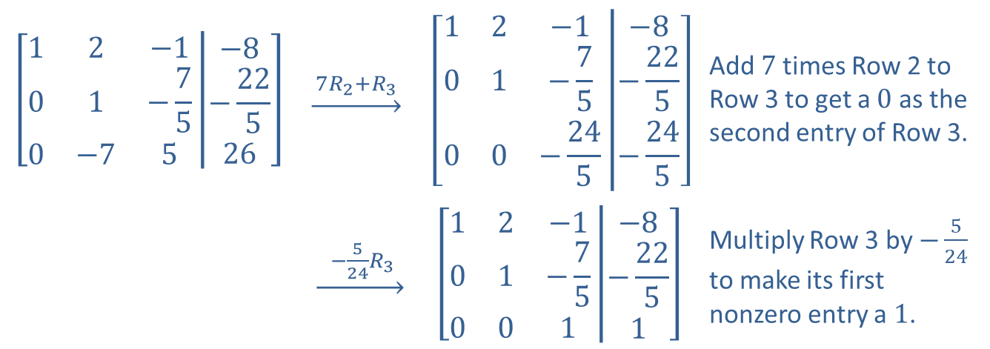
Example 5: Gaussian Elimination₄
$$\left[\begin{matrix}1 & 2 & −1 \\ 0 & 1 & −\frac{7}{5} \\ 0 & −7 & 5\end{matrix}\left|\begin{matrix}−8 \\ −\frac{22}{5} \\ 26\end{matrix}\right.\right]$$ | $$\underset{→}{ {7R}_{2}+R_{3} }$$ | $$\left[\begin{matrix}1 & 2 & −1 \\ 0 & 1 & −\frac{7}{5} \\ 0 & 0 & −\frac{24}{5}\end{matrix}\left|\begin{matrix}−8 \\ −\frac{22}{5} \\ −\frac{24}{5}\end{matrix}\right.\right]$$ | Add 7 times Row 2 to Row 3 to get a 0 as the second entry of Row 3.
 | ​$\underset{→}{ −\frac{5}{24}R_{3} }$ | $$\left[\begin{matrix}1 & 2 & −1 \\ 0 & 1 & −\frac{7}{5} \\ 0 & 0 & 1\end{matrix}\left|\begin{matrix}−8 \\ −\frac{22}{5} \\ 1\end{matrix}\right.\right]$$ | Multiply Row 3 by $−\frac{5}{24}$ to make its first nonzero entry a 1.

Slide 22
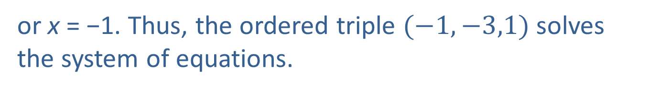
Example 5: Gaussian Elimination₅
The third row in the last matrix tells us that z = 1. When we substitute this in the second equation, we obtain
so y = −3. From the first row equation, we then obtain
or x = −1. Thus, the ordered triple $(−1,−3,1)$ solves the system of equations.

Slide 23
Definition: Reduced Row Echelon Form
A matrix is said to be in reduced row echelon form if
it is in row echelon form and
​each entry above a leading 1 is also 0.

Slide 24
Example 6: Reduced Row Echelon Form₁
Use Gauss-Jordan elimination to solve the system

Slide 25
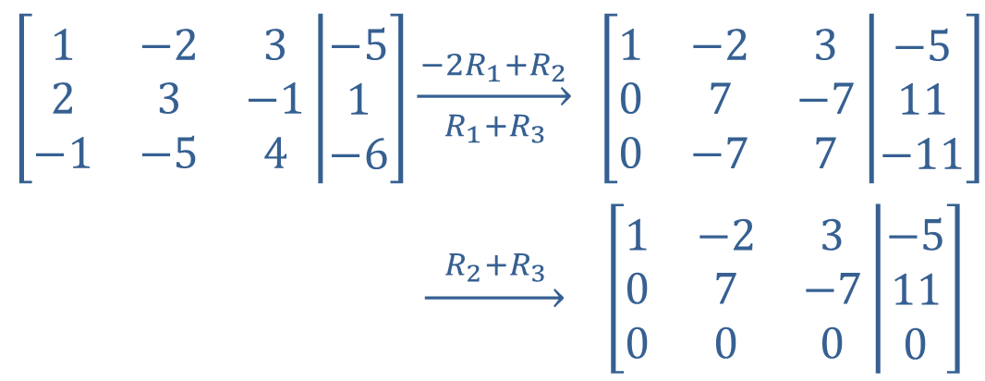
Example 6: Reduced Row Echelon Form₂
Solution
$$\left[\begin{matrix}1 & −2 & 3 \\ 2 & 3 & −1 \\ −1 & −5 & 4\end{matrix}\left|\begin{matrix}−5 \\ 1 \\ −6\end{matrix}\right.\right]$$ | $$\overset{−2R_{1}+R_{2}}{\overset{→}{ { R}_{1}+R_{3 } }}$$ | $$\left[\begin{matrix}1 & −2 & 3 \\ 0 & 7 & −7 \\ 0 & −7 & 7\end{matrix}\left|\begin{matrix}−5 \\ 11 \\ −11\end{matrix}\right.\right]$$
 | $$\underset{→}{{ R}_{2}+R_{3 }}$$ | $$\left[\begin{matrix}1 & −2 & 3 \\ 0 & 7 & −7 \\ 0 & 0 & 0\end{matrix}\left|\begin{matrix}−5 \\ 11 \\ 0\end{matrix}\right.\right]$$
Note that the row of 0s at the bottom corresponds to the true statement 0 = 0, indicating that this system has an infinite number of solutions. In order to describe the solution set algebraically, we continue the row operations until the matrix is in reduced row echelon form.

Slide 26
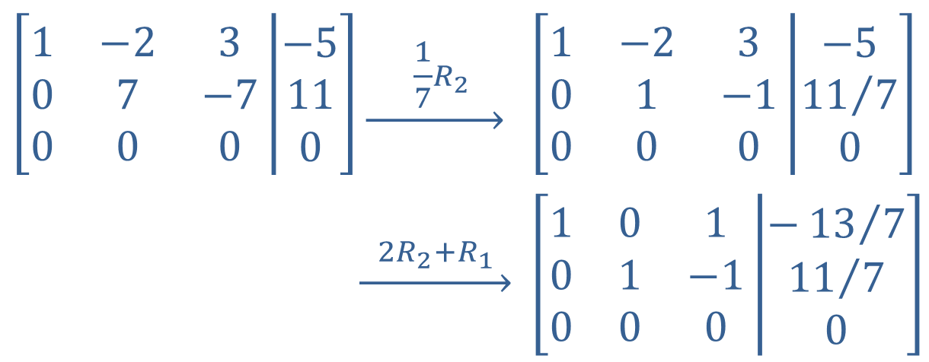

Example 6: Reduced Row Echelon Form₃
The last matrix is in reduced row echelon form, as every leading $1$ has 0s both below and above it.
$$\left[\begin{matrix}1 & −2 & 3 \\ 0 & 7 & −7 \\ 0 & 0 & 0\end{matrix}\left|\begin{matrix}−5 \\ 11 \\ 0\end{matrix}\right.\right]$$ | $$\underset{→}{ \frac{1}{7}R_{2} }$$ | $$\left[\begin{matrix}1 & −2 & 3 \\ 0 & 1 & −1 \\ 0 & 0 & 0\end{matrix}\left|\begin{matrix}−5 \\ {11}/7 \\ 0\end{matrix}\right.\right]$$
 | $$\underset{→}{{ 2R}_{2}+R_{1 }}$$ | $$\left[\begin{matrix}1 & 0 & 1 \\ 0 & 1 & −1 \\ 0 & 0 & 0\end{matrix}\left|\begin{matrix}−{13}/7 \\ {11}/7 \\ 0\end{matrix}\right.\right]$$

Slide 27
Example 6: Reduced Row Echelon Form₄
The corresponding system of equations is
which is equivalent to
Thus, we can describe the solution set as

