Slide 1
Section 7.4
Logarithmic Properties and Models

Slide 2
Example 1: Continuously Compounded Interest₁
Anne reads an ad in the paper for a new bank in town. The bank is advertising “continuously compounded savings accounts” in an attempt to attract customers, but fails to mention the annual interest rate. Curious, she goes to the bank and is told by an account agent that if she were to invest $10,000 in an account, her money would grow to $10,202.01 in one year’s time. But strangely, the agent also refuses to divulge the yearly interest rate. What rate is the bank offering?

Slide 3
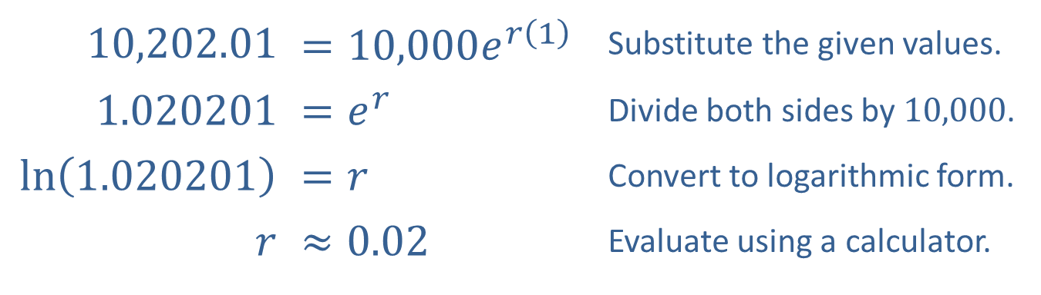
Example 1: Continuously Compounded Interest₂
Solution
We need to solve the equation
for r, given that
A = 10,202.21, P = 10,000, and t = 1.
​10,202.01 | ​$=10,000e^{r\left(1\right)}$ | Substitute the given values.
​1.020201 | ​$=e^{r}$ | Divide both sides by 10,000.
​$ln⁡\left(1.020201\right)$ | ​$=r$ | Convert to logarithmic form.
$$r$$ | ​$≈0.02$ | Evaluate using a calculator.
Note that we use the natural logarithm since the base of the exponential function is e. While we must use a calculator, we can now solve the equation for r.

Slide 4
Example 2: Solving Exponential Equations₁
Solve the equation

Slide 5
Example 2: Solving Exponential Equations₂
Solution
We convert the equation to logarithmic form to obtain the solution
Unfortunately, this answer still
doesn’t tell us anything about x in decimal form, other than that it is bound to be slightly more than 3. Further,
we can’t use a calculator to evaluate
since the
base is neither 10 nor e.

Slide 6
Properties of Logarithms
Let a (the logarithmic base) be a positive real number not equal to 1, let x and y be positive real numbers, and let r be any real number.

Slide 7
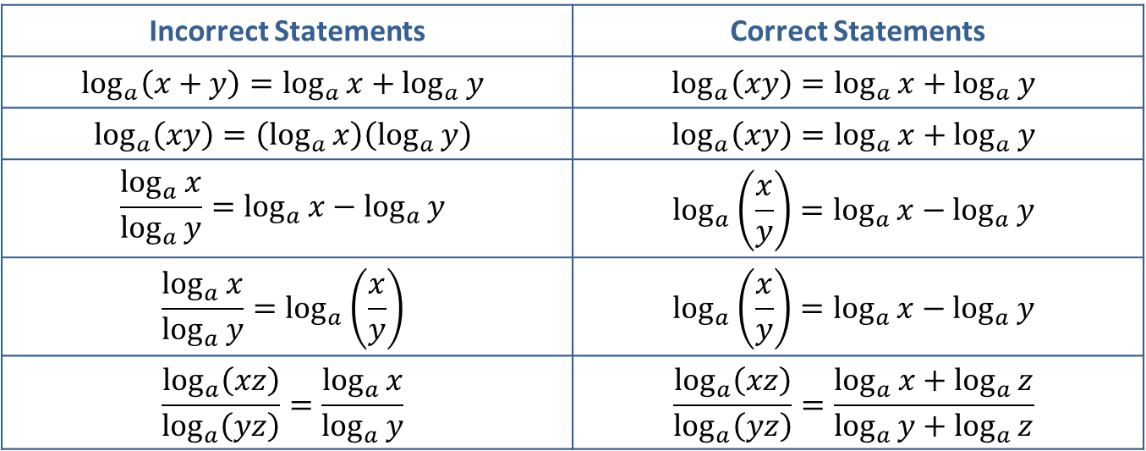
CAUTION!
Errors in working with logarithms often arise from incorrect recall of the logarithmic properties. The comparisons below highlight some common mistakes.
Incorrect Statements | Correct Statements
$$\log_{a}\left(x+y\right)=\log_{a}{x}+\log_{a}{y}$$ | $$\log_{a}\left(xy\right)=\log_{a}{x}+\log_{a}{y}$$
$$\log_{a}\left(xy\right)=\left(\log_{a}{x}\right)\left(\log_{a}{y}\right)$$ | $$\log_{a}\left(xy\right)=\log_{a}{x}+\log_{a}{y}$$
$$\frac{\log_{a}{x}}{\log_{a}{y}}=\log_{a}{x}−\log_{a}{y}$$ | $$\log_{a}\left(\frac{x}{y}\right)=\log_{a}{x}−\log_{a}{y}$$
$$\frac{\log_{a}{x}}{\log_{a}{y}}=\log_{a}\left(\frac{x}{y}\right)$$ | $$\log_{a}\left(\frac{x}{y}\right)=\log_{a}{x}−\log_{a}{y}$$
$$\frac{\log_{a}\left(xz\right)}{\log_{a}\left(yz\right)}=\frac{\log_{a}{x}}{\log_{a}{y}}$$ | $$\frac{\log_{a}\left(xz\right)}{\log_{a}\left(yz\right)}=\frac{\log_{a}{x}+\log_{a}{z}}{\log_{a}{y}+\log_{a}{z}}$$

Slide 8
Example 3: Expanding Logarithmic Expressions₁
Use the properties of logarithms to expand the following expressions as much as possible (that is, decompose the expressions into sums or differences of the simplest possible terms).

Slide 9
Note₁
As long as the base is the same for each term, its value does not affect the use of the properties.

Slide 10
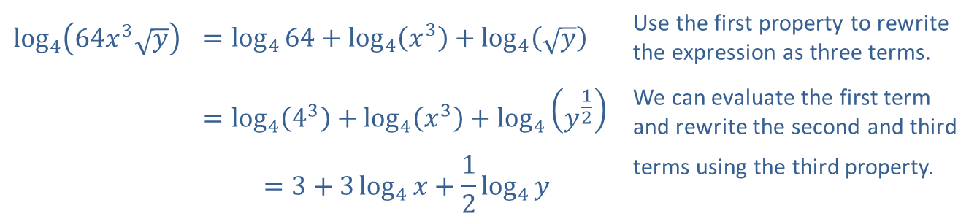
Example 3: Expanding Logarithmic Expressions₂
Solution
a.
​$\log_{4}\left(64x^{3}\sqrt{y}\right)$ | $$=\log_{4}{64}+\log_{4}\left(x^{3}\right)+\log_{4}\left(\sqrt{y}\right)$$ | Use the first property to rewrite the expression as three terms.
​ | $$=\log_{4}\left(4^{3}\right)+\log_{4}\left(x^{3}\right)+\log_{4}\left(y^{\frac{1}{2}}\right)$$ | We can evaluate the first term and rewrite the second and third
​ | $$=3+3\log_{4}{x}+\frac{1}{2}\log_{4}{y}$$ | terms using the third property.

Slide 11
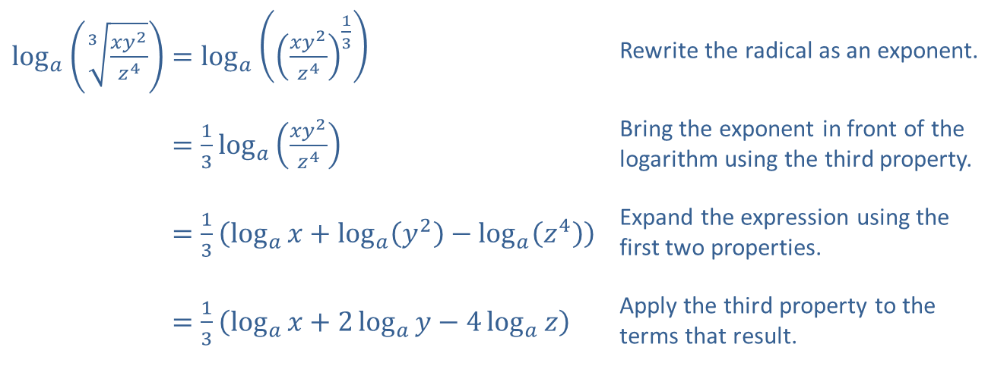
Example 3: Expanding Logarithmic Expressions₃
​$\log_{a}\left(\sqrt[3]{\frac{xy^{2}}{z^{4}}}\right)=\log_{a}\left({\left(\frac{xy^{2}}{z^{4}}\right)}^{\frac{1}{3}}\right)$ | Rewrite the radical as an exponent.
​log𝑎⁡3𝑥𝑦2𝑧4=13log𝑎⁡𝑥𝑦2𝑧4 | Bring the exponent in front of the logarithm using the third property.
​log𝑎⁡3𝑥𝑦2𝑧4=13log𝑎𝑥+log𝑎𝑦2−log𝑎𝑧4 | Expand the expression using the first two properties.
​log𝑎⁡3𝑥𝑦2𝑧4=13log𝑎𝑥+2log𝑎𝑦−4log𝑎𝑧 | Apply the third property to the terms that result.
b.

Slide 12
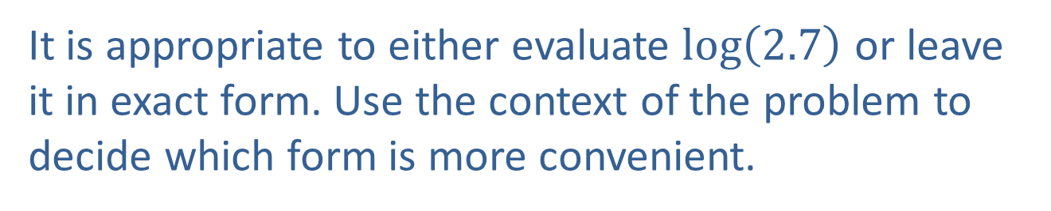
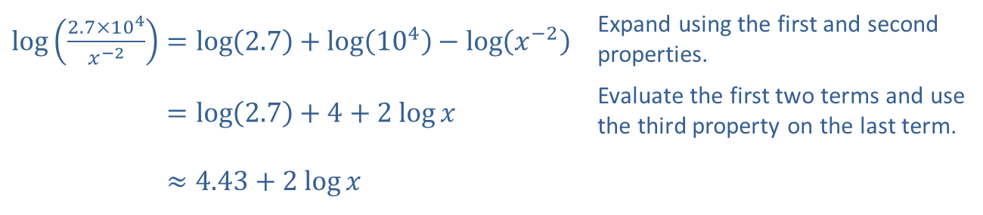
Example 3: Expanding Logarithmic Expressions₄
​Recall that if a base is not explicitly written, it is assumed to be 10. This base is convenient when working with numbers in scientific notation.
​$\log\left(\frac{2.7×{10}^{4}}{x^{−2}}\right)=\log\left(2.7\right)+\log\left({10}^{4}\right)−\log\left(x^{−2}\right)$ | Expand using the first and second properties.
​log⁡2.7×104𝑥−2=log2.7+4+2 log⁡𝑥 | Evaluate the first two terms and use the third property on the last term.
​log⁡2.7×104𝑥−2≈4.43+2 log⁡𝑥
It is appropriate to either evaluate $log⁡\left(2.7\right)$ or leave it in exact form. Use the context of the problem to decide which form is more convenient.

Slide 13
Example 4: Condensing Logarithmic Expressions₅
Use the properties of logarithms to condense the following expressions as much as possible (that is, rewrite the expressions as a sum or difference of as few logarithms as possible).

Slide 14
Note₂
Often, there will be multiple orders in which we can apply the properties to find the final result.

Slide 15
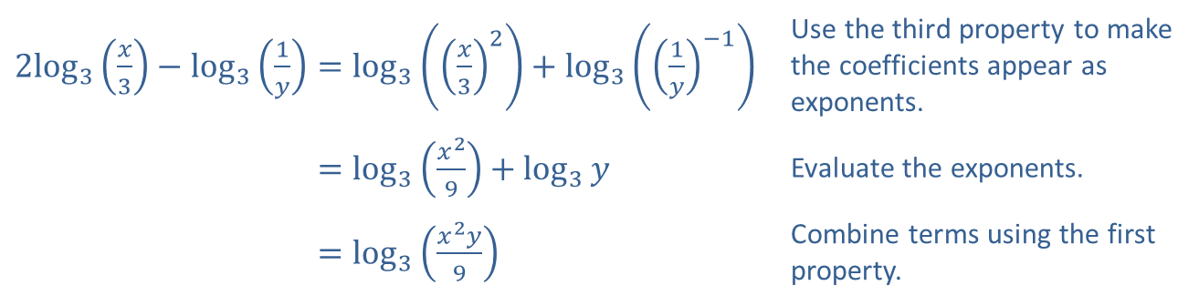
Example 4: Condensing Logarithmic Expressions₆
Solution
​
​$2\log_{3}⁡\left(\frac{x}{3}\right)−\log_{3}\left(\frac{1}{y}\right)=\log_{3}\left({\left(\frac{x}{3}\right)}^{2}\right)+\log_{3}\left({\left(\frac{1}{y}\right)}^{−1}\right)$ | Use the third property to make the coefficients appear as exponents.
​2log3⁡𝑥3−log31𝑦=log3𝑥29+log3𝑦 | Evaluate the exponents.
​2log3⁡𝑥3−log31𝑦=log3𝑥2𝑦9 | Combine terms using the first property.

Slide 16
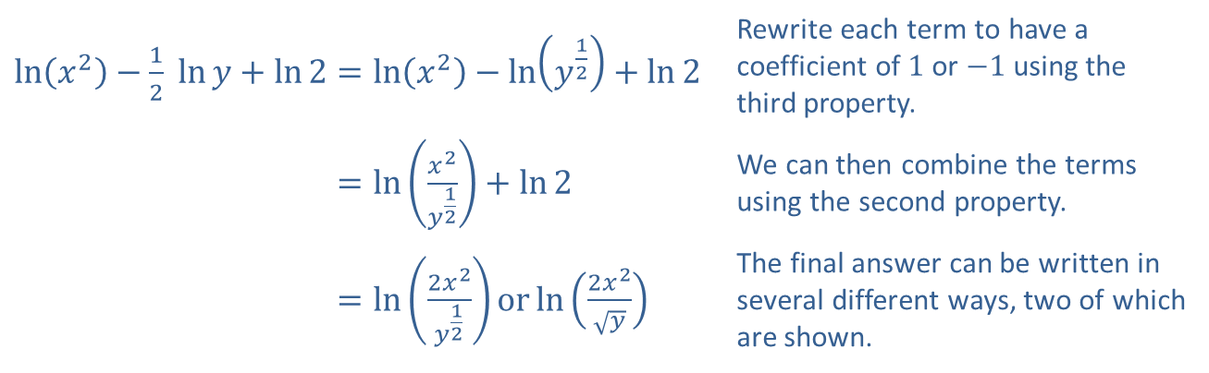
Example 4: Condensing Logarithmic Expressions₇
​$\ln\left(x^{2}\right)−\frac{1}{2} ln⁡y+\ln{2}=\ln\left(x^{2}\right)−\ln\left(y^{\frac{1}{2}}\right)+\ln{2}$ | Rewrite each term to have a coefficient of 1 or $−1$ using the third property.
​ln𝑥2−12 ln⁡𝑦+ln2=ln𝑥2𝑦12+ln2 | We can then combine the terms using the second property.
​ln𝑥2−12 ln⁡𝑦+ln2=ln2𝑥2𝑦12orln2𝑥2𝑦 | The final answer can be written in several different ways, two of which are shown.
​

Slide 17
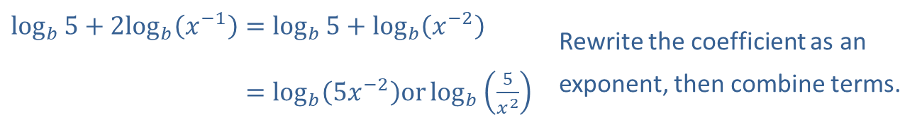
Example 4: Condensing Logarithmic Expressions₈
​
​$\log_{b}{5}+2\log_{b}⁡\left(x^{−1}\right)=\log_{b}{5}+\log_{b}\left(x^{−2}\right)$ | Rewrite the coefficient as an
​log𝑏5+2log𝑏⁡𝑥−1=log𝑏⁡5𝑥−2orlog𝑏5𝑥2 | exponent, then combine terms.

Slide 18
Formula: Change of Base Formula
Let a and b both be positive real numbers, neither of them equal to 1, and let x be a positive real number. Then

Slide 19
Example 5: Change of Base Formula₁
Evaluate the following logarithmic expressions, using the base of your choice.

Slide 20
Note₃
Both the common and natural logarithm work in solving these problems.

Slide 21
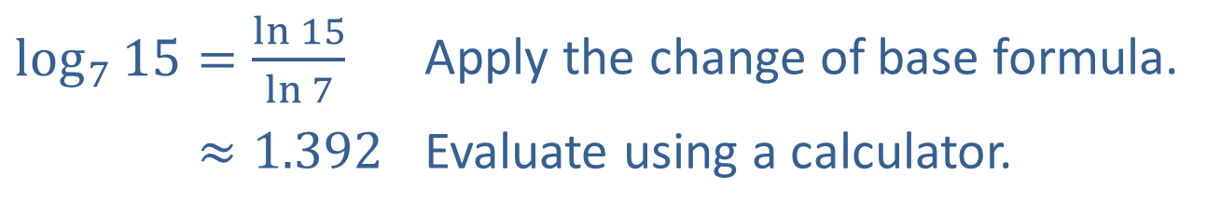
Example 5: Change of Base Formula₂
Solution
​
​$\log_{7}{15}=\frac{\ln{15}}{\ln{7}}$ | Apply the change of base formula.
​log7⁡15≈1.392 | Evaluate using a calculator.

Slide 22
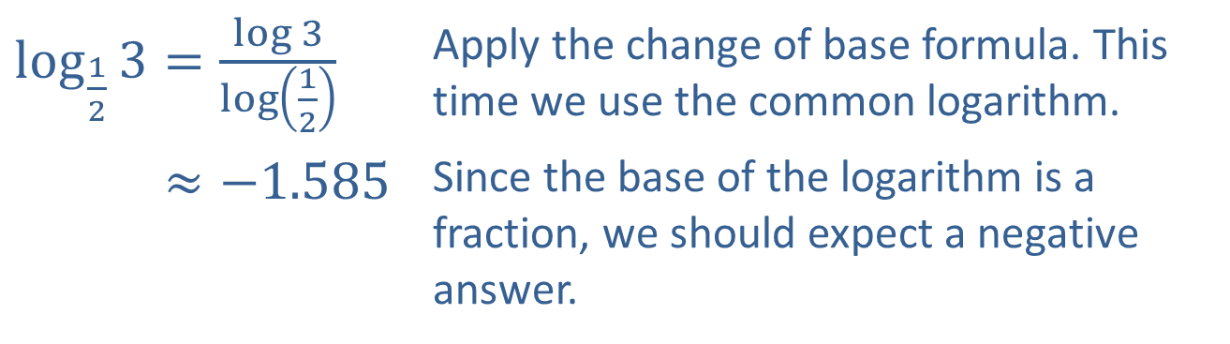
Example 5: Change of Base Formula₃
​$\log_{\frac{1}{2}}{3}=\frac{\log{3}}{\log\left(\frac{1}{2}\right)}$ | Apply the change of base formula. This time we use the common logarithm.
​log12⁡3≈−1.585 | Since the base of the logarithm is a fraction, we should expect a negative answer.
​

Slide 23
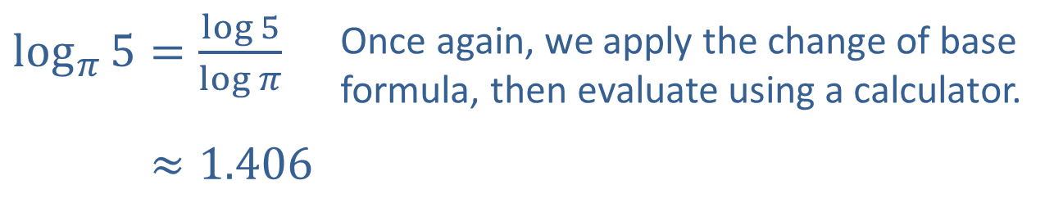
Example 5: Change of Base Formula₄
​$\log_{π}{5}=\frac{\log{5}}{\log{π}}$ | Once again, we apply the change of base formula, then evaluate using a calculator.
​log𝜋⁡5≈1.406
​

Slide 24
Definition: The pH Scale₁
The pH of a solution is defined to be
where
is the concentration of hydronium ions in
units of moles/liter. Solutions with a pH less than 7 are said to be acidic, while those with a pH greater than 7 are basic.

Slide 25
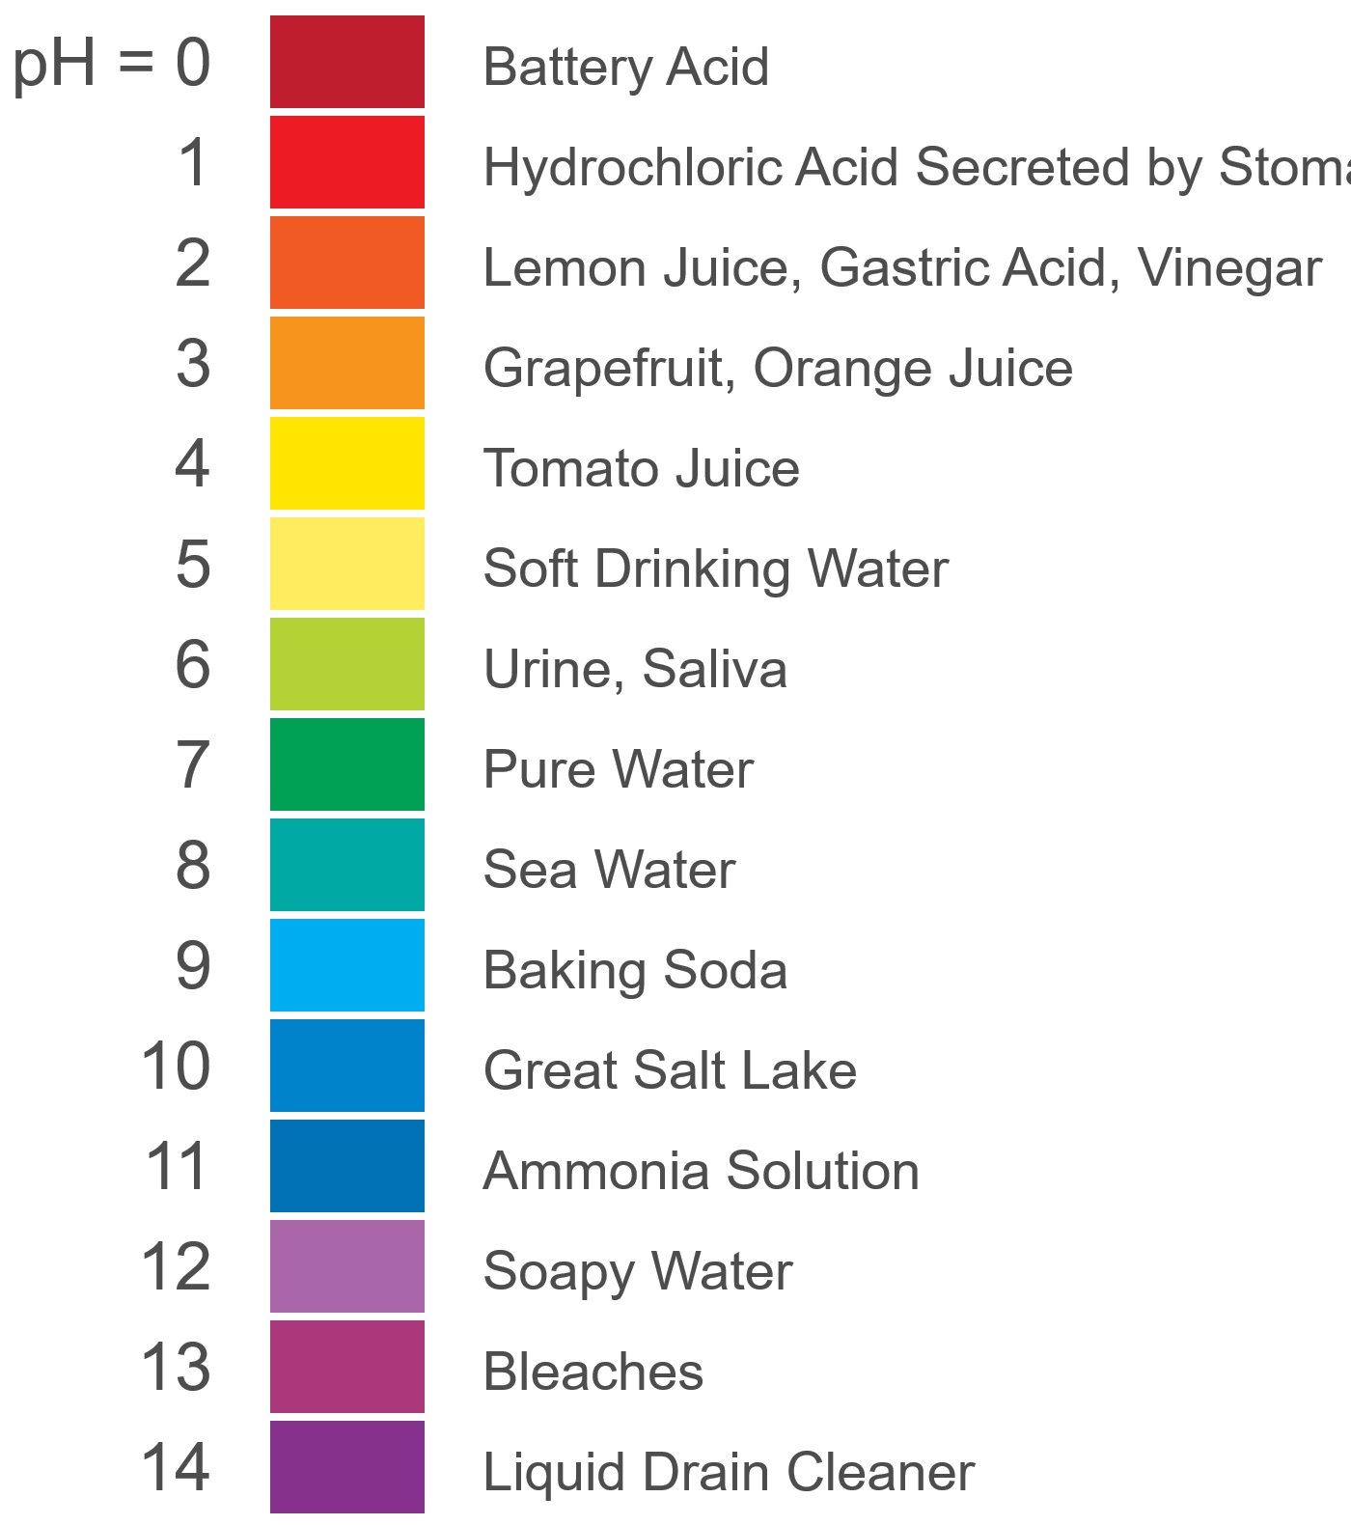
Definition: The pH Scale₂
Figure 1: pH of Common Substances

Slide 26
Example 6: The pH Scale₁
If a sample of orange juice is determined to have a
concentration of
moles/liter, what
is its pH?

Slide 27
Example 6: The pH Scale₂
Solution
Applying the formula from the definition (and using a calculator), the pH is equal to
After doing this calculation, the reason for the minus sign in the formula is more apparent. By multiplying the log of the concentration by −1, the pH of a solution is positive, which is convenient for comparative purposes.

Slide 28

Definition: The Richter Scale
Earthquake intensity is measured on the Richter scale (named for the American seismologist Charles Richter, 1900–985). In the original formula that follows,
is the intensity of a just-
discernible earthquake, I is the intensity of an earthquake being analyzed, and $R$ is its ranking on the Richter scale.
By this measure, earthquakes range from a classification of minor (R < 4), to light (4 ≤ R < 5), to moderate (5 ≤ R < 6), to strong (6 ≤ R < 7), to major (7 ≤ R < 8), to great (8 ≤ R).

Slide 29
Example 7: The Richter Scale₁
The January 2001 earthquake in the state of Gujarat in India was 7,940,000 times as intense as a 0-level earthquake. What was the Richter ranking of this devastating event?

Slide 30
Example 7: The Richter Scale₂
Solution
If we let I denote the intensity of the Gujarat earthquake, then
The Gujarat earthquake thus fell in the category of strong on the Richter scale.

Slide 31
Definition: The Decibel Scale
In the decibel scale,
is the intensity of a just-
discernible sound, I is the intensity of the sound being analyzed, and D is its decibel level.
Decibel levels range from 0 for a barely discernible sound, to 60 for the level of normal conversation, to 80 for heavy traffic, to 120 for a loud rock concert, and finally (as far as humans are concerned) to around 160, at which point the eardrum is likely to rupture.

Slide 32
Example 8: The Decibel Scale₁
Given that
what is the
decibel level of a jet airliner’s engines at a distance of 45 meters, for which the sound intensity is

Slide 33
Example 8: The Decibel Scale₂
Solution
In other words, the sound level would probably not be literally earsplitting, but it would be very painful.

Slide 34
Example 9: Logarithmic Regression₁
A manufacturer of aviation instruments has designed a new pressure altimeter, a device that determines altitude as a function of atmospheric pressure. The data in Table 1 was collected in order to calibrate the device, where the pressure p (in pascals) was measured by the new device and its altitude h above sea level (in meters) was measured by another instrument of known accuracy. Use the data and logarithmic regression to find a logarithmic function that models altitude as a function of pressure and plot its graph along with the given points.

Slide 35
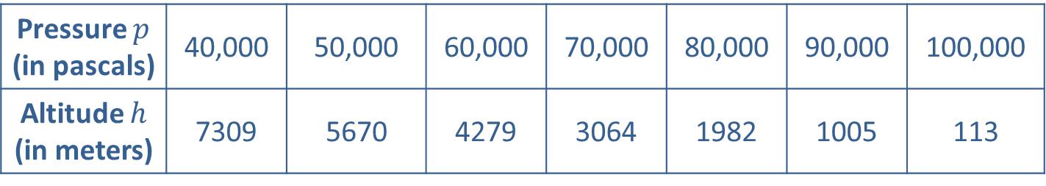
Example 9: Logarithmic Regression₂
Table 1
Pressure $p$ (in pascals) | 40,000 | 50,000 | 60,000 | 70,000 | 80,000 | 90,000 | 100,000
Altitude $h$ (in meters) | 7309 | 5670 | 4279 | 3064 | 1982 | 1005 | 113

Slide 36
Example 9: Logarithmic Regression₃
Solution
Entering the data into a TI-84 Plus and performing a logarithmic regression results in the function
h (p) = 90,678.9 − 7859.23 ln p. This is the logarithmic curve of best fit for the given data. The regression equation is displayed in Figure 2, and the graph is shown in Figure 3.

Slide 37
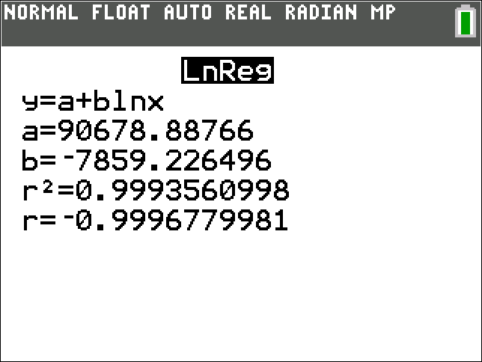
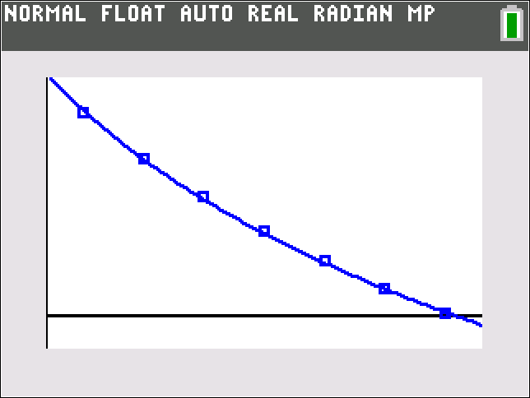
Example 9: Logarithmic Regression₄
Figure 2
Figure 3

