Slide 1
Section 7.3
Logarithmic Functions and Their Graphs

Slide 2
Definition: Logarithmic Functions
Let a be a fixed positive real number not equal to 1. The logarithmic function with base a is defined to be the inverse of the exponential function with base a, and is denoted
In equation form, the definition of logarithm means that the equations
are equivalent. Note that a is the base in both equations: either the base of the exponential function or the base of the logarithmic function.

Slide 3
Example 1: Exponential and Logarithmic Equations₁
Use the definition of logarithmic functions to rewrite the following exponential equations as logarithmic equations.
Then rewrite the following logarithmic equations as exponential equations.

Slide 4
Example 1: Exponential and Logarithmic Equations₂
Solution
Note that in each case, the base of the exponential equation is the base of the logarithmic equation.

Slide 5
CAUTION!
While it may appear so on the graph, logarithmic functions do not have a horizontal asymptote. The reason that logarithmic functions often look like they have a horizontal asymptote is because they are among the slowest growing functions in mathematics! Consider the function
the function may increase its value very slowly as x increases, it never approaches an asymptote.

Slide 6
Example 2: Graphing Logarithmic Functions₁
Sketch the graphs of the following logarithmic functions.

Slide 7
Note₁
Once again, plotting a few key points will provide a good idea of the shape of the function.

Slide 8
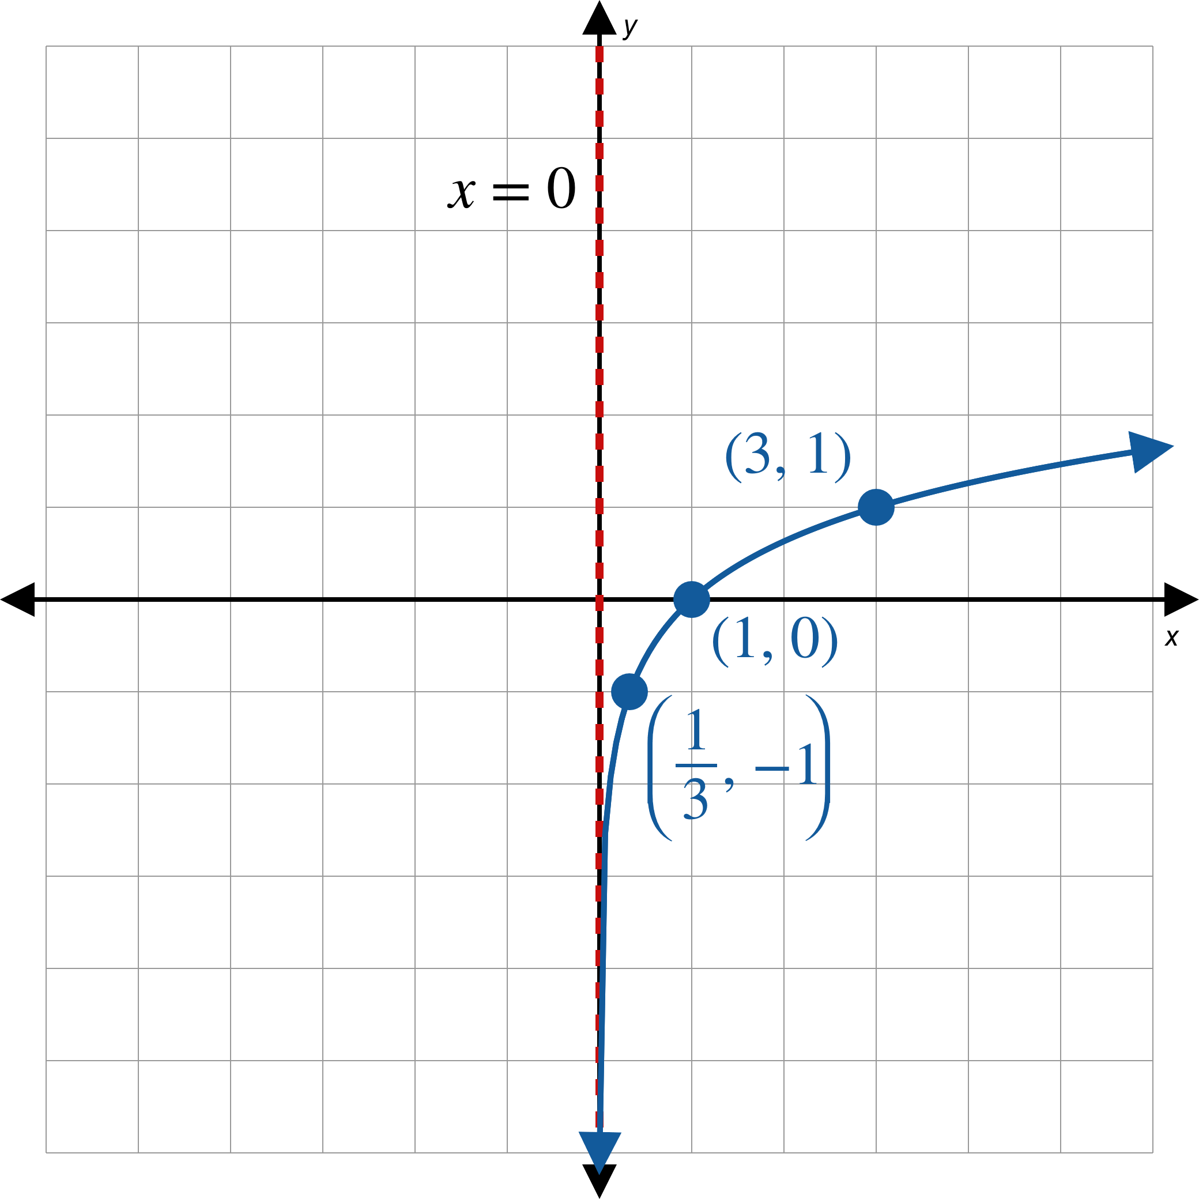
Example 2: Graphing Logarithmic Functions₂
Solution
a.
Figure 2

Slide 9
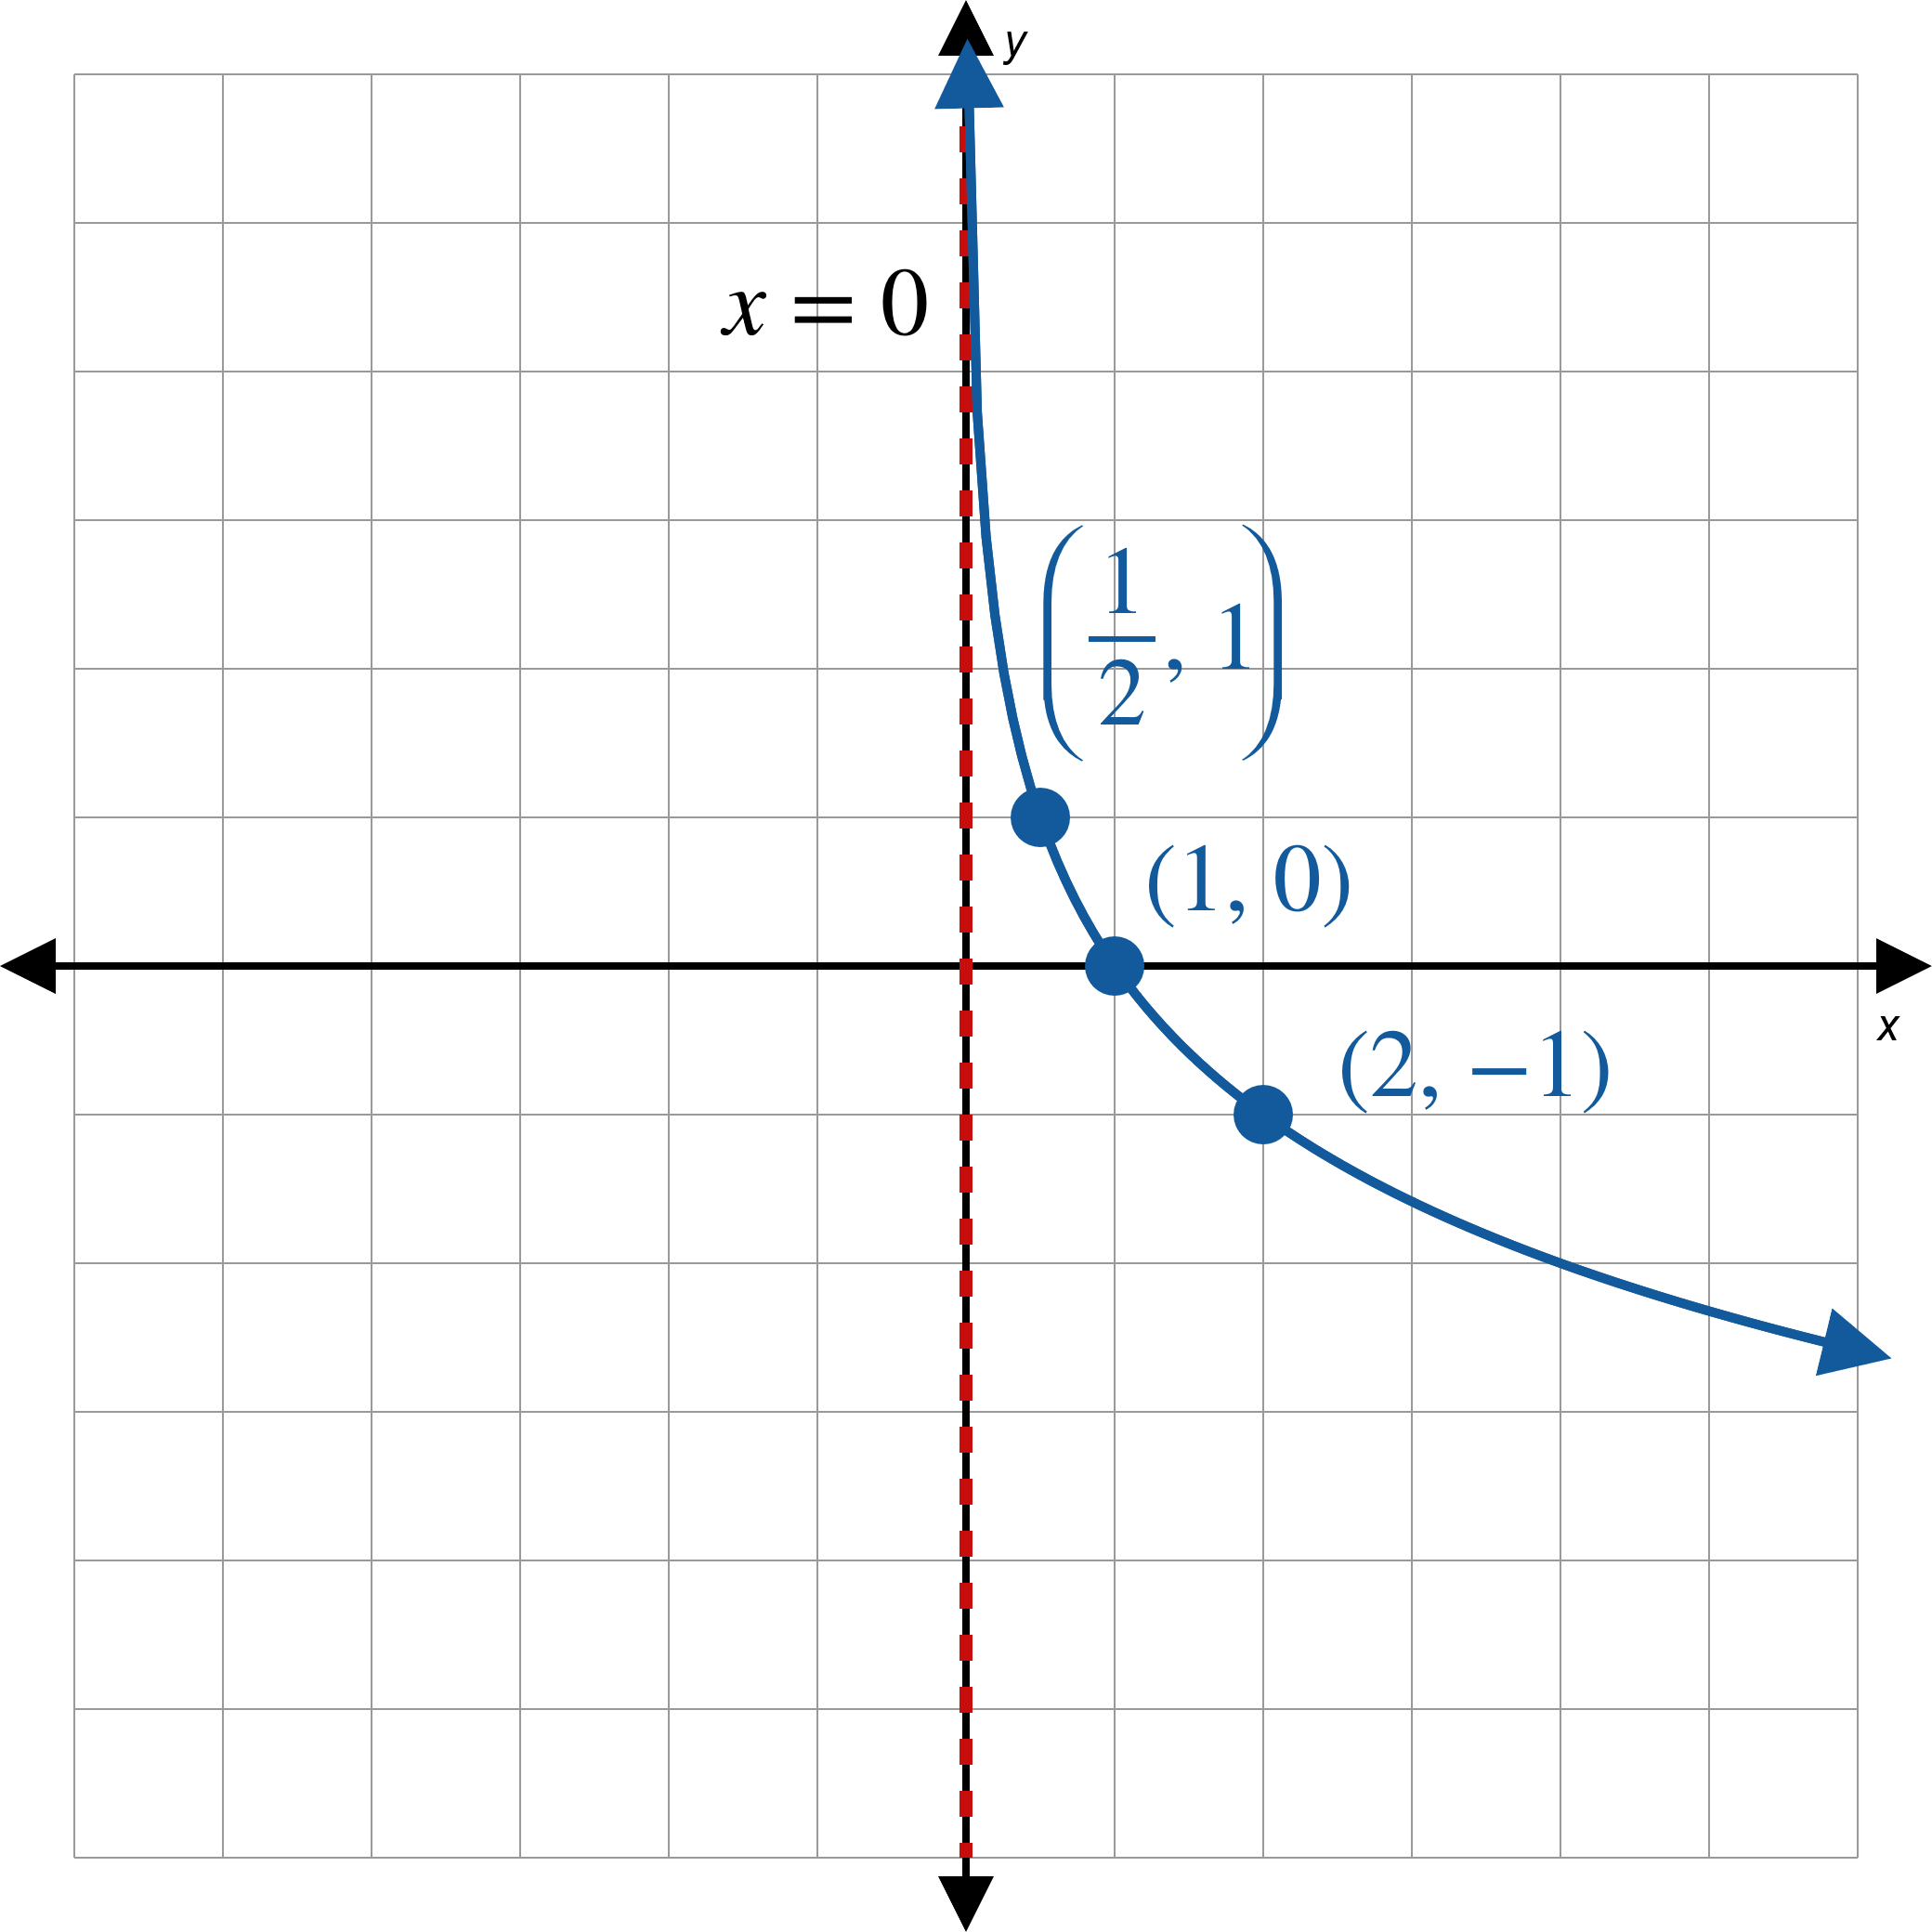
Example 2: Graphing Logarithmic Functions₃
b.
Figure 3

Slide 10
Example 3: Graphing Logarithmic Functions₄
Sketch the graphs of the following functions. State their domain and range.

Slide 11
Note₂
Begin by graphing the base function, then apply any transformations.

Slide 12
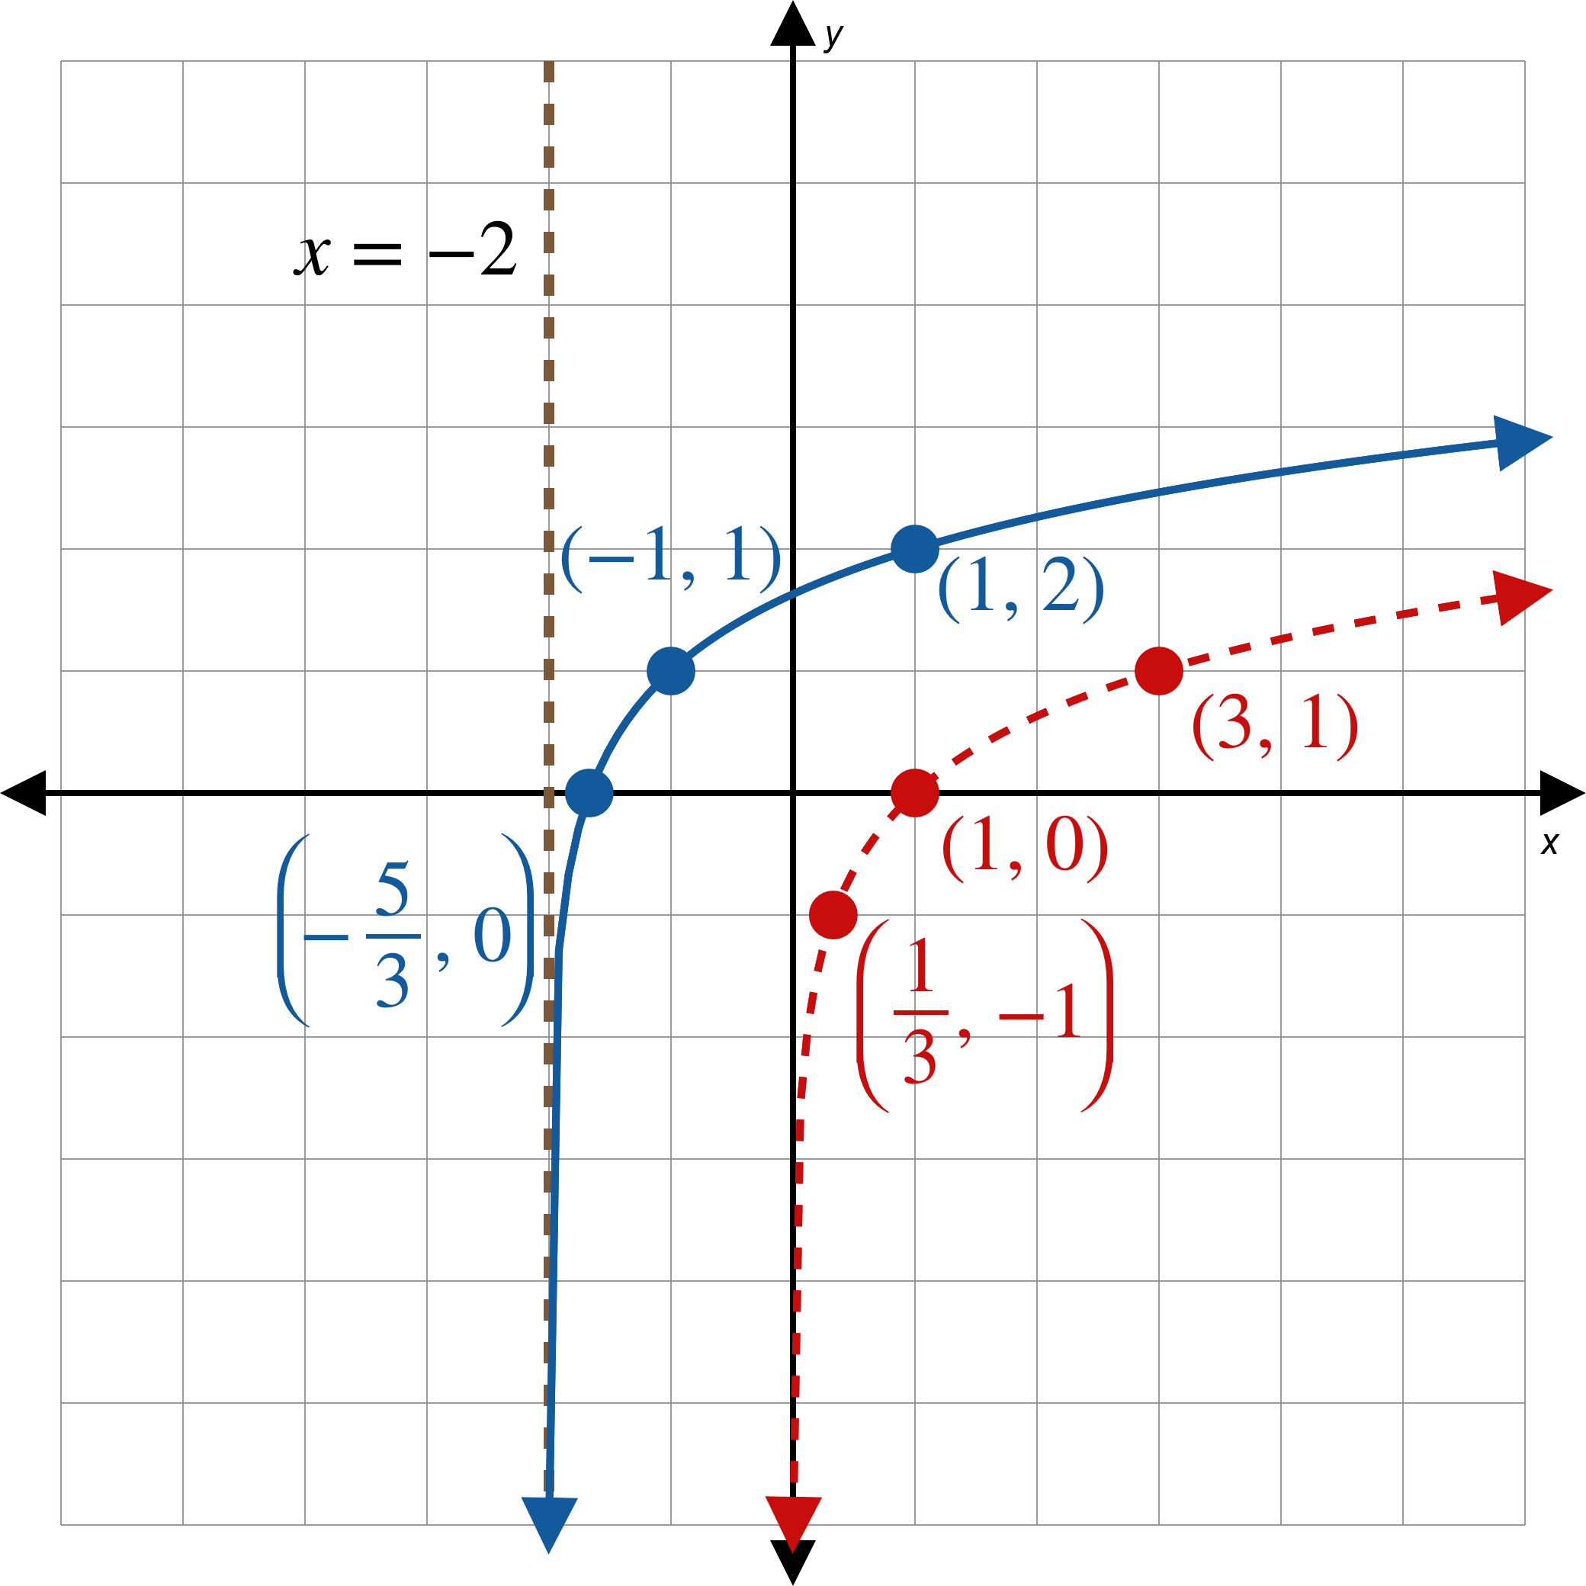
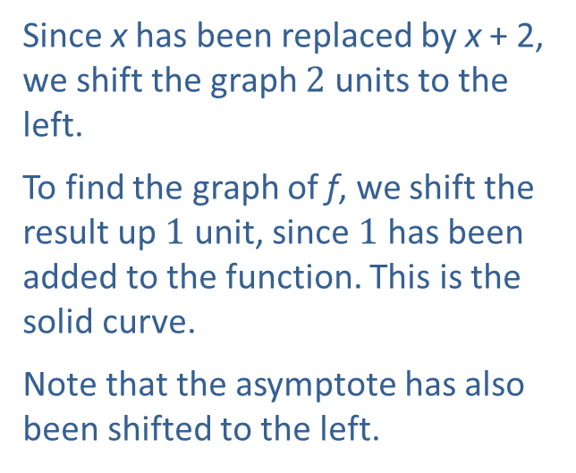
Example 3: Graphing Logarithmic Functions₅
Solution
Begin by graphing the base function,
This is the dashed
curve.
Since x has been replaced by x + 2, we shift the graph $2$ units to the left.
To find the graph of f, we shift the result up $1$ unit, since $1$ has been added to the function. This is the solid curve.
Note that the asymptote has also been shifted to the left.
Figure 4

Slide 13
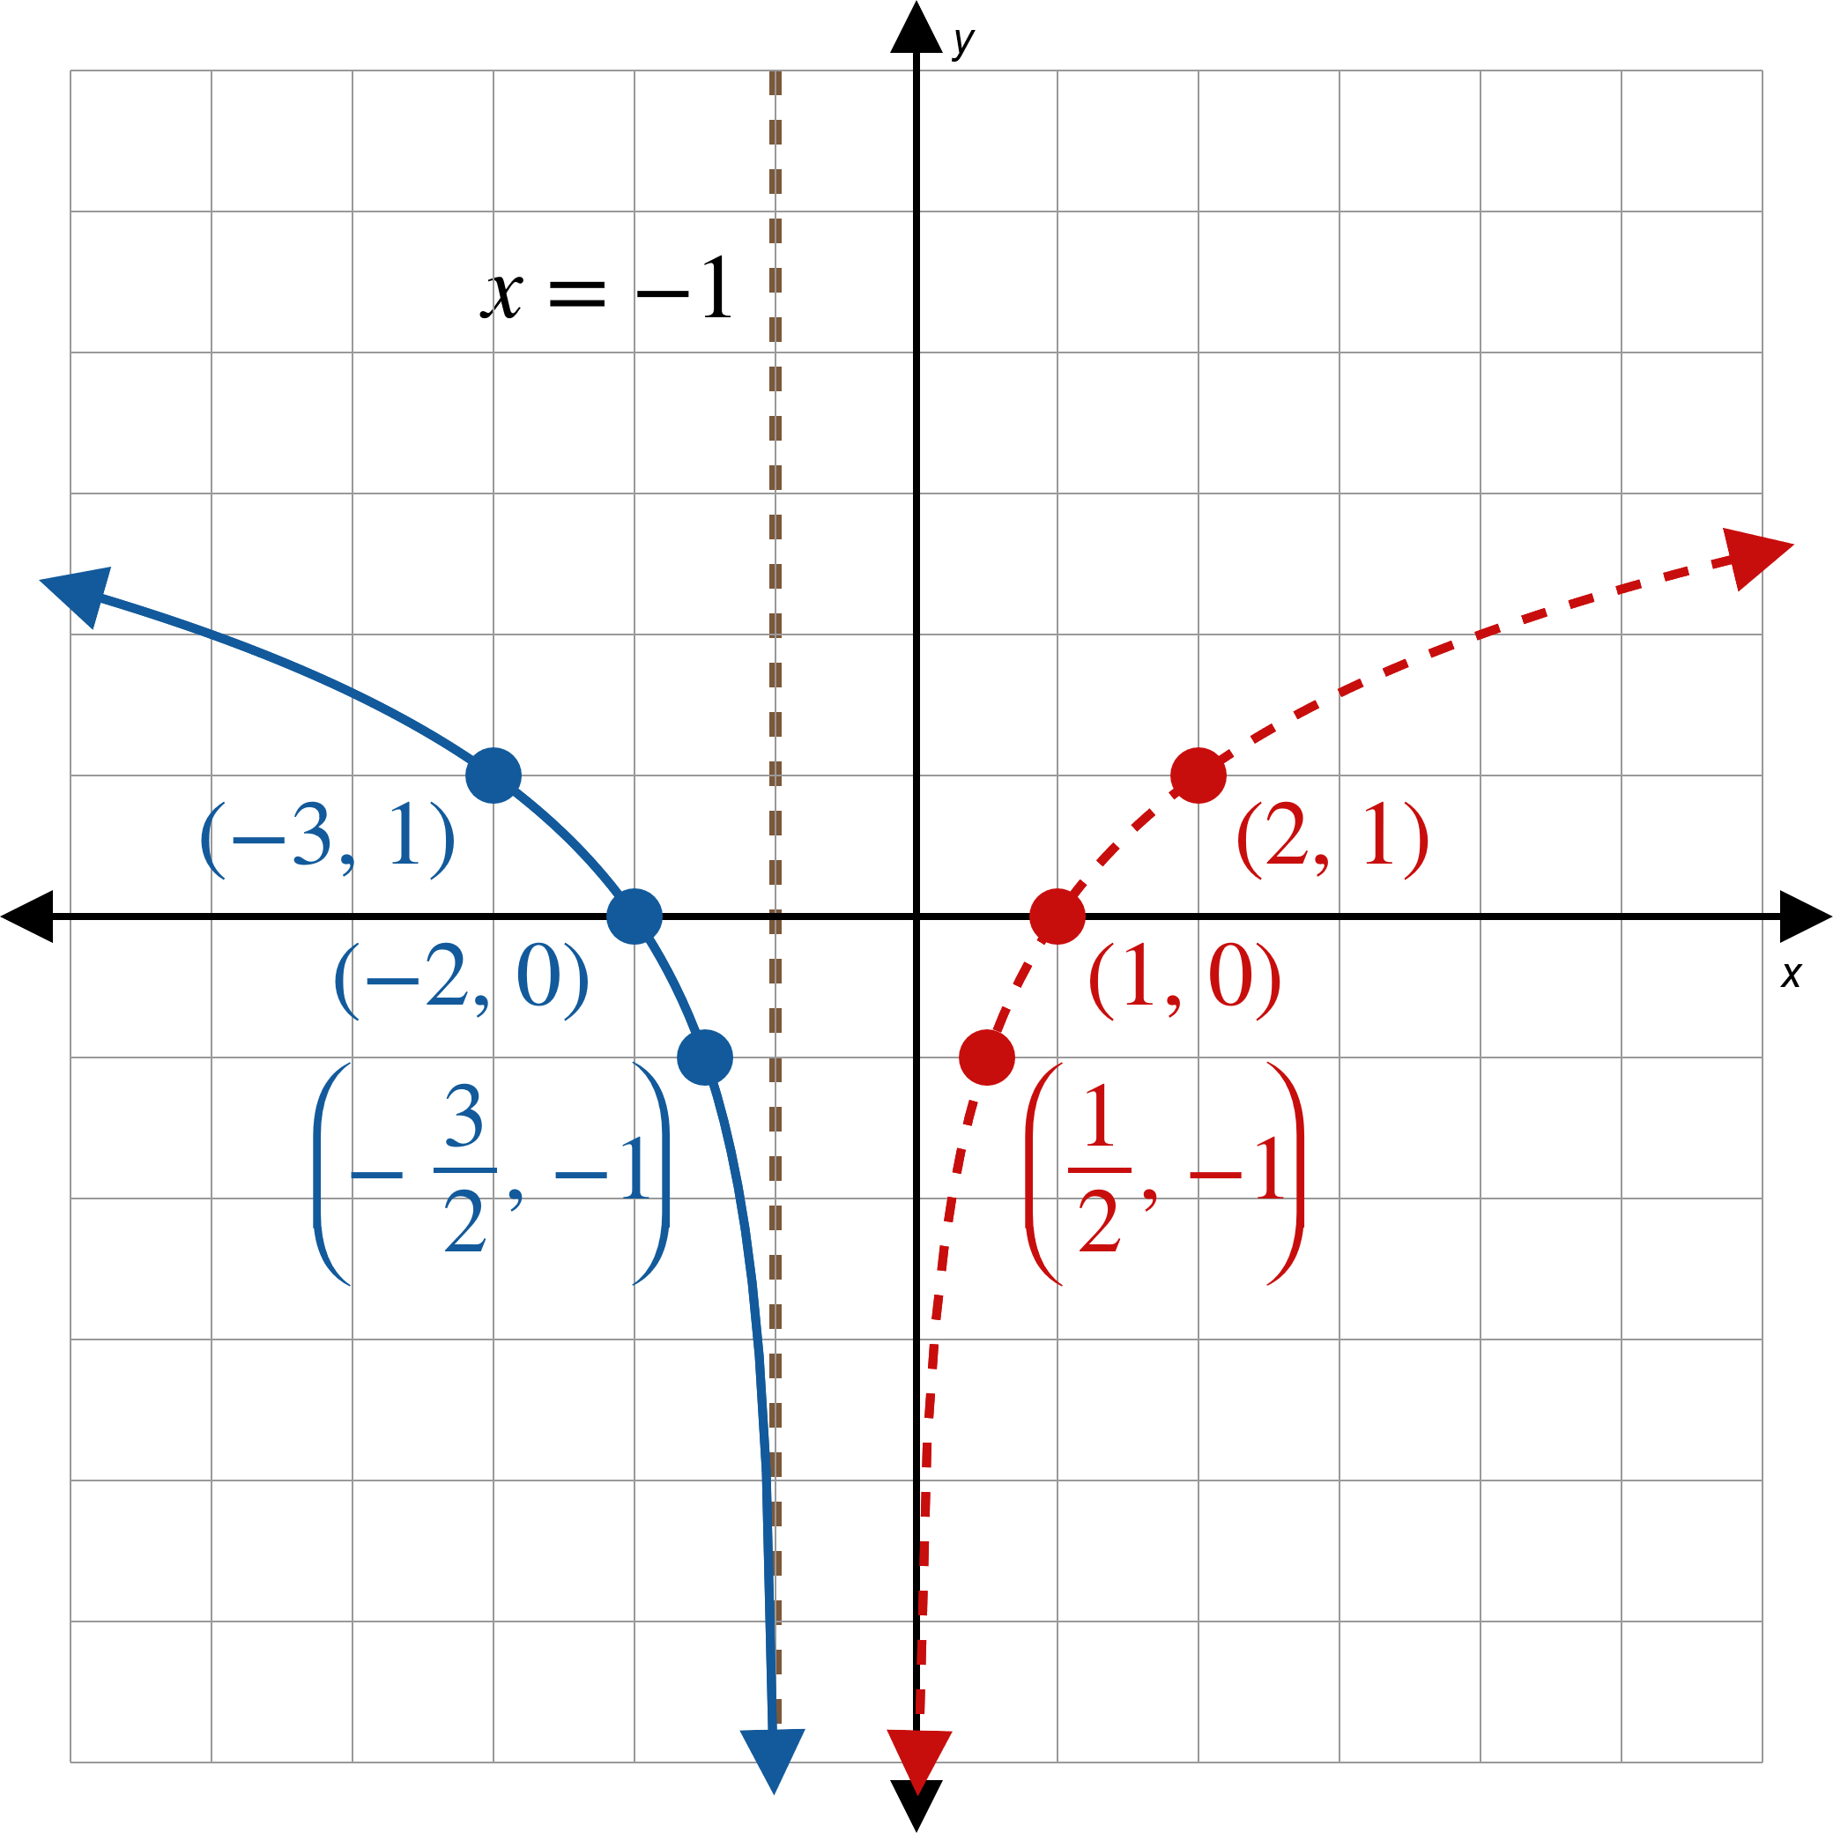
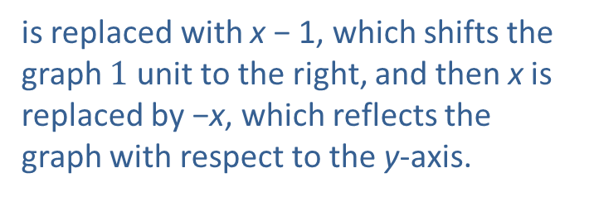
Example 3: Graphing Logarithmic Functions₆
The basic shape of the graph of g is the same as the shape of
which is the dashed curve.
is replaced with x − 1, which shifts the graph $1$ unit to the right, and then x is replaced by −x, which reflects the graph with respect to the y-axis.
Figure 5

Slide 14
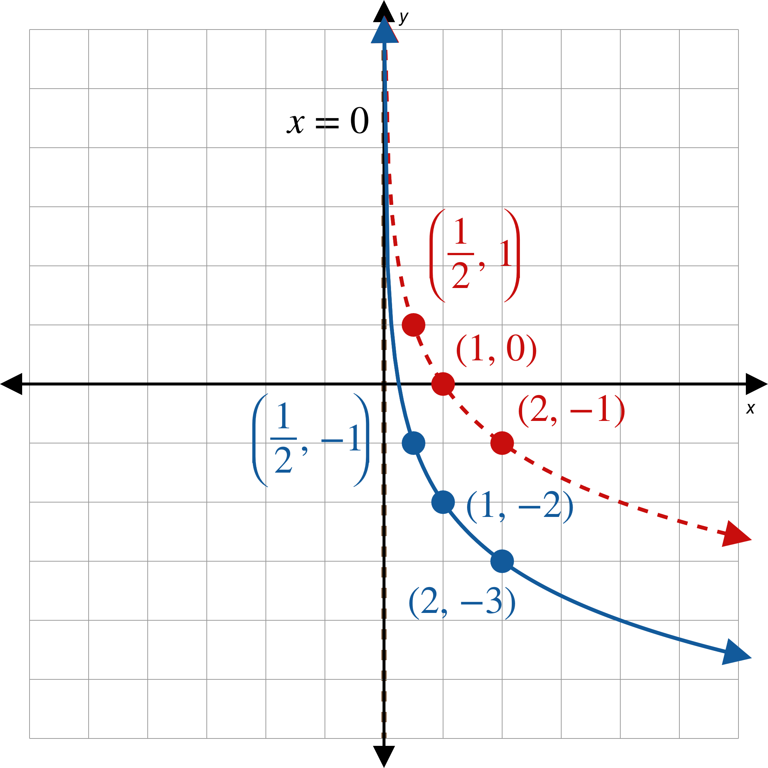
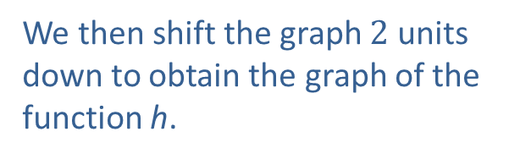
Example 3: Graphing Logarithmic Functions₇
We begin with the dashed curve, which is the graph of
We then shift the graph $2$ units down to obtain the graph of the function h.
Figure 6

Slide 15
Example 4: Logarithmic Expressions₁
Evaluate the following logarithmic expressions.

Slide 16
Note₃
We write each of the equivalent exponential equations as a reference.

Slide 17
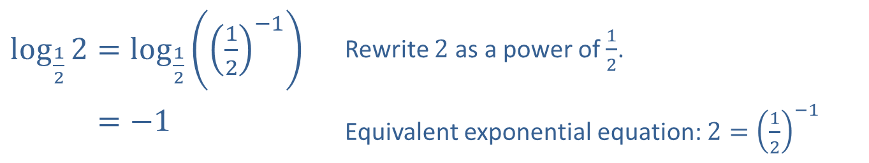
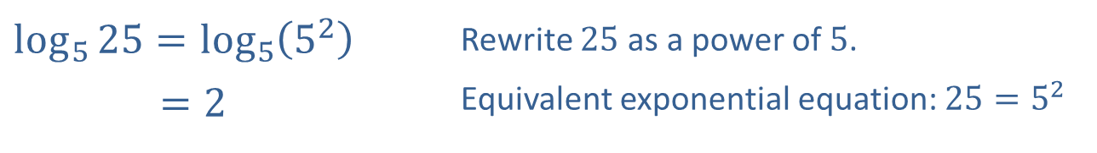
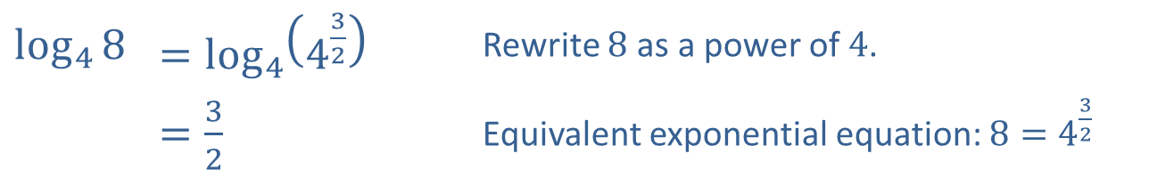
Example 4: Logarithmic Expressions₄
Solution
a.
​$\log_{5}{25}=\log_{5}\left(5^{2}\right)$ | Rewrite 25 as a power of 5.
​𝑙𝑜𝑔5⁡25=2 | Equivalent exponential equation: $25=5^{2}$
​$\log_{\frac{1}{2}}{2}=\log_{\frac{1}{2}}\left({\left(\frac{1}{2}\right)}^{−1}\right)$ | Rewrite 2 as a power of $\frac{1}{2}$.
​log12⁡2=−1 | Equivalent exponential equation: $2={\left(\frac{1}{2}\right)}^{−1}$
b.
c.
​$\log_{4}⁡8$ | ​$=\log_{4}\left(4^{\frac{3}{2}}\right)$ | Rewrite 8 as a power of 4.
​ | ​$=\frac{3}{2}$ | Equivalent exponential equation: $8=4^{\frac{3}{2}}$

Slide 18
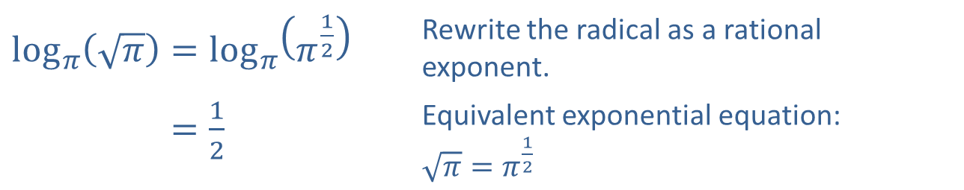
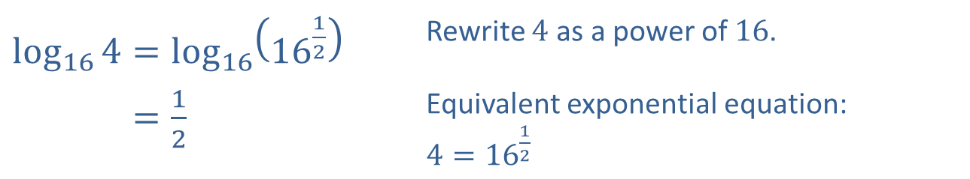
Example 4: Logarithmic Expressions₅
d.
​$\log_{π}\left(\sqrt{π}\right)=\log_{π}\left(π^{\frac{1}{2}}\right)$ | Rewrite the radical as a rational exponent.
​log𝜋⁡𝜋=12 | Equivalent exponential equation: $\sqrt{π}=π^{\frac{1}{2}}$
e.
$$log_{17}1=0$$ | Equivalent exponential equation: $1=17^{0}$
f.
​$\log_{16}{4}=\log_{16}\left({16}^{\frac{1}{2}}\right)$ | Rewrite 4 as a power of 16.
​log16⁡4=12 | Equivalent exponential equation: $4={16}^{\frac{1}{2}}$

Slide 19
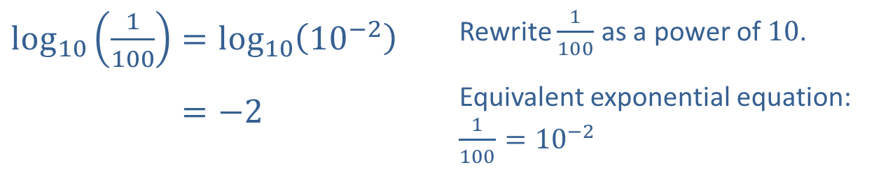
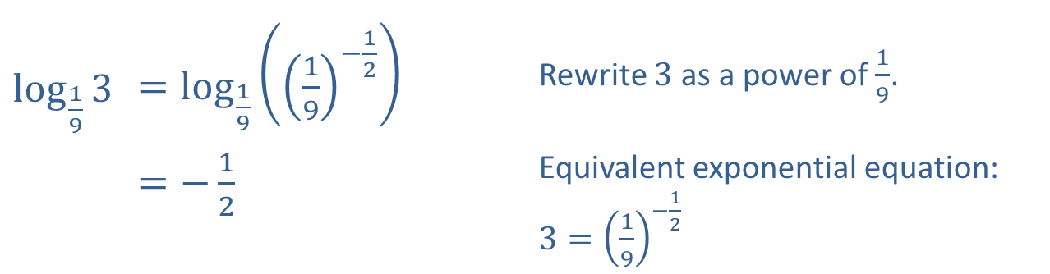
Example 4: Logarithmic Expressions₆
​$\log_{\frac{1}{9}}⁡3$ | ​$=\log_{\frac{1}{9}}\left({\left(\frac{1}{9}\right)}^{−\frac{1}{2}}\right)$ | Rewrite 3 as a power of $\frac{1}{9}$.
 | ​$=−\frac{1}{2}$ | Equivalent exponential equation: $3={\left(\frac{1}{9}\right)}^{−\frac{1}{2}}$
g.
h.
​$\log_{10}\left(\frac{1}{100}\right)=\log_{10}\left({10}^{−2}\right)$ | Rewrite $\frac{1}{100}$ as a power of 10.
​log10⁡1100=−2 | Equivalent exponential equation: $\frac{1}{100}={10}^{−2}$

Slide 20
Example 5: Solving Logarithmic Equations₁
Use elementary properties of exponents and logarithms to solve the following equations.

Slide 21
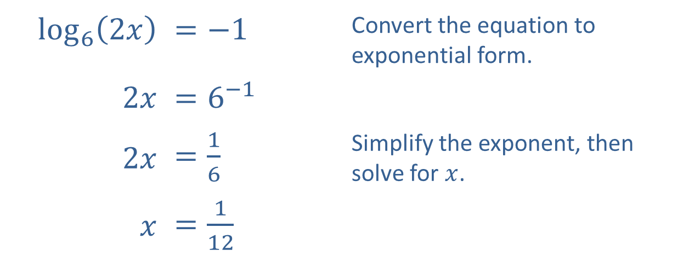
Example 5: Solving Logarithmic Equations₂
Solution
​
​$\log_{6}⁡\left(2x\right)$ | ​$=−1$ | Convert the equation to exponential form.
​$2x$ | ​$=6^{−1}$
​$2x$ | ​$=\frac{1}{6}$ | Simplify the exponent, then solve for $x$.
$x$ | ​$=\frac{1}{12}$

Slide 22
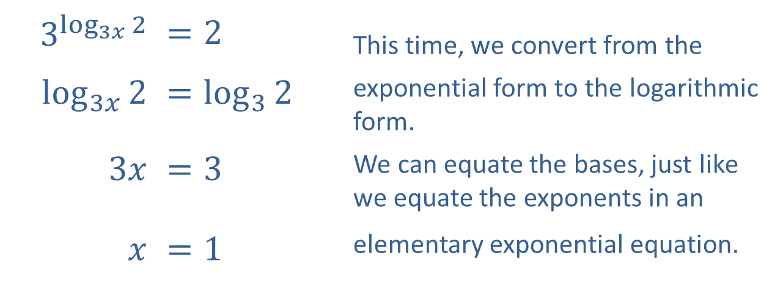
Example 5: Solving Logarithmic Equations₃
​$3^{\log_{3x}{2}}$ | ​$=2$ | This time, we convert from the
​$\log_{3x}⁡2$ | ​$=\log_{3}{2}$ | exponential form to the logarithmic form.
​$3x$ | ​$=3$ | We can equate the bases, just like we equate the exponents in an
$x$ | ​$=1$ | elementary exponential equation.
​

Slide 23
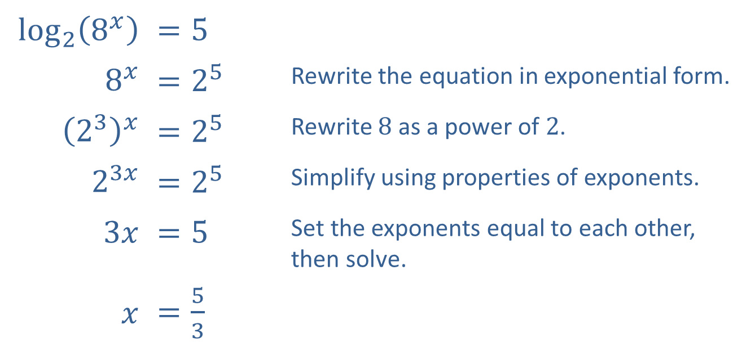
Example 5: Solving Logarithmic Equations₄
​$\log_{2}⁡\left(8^{x}\right)$ | ​$=5$
​$8^{x}$ | ​$=2^{5}$ | Rewrite the equation in exponential form.
​${\left(2^{3}\right)}^{x}$ | ​$=2^{5}$ | Rewrite 8 as a power of 2.
​$2^{3x}$ | ​$=2^{5}$ | Simplify using properties of exponents.
​$3x$ | ​$=5$ | Set the exponents equal to each other, then solve.
$x$ | ​$=\frac{5}{3}$
​

Slide 24
Definition: Common and Natural Logarithms
​The function
is called the common logarithm
and is usually written log x.
is called the natural logarithm
​The function
and is usually written ln x.

Slide 25
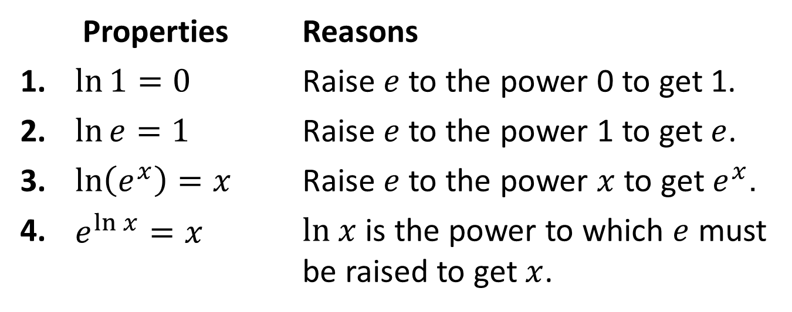
Properties: Properties of Natural Logarithms
 | Properties | Reasons
1. | $\ln{1}=0$ | Raise $e$ to the power 0 to get 1.
2. | $\ln{e}=1$ | Raise $e$ to the power 1 to get $e$.
3. | $\ln\left(e^{x}\right)=x$ | Raise $e$ to the power $x$ to get $e^{x}$.
4. | $e^{\ln{x}}=x$ | $ln x$ is the power to which $e$ must be raised to get $x$.

Slide 26
Example 6: Evaluating Logarithmic Expressions₁
Evaluate the following logarithmic expressions.

Slide 27
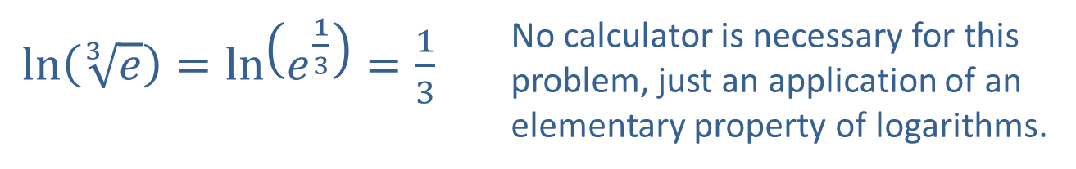
Example 6: Evaluating Logarithmic Expressions₂
Solution
​
$\ln\left(\sqrt[3]{e}\right)=\ln\left(e^{\frac{1}{3}}\right)=\frac{1}{3}$ | No calculator is necessary for this problem, just an application of an elementary property of logarithms.
b.
$\log{1000}=\log\left({10}^{3}\right)=3$ | Again, no calculator is required.

Slide 28
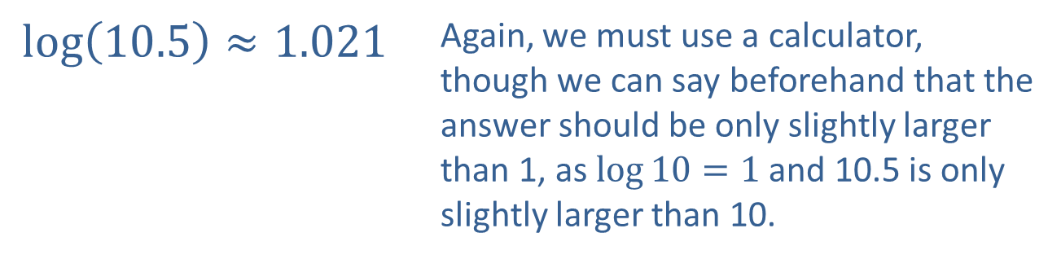
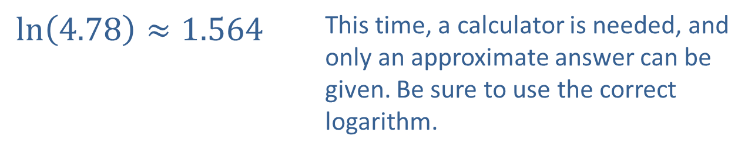
Example 6: Evaluating Logarithmic Expressions₃
$\ln\left(4.78\right)≈1.564$ | This time, a calculator is needed, and only an approximate answer can be given. Be sure to use the correct logarithm.
​
d.
$\log\left(10.5\right)≈1.021$ | Again, we must use a calculator, though we can say beforehand that the answer should be only slightly larger than 1, as $\log{10}=1$ and 10.5 is only slightly larger than 10.

