Slide 1
Section 6.4
The Fundamental Theorem of Algebra

Slide 2
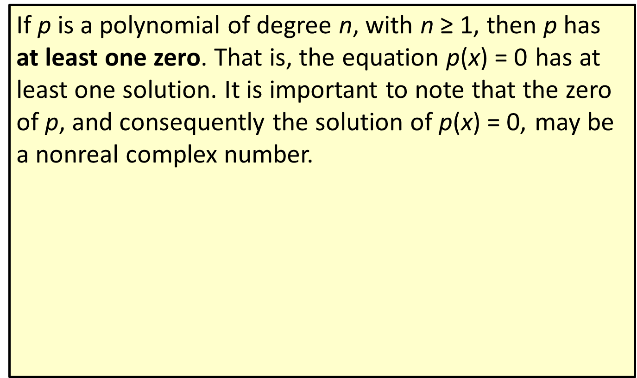
Theorem: The Fundamental Theorem of Algebra
If p is a polynomial of degree n, with n ≥ 1, then p has at least one zero. That is, the equation p(x) = 0 has at least one solution. It is important to note that the zero of p, and consequently the solution of p(x) = 0, may be a nonreal complex number.

Slide 3
Theorem: The Linear Factors Theorem
Given the polynomial
where n ≥ 1 and a _{n} ≠ 0, p can be factored as
are constants (possibly nonreal complex constants and not necessarily distinct). In other words, an
n ^{th}-degree polynomial can be factored as a product of n linear factors.

Slide 4
CAUTION!
The linear factors theorem does not tell us the following things:
​1. The theorem does not tell us that a polynomial has all real zeros. Some, or all, of the constants
may be nonreal complex numbers.
​2. The theorem does not tell us that a polynomial has n distinct zeros. Some, or all, of the constants
may be identical.
​3. The theorem does tell us that any polynomial can be written as a product of linear factors; it does not tell us how to determine the linear factors.

Slide 5
Theorem: Interpreting the Linear Factors Theorem
The graph of an n ^{th}-degree polynomial function has at most n x-intercepts and at most n − 1 turning points. This also means that an n ^{th}-degree polynomial function has at most n zeros.

Slide 6
Definition: Multiplicity of Zeros
If the linear factor (x − c) appears k > 0 times in the factorization of a polynomial
number c is a zero of multiplicity k.

Slide 7
Properties: Geometric Meaning of Multiplicity
If c is a real zero of multiplicity k of a polynomial p (alternatively, if
is a factor of p), the graph of p
will touch the x-axis at (c, 0) and
​cross through the x-axis if k is odd, or
​stay on the same side of the x-axis if k is even
Further, if k > 1, the graph of p will “flatten out” near (c, 0).

Slide 8

Example 1: Graphing Polynomial Functions$\text{1}$
Sketch the graph of the polynomial

Slide 9

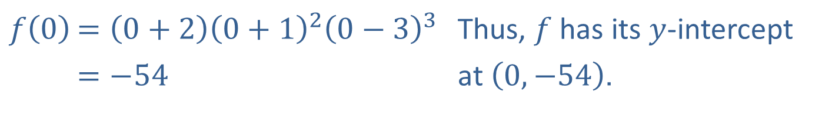
Example 1: Graphing Polynomial Functions$\text{2}$
Solution
We begin with the steps from before. Since f has even degree (6) and a positive leading coefficient (1), we know the end behaviour:
Then plug in x = 0 to find the y-intercept.
$$f\left(0\right)$$ | $=\left(0+2\right){\left(0+1\right)}^{2}{\left(0−3\right)}^{3}$ | Thus, $f$ has its $y$-intercept
 | $=−54$ | at $\left(0,−54\right)$.
Using our knowledge of multiplicity, we can determine that f crosses the x-axis at −2 and 3, but not at −1, and that the graph of f flattens out near −1 and 3. Putting all of this together, we obtain the sketch in Figure 4.

Slide 10
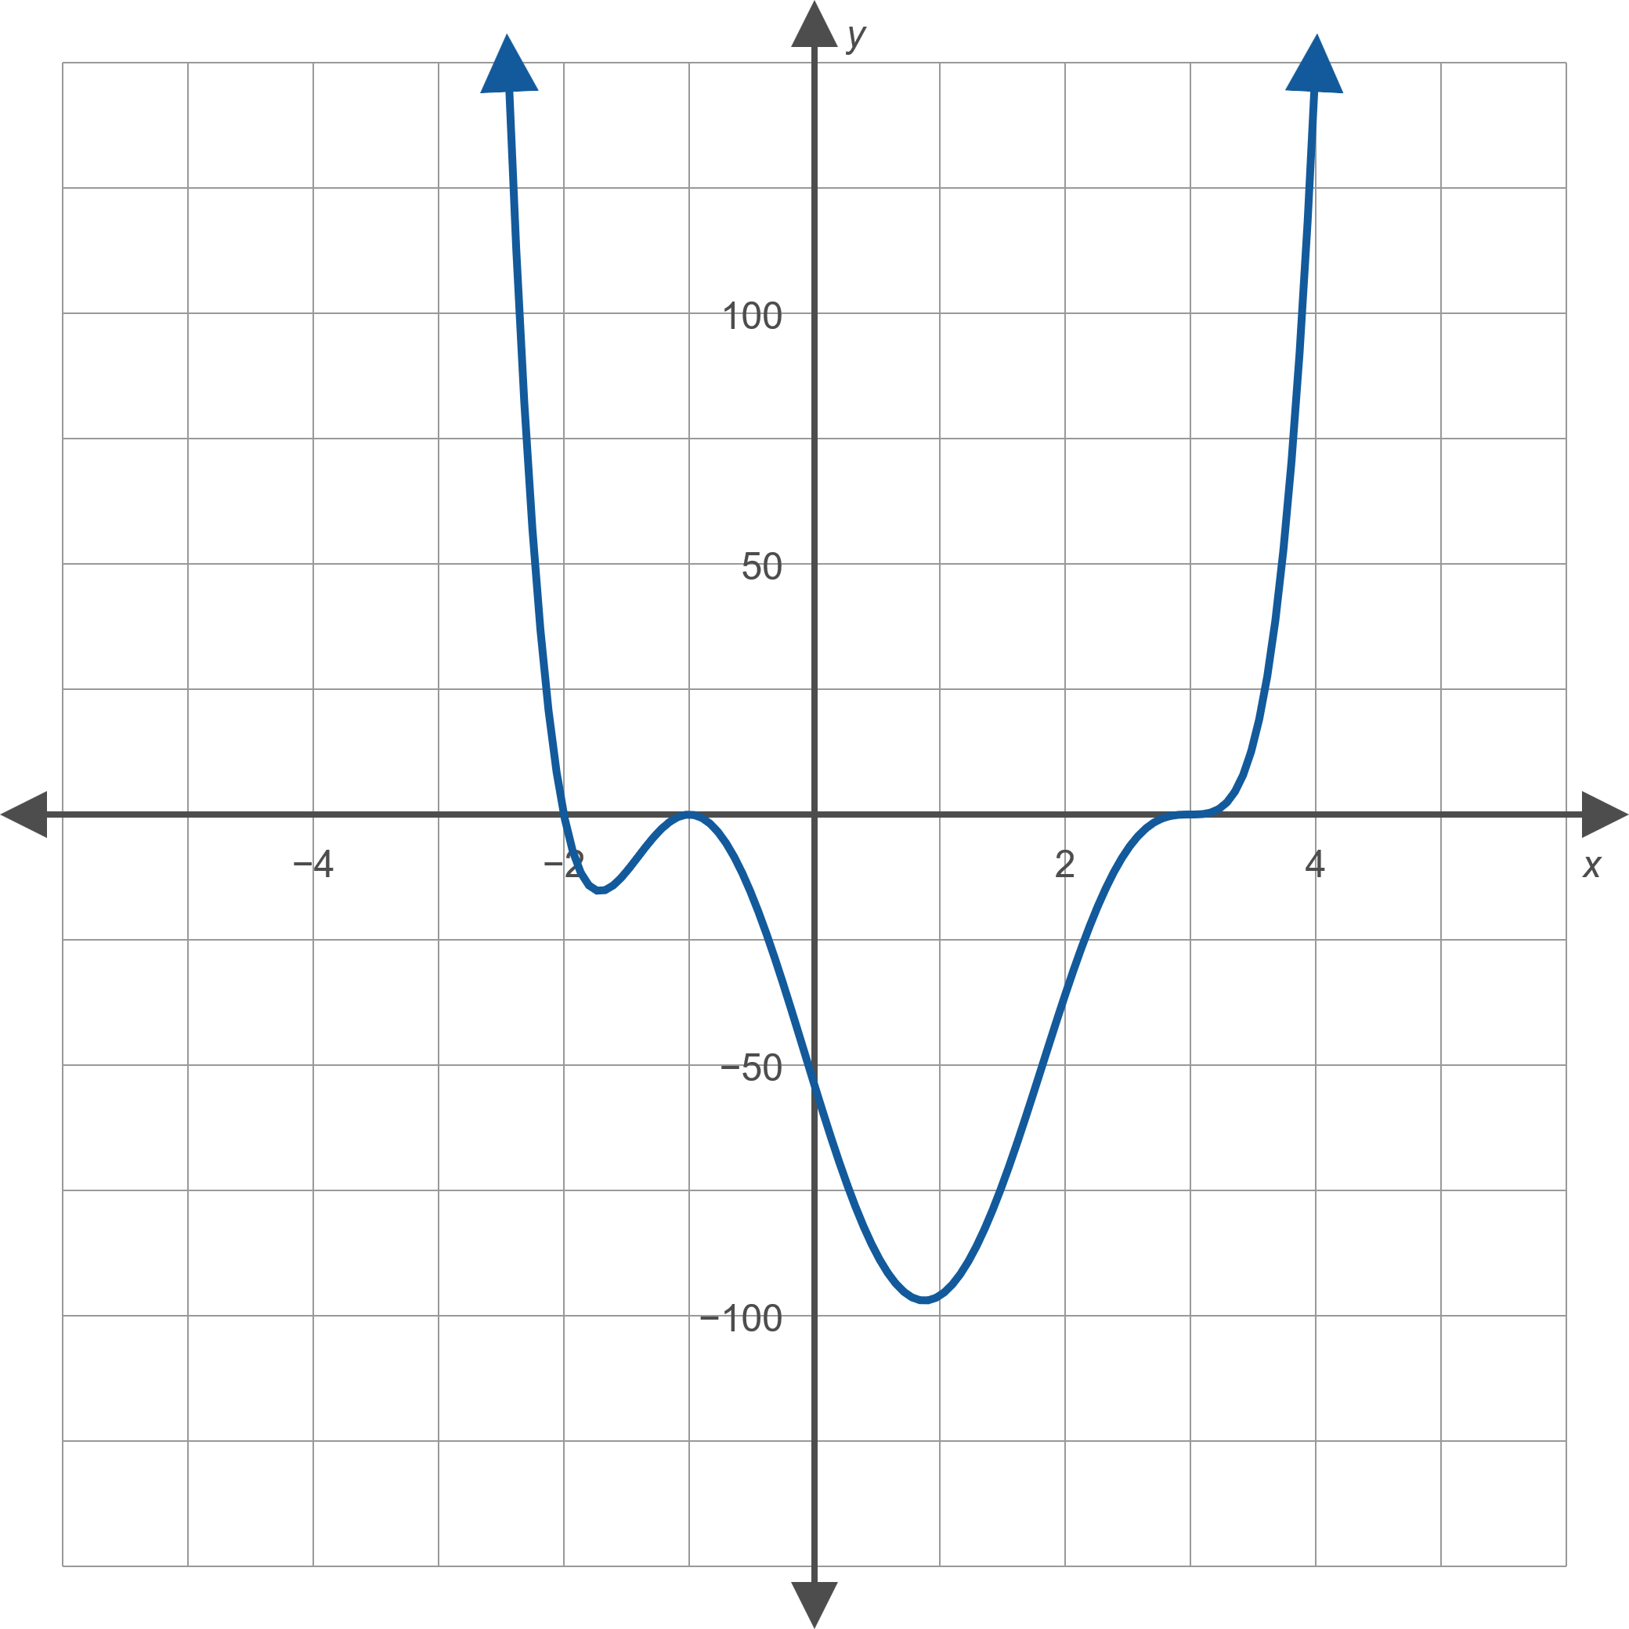

Example 1: Graphing Polynomial Functions$\text{3}$
Note the extreme difference in the scales of the two axes.
To fill in portions of the graph between zeros accurately, we must still compute a few values of the function. For instance, f(1) = − 96 and
f(2) = − 36. This also gives us a way to double-check our analysis of the behavior on either side of a zero.
Figure 4

Slide 11
Theorem: The Conjugate Roots Theorem
Let
be a polynomial with only real coefficients. If the complex number a + b i is a zero of p, then so is the complex number a − b i. In terms of the linear factors of p, this means that if

Slide 12

Example 2: Factoring Polynomials$\text{1}$
Given that 4 − 3i is a zero of the polynomial
factor f completely.

Slide 13


Example 2: Factoring Polynomials$\text{2}$
Solution
By the Conjugate Roots Theorem, since 4 − 3i is a zero of f, we know that 4 + 3i is a zero as well.
This gives us two ways to proceed:
​1. We could divide f by
and then divide the
result by
(most efficiently done with synthetic division).
2. Or, we could multiply
and
and divide f by their product (using polynomial long division).

Slide 14
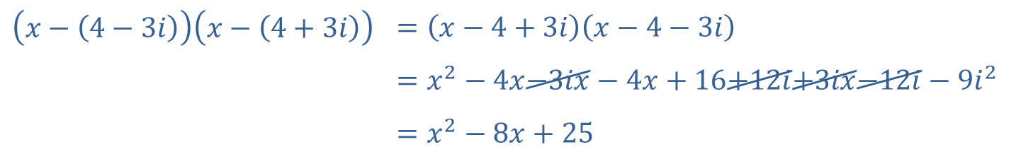

Example 2: Factoring Polynomials$\text{3}$
In either case, we will be left with a quadratic polynomial that we know we can factor.
If we take the second approach, the first step is as follows:
$$\left(x−\left(4−3i\right)\right)\left(x−\left(4+3i\right)\right)$$ | $$=\left(x−4+3i\right)\left(x−4−3i\right)$$
 | $$=x^{2}−4x−3ix−4x+16+12i+3ix−12i−9i^{2}$$
 | $$=x^{2}−8x+25$$

Slide 15

Example 2: Factoring Polynomials$\text{4}$
Now we divide f by this product:
The quotient, x² − 25, is a difference of two squares and is easily factored, giving us our final result:

Slide 16

Example 3: Constructing Polynomials$\text{1}$
Construct a fourth-degree real-coefficient polynomial function f with zeros of 2, −5, and 1 + i such that f(1) = 12.

Slide 17

Example 3: Constructing Polynomials$\text{2}$
Solution
Since 1 + i is one of the zeros and f is to have only real coefficients, 1 − i must be a zero as well by the Conjugate Roots Theorem. Based on this, f must be of the form
for some real constant a ₄.

Slide 18

Example 3: Constructing Polynomials$\text{3}$
We must find a ₄ so that f(1) = 12. In order to do this, we begin by multiplying out

Slide 19
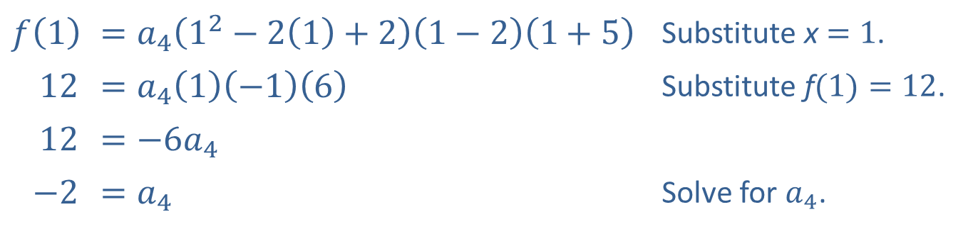

Example 3: Constructing Polynomials$\text{4}$
We then plug in x = 1 and f(1) = 12, then solve for a ₄.
$$f⁡\left(1\right)$$ | ​$=a_{4}\left(1^{2}−2\left(1\right)+2\right)\left(1−2\right)\left(1+5\right)$ | Substitute x$=1$.
​12 | ​$=a_{4}\left(1\right)\left(−1\right)\left(6\right)$ | Substitute f$(1)=12$.
​12 | ​$=−6a_{4}$
​$−2$ | ​$=a_{4}$ | Solve for $a_{4}$.
In factored form, the polynomial is
which, if multiplied out, is

