Slide 1
Section 6.1
Polynomial Functions and Polynomial Inequalities

Slide 2
Definition: Zeros of a Polynomial
The number c (c may be a complex number) is a zero of the polynomial function p(x) if p(c) = 0. This is also expressed by saying that c is a root of the polynomial or a solution of the equation p(x) = 0.

Slide 3
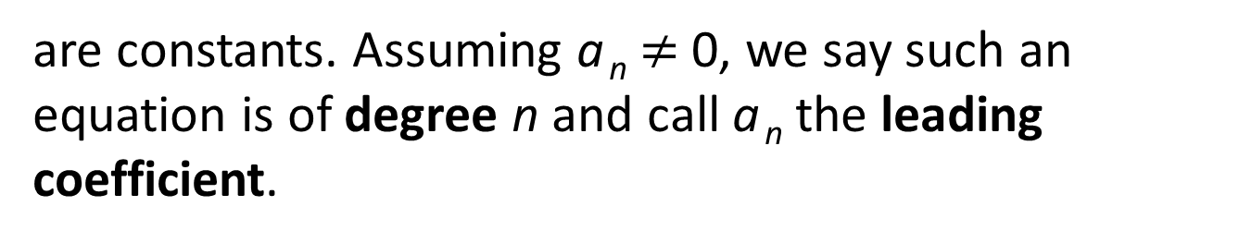
Definition: Polynomial Equations
A polynomial equation in one variable, say the variable x, is an equation that can be written in the form
where n is a nonnegative integer and
are constants. Assuming a _{n} $≠$ 0, we say such an equation is of degree n and call a _{n} the leading coefficient.

Slide 4

Example 1: Solutions of Polynomial Equations$\text{1}$
Verify that the given values of x solve the corresponding polynomial equations.

Slide 5

Note$\text{1}$
When verifying a zero, there is no need to rewrite the equation in the form of the definition.

Slide 6
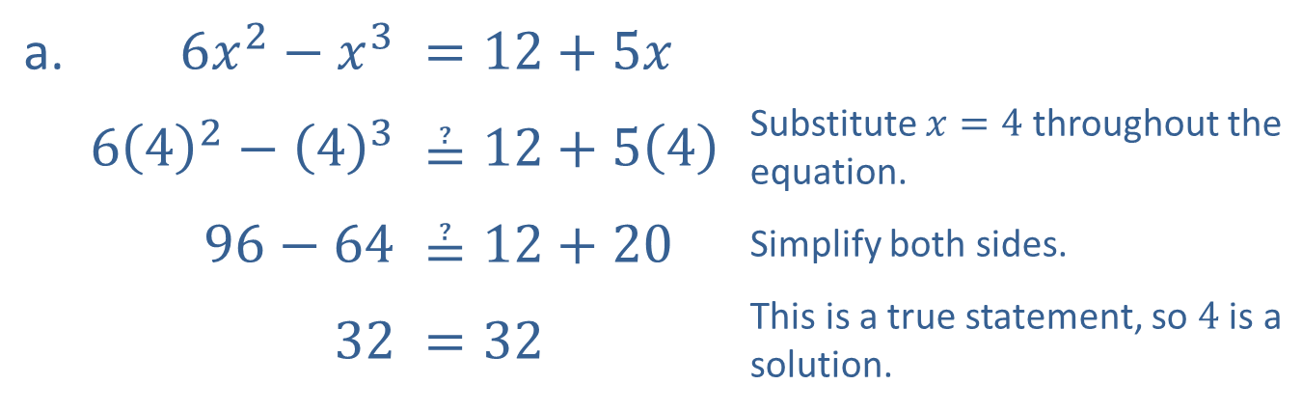

Example 1: Solutions of Polynomial Equations$\text{2}$
Solution
a. ​$6x^{2}−x^{3}$ | ​$=12+5x$
​$6{\left(4\right)}^{2}−{\left(4\right)}^{3}$ | ​$≟12+5\left(4\right)$ | Substitute $x=4$ throughout the equation.
​$96−64$ | ​$≟12+20$ | Simplify both sides.
​32 | ​$=32$ | This is a true statement, so 4 is a solution.

Slide 7
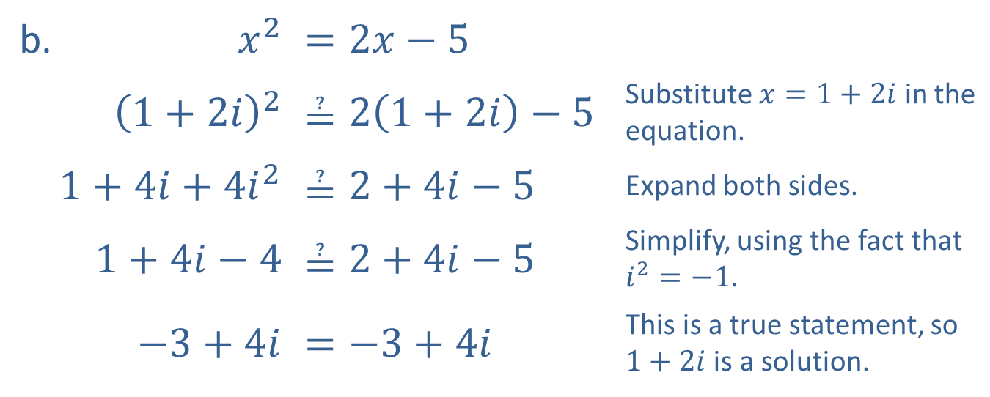

Example 1: Solutions of Polynomial Equations$\text{3}$
b. ​$x^{2}$ | ​$=2x−5$
​${\left(1+2i\right)}^{2}$ | ​$≟2\left(1+2i\right)−5$ | Substitute $x=1+2i$ in the equation.
​$1+4i+4i^{2}$ | ​$≟2+4i−5$ | Expand both sides.
​$1+4i−4$ | ​$≟2+4i−5$ | Simplify, using the fact that $i^{2}=−1$.
​$−3+4i$ | ​$=−3+4i$ | This is a true statement, so $1+2i$ is a solution.

Slide 8
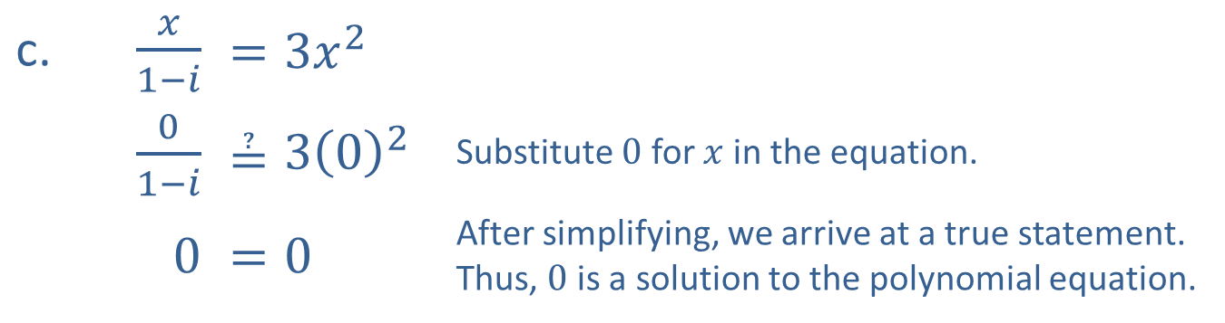

Example 1: Solutions of Polynomial Equations$\text{4}$
c. ​$\frac{x}{1−i}$ | ​$=3x^{2}$
​$\frac{0}{1−i}$ | ​$≟3{\left(0\right)}^{2}$ | Substitute 0 for $x$ in the equation.
​0 | ​$=0$ | After simplifying, we arrive at a true statement. Thus, 0 is a solution to the polynomial equation.

Slide 9

Properties: Behavior of Polynomials as x$→±∞\text{1}$
Given a polynomial function p(x) with degree n, the behavior of p(x) as
can be determined from the leading term

Slide 10
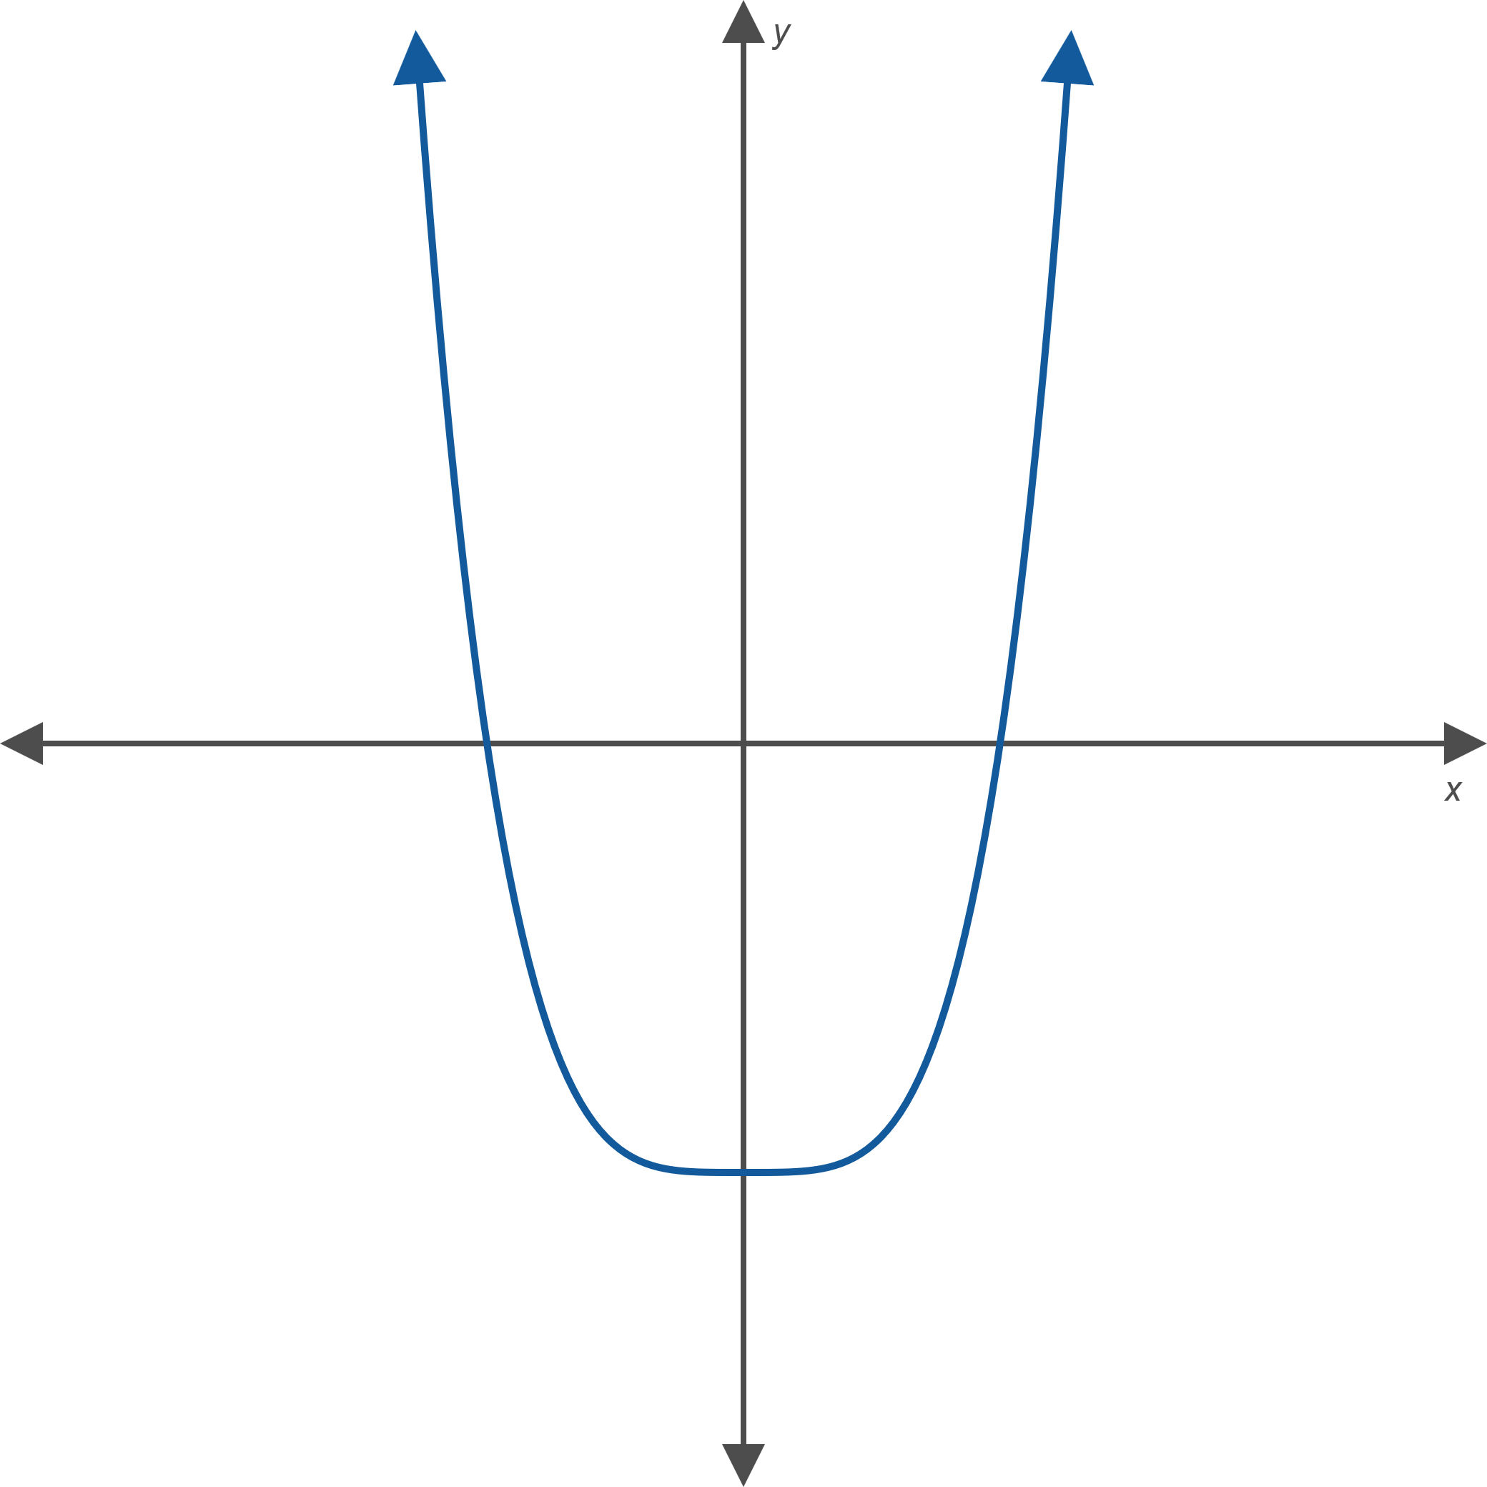
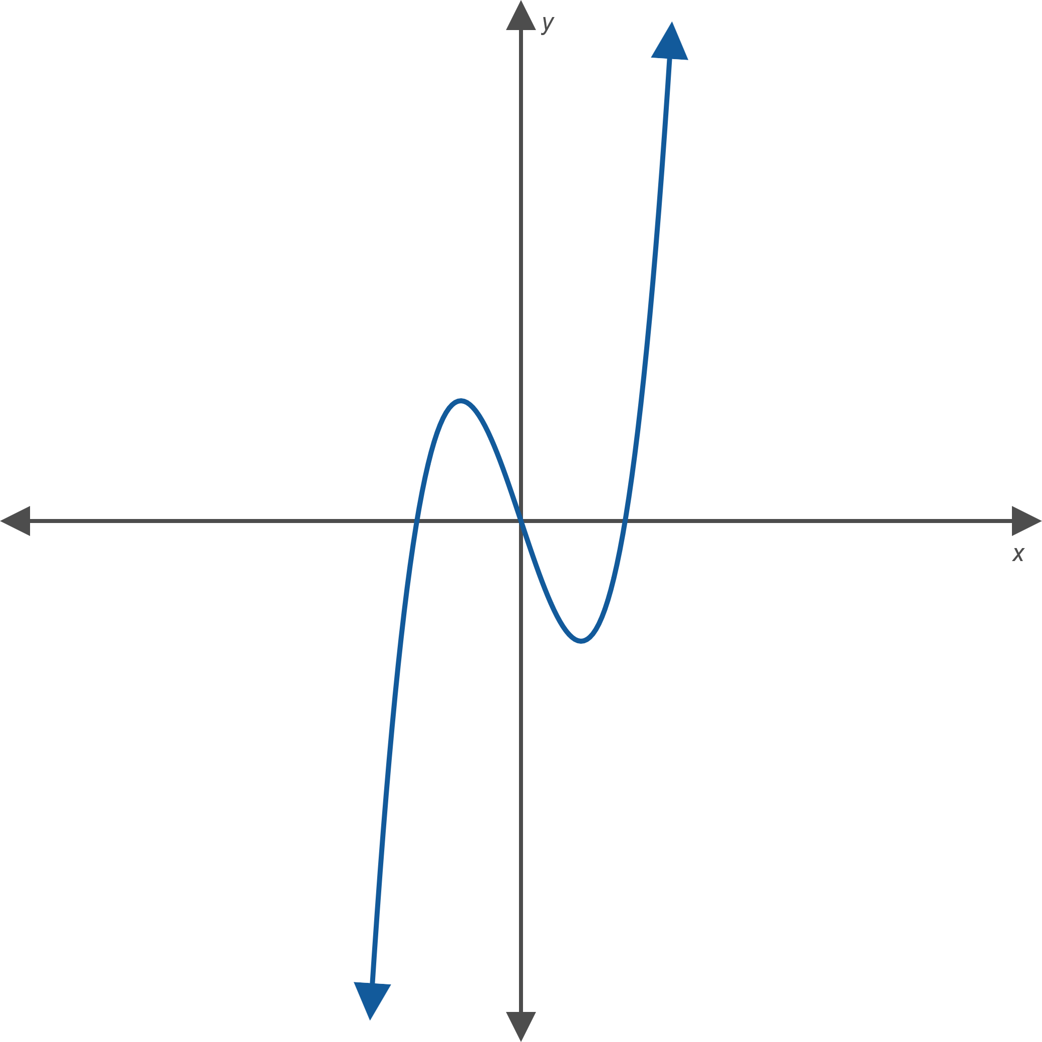
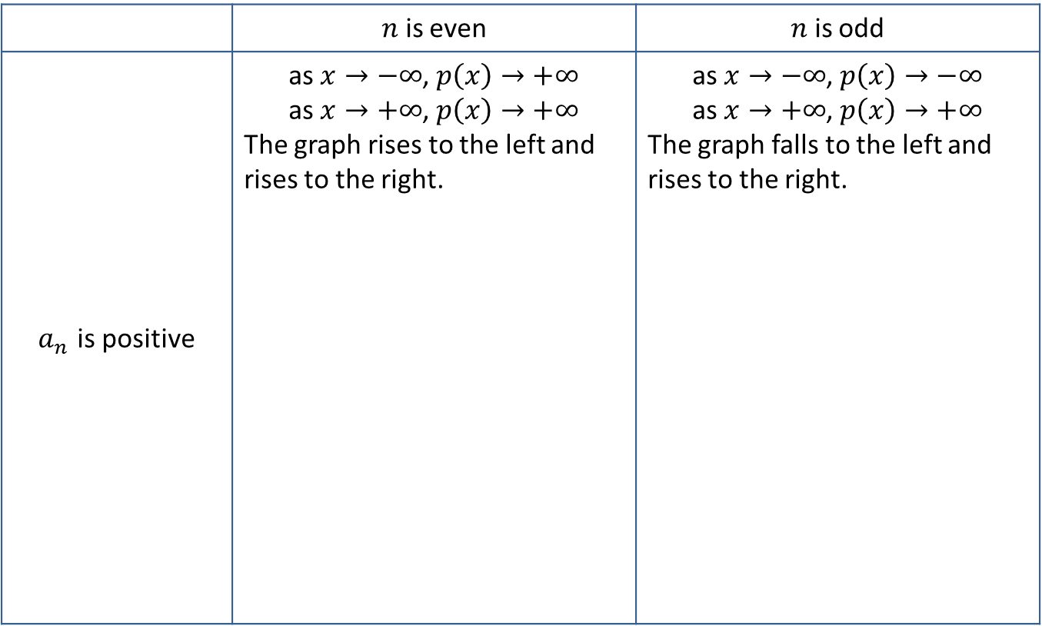

Properties: Behavior of Polynomials as x$→±∞$₂
 | $n$ is even | $n$ is odd
$a_{n}$ is positive | as $x→−∞$, $p\left(x\right)→+∞$ as $x→+∞$, $p\left(x\right)→+∞$ The graph rises to the left and rises to the right. | as $x→−∞$, $p\left(x\right)→−∞$ as $x→+∞$, $p\left(x\right)→+∞$ The graph falls to the left and rises to the right.

Slide 11
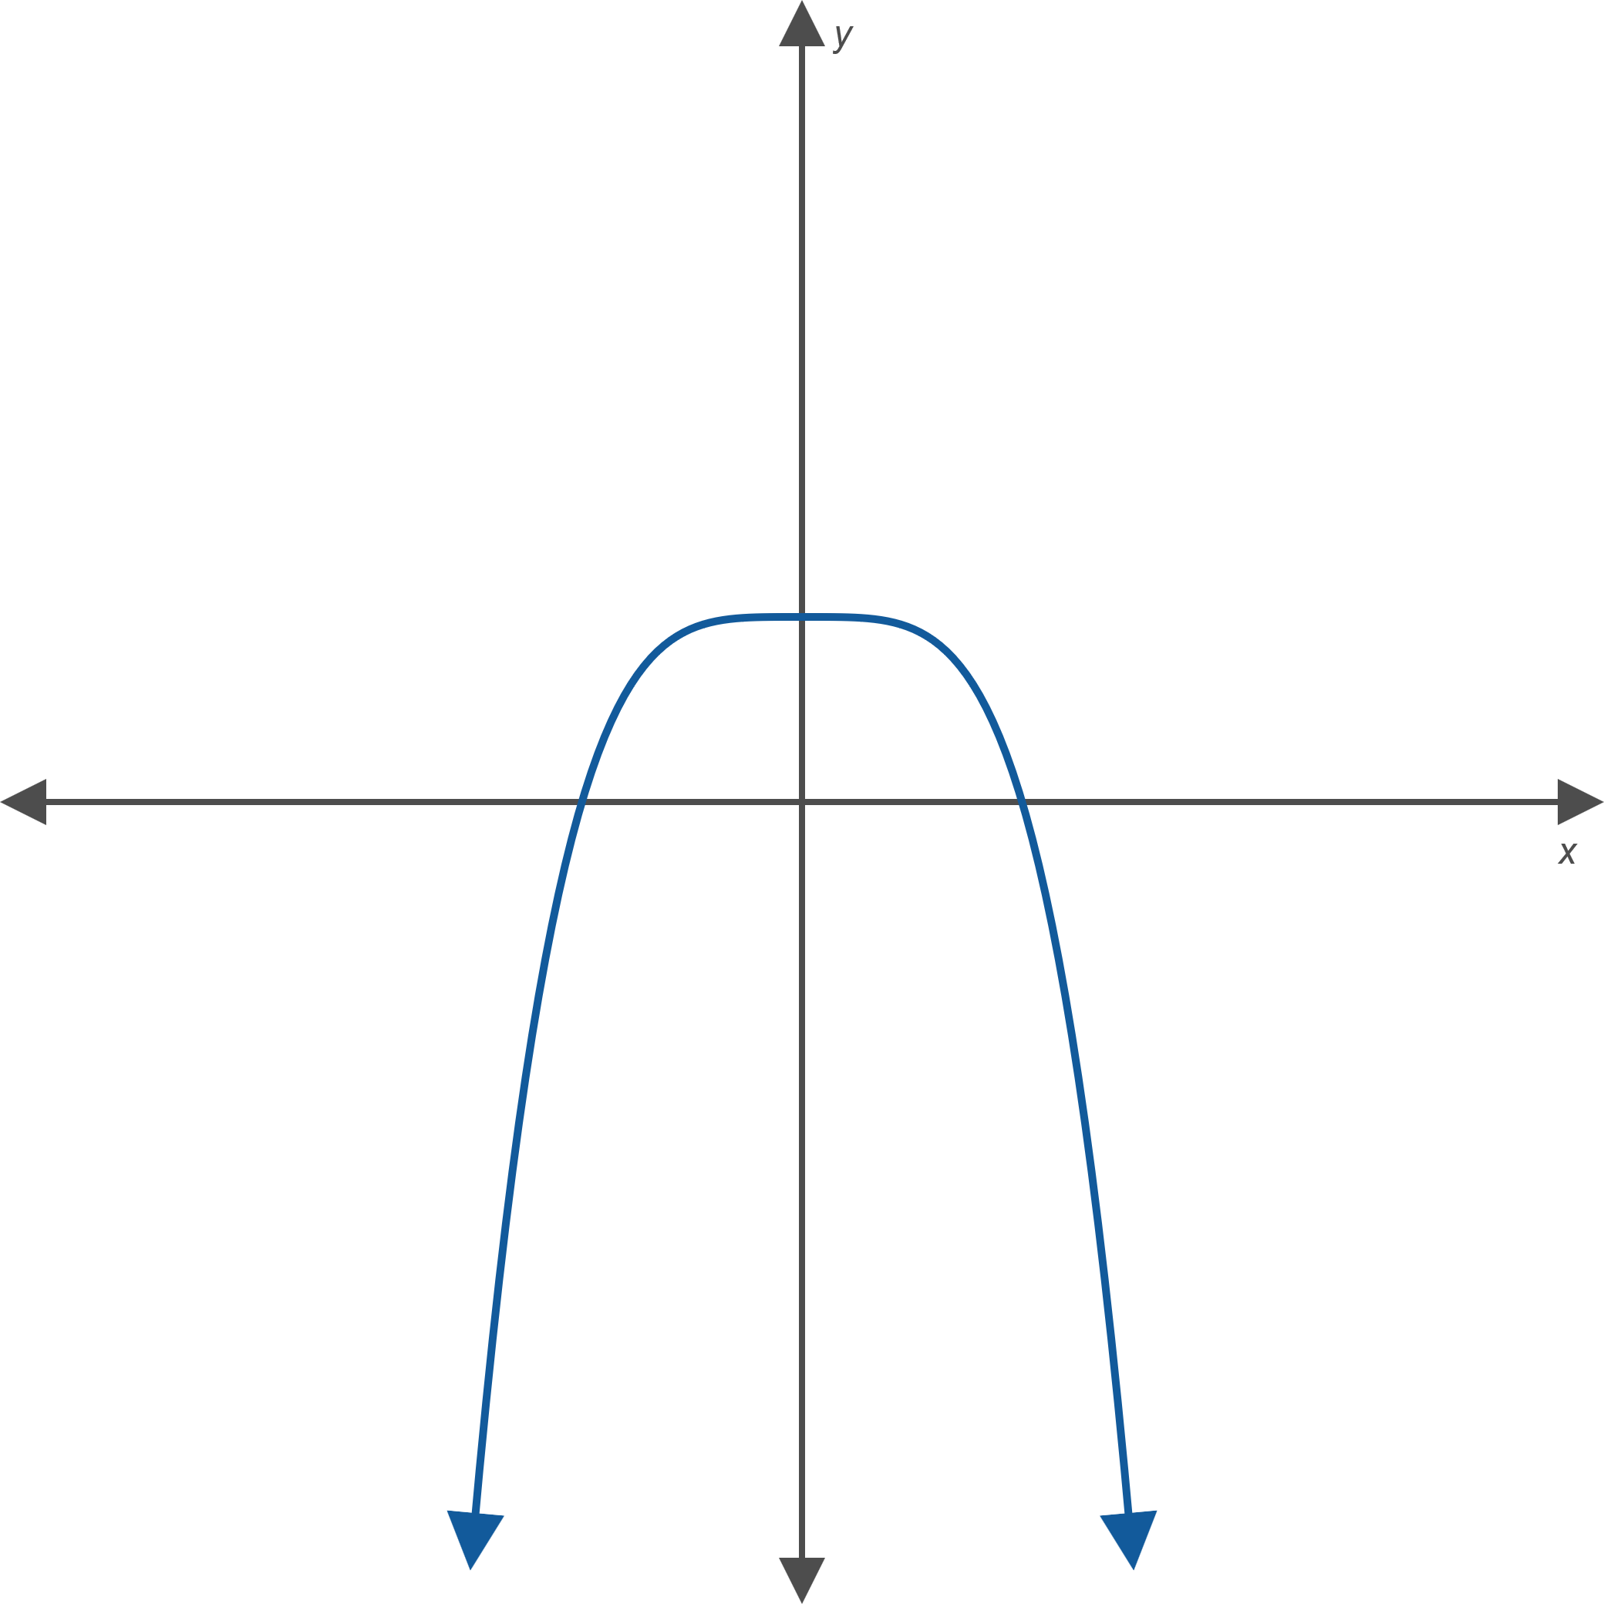
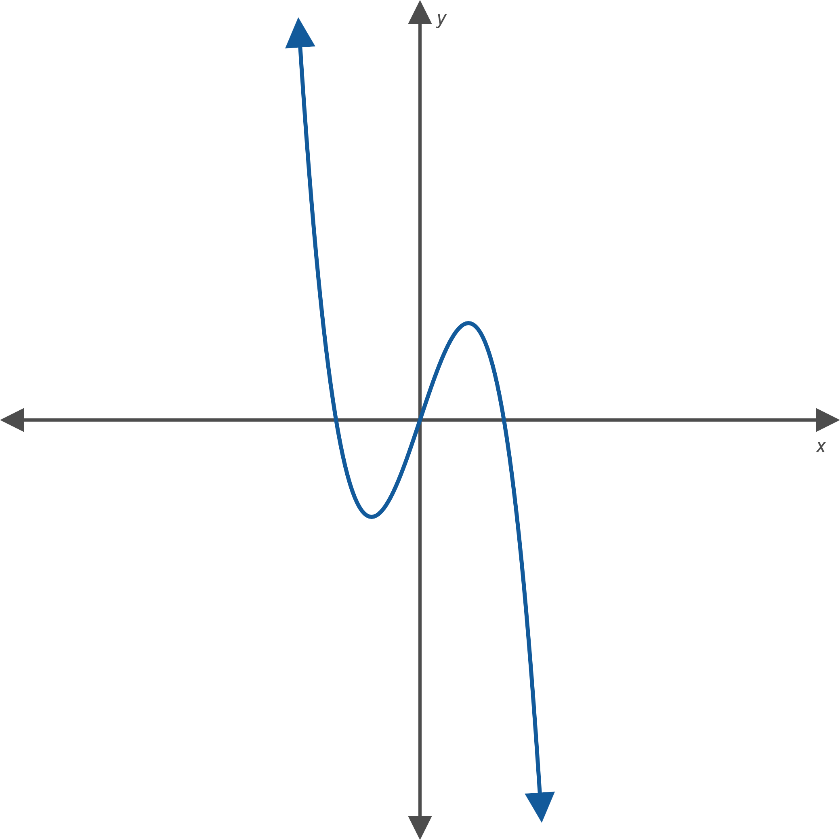
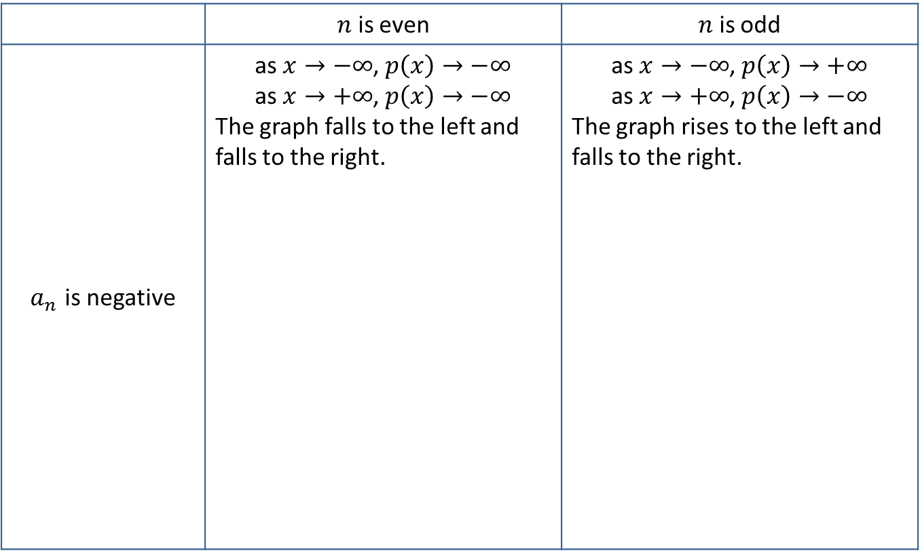

Properties: Behavior of Polynomials as x$→±∞$₃
 | $n$ is even | $n$ is odd
$a_{n}$ is negative | as $x→−∞$, $p\left(x\right)→−∞$ as $x→+∞$, $p\left(x\right)→−∞$ The graph falls to the left and falls to the right. | as $x→−∞$, $p\left(x\right)→+∞$ as $x→+∞$, $p\left(x\right)→−∞$ The graph rises to the left and falls to the right.

Slide 12

Example 2: Graphing Polynomial Functions$\text{1}$
Sketch the graphs of the following polynomial functions, paying particular attention to the x-intercept(s), the y-intercept, and the behavior as

Slide 13

Note$\text{2}$
As always, plotting additional points will help in sketching an accurate graph.

Slide 14

Example 2: Graphing Polynomial Functions$\text{2}$
Solution
a. Begin with the x-intercepts. Using the Zero-Factor Property, we solve f(x) = 0. ​
Thus, the x-intercepts are

Slide 15

Example 2: Graphing Polynomial Functions$\text{3}$
We could plug in x = 0 to find the y-intercept, but we already found it when calculating the x-intercepts! The y-intercept is the origin
All that remains is to determine the end behavior. Find the highest-degree term by multiplying
The leading coefficient is negative, and the degree is odd, so
Putting all this together, we obtain the graph in Figure 8. ​

Slide 16
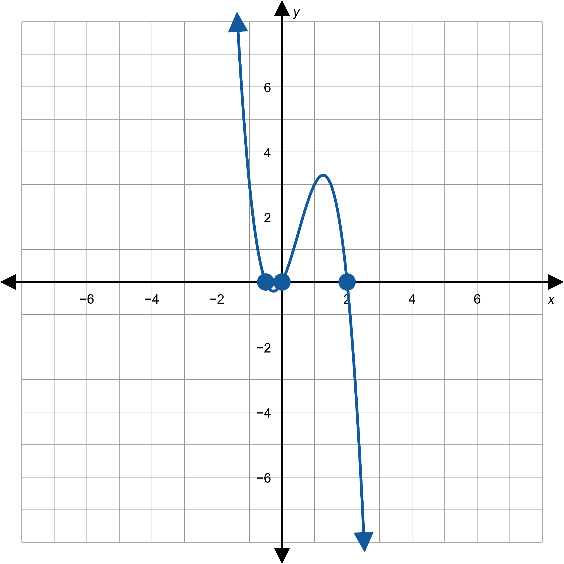

Example 2: Graphing Polynomial Functions$\text{4}$
Figure 8:

Slide 17

Example 2: Graphing Polynomial Functions$\text{5}$
b. This polynomial is not in factored form. Before factoring, we can collect information about the y-intercept and behaviour as .
​
so a ₀ = −3 and the leading term is x ². This means that the y-intercept is (0, −3) and that

Slide 18

Example 2: Graphing Polynomial Functions$\text{6}$
​Now, to find the x-intercepts, we factor the polynomial.
​
​Thus, the x-intercepts are (−3, 0) and (1, 0).

Slide 19
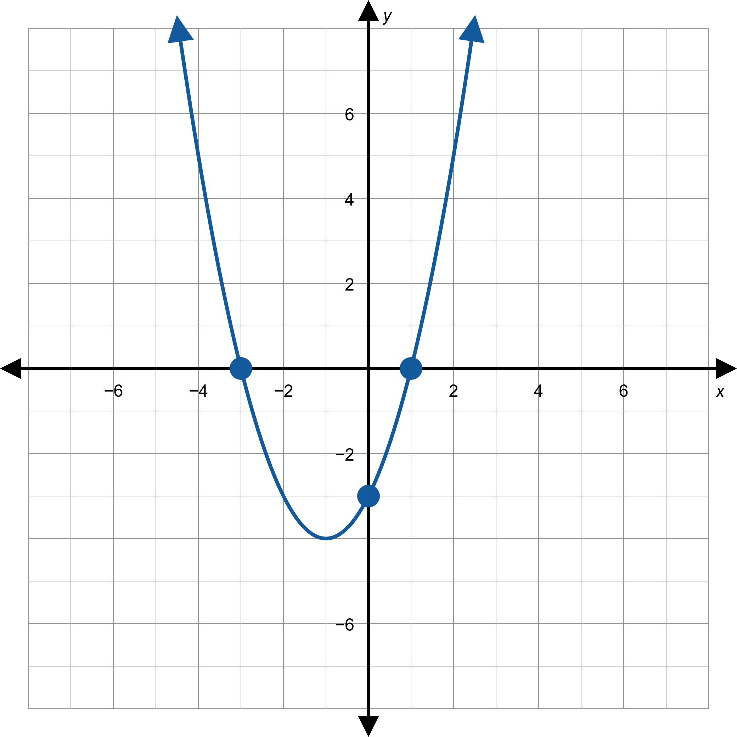

Example 2: Graphing Polynomial Functions$\text{7}$
Figure 9:

Slide 20

Example 2: Graphing Polynomial Functions$\text{8}$
c. As with the previous example, we determine the y-intercept and behavior before factoring.
so a₀ = −1 and the leading term is
This tells us
that the y-intercept is (0, −1) and that

Slide 21
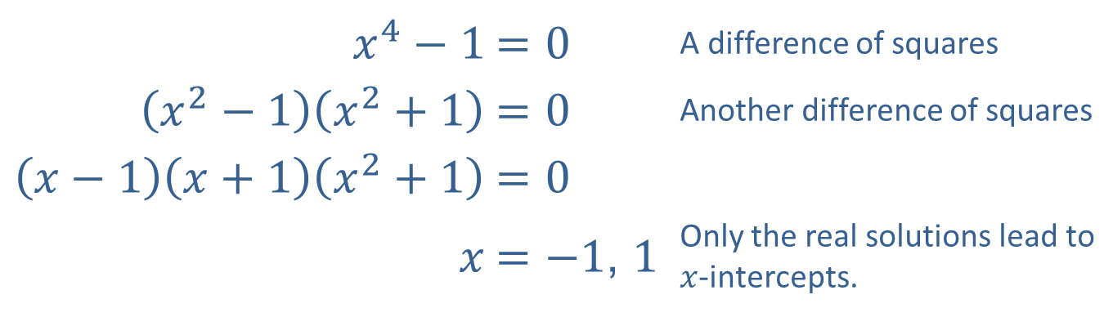

Example 2: Graphing Polynomial Functions$\text{9}$
​Once again, we factor the polynomial to calculate the x-intercepts.
​
​
​$x^{4}−1$ | ​$=0$ | A difference of squares
​$\left(x^{2}−1\right)\left(x^{2}+1\right)$ | ​$=0$ | Another difference of squares
$$\left(x−1\right)\left(x+1\right)\left(x^{2}+1\right)$$ | $$=0$$
​$x$ | ​$=\left.−1\text{, }1\right.$ | Only the real solutions lead to $x$-intercepts.
Here, the x-intercepts are (−1, 0) and (1, 0).

Slide 22
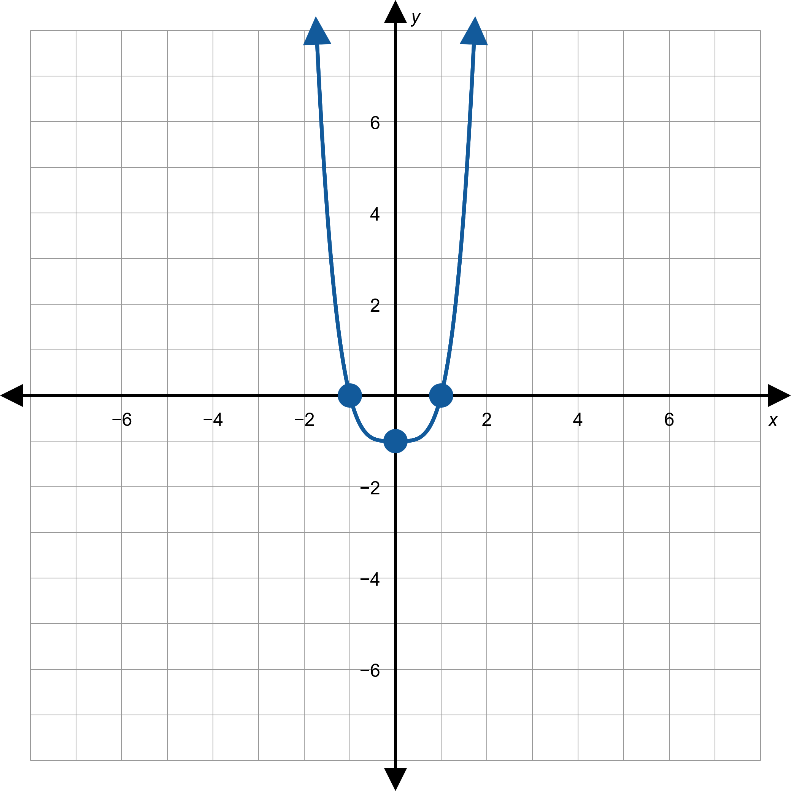

Example 2: Graphing Polynomial Functions$\text{1}\text{0}$
Figure 10:
h(x) = x ⁴ − 1

Slide 23
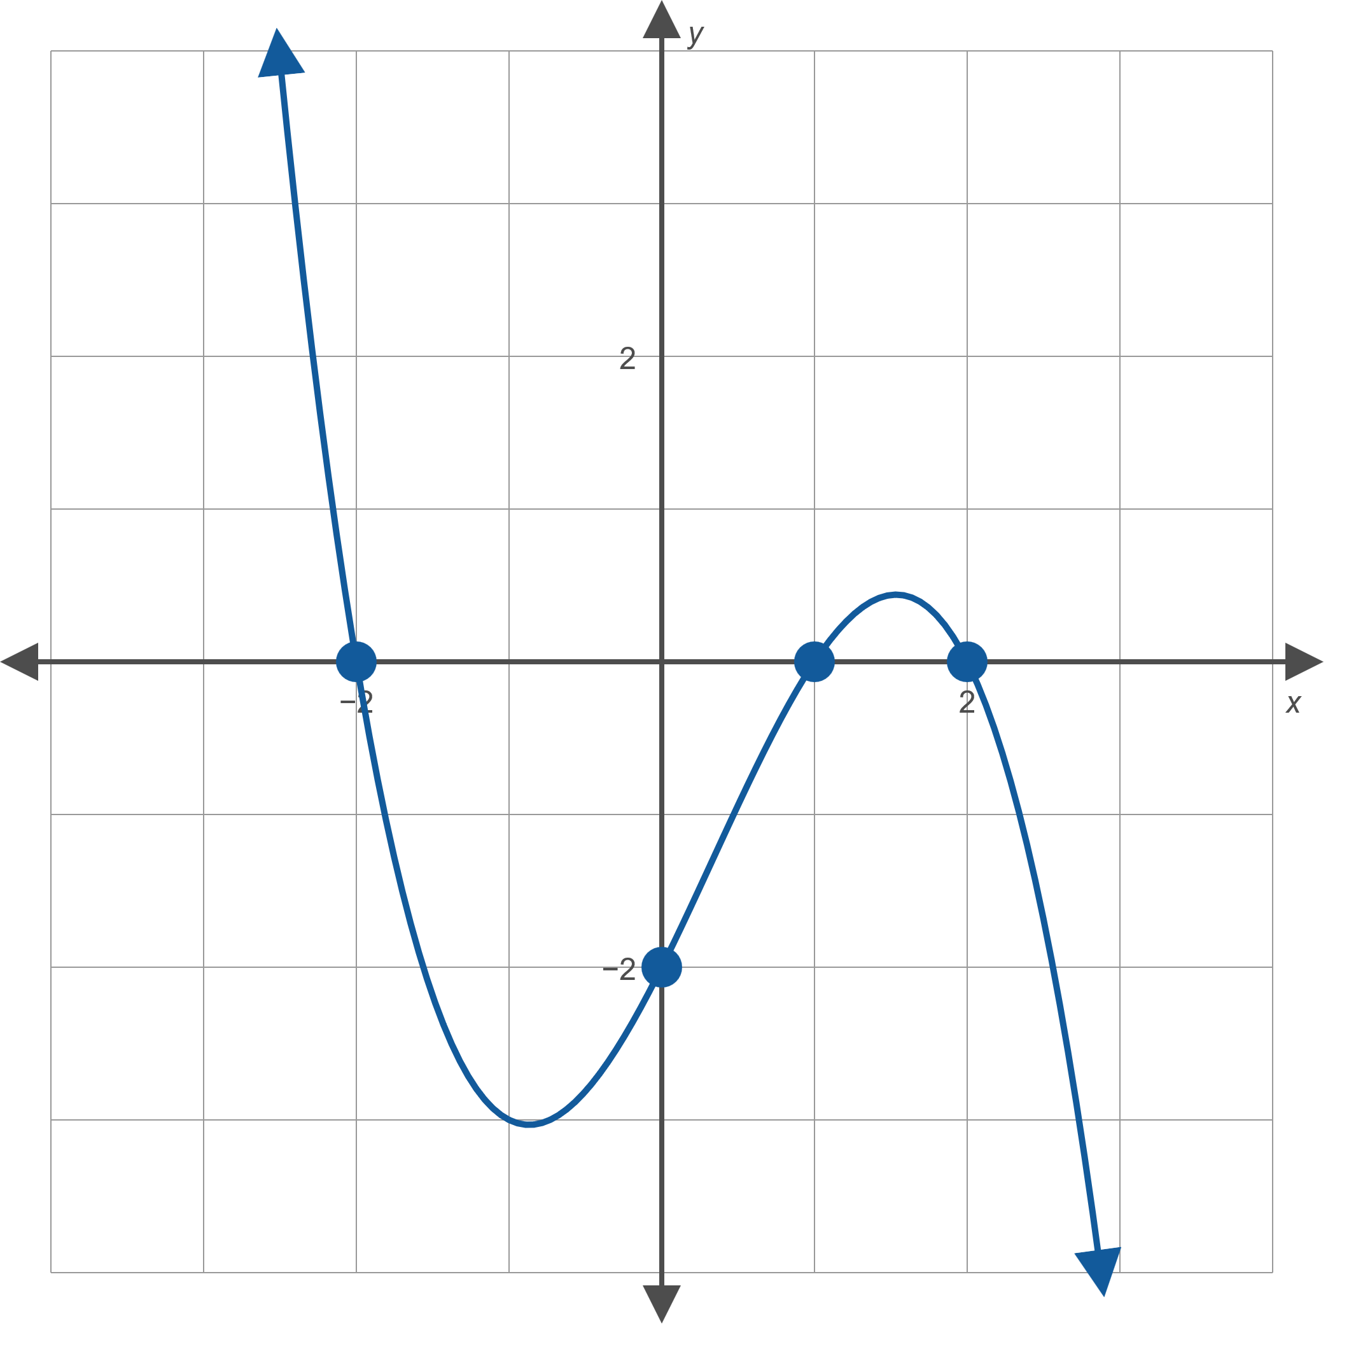

Example 3: Constructing a Polynomial Function from a Graph$\text{1}$
Find the polynomial of lowest possible degree that corresponds to the graph in Figure 11.
Figure 11

Slide 24

Example 3: Constructing a Polynomial Function from a Graph$\text{2}$
Solution
Let p(x) represent the polynomial to be found. The graph indicates that the zeros of p are −2, 1, and 2, so p(x) must have factors of (x + 2), (x − 1), and (x − 2). In addition, p(x) may have a constant factor a—in fact, we know a must be a negative number because the graph has the appearance of a cubic polynomial with a negative leading coefficient. So we know that
with a still to be determined.

Slide 25

Example 3: Constructing a Polynomial Function from a Graph$\text{3}$
We can solve for a by noting that the graph has a y-intercept at (0, −2), so
​
is the desired polynomial.

Slide 26
Definition: Polynomial Inequalities
A polynomial inequality is any inequality that can be written in the form
where p(x) is a polynomial function.

Slide 27

Example 4: Solving Polynomial Inequalities Using a Graph$\text{1}$
Solve the polynomial inequalities, given the graph of
in Figure 12.

Slide 28
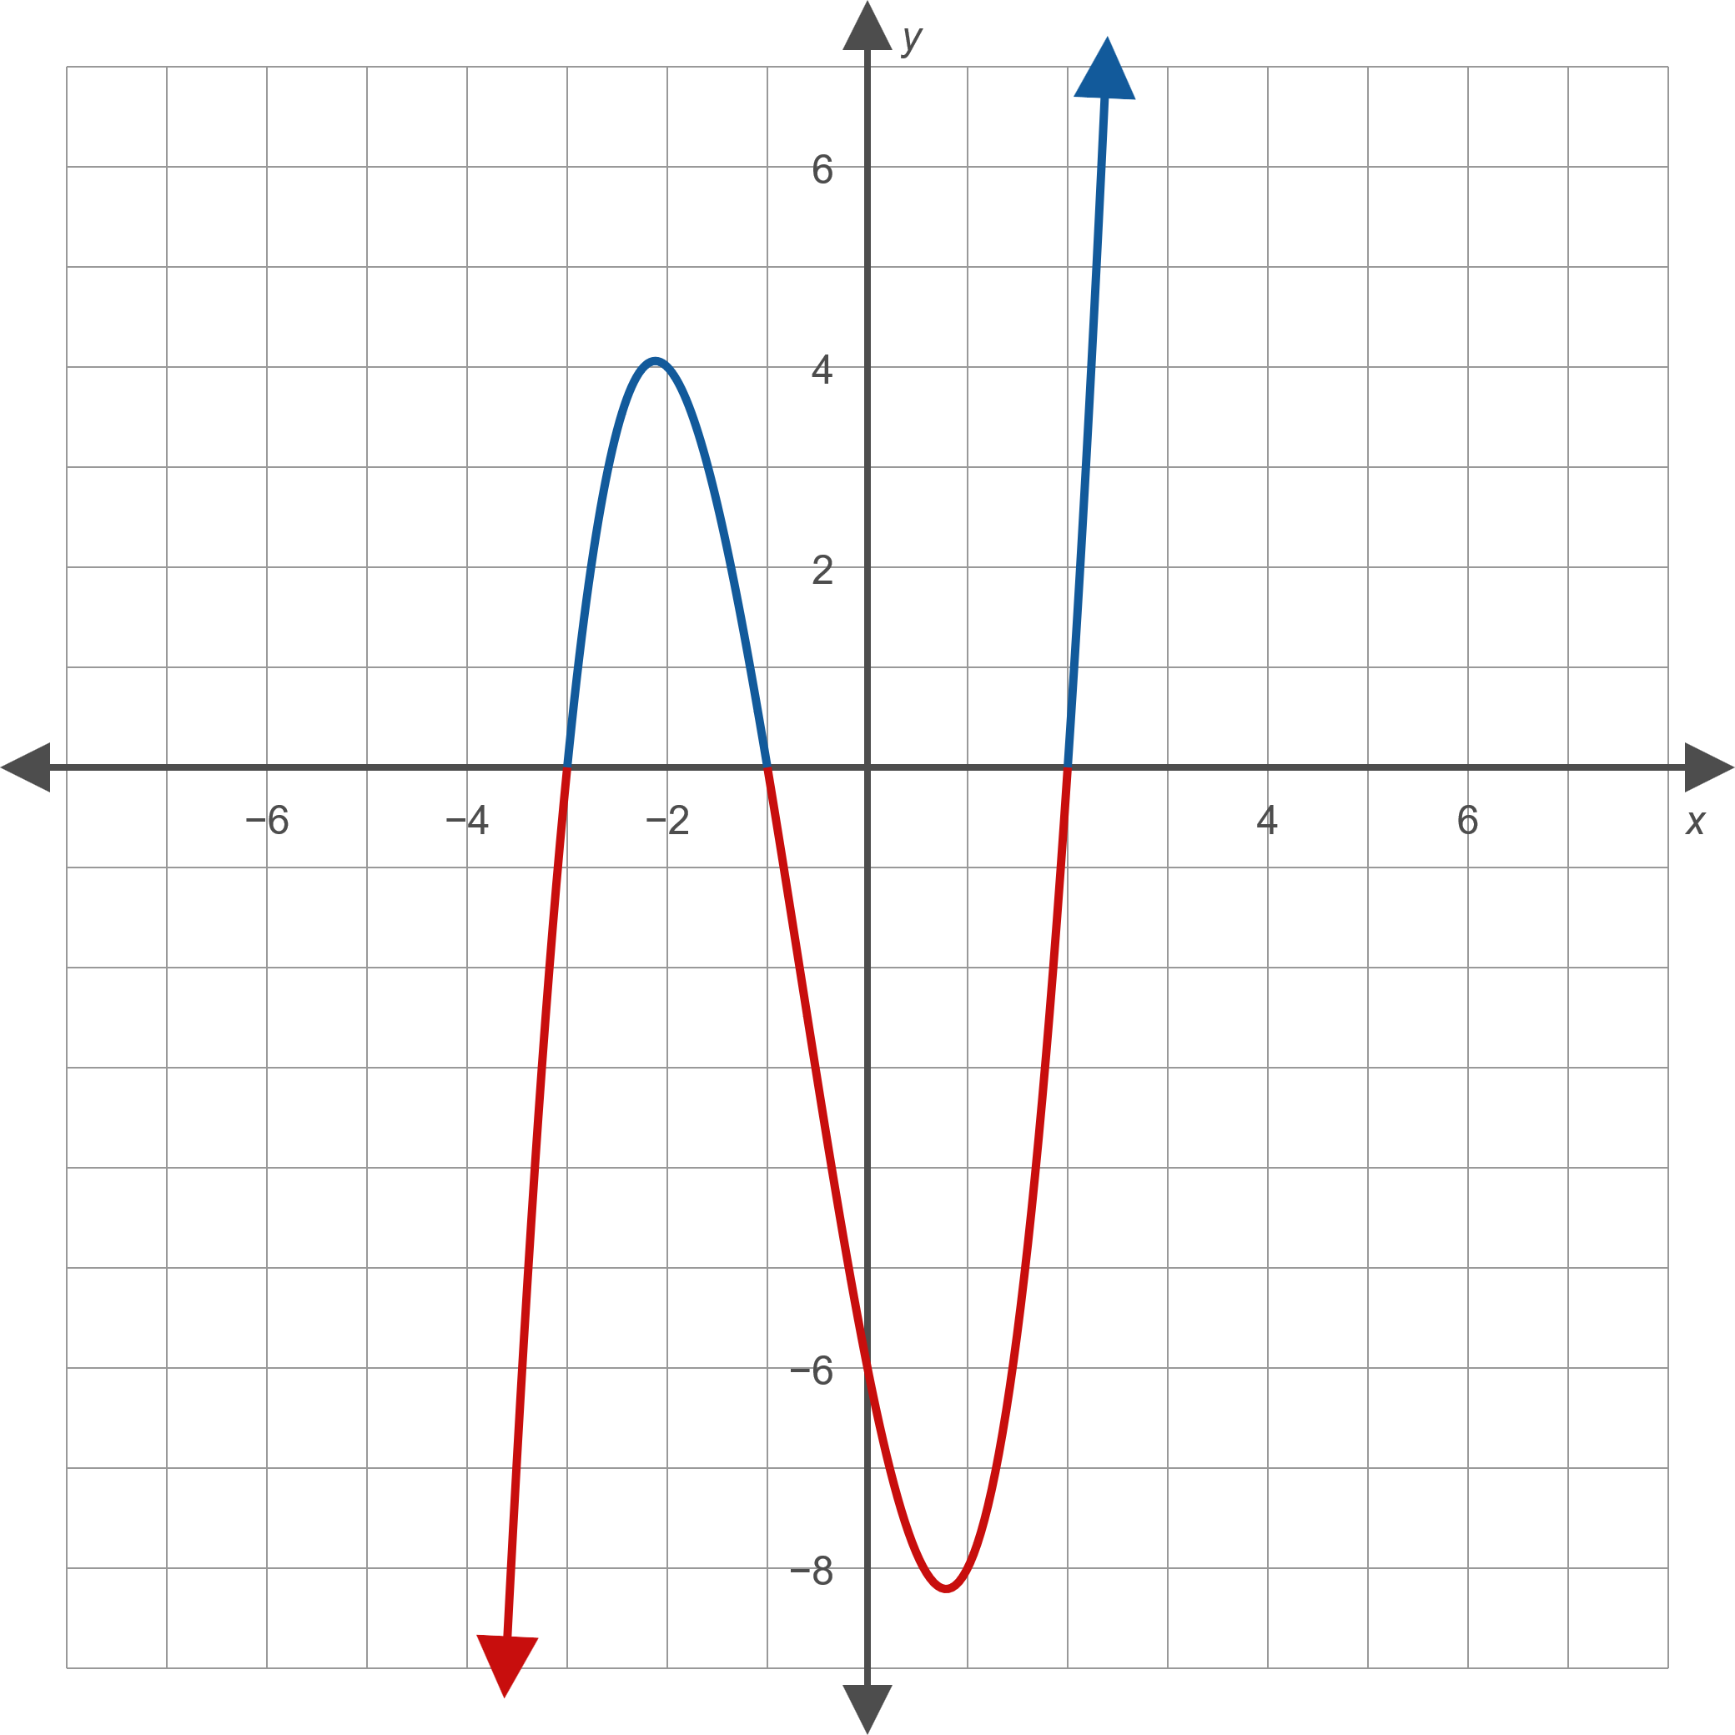

Example 4: Solving Polynomial Inequalities Using a Graph$\text{2}$
Figure 12:

Slide 29

Example 4: Solving Polynomial Inequalities Using a Graph$\text{3}$
Solution
a. ​From the graph, we see that f(x) < 0 on the intervals
Since the inequality is strict, we do not include the endpoints. Thus, the solution to this inequality is
b. Similarly, the graph reveals that f(x) > 0 on the intervals
This inequality is not strict, so we include the x-values where f(x) = 0. Therefore, the solution to this inequality is

Slide 30

Procedure: Solving Polynomial Inequalities Using the Sign-Test Method$\text{1}$
To solve a polynomial inequality
perform the following steps.
Step 1: Find the real zeros of p(x). Equivalently, find the real solutions of p(x) = 0.
Step 2: Place the zeros on a number line, splitting it into intervals.

Slide 31

Procedure: Solving Polynomial Inequalities Using the Sign-Test Method$\text{2}$
Step 3: Within each interval, select a test point and evaluate p at that number. If the result is positive, then p(x) > 0 for all x in the interval. If the result is negative, then p(x) < 0 for all x in the interval.
Step 4: Write the solution set, consisting of all of the intervals that satisfy the given inequality. If the inequality is not strict (uses ≤ or ≥), then the zeros are included in the solution set as well.

Slide 32

Example 5: Solving Polynomial Inequalities Using the Sign-Test Method$\text{1}$
Solve the polynomial inequality

Slide 33
Note₃
When choosing test points, integers (especially 0) are usually easiest to work with.

Slide 34

Example 5: Solving Polynomial Inequalities Using the Sign-Test Method$\text{2}$
Solution
Follow the steps in the procedure for the Sign-Test Method.
Step 1: Find the zeros of
By the Zero-Factor Property, we can see that p(x) = 0 when x = −5, 2, or 4.

Slide 35
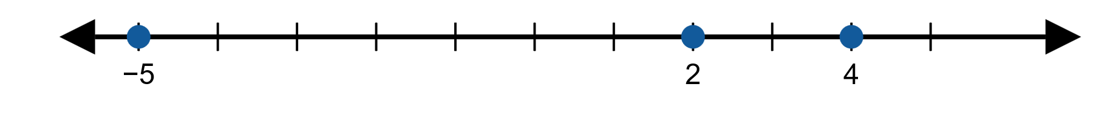

Example 5: Solving Polynomial Inequalities Using the Sign-Test Method$\text{3}$
Step 2: Place the zeros on a number line.
Figure 15
This splits the number line into the intervals

Slide 36
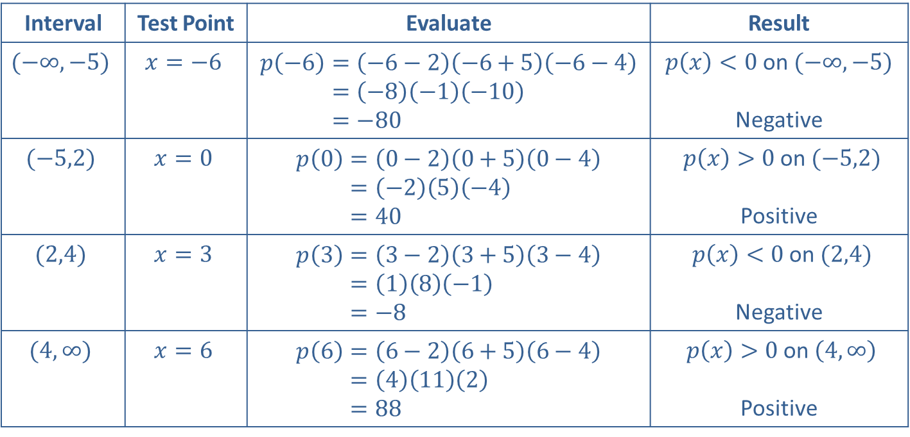

Example 5: Solving Polynomial Inequalities Using the Sign-Test Method$\text{4}$
Step 3: Evaluate p(x) for a test point in each interval.
Interval | Test Point | Evaluate | Result
$$(−∞,−5)$$ | $$x=−6$$ | 𝑝−6=−6−2−6+5−6−4𝑝⁡−6=−8−1−10𝑝⁡−6=−80 | $p\left(x\right)<0$ on $(−∞,−5)$ Negative
$$(−5,2)$$ | $$x=0$$ | 𝑝0=0−20+50−4𝑝⁡0=−25−4𝑝⁡0=40 | $p\left(x\right)>0$ on $(−5,2)$ Positive
$$(2,4)$$ | $$x=3$$ | 𝑝3=3−23+53−4𝑝⁡3=18−1𝑝⁡3=−8 | $p\left(x\right)<0$ on $(2,4)$ Negative
$$(4,∞)$$ | $$x=6$$ | 𝑝6=6−26+56−4𝑝⁡6=4112𝑝⁡6=88 | $p\left(x\right)>0$ on $\left(4,∞\right)$ Positive
Table 1

Slide 37

Example 5: Solving Polynomial Inequalities Using the Sign-Test Method$\text{5}$
Step 4: Write the solution set to the original inequality, p(x) > 0. From Table 1, we see that p(x) > 0 on the intervals
Since the inequality is strict, we do not include the zeros of p(x) in our solution set. Thus, the solution to the inequality is

Slide 38

Example 6: Solving Polynomial Inequalities$\text{1}$
Solve the polynomial inequality

Slide 39


Example 6: Solving Polynomial Inequalities$\text{2}$
Solution
We will use a slight variation on our solution method that saves some computation time. The first two steps are the same, and since the zeros of the polynomial
are −2, 1, and 3, we divide the real number line at these points as shown in Figure 16.
Figure 16

Slide 40

Example 6: Solving Polynomial Inequalities$\text{3}$
We also again select a test point within each of the four intervals defined by the zeros, but instead of computing the exact value of p(x) at each test point, we simply determine its sign. For instance, using the test point x = −3 in the interval
positive because
and the product of a negative factor, a positive factor, and a negative factor is positive.

Slide 41
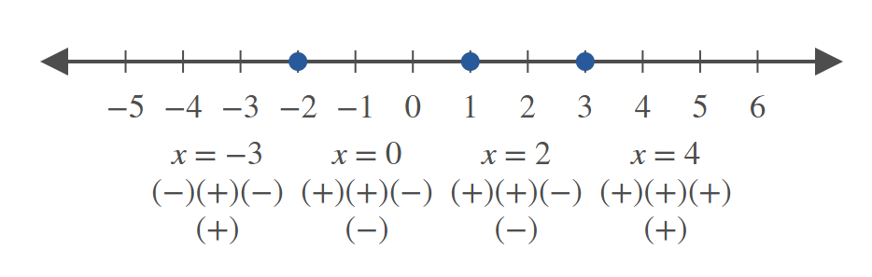

Example 6: Solving Polynomial Inequalities$\text{4}$
In Figure 17, a representative test point for each interval is shown, followed by a string of “+” and “−” signs indicating the sign of each factor of p(x) at the test point. Finally, the sign of p(x) overall on the interval is shown.
Figure 17

Slide 42

Example 6: Solving Polynomial Inequalities$\text{5}$
The last step of the method is to use the sign chart to identify the interval(s) on which p(x) ≤ 0. Since the inequality is not strict and the two intervals on which p(x) is nonpositive overlap at x = 1, the solution is

