Slide 1
Section 5.3
Combining Functions

Slide 2

Definition: Addition, Subtraction, Multiplication and Division of Functions
Let f and g be two functions. The sum f + g, difference f − g,
product fg and quotient
are four new functions defined as follows.
The domain of each of these new functions consists of the common elements (or the intersection of elements) of the domains of f and g individually, with the added condition that in the quotient function we have to omit those elements for which g(x) = 0.

Slide 3
Example 1: Combining Functions Arithmetically₁
Given that

Slide 4
Example 1: Combining Functions Arithmetically₂
Solution
By the definition of the difference and quotient of functions,
and

Slide 5
Example 2: Combining Functions Arithmetically₁
Given the two functions f(x) = 4x ²− 1 and g(x) = √x,

Slide 6
Example 2: Combining Functions Arithmetically₂
Solution
By the definition of the sum and product of functions,
and

Slide 7
Example 2: Combining Functions Arithmetically₃
What are the domains of f + g and fg? We first need to find the domains of the individual functions f and g.
Domain of f: (−∞, ∞) since f is a quadratic function
Domain of
since square roots of negative numbers
are undefined Since the domain of two functions combined arithmetically is the intersection of the individual domains, f + g and fg both have a domain of

Slide 8
Example 3: Combining Functions Arithmetically₁
Given the graphs of f and g in Figure 1, determine the
domain of f + g and
and evaluate (f + g)(1) and

Slide 9
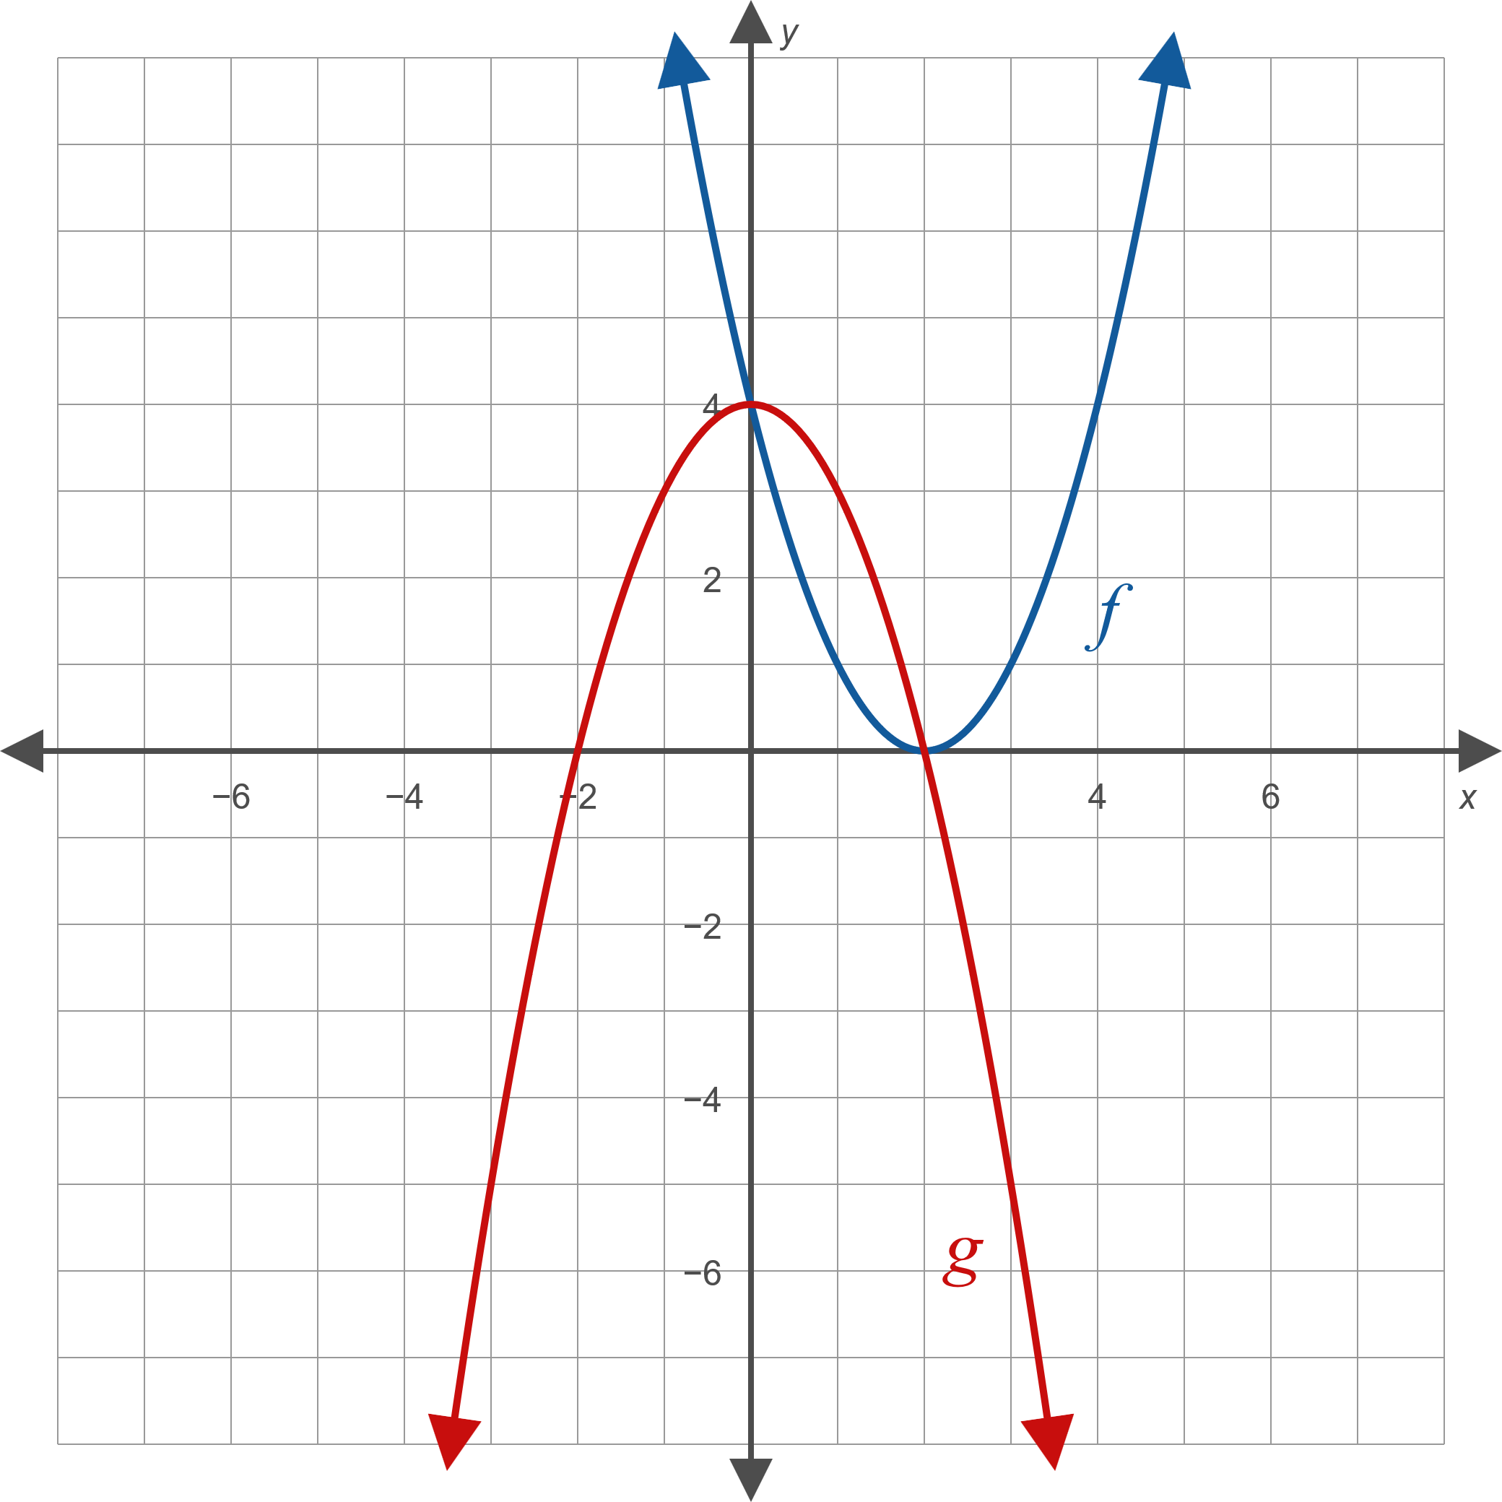
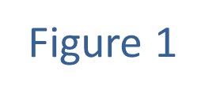
Example 3: Combining Functions Arithmetically₂

Slide 10
Example 3: Combining Functions Arithmetically₃
Solution
From the graph, we can see that the domain of both f and g is the set of all real numbers (−∞, ∞). This means that the domain of f + g is also (−∞, ∞). To find the domain of the quotient, we need to check where
g(x) = 0. The graph shows us that this occurs when
x = ± 2, so the domain of
is all real numbers except 2 and −2.

Slide 11
Example 3: Combining Functions Arithmetically₄
To evaluate the new functions, we need to find f(1) and g(1) using the graph.
We can see that f(1) = 1 and g(1) = 3, which means

Slide 12
Definition: Composing Functions
Let f and g be two functions. The composition of f and g, denoted
is the function defined by
The domain of
consists of all x in the domain of g for which g(x) is in turn in the domain of f. The function
is read "f composed with g", or "f of g."

Slide 13
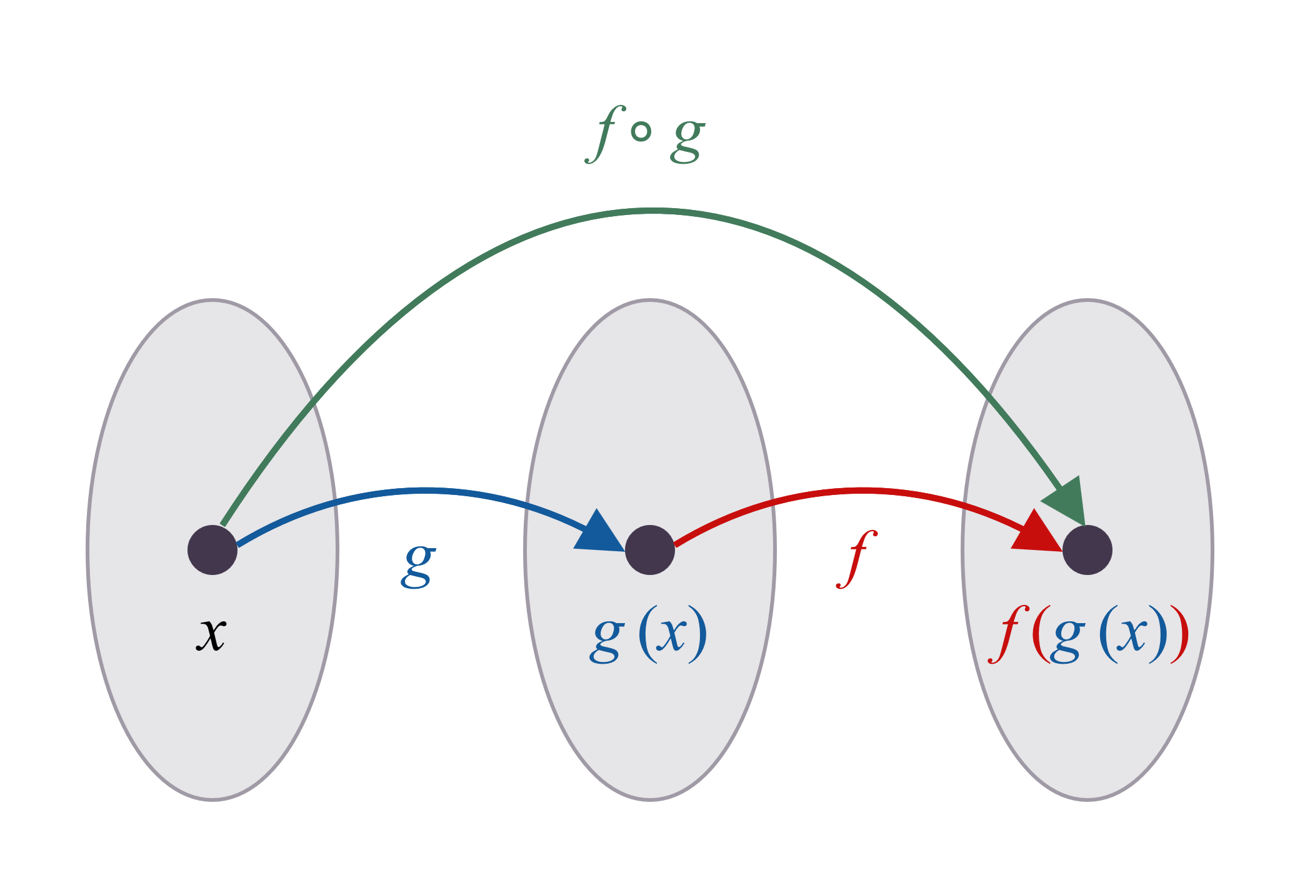
Figure 2: Composition of f and g

Slide 14
CAUTION!₁
Note that the order of f and g is important. In general,
we can expect the function
to be different from
the function
In formal terms, the composition of
two functions, unlike the sum and product of two functions, is not commutative.

Slide 15
Example 4: Composing Functions₁
Given f(x) = x ² and g(x) = x − 3, find the following.

Slide 16
Example 4: Composing Functions₂
Solution
​Since
the first step is to calculate g(6).
g(6) = 6 − 3 = 3
​Then, apply f to the result.

Slide 17
Example 4: Composing Functions₃
This time, we begin by finding f(6).
f(6) = 6 ² = 36
​Now, apply g to the result.
g(f(6)) = g(36) = 36 − 3 = 33

Slide 18
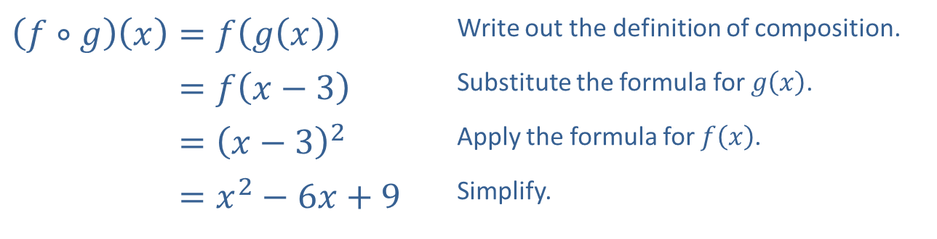
Example 4: Composing Functions₄
​To find the formula for​
we apply the definition
of composition, then simplify.
​$\left(f∘g\right)\left(x\right)=f\left(g\left(x\right)\right)$ | Write out the definition of composition.
​𝑓∘𝑔⁡𝑥=𝑓𝑥−3 | Substitute the formula for $g⁡\left(x\right)$.
​𝑓∘𝑔⁡𝑥=𝑥−32 | Apply the formula for $f⁡\left(x\right)$.
​𝑓∘𝑔⁡𝑥=𝑥2−6𝑥+9 | Simplify.

Slide 19
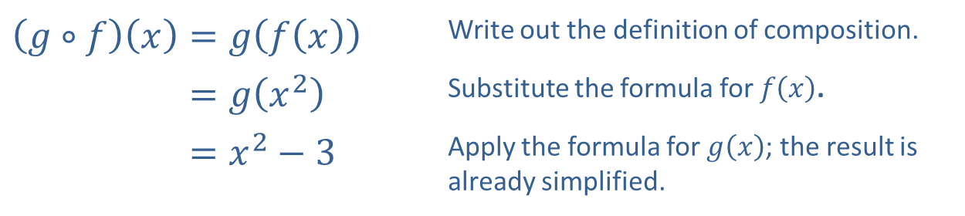
Example 4: Composing Functions₅
​To find a formula for the function ​
we follow
the same process.
​$\left(g∘f\right)\left(x\right)=g\left(f\left(x\right)\right)$ | Write out the definition of composition.
​𝑔∘𝑓⁡𝑥=𝑔𝑥2 | Substitute the formula for $f⁡\left(x\right)$.
​𝑔∘𝑓⁡𝑥=𝑥2−3 | Apply the formula for $g⁡\left(x\right)$; the result is already simplified.

Slide 20
Example 4: Composing Functions₆
​Note that once we have found formulas
we can answer the first two parts by directly plugging into these formulas.

Slide 21
CAUTION!₂
When evaluating the composition
at a point
x, there are two reasons the value might be undefined:
1. If x is not in the domain of g, then g(x) is undefined and we can't evaluate f(g(x)).
2. If g(x) is not in the domain of f, then f(g(x)) is undefined and we can't evaluate it.
In either case,
is undefined, and
x is not in the domain of

Slide 22
Example 5: Domains of Compositions of Functions₁
Evaluate the following.

Slide 23
Example 5: Domains of Compositions of Functions₂
Solution
​
​
​But, if we try to evaluate g(−1), we see that it is
undefined, so
is also undefined.
​First, we evaluate g(1).
We plug this result into f(x) but see that
is undefined. Thus,
is also undefined.

Slide 24
Example 6: Domains of Compositions of Functions₃
Let f(x) = x ² − 4 and g(x) = √x. Find formulas
and state the domains for the following.

Slide 25
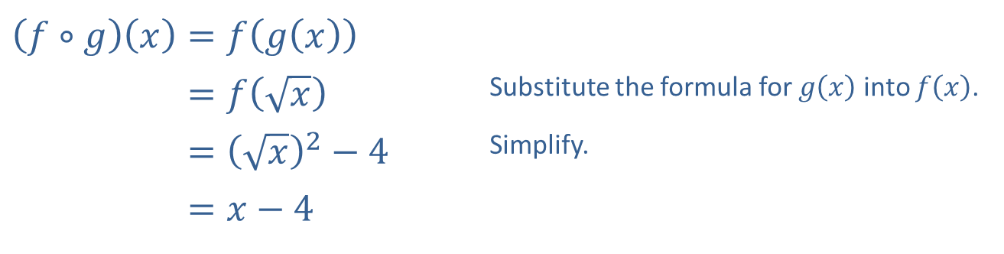
Example 6: Domains of Compositions of Functions₄
Solution
a.
​$\left(f∘g\right)\left(x\right)=f\left(g\left(x\right)\right)$
​𝑓∘𝑔⁡𝑥=𝑓𝑥 | Substitute the formula for $g⁡\left(x\right)$ into $f⁡\left(x\right)$.
​𝑓∘𝑔⁡𝑥=𝑥2−4 | Simplify.
​𝑓∘𝑔⁡𝑥=𝑥−4
While the domain of x − 4 is the set of all real numbers,
the domain of
numbers can be plugged into g.

Slide 26
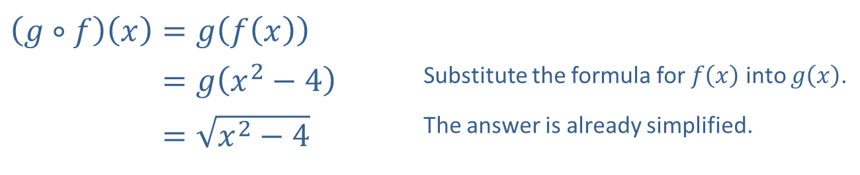
Example 6: Domains of Compositions of Functions₅
b.
​$\left(g∘f\right)\left(x\right)=g\left(f\left(x\right)\right)$
​𝑔∘𝑓⁡𝑥=𝑔𝑥2−4 | Substitute the formula for $f⁡\left(x\right)$ into $g⁡\left(x\right)$.
​𝑔∘𝑓⁡𝑥=𝑥2−4 | The answer is already simplified.
The domain of
consists of all x for which
We can write this in interval
form as

Slide 27
Example 7: Decomposing Functions₁
Decompose the function
into the following.
a. ​a composition of two functions
b. ​a composition of three functions

Slide 28
Example 7: Decomposing Functions₂
Solution
Note: These are not the only possible solutions for the decompositions of f(x).

