Slide 1
Section 5.2
Properties of Functions

Slide 2
Definition: y-Axis Symmetry
The graph of a function f has y-axis symmetry, or is symmetric with respect to the y-axis, if
for all x in the domain of f. Such functions are called even functions.

Slide 3
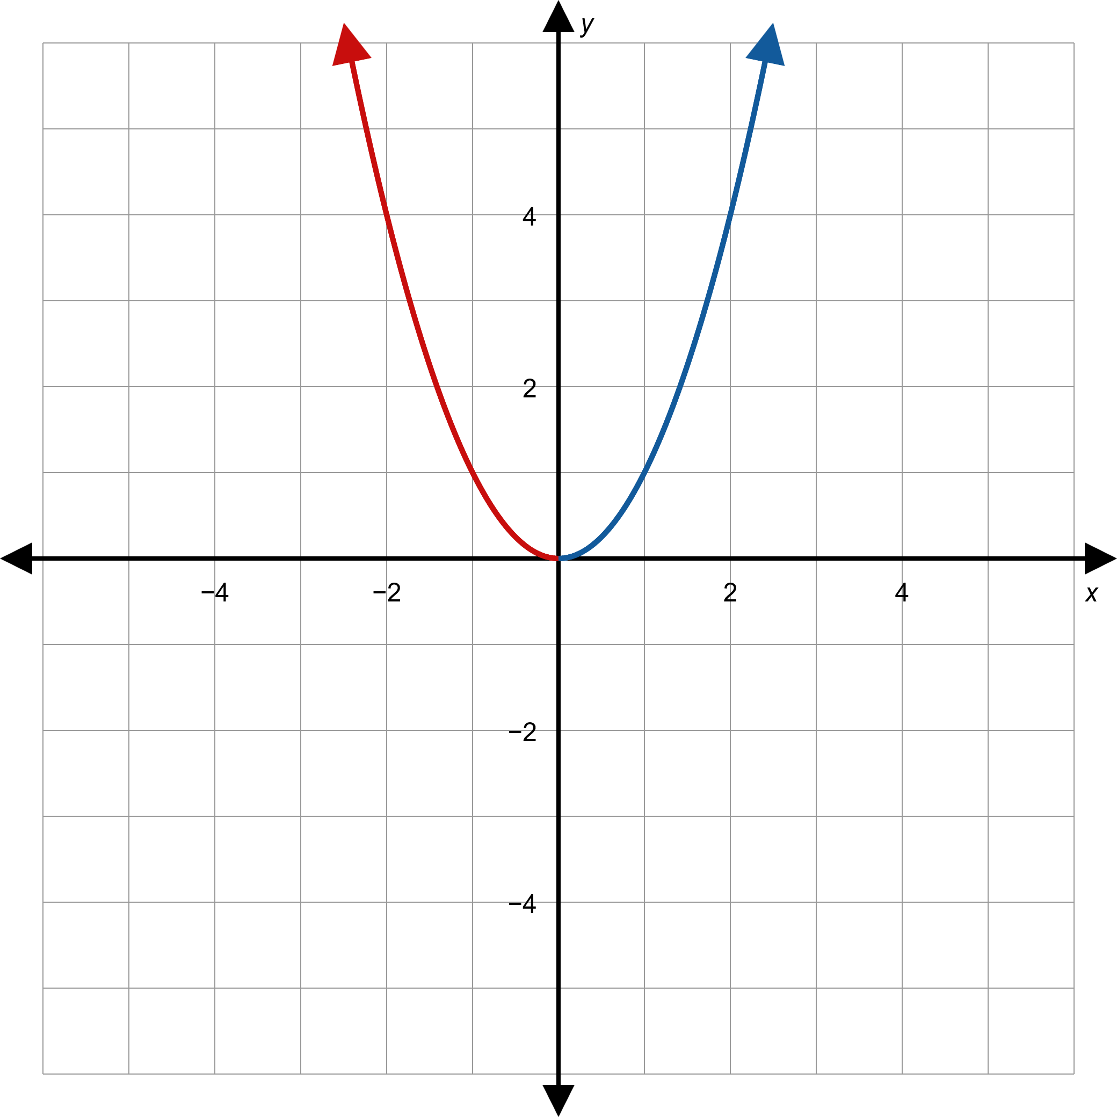
Figure 1: A Function with y-Axis Symmetry

Slide 4
Definition: Origin Symmetry
The graph of a function f has origin symmetry, or is symmetric with respect to the origin, if
for all x in the domain of f. Such functions are called odd functions.

Slide 5
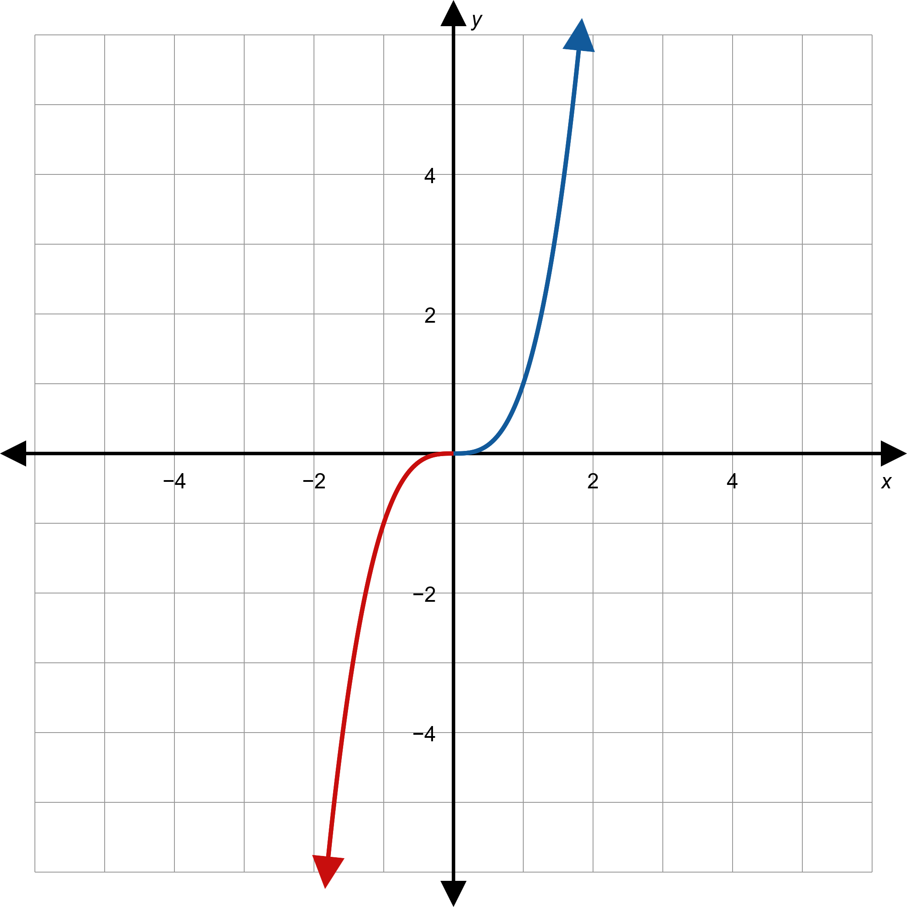
Figure 2: A Function with Origin Symmetry

Slide 6
Definition: Symmetry of Equations
We say that an equation in x and y is symmetric with respect to
​the y-axis if replacing x with −x results in an equivalent equation;
​the x-axis if replacing y with −y results in an equivalent equation;
​the origin if replacing x with −x and y with −y results in an equivalent equation.

Slide 7
Example 1: Using Symmetry to Graph Relations₁
Sketch the graphs of the following relations, making use of symmetry.

Slide 8
Note:
If you don't know where to begin when sketching a graph, plotting points often helps you understand the basic shape.

Slide 9
Example 1: Using Symmetry to Graph Relations₂
Solution
​This relation is a function. Note that it is indeed an even function and exhibits y-axis symmetry.
​

Slide 10
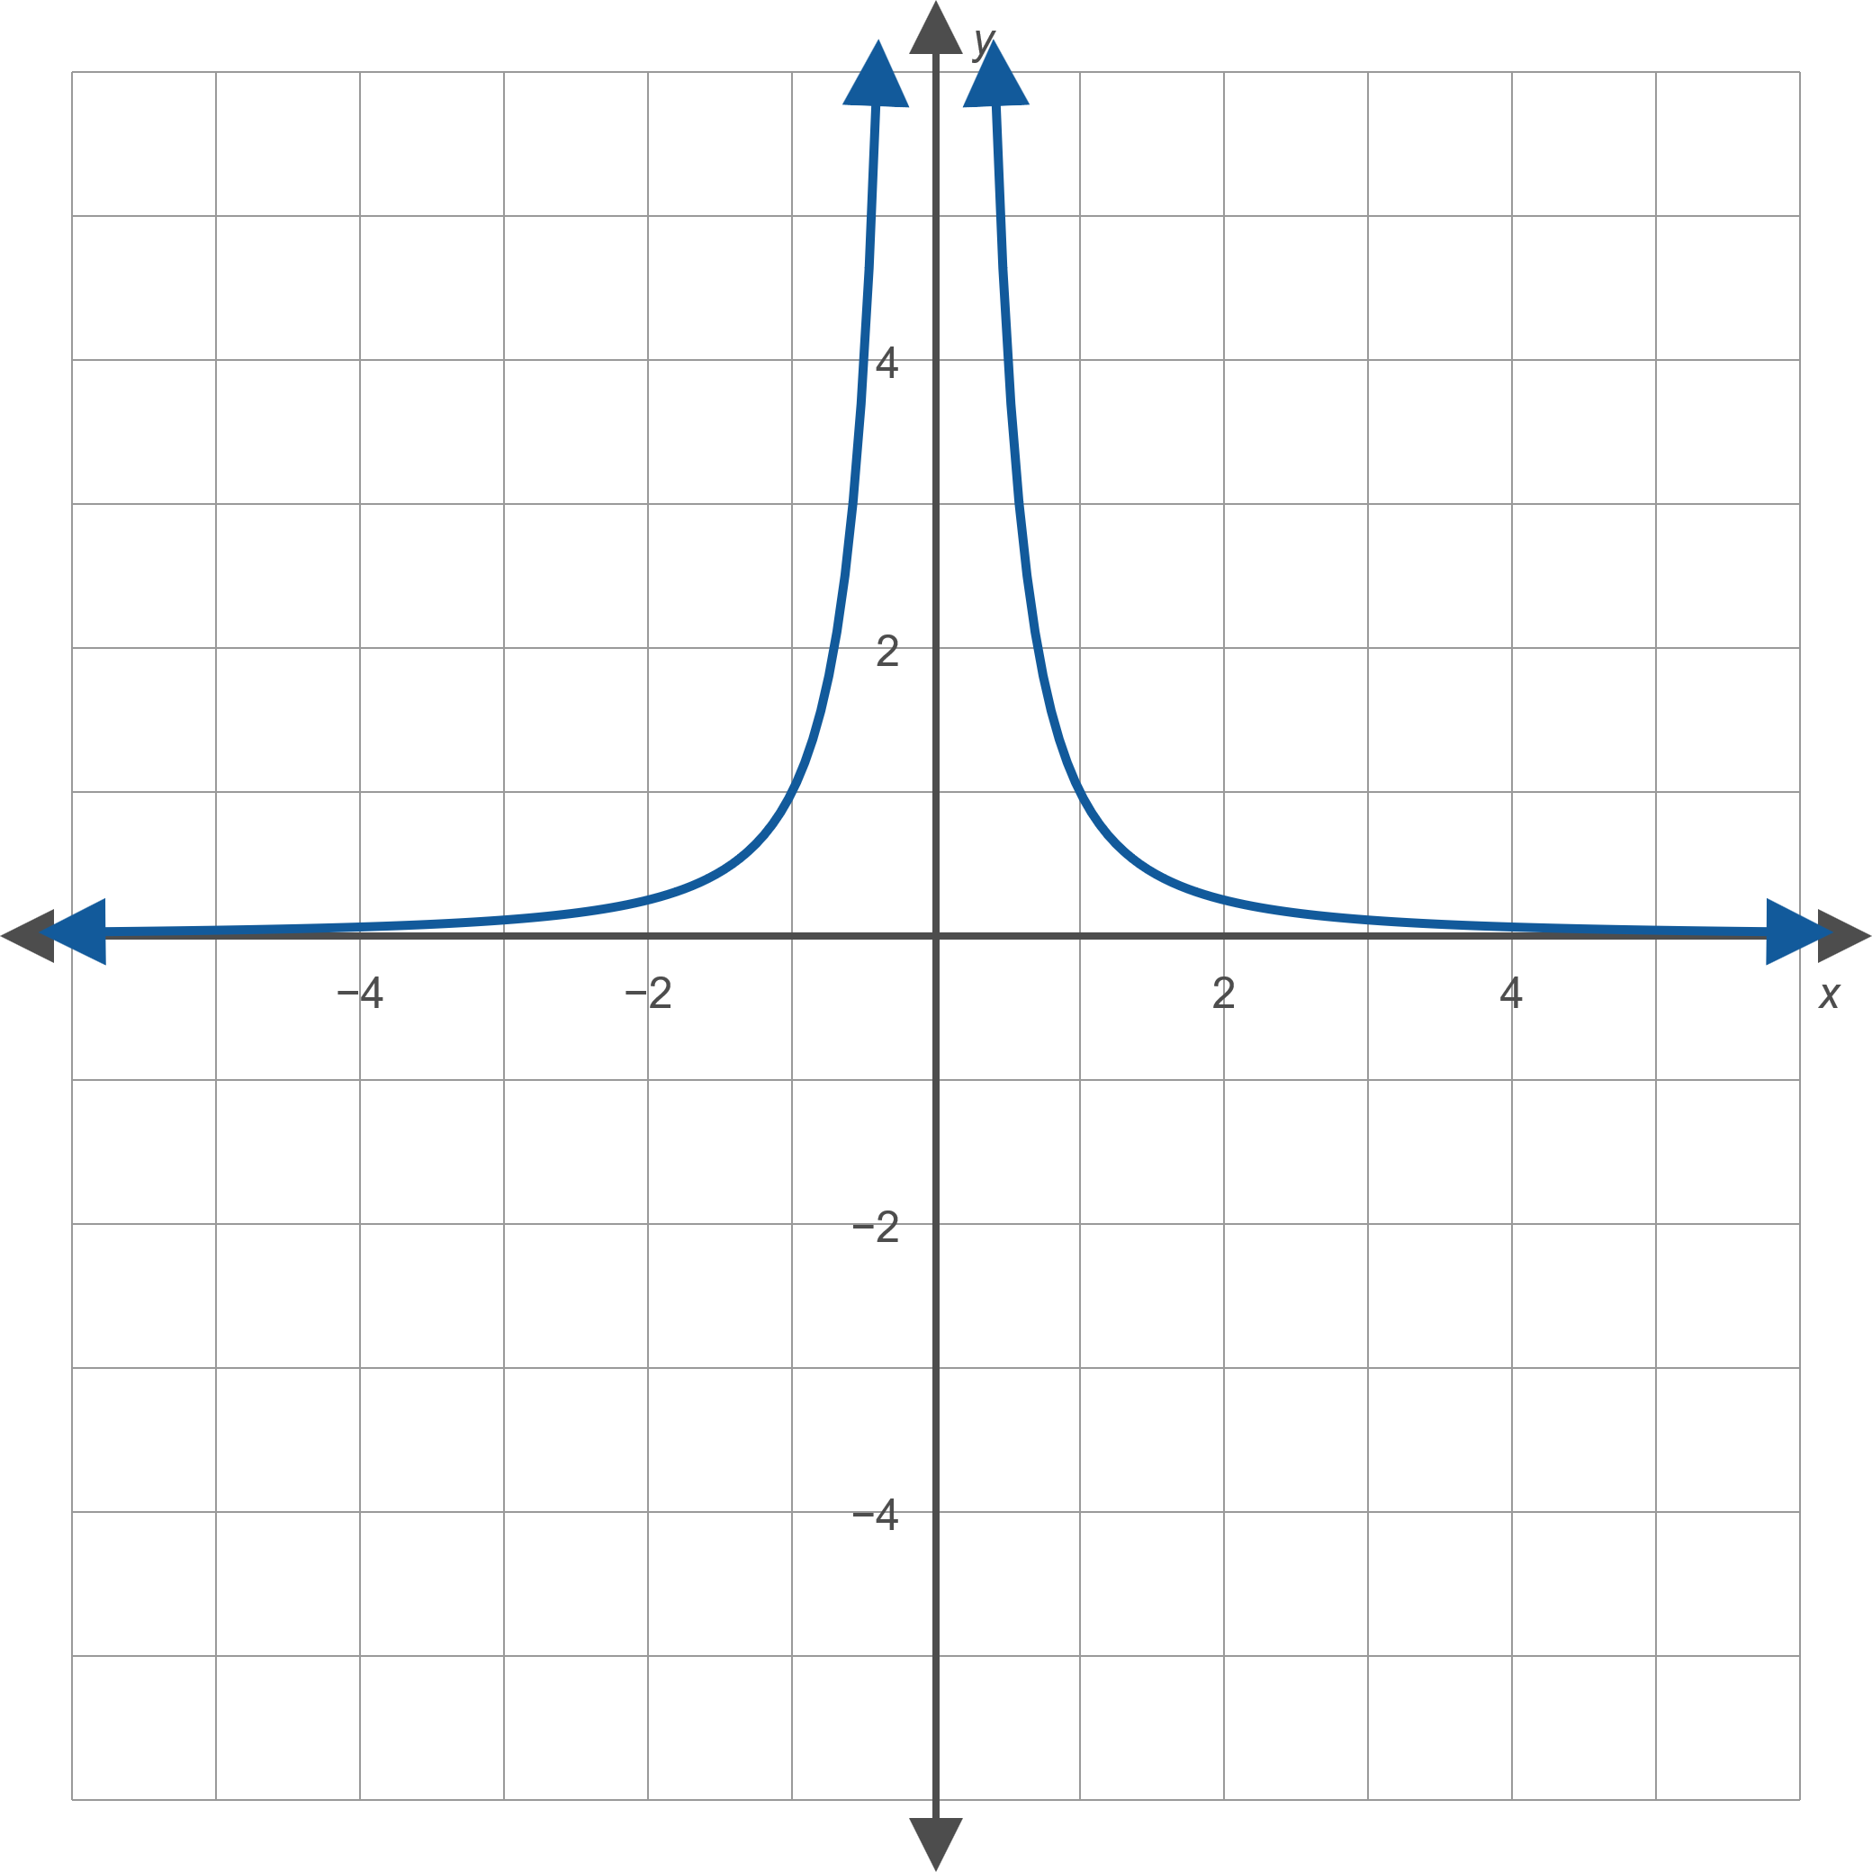
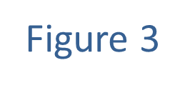
Example 1: Using Symmetry to Graph Relations₃

Slide 11
Example 1: Using Symmetry to Graph Relations₄
​While we do not yet have the tools to graph general polynomial functions, we can obtain a good sketch of
First, g is odd:
(verify this).
If we calculate a few values, such as g(0) = 0,
and then reflect
these through the origin, we get a good idea of the shape of g.

Slide 12
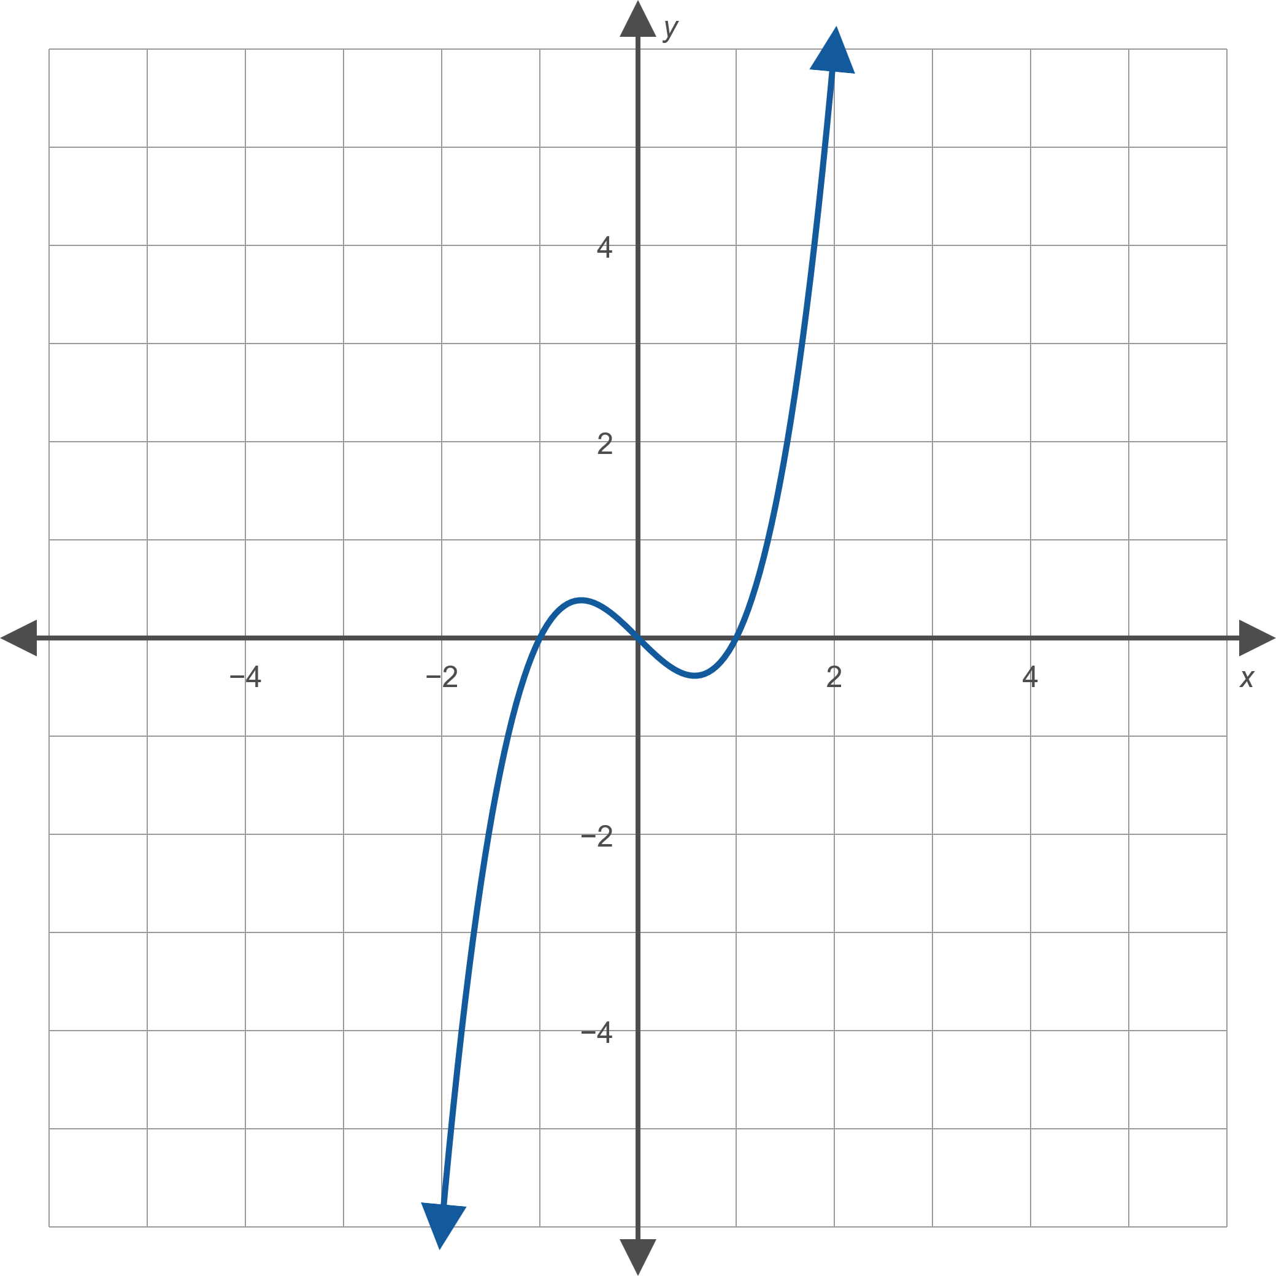
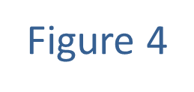
Example 1: Using Symmetry to Graph Relations₅

Slide 13
Example 1: Using Symmetry to Graph Relations₆
​The equation x = y ² is not a function, but it is a
relation in x and y that has x-axis symmetry. If we replace y with −y and simplify the result, we obtain the original equation.
​The upper half of the graph is the function y = √x so drawing this and its reflection gives us the complete ​graph of x = y ².

Slide 14
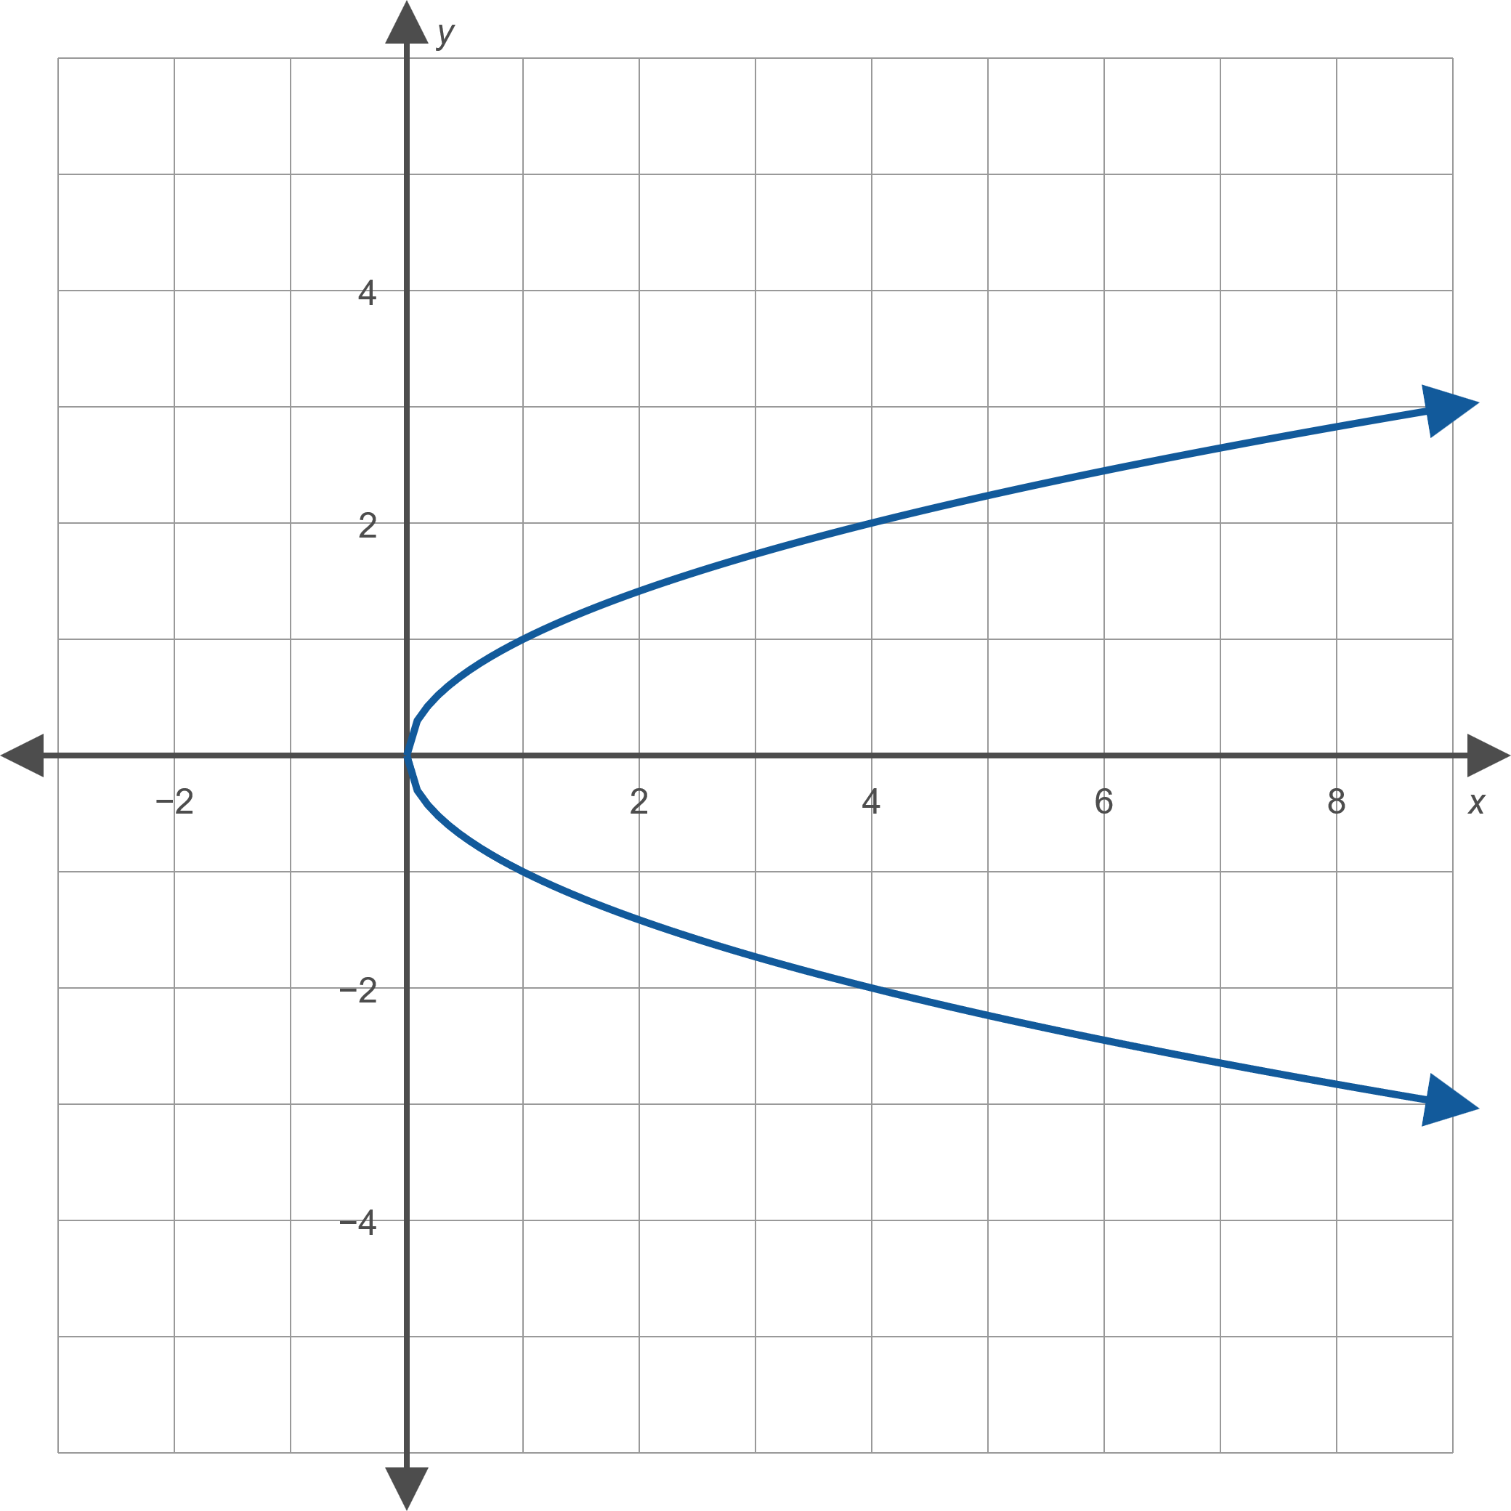
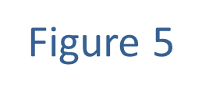
Example 1: Using Symmetry to Graph Relations₇

Slide 15
Definition: Increasing, Decreasing, and Constant
We say that a function f is
​increasing on an interval if for any
​decreasing on an interval if for any
​constant on an interval if for any

Slide 16
Example 2: Determining Intervals of Monotonicity₁
Determine the open intervals of monotonicity of the function

Slide 17
Example 2: Determining Intervals of Monotonicity₂
Solution
We know that the graph of f is the basic parabola shifted 2 units to the right and 1 unit down, as shown in Figure 6.

Slide 18
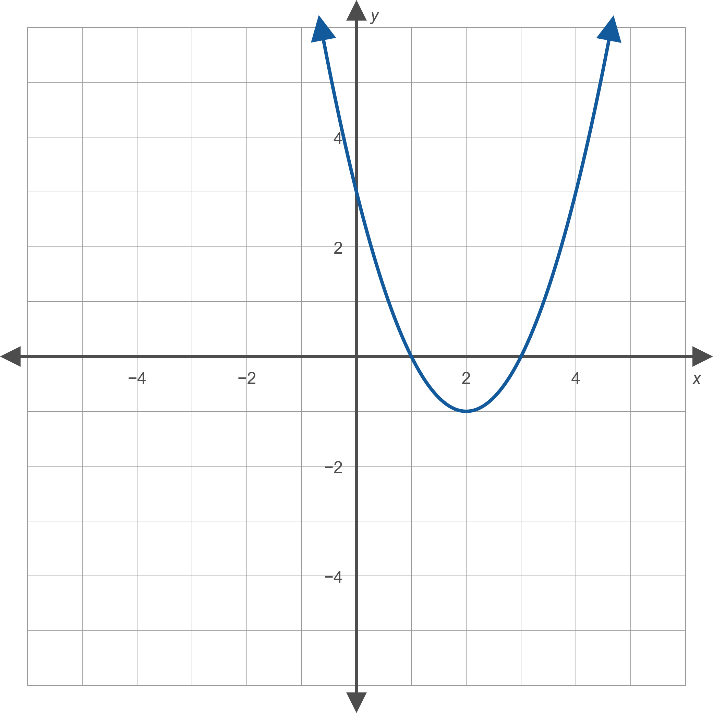
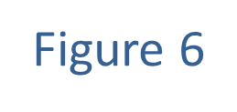
Example 2: Determining Intervals of Monotonicity₃

Slide 19
Example 2: Determining Intervals of Monotonicity₄
From the graph, we can see that f is decreasing on the interval (−∞, 2) and increasing on the interval (2, ∞). Remember that these are intervals of the x-axis: if x₁ and x₂ are any two points in the interval (−∞, 2) with
In other words, f is falling on this interval as we scan the graph from left to right. On the other hand, f is rising on the interval (2, ∞) as we scan the graph from left to right.

Slide 20
Example 3: Modeling the Water Level of a River₁
The water level of a certain river varied over the course of a year as follows. In January, the level was 13 feet. From that level, the water increased linearly to a level of 18 feet in May. The water remained constant at that level until July, at which point it began to decrease linearly to a final level of 11 feet in December. Graph the water level as a function of time and determine the open intervals of monotonicity.

Slide 21
Example 3: Modeling the Water Level of a River₂
Solution
If we let 1 to 12 represent January through December, the intervals of monotonicity are as follows: increasing on (1, 5), constant on (5, 7), and decreasing on (7, 12). The graph of the water level as a function of the month is shown in Figure 7.

Slide 22
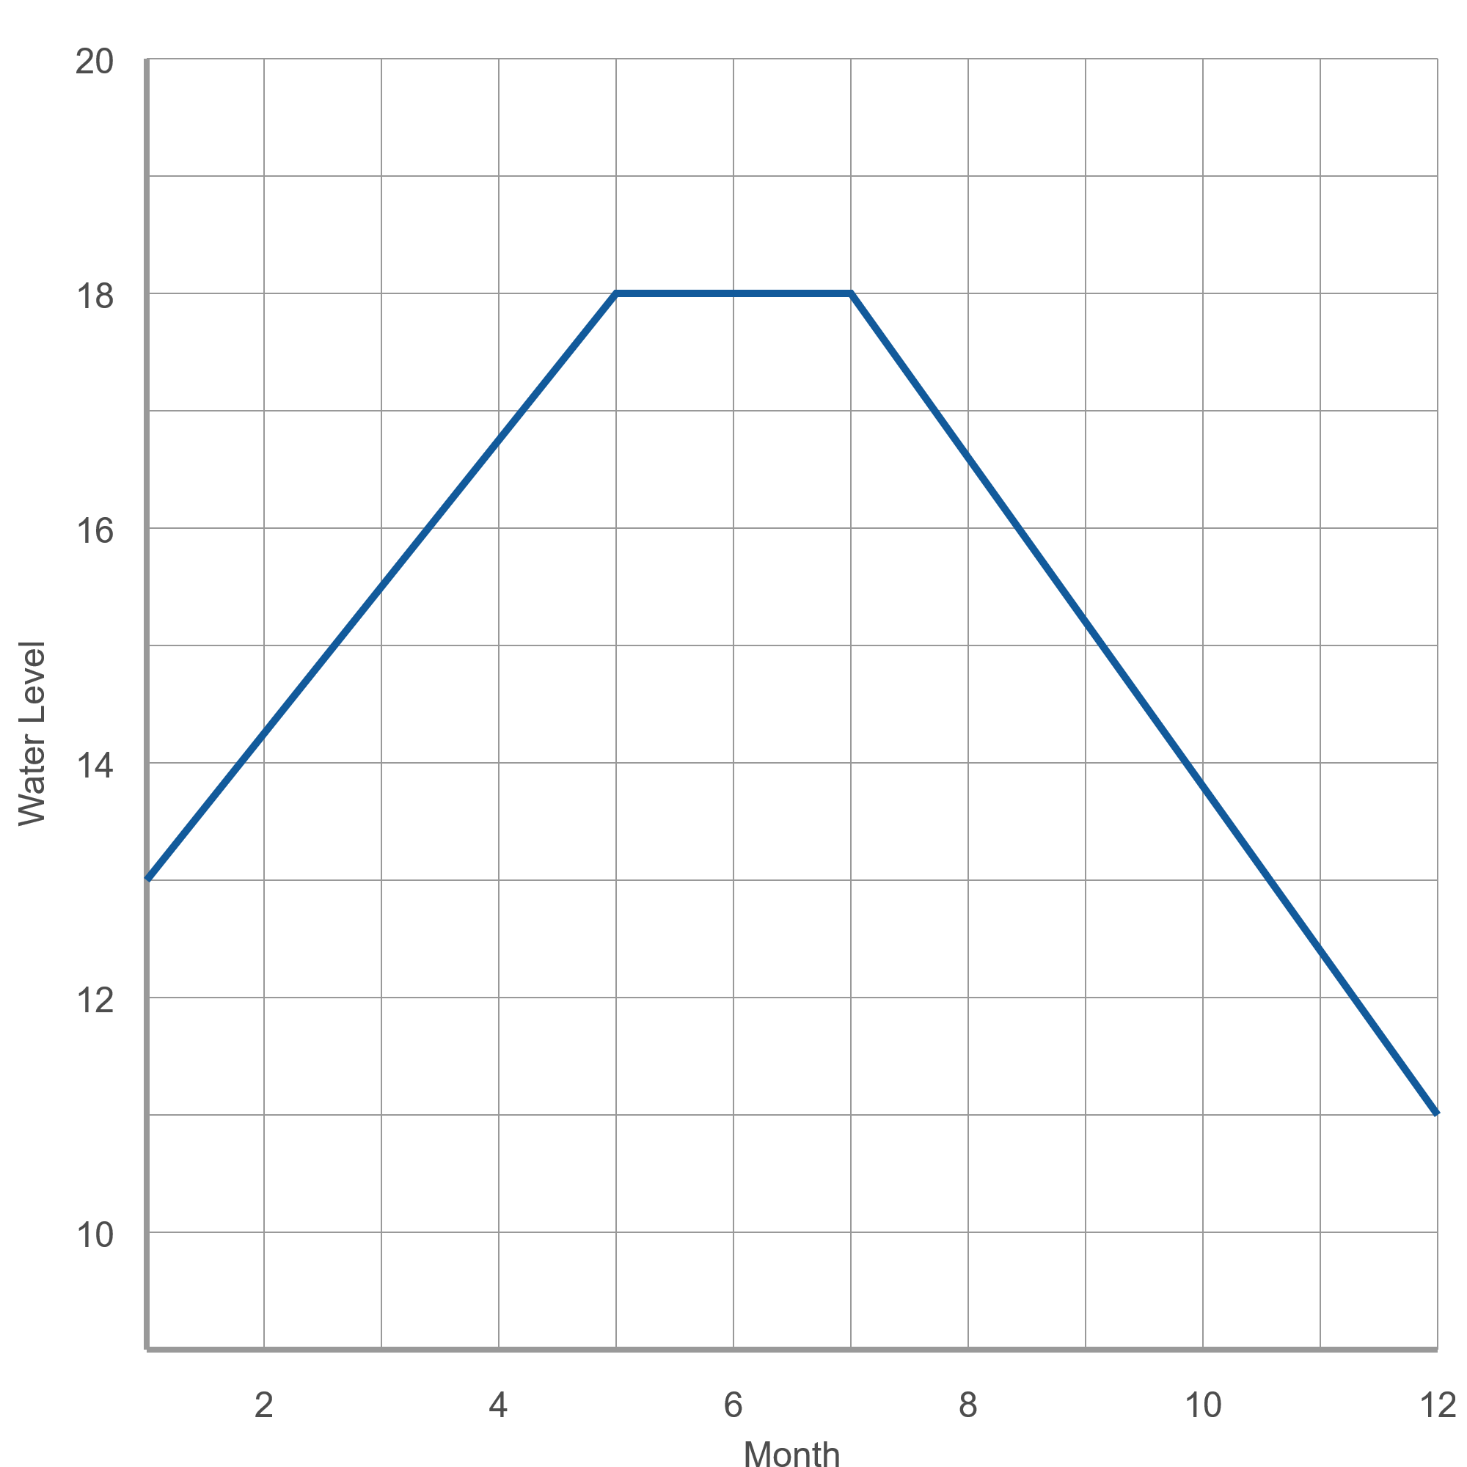
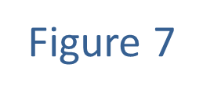
Example 3: Modeling the Water Level of a River₃

Slide 23
Definition: Local Extrema
A function f has a local maximum at c if there is an open interval (a, b) containing c for which f(x) ≤ f(c) for all x in (a, b). In this case we say f(c) is the local maximum value of f. Similarly, f has a local minimum at c if there is an open interval (a, b) containing c for which f(x) ≥ f(c) for all x in (a, b), and in this case we say f(c) is the local minimum value of f. The local maxima and minima of a function are collectively referred to as local extrema.

Slide 24
Example 4: Determining Local Extrema₁
Figure 10 shows the graph of a function f.
​Determine the locations and type of the local extrema of f.
​Determine the values of the local extrema of f.

Slide 25
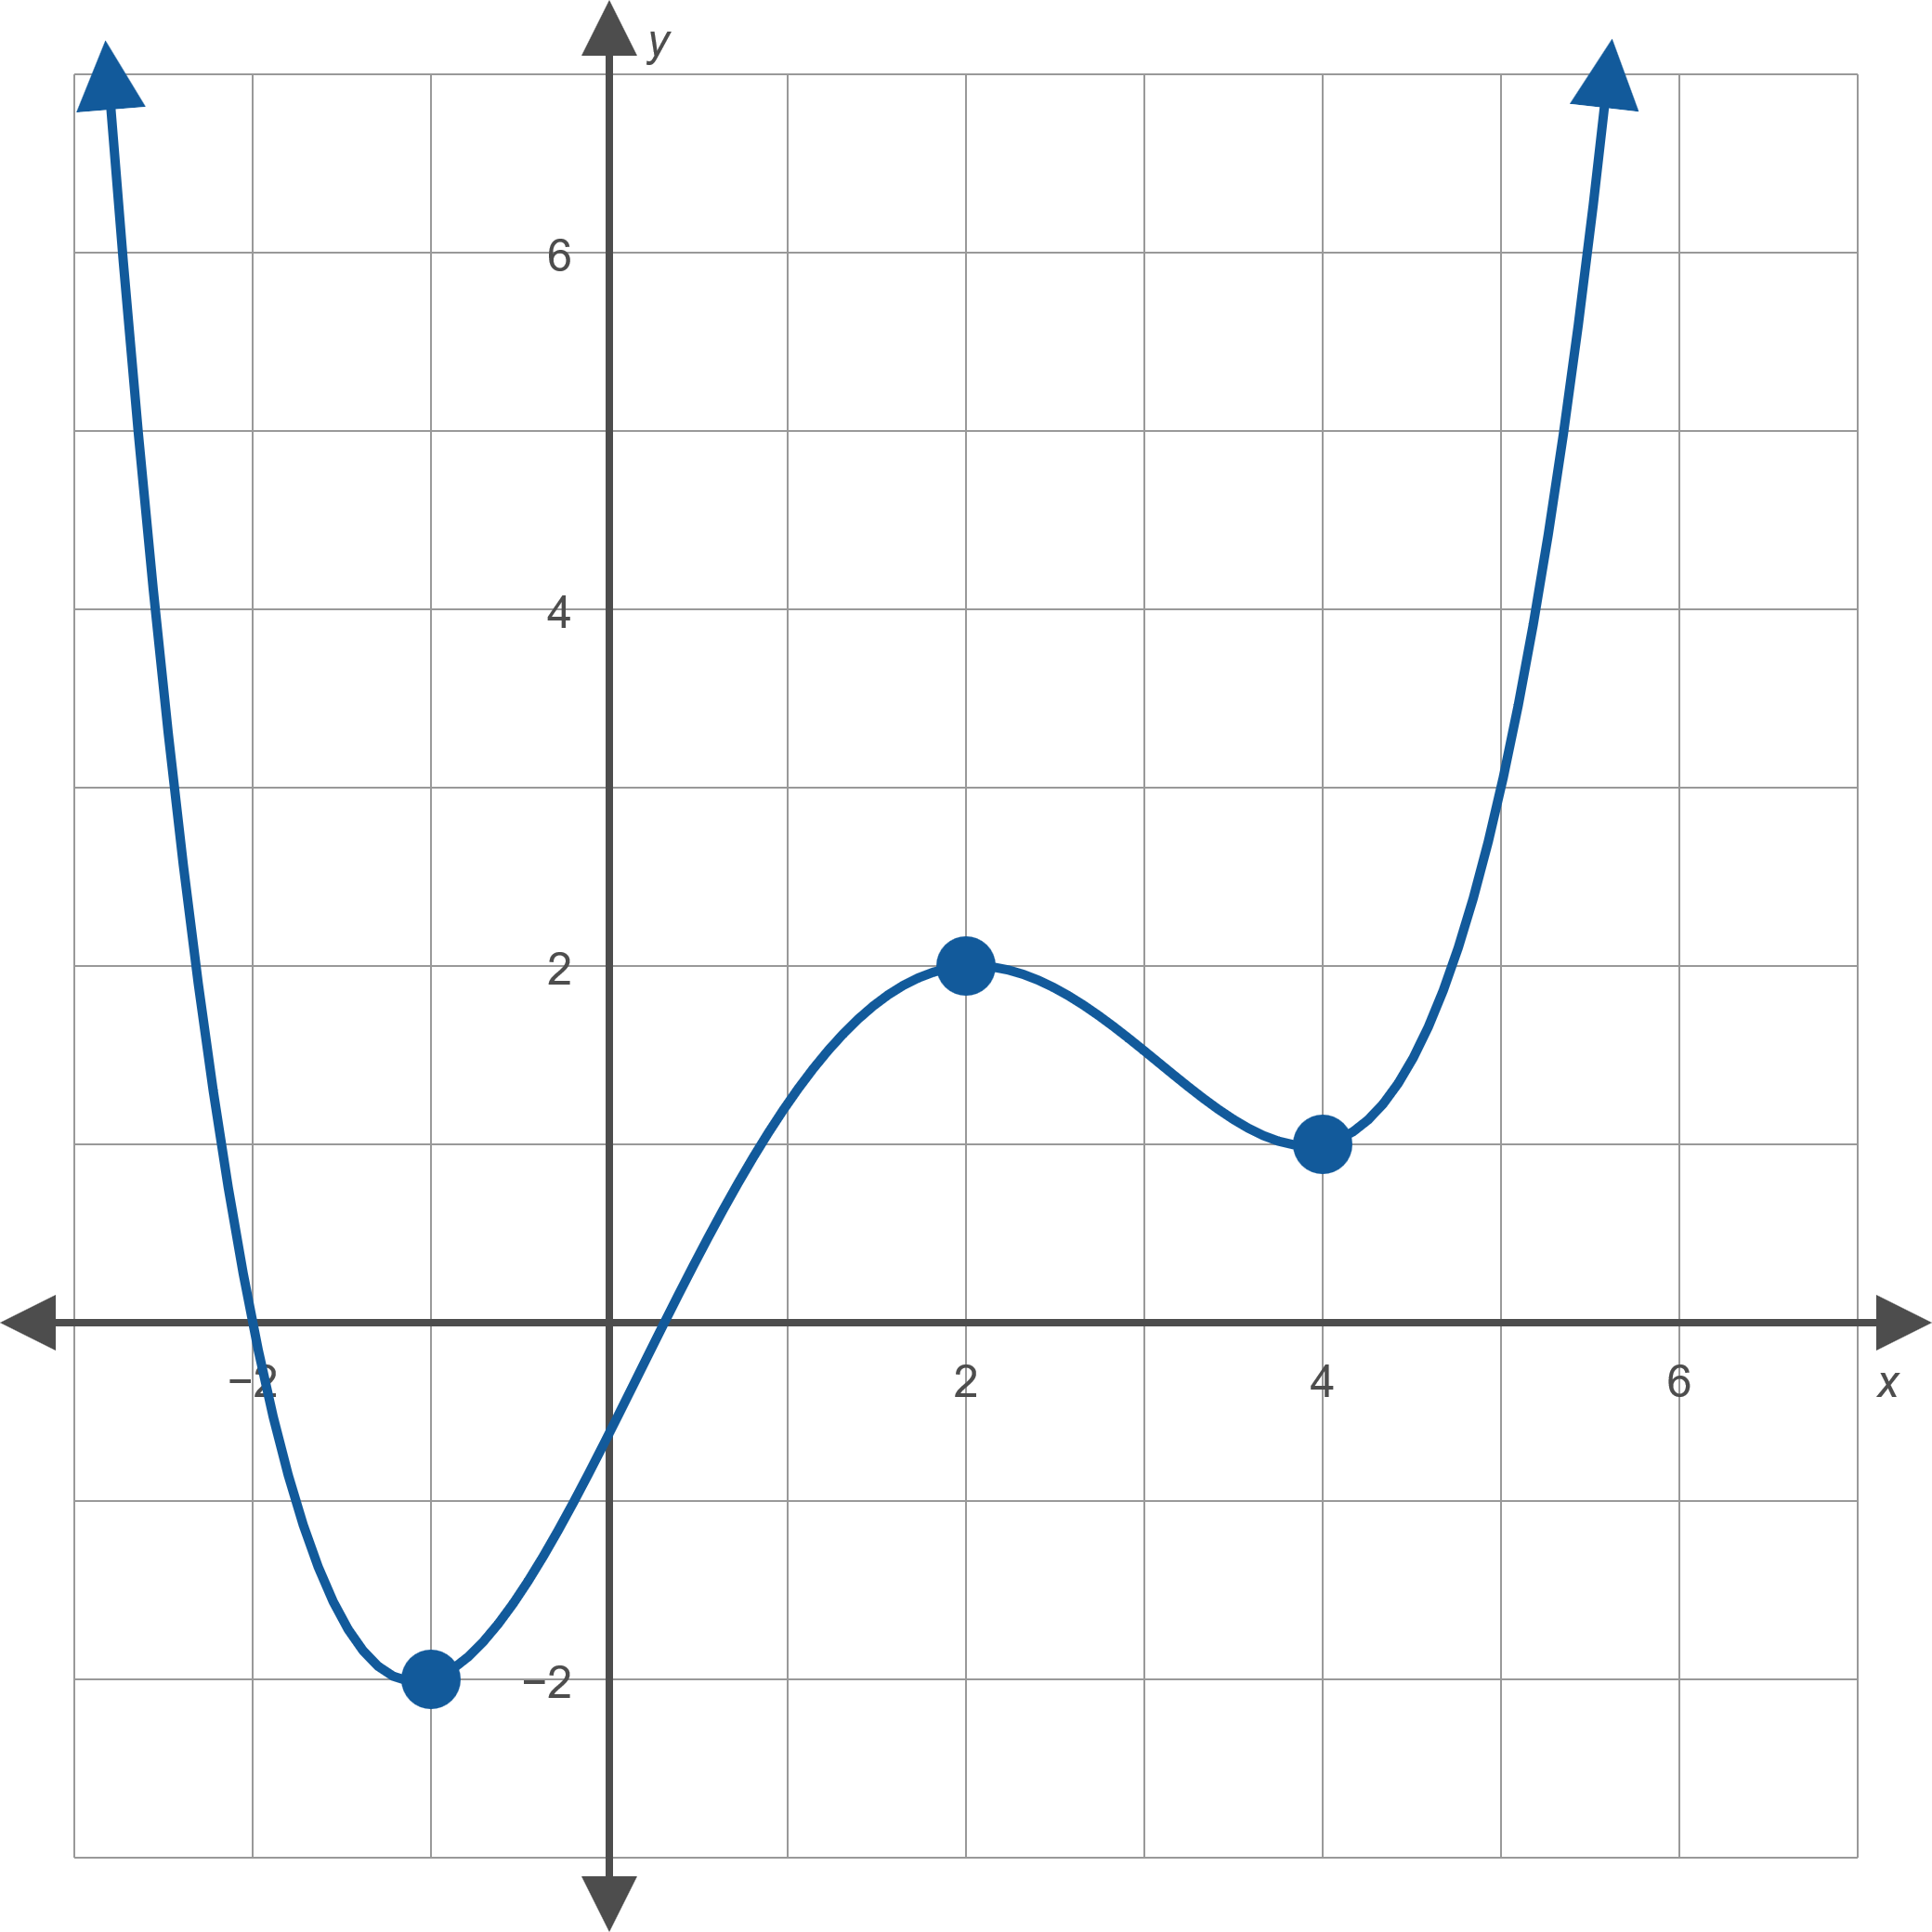
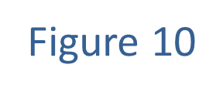
Example 4: Determining Local Extrema₂

Slide 26
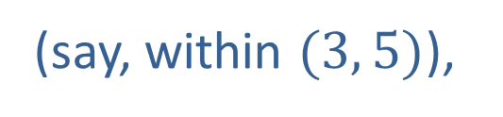
Example 4: Determining Local Extrema₃
Solution
​The function f has local minima at −1 and at 4, since for all x near −1 (for instance, within the interval
(−2, 0)),
and for all x near 4
(say, within $(3, 5)$),
The function f has a local maximum at 2, since
f(x) ≤ f(2) for all x near 2.
b. Based on the graph, the value of the local minimum at −1 is −2 and the value of the local minimum at 4 is 1. The value of the local maximum at 2 is 2.

Slide 27
Definition: Average Rate of Change₁
Given a function f defined on an interval
the average rate of change of f over
If y = f(x), then any of the following expressions may be used to represent the average rate of change of f over

Slide 28
Definition: Average Rate of Change₂
where the Greek letter Δ is used in this context to denote a change in the variable that follows it. The average rate of change of f over
represents the
slope of the secant line drawn between the points
on the graph of f, as shown in
Figure 15.

Slide 29
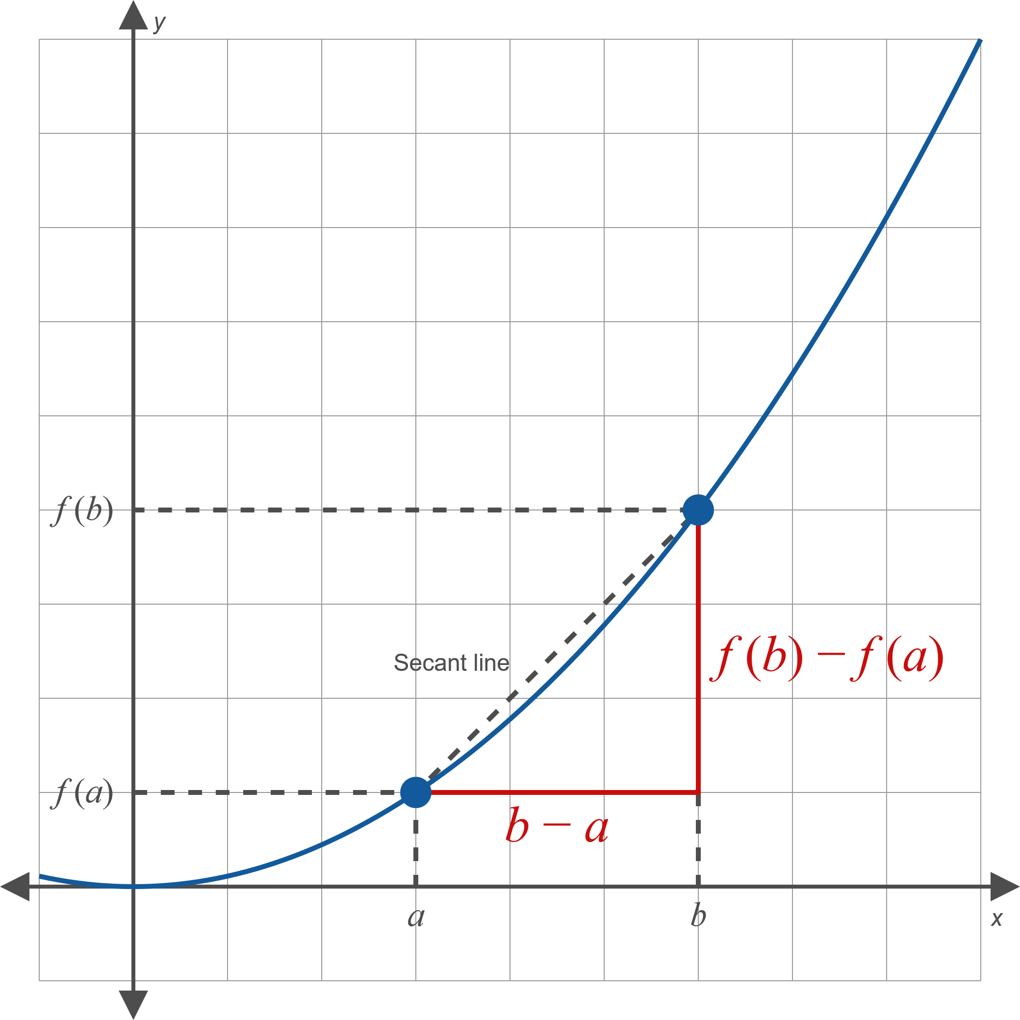
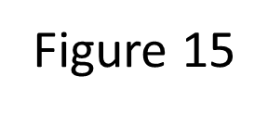
Definition: Average Rate of Change₃

Slide 30
Example 5: Determining Average Rate of Change₁
Given the function f(x) = 3x ² − 5x + 2 , determine the average rate of change over each of the following intervals.

Slide 31
Example 5: Determining Average Rate of Change₂
Solution
​Using one of the equivalent choices of notation for average rate of change, we find the following.

Slide 32
Example 5: Determining Average Rate of Change₃
​Over this interval, we calculate the average rate of change as follows.

Slide 33
Example 5: Determining Average Rate of Change₄
​While neither c nor h are given as fixed numbers, we can find the average rate of change over the interval [c, c + h] using the same process.

Slide 34
Example 6: Determining Intervals of Average Rate of Change₁
Use the given graph of the function f and the marked locations on the x-axis as endpoints to determine intervals over which the average rate of change of f is
​positive,
​negative,
​zero.

Slide 35
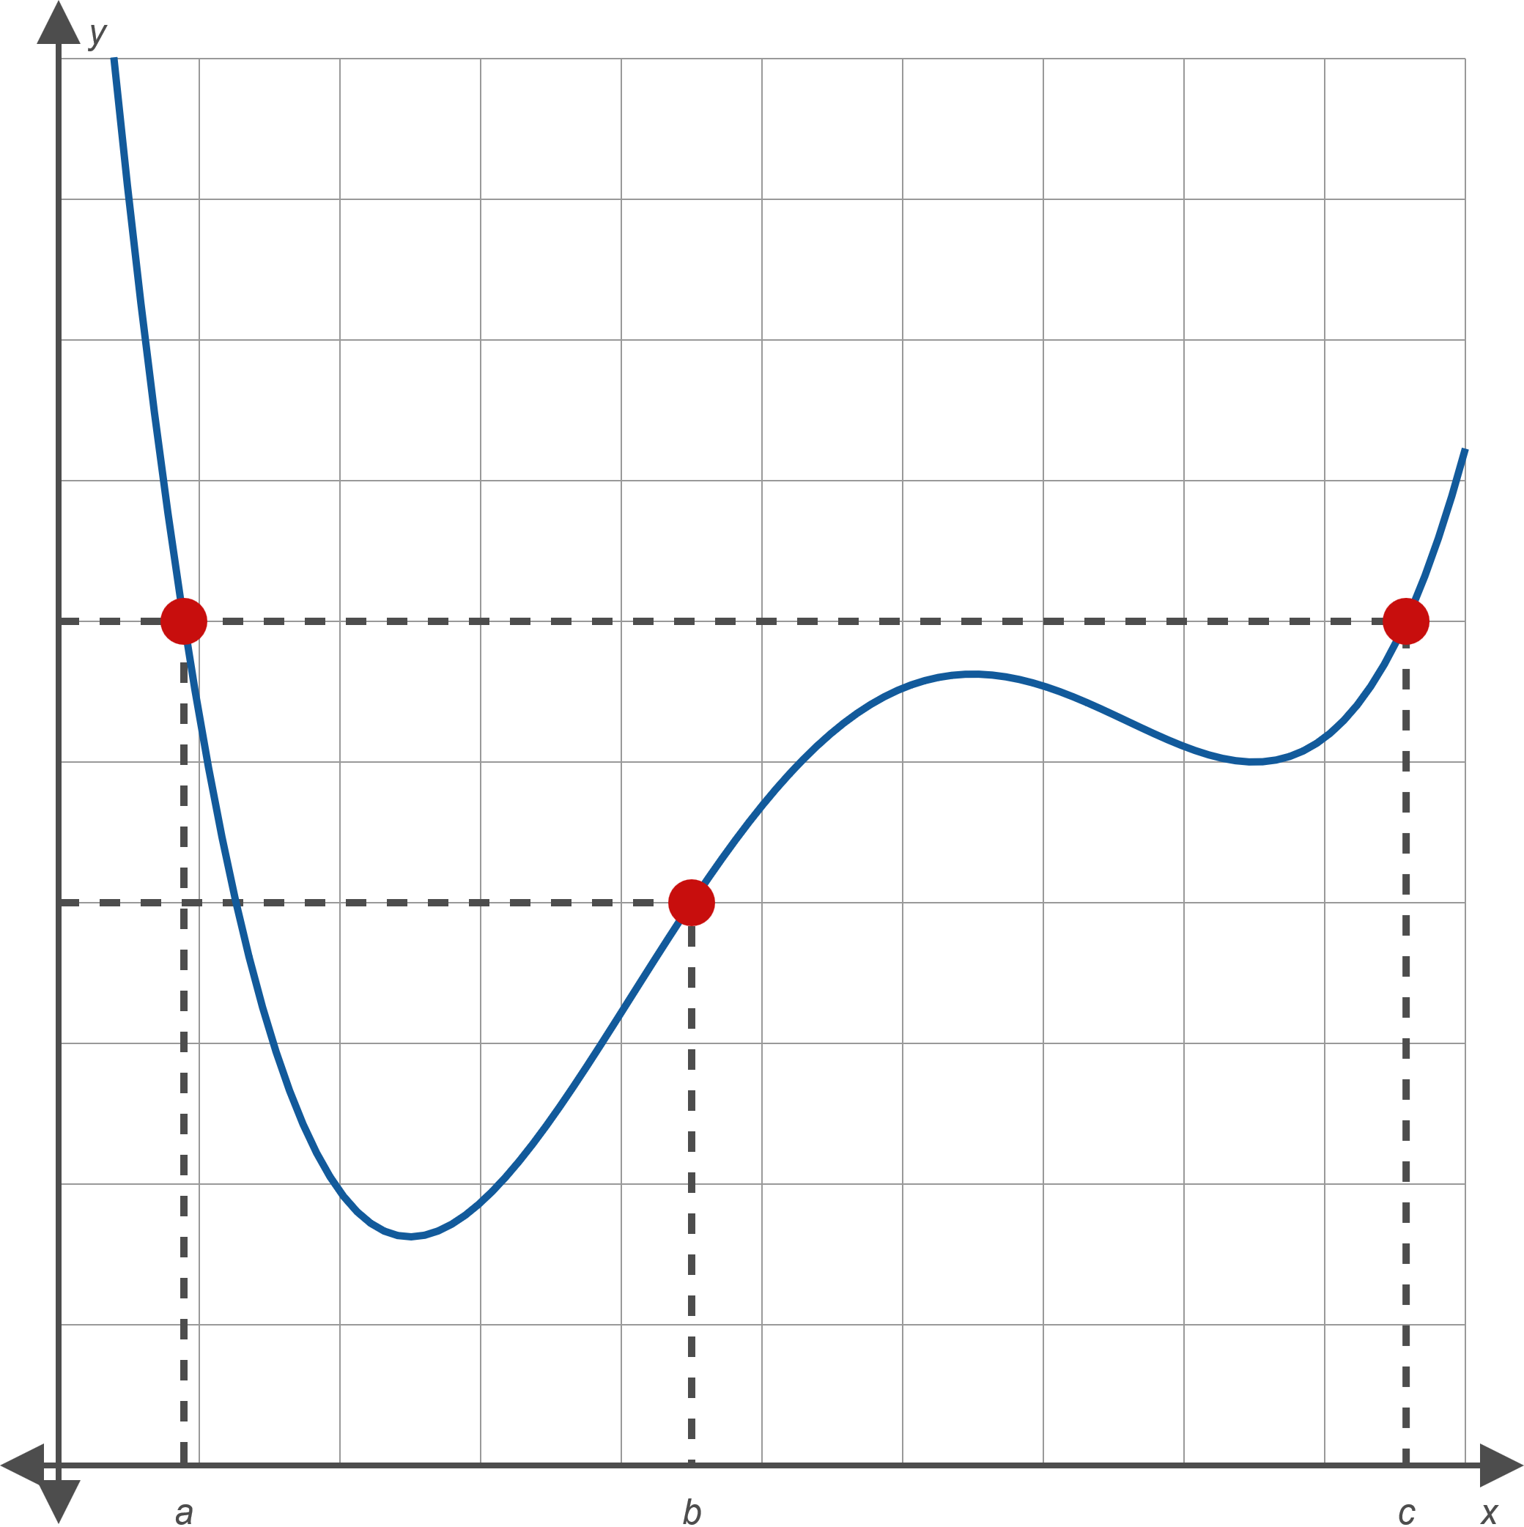
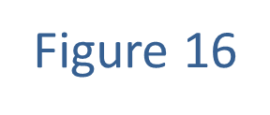
Example 6: Determining Intervals of Average Rate of Change₂

Slide 36
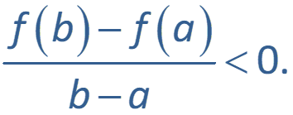
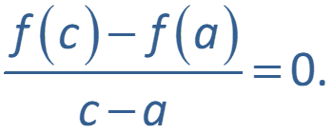
Example 6: Determining Intervals of Average Rate of Change₃
Solution
a.
Since f(c) − f(b) < 0 but c − b > 0,
That is, the average rate of change of f is positive on
b.
Since f(b) − f(a) < 0 but b − a > 0,
That is, the average rate of change of f is negative on
c.
​Since f(c) = f(a),
That is, the average rate of change of f is zero on

