Slide 1
Section 3.6
Linear Inequalities in Two Variables

Slide 2
Procedure: Solving Linear Inequalities in Two Variables
Step 1: Graph the line that results from replacing the inequality symbol with =.
Step 2: Make the line solid if the inequality symbol is ≤ or ≥ (not strict) and dashed if the symbol is < or > (strict). A solid line indicates that points on the line are included in the solution set while a dashed line indicates that points on the line are excluded from the solution set.
Step 3: Determine which of the half-planes defined by the boundary line solves the inequality by substituting a test point from one of the two half-planes into the inequality. If the resulting numerical statement is true, all the points in the same half-plane as the test point solve the inequality. Otherwise, the points in the other half-plane solve the inequality. Shade in the half-plane that solves the inequality.

Slide 3
Example 1: Solving Linear Inequalities
Solve the following linear inequalities by graphing their solution sets.

Slide 4
Note:
Whenever possible, use the origin as a test point, since it makes for a very simple calculation.

Slide 5
Example 1: Solving Linear Inequalities₁
Solution
​To graph the boundary line, replace the inequality symbol with an equal sign, then find the x- and
y-intercepts.

Slide 6
Example 1: Solving Linear Inequalities₂
​x-intercept of boundary: (4, 0)
y-intercept of boundary: (0, 6)
​The graph of the equation is drawn with a dashed line since the inequality is strict.
​The origin (0, 0) clearly lies on one side of the boundary line, so we can use it as our test point.
​When both x and y in the inequality are replaced with 0, we obtain the true statement 0 < 12. This tells us to shade the half-plane that contains (0, 0).
​

Slide 7
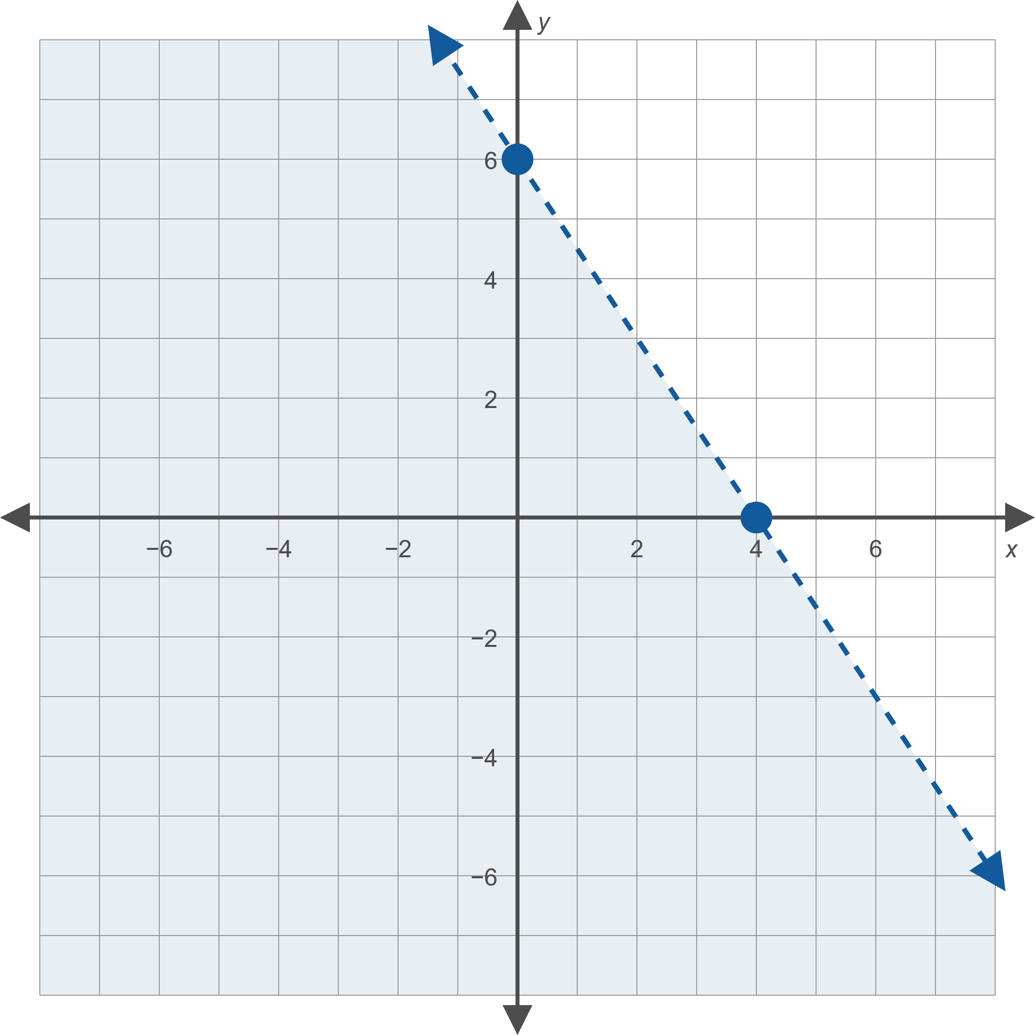

Example 1: Solving Linear Inequalities₃

Slide 8
Example 1: Solving Linear Inequalities₄
b.
In slope-intercept form, the equation for the
boundary is y = x, a line with a y-intercept of
(0, 0) and a slope of 1.

Slide 9
Example 1: Solving Linear Inequalities₅
​Graph the boundary with a solid line since the inequality is not strict. Thus, points on the boundary do solve the inequality.
​This time, the origin cannot be used as a test point, since it lies directly on the boundary line. The point
(1, −1) lies below the boundary, and if we substitute
x = 1 and y = −1 into the inequality x − y ≤ 0, we obtain the false statement 2 ≤ 0. Thus, we shade the half-plane that does not contain (1, −1).

Slide 10
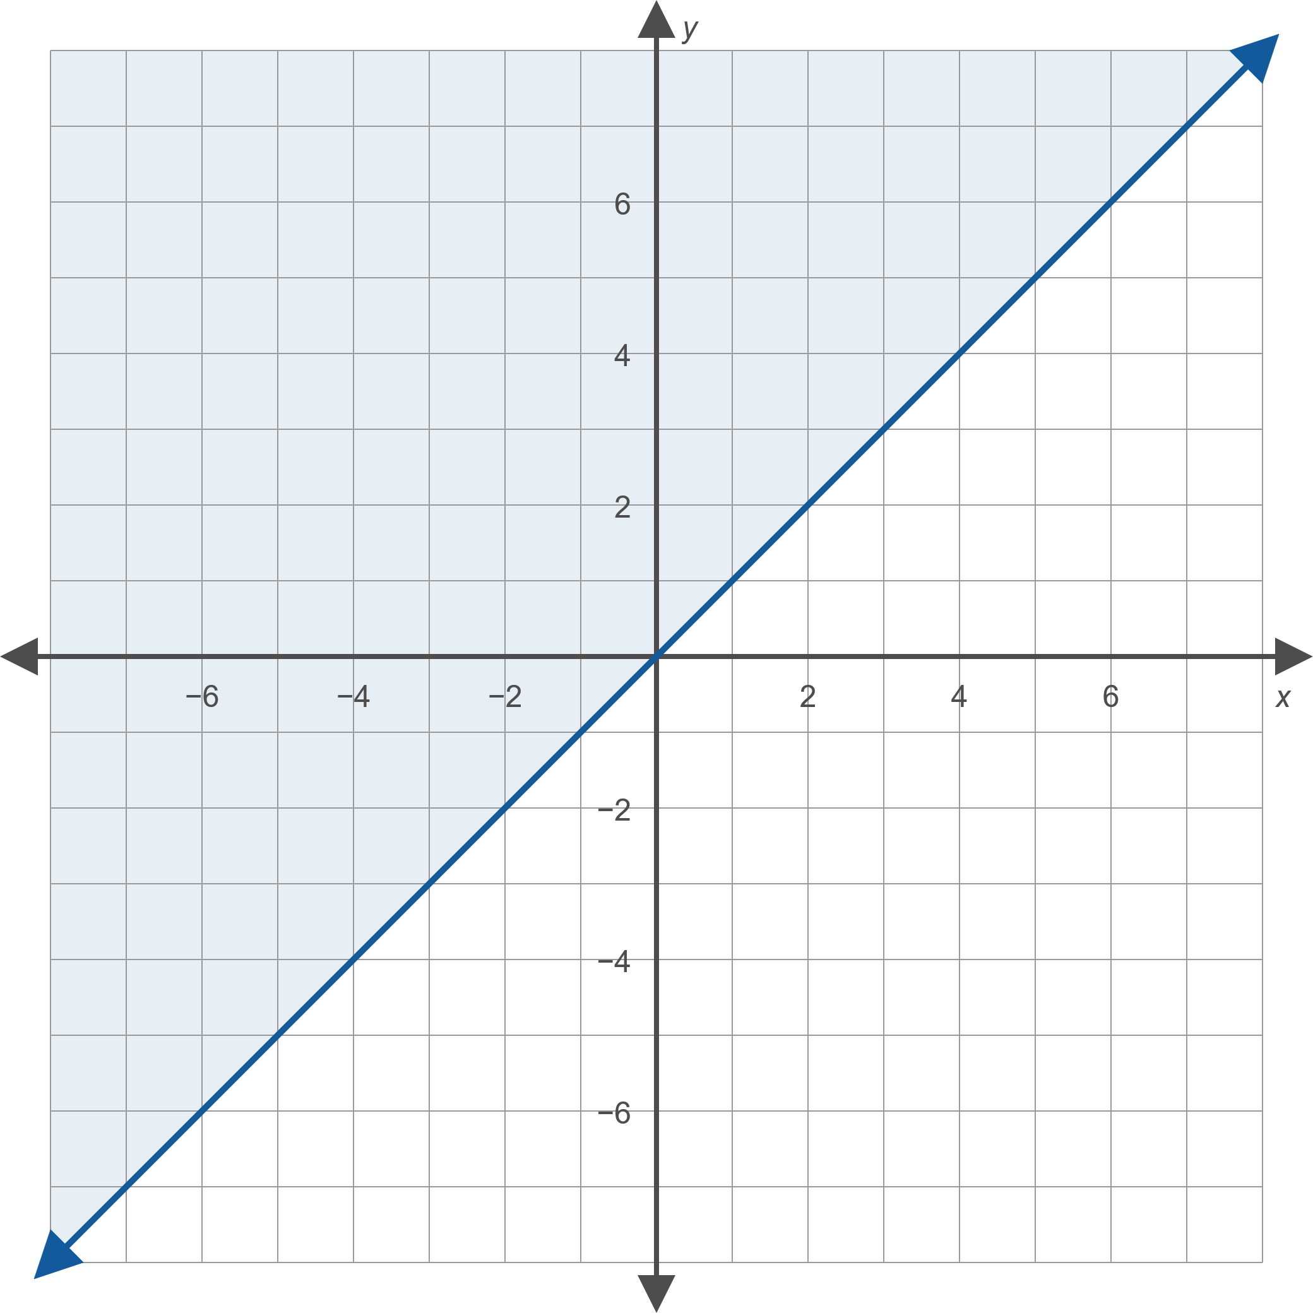
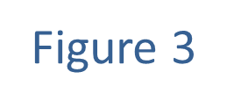
Example 1: Solving Linear Inequalities₆

Slide 11
Example 1: Solving Linear Inequalities₇
​x > 3
​In this example, the boundary line is a vertical line with x-intercept (3, 0).
​Since the inequality is strict, we graph the boundary line as a dashed line.
​The origin can be used as a convenient test point, and results in the false statement 0 > 3, leading us to shade the half-plane to the right of the boundary. ​

Slide 12
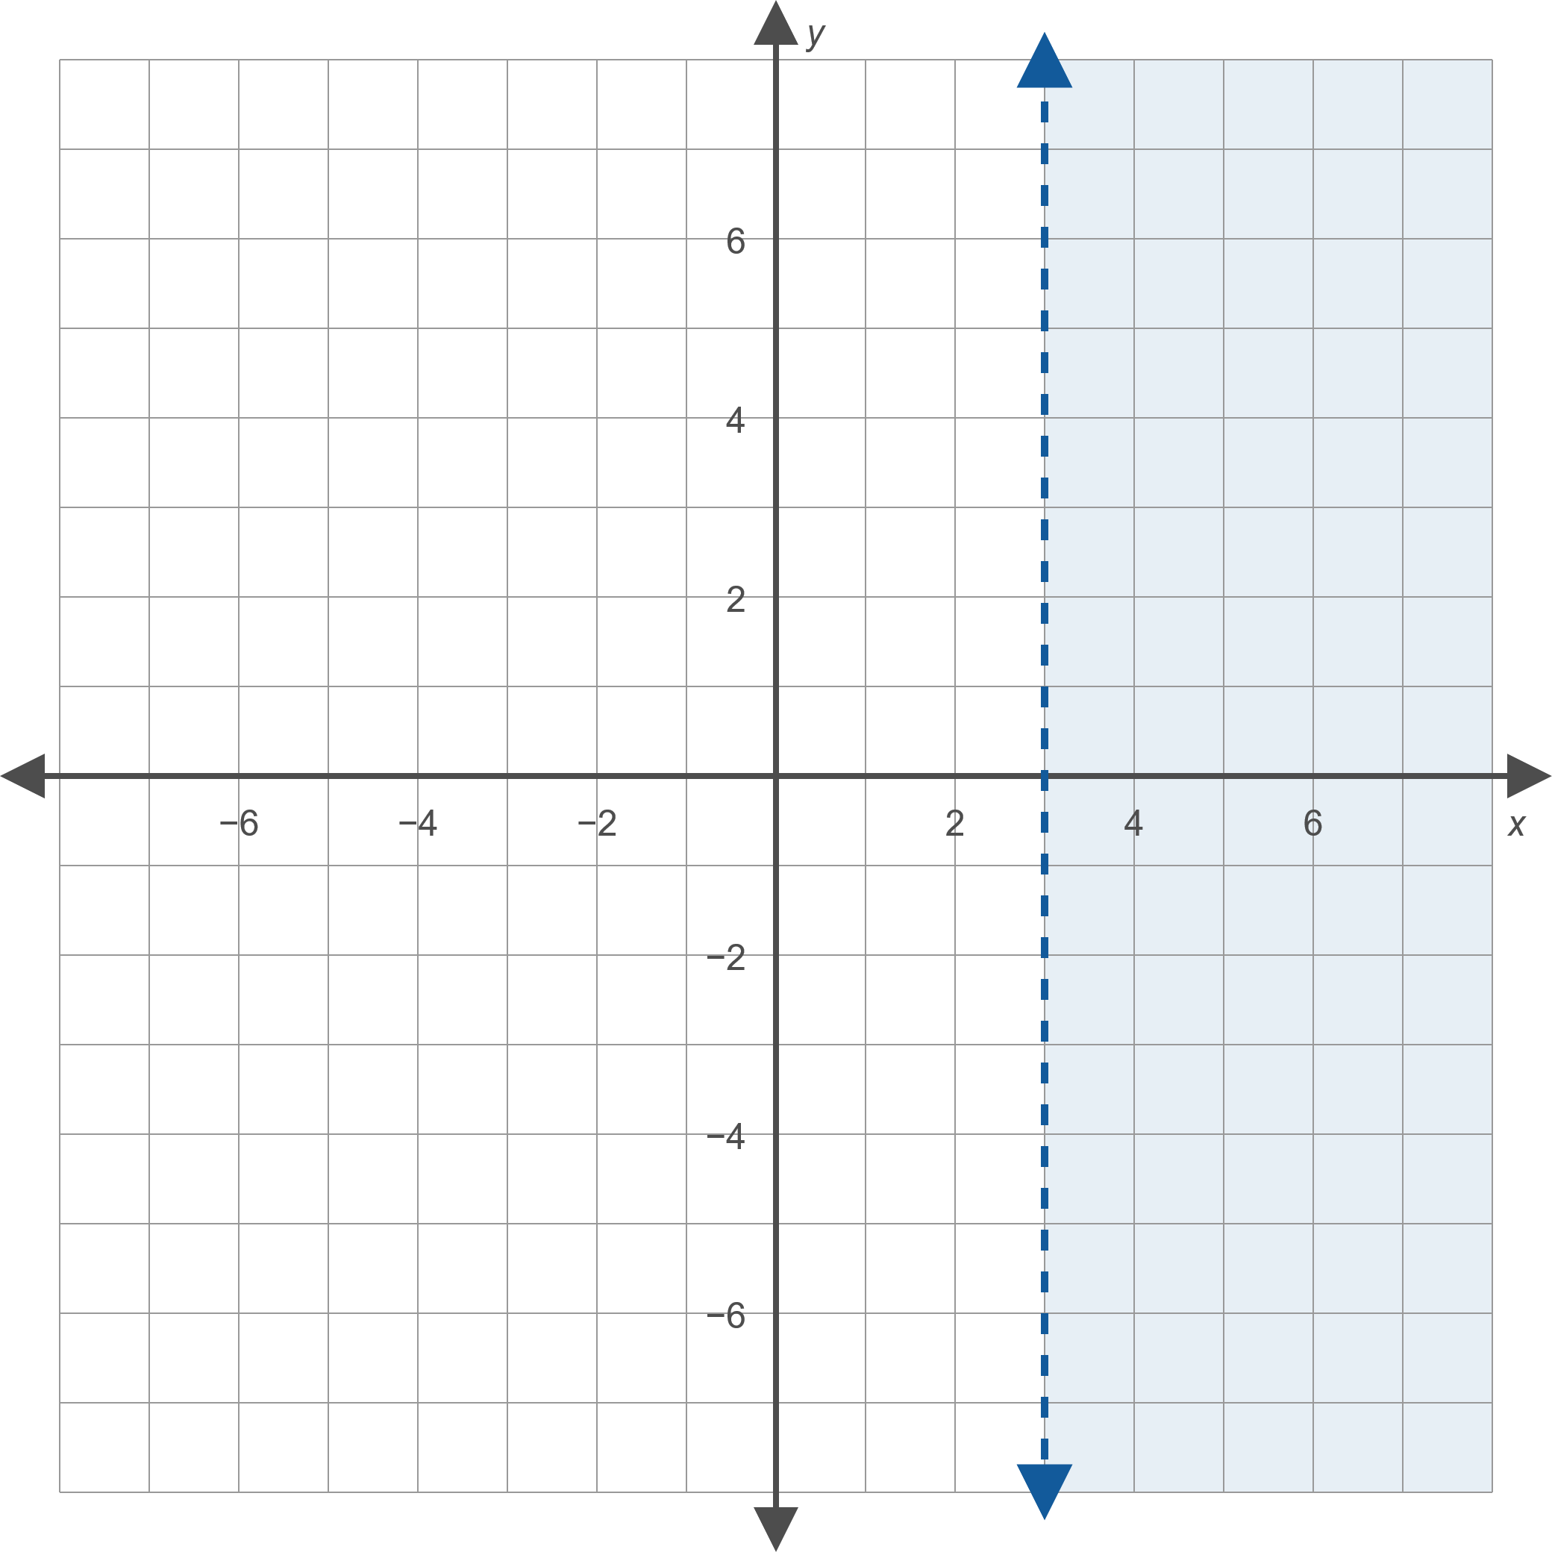
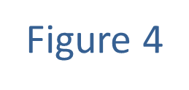
Example 1: Solving Linear Inequalities₈

Slide 13
Example 2: Solving Linear Inequalities₁
Graph the solution sets that satisfy the following inequalities.

Slide 14
Example 2: Solving Linear Inequalities₂
Solution
​5x − 2y < 10 and y ≤ x
​First graph the individual inequalities. We graph the line
5x − 2y = 10 with a dashed line and the line y = x with a solid line.
​We then note that the half-plane lying above 5x − 2y = 10 solves the first inequality (verify this by using the test point (0, 0)) and that the half-plane lying below y = x solves the second inequality (this can be verified using the test point (1, −1)).
​Since the two inequalities are joined by the word "and", we shade in the intersection of the two half-planes, resulting in the graph shown in Figure 9.
​

Slide 15
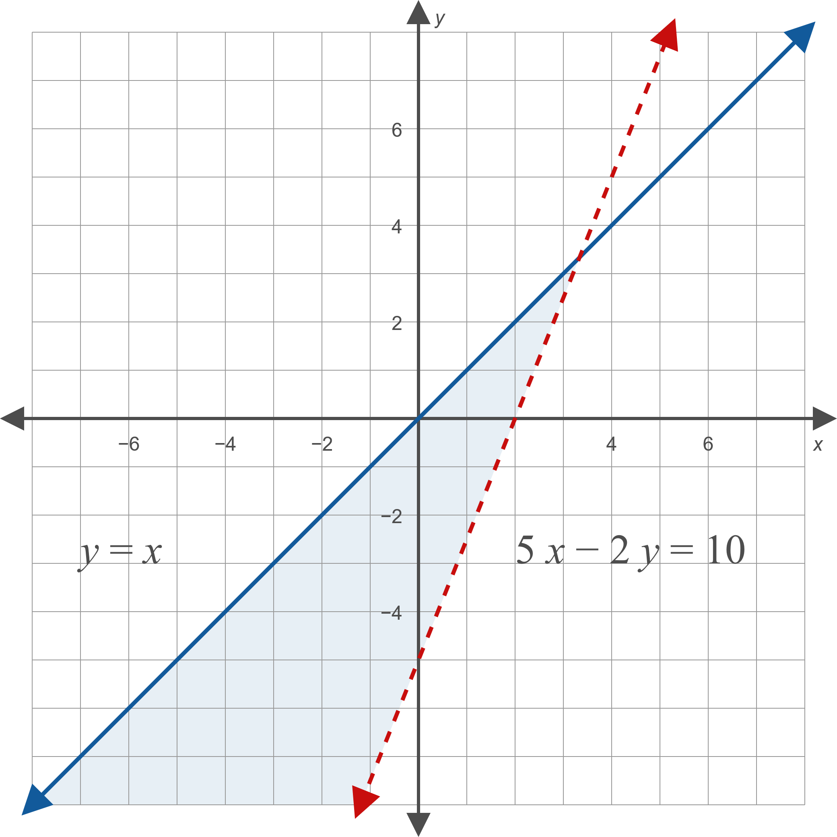

Example 2: Solving Linear Inequalities₃

Slide 16
Example 2: Solving Linear Inequalities₄
​x + y < 4 or x ≥ 4
​Again, begin by solving each inequality separately. We graph the line x + y = 4 with a dashed line, and the line x = 4 with a solid line, and note that the half-plane below x + y = 4 solves the first inequality and that the half-plane to the right of x = 4 solves the second.
​Since the two inequalities are joined by "or", we shade the union of the two half-planes. Note that this results in a larger solution set than either of the two individual solutions. Any ordered pair in the shaded region will satisfy one or both of the inequalities. ​

Slide 17
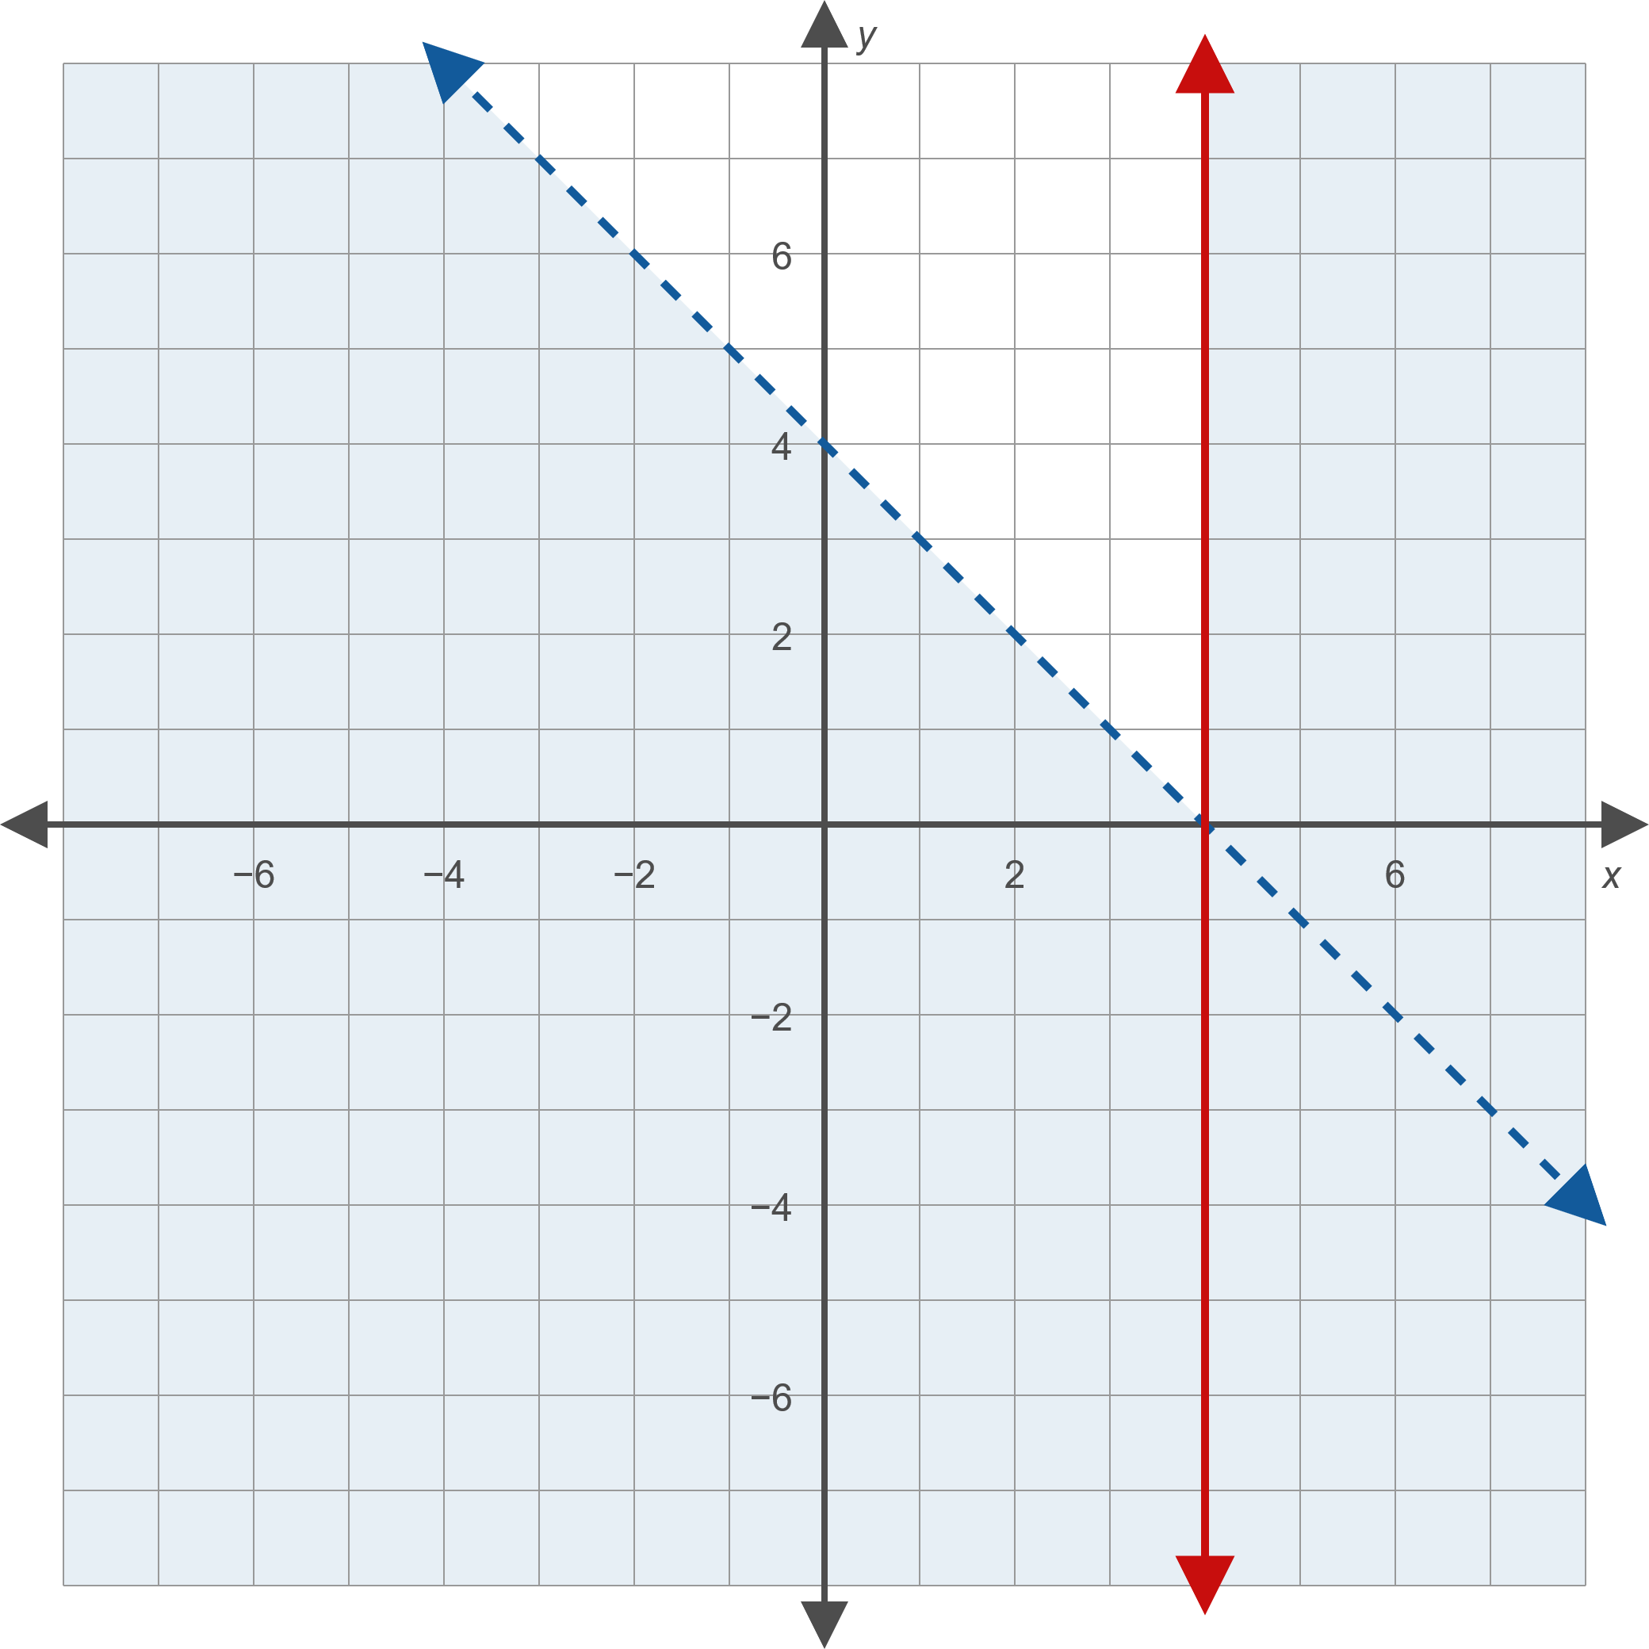

Example 2: Solving Linear Inequalities₅

Slide 18
Example 3: Solving Absolute Value Linear Inequalities₁
Graph the solution set in
that satisfies the joint
conditions

Slide 19
Example 3: Solving Absolute Value Linear Inequalities₂
Solution
First, we need to find the solution to each individual inequality.

Slide 20
Example 3: Solving Absolute Value Linear Inequalities₃
Begin by rewriting the absolute value inequality as two linear inequalities.
Simplify. We have a union of solutions.

Slide 21
Example 3: Solving Absolute Value Linear Inequalities₄
Again, rewrite the inequality without absolute value signs.
This time, we have an intersection of solutions.

Slide 22
Example 3: Solving Absolute Value Linear Inequalities₅
Now we can graph the solutions to the individual conditions.

Slide 23
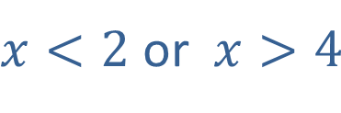
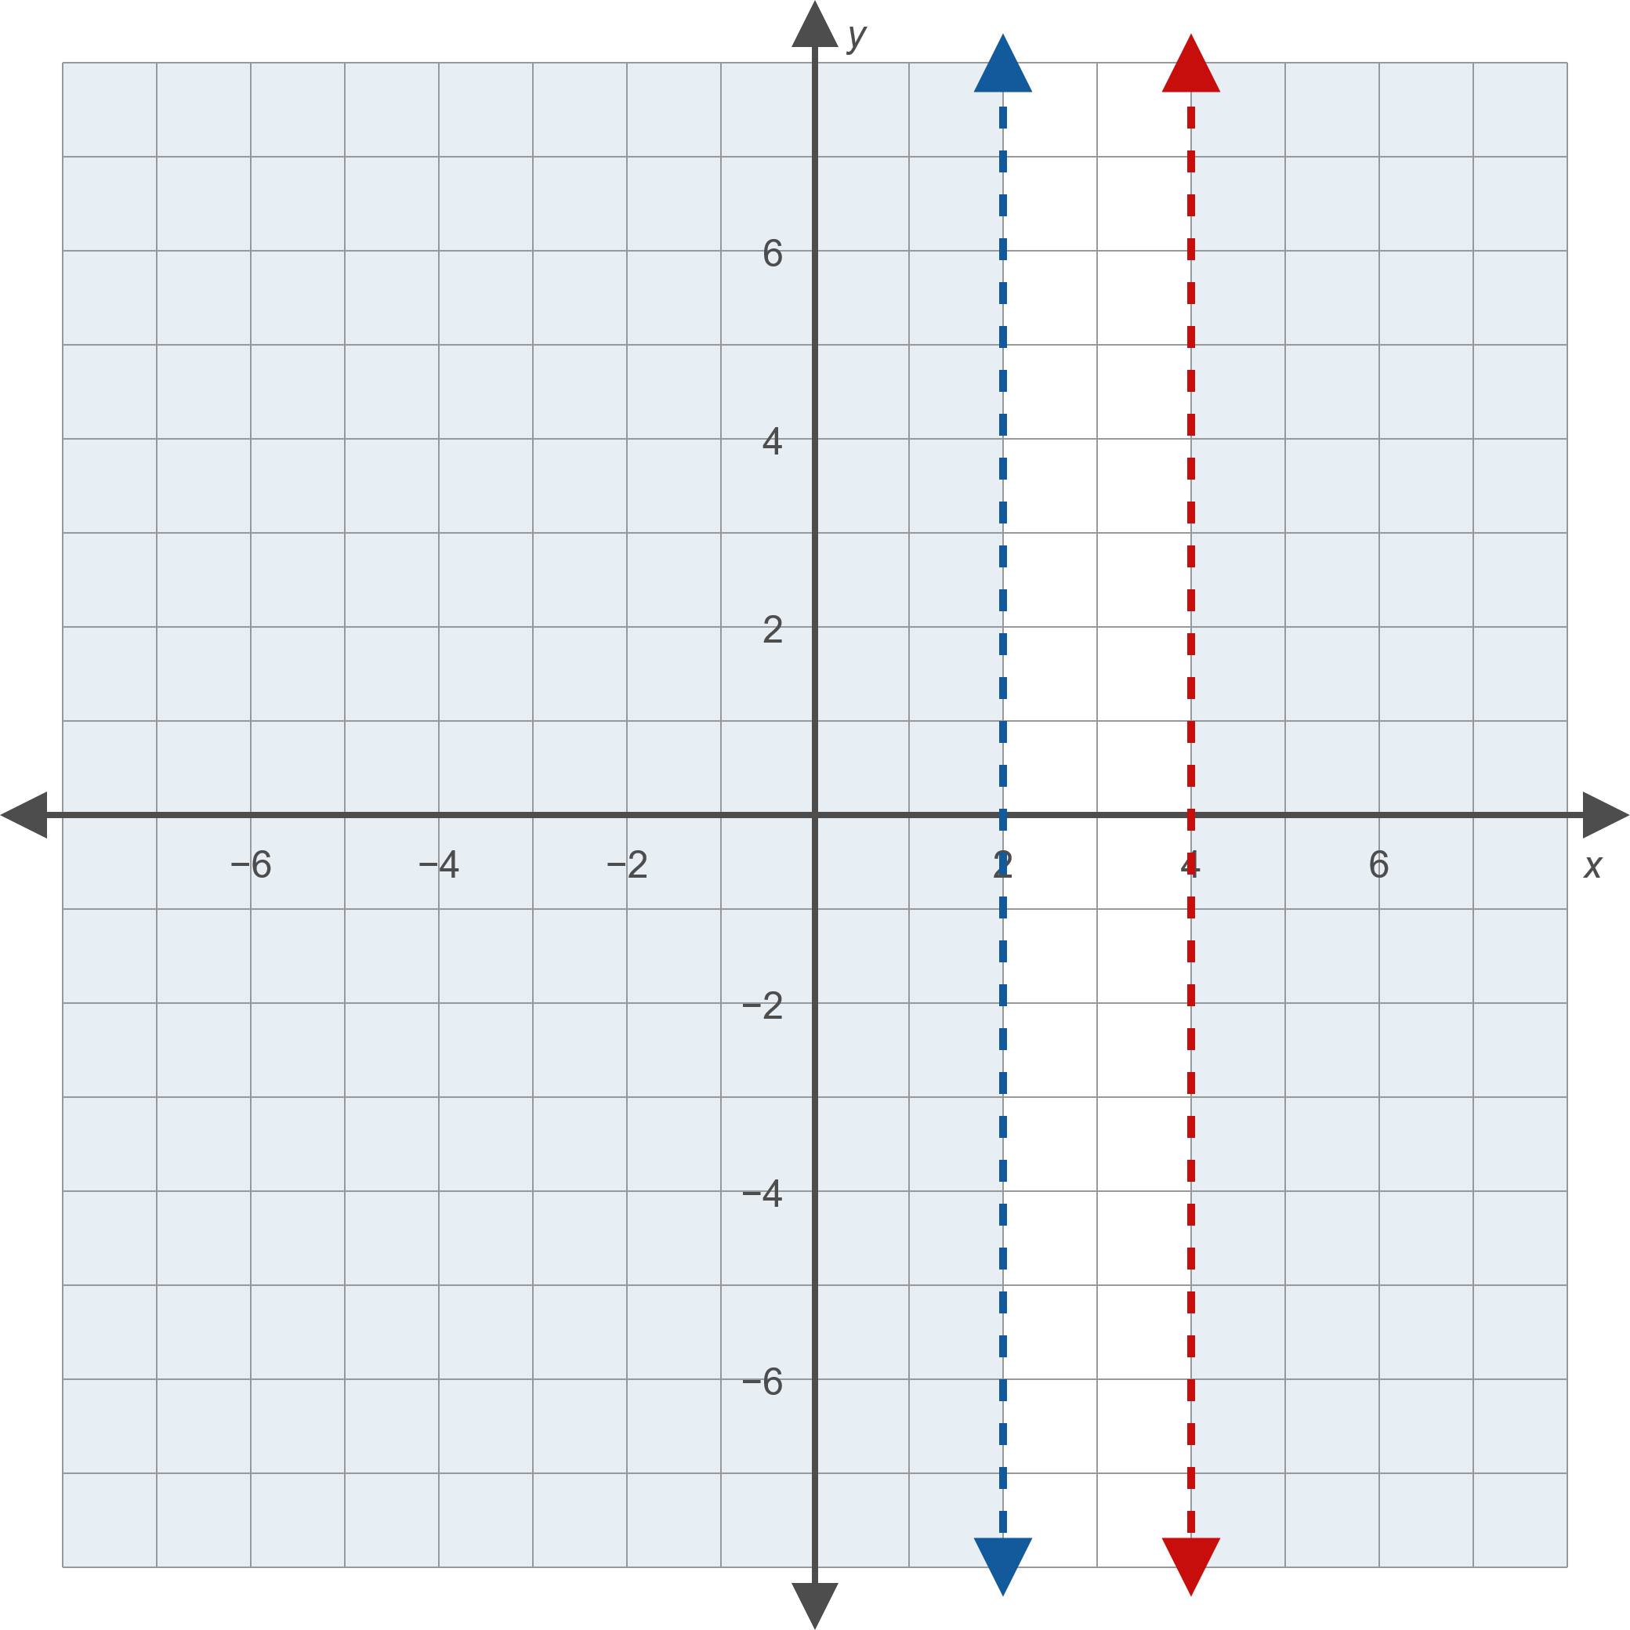
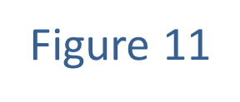
Example 3: Solving Absolute Value Linear Inequalities₆

Slide 24
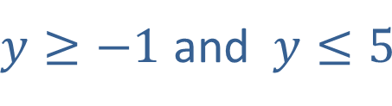
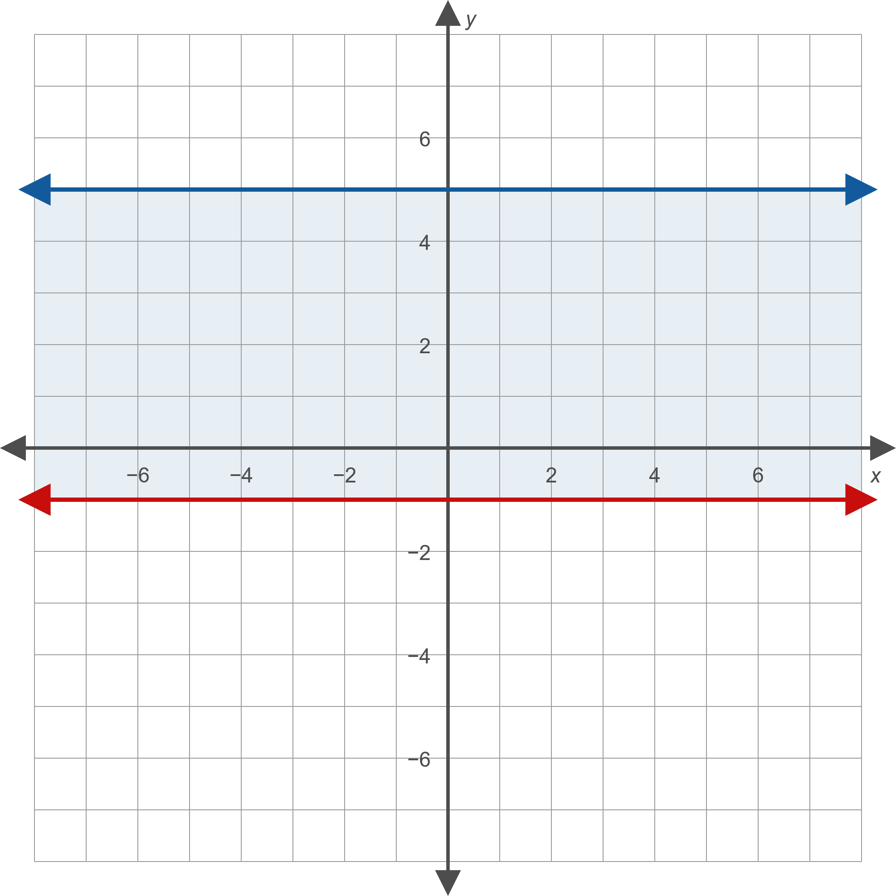
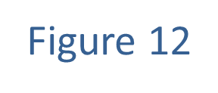
Example 3: Solving Absolute Value Linear Inequalities₇

Slide 25
Example 3: Solving Absolute Value Linear Inequalities₈
We now intersect the solution sets to obtain the final answer:

Slide 26
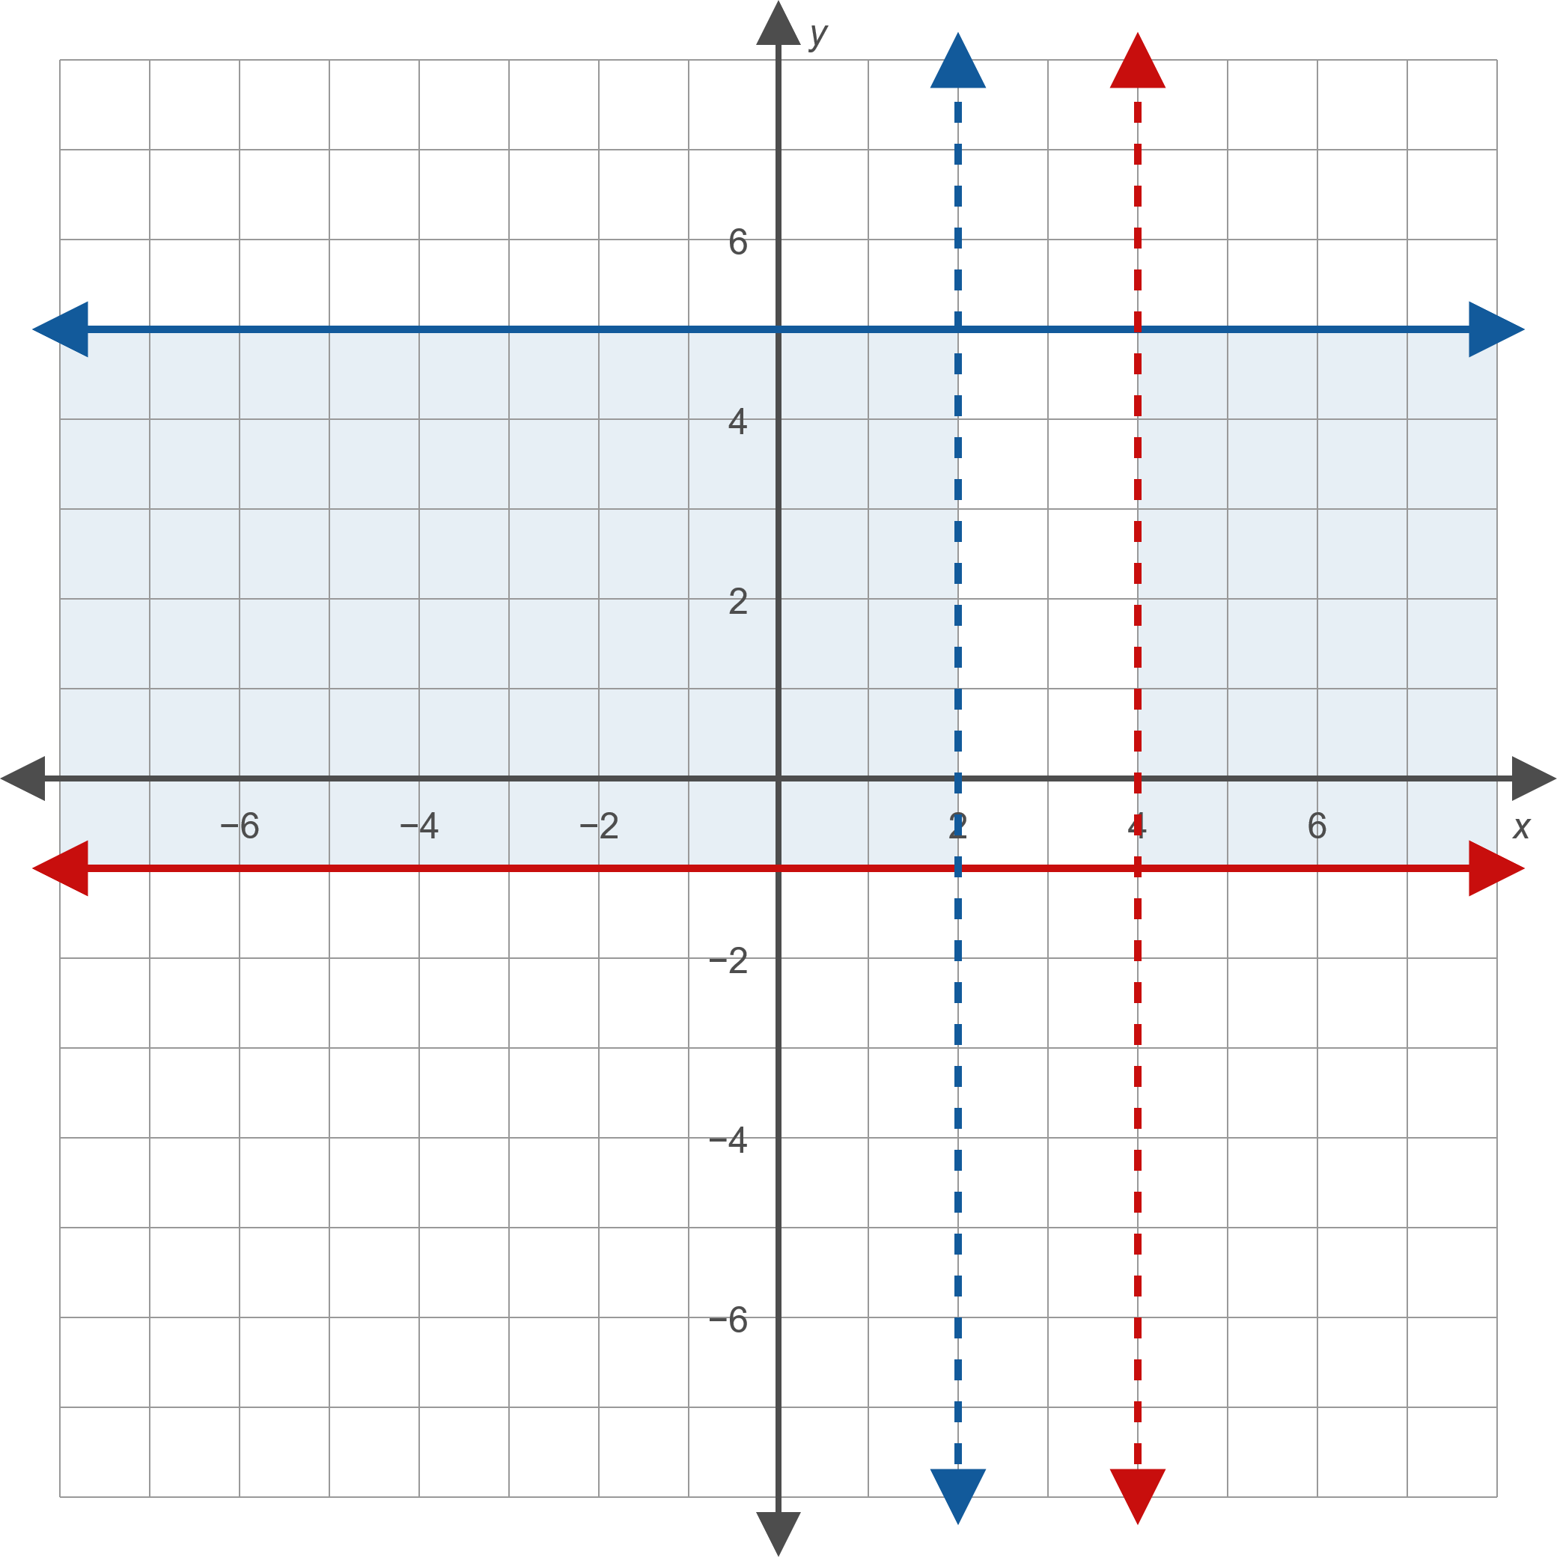
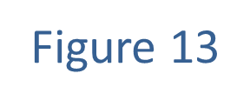
Example 3: Solving Absolute Value Linear Inequalities₉

