Slide 1
Section 2.5
Rational Equations in One Variable

Slide 2
Rational Equations
A rational equation is an equation that contains at least one rational expression, while any nonrational expressions are polynomials.

Slide 3
Example 1: Solving Rational Equations₁
Solve the following rational equations.

Slide 4
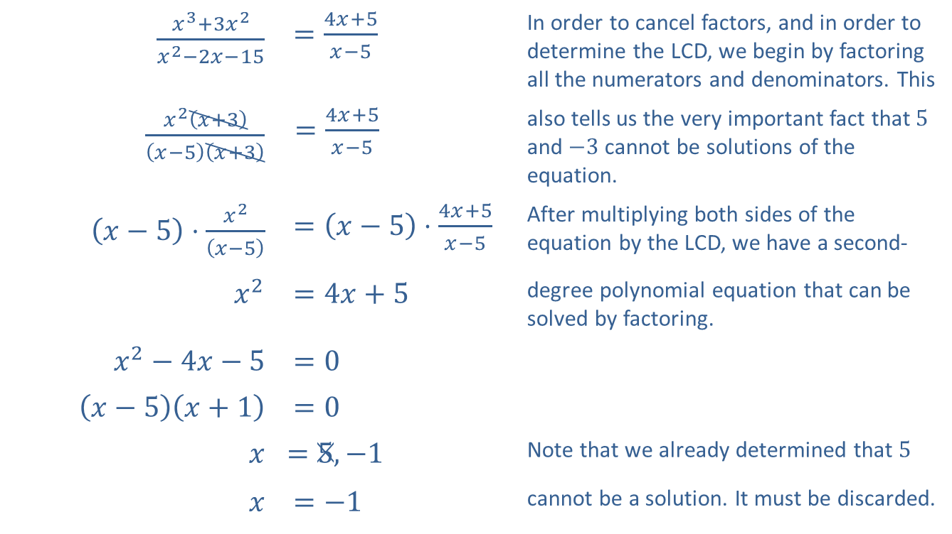
Example 1: Solving Rational Equations₂
Solution
​
$\frac{x^{3}+3x^{2}}{x^{2}−2x−15}$ | $=\frac{4x+5}{x−5}$ | In order to cancel factors, and in order to determine the LCD, we begin by factoring all the numerators and denominators. This
$\frac{x^{2}\left(x+3\right)}{\left(x−5\right)\left(x+3\right)}$ | $=\frac{4x+5}{x−5}$ | also tells us the very important fact that 5 and $−3$ cannot be solutions of the equation.
$\left(x−5\right)⋅\frac{x^{2}}{\left(x−5\right)}$ | $=\left(x−5\right)⋅\frac{4x+5}{x−5}$ | After multiplying both sides of the equation by the LCD, we have a second-
$x^{2}$ | $=4x+5$ | degree polynomial equation that can be solved by factoring.
$x^{2}−4x−5$ | $=0$
$\left(x−5\right)\left(x+1\right)$ | $=0$
$$x$$ | ​$=5,−1$ | Note that we already determined that 5
$$x$$ | $=−1$ | cannot be a solution. It must be discarded.

Slide 5
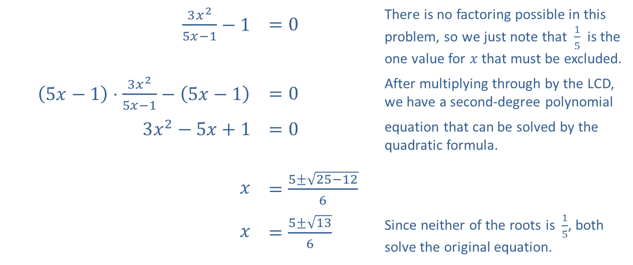
Example 1: Solving Rational Equations₃
$\frac{3x^{2}}{5x−1}−1$ | $=0$ | There is no factoring possible in this problem, so we just note that $\frac{1}{5}$ is the one value for $x$ that must be excluded.
$\left(5x−1\right)⋅\frac{3x^{2}}{5x−1}−\left(5x−1\right)$ | $=0$ | After multiplying through by the LCD, we have a second-degree polynomial
$3x^{2}−5x+1$ | $=0$ | equation that can be solved by the quadratic formula.
$$x$$ | $=\frac{5±\sqrt{25−12}}{6}$
$$x$$ | $=\frac{5±\sqrt{13}}{6}$ | Since neither of the roots is $\frac{1}{5}$, both solve the original equation.
​

Slide 6
Example 2: Solving an Absolute Value Rational Equation₁
Solve the equation

Slide 7
Example 2: Solving an Absolute Value Rational Equation₂
Solution
The key step is to remember that
can represent
either x − 5 or −(x − 5), depending on whether x − 5 is positive or negative; that is, every occurrence of an absolute value expression in an equation leads to two equations without the absolute value symbols. In this case, we need to solve both
remembering to check for extraneous solutions at the end.

Slide 8
Example 2: Solving an Absolute Value Rational Equation₃
We will carry out the solutions of the two equations in parallel, as the steps are the same.
​

Slide 9
Example 2: Solving an Absolute Value Rational Equation₄
Checking the two potential solutions obtained from the first equation, we see that it is indeed the case that
as both expressions are equal
to 1, so x = 6 is a solution of the original equation.
However,
so x = −2 is extraneous and not a solution.

Slide 10
Example 2: Solving an Absolute Value Rational Equation₅
We check the two potential solutions obtained from the second equation the same way, remembering a technique for working with radical expressions in order to compare the two sides of the equation, as follows.

Slide 11
Example 2: Solving an Absolute Value Rational Equation₆
So both
are valid solutions of
the original equation, in addition to x = 6, and thus the complete solution set is

Slide 12
Example 3: Filling a Pool₁
One hose can fill a swimming pool in 12 hours. The owner buys a second hose that can fill the pool at twice the rate of the first one. If both hoses are used together, how long does it take to fill the pool?

Slide 13
Example 3: Filling a Pool₂
Solution
The rate of work of the first hose is
so the rate of the second hose is
If we let x denote the time needed to fill the pool when both hoses are used together, the sum of the two individual rates must equal
So we need to solve the equation

Slide 14
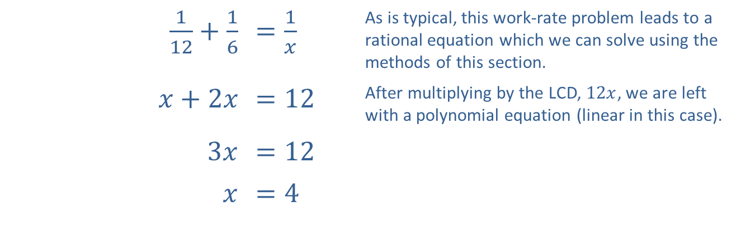
Example 3: Filling a Pool₃
​$\frac{1}{12}+\frac{1}{6}$ | ​$=\frac{1}{x}$ | As is typical, this work-rate problem leads to a rational equation which we can solve using the methods of this section.
​$x+2x$ | ​$=12$ | After multiplying by the LCD, $12x$, we are left with a polynomial equation (linear in this case).
​$3x$ | ​$=12$
$$x$$ | ​$=4$
Thus, using both hoses, it will take 4 hours to fill the pool.

Slide 15
Example 4: Filling a Pool Poorly₁
The pool owner in Example 3 is a bit clumsy, and one day proceeds to fill his empty pool with the two hoses but accidentally turns on the pump that drains the pool also. Fortunately, the pump rate is slower than the combined rate of the two hoses, and the pool fills anyway, but it takes 10 hours to do so. How long does it take the pump to empty the pool?

Slide 16
Example 4: Filling a Pool Poorly₂
Solution
First, let's translate the information in the problem into a work-rate rational equation. If we let x denote the time it takes the pump to empty the pool, we can say that the pump has a filling rate of
(since emptying is the opposite of filling). Since the two hoses can fill the pool in 4 hours, the combined filling rate of the two hoses is
Finally, the total rate at which the pool is filled on this unfortunate day is

Slide 17
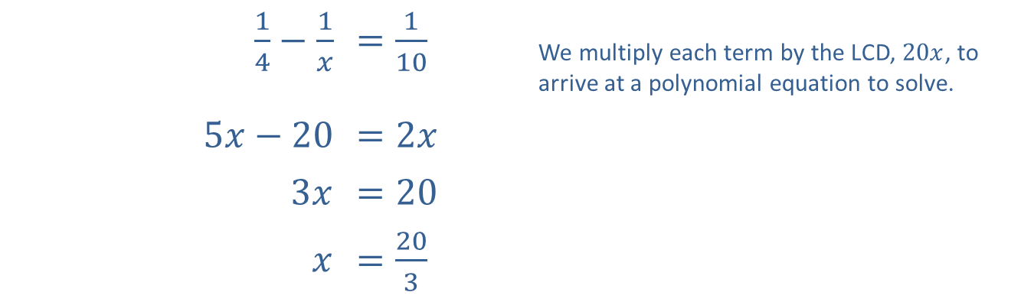
Example 4: Filling a Pool Poorly₃
Again, the sum of the individual rates is equal to the combined rate, so the following rational equation reflects this situation.
​$\frac{1}{4}−\frac{1}{x}$ | ​$=\frac{1}{10}$ | We multiply each term by the LCD, $20x$, to arrive at a polynomial equation to solve.
​$5x−20$ | ​$=2x$
​$3x$ | ​$=20$
$$x$$ | ​$=\frac{20}{3}$
Thus, working alone, the pump can empty the pool in
hours, or 6 hours and 40 minutes.

