Slide 1
Section 2.4
Polynomial and Polynomial-Like Equations in One Variable

Slide 2
Definition: Quadratic-Like Equations
An equation is quadratic-like, or quadratic in form, if it can be written in the form
where a, b, and c are constants, a ≠ 0, and A is an algebraic expression. Such equations can be solved by first solving for A and then solving for the variable in the expression A. This method of solution is called substitution.

Slide 3
Example 1: Quadratic-Like Equations₁
Solve the quadratic-like equations.

Slide 4
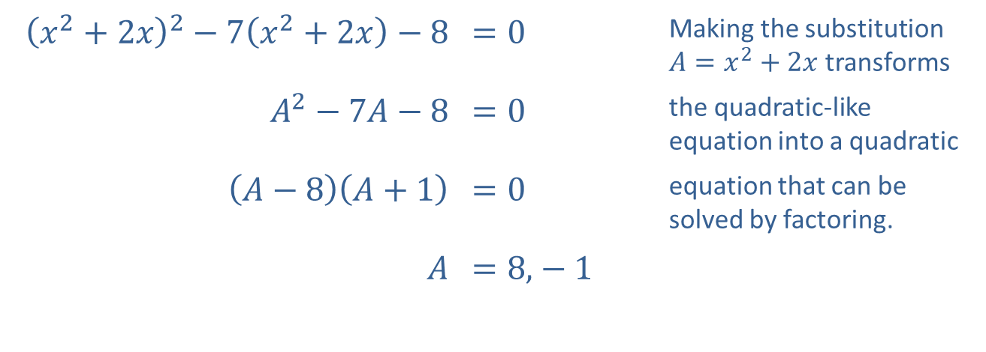
Example 1: Quadratic-Like Equations₂
Solution
​
​${\left(x^{2}+2x\right)}^{2}−7\left(x^{2}+2x\right)−8$ | ​$=0$ | Making the substitution $A=x^{2}+2x$ transforms
​$A^{2}−7A−8$ | ​$=0$ | the quadratic-like equation into a quadratic
​$\left(A−8\right)\left(A+1\right)$ | ​$=0$ | equation that can be solved by factoring.
$A$ | ​$=8\text{,}−1$

Slide 5
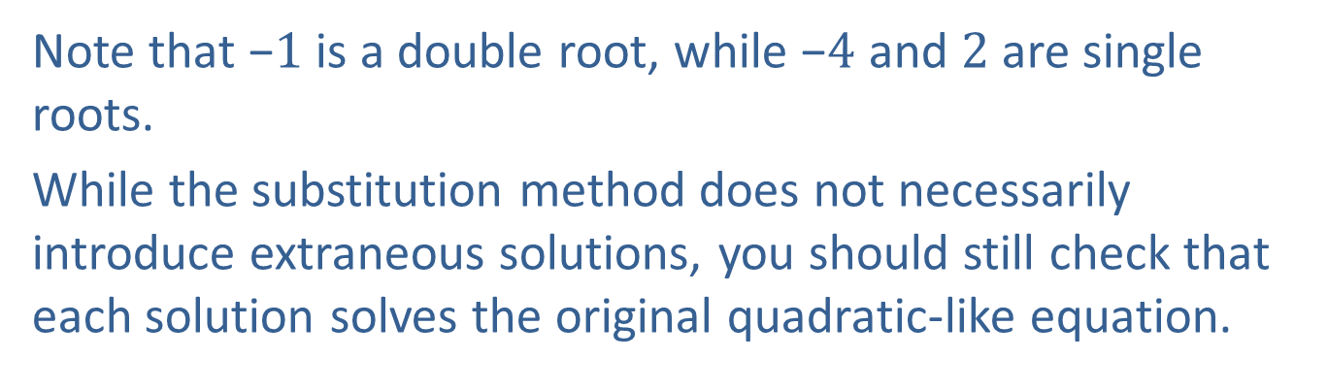
Example 1: Quadratic-Like Equations₃
Note that −$1$ is a double root, while −$4$ and 2 are single roots.
While the substitution method does not necessarily introduce extraneous solutions, you should still check that each solution solves the original quadratic-like equation.

Slide 6
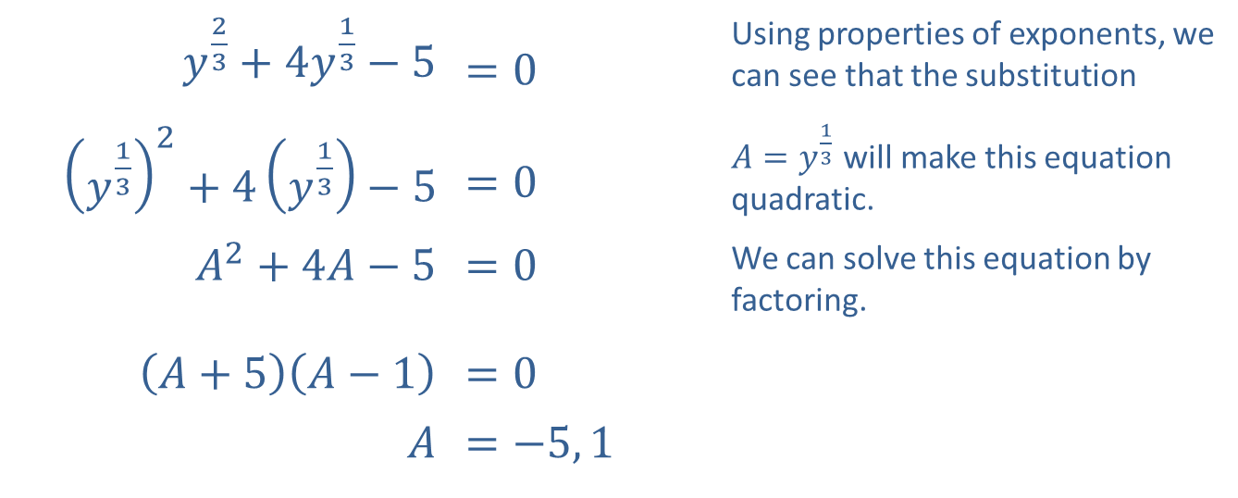
Example 1: Quadratic-Like Equations₄
​$y^{\frac{2}{3}}+4y^{\frac{1}{3}}−5$ | ​$=0$ | Using properties of exponents, we can see that the substitution
​${\left(y^{\frac{1}{3}}\right)}^{2}+4\left(y^{\frac{1}{3}}\right)−5$ | ​$=0$ | $A=y^{\frac{1}{3}}$ will make this equation quadratic.
​$A^{2}+4A−5$ | ​$=0$ | We can solve this equation by factoring.
​$\left(A+5\right)\left(A−1\right)$ | ​$=0$
$A$ | ​$=−5, 1$
​

Slide 7
Example 1: Quadratic-Like Equations₅
Now that we have solved for A, we reverse the substitution and solve for y in each case.​
​
Once again, you should confirm that both values do indeed solve the original equation

Slide 8
Example 2: Solving Equations by Factoring₁
Solve the equations by factoring.

Slide 9
Note:
While checking solutions is always a good practice, solving by factoring does not produce any extraneous solutions.

Slide 10
Example 2: Solving Equations by Factoring₂
Solution
​
After isolating 0 on one side, we see the polynomial is a difference of two squares, which can always be factored.
The Zero-Product Property gives us two equations, both of which can be solved by taking square roots.

Slide 11
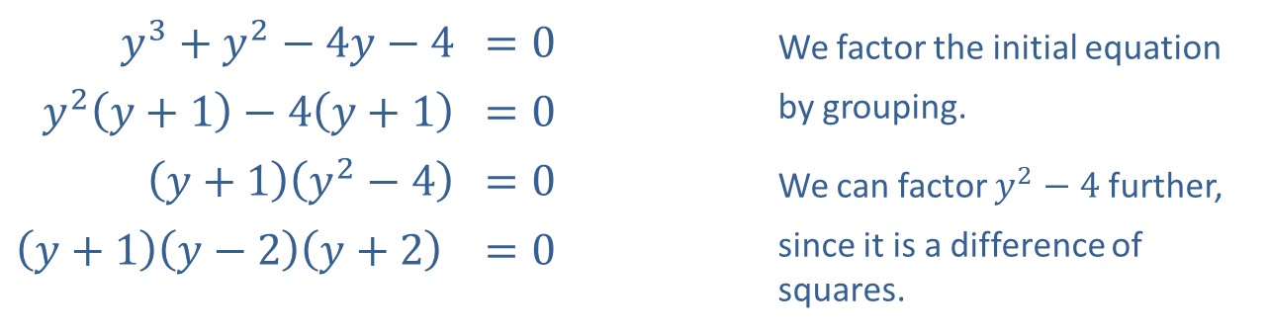
Example 2: Solving Equations by Factoring₃
​
​$y^{3}+y^{2}−4y−4$ | ​$=0$ | We factor the initial equation
​$y^{2}\left(y+1\right)−4\left(y+1\right)$ | ​$=0$ | by grouping.
​$\left(y+1\right)\left(y^{2}−4\right)$ | ​$=0$ | We can factor $y^{2}−4$ further,
​$\left(y+1\right)\left(y−2\right)\left(y+2\right)$ | ​$=0$ | since it is a difference of squares.
There are three solutions by the Zero-Factor Property.
y = −1 or y = 2 or y = −2

Slide 12
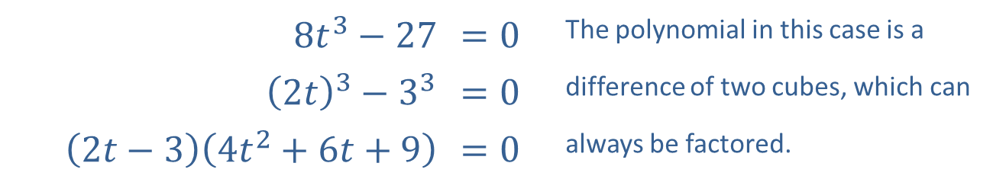
Example 2: Solving Equations by Factoring₄
​
​$8t^{3}−27$ | ​$=0$ | The polynomial in this case is a
​${\left(2t\right)}^{3}−3^{3}$ | ​$=0$ | difference of two cubes, which can
​$\left(2t−3\right)\left(4t^{2}+6t+9\right)$ | ​$=0$ | always be factored.

Slide 13
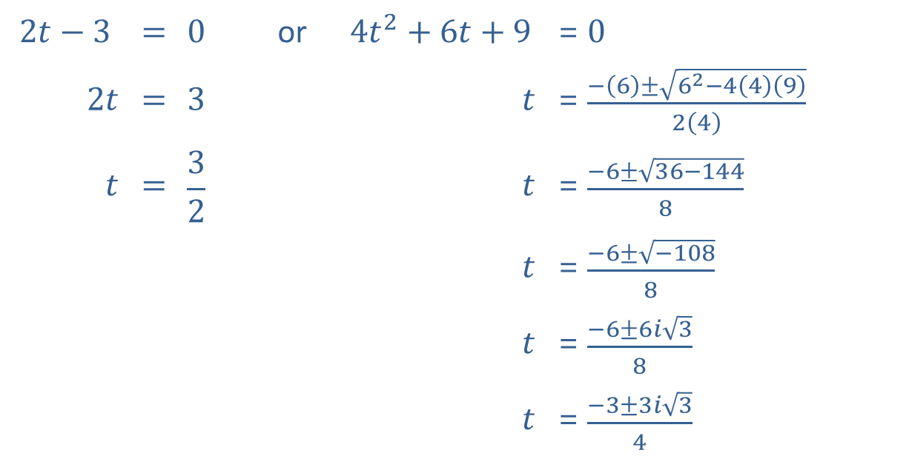
Example 2: Solving Equations by Factoring₅
The Zero-Factor Property gives us two equations to solve. One of the equations is quadratic, and we can use the quadratic formula to solve it.
$$2t−3$$ | $$=$$ | $$0$$ | or | $$4t^{2}+6t+9$$ | $$=$$ | $0$
$2t$ | $$=$$ | $$3$$ |  | $t$ | $$=$$ | $\frac{−\left(6\right)±\sqrt{6^{2}−4\left(4\right)\left(9\right)}}{2\left(4\right)}$
$t$ | $$=$$ | $$\frac{3}{2}$$ |  | $t$ | $$=$$ | $\frac{−6±\sqrt{36−144}}{8}$
 |  |  |  | $t$ | $$=$$ | $\frac{−6±\sqrt{−108}}{8}$
 |  |  |  | $t$ | $$=$$ | $\frac{−6±6i\sqrt{3}}{8}$
 |  |  |  | $t$ | $$=$$ | $\frac{−3±3i\sqrt{3}}{4}$

Slide 14
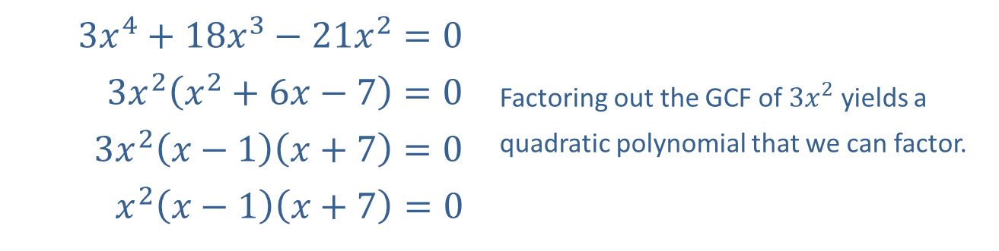
Example 2: Solving Equations by Factoring₆
​
​$3x^{4}+18x^{3}−21x^{2}=0$
​$3x^{2}\left(x^{2}+6x−7\right)=0$ | Factoring out the GCF of $3x^{2}$ yields a
​$3x^{2}\left(x−1\right)\left(x+7\right)=0$ | quadratic polynomial that we can factor.
​$x^{2}\left(x−1\right)\left(x+7\right)=0$
The Zero-Factor Property yields three solutions to the original equation.
x = 0, 1, or −7

Slide 15
Example 3: Solving Equations by Factoring₁
Solve the equations by factoring.

Slide 16
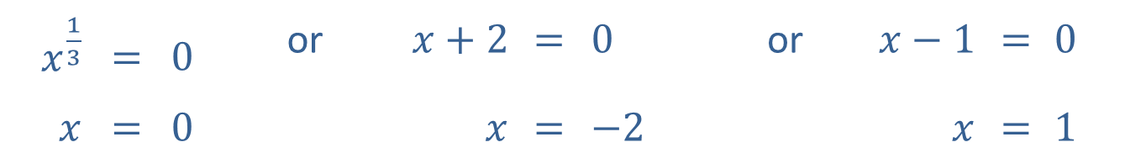
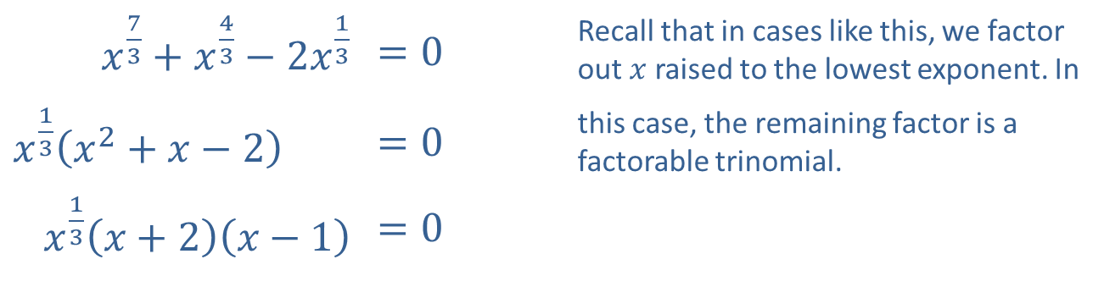
Example 3: Solving Equations by Factoring₂
Solution
​
​$x^{\frac{7}{3}}+x^{\frac{4}{3}}−2x^{\frac{1}{3}}$ | ​$=0$ | Recall that in cases like this, we factor out $x$ raised to the lowest exponent. In
​$x^{\frac{1}{3}}\left(x^{2}+x−2\right)$ | ​$=0$ | this case, the remaining factor is a factorable trinomial.
​$x^{\frac{1}{3}}\left(x+2\right)\left(x−1\right)$ | ​$=0$
The Zero-Factor Property leads to three simple equations.
$x^{\frac{1}{3}}$ | $$=$$ | $0$ | or | $x+2$ | $$=$$ | $0$ | or | $x−1$ | $$=$$ | $0$
$x$ | $$=$$ | $0$ |  | $x$ | $$=$$ | $−2$ |  | $x$ | $$=$$ | $1$

Slide 17
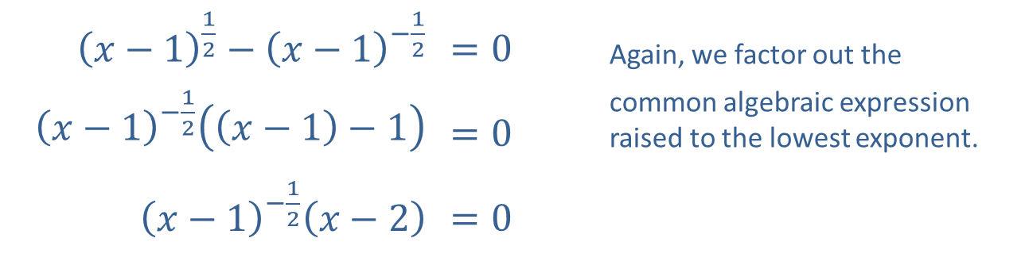
Example 3: Solving Equations by Factoring₃
​${\left(x−1\right)}^{\frac{1}{2}}−{\left(x−1\right)}^{−\frac{1}{2}}$ | ​$=0$ | Again, we factor out the
​${\left(x−1\right)}^{−\frac{1}{2}}\left(\left(x−1\right)−1\right)$ | ​$=0$ | common algebraic expression raised to the lowest exponent.
​${\left(x−1\right)}^{−\frac{1}{2}}\left(x−2\right)$ | ​$=0$
​

Slide 18
Example 3: Solving Equations by Factoring₄
​This equation leads to two equations, only one of which has a solution. (Note that there is no value for x which would solve the first of the two equations.)
​
​
​The original equation has only one solution.
x = 2

Slide 19
Example 4: Solving Equations by Factoring₁
Solve the equation
by factoring.

Slide 20
Example 4: Solving Equations by Factoring₂
Solution
While the given equation is not quadratic, it certainly bears a strong resemblance to one that is. In fact, if we make the substitution
we obtain the quadratic equation
which we can solve by factoring the trinomial as (y − 3)(y − 4). This gives us y = 3 or y = 4. Translating this back to the variable x, we have

