Slide 1
Section 2.3
Quadratic Equations in One Variable

Slide 2
Definition: Quadratic Equations
A quadratic equation in one variable, say the variable x, is an equation that can be transformed into the form
Where a, b, and c are real numbers and a ≠ 0. Such equations are also called second-degree equations, as x appears to the second power. The name quadratic comes from the Latin word quadrus, meaning "square."

Slide 3
Example 1: Solving Quadratic Equations by Factoring₁
Solve the quadratic equations by factoring.

Slide 4
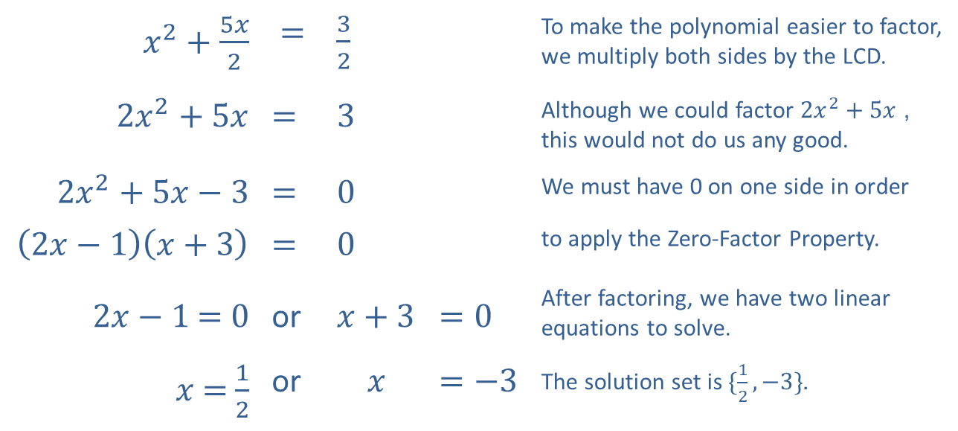
Example 1: Solving Quadratic Equations by Factoring₂
Solution
​
​$x^{2}+\frac{5x}{2}$ | ​​$=$ | ​$\frac{3}{2}$ |  | To make the polynomial easier to factor, we multiply both sides by the LCD.
​$2x^{2}+5x$ | ​​$=$ | ​$3$ |  | Although we could factor $2x^{2}+5x$, this would not do us any good.
​$2x^{2}+5x−3$ | ​​$=$ | ​$0$ |  | We must have 0 on one side in order
​$\left(2x−1\right)\left(x+3\right)$ | ​​$=$ | ​$0$ |  | to apply the Zero-Factor Property.
​$2x−1$ ​​$=$ ​$0$ | or | ​$x+3$ | ​$=0$ | After factoring, we have two linear equations to solve.
$x$ ​​$=$​$\frac{1}{2}$ | or | $$x$$ | ​​$=−3$ | The solution set is $\{\frac{1}{2},−3\}$.

Slide 5
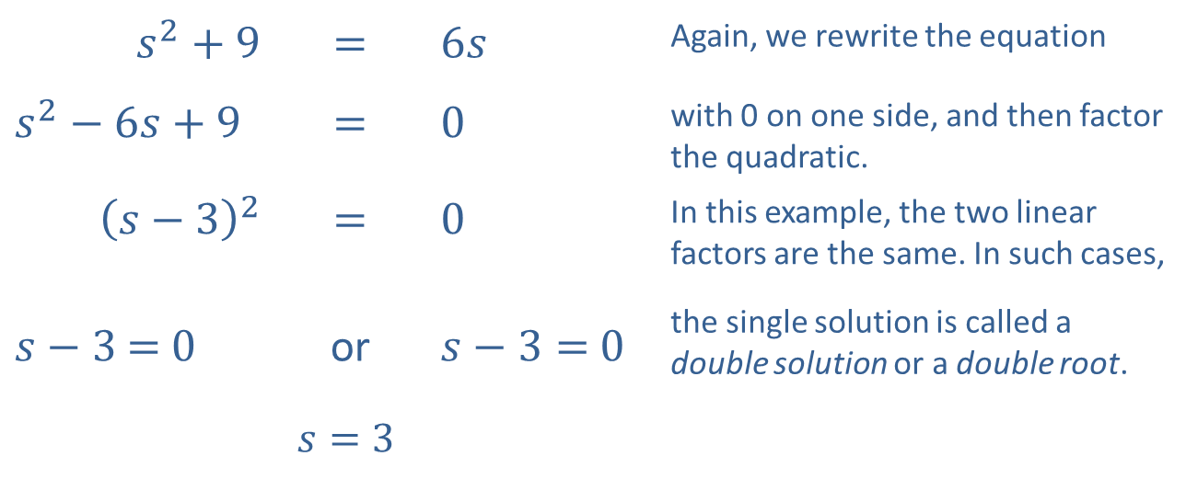
Example 1: Solving Quadratic Equations by Factoring₃
​
​$s^{2}+9$ | ​$=$ | ​$6s$ | Again, we rewrite the equation
​$s^{2}−6s+9$ | ​$=$ | ​$0$ | with 0 on one side, and then factor the quadratic.
​${\left(s−3\right)}^{2}$ | ​$=$ | ​$0$ | In this example, the two linear factors are the same. In such cases,
​$s−3$ $=$​$0$ | or | ​$s−3=$​$0$ | the single solution is called a double solution or a double root.
 | $$s=3$$

Slide 6
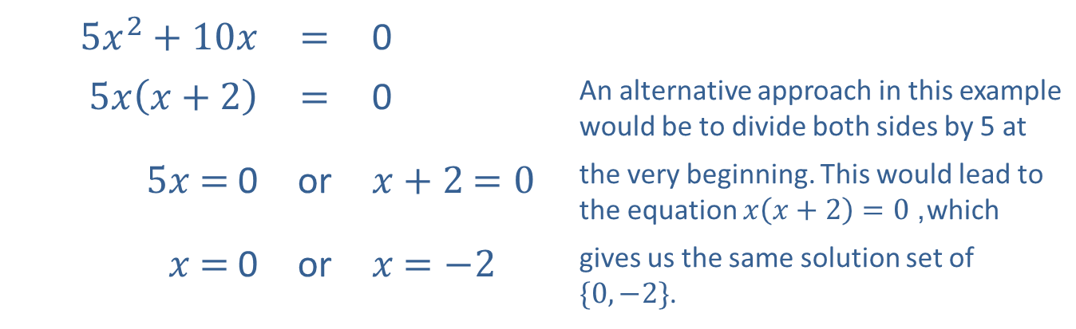
Example 1: Solving Quadratic Equations by Factoring₄
​
​$5x^{2}+10x$ | ​$=$ | ​0
​$5x\left(x+2\right)$ | ​$=$ | ​0 | An alternative approach in this example would be to divide both sides by 5 at
​$5x$ ​$=$​0 | or | ​$x+2$ ​$=0$ | the very beginning. This would lead to the equation $x\left(x+2\right)=0$, which
$x$ ​$=$​0 | or | $x$ ​$=−2$ | gives us the same solution set of $\{0,−2\}$.

Slide 7
Example 2: Perfect Square Quadratic Equations₁
Solve the quadratic equations by taking square roots.

Slide 8
Note:
In the factoring method, we move all terms to one side. Here, we isolate a term that is squared, ideally with only a constant on the other side.

Slide 9
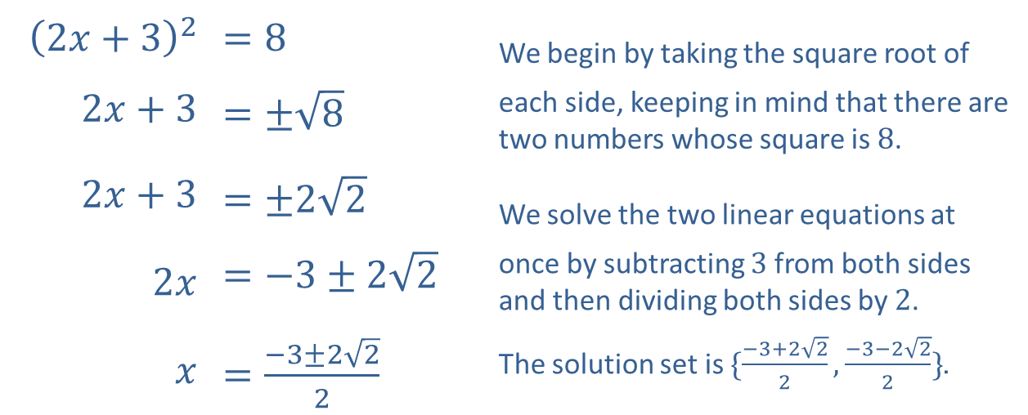
Example 2: Perfect Square Quadratic Equations₂
Solution
​
​${\left(2x+3\right)}^{2}$ | ​$=8$ | We begin by taking the square root of
​$2x+3$ | ​$=±\sqrt{8}$ | each side, keeping in mind that there are two numbers whose square is 8.
​$2x+3$ | ​$=±2\sqrt{2}$ | We solve the two linear equations at
​$2x$ | ​$=−3±2\sqrt{2}$ | once by subtracting 3 from both sides and then dividing both sides by 2.
$x$ | ​$=\frac{−3±2\sqrt{2}}{2}$ | The solution set is $\{\frac{−3+2\sqrt{2}}{2},\frac{−3−2\sqrt{2}}{2}\}$.

Slide 10
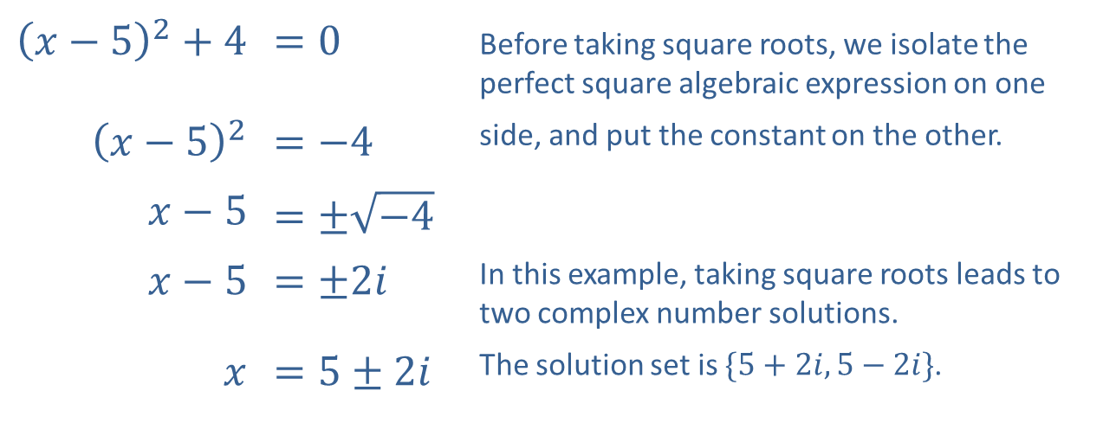
Example 2: Perfect Square Quadratic Equations₃
​
​${\left(x−5\right)}^{2}+4$ | ​$=0$ | Before taking square roots, we isolate the perfect square algebraic expression on one
​${\left(x−5\right)}^{2}$ | ​$=−4$ | side, and put the constant on the other.
​$x−5$ | ​$=±\sqrt{−4}$
​$x−5$ | ​$=±2i$ | In this example, taking square roots leads to two complex number solutions.
$x$ | ​$=5±2i$ | The solution set is $\{5+2i,5−2i\}$.

Slide 11
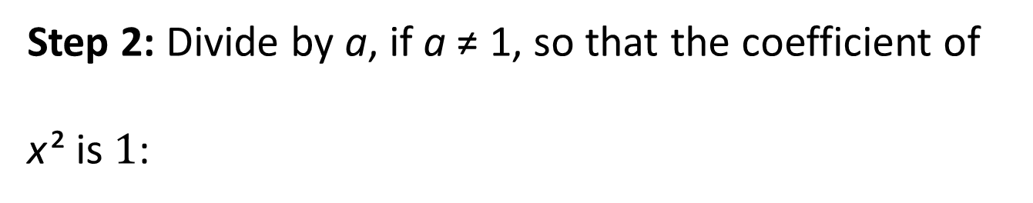
Procedure: Completing the Square₁
Step 1: Write the equation
Step 2: Divide by a, if a ≠ 1, so that the coefficient of
x ² is $1$:

Slide 12

Procedure: Completing the Square₂
Step 3: Divide coefficients of x by $2$, square the result, and add this to both sides:
Step 4: The trinomial on the left side will now be a perfect square trinomial. That is, it an be written as the square of a binomial.

Slide 13
Example 3: Completing the Square₁
Solve the quadratic equations by completing the square.

Slide 14
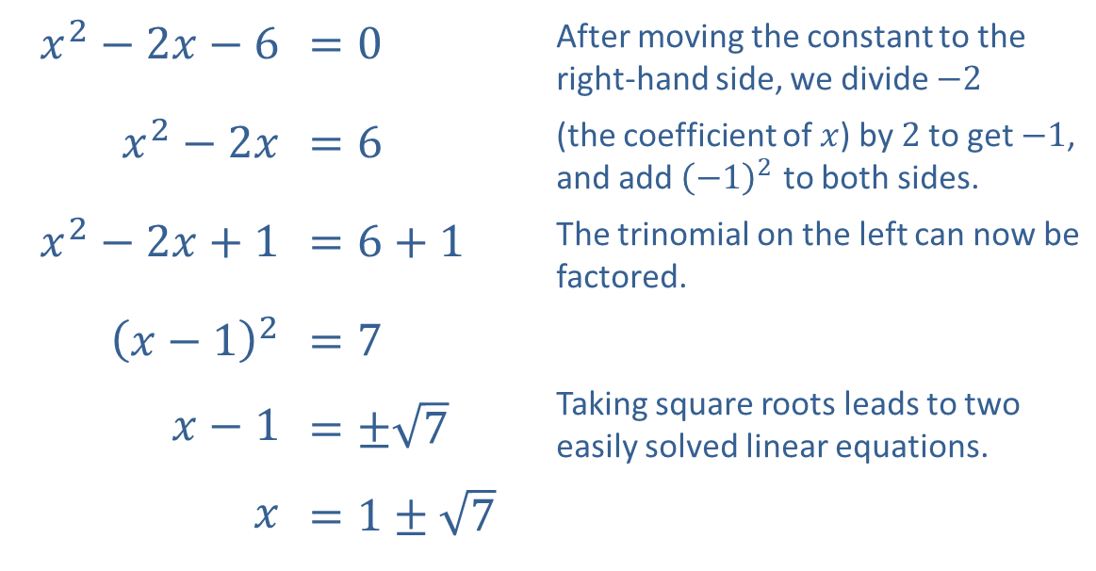
Example 3: Completing the Square₂
Solution
​
​$x^{2}−2x−6$ | ​$=0$ | After moving the constant to the right-hand side, we divide $−2$
​$x^{2}−2x$ | ​$=6$ | (the coefficient of $x$) by 2 to get $−1$, and add ${\left(−1\right)}^{2}$ to both sides.
​$x^{2}−2x+1$ | ​$=6+1$ | The trinomial on the left can now be factored.
​${\left(x−1\right)}^{2}$ | ​$=7$
​$x−1$ | ​$=±\sqrt{7}$ | Taking square roots leads to two easily solved linear equations.
$x$ | ​$=1±\sqrt{7}$

Slide 15
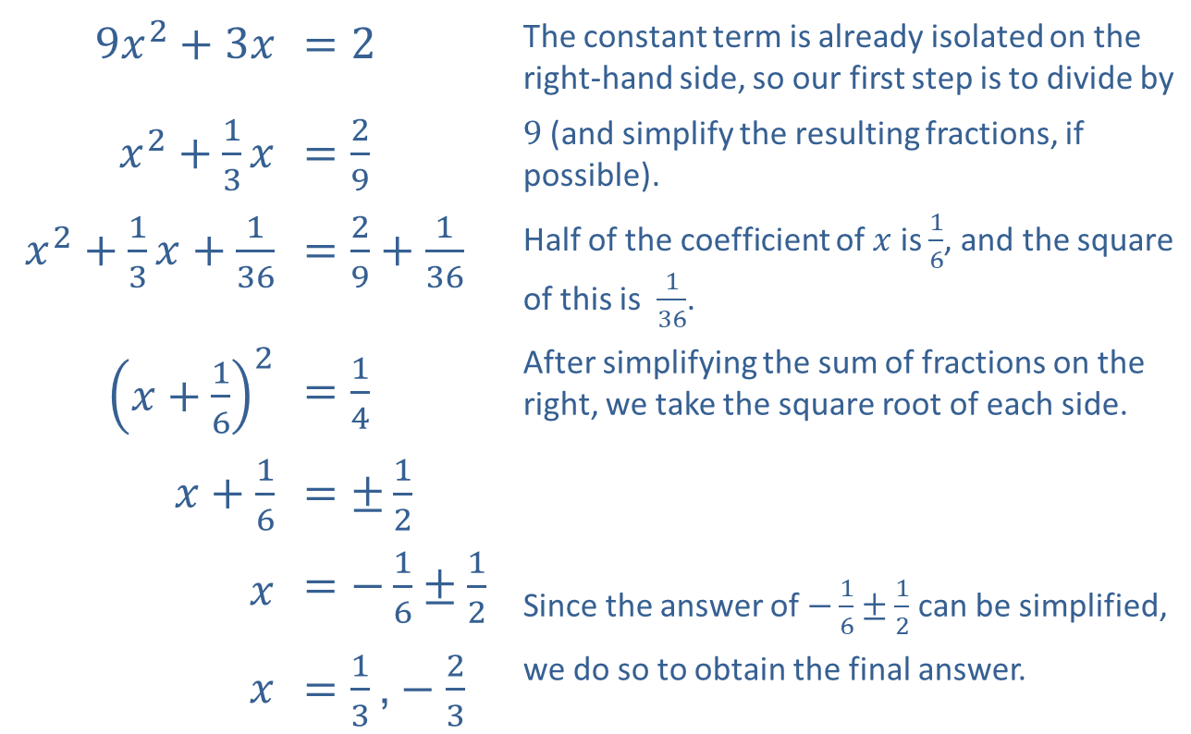
Example 3: Completing the Square₃
​
​$9x^{2}+3x$ | ​$=2$ | The constant term is already isolated on the right-hand side, so our first step is to divide by
​$x^{2}+\frac{1}{3}x$ | ​$=\frac{2}{9}$ | 9 (and simplify the resulting fractions, if possible).
​$x^{2}+\frac{1}{3}x+\frac{1}{36}$ | ​$=\frac{2}{9}+\frac{1}{36}$ | Half of the coefficient of $x$ is $\frac{1}{6}$, and the square of this is $\frac{1}{36}$.
​${\left(x+\frac{1}{6}\right)}^{2}$ | ​$=\frac{1}{4}$ | After simplifying the sum of fractions on the right, we take the square root of each side.
​$x+\frac{1}{6}$ | ​$=±\frac{1}{2}$
$$x$$ | ​$=−\frac{1}{6}±\frac{1}{2}$ | Since the answer of $−\frac{1}{6}±\frac{1}{2}$ can be simplified,
$$x$$ | ​$=\frac{1}{3}\text{,}−\frac{2}{3}$ | we do so to obtain the final answer.

Slide 16

Formula: The Quadratic Formula₁
The solutions of the general quadratic equation
with a ≠ $0$, are given by the
The expression beneath the radical, b ² − 4ac, is called the discriminant. Its value determines the number and type (real or complex) of solutions.

Slide 17
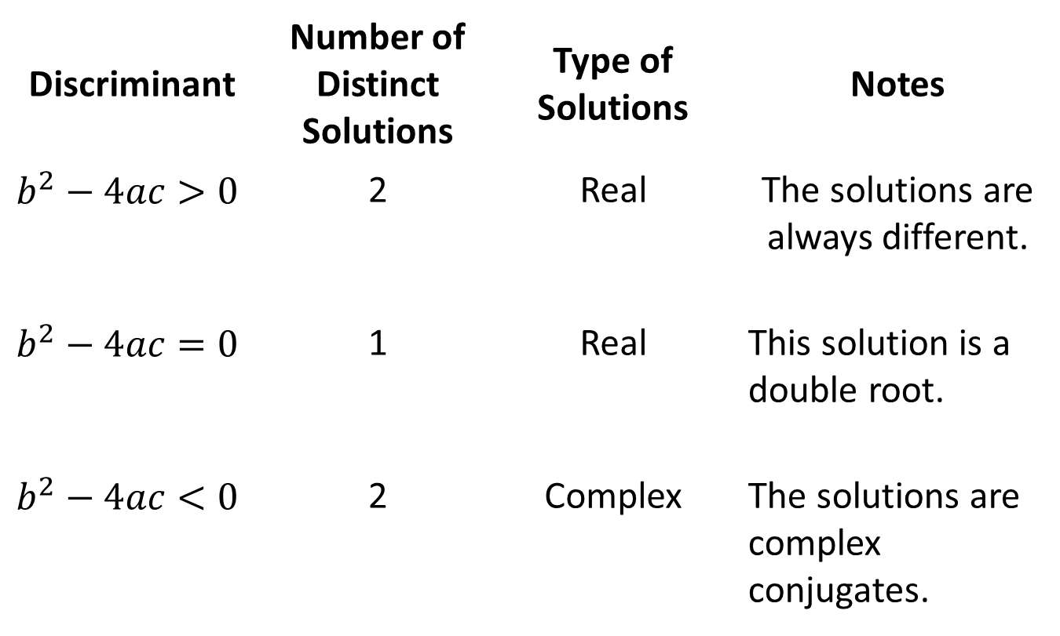
Formula: The Quadratic Formula₂
Discriminant | Number of Distinct Solutions | Type of Solutions | Notes
$$b^{2}−4ac>0$$ | 2 | Real | The solutions are always different.
$$b^{2}−4ac=0$$ | 1 | Real | This solution is a double root.
$$b^{2}−4ac<0$$ | 2 | Complex | The solutions are complex conjugates.

Slide 18
Example 4: Using the Quadratic Formula₁
Solve the quadratic equations by using the quadratic formula.
​

Slide 19
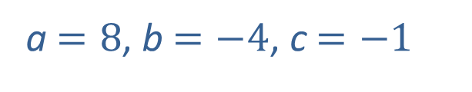
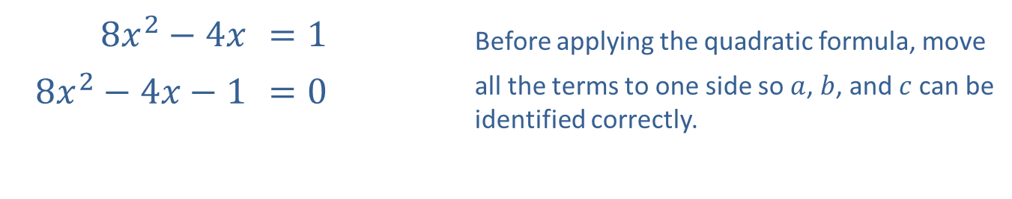
Example 4: Using the Quadratic Formula₂
Solution
​
​$8x^{2}−4x$ | ​$=1$ | Before applying the quadratic formula, move
​$8x^{2}−4x−1$ | ​$=0$ | all the terms to one side so $a$, $b$, and $c$ can be identified correctly.
a $=8$, b$=−4$, c$=−1$

Slide 20
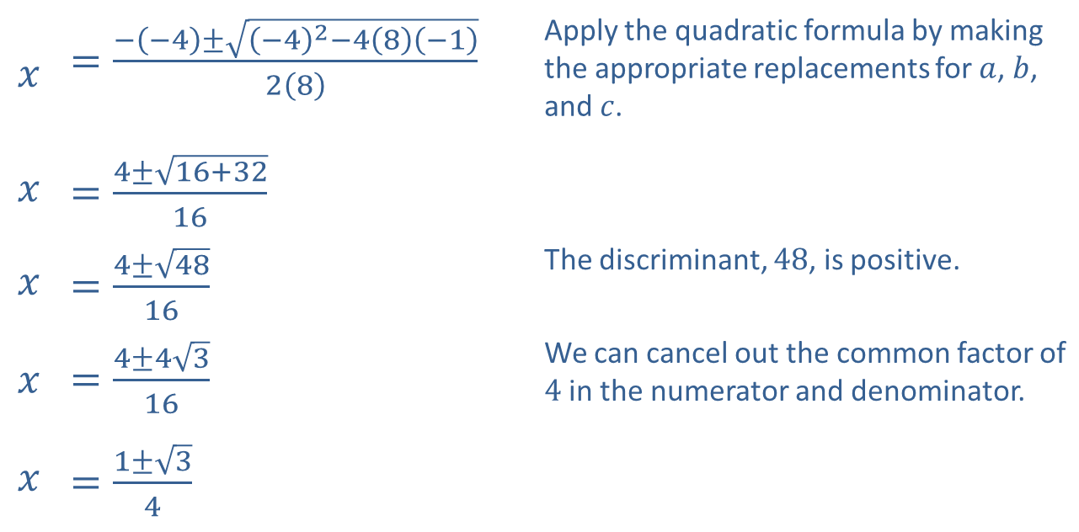
Example 4: Using the Quadratic Formula₃
$$x$$ | ​$=\frac{−\left(−4\right)±\sqrt{{\left(−4\right)}^{2}−4\left(8\right)\left(−1\right)}}{2\left(8\right)}$ | Apply the quadratic formula by making the appropriate replacements for $a$, $b$, and $c$.
$$x$$ | ​$=\frac{4±\sqrt{16+32}}{16}$
$$x$$ | ​$=\frac{4±\sqrt{48}}{16}$ | The discriminant, 48, is positive.
$$x$$ | ​$=\frac{4±4\sqrt{3}}{16}$ | We can cancel out the common factor of 4 in the numerator and denominator.
$$x$$ | ​$=\frac{1±\sqrt{3}}{4}$

Slide 21
Example 4: Using the Quadratic Formula₄
​Thus, the solutions are
​
two unique, real solutions.

Slide 22
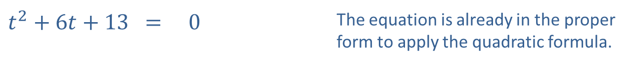
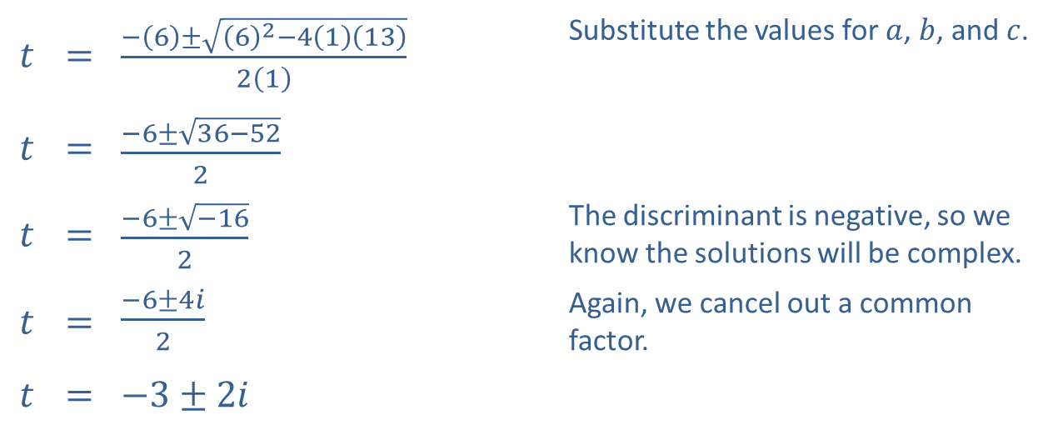
Example 4: Using the Quadratic Formula₅
​
​$t^{2}+6t+13$ | ​= | ​0 | The equation is already in the proper form to apply the quadratic formula.
​a$=1$, b$=6$, c $=13$
$$t$$ | ​= | ​$\frac{−\left(6\right)±\sqrt{{\left(6\right)}^{2}−4\left(1\right)\left(13\right)}}{2\left(1\right)}$ | Substitute the values for $a$, $b$, and $c$.
$$t$$ | ​= | ​$\frac{−6±\sqrt{36−52}}{2}$
$$t$$ | ​= | ​$\frac{−6±\sqrt{−16}}{2}$ | The discriminant is negative, so we know the solutions will be complex.
$$t$$ | ​= | ​$\frac{−6±4i}{2}$ | Again, we cancel out a common factor.
$$t$$ | ​= | ​$−3±2i$

Slide 23
Example 4: Using the Quadratic Formula₆
​Thus, the solutions are t = −3 + 2i and t = −3 − 2i; two complex conjugate solutions.

Slide 24
Example 5: The Discriminant₁
For each of the following quadratic equations, calculate the discriminant and determine the number and type of solutions.
​

Slide 25
Example 5: The Discriminant₂
Solution
We identify the values of a, b, and c, then calculate the discriminant b ² − 4ac.
​
​We substitute, then calculate the discriminant.
Since the discriminant is zero, we know there will be one real solution, also known as double root.

Slide 26
Example 5: The Discriminant₃
This time, the discriminant is positive, so there are two distinct real solutions.

Slide 27
Example 5: The Discriminant₄
The discriminant is negative, so the equation has two complex conjugate solutions.

Slide 28
Example 6: Methods of Solving Quadratic Equations₁
Solve each of the following quadratic equations, identifying the most efficient method of solution.

Slide 29
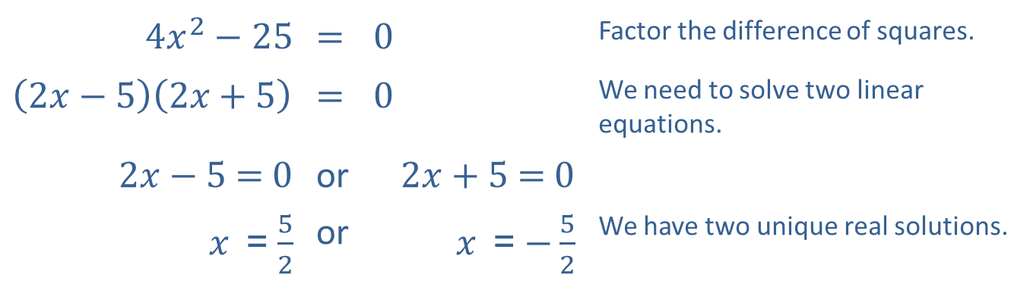
Example 6: Methods of Solving Quadratic Equations₂
Solutions
​The left-hand side is a difference of squares, so factoring is the easiest method.
​
​$4x^{2}−25$ | ​= | ​0 | Factor the difference of squares.
​$\left(2x−5\right)\left(2x+5\right)$ | ​= | ​0 | We need to solve two linear equations.
​$2x−5$​= ​0 | or | ​$2x+5$​= ​0
$x$​ = $\frac{5}{2}$ | or | $x$ ​=$−\frac{5}{2}$ | We have two unique real solutions.

Slide 30
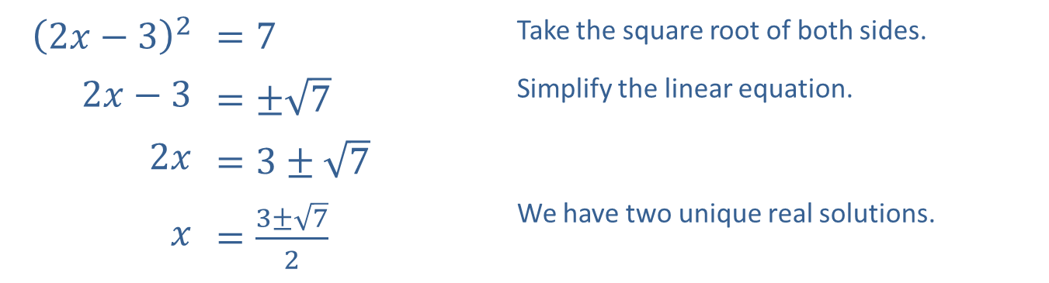
Example 6: Methods of Solving Quadratic Equations₃
​The left-hand side is already a squared quantity, but the right-hand side is not zero, so we want to use the square root method.
​
​${\left(2x−3\right)}^{2}$ | ​$=7$ | Take the square root of both sides.
​$2x−3$ | ​$=±\sqrt{7}$ | Simplify the linear equation.
​$2x$ | ​$=3±\sqrt{7}$
$x$ | ​$=\frac{3±\sqrt{7}}{2}$ | We have two unique real solutions.

Slide 31
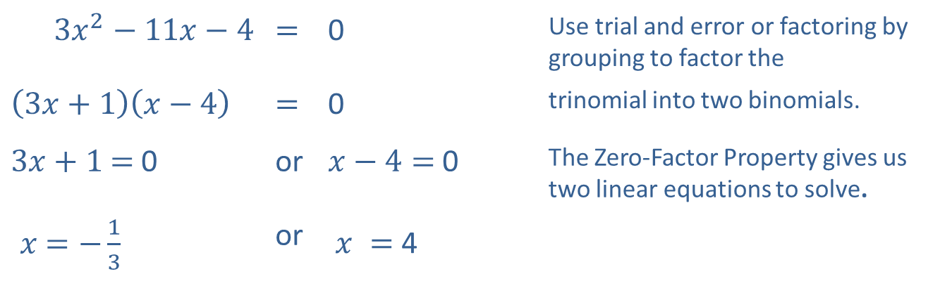
Example 6: Methods of Solving Quadratic Equations₄
​While the quadratic formula certainly works, this quadratic equation is factorable.
​
​$3x^{2}−11x−4$ | ​​$=$ | ​0 | Use trial and error or factoring by grouping to factor the
​$\left(3x+1\right)\left(x−4\right)$ | ​​$=$ | ​0 | trinomial into two binomials.
​$3x+1$​​$=$ 0 | or | ​$x−4=$ 0 | The Zero-Factor Property gives us two linear equations to solve.
$x$​$=−\frac{1}{3}$ | or | $x =$ 4

Slide 32
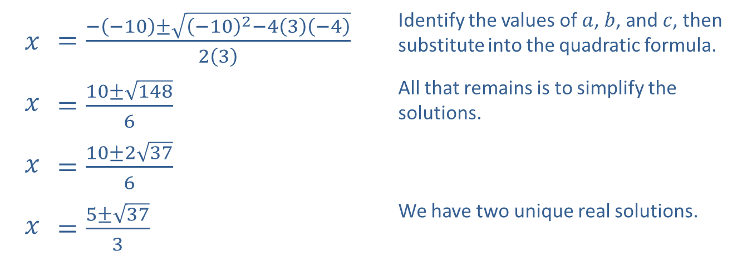
Example 6: Methods of Solving Quadratic Equations₅
​Here, the equation is not factorable, so we use the quadratic formula.
​​
$$x$$ | ​$=\frac{−\left(−10\right)±\sqrt{{\left(−10\right)}^{2}−4\left(3\right)\left(−4\right)}}{2\left(3\right)}$ | Identify the values of $a$, $b$, and $c$, then substitute into the quadratic formula.
$$x$$ | ​$=\frac{10±\sqrt{148}}{6}$ | All that remains is to simplify the solutions.
$$x$$ | ​$=\frac{10±2\sqrt{37}}{6}$
$$x$$ | ​$=\frac{5±\sqrt{37}}{3}$ | We have two unique real solutions.

Slide 33

Example 7: Gravity Problems₁
Robert stands on the topmost tier of seats in a baseball stadium, and throws a ball out onto the field with a vertical upward velocity of $60 ft/s$. The ball is 50 feet above the ground at the moment he releases the ball. When does the ball land?

Slide 34
Example 7: Gravity Problems₂
Solution
First, note that although the thrown ball has a horizontal velocity as well as a vertical velocity (otherwise it would go straight up and come straight back down), the horizontal velocity is irrelevant in such questions. All we are interested in is when the ball lands on the ground (h = 0). If we wanted to determine where in the field the ball lands, we would have to know the horizontal velocity as well.

Slide 35
Example 7: Gravity Problems₃
We are given the following: h₀ = 50 ft and v₀ = 60 ft/s. Since the units in the problem are feet and seconds, we know to use g = 32 ft/s ². What we are interested in determining is the time, t, when the height, h, of the ball is 0. That is, we need to solve the quadratic equation

Slide 36
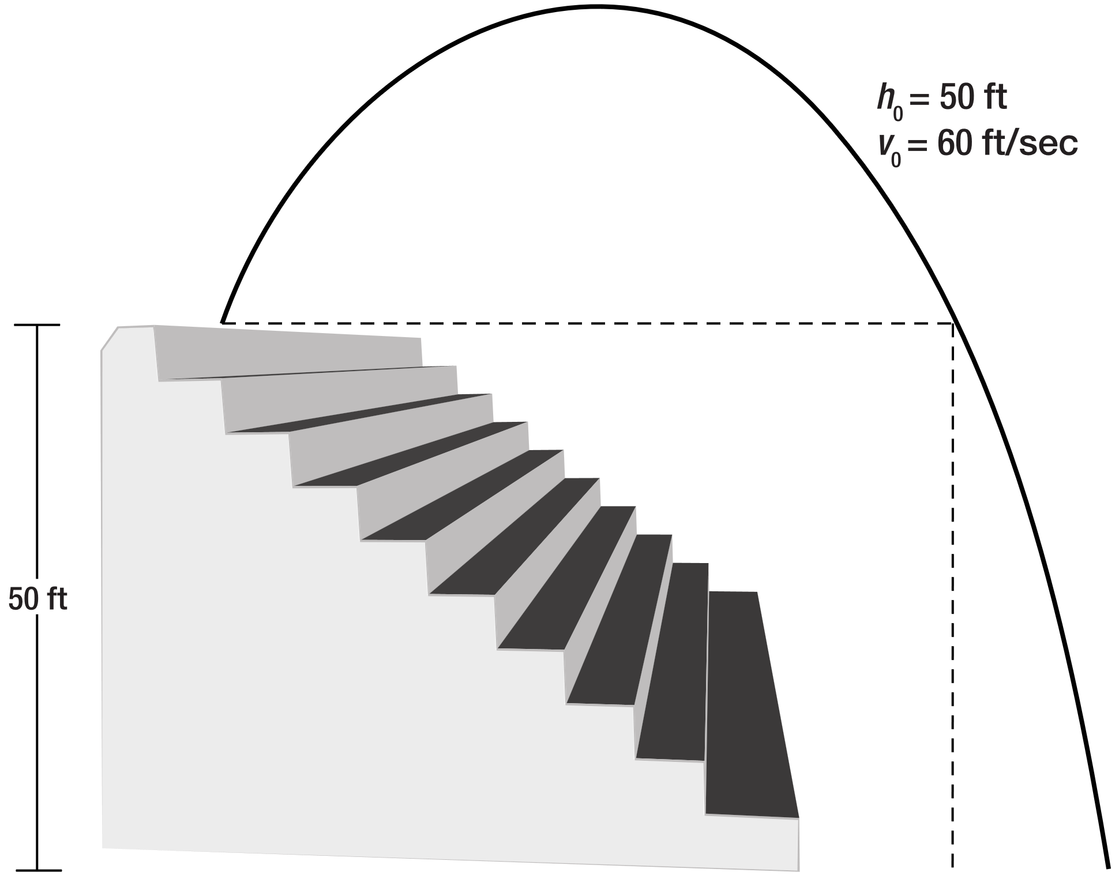
Example 7: Gravity Problems₄
Figure 1

Slide 37

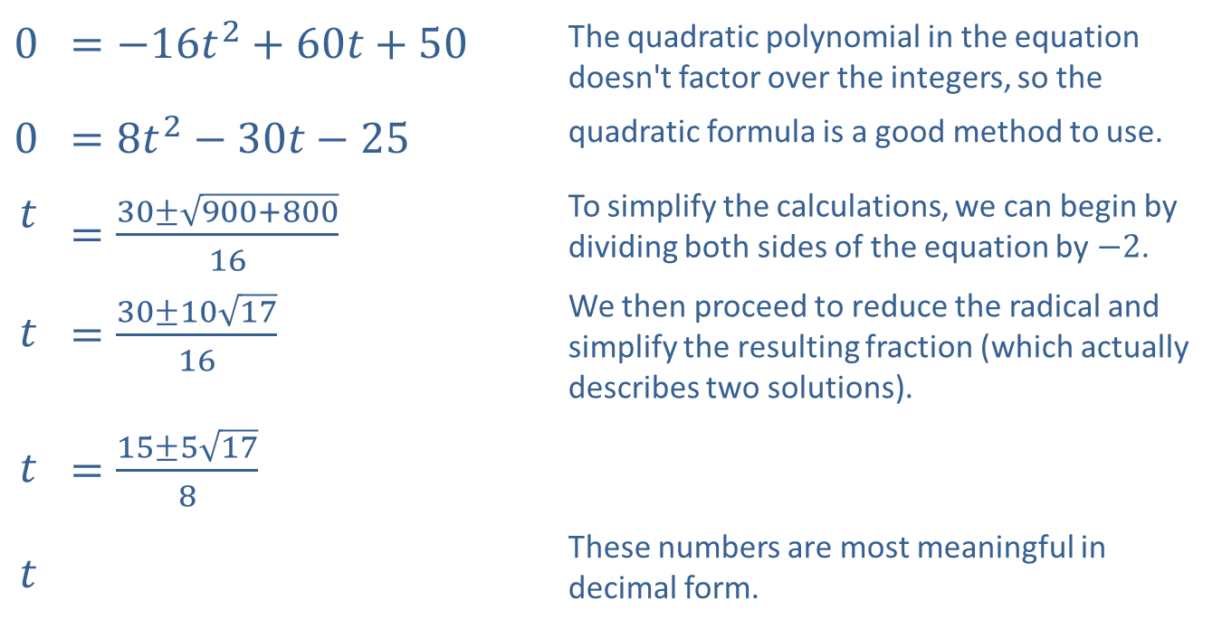
Example 7: Gravity Problems₅
​0 | ​$=−16t^{2}+60t+50$ | The quadratic polynomial in the equation doesn't factor over the integers, so the
​0 | ​$=8t^{2}−30t−25$ | quadratic formula is a good method to use.
$$t$$ | ​$=\frac{30±\sqrt{900+800}}{16}$ | To simplify the calculations, we can begin by dividing both sides of the equation by $−2$.
$$t$$ | ​$=\frac{30±10\sqrt{17}}{16}$ | We then proceed to reduce the radical and simplify the resulting fraction (which actually describes two solutions).
$$t$$ | ​$=\frac{15±5\sqrt{17}}{8}$
$$t$$ |  | These numbers are most meaningful in decimal form.
$$≈−0.70,4.45$$

Slide 38
Example 7: Gravity Problems₆
The negative solution is immaterial in this problem, as this represents a time before the ball is thrown, so it is discarded. The ball lands 4.45 seconds after being thrown.

