Slide 1
Section 1.8
Complex Numbers

Slide 2
Definition: The Imaginary Unit i
The imaginary unit i is defined as
In other words, i has the property that its square is −1:

Slide 3
Definition: Square Roots of Negative Numbers
If a is a positive real number, √−a = i √a. Note that by this definition, and by a logical extension of exponentiation,

Slide 4
Example 1: The Number i₁
​
write a constant such as 4 before letters in algebraic expressions, even if, as in this case, the letter is not a variable. Remember that i has a fixed meaning: i is the square root of −1.
b.
again, we write the radical factor last. You should

Slide 5
Example 1: The Number i₂
​i ³ = i ² i = (−1)(i) = − i, and
i ² = −1 allows us, by our extension of
number n.
d. (− i ) ² = (− 1 ) ² i ² = i ² = −1. This shows that − i
also has the property that its square is −1.

Slide 6
Example 2: Powers of i₁
Compute the following powers of i.

Slide 7
Example 2: Powers of i₂
Solution
​When we divide 9 by 4, we have a remainder of 1. This means this power of i takes the form
b. When we divide 28 by 4, the remainder is 0. This means this
c. When we divide 102 by 4, the remainder is 2. This means

Slide 8
Definition: Complex Numbers
For any two real numbers a and b, the sum
complex number. The collection
is called the set of complex numbers and is another example of a field. The number a is called the real part
part. If the imaginary part of a given complex number is 0, the number is simply a real number. If the real part of a given complex number is 0, the number is a pure imaginary number.

Slide 9
Procedure: Simplifying Complex Expression
Step 1: Add, subtract or multiply the complex numbers, as required, by treating every complex number a + b i as a polynomial expression. Remember, though, that i is not actually a variable. Treating a + b i as a binomial in i is just a handy device.
Step 2: Complete the simplification by using the fact that i ² = −1.

Slide 10
Example 3: Simplifying Complex Expressions₁
Simplify the following complex expressions.

Slide 11
Note₁
Remember that a complex number is not simplified until it has the form

Slide 12
Example 3: Simplifying Complex Expressions₂
Solution
​As if adding polynomials, we combine the real parts, then the imaginary parts.

Slide 13
Example 3: Simplifying Complex Expressions₃
Begin by distributing the minus sign over the second complex number.

Slide 14
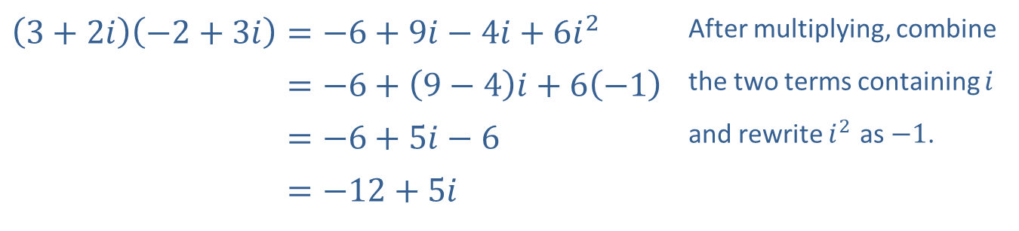
Example 3: Simplifying Complex Expressions₄
​
​$\left(3+2i\right)\left(−2+3i\right)=−6+9i−4i+6i^{2}$ | After multiplying, combine
​3+2𝑖−2+3𝑖=−6+9−4𝑖+6−1 | the two terms containing $i$
​3+2𝑖−2+3𝑖=−6+5𝑖−6 | and rewrite $i^{2}$ as $−1$.
​3+2𝑖−2+3𝑖=−12+5𝑖

Slide 15
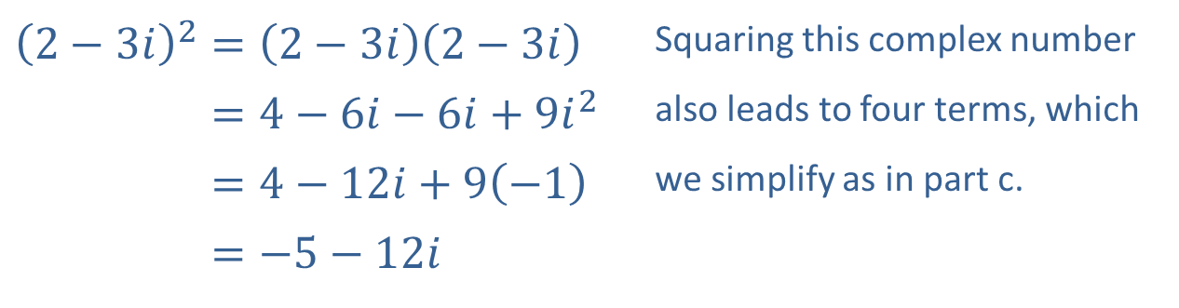
Example 3: Simplifying Complex Expressions₅
​
​${\left(2−3i\right)}^{2}=\left(2−3i\right)\left(2−3i\right)$ | Squaring this complex number
​2−3𝑖2=4−6𝑖−6𝑖+9𝑖2 | also leads to four terms, which
​2−3𝑖2=4−12𝑖+9−1 | we simplify as in part c.
​2−3𝑖2=−5−12𝑖

Slide 16
Definition: Complex Conjugates
Given any complex number a + b i, the complex number a − b i is called its complex conjugate.

Slide 17
Example 4: Dividing Complex Numbers₁
Simplify the following expressions.

Slide 18
Note₂
Always begin by finding the complex conjugate of the denominator, then multiply the numerator and denominator by this conjugate.

Slide 19
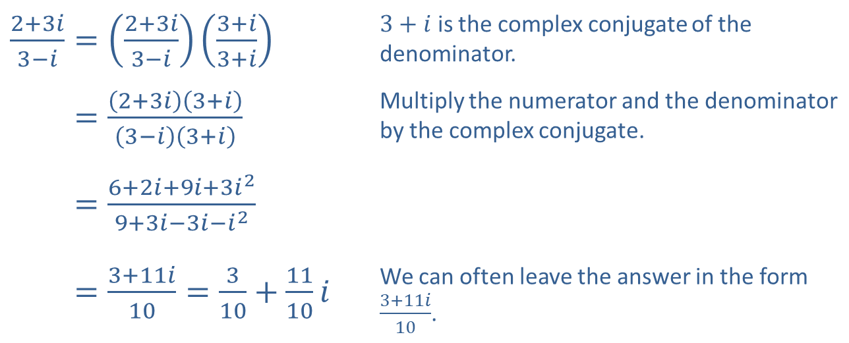
Example 4: Dividing Complex Numbers₂
Solution
​
​$\frac{2+3i}{3−i}=\left(\frac{2+3i}{3−i}\right)\left(\frac{3+i}{3+i}\right)$ | $3+i$ is the complex conjugate of the denominator.
​2+3𝑖3−𝑖=2+3𝑖3+𝑖3−𝑖3+𝑖 | Multiply the numerator and the denominator by the complex conjugate.
​2+3𝑖3−𝑖=6+2𝑖+9𝑖+3𝑖29+3𝑖−3𝑖−𝑖2
​2+3𝑖3−𝑖=3+11𝑖10=310+1110𝑖 | We can often leave the answer in the form $\frac{3+11i}{10}$.

Slide 20
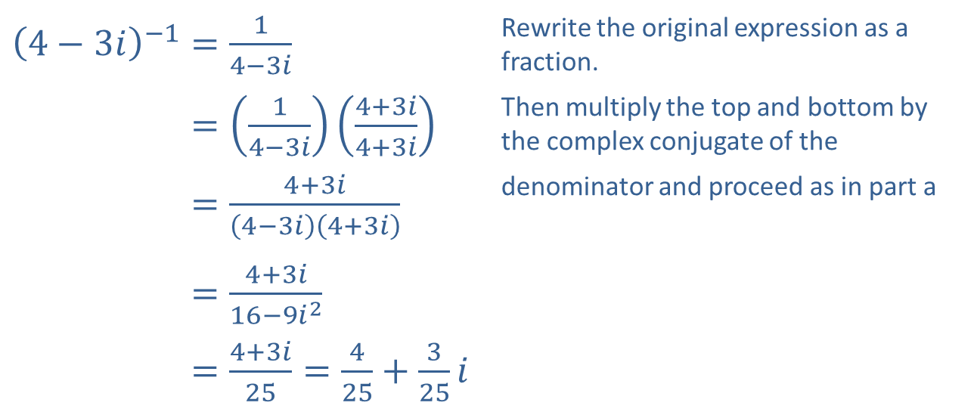
Example 4: Dividing Complex Numbers₃
​${\left(4−3i\right)}^{−1}=\frac{1}{4−3i}$ | Rewrite the original expression as a fraction.
​4−3𝑖−1=14−3𝑖4+3𝑖4+3𝑖 | Then multiply the top and bottom by the complex conjugate of the
​4−3𝑖−1=4+3𝑖4−3𝑖4+3𝑖 | denominator and proceed as in part a
​4−3𝑖−1=4+3𝑖16−9𝑖2
​4−3𝑖−1=4+3𝑖25=425+325𝑖
​

Slide 21
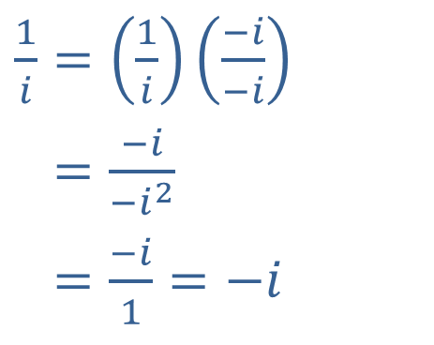
Example 4: Dividing Complex Numbers₄
​$\frac{1}{i}=\left(\frac{1}{i}\right)\left(\frac{−i}{−i}\right)$
​1𝑖=−𝑖−𝑖2
​1𝑖=−𝑖1=−𝑖
​
Here we write the reciprocal of the imaginary unit as a complex number. With this as a starting point, we could now calculate

Slide 22
CAUTION!
In simplifying radical expressions, we have made frequent use of the
properties that if √a and √b are real numbers, then
There is a subtle but important condition in the above statement:√a and √b must both be real numbers. If this condition is not met, these properties of radicals do not necessarily hold. For instance,
In order to apply either of these two properties, then, first simplify any square roots of negative numbers by rewriting them as pure imaginary numbers.

Slide 23
Example 5: Roots and Complex Numbers₁
Simplify the following expressions.

Slide 24
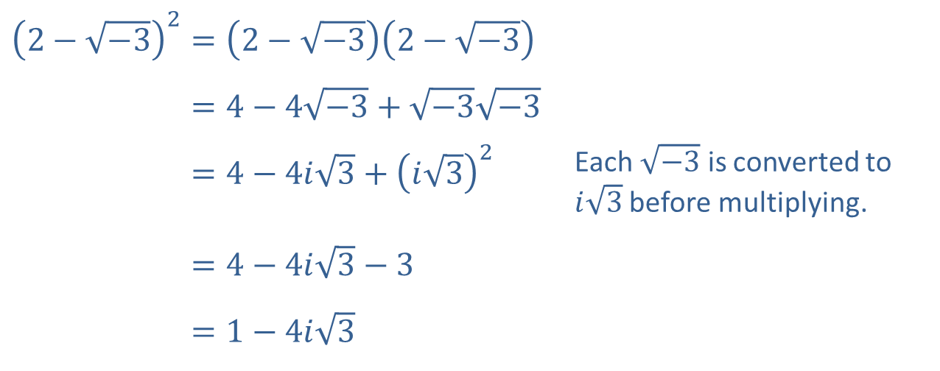
Example 5: Roots and Complex Numbers₂
Solution
​
​${\left(2−\sqrt{−3}\right)}^{2}=\left(2−\sqrt{−3}\right)\left(2−\sqrt{−3}\right)$
​2−−32=4−4−3+−3−3
​2−−32=4−4𝑖3+𝑖32 | Each $\sqrt{−3}$ is converted to $i\sqrt{3}$ before multiplying.
​2−−32=4−4𝑖3−3
​2−−32=1−4𝑖3

Slide 25
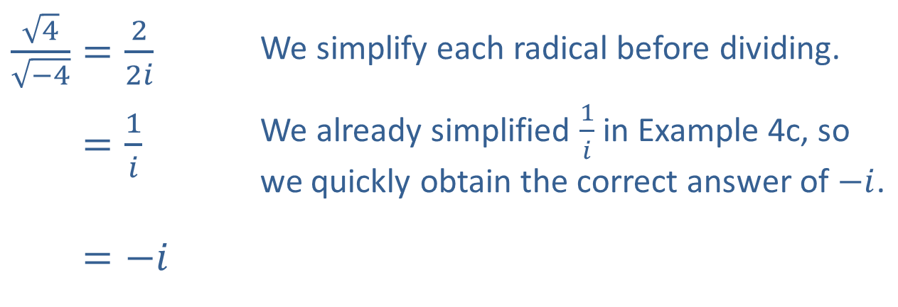
Example 5: Roots and Complex Numbers₃
​$\frac{\sqrt{4}}{\sqrt{−4}}=\frac{2}{2i}$ | We simplify each radical before dividing.
​4−4=1𝑖 | We already simplified $\frac{1}{i}$ in Example 4c, so we quickly obtain the correct answer of $−i$.
​4−4=−𝑖
​

