Slide 1
Section 9.5
Inverses of Matrices

Slide 2
Example 1: Matrix Equation₁
Write each linear system as a matrix equation.

Slide 3
Example 1: Matrix Equation₂
Solution
​Since the system is in standard form, we can just read off the coefficients of x and y to form the equation

Slide 4
Example 1: Matrix Equation₃
​First, we write each equation in standard form.
​
​
Now we can read off the coefficients to form the matrix equation

Slide 5

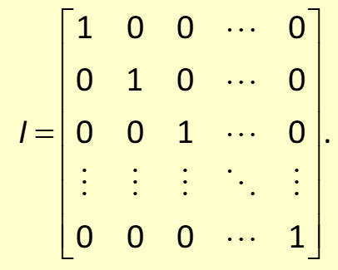
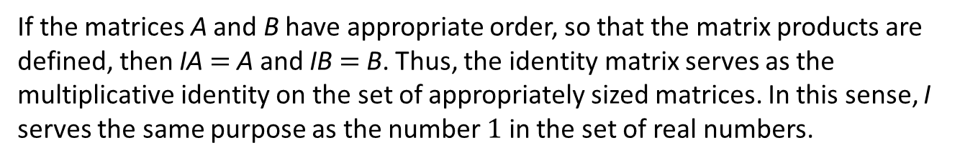
Definition: Identity Matrices
The
identity matrix, denoted Iₙ (just I when there is no possibility of
confusion), is the
matrix consisting of 1s on the main diagonal and 0s
everywhere else. The main diagonal consists of those entries in the first row-first column, the second row-second column, and so on down to the n^{th} row-n^{th} column. Every identity matrix has the form
If the matrices A and B have appropriate order, so that the matrix products are defined, then IA$=$A and IB$=$B. Thus, the identity matrix serves as the multiplicative identity on the set of appropriately sized matrices. In this sense, I serves the same purpose as the number 1 in the set of real numbers.

Slide 6
Definition: The Inverse of a Matrix
matrix
Let A be an
matrix. If there exists an
the inverse of A.

Slide 7
Example 2: Finding the Inverse of a Matrix₁
Find the inverse of the matrix

Slide 8
Example 2: Finding the Inverse of a Matrix₂
Solution
If we let
we can use the equation
Multiplying the left-hand side out, we see that we need to solve the equation

Slide 9
Example 2: Finding the Inverse of a Matrix₃
which, if we equate columns on each side, means we need to solve the two linear systems

Slide 10
Example 2: Finding the Inverse of a Matrix₄
We have covered many methods for solving such systems. If we write the augmented matrix for each system, we get
Note that the left-hand sides of these matrices are the same. This allows us to combine them into a new kind of augmented matrix so we can use Gauss-Jordan elimination to solve the systems at the same time. Combining the matrices, we get

Slide 11
Example 2: Finding the Inverse of a Matrix₅
When we change this new matrix into reduced row echelon form, we will have solved the first system with the numbers in the third column and the second system with the numbers in the fourth column.

Slide 12
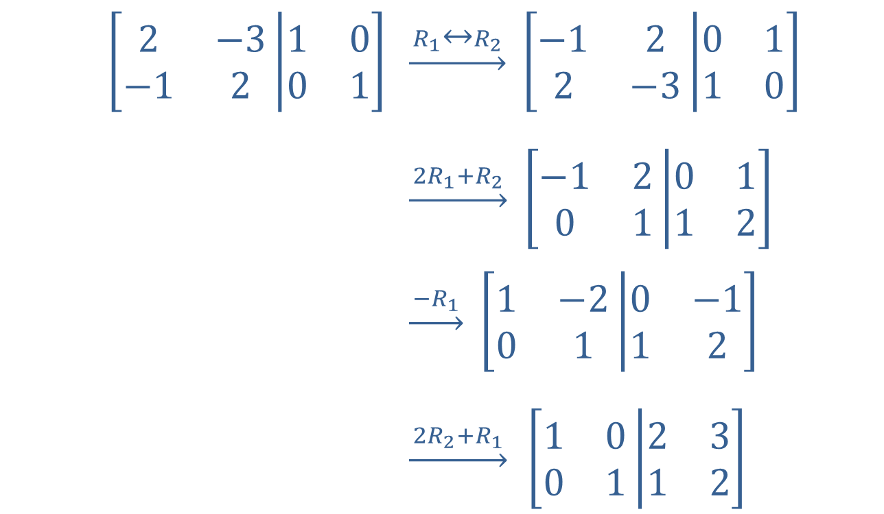
Example 2: Finding the Inverse of a Matrix₆
$$\left[\begin{matrix}2 & −3 \\ −1 & 2\end{matrix}\left|\begin{matrix}1 & 0 \\ 0 & 1\end{matrix}\right.\right]$$ | $\underset{→}{{ R}_{1}↔R_{2 }}$ $\left[\begin{matrix}−1 & 2 \\ 2 & −3\end{matrix}\left|\begin{matrix}0 & 1 \\ 1 & 0\end{matrix}\right.\right]$
 | $\underset{→}{ 2R_{1}+R_{2 }}$ $\left[\begin{matrix}−1 & 2 \\ 0 & 1\end{matrix}\left|\begin{matrix}0 & 1 \\ 1 & 2\end{matrix}\right.\right]$
 | $\underset{→}{ −R_{1 }}$ $\left[\begin{matrix}1 & −2 \\ 0 & 1\end{matrix}\left|\begin{matrix}0 & −1 \\ 1 & 2\end{matrix}\right.\right]$
 | $\underset{→}{ 2R_{2}+R_{1 }}$ $\left[\begin{matrix}1 & 0 \\ 0 & 1\end{matrix}\left|\begin{matrix}2 & 3 \\ 1 & 2\end{matrix}\right.\right]$

Slide 13
Example 2: Finding the Inverse of a Matrix₇
This tells us that w = 2 and y = 1 (from the third column) and x = 3 and z = 2 (from the fourth column). So

Slide 14
Example 2: Finding the Inverse of a Matrix₈
We can now verify that
so we have indeed found

Slide 15
Procedure: Finding the Inverse of a Matrix
matrix. The inverse of A can be found by
Let A be an
Step 1: | Forming the augmented matrix [A|I], where I is the n × n identity matrix.
Step 2: | Using Gauss-Jordan elimination to put [A|I] into the form [I|B], if possible.
Step 3:
If it is not possible to put
into reduced row echelon form, then A
doesn't have an inverse, and we say A is not invertible.
If the coefficient matrix of a system of equations is not invertible, it means that the system either has an infinite number of solutions or has no solution.

Slide 16
Formula: Inverse of a
Let
Then
Where
is the determinant of A.
appears in the denominator of a fraction,

Slide 17
Theorem: Invertible Matrices
A square matrix A is invertible if and only if

Slide 18
Example 3: Finding the Inverse of a Matrix₁
Find the inverses of the following matrices, if possible.

Slide 19
Example 3: Finding the Inverse of a Matrix₂
Solution
​Since A is
​
we can use the shortcut,
​We can verify our work as follows:

Slide 20
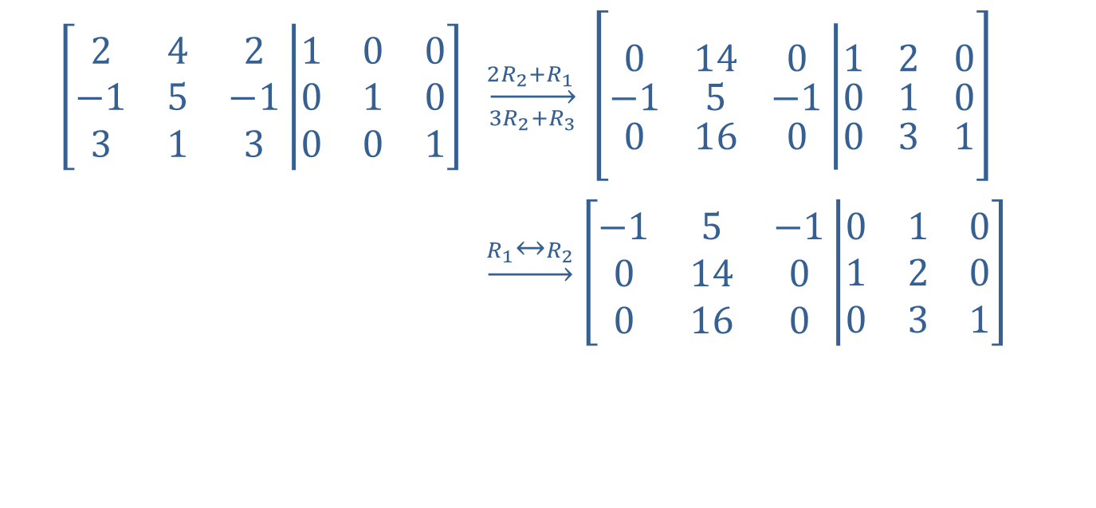
Example 3: Finding the Inverse of a Matrix₃
matrix, we use the augmented
​Since B is a
identity matrix process.
$$\left[\begin{matrix}2 & 4 & 2 \\ −1 & 5 & −1 \\ 3 & 1 & 3\end{matrix}\left|\begin{matrix}1 & 0 & 0 \\ 0 & 1 & 0 \\ 0 & 0 & 1\end{matrix}\right.\right]$$ | $$\overset{2R_{2}+R_{1 }}{\overset{→}{3R_{2}+R_{3}}} \left[\begin{matrix}0 & 14 & 0 \\ −1 & 5 & −1 \\ 0 & 16 & 0\end{matrix}\left|\begin{matrix}1 & 2 & 0 \\ 0 & 1 & 0 \\ 0 & 3 & 1\end{matrix}\right.\right]$$
 | $\underset{→}{R_{1}↔R_{2}}$ $\left[\begin{matrix}−1 & 5 & −1 \\ 0 & 14 & 0 \\ 0 & 16 & 0\end{matrix}\left|\begin{matrix}0 & 1 & 0 \\ 1 & 2 & 0 \\ 0 & 3 & 1\end{matrix}\right.\right]$

Slide 21
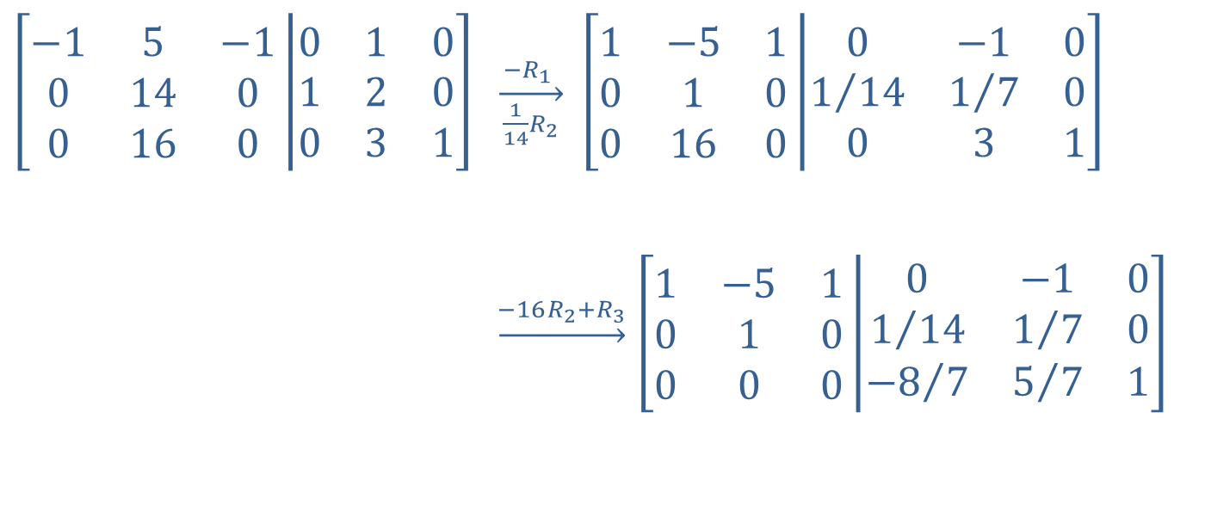
Example 3: Finding the Inverse of a Matrix₄
$$\left[\begin{matrix}−1 & 5 & −1 \\ 0 & 14 & 0 \\ 0 & 16 & 0\end{matrix}\left|\begin{matrix}0 & 1 & 0 \\ 1 & 2 & 0 \\ 0 & 3 & 1\end{matrix}\right.\right]$$ | $\overset{−R_{1} }{\overset{→}{ \frac{1}{14}R_{2} }}$ $\left[\begin{matrix}1 & −5 & 1 \\ 0 & 1 & 0 \\ 0 & 16 & 0\end{matrix}\left|\begin{matrix}0 & −1 & 0 \\ 1/{14} & 1/7 & 0 \\ 0 & 3 & 1\end{matrix}\right.\right]$
 | $\underset{→}{−16R_{2}+R_{3}}$ $\left[\begin{matrix}1 & −5 & 1 \\ 0 & 1 & 0 \\ 0 & 0 & 0\end{matrix}\left|\begin{matrix}0 & −1 & 0 \\ 1/{14} & 1/7 & 0 \\ {−8}/7 & 5/7 & 1\end{matrix}\right.\right]$

Slide 22
Example 3: Finding the Inverse of a Matrix₅
At this point, we can stop. Once the first three entries of any row are 0 in the
​
matrix, there is no way to
put the matrix into reduced row echelon form. Thus, B has no inverse.

Slide 23
Example 3: Finding the Inverse of a Matrix₆
​We could have seen this fact earlier by considering the determinant of B, which is 0, meaning B has no inverse.
identical columns. Recall that switching two columns changes the sign of the determinant, but if we switch identical columns, the determinant must remain the same! The only way this is possible is if

Slide 24
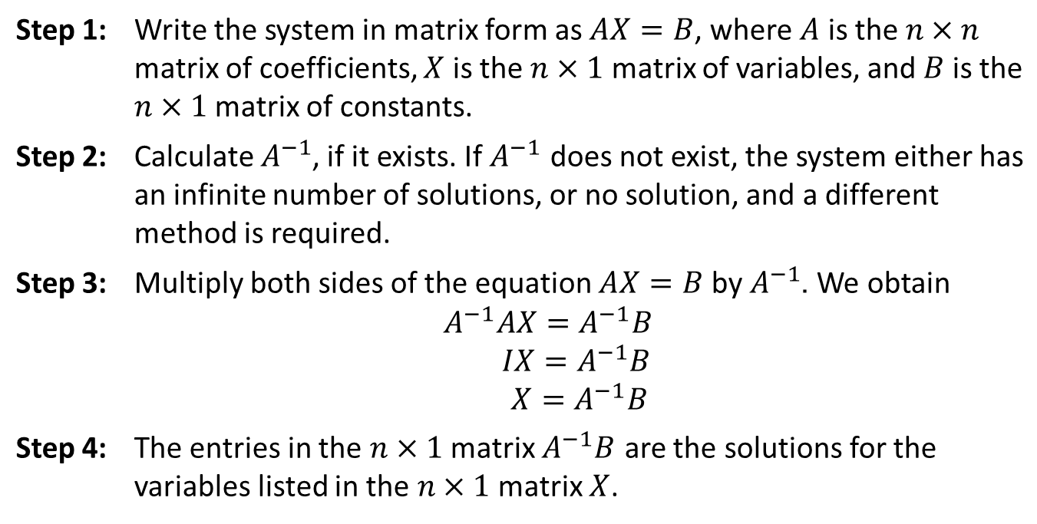
Procedure: The Inverse Matrix Method
To solve a linear system of n equations in n variables

Slide 25
CAUTION!
It is crucial to multiply both sides of the equation
on the left-hand side. Recall that matrix
multiplication is not commutative, so failing to do this can result in an incorrect answer, and often the multiplication will not even be defined.

Slide 26
Example 4: Inverse Matrix Method₁
Solve the following systems by the inverse matrix method.

Slide 27
Example 4: Inverse Matrix Method₂
Solution
​
Write the system in matrix form.

Slide 28
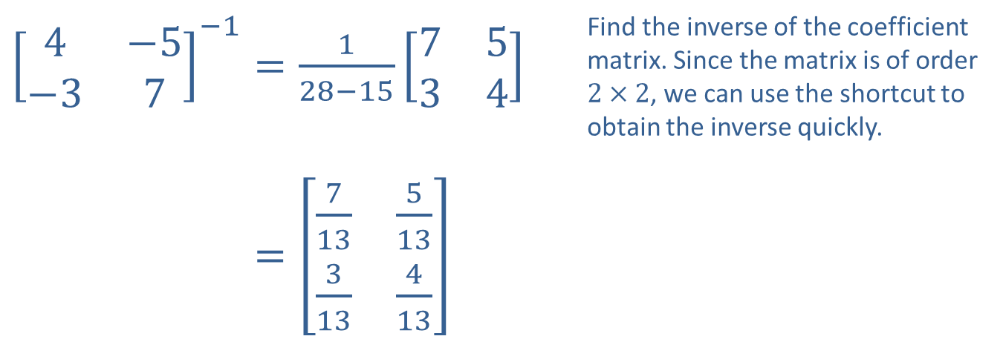
Example 4: Inverse Matrix Method₃
​${\left[\begin{matrix}4 & −5 \\ −3 & 7\end{matrix}\right]}^{−1}=\frac{1}{28−15}\left[\begin{matrix}7 & 5 \\ 3 & 4\end{matrix}\right]$ | Find the inverse of the coefficient matrix. Since the matrix is of order $2×2$, we can use the shortcut to obtain the inverse quickly.
​4−5−37−1=713513313413

Slide 29
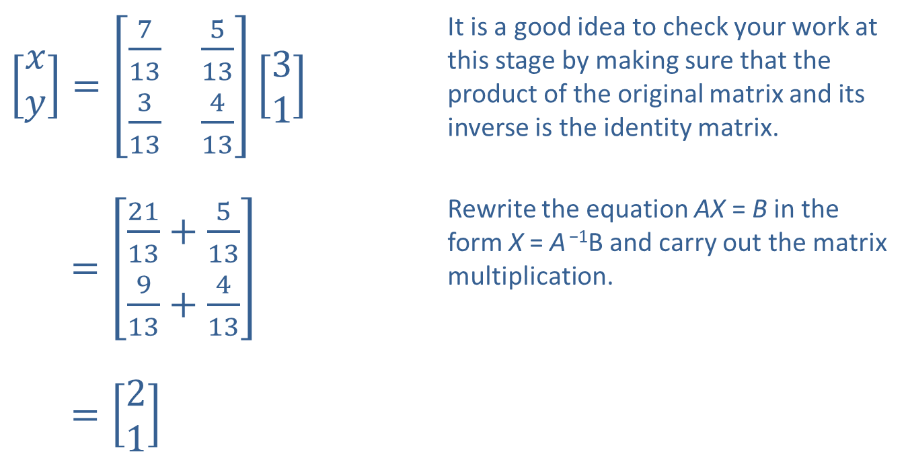
Example 4: Inverse Matrix Method₄
​$\left[\begin{aligned}x \\ y\end{aligned}\right]=\left[\begin{matrix}\frac{7}{13} & \frac{5}{13} \\ \frac{3}{13} & \frac{4}{13}\end{matrix}\right]\left[\begin{aligned}3 \\ 1\end{aligned}\right]$ | It is a good idea to check your work at this stage by making sure that the product of the original matrix and its inverse is the identity matrix.
​[𝑥𝑦]=2113+513913+413 | Rewrite the equation AX = B in the form X = A ⁻¹B and carry out the matrix multiplication.
​[𝑥𝑦]=21

Slide 30
Example 4: Inverse Matrix Method₅
​Thus, the solution to the system is (2, 1).

Slide 31
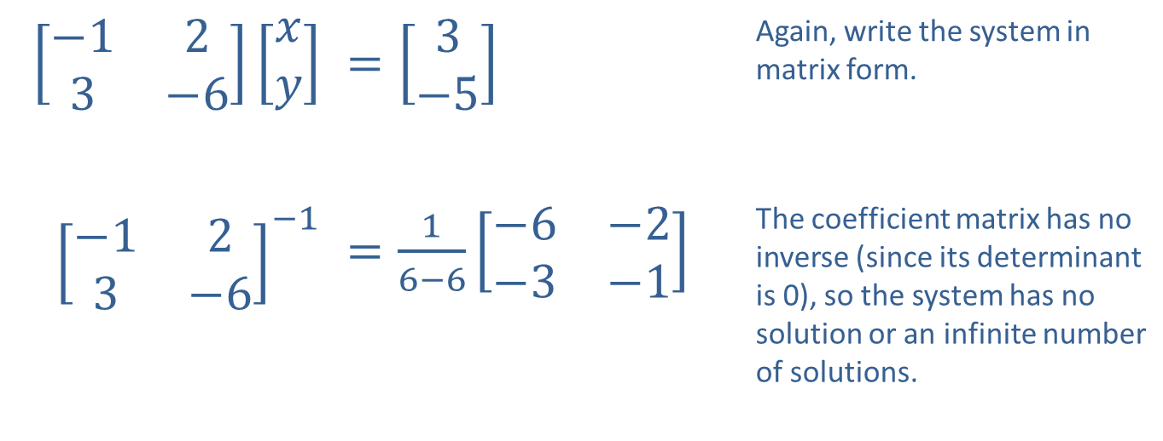
Example 4: Inverse Matrix Method₆
​$\left[\begin{matrix}−1 & 2 \\ 3 & −6\end{matrix}\right]\left[\begin{aligned}x \\ y\end{aligned}\right]$ | ​$=\left[\begin{aligned}3 \\ −5\end{aligned}\right]$ | Again, write the system in matrix form.
​${\left[\begin{matrix}−1 & 2 \\ 3 & −6\end{matrix}\right]}^{−1}$ | ​$=\frac{1}{6−6}\left[\begin{matrix}−6 & −2 \\ −3 & −1\end{matrix}\right]$ | The coefficient matrix has no inverse (since its determinant is 0), so the system has no solution or an infinite number of solutions.

Slide 32
Example 4: Inverse Matrix Method₇
Cramer's Rule tells us the system has no
solution. Thus, this system has no solution.

Slide 33
Example 5: Using the Inverse Matrix Method₁
Solve the following three linear systems.

Slide 34
Example 5: Using the Inverse Matrix Method₂
Solution
The coefficient matrix is the same for the three systems, and this means we can avoid unnecessary computation if we use the inverse matrix method. We begin by finding the inverse of the coefficient matrix.

Slide 35
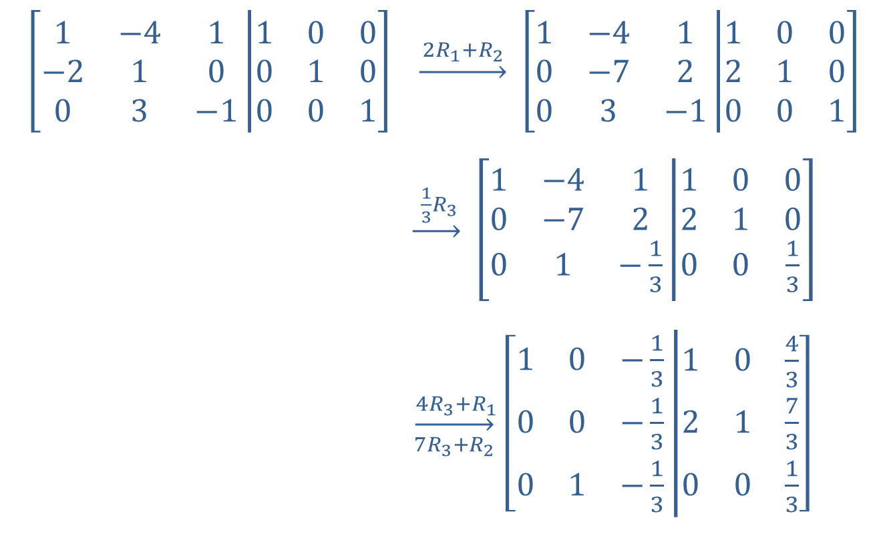
Example 5: Using the Inverse Matrix Method₃
$$\left[\begin{matrix}1 & −4 & 1 \\ −2 & 1 & 0 \\ 0 & 3 & −1\end{matrix}\left|\begin{matrix}1 & 0 & 0 \\ 0 & 1 & 0 \\ 0 & 0 & 1\end{matrix}\right.\right]$$ | $\underset{→}{ 2R_{1}+R_{2 }}$ $\left[\begin{matrix}1 & −4 & 1 \\ 0 & −7 & 2 \\ 0 & 3 & −1\end{matrix}\left|\begin{matrix}1 & 0 & 0 \\ 2 & 1 & 0 \\ 0 & 0 & 1\end{matrix}\right.\right]$
 | $\underset{→}{ \frac{1}{3}R_{3 }}$ $\left[\begin{matrix}1 & −4 & 1 \\ 0 & −7 & 2 \\ 0 & 1 & −\frac{1}{3}\end{matrix}\left|\begin{matrix}1 & 0 & 0 \\ 2 & 1 & 0 \\ 0 & 0 & \frac{1}{3}\end{matrix}\right.\right]$
 | $\overset{ 4R_{3}+R_{1}}{\overset{→}{7R_{3}+R_{2}}}$ $\left[\begin{matrix}1 & 0 & −\frac{1}{3} \\ 0 & 0 & −\frac{1}{3} \\ 0 & 1 & −\frac{1}{3}\end{matrix}\left|\begin{matrix}1 & 0 & \frac{4}{3} \\ 2 & 1 & \frac{7}{3} \\ 0 & 0 & \frac{1}{3}\end{matrix}\right.\right]$

Slide 36
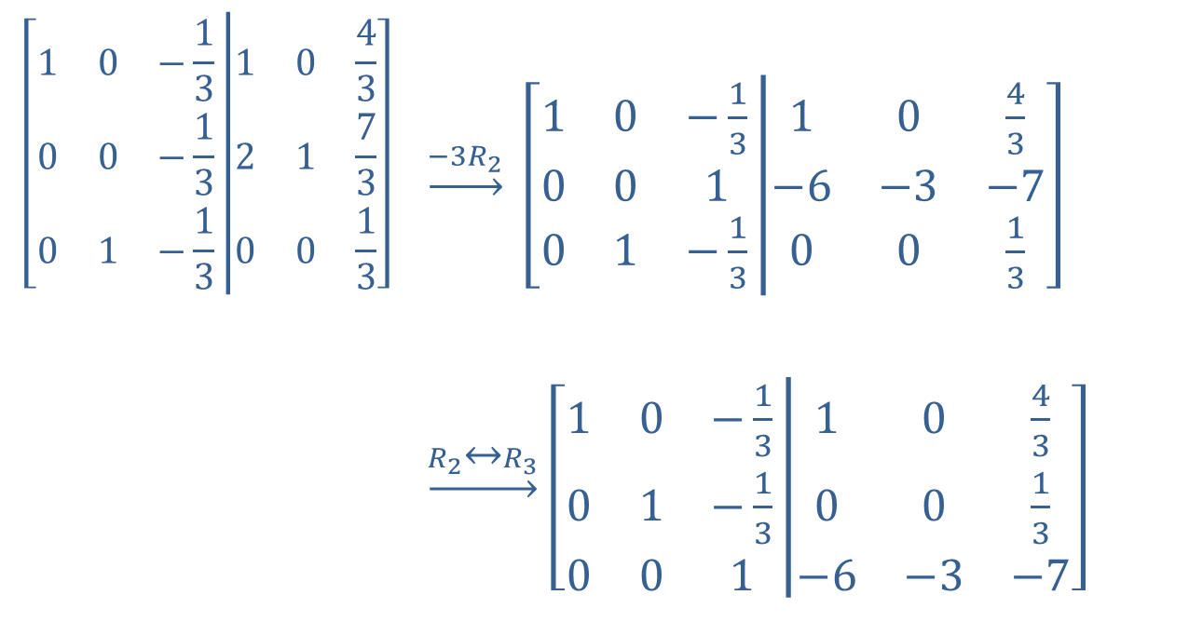
Example 5: Using the Inverse Matrix Method₄
$$\left[\begin{matrix}1 & 0 & −\frac{1}{3} \\ 0 & 0 & −\frac{1}{3} \\ 0 & 1 & −\frac{1}{3}\end{matrix}\left|\begin{matrix}1 & 0 & \frac{4}{3} \\ 2 & 1 & \frac{7}{3} \\ 0 & 0 & \frac{1}{3}\end{matrix}\right.\right]$$ | $\underset{→}{−3R_{2}}$ $\left[\begin{matrix}1 & 0 & −\frac{1}{3} \\ 0 & 0 & 1 \\ 0 & 1 & −\frac{1}{3}\end{matrix}\left|\begin{matrix}1 & 0 & \frac{4}{3} \\ −6 & −3 & −7 \\ 0 & 0 & \frac{1}{3}\end{matrix}\right.\right]$
 | $\underset{→}{R_{2}↔R_{3}}$ $\left[\begin{matrix}1 & 0 & −\frac{1}{3} \\ 0 & 1 & −\frac{1}{3} \\ 0 & 0 & 1\end{matrix}\left|\begin{matrix}1 & 0 & \frac{4}{3} \\ 0 & 0 & \frac{1}{3} \\ −6 & −3 & −7\end{matrix}\right.\right]$

Slide 37
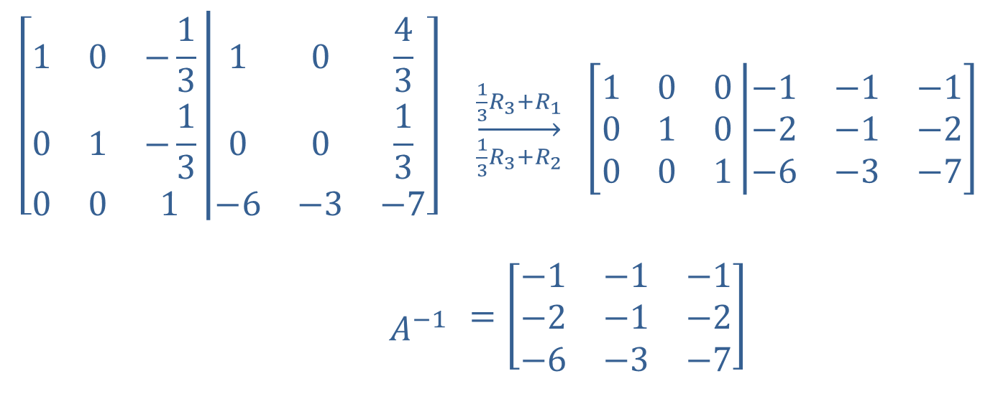
Example 5: Using the Inverse Matrix Method₅
$$\left[\begin{matrix}1 & 0 & −\frac{1}{3} \\ 0 & 1 & −\frac{1}{3} \\ 0 & 0 & 1\end{matrix}\left|\begin{matrix}1 & 0 & \frac{4}{3} \\ 0 & 0 & \frac{1}{3} \\ −6 & −3 & −7\end{matrix}\right.\right]$$ | $\overset{\frac{1}{3}R_{3}+R_{1}}{\overset{→}{\frac{1}{3}R_{3}+R_{2}}}$ $\left[\begin{matrix}1 & 0 & 0 \\ 0 & 1 & 0 \\ 0 & 0 & 1\end{matrix}\left|\begin{matrix}−1 & −1 & −1 \\ −2 & −1 & −2 \\ −6 & −3 & −7\end{matrix}\right.\right]$
$$A^{−1}$$ | $$=\left[\begin{matrix}−1 & −1 & −1 \\ −2 & −1 & −2 \\ −6 & −3 & −7\end{matrix}\right]$$

Slide 38
Example 5: Using the Inverse Matrix Method₆
The majority of the work has now been done, and we can solve the three systems quickly by multiplying by the three matrices consisting of the right-hand-side constants:

Slide 39
Example 5: Using the Inverse Matrix Method₇

