Slide 1
Section 9.3
Determinants and Cramer's Rule

Slide 2
Definition: Determinant of a
The determinant of the matrix
denoted

Slide 3
CAUTION!₁
If A is a matrix,
stands for the determinant of A, not the absolute value of A. In fact, the concept of absolute value does not apply to matrices.

Slide 4
Example 1: Determinant of a 2 by 2 Matrix
Evaluate the determinants of each of the following matrices:

Slide 5
Example 1: Determinant of a 2 by 2 Matrix₂
Solution

Slide 6
Definition: Minors and Cofactors
Let A be an
matrix, and let i and j be numbers
between 1 and n, so that a _{ij} is an element of A.
The minor of the element a_{ij} is the determinant of the
matrix formed from A by
deleting its i ^{th} row and j ^{th} column.
The cofactor of the element a _{ij}
minor of a _{ij}. Thus, if i + j is even, the cofactor of a _{ij} is the same as the minor of a _{ij}; if i + j is odd, the cofactor is the negative of the minor.

Slide 7
Example 2: Minors and Cofactors₁
Consider the matrix
a. Evaluate the minor of a ₁₂.
b. ​Evaluate the cofactor of a ₂₃.

Slide 8
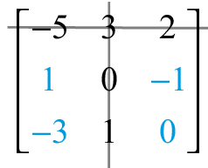
Example 2: Minors and Cofactors₂
Solution
a. ​Finding the minor of a ₁₂ requires deleting the first row and second column of the matrix A. This gives us the following.
Thus, the minor of

Slide 9
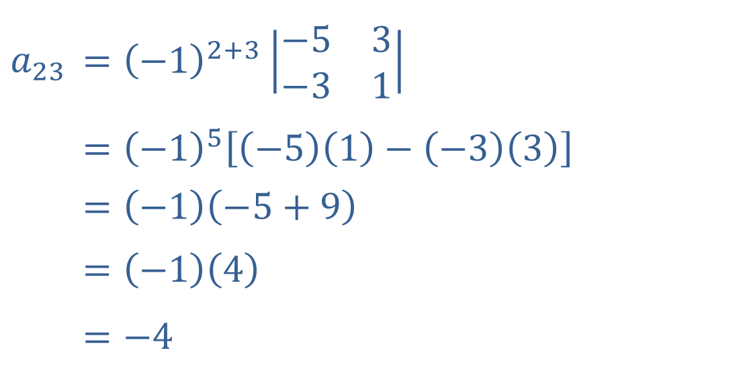
Example 2: Minors and Cofactors₃
b. ​The cofactor of a ₂₃ is the minor of a ₂₃ multiplied by −1, since 2 + 3 is odd.
$$a_{2⁣3}$$ | ​$={\left(−1\right)}^{2+3}\left|\begin{matrix}−5 & 3 \\ −3 & 1\end{matrix}\right|$
 | ​$={\left(−1\right)}^{5}\left[\left(−5\right)\left(1\right)−\left(−3\right)\left(3\right)\right]$
 | $$=\left(−1\right)\left(−5+9\right)$$
 | $$=\left(−1\right)\left(4\right)$$
 | ​$=−4$

Slide 10
Definition: Determinant of an n by n Matrix₁
determinant is accomplished by
Evaluation of an
expansion along a fixed row or column. The result does not depend on which row or column is chosen.
​To expand along the i^{th} row, each element of that row is multiplied by its cofactor, and the n products are then added.
​To expand along the j^{th} column, each element of that column is multiplied by its cofactor, and the n products are then added.

Slide 11
Definition: Determinant of an n by n Matrix₂
For example, if we expand along the first column of a
matrix, we get the following.
Note the minus sign in front of a ₂₁.
We could expand along a row or a different column in a similar manner.

Slide 12
Example 3: Determinant of an n by n Matrix₁
Evaluate the determinant of the matrix

Slide 13
Note
Minimize the number of computations by choosing which row or column to expand along carefully.

Slide 14
Example 3: Determinant of an n by n Matrix₂
Solution
First, we decide which row or column to expand along. A row or column with many zeros is generally a good choice, since it makes the multiplication much easier. In this case, Row 2 has the most zeros, so expand along it.

Slide 15
Example 3: Determinant of an n by n Matrix₃
Thus,
We get the same answer if we expand along a different row or column.

Slide 16
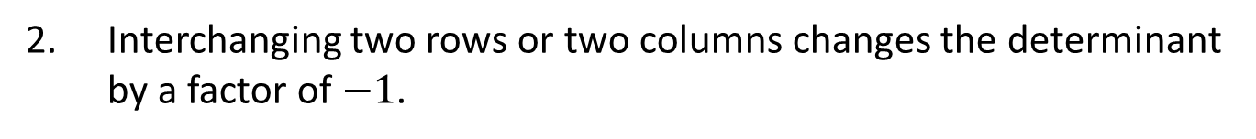
Properties: Properties of Determinants
1. A constant can be factored out of each of the terms in a given row or column when computing determinants.
​
​
​
​
2. Interchanging two rows or two columns changes the determinant by a factor of $−1$.
3. ​The determinant is unchanged by adding a multiple of one row (or column) to another row (or column).

Slide 17
Example 4: Properties of Determinants₁
Evaluate the determinant of the matrix

Slide 18
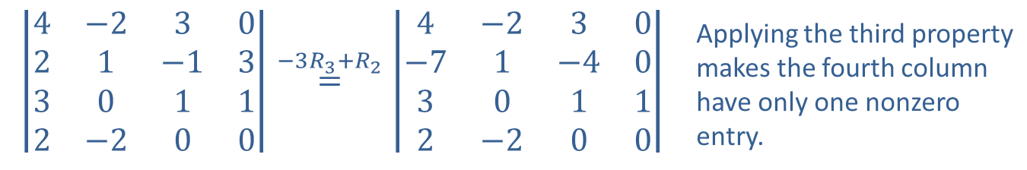
Example 4: Properties of Determinants₂
Solution
Use the properties of determinants to try to obtain rows or columns with as many zeros as possible.
$$\left|\begin{matrix}4 & −2 & 3 & 0 \\ 2 & 1 & −1 & 3 \\ 3 & 0 & 1 & 1 \\ 2 & −2 & 0 & 0\end{matrix}\right|\overset{−3R_{3}+R_{2}}{=}\left|\begin{matrix}4 & −2 & 3 & 0 \\ −7 & 1 & −4 & 0 \\ 3 & 0 & 1 & 1 \\ 2 & −2 & 0 & 0\end{matrix}\right|$$ | Applying the third property makes the fourth column have only one nonzero entry.
Now expand along the fourth column (remembering that the minus sign is part of the cofactor):

Slide 19
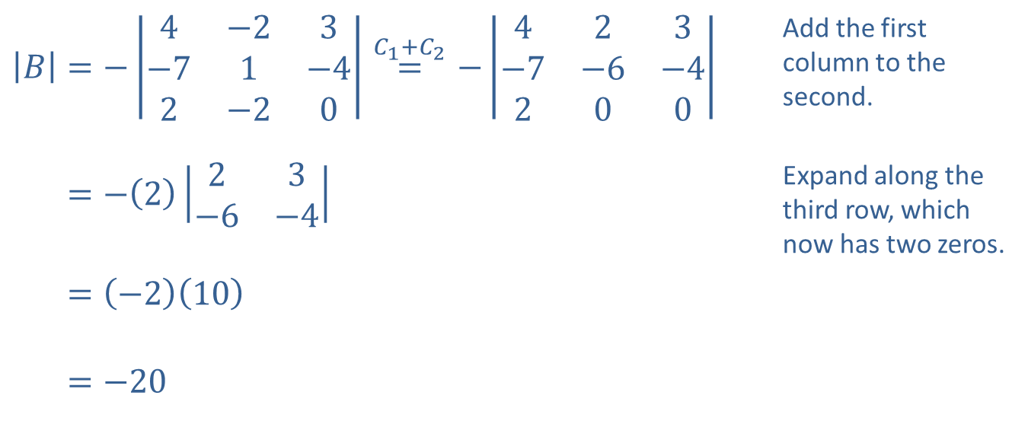
Example 4: Properties of Determinants₃
We can continue to apply the third property of determinants to simplify the evaluation of the
determinant.
​$\left|B\right|=−\left|\begin{matrix}4 & −2 & 3 \\ −7 & 1 & −4 \\ 2 & −2 & 0\end{matrix}\right|\overset{C_{1}+C_{2}}{=}−\left|\begin{matrix}4 & 2 & 3 \\ −7 & −6 & −4 \\ 2 & 0 & 0\end{matrix}\right|$ | Add the first column to the second.
​|𝐵|=−223−6−4 | Expand along the third row, which now has two zeros.
​|𝐵|=−210
​|𝐵|=−20

Slide 20
Example 4: Properties of Determinants₄
Notice that we have reduced the work to the evaluation of only one
determinant, which in turn
involved evaluating only one
determinant.

Slide 21
Theorem: Cramer's Rule for Two-Variable, Two-Equation Linear Systems
The solution of a two-variable, two-equation linear system
is given by
where D is the determinant of the coefficient matrix
is the determinant of the matrix formed by replacing the column of x-coefficients with the column of constant terms
is the determinant of the matrix formed by replacing the column of y-coefficients with the column of constant terms

Slide 22
CAUTION!₂
Whenever a fraction appears in our work, we need to ask if the expression in the denominator can ever be zero, and what it means if this happens. In Cramer's Rule, the determinant D can equal 0, which prevents us from using the given formulas.
If D = 0, the system is either dependent or inconsistent. If both D_{x} and D_{y} are also zero, the system is dependent. If at least one of D_{x} and D_{y} is nonzero, the system has no solution.

Slide 23
Example 5: Cramer's Rule₁
Use Cramer's Rule to solve the following systems.

Slide 24
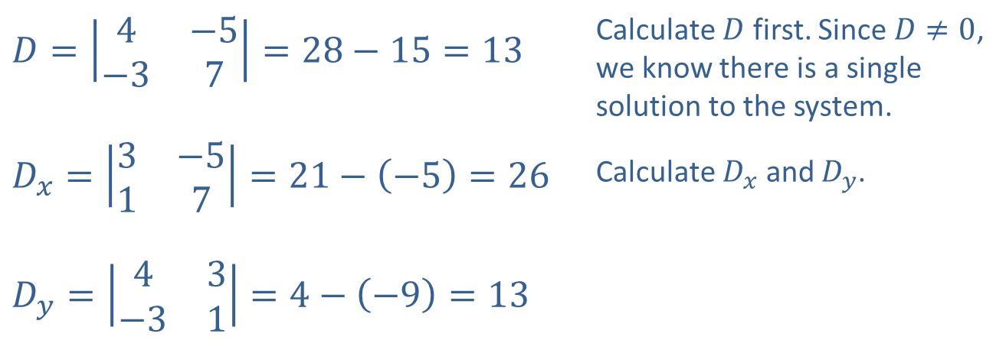
Example 5: Cramer's Rule₂
Solution
​
​$D=\left|\begin{matrix}4 & −5 \\ −3 & 7\end{matrix}\right|=28−15=13$ | Calculate $D$ first. Since $D≠0$, we know there is a single solution to the system.
​$D_{x}=\left|\begin{matrix}3 & −5 \\ 1 & 7\end{matrix}\right|=21−\left(−5\right)=26$ | Calculate $D_{x}$ and $D_{y}$.
​$D_{y}=\left|\begin{matrix}4 & 3 \\ −3 & 1\end{matrix}\right|=4−\left(−9\right)=13$

Slide 25

Example 5: Cramer's Rule₃
​Applying Cramer's Rule, we have
so the solution is $(2,1)$.

Slide 26
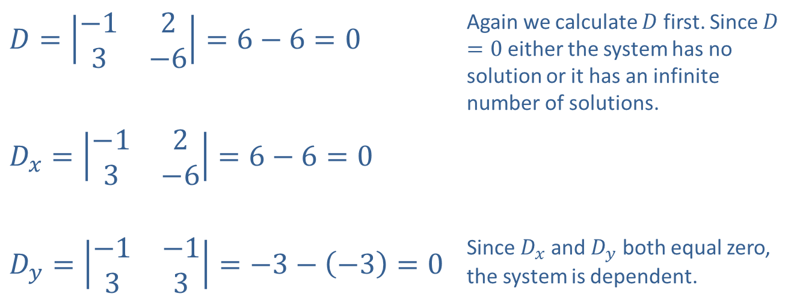
Example 5: Cramer's Rule₄
​$D=\left|\begin{matrix}−1 & 2 \\ 3 & −6\end{matrix}\right|=6−6=0$ | Again we calculate $D$ first. Since $D=0$ either the system has no solution or it has an infinite number of solutions.
​$D_{x}=\left|\begin{matrix}−1 & 2 \\ 3 & −6\end{matrix}\right|=6−6=0$
​$D_{y}=\left|\begin{matrix}−1 & −1 \\ 3 & 3\end{matrix}\right|=−3−\left(−3\right)=0$ | Since $D_{x}$ and $D_{y}$ both equal zero, the system is dependent.
​

Slide 27

Example 5: Cramer's Rule₅
​The solution set can be found by solving either equation for either variable:

Slide 28

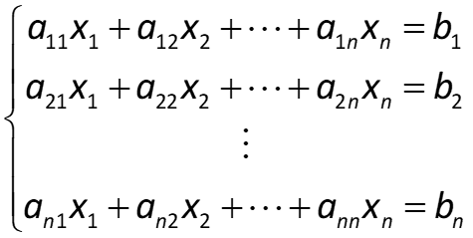
Theorem: Cramer's Rule
The solution of the system is given by the formulas
can be written in the following form.
The solution of the system is given by the formulas
where D is the determinant of the coefficient matrix and
is the determinant of the
same matrix with the i ^{th} column replaced by the column of constants
If D = 0 and if each
as well, the system is dependent and has an infinite
number of solutions. If D = 0 and
is nonzero for at least one value of i, the
system has no solution.

Slide 29
Example 6: Cramer's Rule₁
Use Cramer's Rule to solve the system

Slide 30
Example 6: Cramer's Rule₂
Solution
Note how the properties of determinants are used to simplify each calculation. In each case, the row or column used for expansion is bold.
Since D ≠ 0, the system has a unique solution.

Slide 31
Example 6: Cramer's Rule₃

Slide 32
Example 6: Cramer's Rule₄
After evaluating
we know the solution is the single ordered triple

