Slide 1
Section 9.1
Solving Systems of Linear Equations by Substitution and Elimination

Slide 2
Definition: Solutions to Systems of Linear Equations
​A system of linear equations with no solution is called inconsistent.
​A system of linear equations that has at least one solution is called consistent.
1. A consistent system with exactly one solution is called independent.
2. A consistent system with more than one solution must have an infinite number of solutions and is called dependent.

Slide 3
Example 1: Solving an Independent System by Substitution₁
Use the method of substitution to solve the system

Slide 4
Note:
Solving for a variable with a coefficient of 1 will make the process of substitution a bit easier.

Slide 5
Example 1: Solving an Independent System by Substitution₂
Solution
Either equation can be solved for either variable, and the choice doesn't affect the final answer. We will solve the second equation for x, and then substitute the result in the first equation, giving us one equation in the variable y. Once we have solved for y, we can substitute the value of y into either original equation to find x.

Slide 6
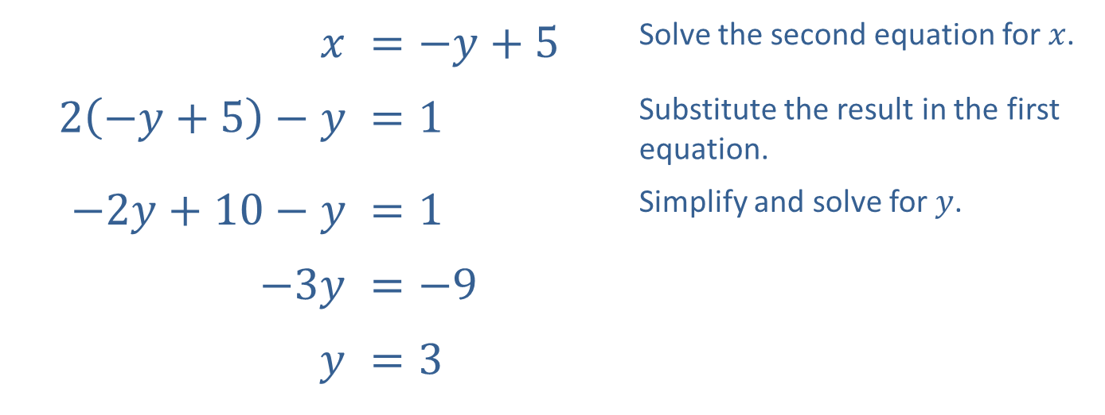
Example 1: Solving an Independent System by Substitution₃
$$x$$ | ​$=−y+5$ | Solve the second equation for $x$.
​$2\left(−y+5\right)−y$ | ​$=1$ | Substitute the result in the first equation.
​$−2y+10−y$ | ​$=1$ | Simplify and solve for $y$.
​$−3y$ | ​$=−9$
$$y$$ | ​$=3$

Slide 7
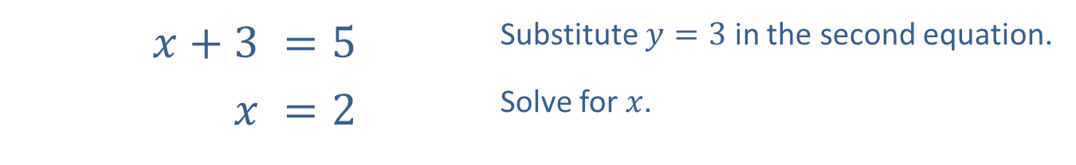
Example 1: Solving an Independent System by Substitution₄
We then substitute our answer for y into the original second equation.
​$x+3$ | ​$=5$ | Substitute $y=3$ in the second equation.
$$x$$ | ​$=2$ | Solve for $x$.

Slide 8
Example 1: Solving an Independent System by Substitution₅
Thus, the solution to the system of equations is (2, 3).
Note how the graph in Figure 2 corresponds to the system and the ordered pair solution that we have found.

Slide 9
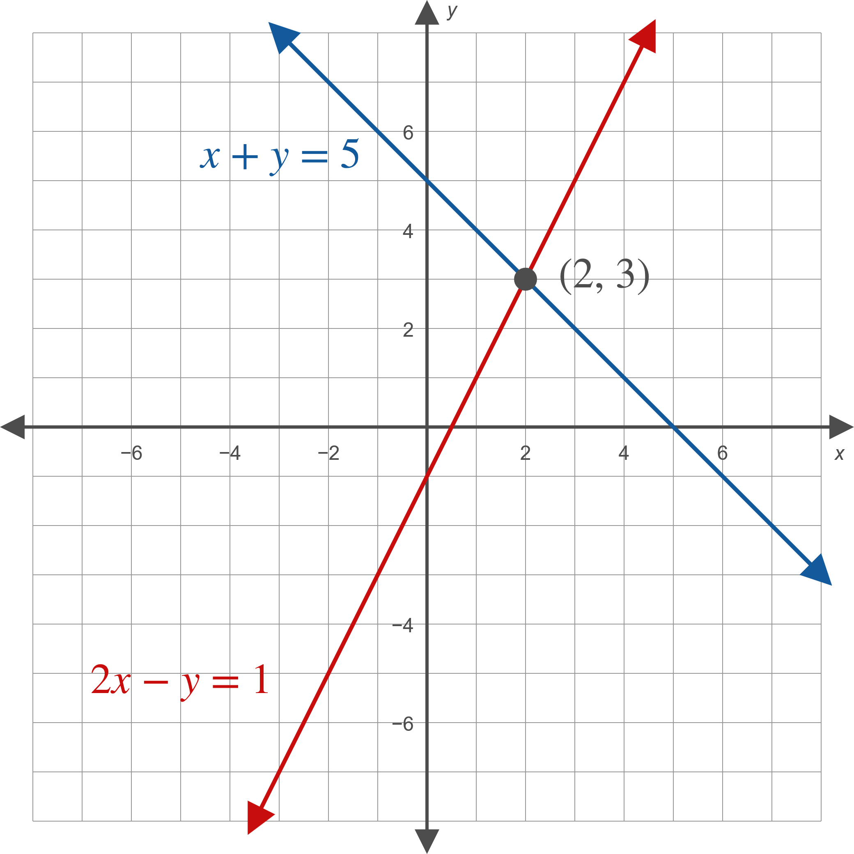
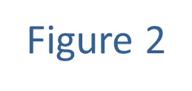
Example 1: Solving an Independent System by Substitution₆

Slide 10
Example 2: Solving a Dependent System by Substitution₁
Use the method of substitution to solve the system

Slide 11
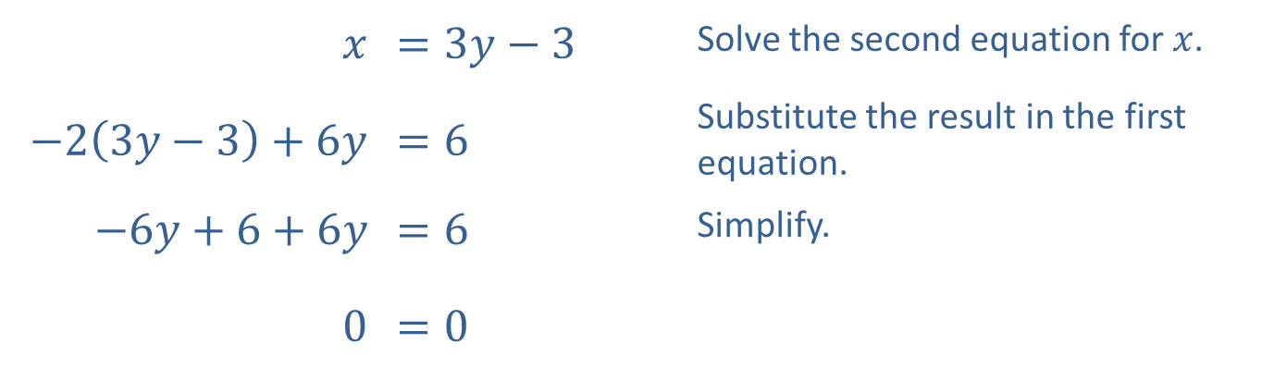
Example 2: Solving a Dependent System by Substitution₂
Solution
$$x$$ | ​$=3y−3$ | Solve the second equation for $x$.
​$−2\left(3y−3\right)+6y$ | ​$=6$ | Substitute the result in the first equation.
​$−6y+6+6y$ | ​$=6$ | Simplify.
​0 | ​$=0$

Slide 12
Example 2: Solving a Dependent System by Substitution₃
The resulting equation is always true. This means that for any value of y, letting x = 3y − 3 results in an ordered pair (x, y) = (3y − 3, y) that solves both equations. Since there are an infinite number of solutions, the system is dependent.
Graphically, this means the graphs of the two equations are exactly the same. In fact, the first equation is simply a rearranged multiple of the second equation.

Slide 13
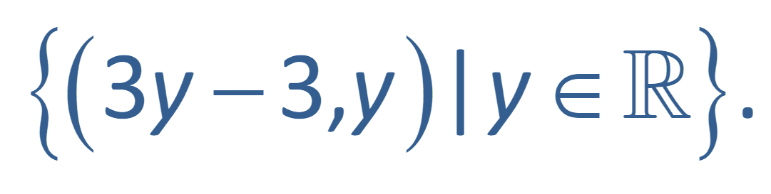
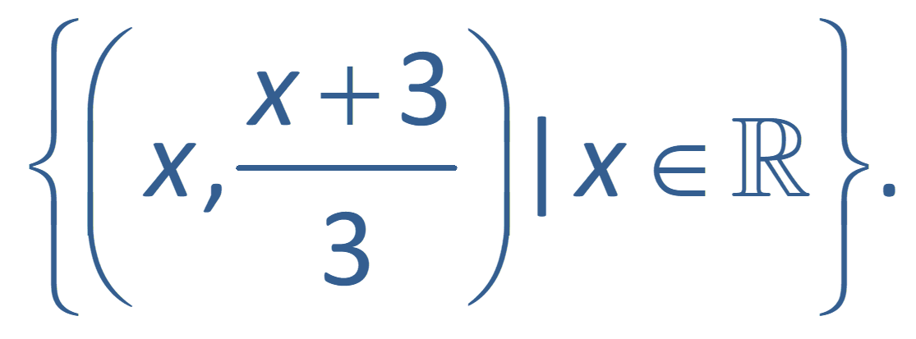
Example 2: Solving a Dependent System by Substitution₄
Algebraically, we can describe the solution set as
If we had solved either equation for y
instead of x, we would have obtained the alternative
but equivalent solution

Slide 14
Example 3: Solving an Independent System by Elimination₁
Use the method of elimination to solve the system

Slide 15
Example 3: Solving an Independent System by Elimination₂
Solution
The coefficient of y in the second equation is −6, while the coefficient of y in the first equation is 3. This means that if we multiply all the terms in the first equation by 2, the coefficients of y will be negatives of one another, so adding the two equations will eliminate the y variable.

Slide 16
Example 3: Solving an Independent System by Elimination₃
In order to keep track of these steps, we annotate our work with labeled arrows. When we modify the system, we are not changing the solutions, we are just writing an equivalent system that is easier to solve. The ultimate goal is to rewrite the system so that we can "read off" the answer.

Slide 17
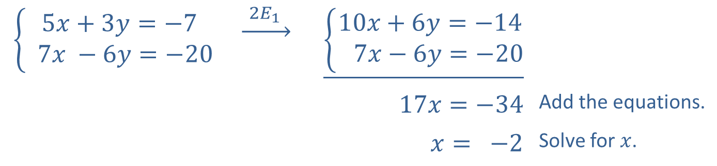
Example 3: Solving an Independent System by Elimination₄
The notation above the arrow indicates that we have modified the system by multiplying each term in equation 1 by the constant 2.
$$\left\{\begin{aligned}5x+3y=−7 \\ 7x −6y=−20\end{aligned}\right.$$ | $$\underset{→}{ 2E_{1 } }$$ | $$\underline{\left\{\begin{aligned}10x+6y=−14 \\ 7x−6y=−20\end{aligned}\right.}$$
 |  | $$17x=−34$$ | Add the equations.
 |  | $$x= −2$$ | Solve for $x$.

Slide 18
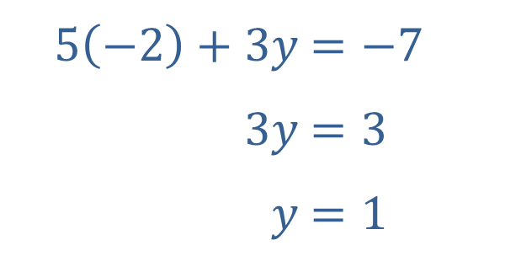
Example 3: Solving an Independent System by Elimination₅
We can then substitute x = −2 into either of the original equations to determine y. Here, we substitute into the first equation of the original system.
​
​$5\left(−2\right)+3y$ | ​$=−7$
​$3y$ | ​$=3$
​$y$ | ​$=1$

Slide 19
Example 3: Solving an Independent System by Elimination₆
The ordered pair (−2, 1) is thus the solution of the system. Note that using the second equation gives the same y-value and is a good way to check our work.

Slide 20
Example 4: Solving an Inconsistent System by Elimination₁
Use the method of elimination to solve the system

Slide 21
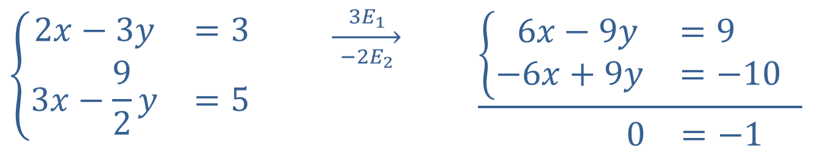
Example 4: Solving an Inconsistent System by Elimination₂
Solution
Eliminate the variable x by multiplying both equations by a constant.
$$\left\{\begin{matrix}2x−3y & =3 \\ 3x−\frac{9}{2}y & =5\end{matrix}\right.$$ | $$\overset{ 3E_{1 }}{\overset{→}{ −2E_{2 }}}$$ | 6𝑥−9𝑦=9 1−6𝑥+9𝑦=−101 0=−1

Slide 22
Example 4: Solving an Inconsistent System by Elimination₃
Although the intent was to obtain coefficients of x that were negatives of one another, we have achieved the same thing for y.
When we add the equations, the result is 0 = −1, a false statement. This means that no ordered pair solves both equations, and the system is inconsistent. Graphically, the two lines defined by the equations are parallel.

Slide 23
Example 5: Solving an Independent System by Elimination₁
Solve the system

Slide 24
Example 5: Solving an Independent System by Elimination₂
Solution
We will follow the same type of approach we used in Example 4. If we add the first equation to the second equation or the third equation, we will eliminate z, resulting in a two-equation system in the variables x and y.

Slide 25
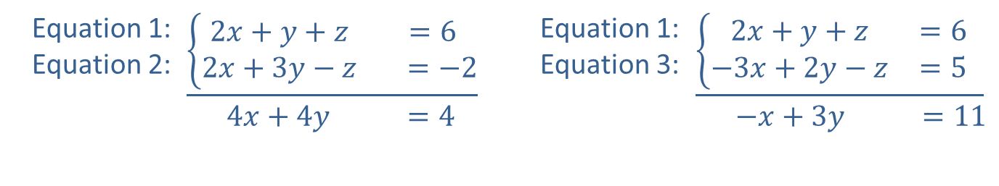
Example 5: Solving an Independent System by Elimination₃
Equation 1: Equation 2: | $$\underline{\left\{\begin{matrix}2x+y+z & =6 \\ 2x+3y−z & =−2\end{matrix}\right.} \\ \begin{matrix} 4x+4y & =4\end{matrix}$$ | Equation 1: Equation 3: | 2𝑥+𝑦+𝑧=61−3𝑥+2𝑦−𝑧=51 −𝑥+3𝑦 =11

Slide 26
Example 5: Solving an Independent System by Elimination₄
Putting these two equations together, we have the following system.
We use elimination once more, multiplying the second equation by 4 to eliminate x.

Slide 27
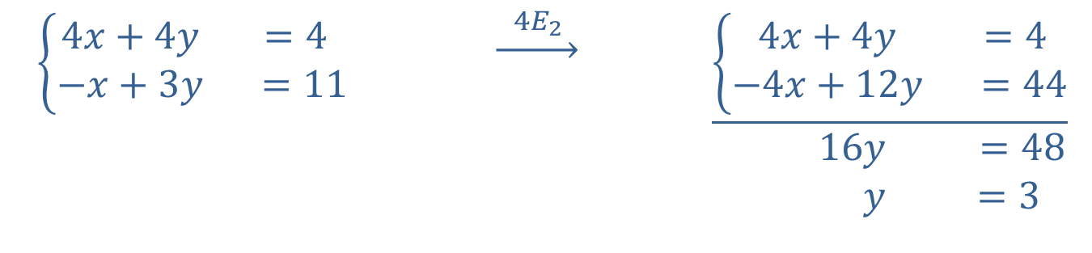
Example 5: Solving an Independent System by Elimination₅
$\left\{\begin{matrix}4x+4y & =4 \\ −x+3y & =11\end{matrix}\right.$ | $$\underset{→}{ 4E_{2 }}$$ | $$\underline{\left\{\begin{matrix}4x+4y & =4 \\ −4x+12y & =44\end{matrix}\right.} \\ \begin{matrix} 16y & =48 \\ y & =3\end{matrix}$$

Slide 28
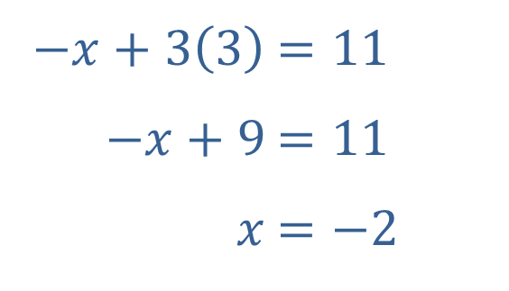
Example 5: Solving an Independent System by Elimination₆
Now that we have solved for y, we can plug this back into one of the equations from the two variable system to solve for x.
​
​$−x+3\left(3\right)$ | ​$=11$
​$−x+9$ | ​$=11$
​$x$ | ​$=−2$

Slide 29
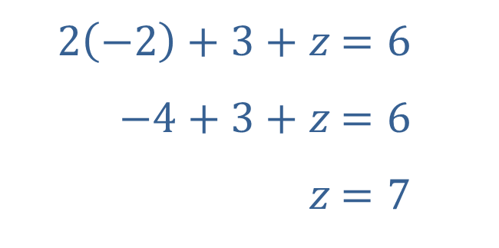
Example 5: Solving an Independent System by Elimination₇
Finally, we substitute both x and y into one of the equations from the original system.
​
​$2\left(−2\right)+3+z$ | ​$=6$
​$−4+3+z$ | ​$=6$
​$z$ | ​$=7$
Thus, the solution to the system of equations is the ordered triple (−2, 3, 7).

Slide 30
Example 6: Solving a Dependent System by Elimination₁
Solve the system

Slide 31
Example 6: Solving a Dependent System by Elimination₂
Solution
In general, a good approach to solving a large system of equations is to try to eliminate a variable and obtain a smaller system.
There are many possible ways to proceed. One option is to use the second equation (or a multiple of it) to eliminate x when we add it to the first and third equations. The result will be a two-equation system in the variables y and z.

Slide 32
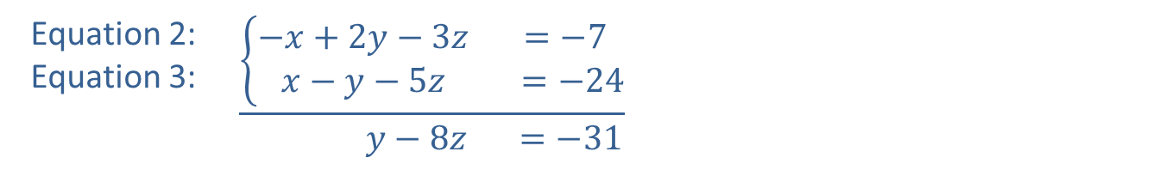
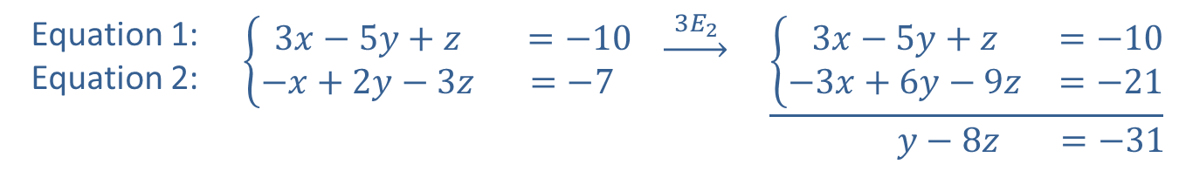
Example 6: Solving a Dependent System by Elimination₃
Equation 1: Equation 2: | $$\left\{\begin{matrix}3x−5y+z & =−10 \\ −x+2y−3z & =−7\end{matrix}\right.$$ | $$\underset{→}{ 3E_{2 }}$$ | $$\underline{\left\{\begin{matrix}3x−5y+z & =−10 \\ −3x+6y−9z & =−21\end{matrix}\right.} \\ \begin{matrix}y−8z & =−31\end{matrix}$$
Equation 2: Equation 3: | $$\underline{\left\{\begin{matrix}−x+2y−3z & =−7 \\ x−y−5z & =−24\end{matrix}\right.} \\ \begin{matrix} y−8z & =−31\end{matrix}$$

Slide 33

Example 6: Solving a Dependent System by Elimination₄
The two resulting equations are identical, and tell us that y = 8z − 31. We can now use any equation that contains x to determine the relation between x and z. For instance, the third equation in the system tells us that x = y + 5z − 24, or
x = (8z − 31) + 5z − 24 = 13z − 55.
One description of the solution set is thus
Geometrically, the three planes described by the equations of the system intersect in a line.

Slide 34
Example 7: Mixing Alloys₁
A foundry needs to produce 75 tons of an alloy that is 34% copper. It has supplies of 9% copper alloy and 84% copper alloy. How many tons of each alloy must be mixed to obtain the desired result?

Slide 35
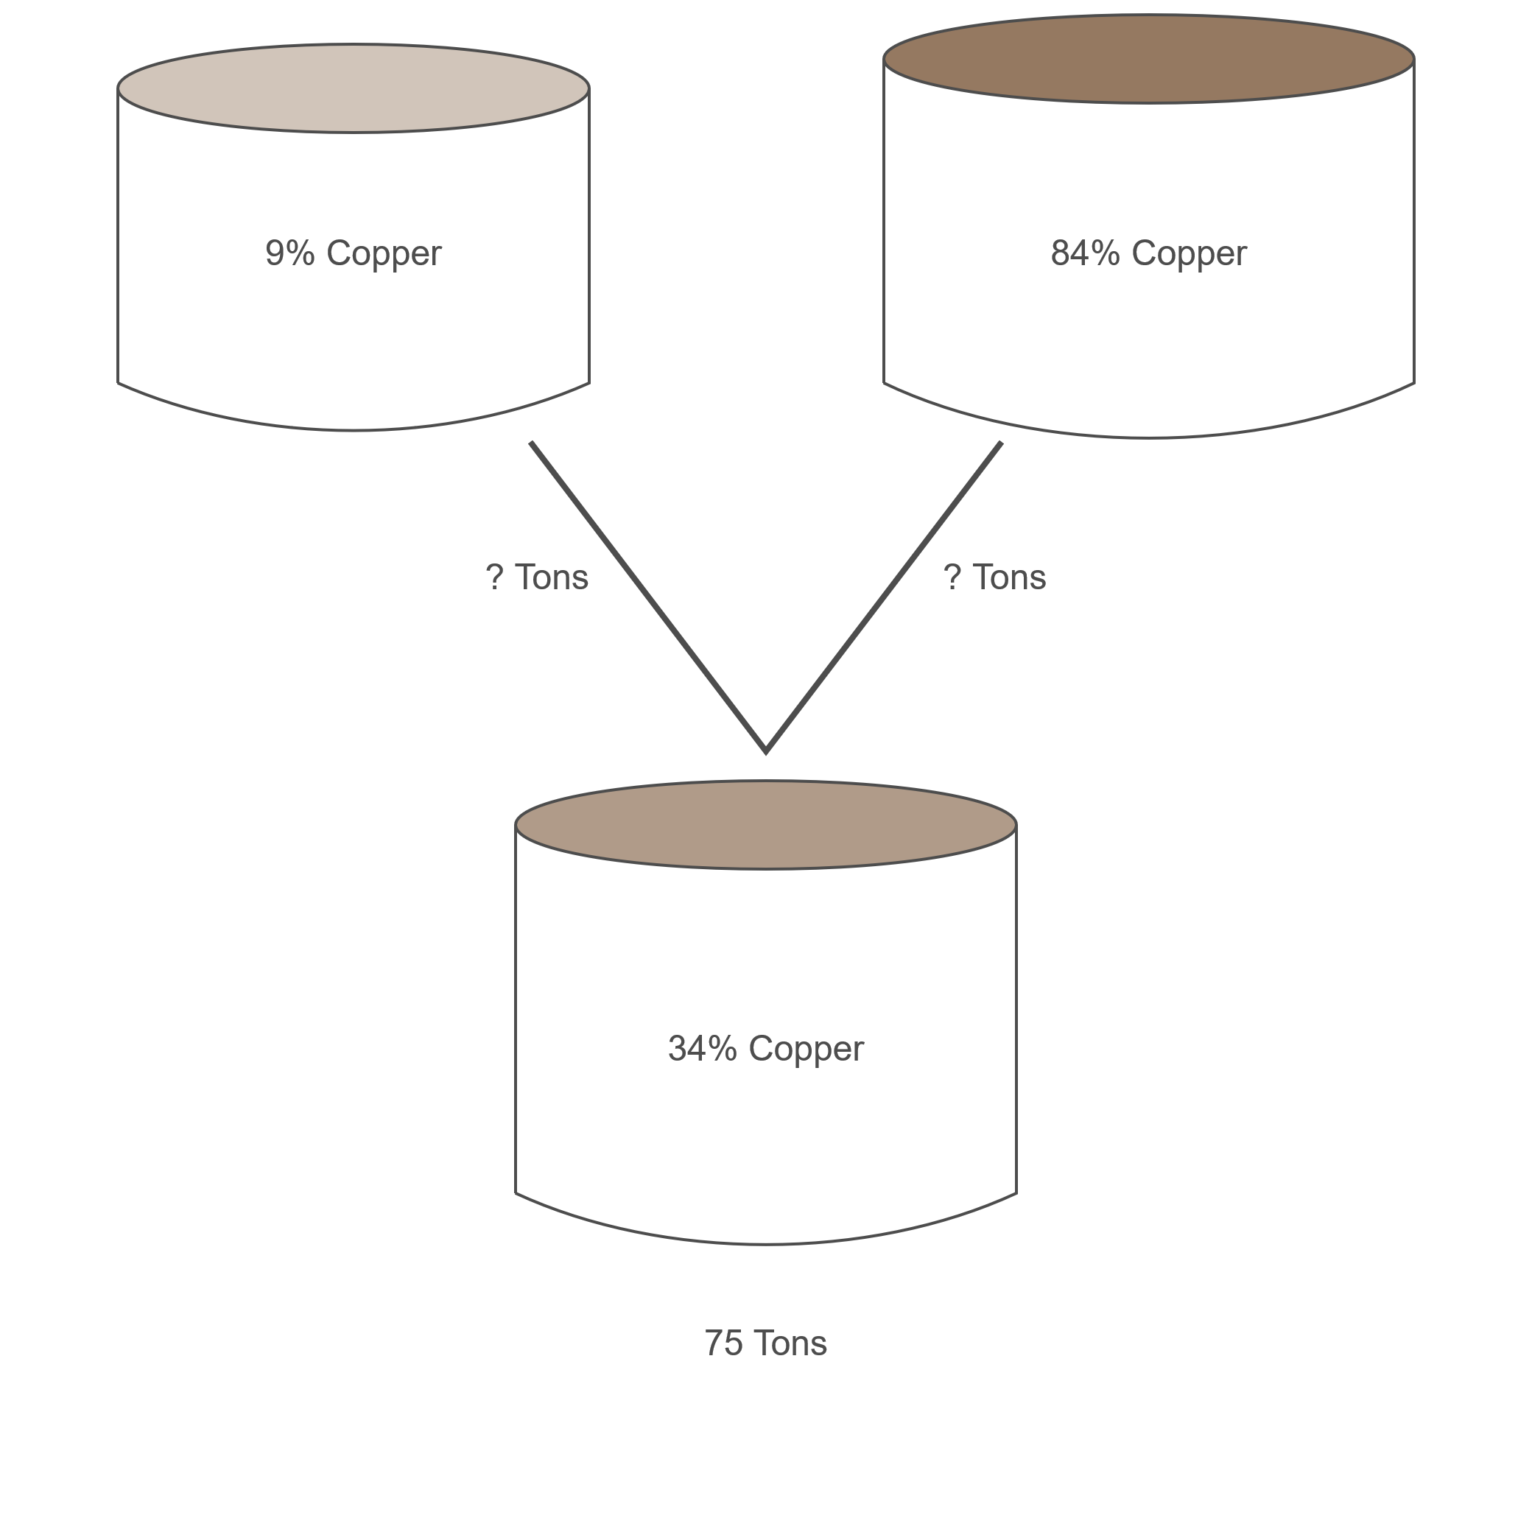
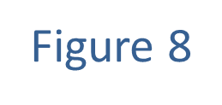
Example 7: Mixing Alloys₂

Slide 36
Example 7: Mixing Alloys₃
Solution
Let x represent the number of tons of 9% copper alloy needed, and y the number of tons of 84% copper alloy needed. We have two variables, so we will need two equations to find the solution.

Slide 37
Example 7: Mixing Alloys₄
Since we need 75 total tons of alloy, one equation is x + y = 75. We also know that 9% of the x tons and 84% of the y tons represent the total amount of copper, and this amount must equal 34% of 75 tons. The second equation is thus 0.09 x + 0.84 y = 0.34 ×75.
This gives us a system that can be solved by elimination.

Slide 38
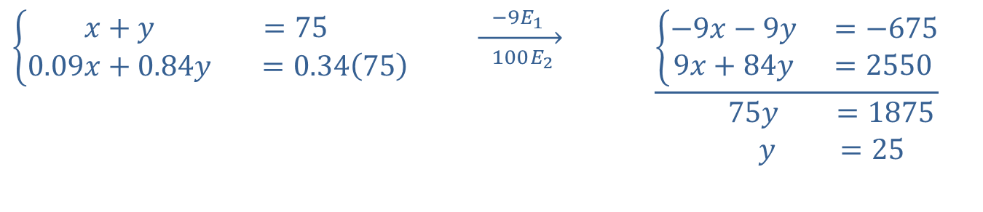
Example 7: Mixing Alloys₅
$$\left\{\begin{matrix}x+y & =75 \\ 0.09x+0.84y & =0.34\left(75\right)\end{matrix}\right.$$ | $$\overset{ −9E_{1 } }{\overset{→}{ 100E_{2 } }}$$ | $$\underline{\left\{\begin{matrix}−9x−9y & =−675 \\ 9x+84y & =2550\end{matrix}\right.} \\ \begin{matrix} 75y & =1875 \\ y & =25\end{matrix}$$

Slide 39
Example 7: Mixing Alloys₆
Substituting back, we have x + 25 = 75, so x = 50. Thus, 50 tons of 9% alloy and 25 tons of 84% alloy are needed.

Slide 40
Example 8: Determining Ages₁
If the ages of three girls, Xenia, Yolanda, and Zsa Zsa, are added, the result is 30. The sum of Xenia's and Yolanda's ages is Zsa Zsa's age, while Xenia's age subtracted from Yolanda's is half of Zsa Zsa's age a year ago. How old is each girl?

Slide 41
Example 8: Determining Ages₂
Solution
Let x, y, and z represent Xenia's, Yolanda's, and Zsa Zsa's ages, respectively. The first sentence tells us that x + y + z = 30. The second sentence tells us that
x + y = z, and that
To make the work easier, these equations can be rewritten as follows.

Slide 42
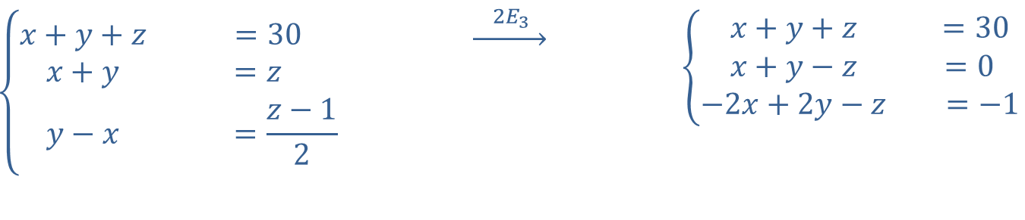
Example 8: Determining Ages₃
$$\left\{\begin{matrix}x+y+z & =30 \\ x+y & =z \\ y−x & =\frac{z−1}{2}\end{matrix}\right.$$ | $$\underset{→}{ 2E_{3 }}$$ | $$\left\{\begin{matrix}x+y+z & =30 \\ x+y−z & =0 \\ −2x+2y−z & =−1\end{matrix}\right.$$

Slide 43
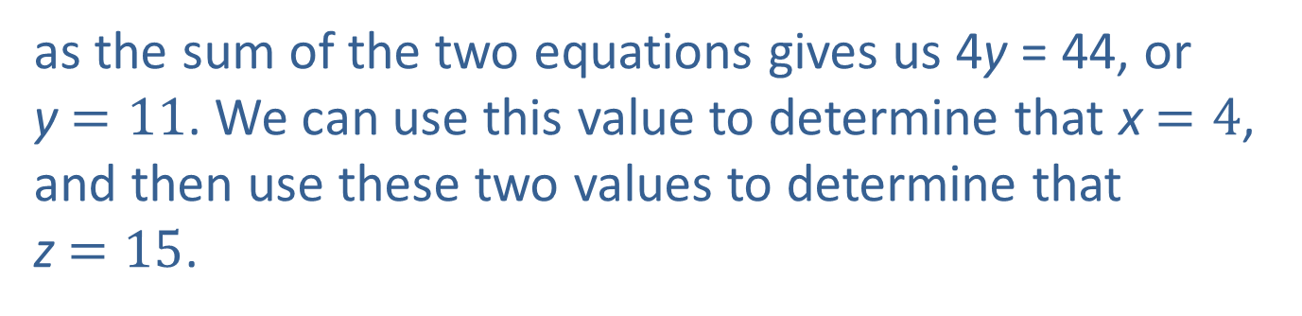
Example 8: Determining Ages₄
From this, we see that the sum of the first and second equations results in 2x + 2y = 30, or x + y = 15, and the sum of the first and third equations is −x + 3y = 29. The method of elimination is the best choice for solving the new system
as the sum of the two equations gives us 4y = 44, or y$=11$. We can use this value to determine that x$=4$, and then use these two values to determine that z$=15$.

Slide 44
Example 8: Determining Ages₅
Geometrically, it means that the ordered triple (4, 11, 15) is the point of intersection of the three planes described by these equations. In context, it means that Xenia is 4, Yolanda is 11, and Zsa Zsa is 15.

