Slide 1
Section 7.1
Exponential Functions and Their Graphs

Slide 2
Definition: Exponential Functions
Let a be a fixed, positive real number not equal to 1. The exponential function with base a is the function

Slide 3
Properties: Behavior of Exponential Functions
Given a positive real number a not equal to 1, the function
a decreasing function if 0 < a < 1, with
​an increasing function if a > 1, with
In either case, the point (0, 1) lies on the graph of f, the domain of f is the set of real numbers, and the range of f is the set of positive real numbers.

Slide 4
Example 1: Graphing Exponential Functions₁
Sketch the graphs of the following exponential functions.

Slide 5
Note₁
Plugging in x = −1, x = 0, and x = 1 will produce a good idea of the shape of the graph.

Slide 6
Example 1: Graphing Exponential Functions₂
Solution
In both cases, we plot 3 points by plugging in x = −1,
x = 0, and x = 1. We then connect the points with a smooth curve.

Slide 7
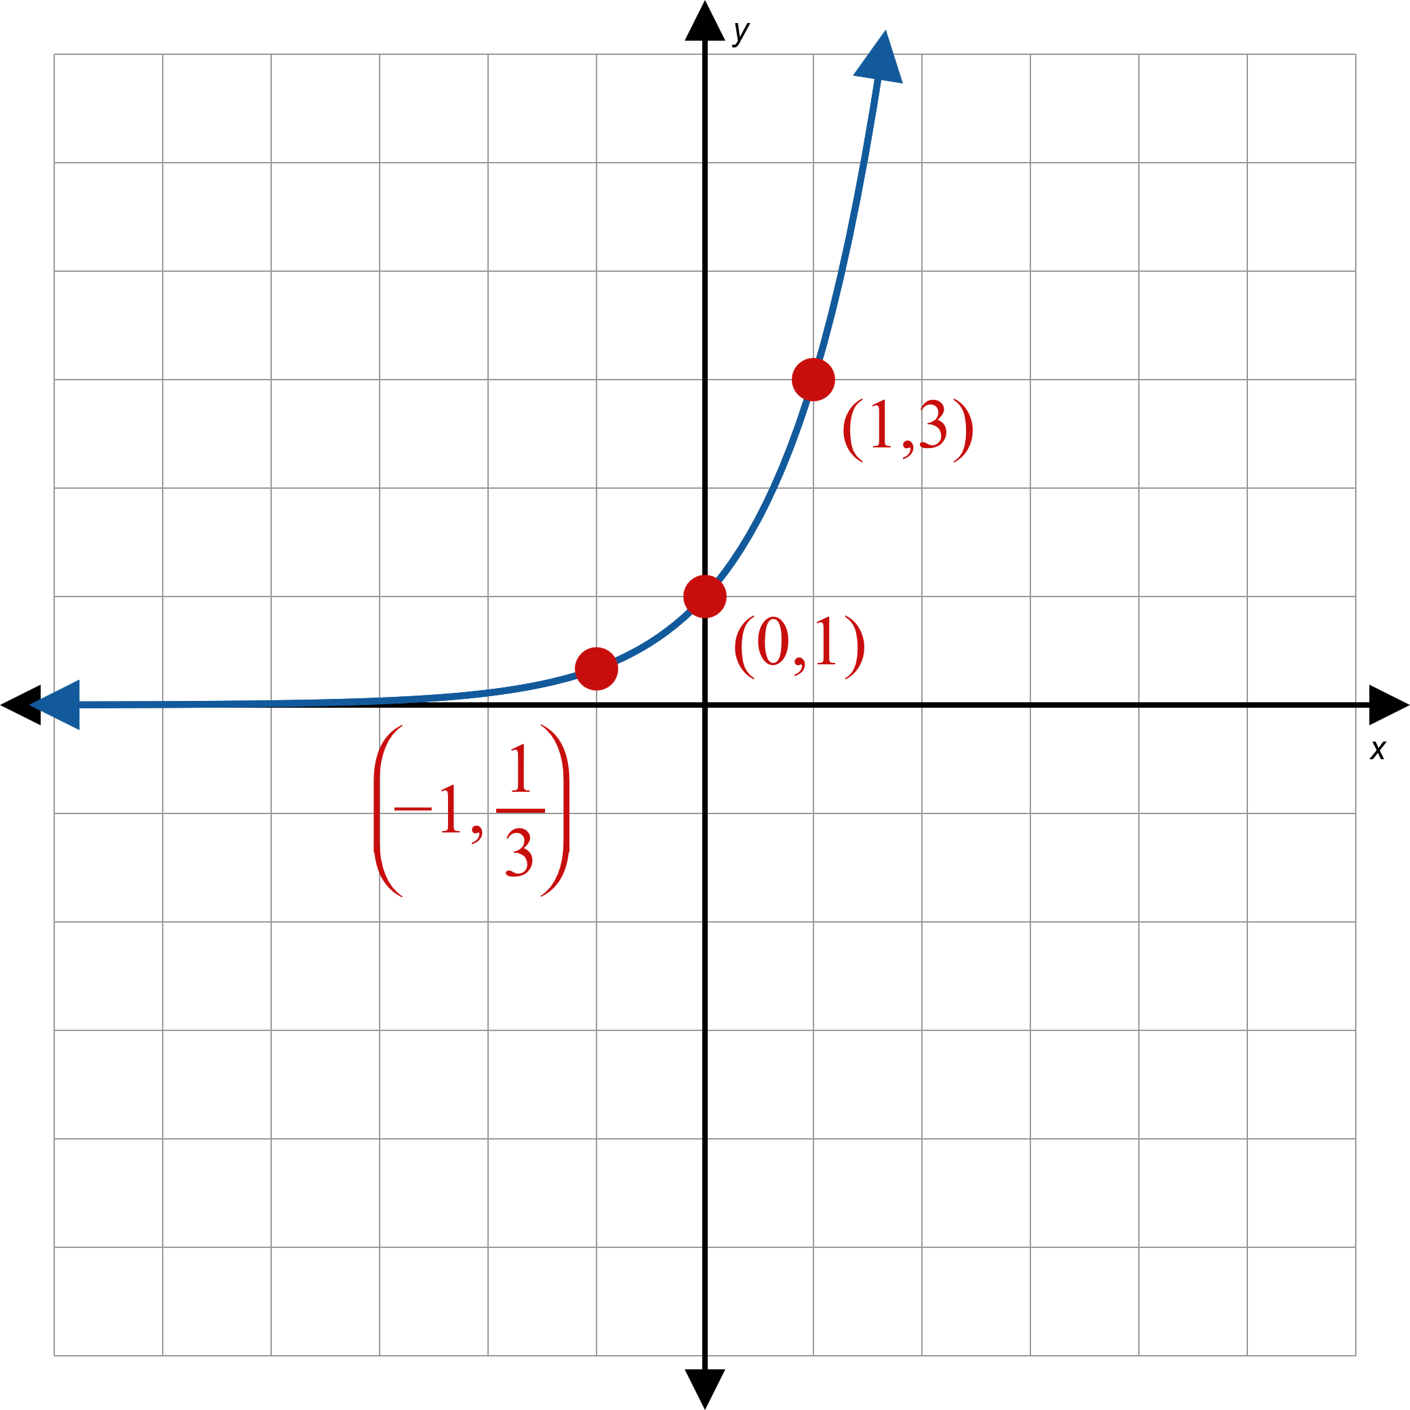
Example 1: Graphing Exponential Functions₃
a.
Figure 2

Slide 8
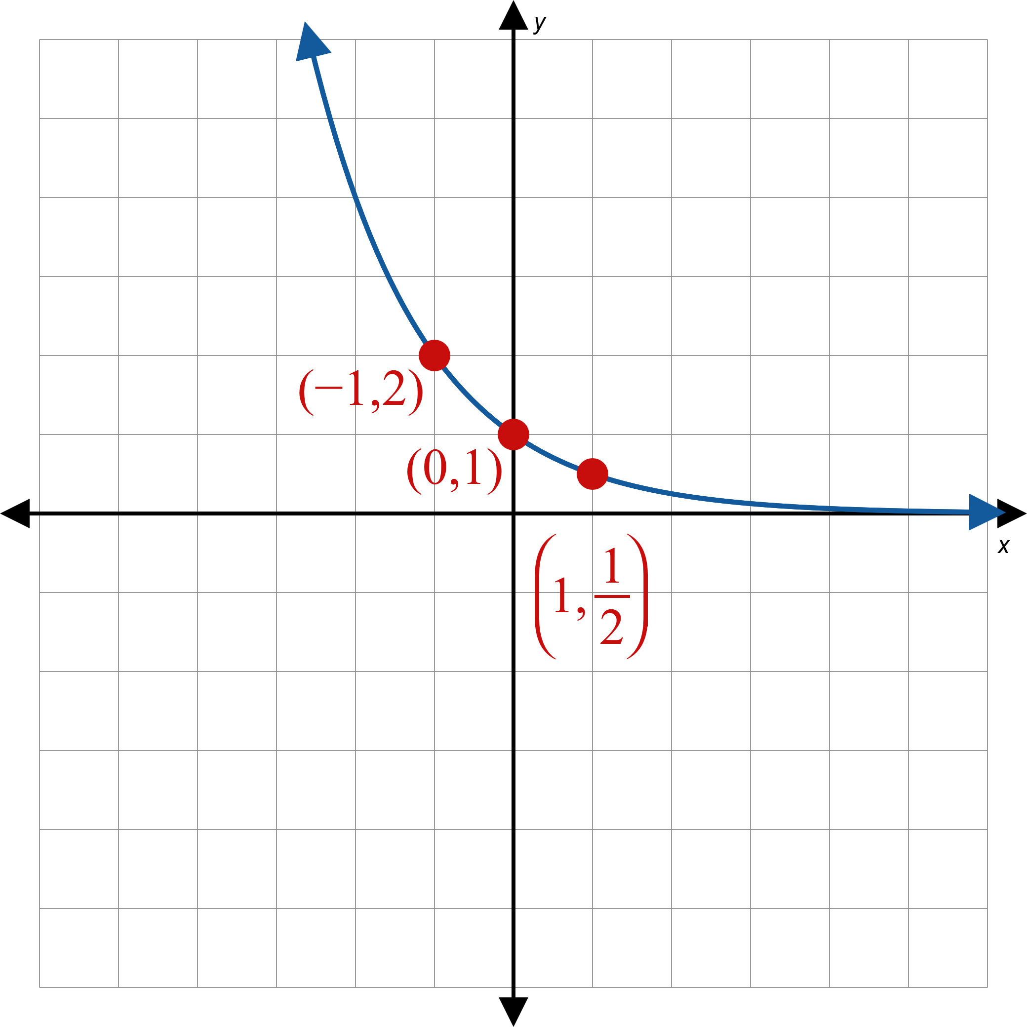
Example 1: Graphing Exponential Functions₄
b.
Figure 3

Slide 9
Example 2: Graphing Exponential Functions₁
Sketch the graphs of each of the following functions. State their domain and range.

Slide 10
Note₂
For each example, first graph the base function, then apply any transformations.

Slide 11
Example 2: Graphing Exponential Functions₂
Solution
First, draw the graph of the function
as in
Example 1b. Then, since x has been replaced by
x + 3, shift the graph to the left by 3 units.

Slide 12
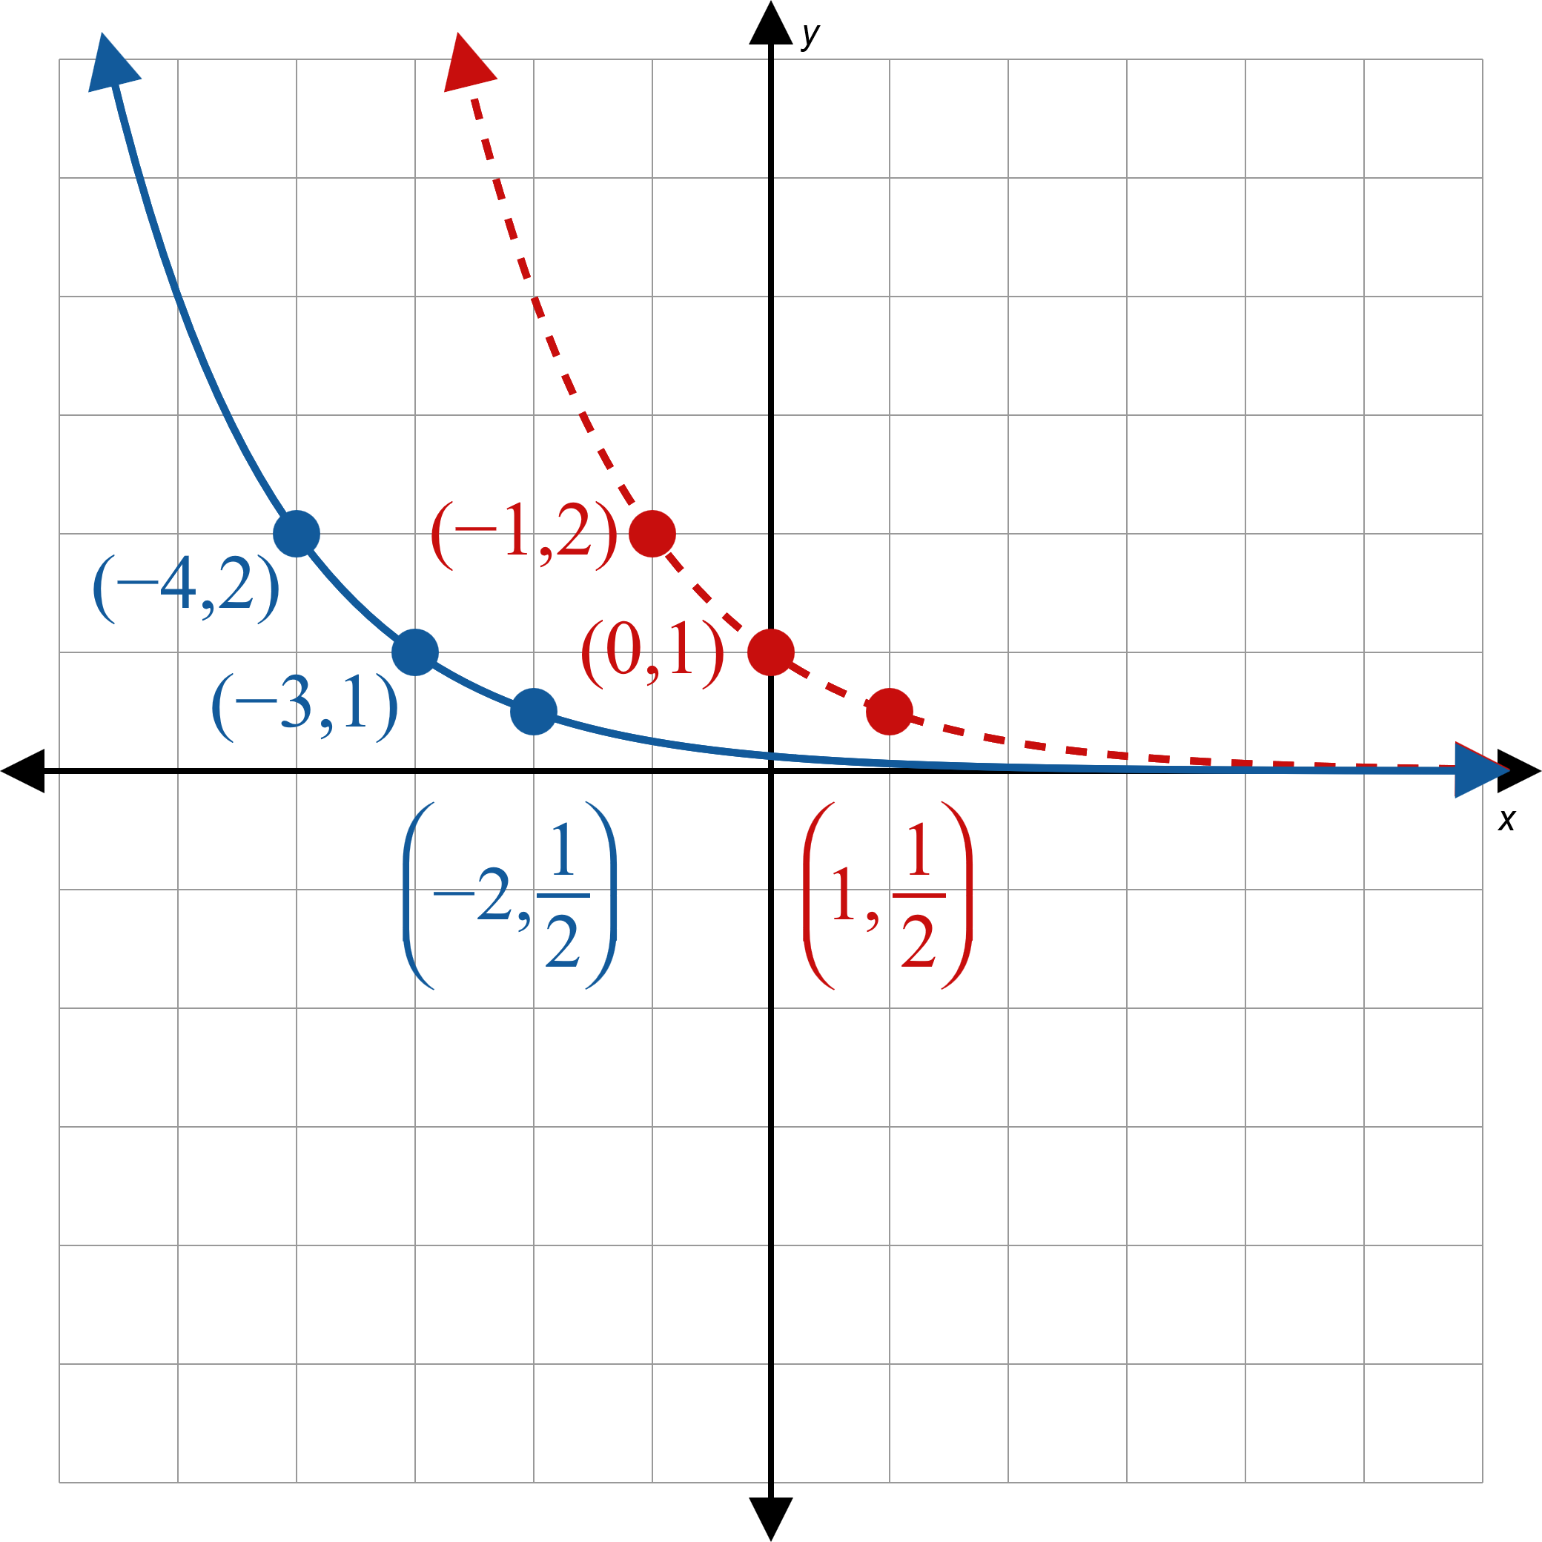
Example 2: Graphing Exponential Functions₃
Figure 4

Slide 13
Example 2: Graphing Exponential Functions₄
Domain = (−∞, ∞), Range = (0, ∞)

Slide 14
Example 2: Graphing Exponential Functions₅
Begin with the graph of
shown as a dashed
curve. The effect of multiplying a function by −1 is to reflect the graph with respect to the x-axis. Following this, the second transformation of adding 1 to a function causes a vertical shift of the graph. The solid line curve is the graph of

Slide 15
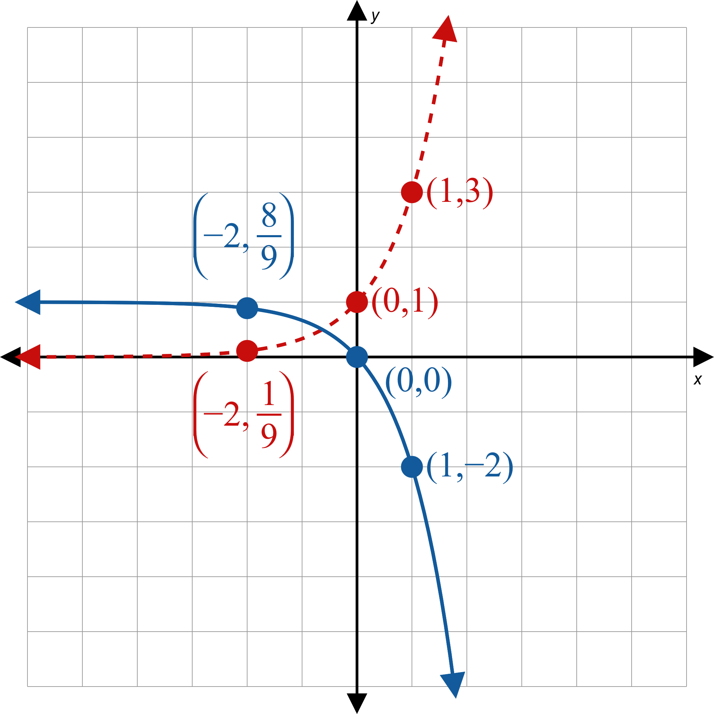
Example 2: Graphing Exponential Functions₆
Figure 5

Slide 16
Example 2: Graphing Exponential Functions₇
Domain = (−∞, ∞), Range = (−∞, 1)

Slide 17
Example 2: Graphing Exponential Functions₈
shown as a
Begin by graphing the base function
dashed curve. For h, x has been replaced by −x, so
we reflect the graph of
across the y-axis to obtain
the graph of h, shown as a solid curve.
Note that this graph is also the graph of
Using
properties of exponents is another way to think about this problem:

Slide 18
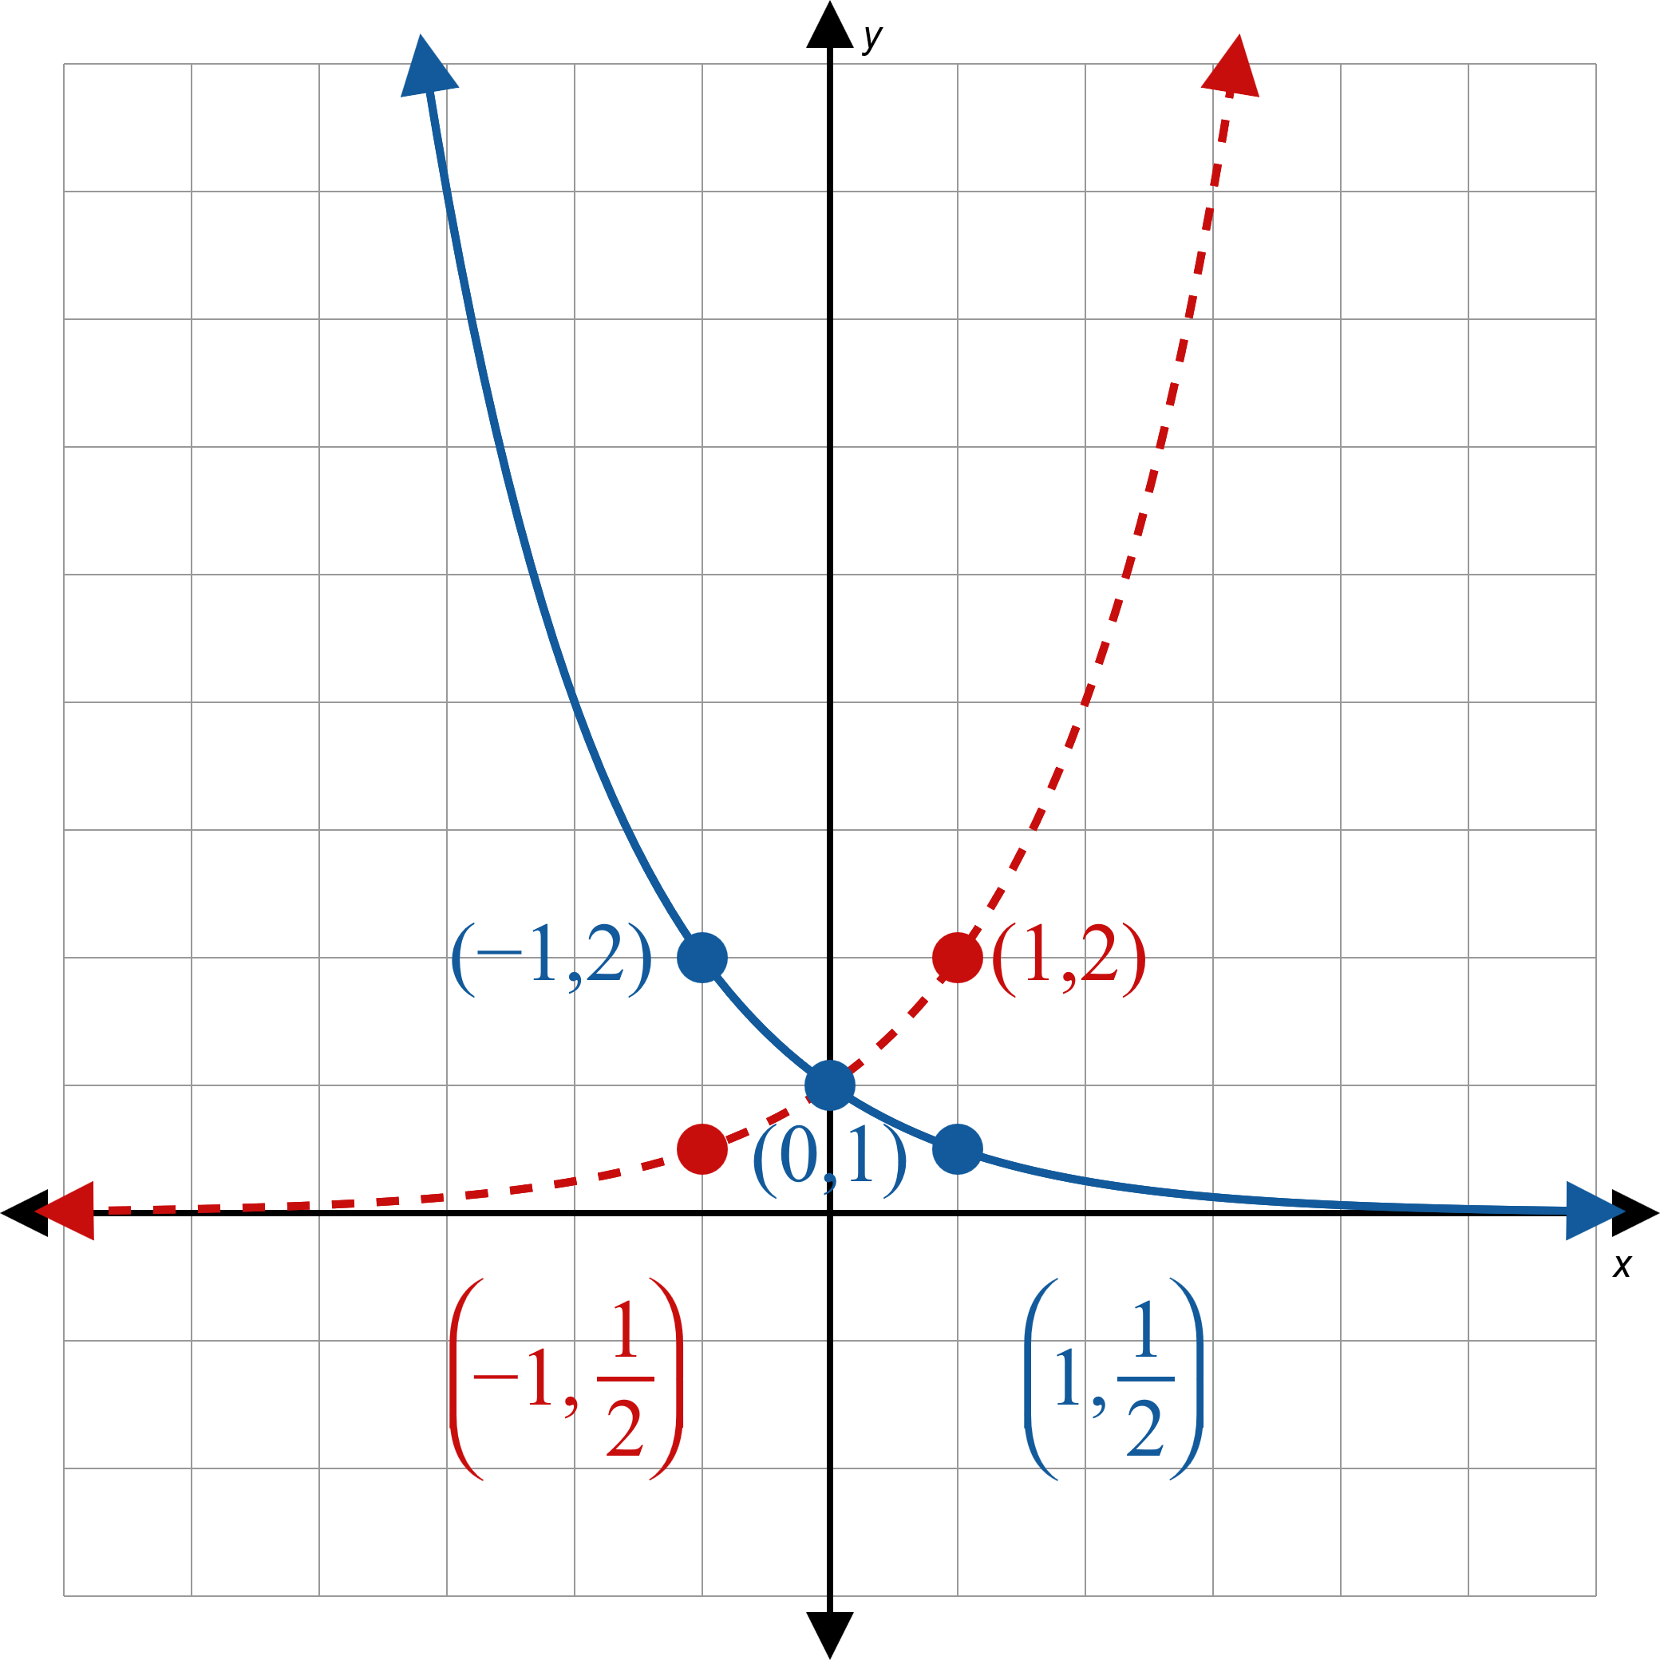
Example 2: Graphing Exponential Functions₉
Figure 6

Slide 19
Example 2: Graphing Exponential Functions₁₀
Domain = (−∞, ∞), Range = (0, ∞)

Slide 20
Procedure: Solving Elementary Exponential Equations
To solve an elementary exponential equation perform the following steps.
Step 1: Isolate the exponential. Move the exponential containing x to one side of the equation and any constants or other variables in the expression to the other side. Simplify, if necessary.
Step 2: Find a base that can be used to rewrite both sides of the equation.
Step 3: Equate the powers, and solve the resulting equation.

Slide 21
Example 3: Solving Elementary Exponential Equations₁
Solve the following exponential equations.

Slide 22
Note₃
As always, it is good practice to check your solution in the original equation.

Slide 23
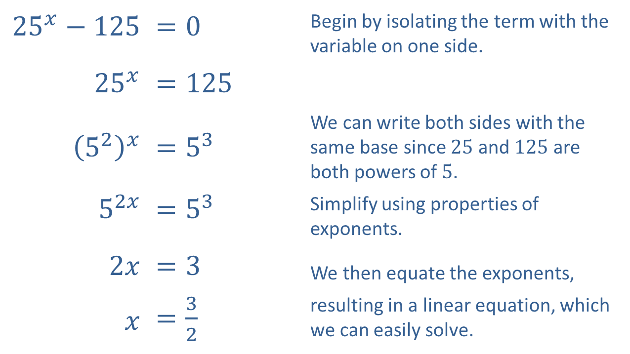
Example 3: Solving Elementary Exponential Equations₂
Solution
​
​${25}^{x}−125$ | ​$=0$ | Begin by isolating the term with the variable on one side.
​${25}^{x}$ | ​$=125$
​${\left(5^{2}\right)}^{x}$ | ​$=5^{3}$ | We can write both sides with the same base since 25 and 125 are both powers of 5.
​$5^{2x}$ | ​$=5^{3}$ | Simplify using properties of exponents.
​$2x$ | ​$=3$ | We then equate the exponents,
$x$ | ​$=\frac{3}{2}$ | resulting in a linear equation, which we can easily solve.

Slide 24
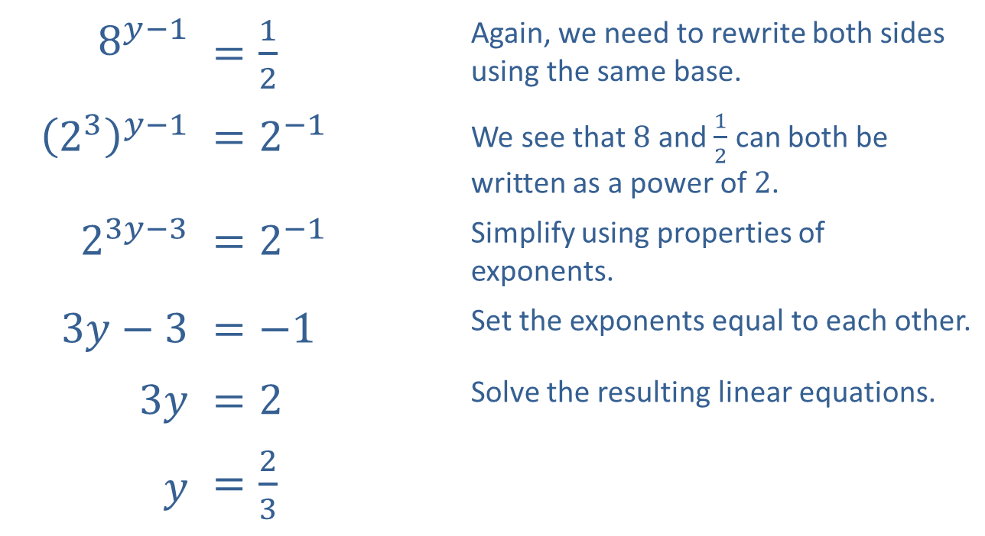
Example 3: Solving Elementary Exponential Equations₃
​
​$8^{y−1}$ | ​$=\frac{1}{2}$ | Again, we need to rewrite both sides using the same base.
​${\left(2^{3}\right)}^{y−1}$ | ​$=2^{−1}$ | We see that 8 and $\frac{1}{2}$ can both be written as a power of 2.
​$2^{3y−3}$ | ​$=2^{−1}$ | Simplify using properties of exponents.
​$3y−3$ | ​$=−1$ | Set the exponents equal to each other.
​$3y$ | ​$=2$ | Solve the resulting linear equations.
$y$ | ​$=\frac{2}{3}$

Slide 25
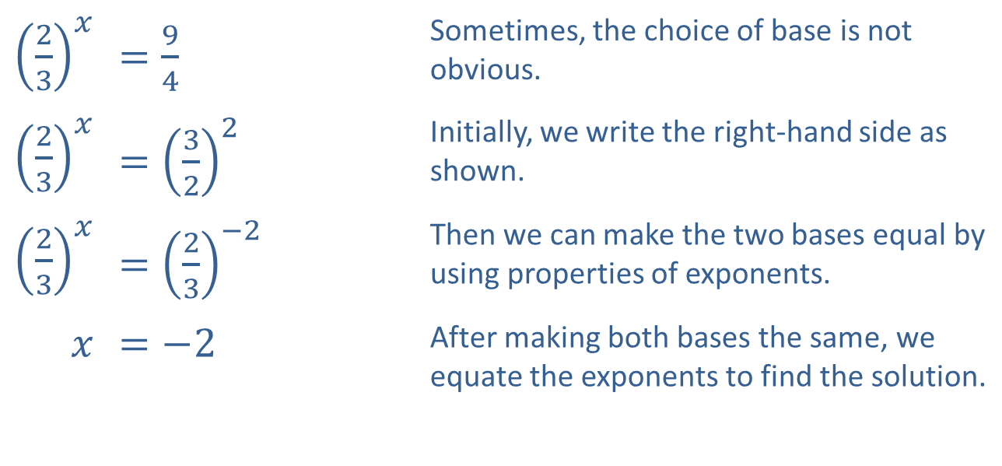
Example 3: Solving Elementary Exponential Equations₄
​${\left(\frac{2}{3}\right)}^{x}$ | ​$=\frac{9}{4}$ | Sometimes, the choice of base is not obvious.
​${\left(\frac{2}{3}\right)}^{x}$ | ​$={\left(\frac{3}{2}\right)}^{2}$ | Initially, we write the right-hand side as shown.
​${\left(\frac{2}{3}\right)}^{x}$ | ​$={\left(\frac{2}{3}\right)}^{−2}$ | Then we can make the two bases equal by using properties of exponents.
$x$ | ​$=−2$ | After making both bases the same, we equate the exponents to find the solution.
​

