Slide 1
Section 5.4
Inverses of Functions

Slide 2
Definition: Inverse of a Relation
Let R be a relation. The inverse of R, denoted
is the relation defined by switching the first and
second coordinates of each ordered pair that is an element of R.

Slide 3
Example 1: Finding the Inverse of a Relation₁
Determine the inverse of each of the following relations. Then graph each relation and its inverse, and determine the domain and range of both.

Slide 4
Example 1: Finding the Inverse of a Relation₂
Solution
a. For each ordered pair, switch the first and second coordinates (x- and y-coordinates).​​​
Recall that the domain is the set of first coordinates, and the range is the set of second coordinates.

Slide 5
Example 1: Finding the Inverse of a Relation₃
​​The relation R consists of three ordered pairs, and its inverse is simply these three ordered pairs with the coordinates exchanged. Note that the domain of R is

Slide 6
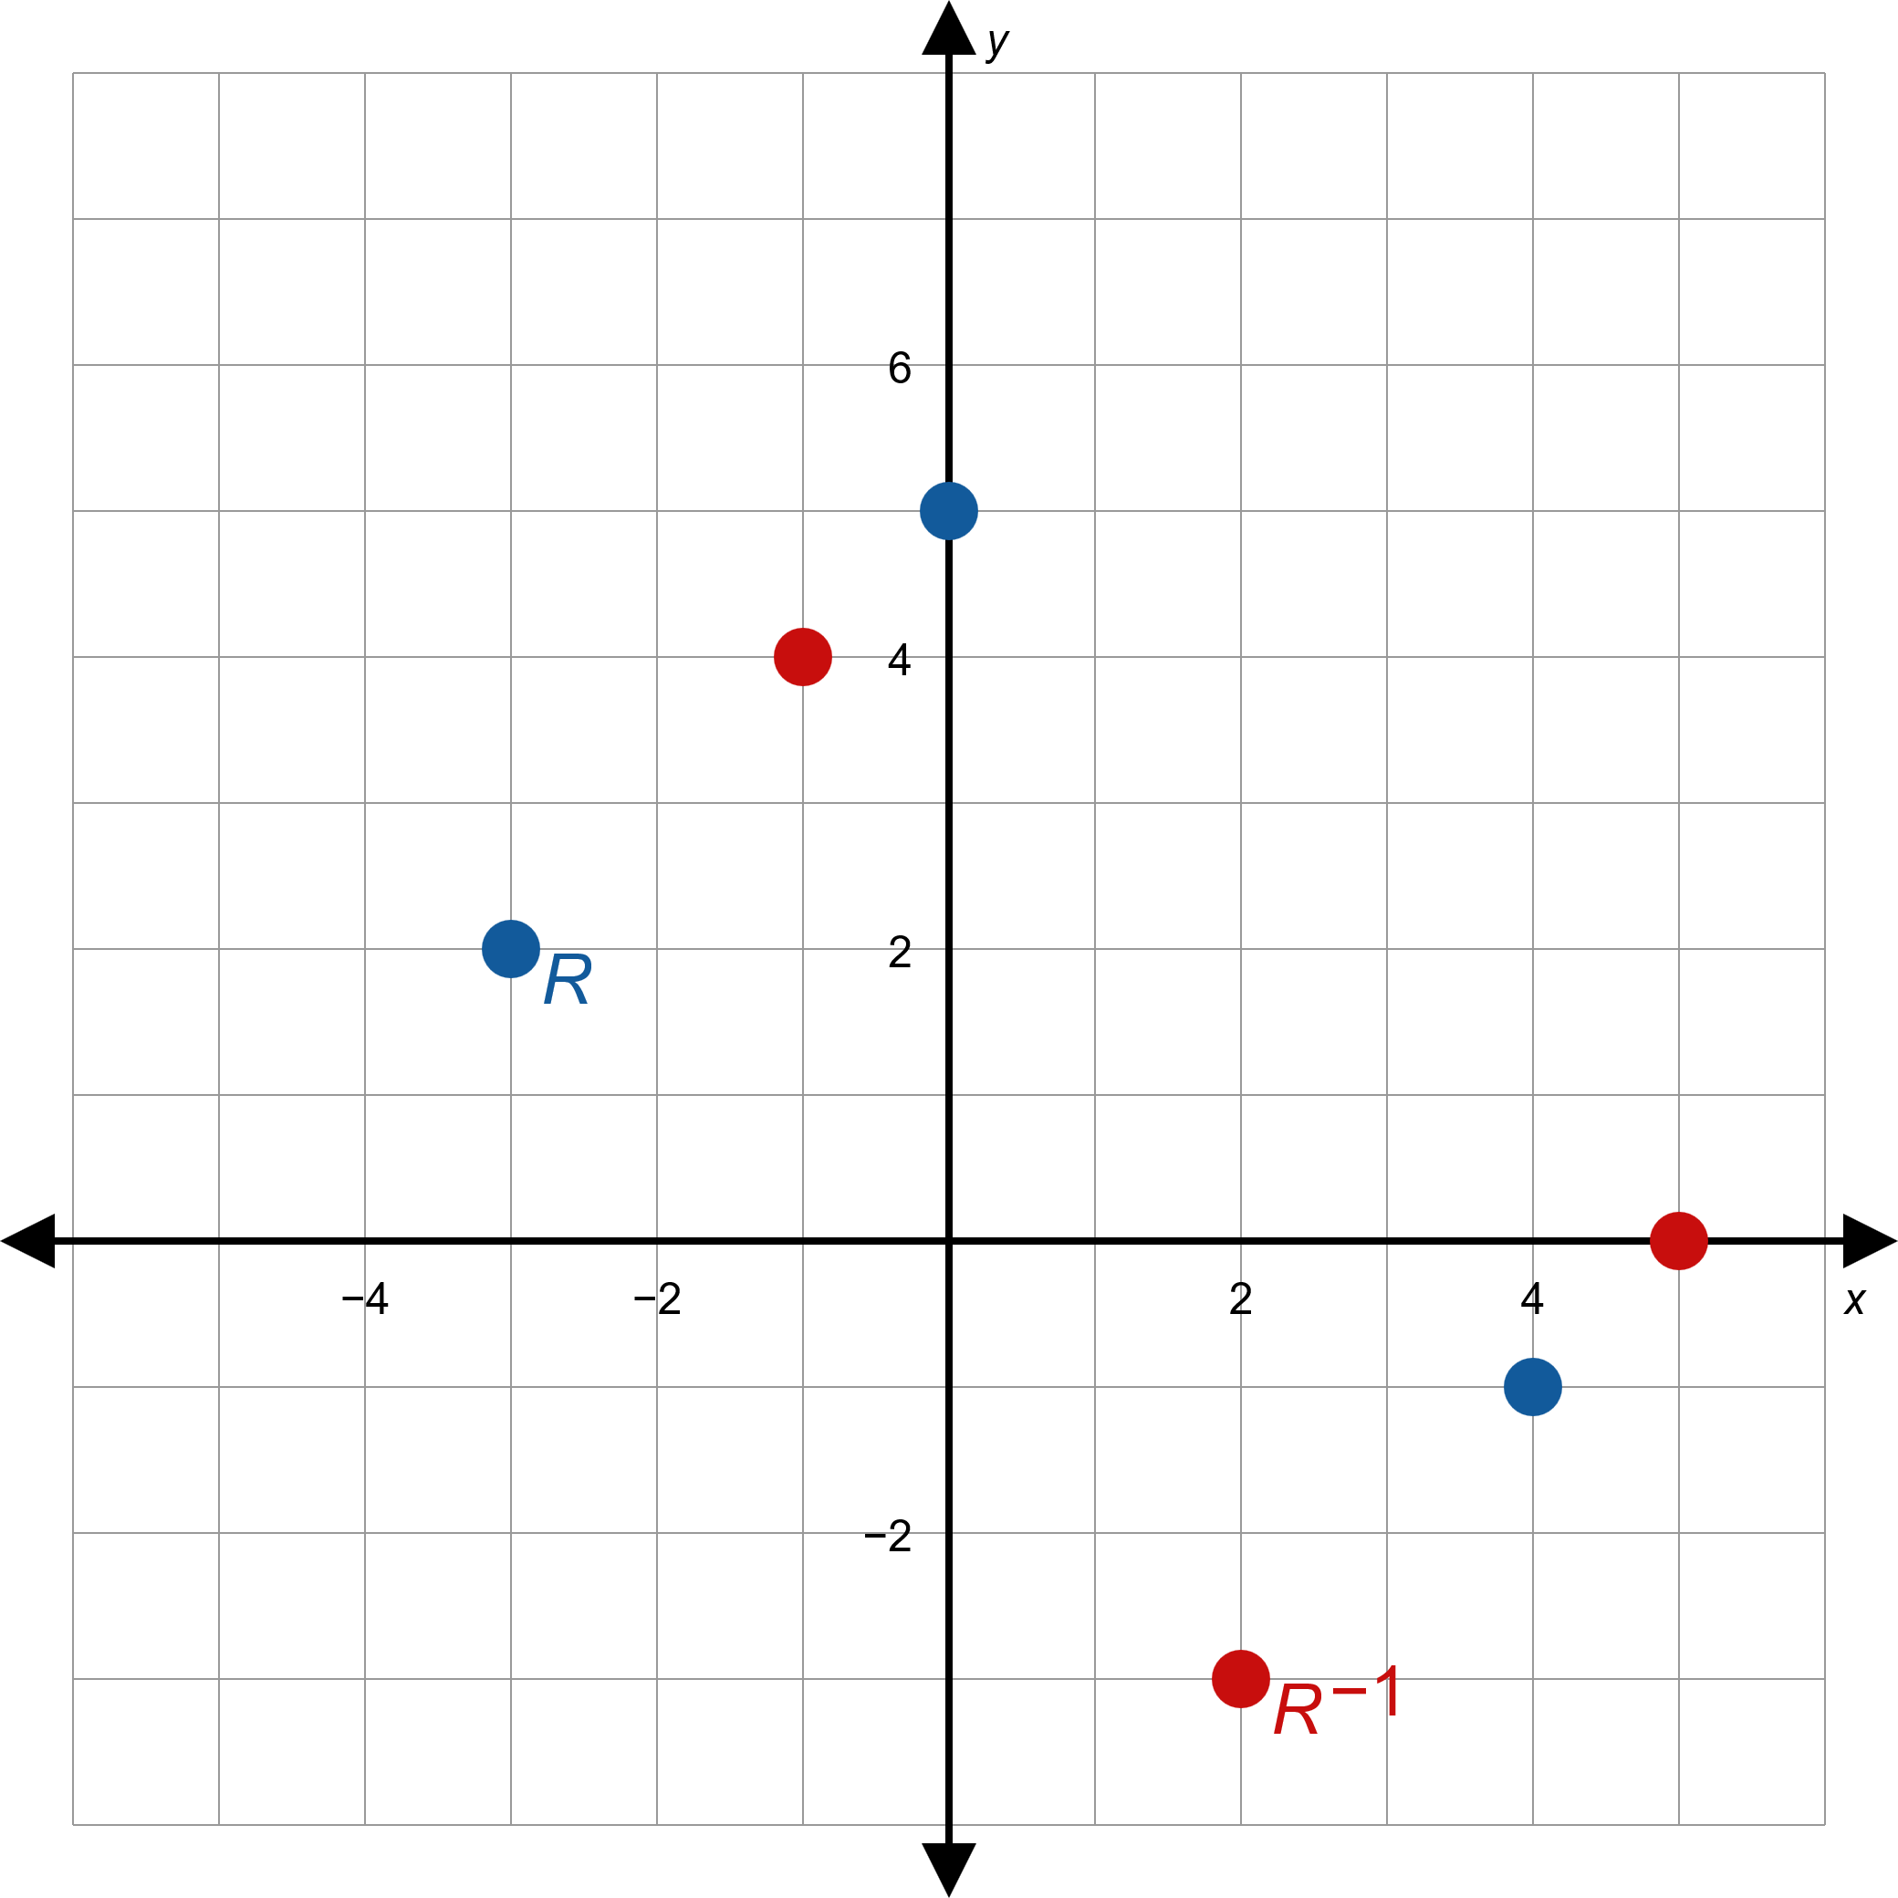
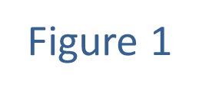
Example 1: Finding the Inverse of a Relation₄

Slide 7
Example 1: Finding the Inverse of a Relation₅
b. In this problem, R is described by the given equation in x and y. The inverse relation is the set of ordered pairs in R with the coordinates exchanged, so we can describe the inverse relation by just exchanging x and y in the equation.
R : Domain = ℝ
Range = ℝ

Slide 8
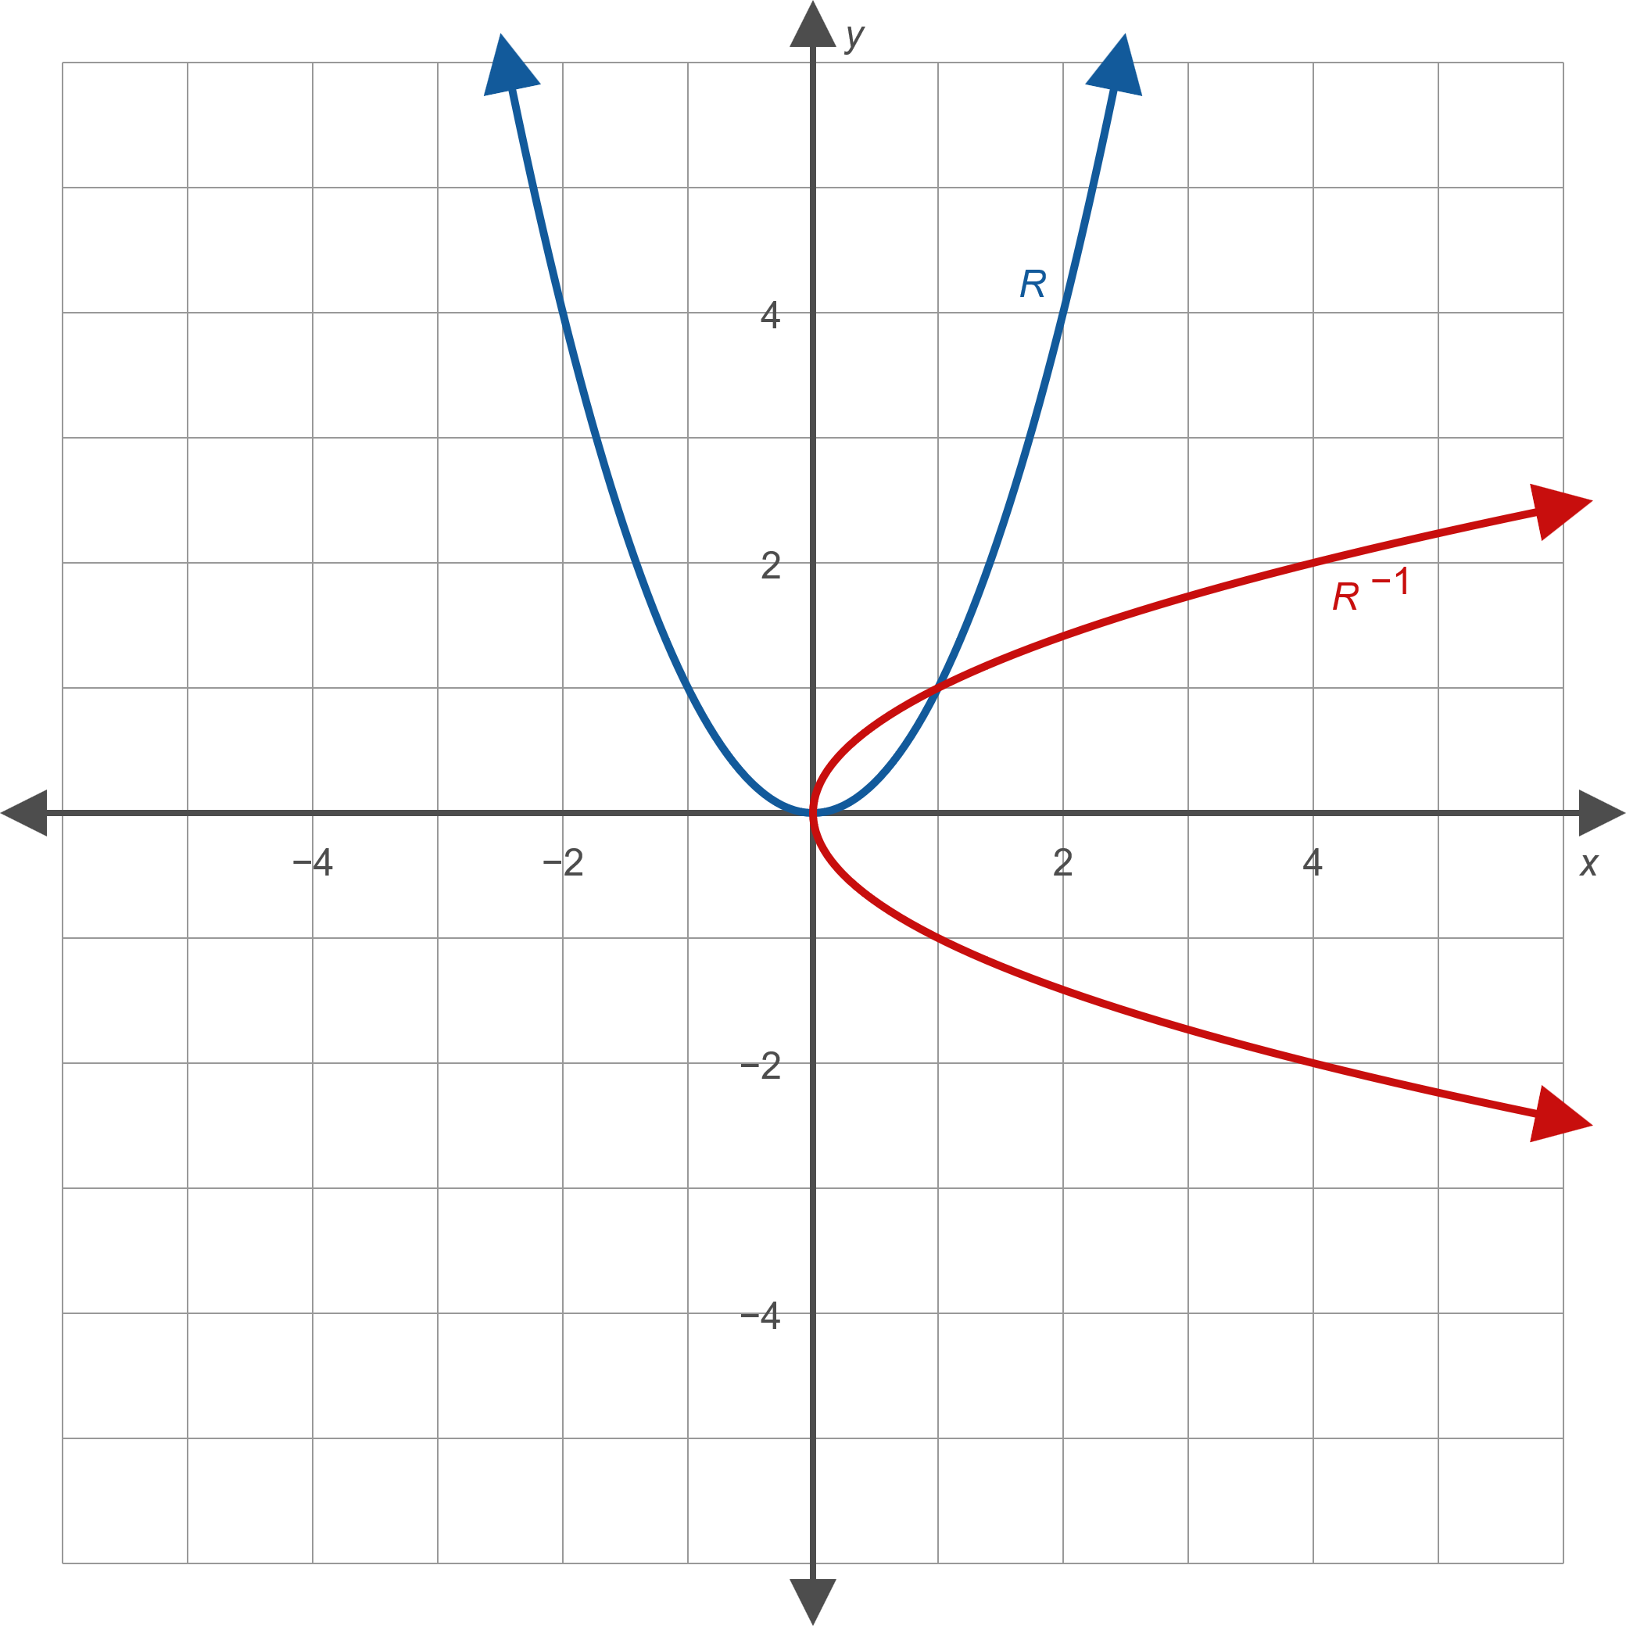
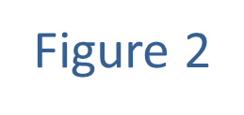
Example 1: Finding the Inverse of a Relation₆

Slide 9
Example 1: Finding the Inverse of a Relation₇
​​Note that the shapes of the graph of the relation and the graph of its inverse are essentially the same.

Slide 10
CAUTION!
We are faced with another example of the reuse of
notation.
function! We use an exponent of −1 to indicate the reciprocal of a number or an algebraic expression, but when applied to a function or a relation it stands for the inverse relation.

Slide 11
Theorem: The Horizontal Line Test
Let f be a function. We say that the graph of f passes the horizontal line test if every horizontal line in the plane intersects the graph no more than once. If f passes the horizontal line test,

Slide 12
Definition: One-to-One Function
A function f is one-to-one if, for every pair of distinct
This means that every element of the
range of f is paired with exactly one element of the domain of f .

Slide 13
Example 2: Inverse Functions₁
Determine if the following functions have inverse functions.

Slide 14
Note
Even when a function f does not have an inverse function, it always has an inverse relation.

Slide 15
Example 2: Inverse Functions₂
Solution
a. The function f does not have an inverse function, a fact demonstrated by showing that its graph does not pass the horizontal line test. We can also prove this algebraically: although −3 ≠ 3, we have
​
Note that it only takes two ordered
pairs to show that f does not have an inverse function.

Slide 16
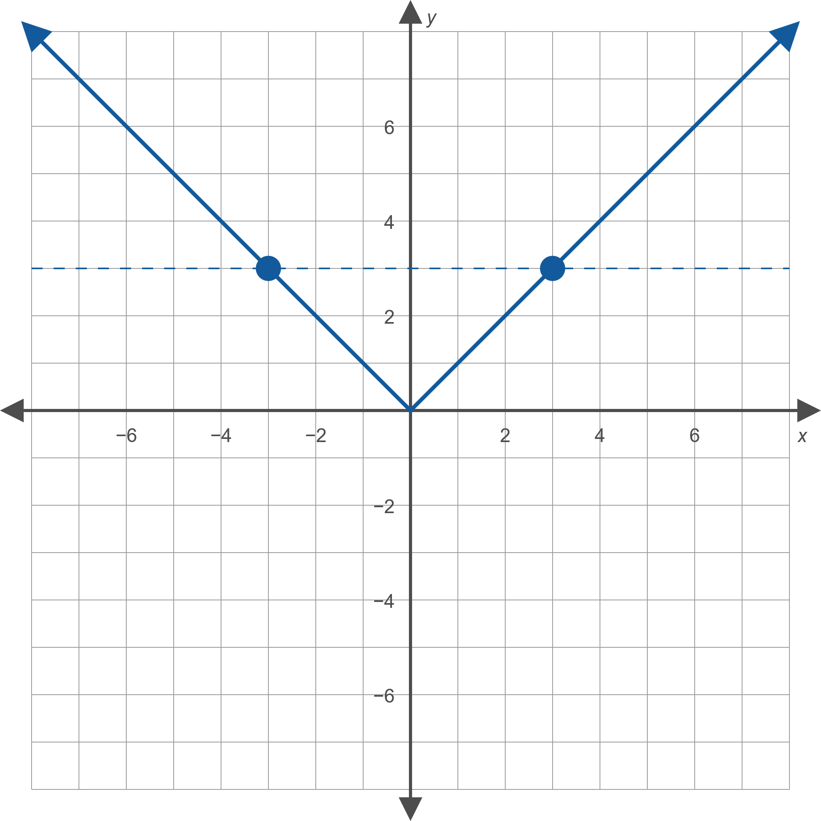
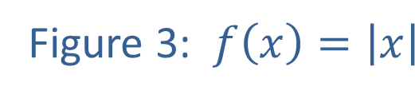
Example 2: Inverse Functions₃

Slide 17
Example 2: Inverse Functions₄
b. ​The graph of g is the standard cubic shape shifted horizontally two units to the left. We can see this graph passes the horizontal line test, so g has an inverse function.
​

Slide 18
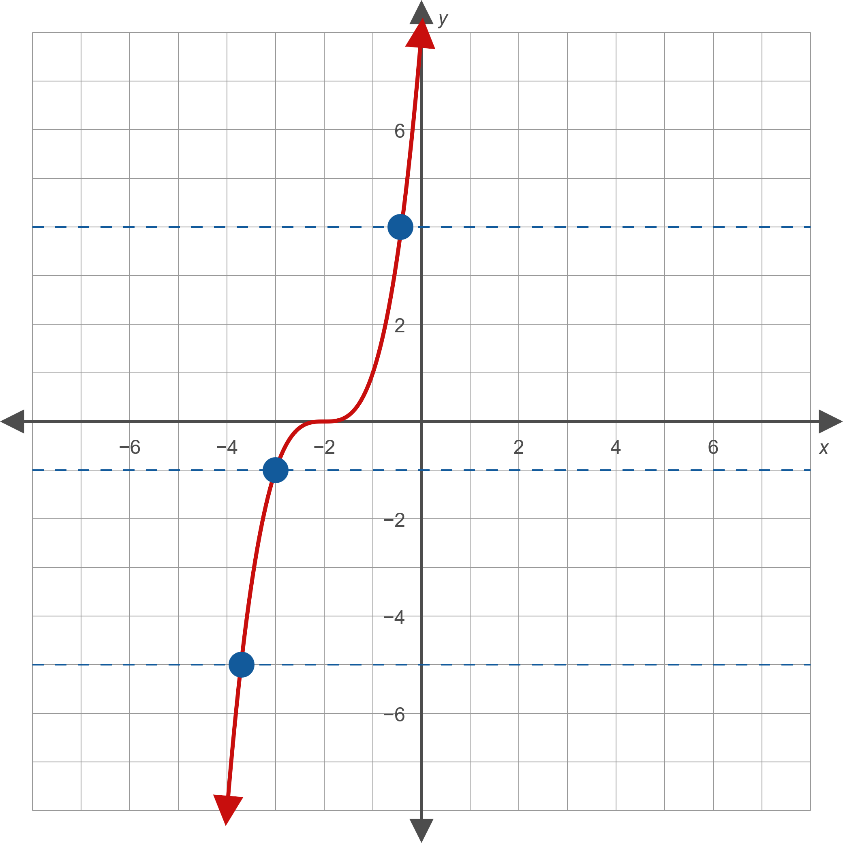
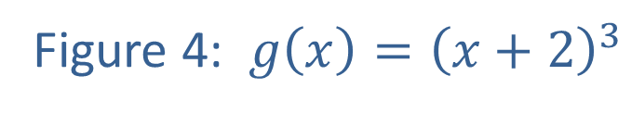
Example 2: Inverse Functions₅

Slide 19
Example 2: Inverse Functions₆
​Algebraically, any two distinct elements of the domain of g lead to different values when substituted into g, so g is one-to-one and hence has an inverse function.

Slide 20
Procedure: Finding Formulas of Inverse Functions
Let f be a one-to-one function, and assume that f is defined by a formula. To find a formula for
the following steps.
Step 1: Replace f(x) in the definition of f with the variable y. The result is an equation in x and y that is solved for y at this point.
Step 2: Solve the equation for x.
Step 3: Replace the x in the resulting equation with

Slide 21
Example 3: Finding Formulas of Inverse Functions₁
Find the inverse of each of the following functions.

Slide 22
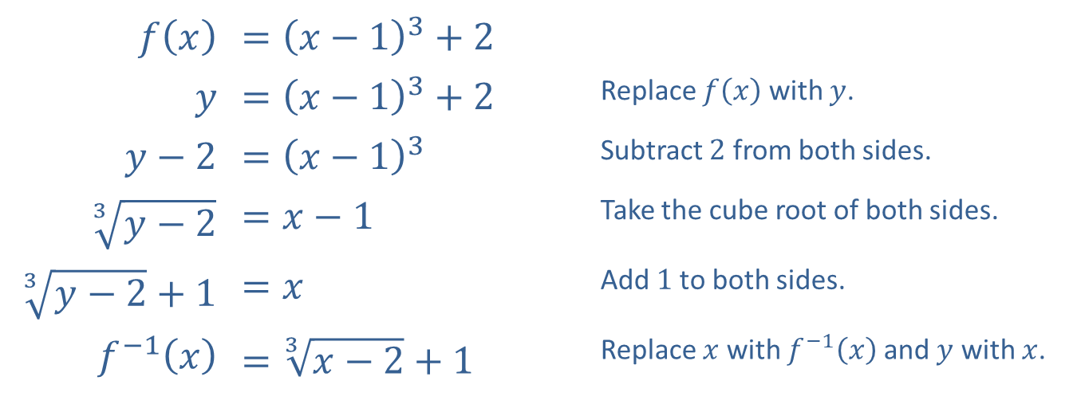
Example 3: Finding Formulas of Inverse Functions₂
Solution
​
​$f⁡\left(x\right)$ | ​$={\left(x−1\right)}^{3}+2$
$$y$$ | ​$={\left(x−1\right)}^{3}+2$ | Replace $f⁡\left(x\right)$ with $y$.
​$y−2$ | ​$={\left(x−1\right)}^{3}$ | Subtract 2 from both sides.
​$\sqrt[3]{y−2}$ | ​$=x−1$ | Take the cube root of both sides.
​$\sqrt[3]{y−2}+1$ | ​$=x$ | Add 1 to both sides.
​$f^{−1}⁡\left(x\right)$ | ​$=\sqrt[3]{x−2}+1$ | Replace $x$ with $f^{−1}⁡\left(x\right)$ and $y$ with $x$.

Slide 23
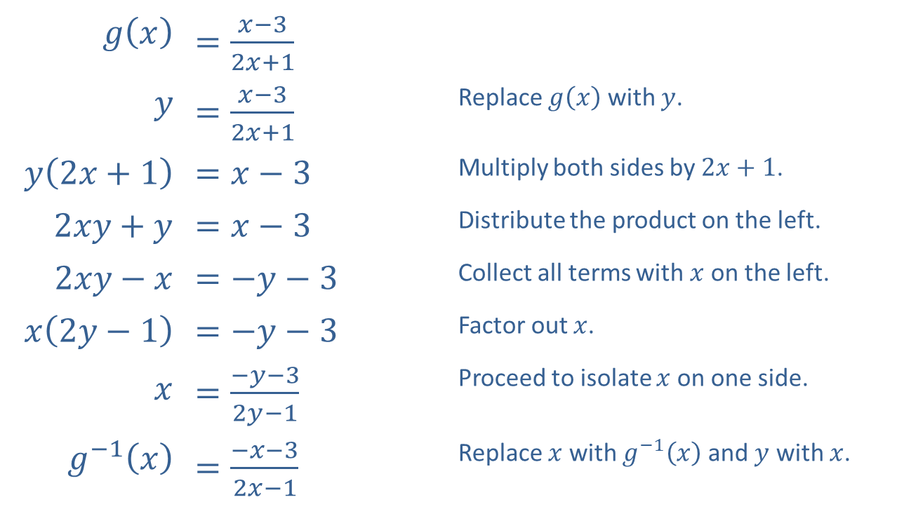
Example 3: Finding Formulas of Inverse Functions₃
​
​$g⁡\left(x\right)$ | ​$=\frac{x−3}{2x+1}$
$$y$$ | ​$=\frac{x−3}{2x+1}$ | Replace $g⁡\left(x\right)$ with $y$.
​$y\left(2x+1\right)$ | ​$=x−3$ | Multiply both sides by $2x+1$.
​$2xy+y$ | ​$=x−3$ | Distribute the product on the left.
​$2xy−x$ | ​$=−y−3$ | Collect all terms with $x$ on the left.
​$x\left(2y−1\right)$ | ​$=−y−3$ | Factor out $x$.
$$x$$ | ​$=\frac{−y−3}{2y−1}$ | Proceed to isolate $x$ on one side.
​$g^{−1}⁡\left(x\right)$ | ​$=\frac{−x−3}{2x−1}$ | Replace $x$ with $g^{−1}⁡\left(x\right)$ and $y$ with $x$.

Slide 24
Example 4: Finding the Inverse of a Restricted-Domain Function₁
Find two suitable restrictions of the domain so that the
find a formula for the inverse for each restricted function.

Slide 25
Example 4: Finding the Inverse of a Restricted-Domain Function₂
Solution
The graph of f is an upward-opening parabola with vertex at (−1, −3), as shown in Figure 5. We can restrict its domain so that the resulting function is
one-to-one by requiring either that

Slide 26
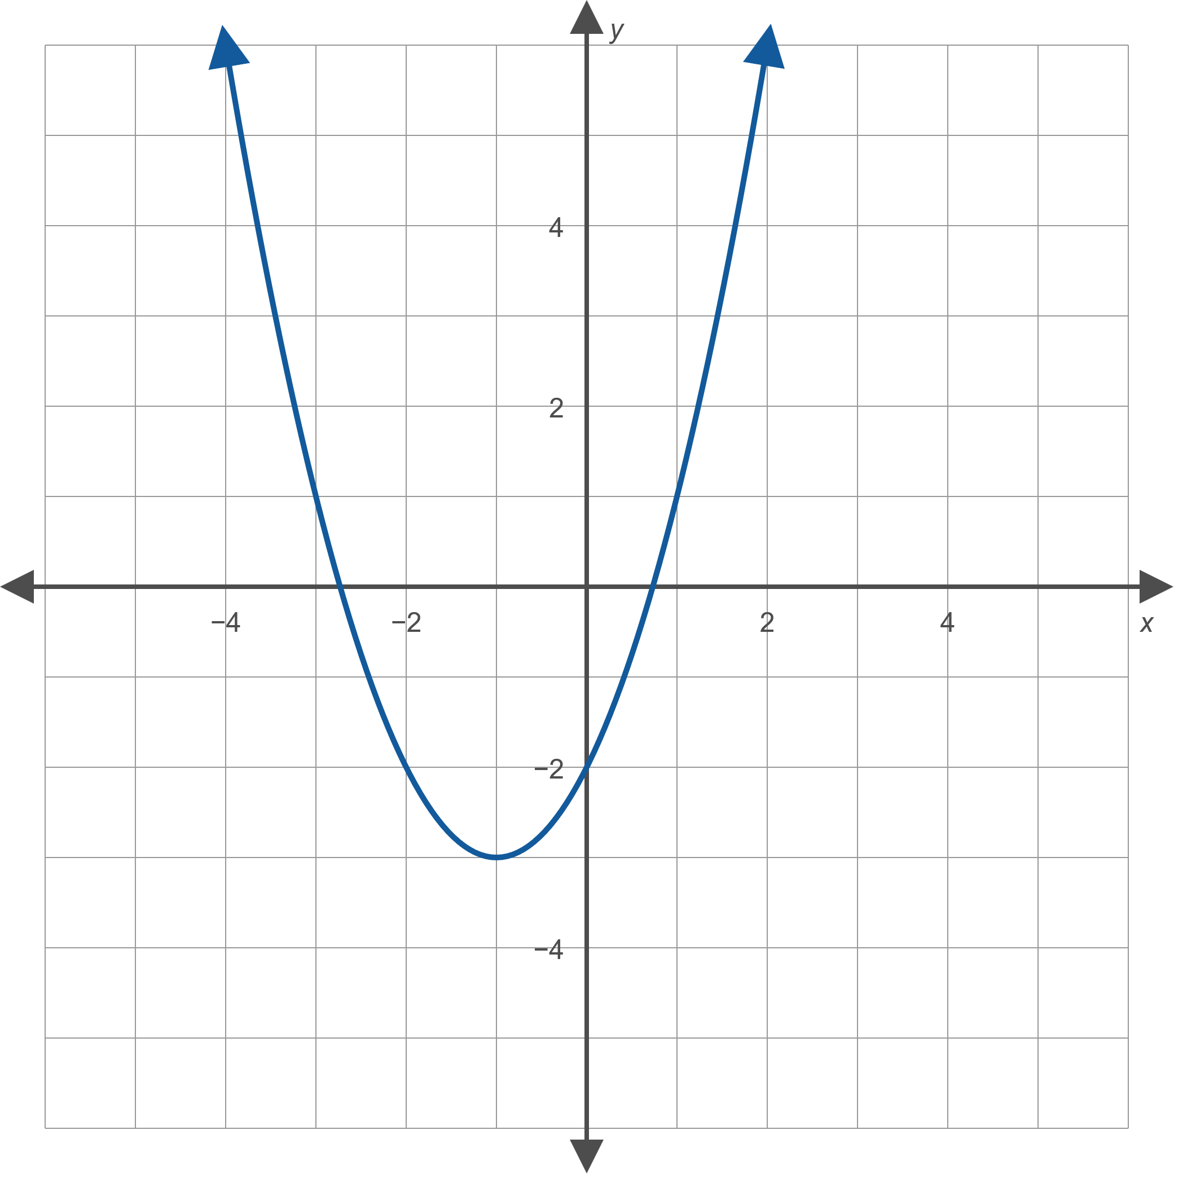
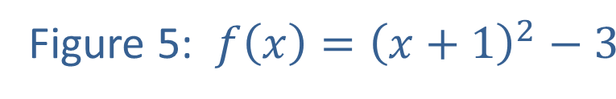
Example 4: Finding the Inverse of a Restricted-Domain Function₃

Slide 27
Example 4: Finding the Inverse of a Restricted-Domain Function₄
Choice 1: If we choose
as the domain of the
restricted function, then the expression x + 1 is guaranteed to be nonnegative. We will use this fact as we work through the procedure to find a formula for the inverse function.

Slide 28
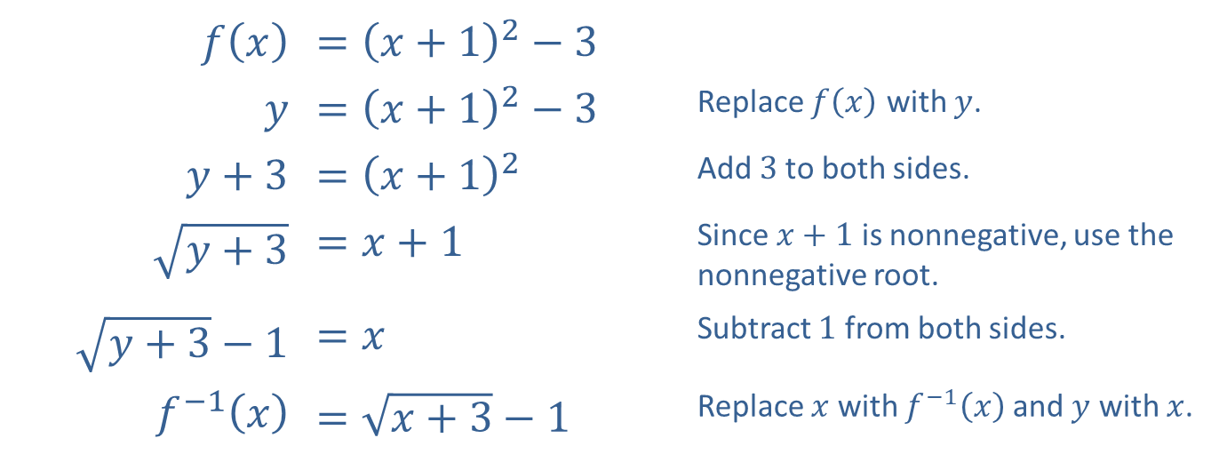
Example 4: Finding the Inverse of a Restricted-Domain Function₅
​$f⁡\left(x\right)$ | ​$={\left(x+1\right)}^{2}−3$
$$y$$ | ​$={\left(x+1\right)}^{2}−3$ | Replace $f⁡\left(x\right)$ with $y$.
​$y+3$ | ​$={\left(x+1\right)}^{2}$ | Add 3 to both sides.
​$\sqrt{y+3}$ | ​$=x+1$ | Since $x+1$ is nonnegative, use the nonnegative root.
​$\sqrt{y+3}−1$ | ​$=x$ | Subtract 1 from both sides.
​$f^{−1}⁡\left(x\right)$ | ​$=\sqrt{x+3}−1$ | Replace $x$ with $f^{−1}⁡\left(x\right)$ and $y$ with $x$.

Slide 29
Example 4: Finding the Inverse of a Restricted-Domain Function₆
Figure 6 shows the graph of the function f restricted to the domain
along with a graph of the function's
inverse.

Slide 30
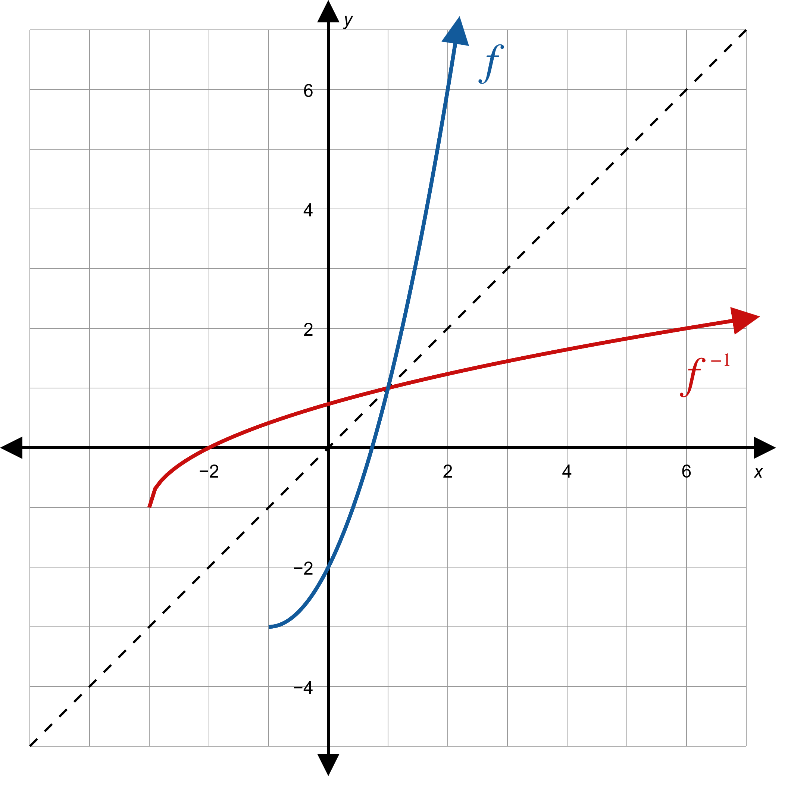
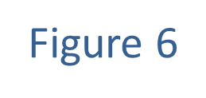
Example 4: Finding the Inverse of a Restricted-Domain Function₇

Slide 31
Example 4: Finding the Inverse of a Restricted-Domain Function₈
Choice 2: If instead we choose
as the domain of the restricted function, then the expression x + 1 is guaranteed to be nonpositive. This fact will lead us to choose the other possible root when we take the square root in the following procedure.

Slide 32
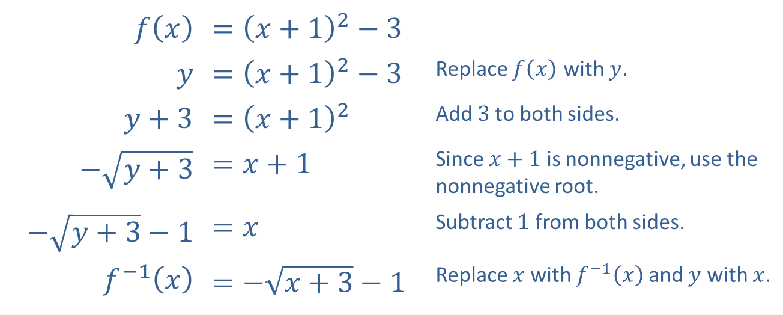
Example 4: Finding the Inverse of a Restricted-Domain Function₉
​$f⁡\left(x\right)$ | ​$={\left(x+1\right)}^{2}−3$
$$y$$ | ​$={\left(x+1\right)}^{2}−3$ | Replace $f⁡\left(x\right)$ with $y$.
​$y+3$ | ​$={\left(x+1\right)}^{2}$ | Add 3 to both sides.
​$−\sqrt{y+3}$ | ​$=x+1$ | Since $x+1$ is nonnegative, use the nonnegative root.
​$−\sqrt{y+3}−1$ | ​$=x$ | Subtract 1 from both sides.
​$f^{−1}⁡\left(x\right)$ | ​$=−\sqrt{x+3}−1$ | Replace $x$ with $f^{−1}⁡\left(x\right)$ and $y$ with $x$.

Slide 33
Example 4: Finding the Inverse of a Restricted-Domain Function₁₀
Figure 7 shows the graph of f restricted to this domain, along with the corresponding inverse function.

Slide 34
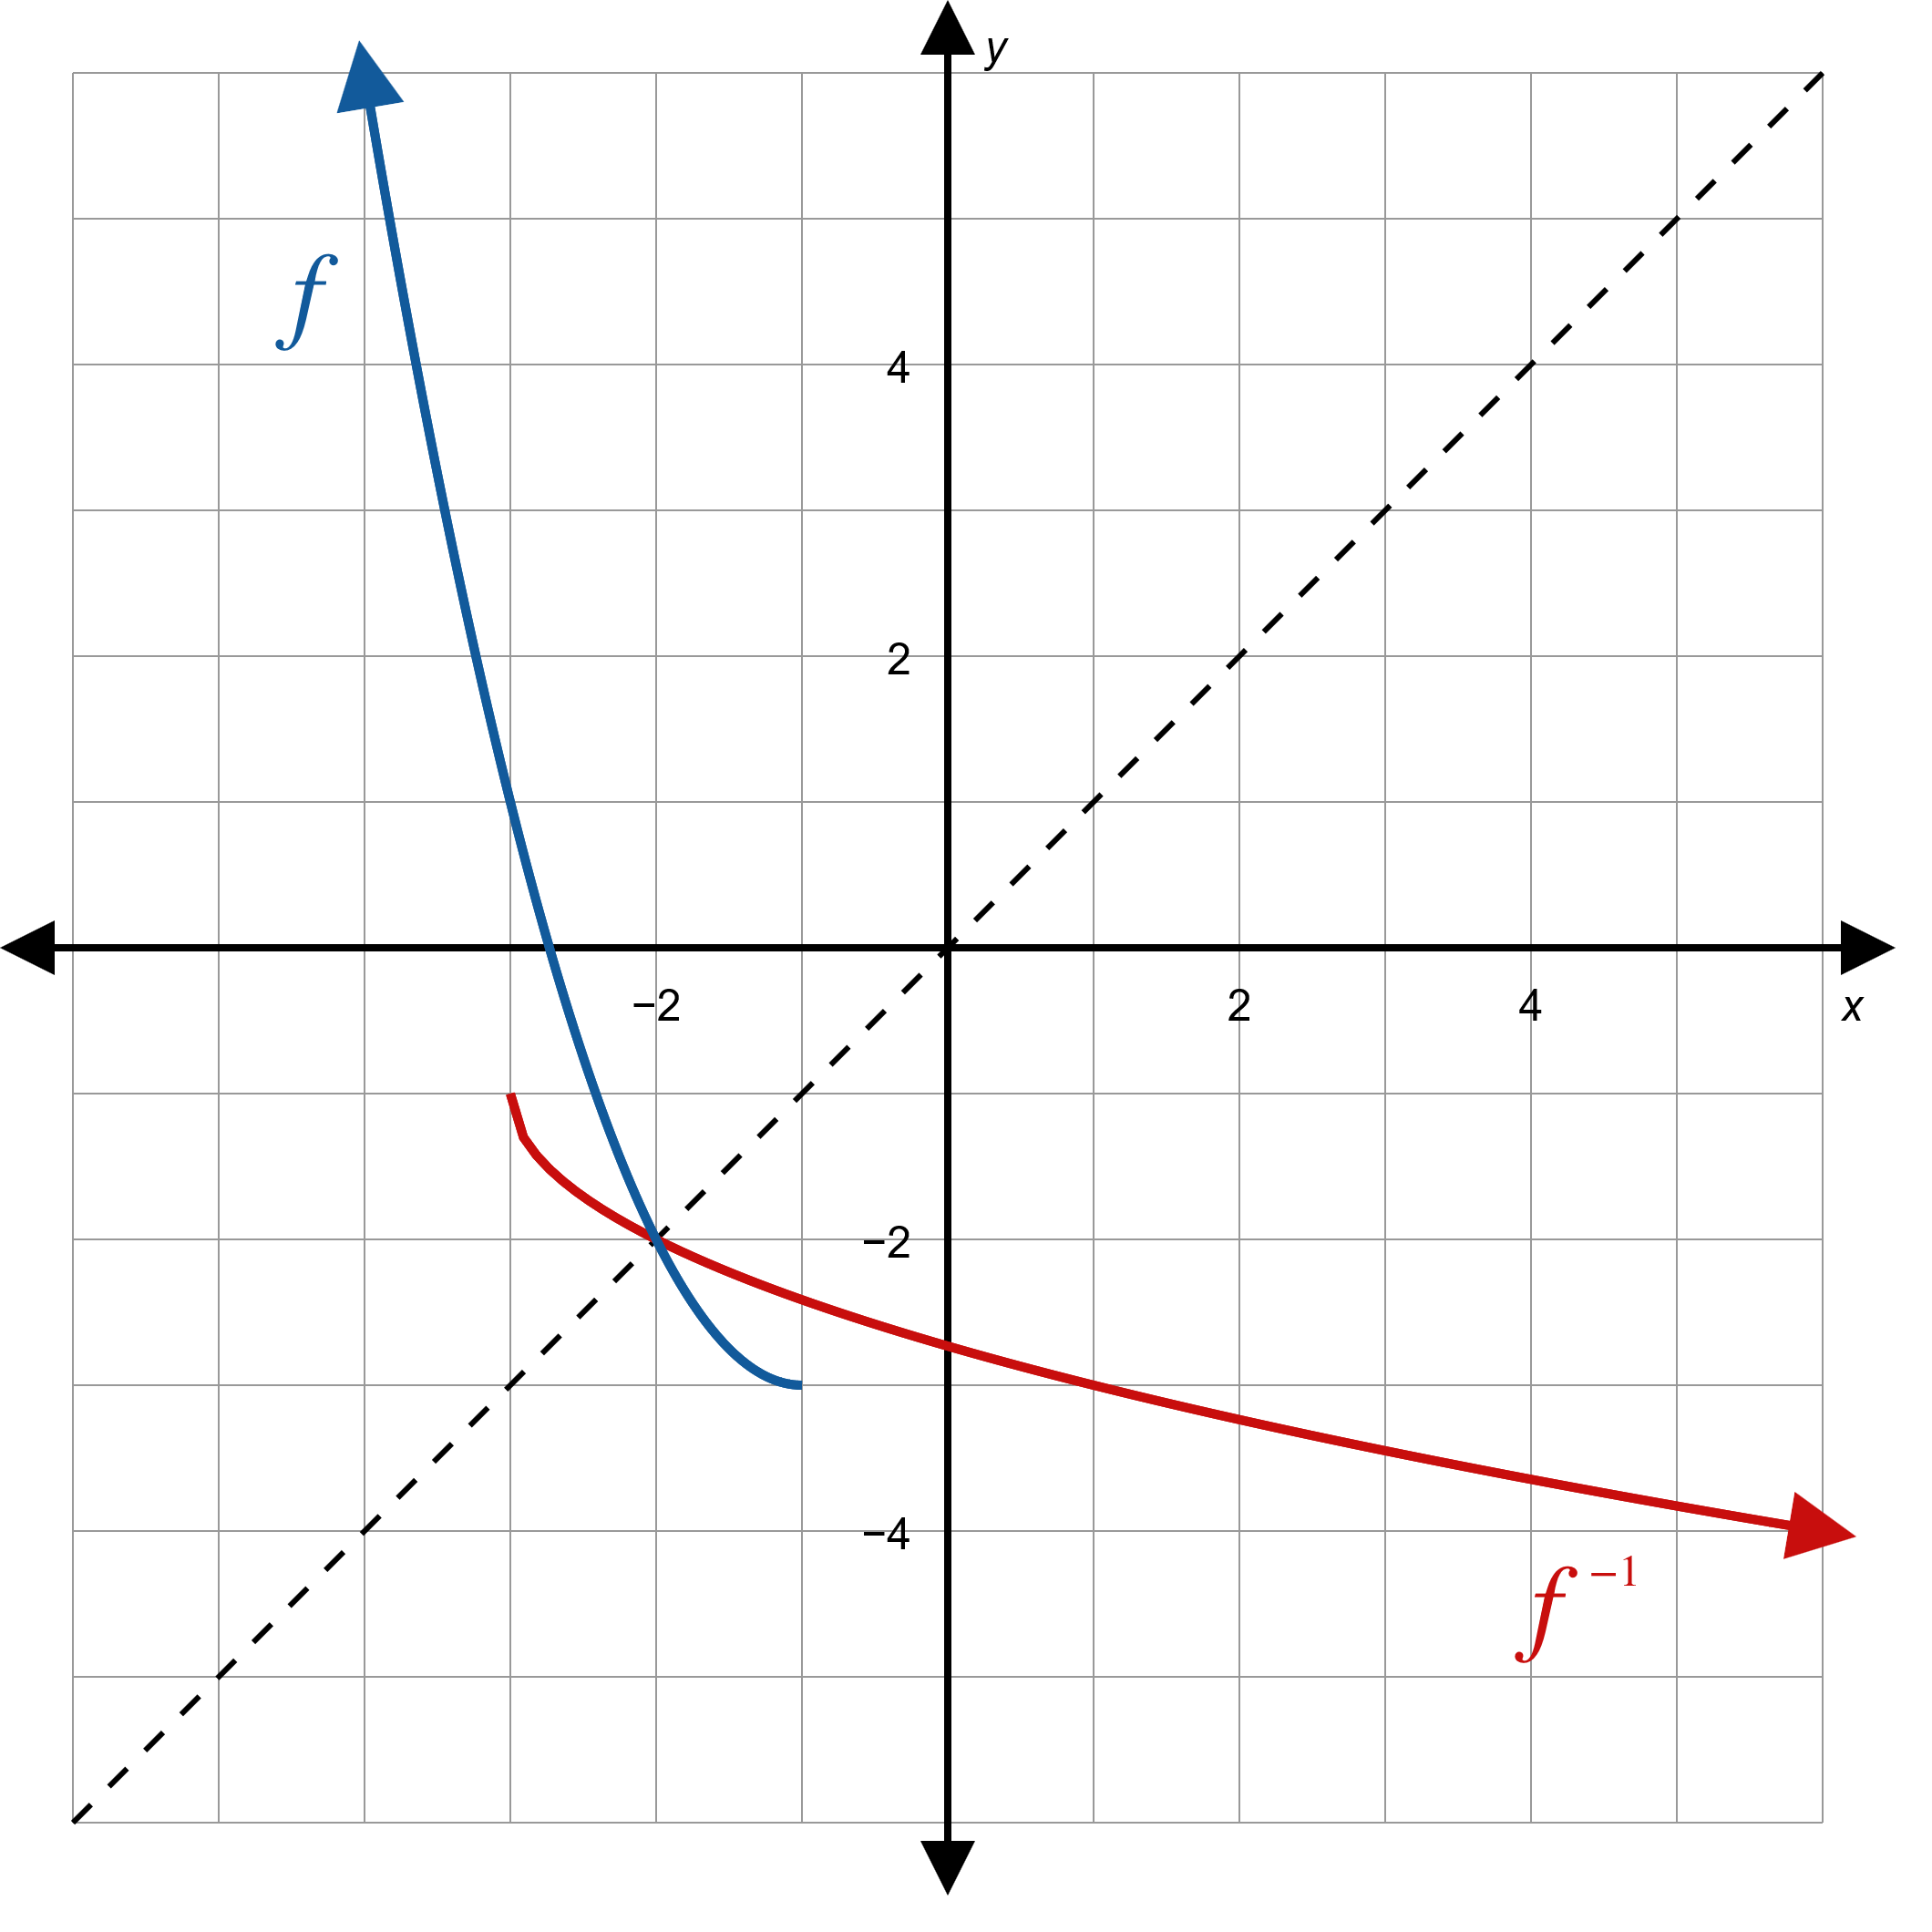
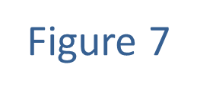
Example 4: Finding the Inverse of a Restricted-Domain Function₁₁

Slide 35
Theorem: Composition of Functions and Inverses
Given a function f and its inverse
statements are true:

Slide 36
Example 5: Composition of Functions and Inverses₁
Use the functions f and g of Example 3 to demonstrate that the composition of a function and its inverse leaves any input unchanged.

Slide 37
Example 5: Composition of Functions and Inverses₂
Solution
  A similar calculation shows that
should verify.

Slide 38
Example 5: Composition of Functions and Inverses₃

