Slide 1
Section 5.1
Transformations of Functions

Slide 2
Theorem: Horizontal Shifting/Translation
Let f (x) be a function, and let h be a fixed real number. If we replace x with x − h, we obtain a new function
The graph of g has the same shape as
the graph of f, but shifted h units to the right if h > 0
and shifted

Slide 3
Example 1: Horizontal Shifting/Translation₁
Sketch the graphs of the following functions.

Slide 4
Note₁
Begin by identifying the underlying function that is being shifted.

Slide 5
Example 1: Horizontal Shifting/Translation₂
Solution
​The basic function being shifted is x³. ​Begin by drawing the basic cubic shape (the shape of y = x³). Since x is replaced with x + 2, the graph of f(x) is the graph of x³ shifted 2 units to the left. Note, for example, that (−2, 0) is one point on the graph.
​

Slide 6
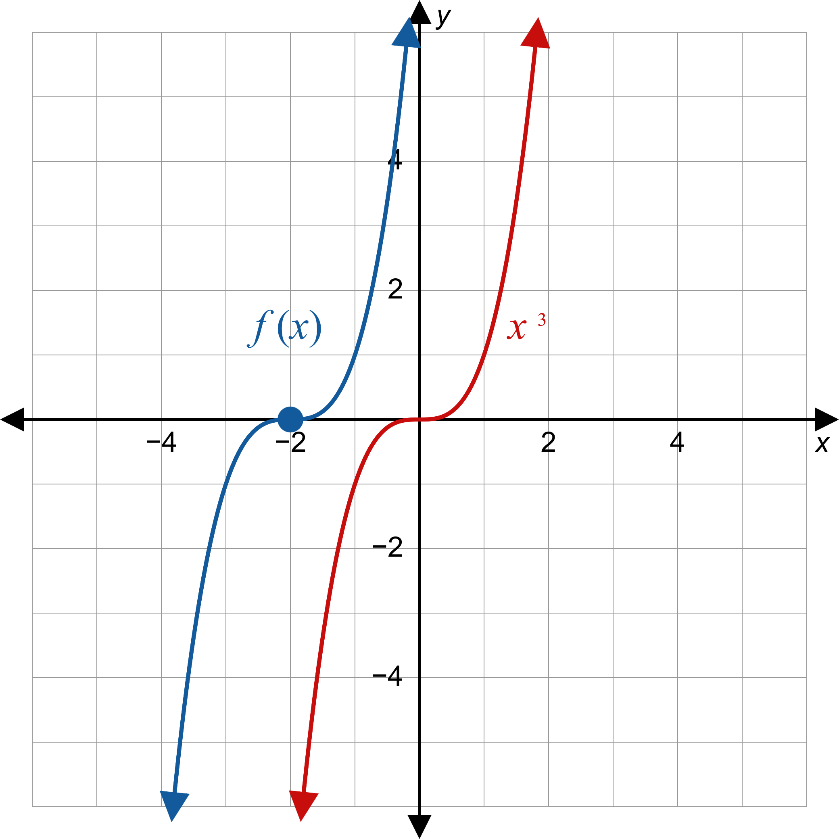

Example 1: Horizontal Shifting/Translation₃

Slide 7
Example 1: Horizontal Shifting/Translation₄
​The basic function being shifted is
​
Start by graphing the basic absolute value function.
The graph of
has the same shape,
but shifted 4 units to the right.
​Note, for example, that (4, 0) lies on the graph of g.

Slide 8
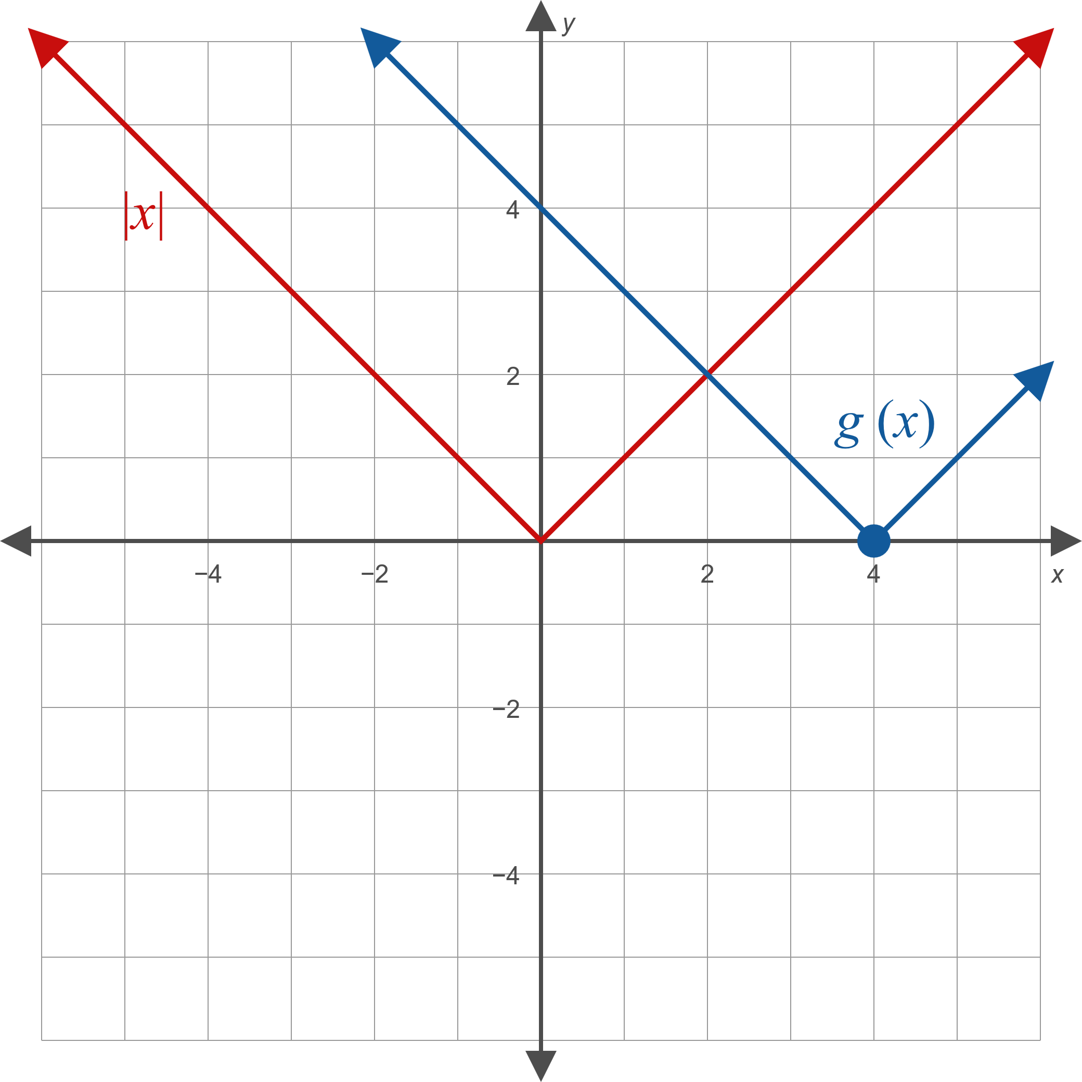

Example 1: Horizontal Shifting/Translation₅

Slide 9
CAUTION!
The minus sign in the expression x − h is critical. When you see an expression in the form x + h you must think of it as
Consider a specific example: replacing x with x − 5 shifts the graph 5 units to the right, since 5 is positive. Replacing x with x + 5 shifts the graph 5 units to the
left, since we have actually replaced x with

Slide 10
Theorem: Vertical Shifting/Translation
Let f(x) be a function whose graph is known, and let k be a fixed real number. The graph of the function g(x) = f(x) + k is the same shape as the graph of f, but shifted k units up if k > 0 and

Slide 11
Example 2: Vertical Shifting/Translation₁
Sketch the graphs of the following functions.

Slide 12
Note₂
As before, begin by identifying the basic function being shifted.

Slide 13
Example 2: Vertical Shifting/Translation₂
Solution
​The basic function being shifted is
​
​
The graph of
is the graph of
shifted 3 units up.

Slide 14
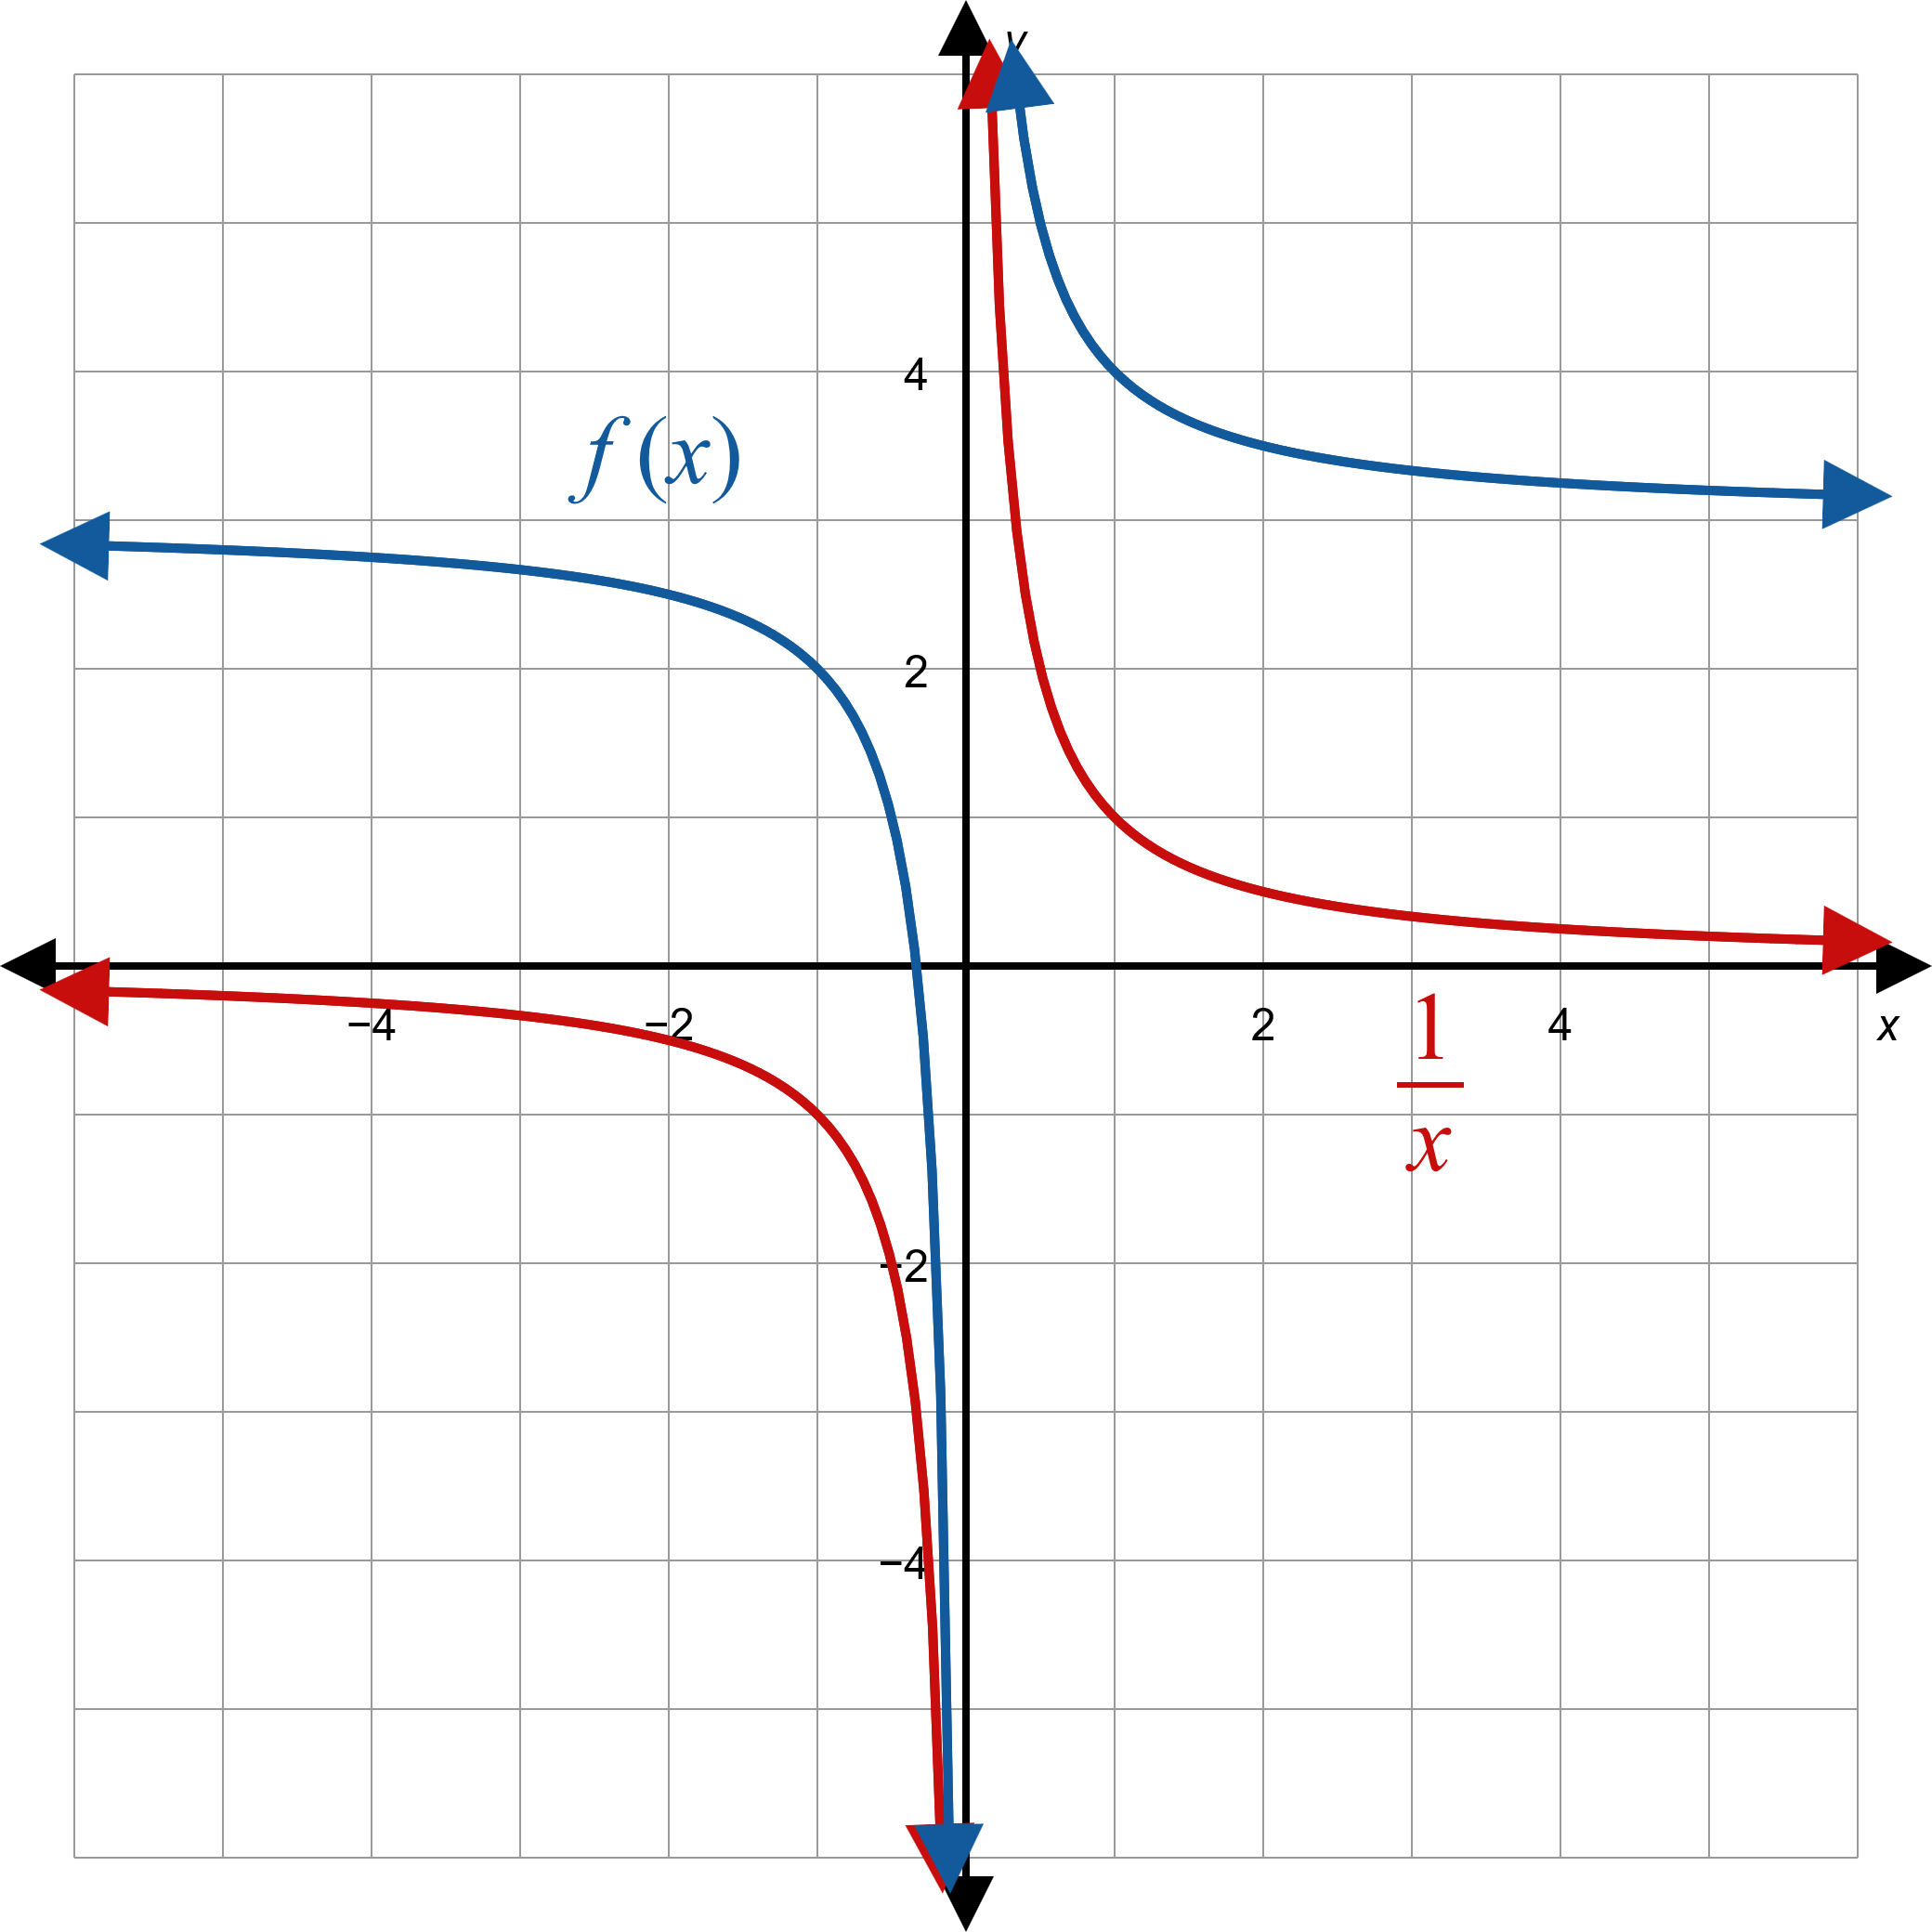
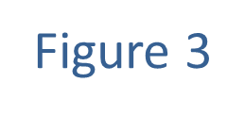
Example 2: Vertical Shifting/Translation₃

Slide 15
Example 2: Vertical Shifting/Translation₄
​Note that this doesn't change the domain.
​However, the range is affected; the range of f is

Slide 16
Example 2: Vertical Shifting/Translation₅
​The basic function being shifted is
​​
Begin by graphing the basic cube root shape.
​To graph
the graph of
is shifted 2 units down.

Slide 17
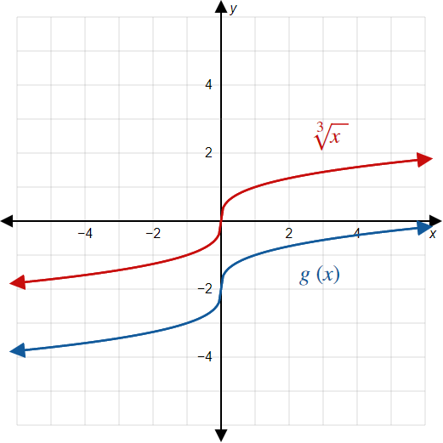

Example 2: Vertical Shifting/Translation₆

Slide 18
Example 3: Horizontal and Vertical Shifting₁
Sketch the graph of the function

Slide 19
Note₃
In this case, it doesn't matter which shift we apply first. However, when functions get more complicated, it is usually best to apply horizontal shifts before vertical shifts.

Slide 20
Example 3: Horizontal and Vertical Shifting₂
Solution
The basic function being shifted is √x. Begin by graphing the basic square root shape.
In f(x) we have replaced x with x + 4, so shift the basic function 4 units to the left.
Then shift the resulting function 1 unit up.

Slide 21
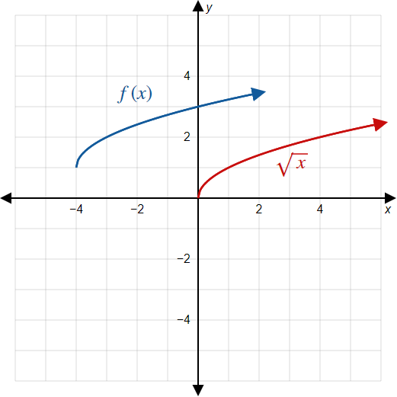

Example 3: Horizontal and Vertical Shifting₃

Slide 22
Theorem: Reflecting with Respect to the Axes
Given a function f(x),
​the graph of the function g(x) = −f(x) is the reflection of the graph of f with respect to the x-axis;
​the graph of the function
is the reflection
of the graph of f with respect to the y-axis.
In other words, a function is reflected with respect to the x-axis by multiplying the entire function by −1, and it is reflected with respect to the y-axis by replacing x with −x.

Slide 23
Example 4: Reflecting with Respect to the Axes₁
Sketch the graphs of the following functions.

Slide 24
Note₄
We state that a function is reflected with respect to a particular axis. Visually, this means the function is reflected over (across) that axis.

Slide 25
Example 4: Reflecting With Respect to the Axes₂
Solution
​To graph f (x) = −x ², begin with the graph of the basic parabola y = x ².
​The entire function is multiplied by −1, so reflect the graph over the x-axis, resulting in the original shape turned upside down.
​

Slide 26
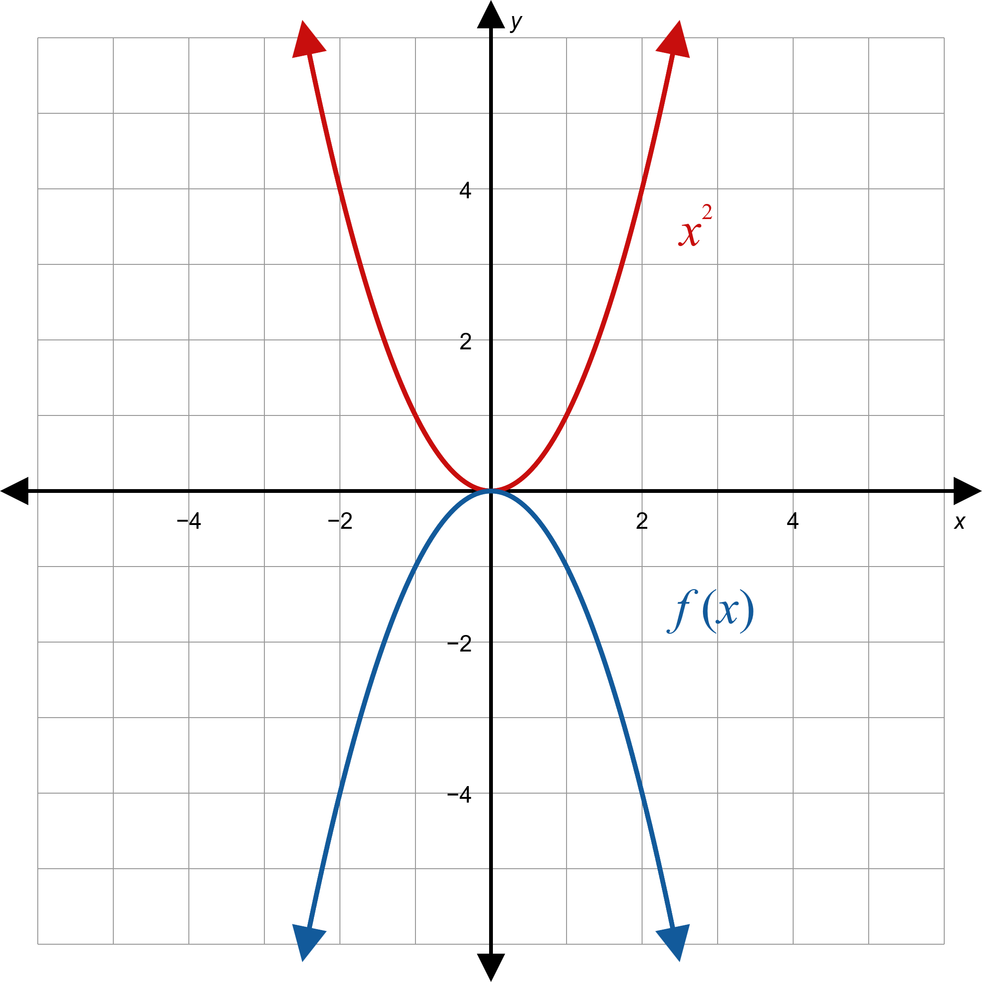

Example 4: Reflecting With Respect to the Axes₃

Slide 27
Example 4: Reflecting With Respect to the Axes₄
Note that the domain is still the entire real line, but the range of f is the interval

Slide 28
Example 4: Reflecting With Respect to the Axes₅
​To graph g(x) = √−x, begin by graphing y = √x, the basic square root function. In g(x), x has been replaced with −x, so reflect the graph with respect to the y-axis.

Slide 29
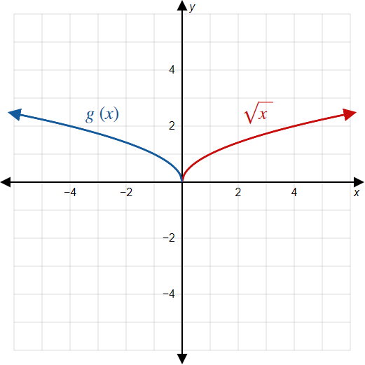

Example 4: Reflecting With Respect to the Axes₆

Slide 30
Example 4: Reflecting With Respect to the Axes₇
Note that this changes the domain but not the range. The domain of g is the interval
and the range is​

Slide 31
Theorem: Vertical Stretching and Compressing
Let f(x) be a function and let a be a positive real number.
​The graph of the function g(x) = a f(x) is stretched vertically compared to the graph of f by a factor of a if a > 1.
​The graph of the function g(x) = a f(x) is compressed vertically compared to the graph of f by a factor of a if 0 < a < 1.

Slide 32
Example 5: Vertical Stretching and Compressing₁
Sketch the graphs of the following functions.

Slide 33
Note₅
When graphing stretched or compressed functions, it may help to plot a few points of the new function.

Slide 34
Example 5: Vertical Stretching and Compressing₂
Solution
​Begin with the graph of √x. The shape of f(x) is similar to the shape of √x, but all of the y-coordinates have been multiplied by the factor of
and are consequently much smaller.

Slide 35
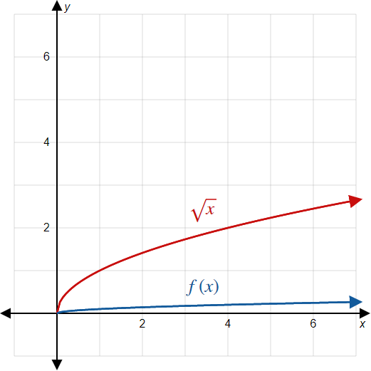

Example 5: Vertical Stretching and Compressing₃

Slide 36
Example 5: Vertical Stretching and Compressing₄
​Begin with the graph of the absolute value function.
​In contrast to the last example, the graph of
is stretched compared to the standard absolute value function.
​Every second coordinate is multiplied by a factor of 5.

Slide 37
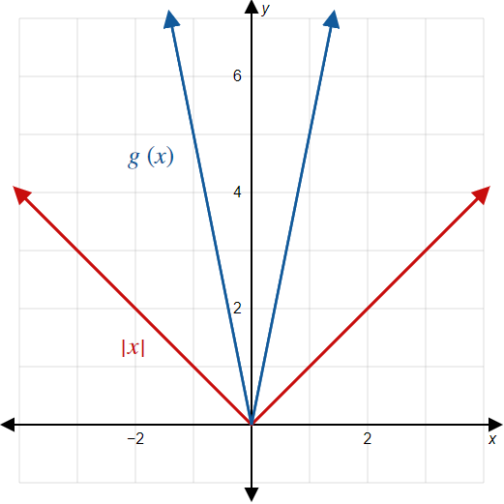

Example 5: Vertical Stretching and Compressing₅

Slide 38
Theorem: Horizontal Stretching and Compressing
Let f(x) be a function and let a be a positive real number.
​The graph of the function
is stretched horizontally compared to the graph of f
by a factor of
The graph of the function
is compressed horizontally compared to the
graph of f by a factor of

Slide 39
Example 6: Horizontal Stretching and Compressing₁
Sketch the graph of the function

Slide 40
Example 6: Horizontal Stretching and Compressing₂
Solution
We obtain the argument
From x by multiplying by the
constant
which means the graph of
is stretched
out compared to the graph of x³ by a factor of
or 3. So, for instance, the point (1, 1) on the graph of x³ corresponds to the point (3, 1) on the graph of f.

Slide 41
Example 6: Horizontal Stretching and Compressing₃
Alternatively, we can rewrite the definition of f as
which we can interpret as the product of the constant
and the function x³. Thinking of f in this manner,
the graph of f is compressed vertically by a factor of
compared to the graph of x³, with the same result.

Slide 42
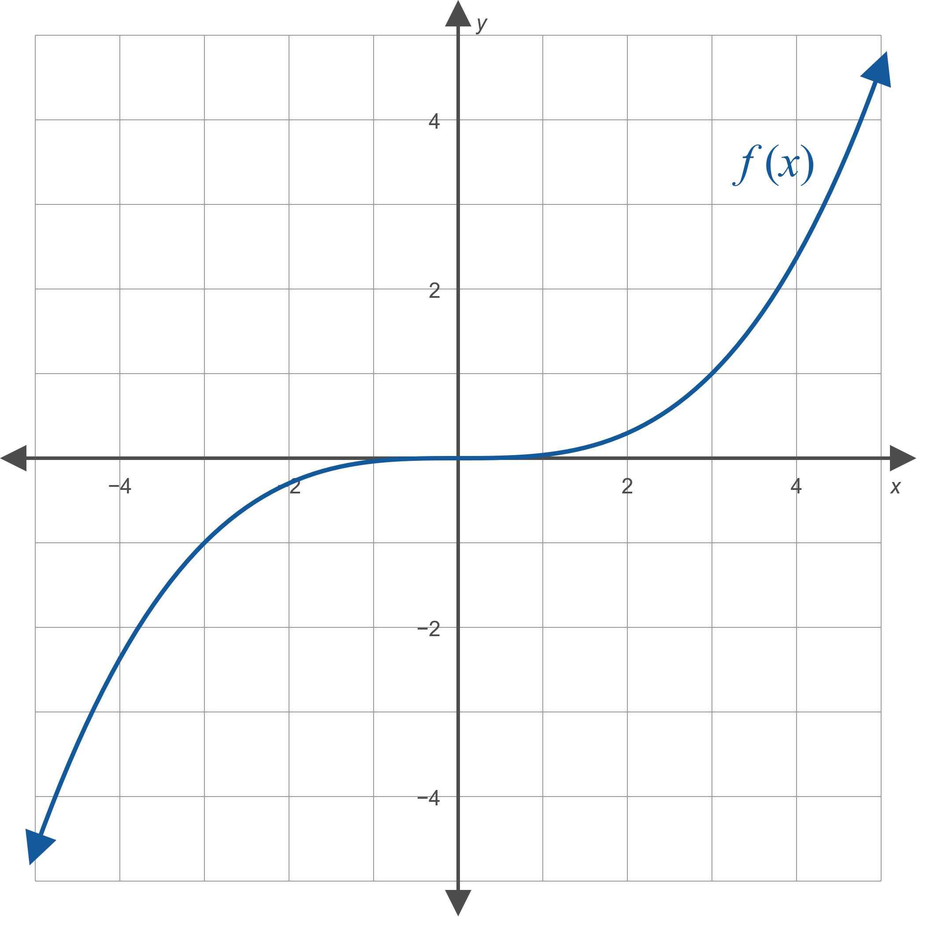

Example 6: Horizontal Stretching and Compressing₄

Slide 43
Procedure: Order of Transformations
If a function g has been constructed from a simpler function f through a number of transformations, g can be understood by looking for transformations in the following order:
​Horizontal shifts
​Horizontal and vertical stretching and compressing
​Reflections
​Vertical shifts

Slide 44
Example 7: Order of Transformations₁
Describe the transformations needed to construct the function
from the basic square root
function using the order of transformations.

Slide 45
Example 7: Order of Transformations₂
Solution
​We first consider the effect of replacing x with x + 1 in the basic square root function. Since x + 1 = x − (−1), the replacement shifts the graph 1 unit to the left. Figures 11 and 12 show the result of this transformation from

Slide 46
Example 7: Order of Transformations₃
​Next,
has been transformed into
That is, the variable in the expression has been
multiplied by 2, resulting in the horizontal
compression by a factor of
shown in Figure 13.
A vertical stretching by a factor of 2 is also accomplished by transforming
with the result shown in Figure 14.

Slide 47
Example 7: Order of Transformations₄
​The next-to-last transformation is the reflection with respect to the x-axis achieved by multiplying the function by −1, as shown in Figure 15.
​Finally, the graph is shifted 3 units up, as shown in Figure 16.

Slide 48
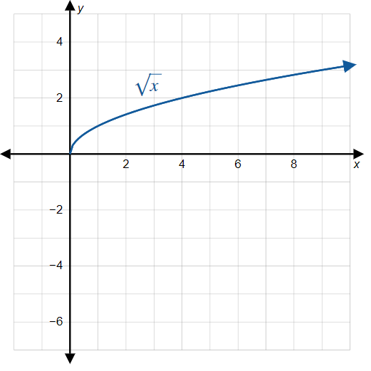
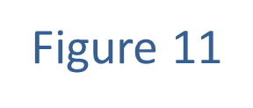
Example 7: Order of Transformations₅

Slide 49
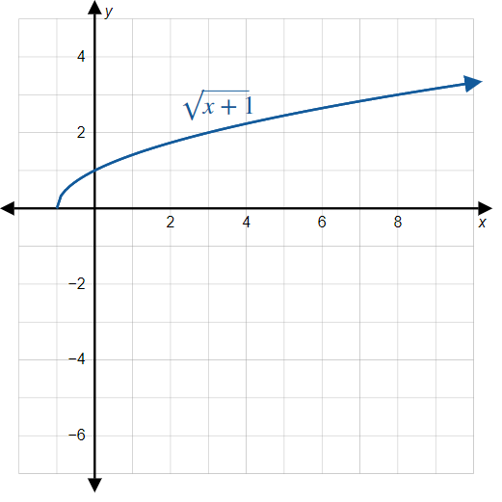
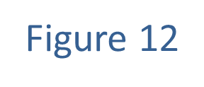
Example 7: Order of Transformations₆

Slide 50
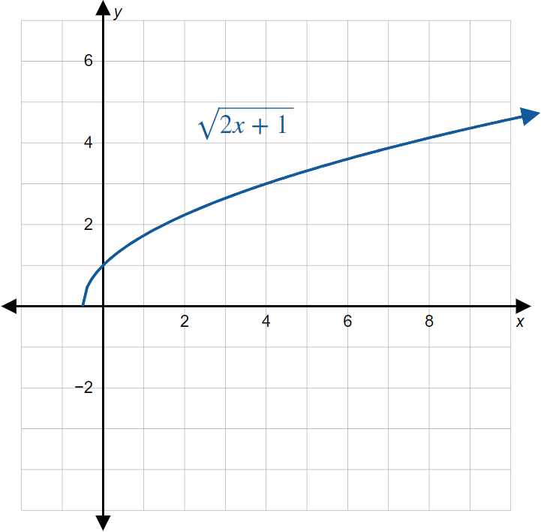
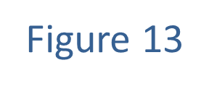
Example 7: Order of Transformations₇

Slide 51
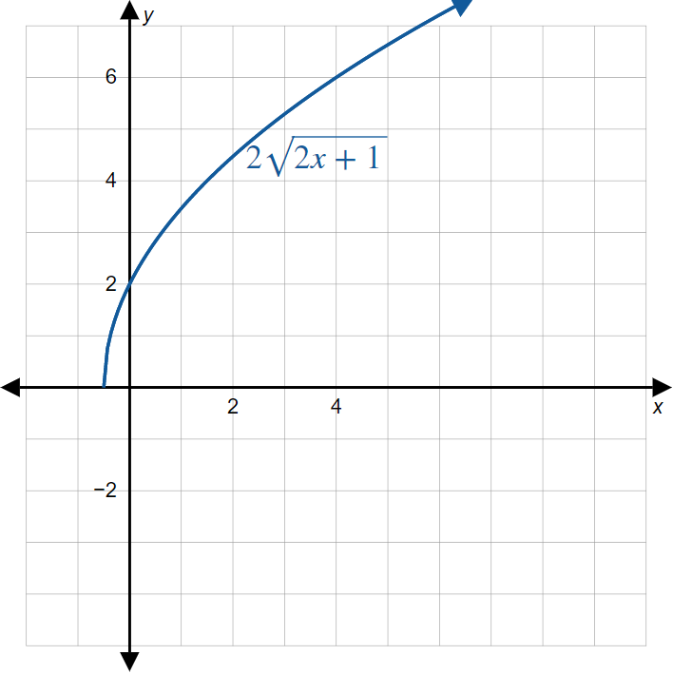

Example 7: Order of Transformations₈

Slide 52
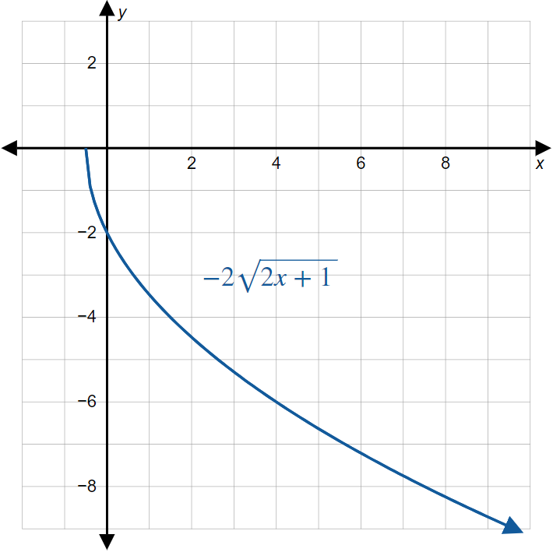

Example 7: Order of Transformations₉

Slide 53
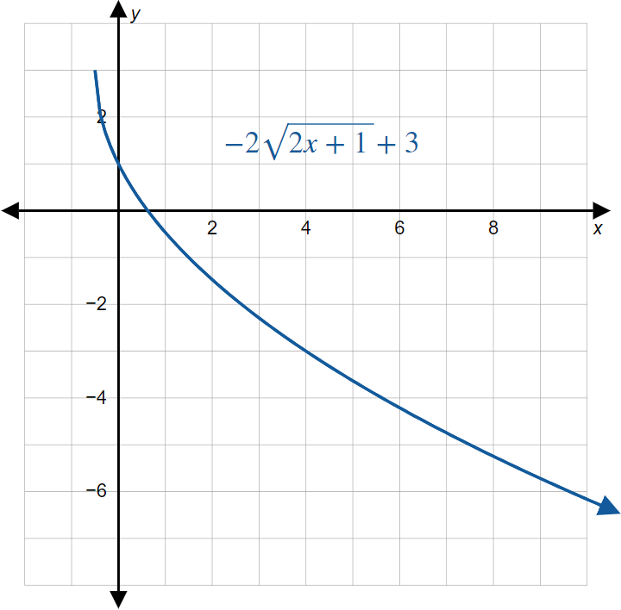

Example 7: Order of Transformations₁₀

Slide 54
Example 8: Order of Transformations₁
Sketch the graph of the function

Slide 55
Example 8: Order of Transformations₂
Solution
The basic function that f is similar to is
Following the
order of transformations, we determine how to sketch the graph of f:
1. If we replace x with x + 2 (shifting the graph 2 units
to the left), we obtain the function
which is
closer to what we want.
2.​ There does not appear to be any stretching or compressing transformation.

Slide 56
Example 8: Order of Transformations₃
​If we replace x with −x, we have
which is equal to f. This reflects the graph of
with respect to the y-axis.
​Since we have already found f, we know there is no vertical shift.

Slide 57
Example 8: Order of Transformations₄
The entire sequence of transformations is shown next, ending with the graph of f.

Slide 58
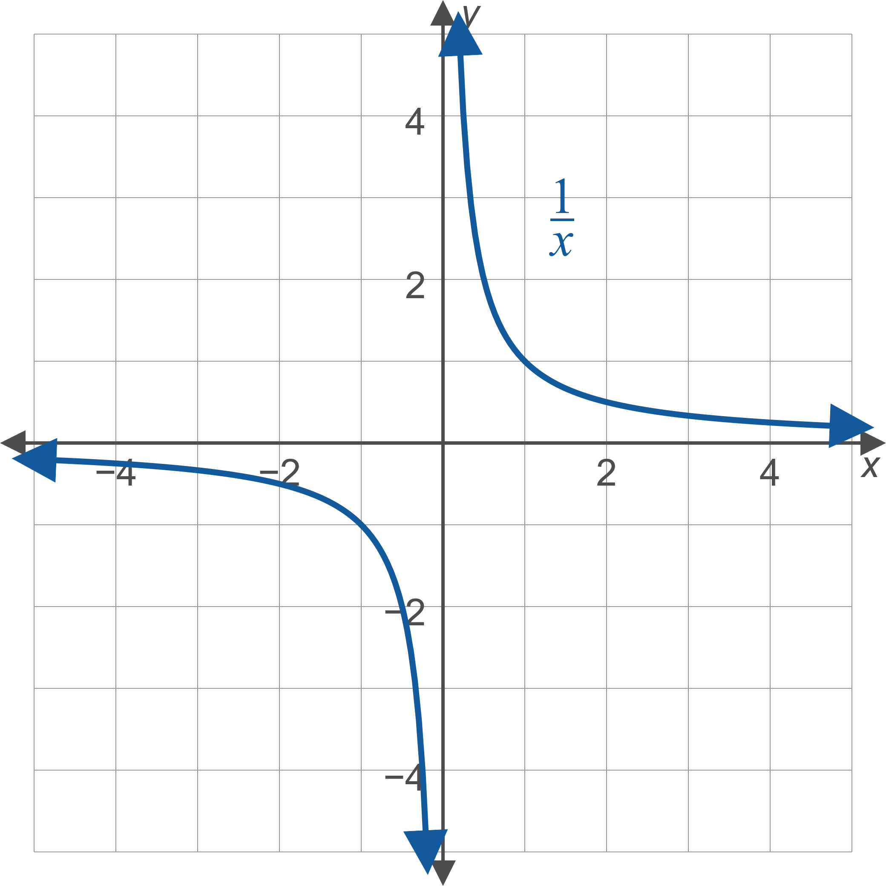
Example 8: Order of Transformations₅

Slide 59
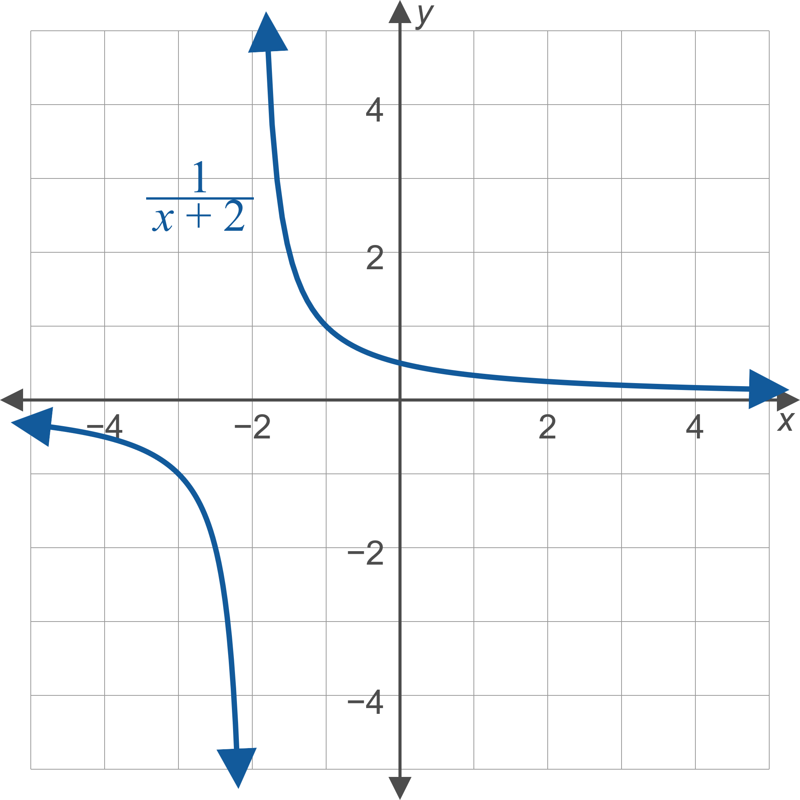
Example 8: Order of Transformations₆

Slide 60
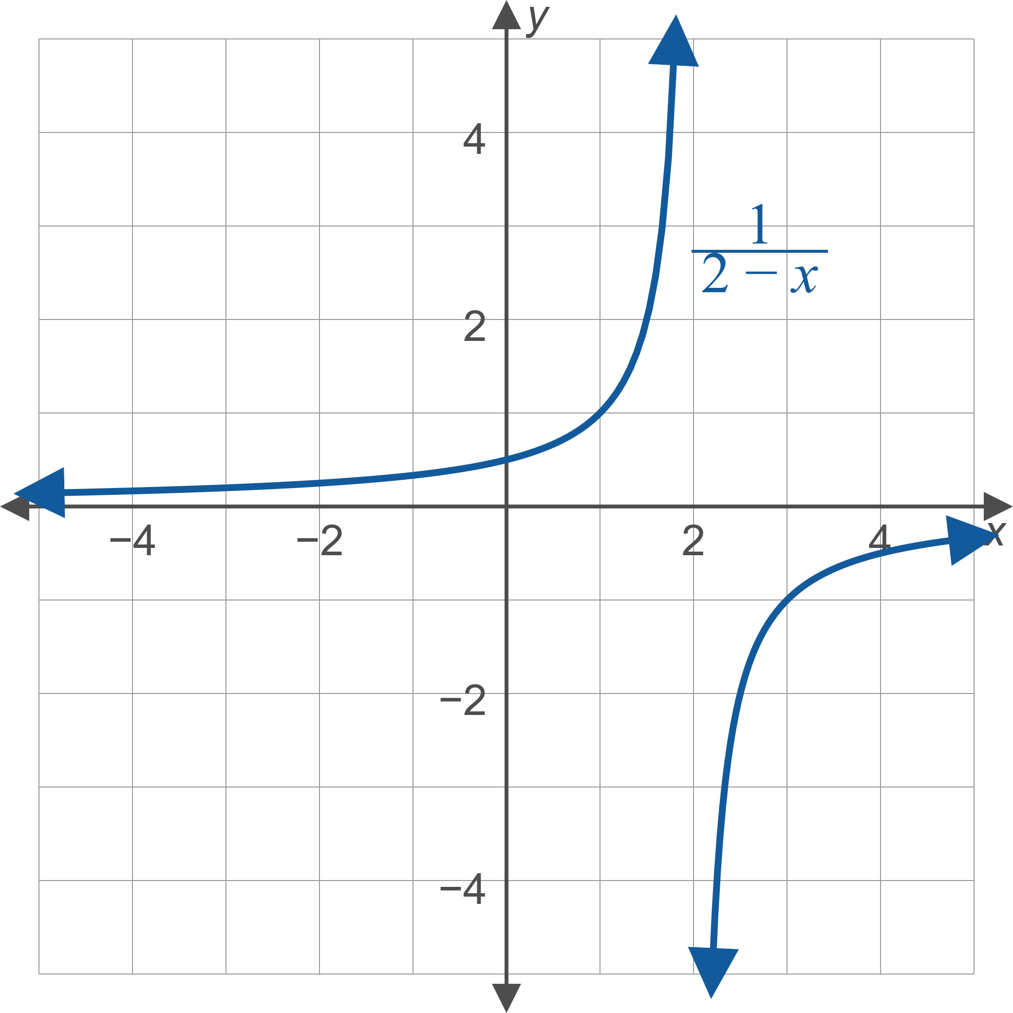
Example 8: Order of Transformations₇

Slide 61
Example 8: Order of Transformations₈
Note: An alternate approach to graphing
is to rewrite the function in the form
In this form, the graph of f is the graph of
shifted two units to the right, and then reflected with respect to the x-axis. The result is the same, as you should verify. Rewriting an equation in a different, equivalent form never changes its graph.

