Slide 1
Section 4.6
Mathematical Models

Slide 2
Example 1: Modeling the Value of Computers₁
A financial-services firm plans to purchase a number of computers, use them for five years, and then trade them in and replace them. The computers they want to buy cost $2000 each and they've been told they'll get a 10% credit of the purchase price at trade-in time. For accounting purposes, they want to be able to assign a value to the computers at any given point in time after purchase, up to five years.
​Assuming a linear depreciation in the value of the computers over the five-year time frame, how does the value of each computer vary as a function of time?
​At what point will the computers have lost half of their initial value?

Slide 3
Example 1: Modeling the Value of Computers₂
Solution
​Since we are asking for the value of each computer over time, we will let V stand for value (measured in dollars) and t for time (measured in years). With the information we're given, V is a function of time, and time alone. Further, we are given that V (0) = 2000,
and that V (5) = 10% of 2000, or V (5) = 200. This means that each computer loses $1800 of value over five years, so each year the loss in value is

Slide 4
Example 1: Modeling the Value of Computers₃
Thus, at the end of one year,
t years, V (t) = 2000 − 360t for 0 ≤ t ≤ 5.
The function V (t) = 2000 − 360t thus provides the answer to the first question, as we can use it to determine the value of each computer at any time t. To check our work, note that V is indeed a linear function
of t and that
and

Slide 5
Example 1: Modeling the Value of Computers₄
​To answer the second question, we're looking for
the value of t at which
Solving this equation for t, we obtain
Since
the value of each computer will
be halved a little more than 2 years and 9 months after purchase.

Slide 6
Example 2: Modeling the Area of Garden Plots₁
Anne and Kay plan to use 600 feet of fencing to construct two large rectangular garden plots along a river, as shown in Figure 1, with the plots sharing a common side and no fence along the river. The overall dimensions can vary a bit, but they want to ensure that the total enclosed area is at least 20,000 ft².

Slide 7
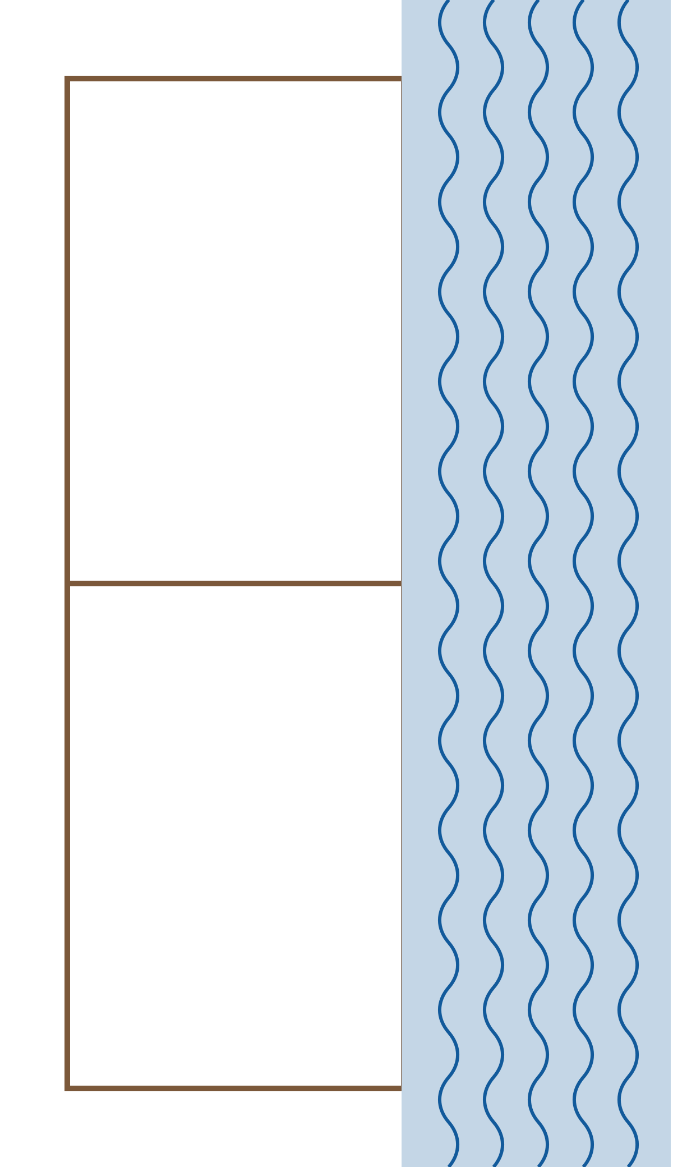
Example 2: Modeling the Area of Garden Plots₂
Figure 1

Slide 8
Example 2: Modeling the Area of Garden Plots₃
​Can this be done? If so, what are the bounds on the dimensions of the plots that will guarantee at least this much enclosed area?
​What is the maximum possible enclosed area?

Slide 9
Example 2: Modeling the Area of Garden Plots₄
Solution
Since Anne and Kay are concerned with the total enclosed area of the two plots, we will represent that quantity with an appropriate label, say A. Since A is the area of a rectangle (divided into two subrectangles), we are led to assign labels to the two dimensions of the rectangle; we will use x for one dimension and y for the other, as shown in Figure 2. Note that there will actually be three runs of fencing of length x, so the total amount of fencing used will be 3x + y.

Slide 10
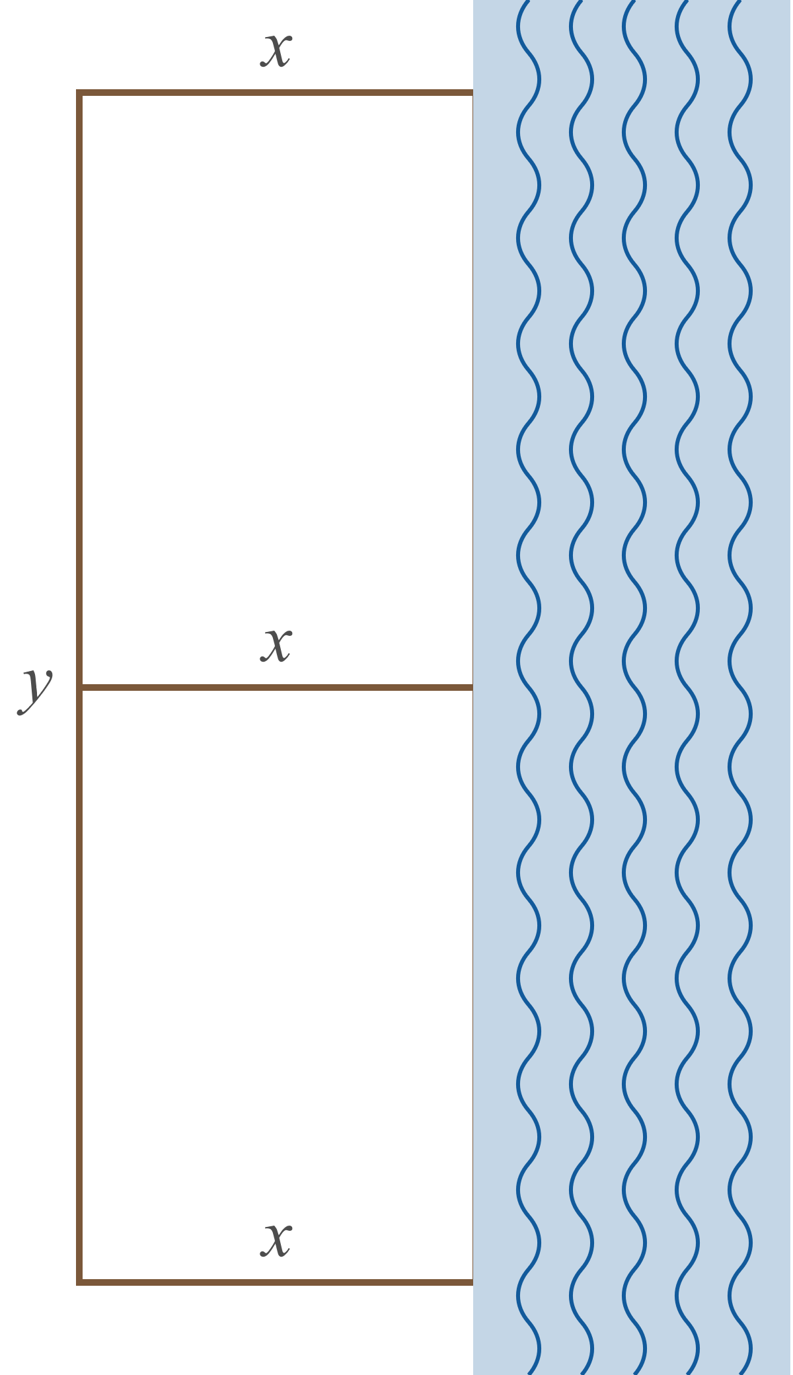
Example 2: Modeling the Area of Garden Plots₅
Figure 2

Slide 11
Example 2: Modeling the Area of Garden Plots₆
Our knowledge of the area of a rectangle tells us that
A = xy. This is fine as far as it goes, but this relationship between A, x, and y doesn't take into account the fact that 3x + y can be no larger than 600. We can reduce the number of variables by letting
y = 600 − 3x (which means we will use all 600 feet of fencing) and substituting this expression for y. With this substitution, we can write A as a function of x alone to obtain

Slide 12
Example 2: Modeling the Area of Garden Plots₇
Note that the domain of A (that is, the set of values for x that make sense in this problem) is the interval

Slide 13
Example 2: Modeling the Area of Garden Plots₈
To answer the first question, we now ask whether the inequality − 3x² + 600x ≥ 20,000 has a solution. We first use the quadratic formula to solve the equation
−3x² + 600x = 20,000 obtaining the solutions
It's also instructive to graph the function A (x), as shown in Figure 3. This graph includes a horizontal line corresponding to an area of 20,000 ft ², which illustrates that any choice of x between 42.3 ft and 157.7 ft will lead to an overall area of the combined plots of at least 20,000 ft ².

Slide 14
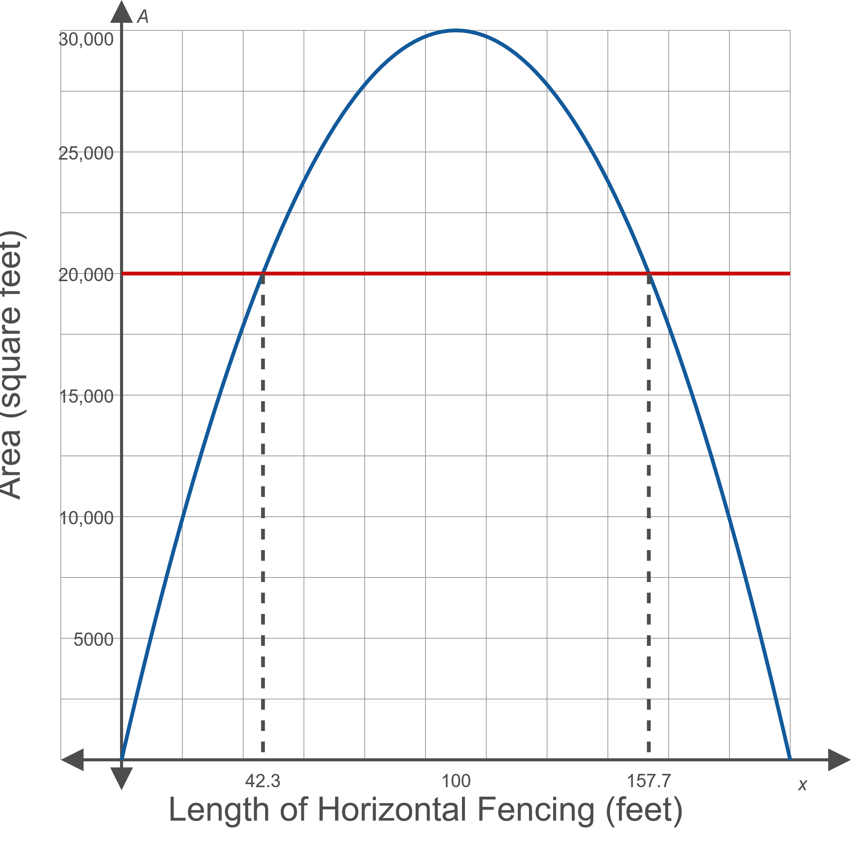
Example 2: Modeling the Area of Garden Plots₉
Figure 3

Slide 15
Example 2: Modeling the Area of Garden Plots₁₀
​To answer the second question, the graph of A certainly hints that the maximum combined area is approximately 30,000 ft² and that this would be achieved by letting x = 100 (and consequently letting y = 30,000). We can prove that 30,000 ft² is indeed the maximum possible combined area by using previous methods to identify (100, 30,000) as the vertex of the downward-opening parabolic function A(x).

Slide 16
Example 3: Modeling the Weight of a Person with a Given Mass₁
Consider the weight, or force of gravitational attraction, of a person with a given mass.
​How does the force of gravitational attraction between a 75 kg person and Earth vary as a function of the person's height above the surface of Earth?
​How does the force at sea level compare to the force when the person is in a jet at 30,000 ft?
​What if the person were on the International Space Station?
​How far above the surface of Earth would the person have to be for the force to be half as much as the force at sea level?

Slide 17
Example 3: Modeling the Weight of a Person with a Given Mass₂
Solution
Unlike the formula for the area of a rectangle, it's likely that the force for gravitational attraction between two masses, and such information as the mass and radius of Earth and the height of the International Space Station, will need to be looked up. But all the details to model the requested force as a function of height are readily found.

Slide 18
Example 3: Modeling the Weight of a Person with a Given Mass₃
The force F in newtons between two masses m₁ and m₂ (in kilograms) whose centers of mass are a distance d meters apart is given by the formula​
where the universal gravitational constant G is
approximately
We also need the mass and radius of Earth, which we find
to be approximately
and
respectively.

Slide 19
Example 3: Modeling the Weight of a Person with a Given Mass₄
​If we let m₁ be the mass of Earth, m₂ the mass of the person (given as 75 kg for the person in question), and h the distance between the person's center of mass and the surface of Earth, we have

Slide 20
Example 3: Modeling the Weight of a Person with a Given Mass₅
​Note that in writing this formula, we've used function notation to point out that F is now simply a function of the variable h—every other quantity is a fixed constant.
​Before we proceed to answer the remaining specific questions we were asked, and to help us better understand the magnitude of the numbers involved, it's helpful to experiment with graphs of F as a function of h. The graph shown in Figure 4 indicates that we need to allow h to be quite large in order to see the overall shape of F. Here, we've graphed F over the h-interval from 0 meters to 10,000,000 meters (about 6214 miles).
​

Slide 21
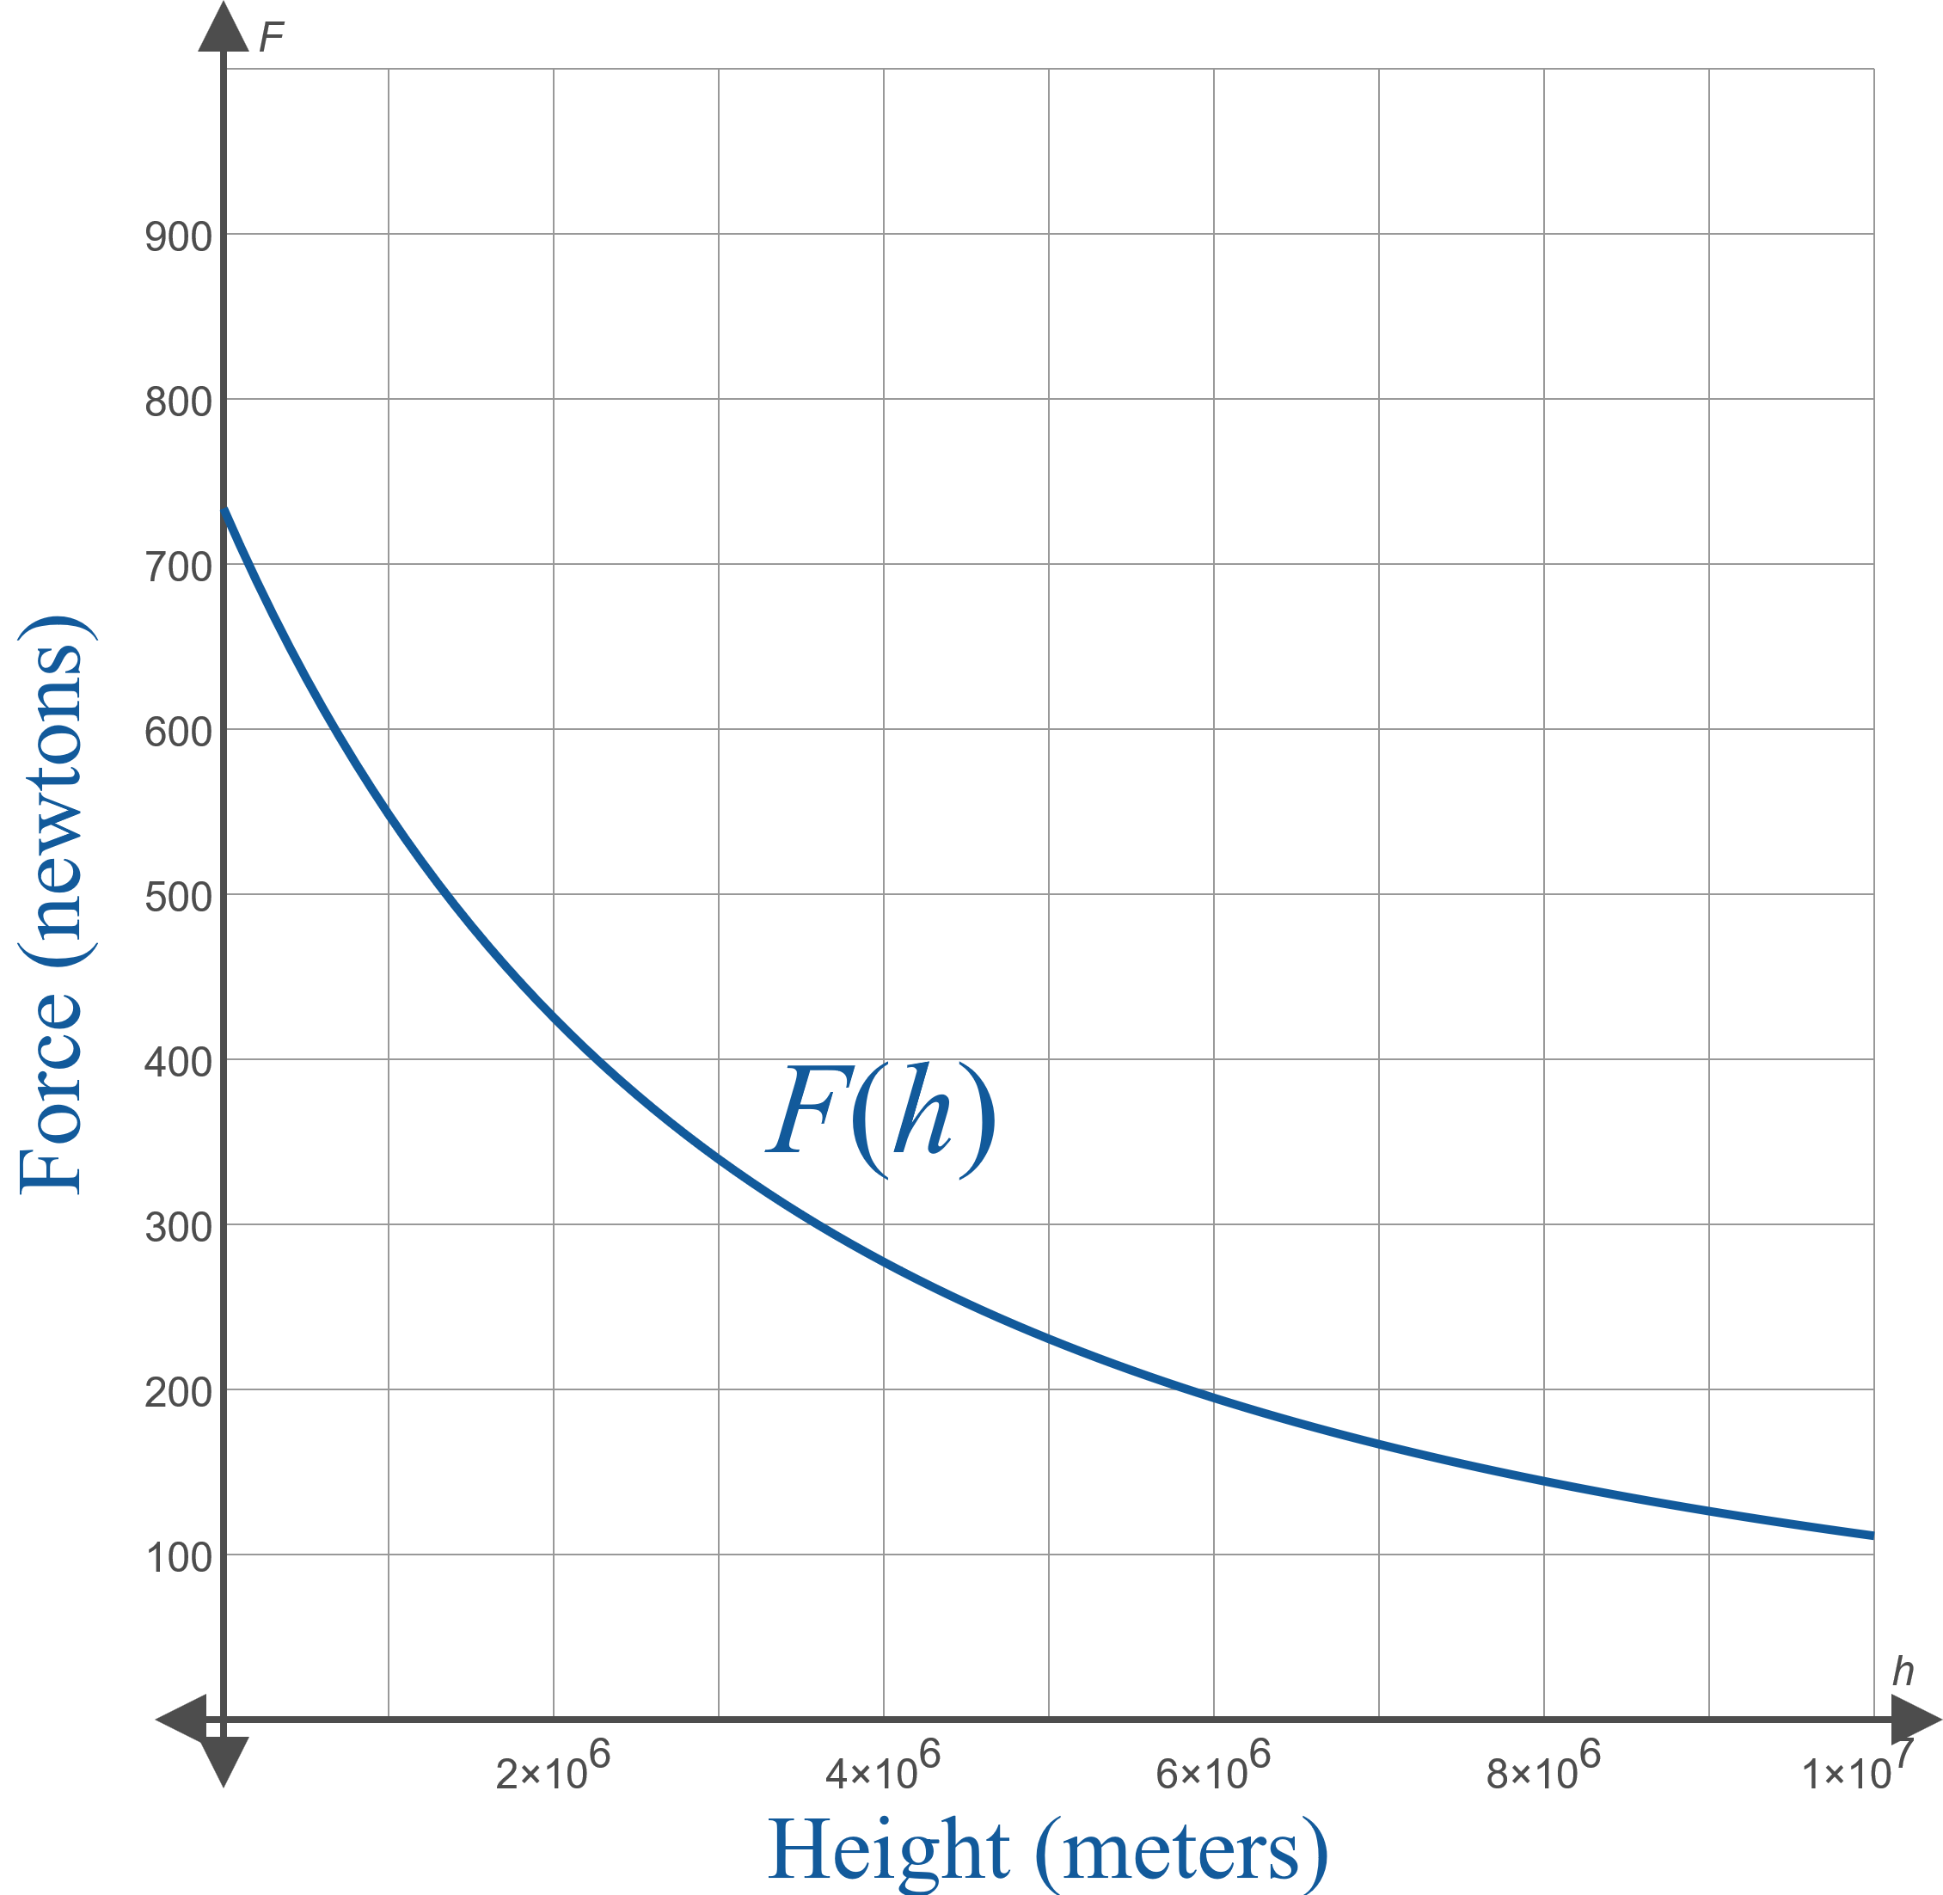
Example 3: Modeling the Weight of a Person with a Given Mass₆
Figure 4

Slide 22
Example 3: Modeling the Weight of a Person with a Given Mass₇
​Note that the force of attraction at sea level
is
and the force of attraction
at 30,000 feet
is
or about 99.7% of the sea-level force.

Slide 23
Example 3: Modeling the Weight of a Person with a Given Mass₈
​The height of the International Space Station varies a bit, but we will use an average value of 248 miles, about 399,117 meters, to obtain
or about 88.6% of the sea-level force.

Slide 24
Example 3: Modeling the Weight of a Person with a Given Mass₉
​To answer the final question, we solve the equation
as follows.

Slide 25
Example 3: Modeling the Weight of a Person with a Given Mass₁₀
​Note that we omitted the negative root in the second-to-last step on the left side of the equation since the height cannot be negative. Putting this into context, this distance is about 41% of the radius of Earth itself.

Slide 26
Example 4: Modeling Profit Earned from Selling Tables₁
A furniture maker has been in the habit of making 10 copies of a particular style of small table during a production run, and has been able to sell them in a reasonable time frame at $100 each. After carefully analyzing his market and the demand for the table, he has determined that he can gain one additional customer in the same time frame for every $2 decrease in price, and conversely lose one customer with every $2 increase in price. He has a fixed cost of $450 for a production run of the tables, and each table costs an additional $20 to make.

Slide 27
Example 4: Modeling Profit Earned from Selling Tables₂
​Assuming that he prices the tables in accordance with his market analysis, what profit will he earn by selling a given number of tables?
​Is there a production interval that he needs to fall within in order to be profitable?
​If there is a profitable interval, what is the ideal number of tables to produce?
​What price corresponds to that number of tables?

Slide 28
Example 4: Modeling Profit Earned from Selling Tables₃
Solution
The cost function is straightforward, as it is simply the fixed cost of $450 plus another $20 for every table made. So if we let x represent the number of tables made in a production run (and consequently sold during the reasonable time frame), then the cost function for making x tables is C (x) = 450 + 20x.

Slide 29
Example 4: Modeling Profit Earned from Selling Tables₄
The revenue function in this situation requires a bit more work to determine. We can organize the given information and work toward the desired function by noting that when x = 10, the corresponding price is $100 and the revenue taken in is
Similar computations for prices above and below $100 will help us identify a pattern.

Slide 30
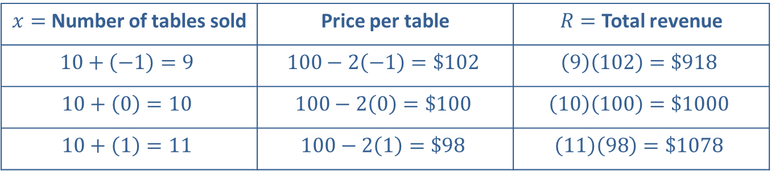
Example 4: Modeling Profit Earned from Selling Tables₅
$x=$ Number of tables sold | Price per table | $R=$ Total revenue
$$10+\left(−1\right)=9$$ | $$100−2\left(−1\right)=\$102$$ | $$\left(9\right)\left(102\right)=\$918$$
$$10+\left(0\right)=10$$ | $$100−2\left(0\right)=\$100$$ | $$\left(10\right)\left(100\right)=\$1000$$
$$10+\left(1\right)=11$$ | $$100−2\left(1\right)=\$98$$ | $$\left(11\right)\left(98\right)=\$1078$$

Slide 31
Example 4: Modeling Profit Earned from Selling Tables₆
In general, if we let n be the number of $2 increments above or below $100 in the price, then a price of
100 − 2n corresponds to x = 10 + n. But there's no need to work with both variables x and n, as we can rewrite the equation as n = x − 10 and note that the price corresponding to x tables sold is
which tells us that the total revenue raised by selling x tables is

Slide 32
Example 4: Modeling Profit Earned from Selling Tables₇
​This means the profit function for this situation is
providing the answer to the first question.

Slide 33
Example 4: Modeling Profit Earned from Selling Tables₈
​We recognize the graph of this function as a downward-opening parabola, which should immediately alert us to the fact that, for small enough x and large enough x, P (x) is guaranteed to be negative, an outcome to be avoided. Indeed, we know that in general the graph of a downward-opening parabola need not have any portion above the x-axis. But if there is a portion of the graph that lies above the x-axis, that is the portion we want to identify, as that is the profitable interval for this product.
​

Slide 34
Example 4: Modeling Profit Earned from Selling Tables₉
​Figure 5 shows the graphs of all three functions,
The graphs tell us many things, among them that P(x) is indeed positive (so the product is profitable) over a certain production interval, which we will soon identify. The endpoints of the profitable interval are those values of x for which C (x) = R (x), which are known as
break-even points in this context. Also, as we would expect with a downward-opening parabola, the vertex represents the point at which maximum profit can be achieved, so we will want to identify that as well.

Slide 35
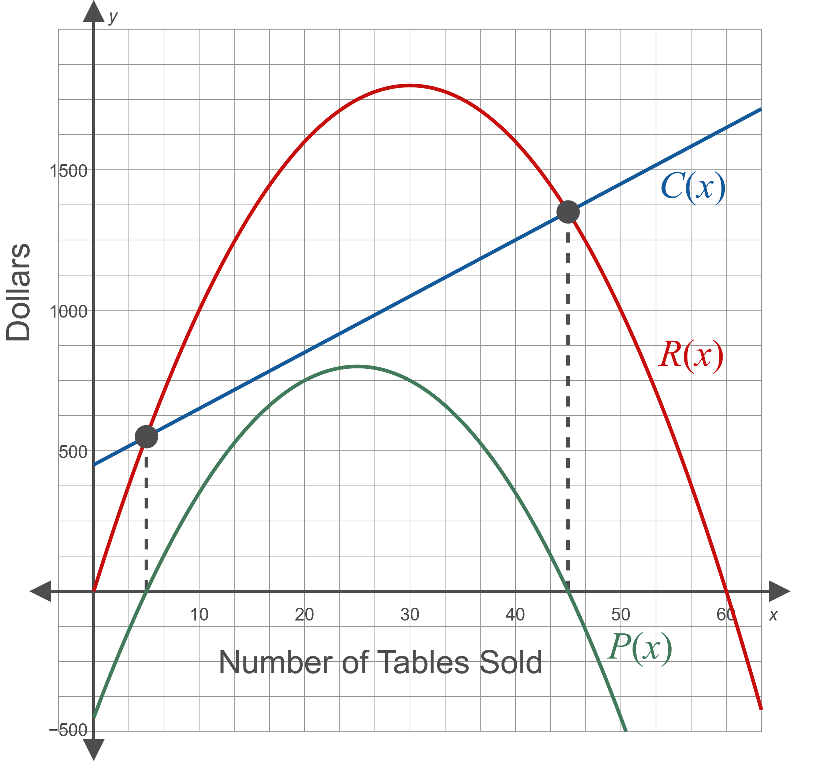
Example 4: Modeling Profit Earned from Selling Tables₁₀
Figure 5

Slide 36
Example 4: Modeling Profit Earned from Selling Tables₁₁
​The profitable interval of production lies between the two x-intercepts of P(x), which we can find by factoring.
The solutions of P(x) = 0 are thus x = 5 and x = 45, so the desired interval is

Slide 37

Example 4: Modeling Profit Earned from Selling Tables₁₂
​The methods for locating the vertex of a parabola tell us that the vertex of the graph of P is
tables to produce is 25, which will maximize profit at $800.
​d. The price per table that corresponds to selling

