Slide 1
Section 4.5
Variation and Multivariable Functions

Slide 2
Definition: Direct Variation
We say that y varies directly as (or is proportional to) the n^{th} power of x if there is a nonzero constant k. (called the constant of proportionality) such that

Slide 3
Example 1: Direct Variation₁
Hooke's Law says that the force exerted on a spring varies directly with the distance that the spring is stretched. If a 5-pound weight suspended on a spring scale stretches the spring 2 inches, how far will a 13-pound weight stretch it?

Slide 4
Example 1: Direct Variation₂
Solution
The first sentence tells us that F = kx, where F represents the force exerted by the spring and x represents the distance that the spring is stretched. When a weight is suspended on a spring scale (and is stationary), the force exerted upward by the spring must equal the force downward due to gravity, so the spring exerts a force of 5 pounds when a 5-pound weight is suspended from it. So the second sentence
tells us that 5 = 2 k , or

Slide 5
Example 1: Direct Variation₃
We can now answer the question.
So the spring stretches
inches when a 13-pound
weight is suspended from it.

Slide 6
Definition: Inverse Variation
We say that y varies inversely as (or is inversely proportional to) the n^{th} power of x if there is a nonzero constant k such that

Slide 7
Example 2: Inverse Variation₁
The weight of a person, relative to Earth, is inversely proportional to the square of the person's distance from the center of Earth. Using a radius for Earth of 6370 kilometers, how much does a 180-pound man weigh when flying in a jet 9 kilometers above Earth's surface?

Slide 8
Example 2: Inverse Variation₂
Solution
If we let W stand for the weight of a person and d the distance between the person and Earth's center, the first sentence tells us that

Slide 9
Example 2: Inverse Variation₃
The second sentence gives us enough information to determine k. Namely, we know that W = 180 (pounds) when d = 6370 (kilometers). Solving the equation for k and substituting in the values that we know, we obtain

Slide 10
Example 2: Inverse Variation₄
When the man is 9 kilometers above Earth's surface, we know d = 6379, so the man's weight while flying is
Flying is not, therefore, a terribly effective way to lose weight.
Flying is not, therefore, a terribly effective way to lose weight

Slide 11
Definition: Joint Variation
We say that z varies jointly as (or is jointly proportional to) the n^{th} power of x and the
of y if there is a nonzero constant k such that

Slide 12
Example 3: Joint Variation₁
The volume of a right circular cylinder varies jointly as the height and the square of the radius. Express this relationship in equation form.

Slide 13
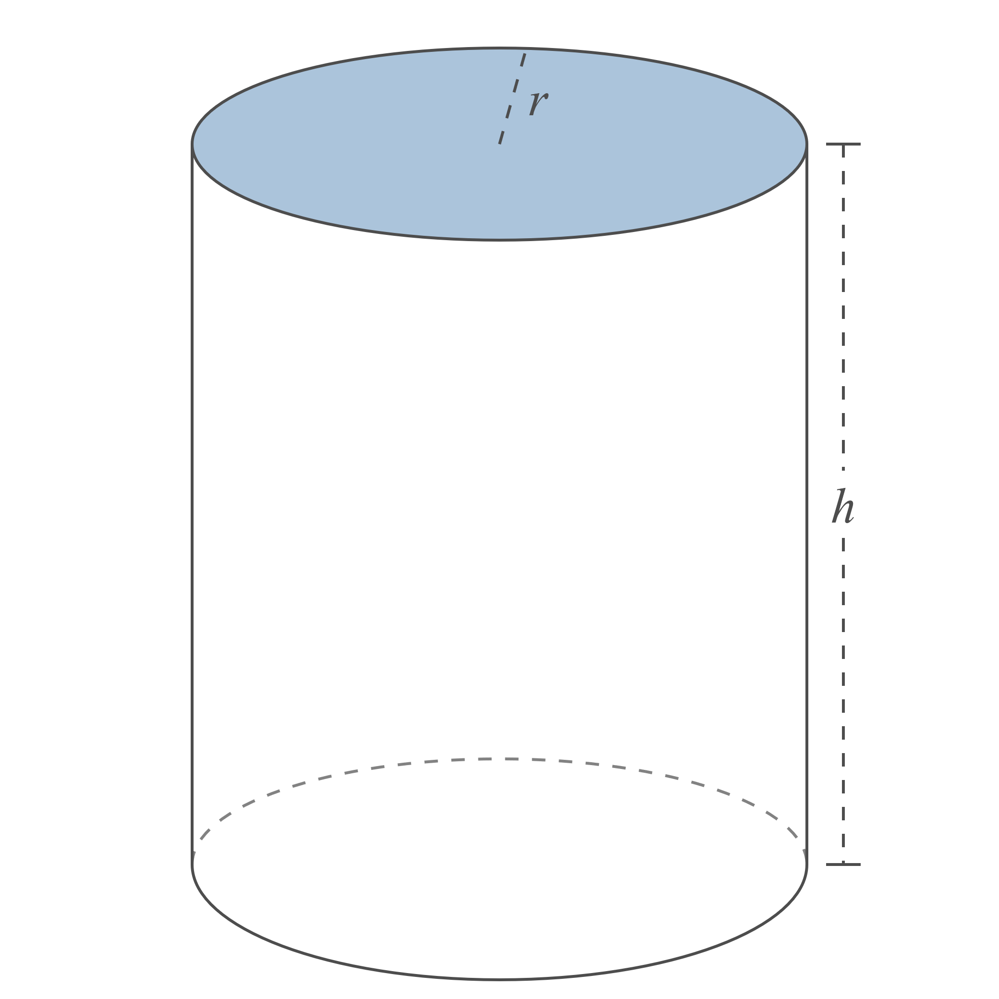
Example 3: Joint Variation₂
Figure 3

Slide 14
Example 3: Joint Variation₃
Solution
This simple problem merely asks for the form of the variation equation. If we let V stand for the volume of a right circular cylinder, r for its radius, and h for its height, we would write
We are already familiar with this volume formula and know that the constant of proportionality is actually π, so we could provide more information and write

Slide 15
Example 4: Finding the Force of Gravity ₁
Determine the approximate force of gravitational attraction between Earth and the moon.

Slide 16
Example 4: Finding the Force of Gravity₂
Solution
The mass of Earth is approximately
and the mass of
the moon is approximately
The distance between
these two bodies varies, but on average it is
Using the function notation
we would write
It is this force of mutual attraction that keeps the moon in orbit around Earth.

