Slide 1
Section 4.4
Other Common Functions

Slide 2
Definition: Power Functions
A power function is a function of the form
where a and r are real numbers.

Slide 3
Example 1: Power Functions of the Form a x ⁿ₁
Sketch the graphs of the following functions.

Slide 4
Example 1: Power Functions of the Form a x ⁿ₂
Solution
​The graph of the function f will have the same basic shape as the function
​
but compressed vertically
because of the factor of
To make the sketch more
accurate, calculate the coordinates of a few points
on the graph. Figure 3 illustrates that

Slide 5
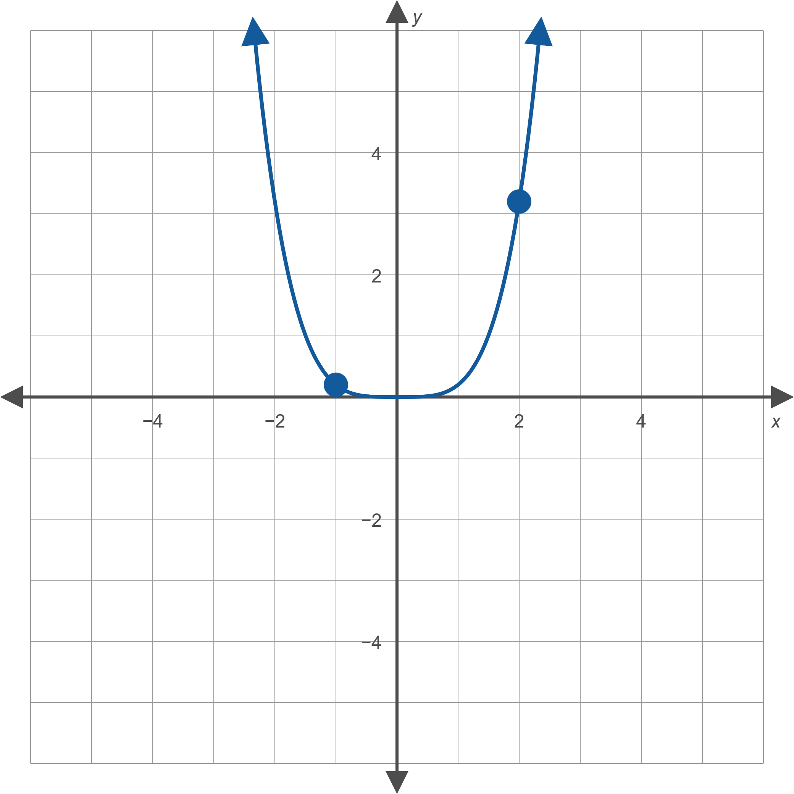
Example 1: Power Functions of the Form a x ⁿ₃
Figure 3:

Slide 6
Example 1: Power Functions of the Form a x ⁿ₄
​We know that the function g will have the same shape as the function x ³, but reflected over the
x-axis because of the factor of −1. The graph in Figure 4 illustrates this.
​We also plot a few points on the graph of g, namely
​

Slide 7
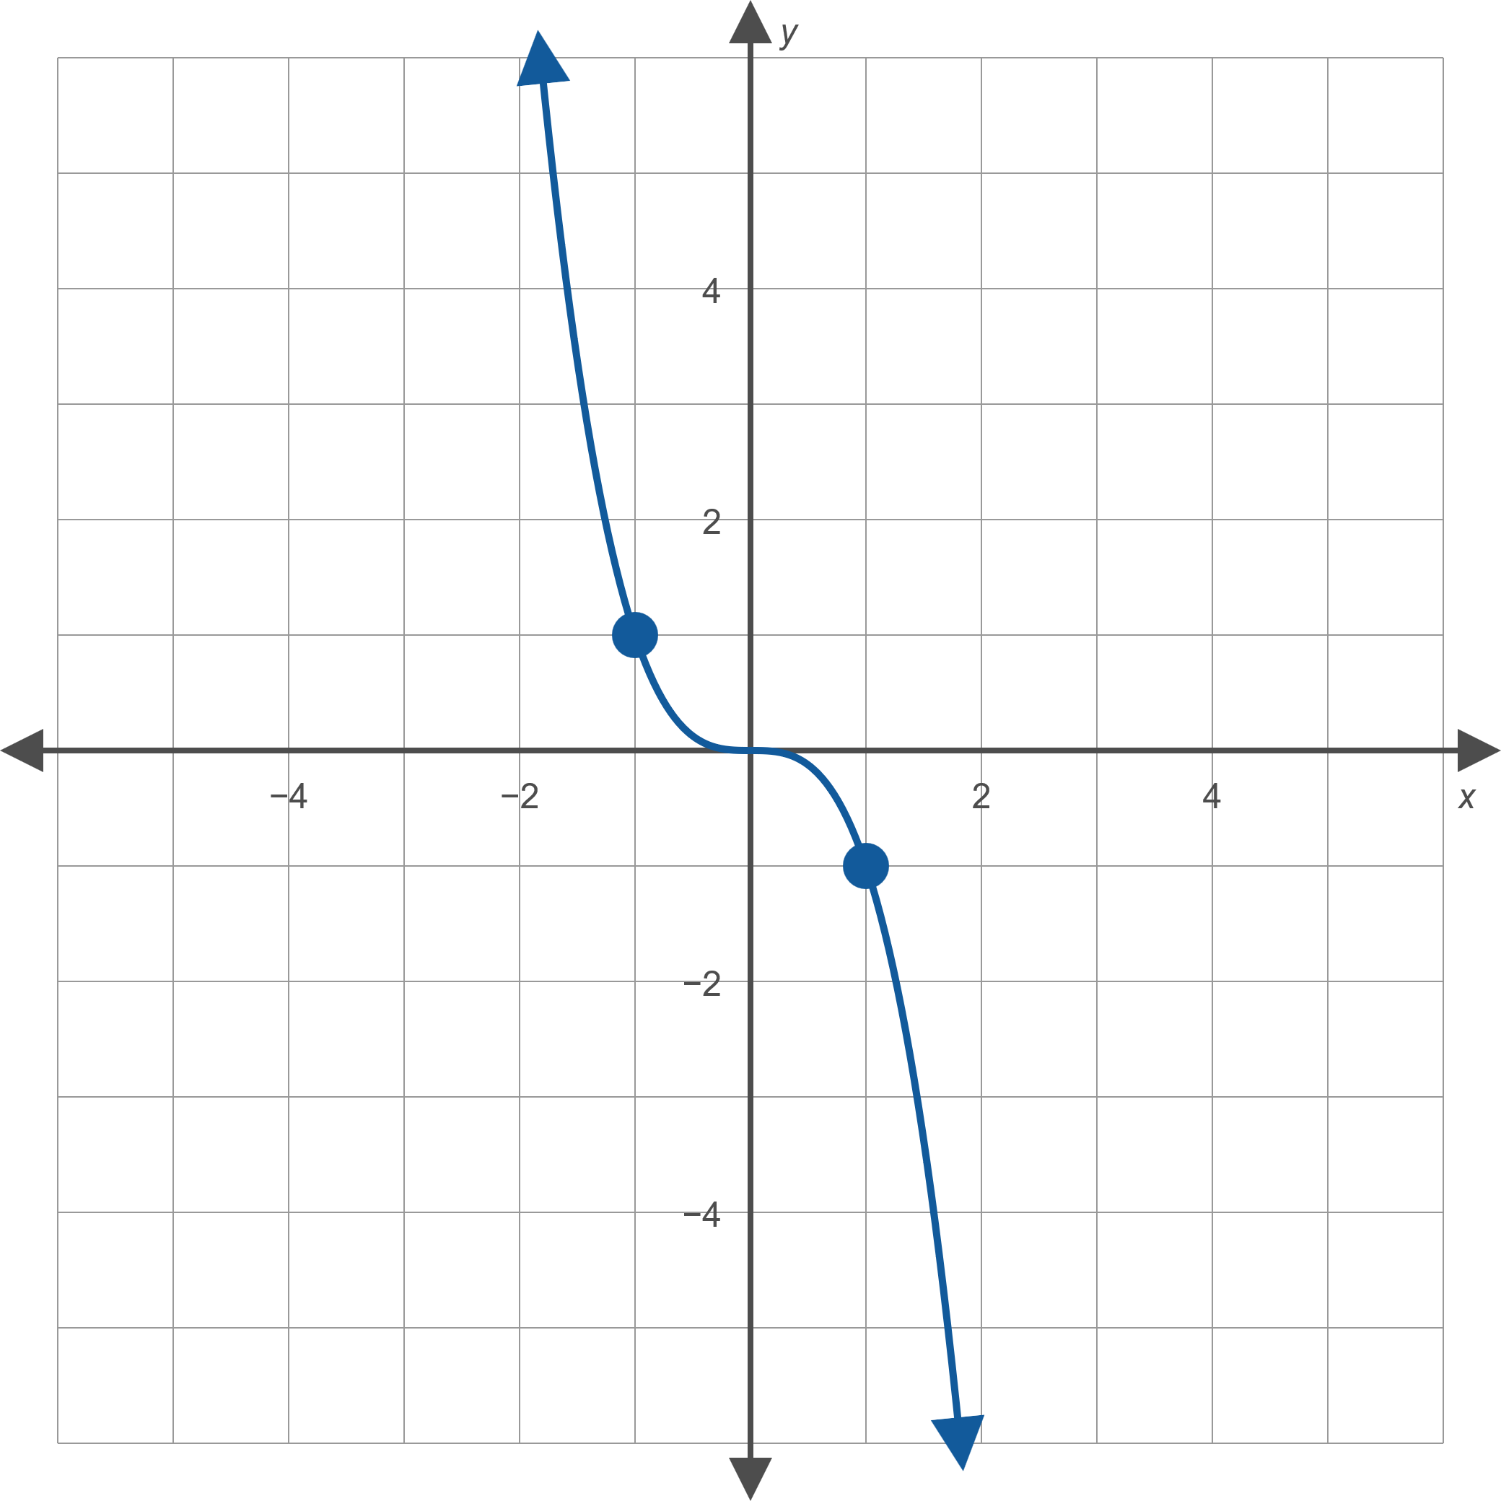
Example 1: Power Functions of the Form a x ⁿ₅
Figure 4: g (x) = − x ³

Slide 8
Example 2: Power Functions of the Form a x ⁻ⁿ₁
Sketch the graph of the function

Slide 9
Example 2: Power Functions of the Form a x ⁻ⁿ₂
Solution
The graph of the function f is similar to that of the function
with two differences. We obtain the formula
by multiplying
by
a negative number between −1
and 1. So one difference is that the graph of f is the
reflection of
with respect to the x-axis. The other
difference is that the graph of f is compressed vertically.
With the above in mind, we can calculate the coordinates of
a few points (such as
and
and sketch the
graph of f as shown in Figure 7.

Slide 10
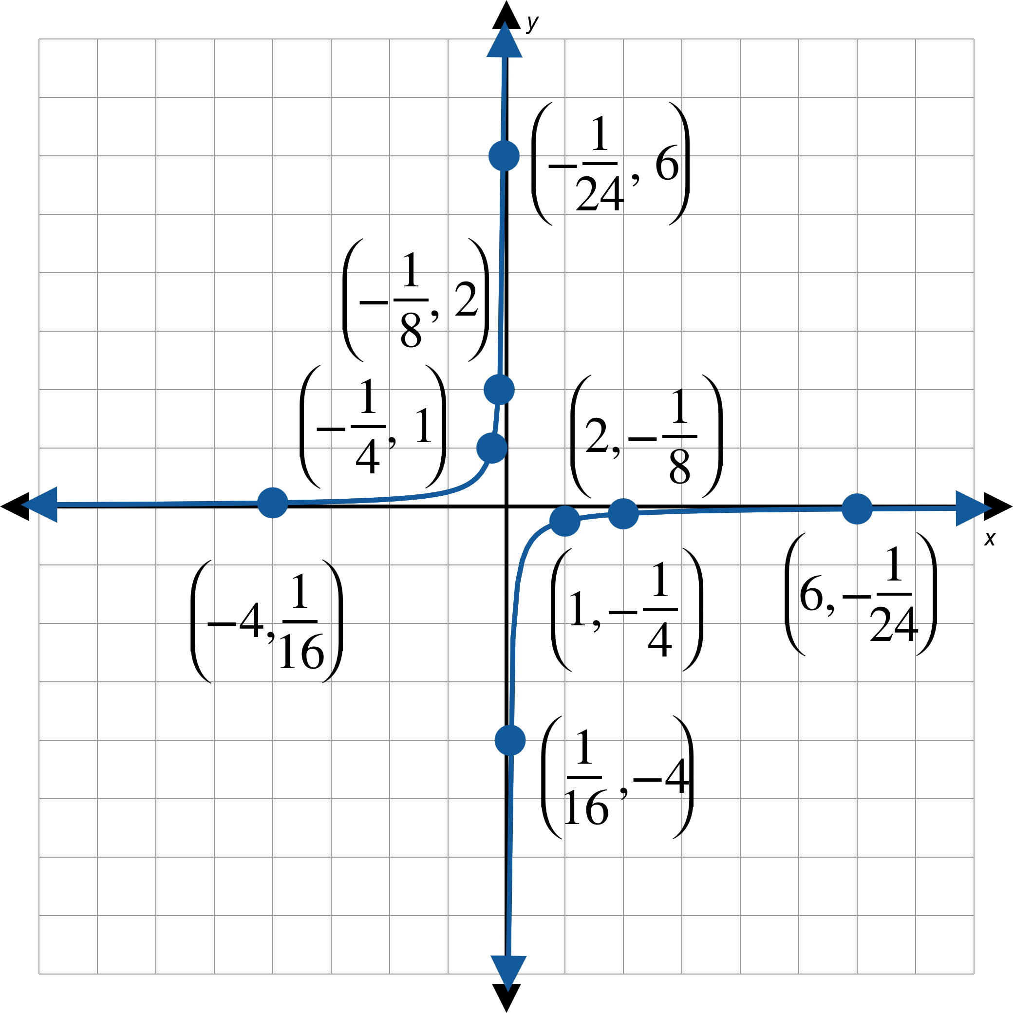
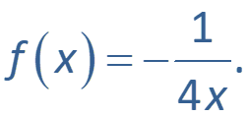
Example 2: Power Functions of the Form a x ⁻ⁿ₃
Figure 7:

Slide 11
Example 3: The Absolute Value Function₁
Sketch the graph of the function

Slide 12
Example 3: The Absolute Value Function₂
Solution
The graph of f will be a vertically stretched version of
reflected over the x-axis. As always, we can plot
a few points to verify that our reasoning is correct. In

Slide 13
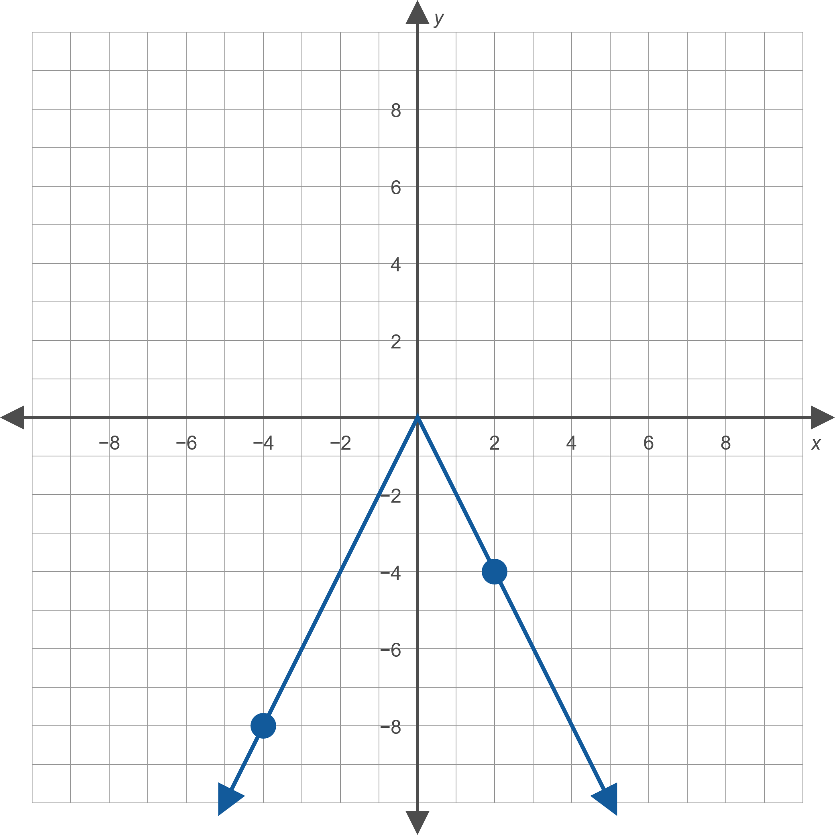
Example 3: The Absolute Value Function₃
Figure 11:

Slide 14



Definition: The Greatest Integer Function
The greatest integer function,
is a function
commonly encountered in computer science applications. It is defined as follows: the greatest integer of x is the largest integer less than or equal to x.
For instance,
and
(note that −3 is the largest integer to the left of −2.9 on the real number line).

Slide 15
Definition: Piecewise-Defined Function
A piecewise-defined function is a function defined in terms of two or more formulas, each valid for its own unique portion of the real number line. In evaluating a piecewise-defined function f at a certain value for x, it is important to correctly identify which formula is valid for that particular value.

Slide 16
Example 4: Piecewise-Defined Function₁
Sketch the graph of the function

Slide 17
Note₁
Always pay close attention to the boundary points of each interval. Remember that only one rule applies at each point.

Slide 18
Example 4: Piecewise-Defined Function₂
Solution
The function f is a piecewise-defined function with different formulas for two separate intervals. To graph f, graph each portion separately, making sure that each formula is applied only on the appropriate interval.
The function f is a linear function on the interval
and a quadratic function on the interval
The complete graph appears in Figure 13, with the points

Slide 19
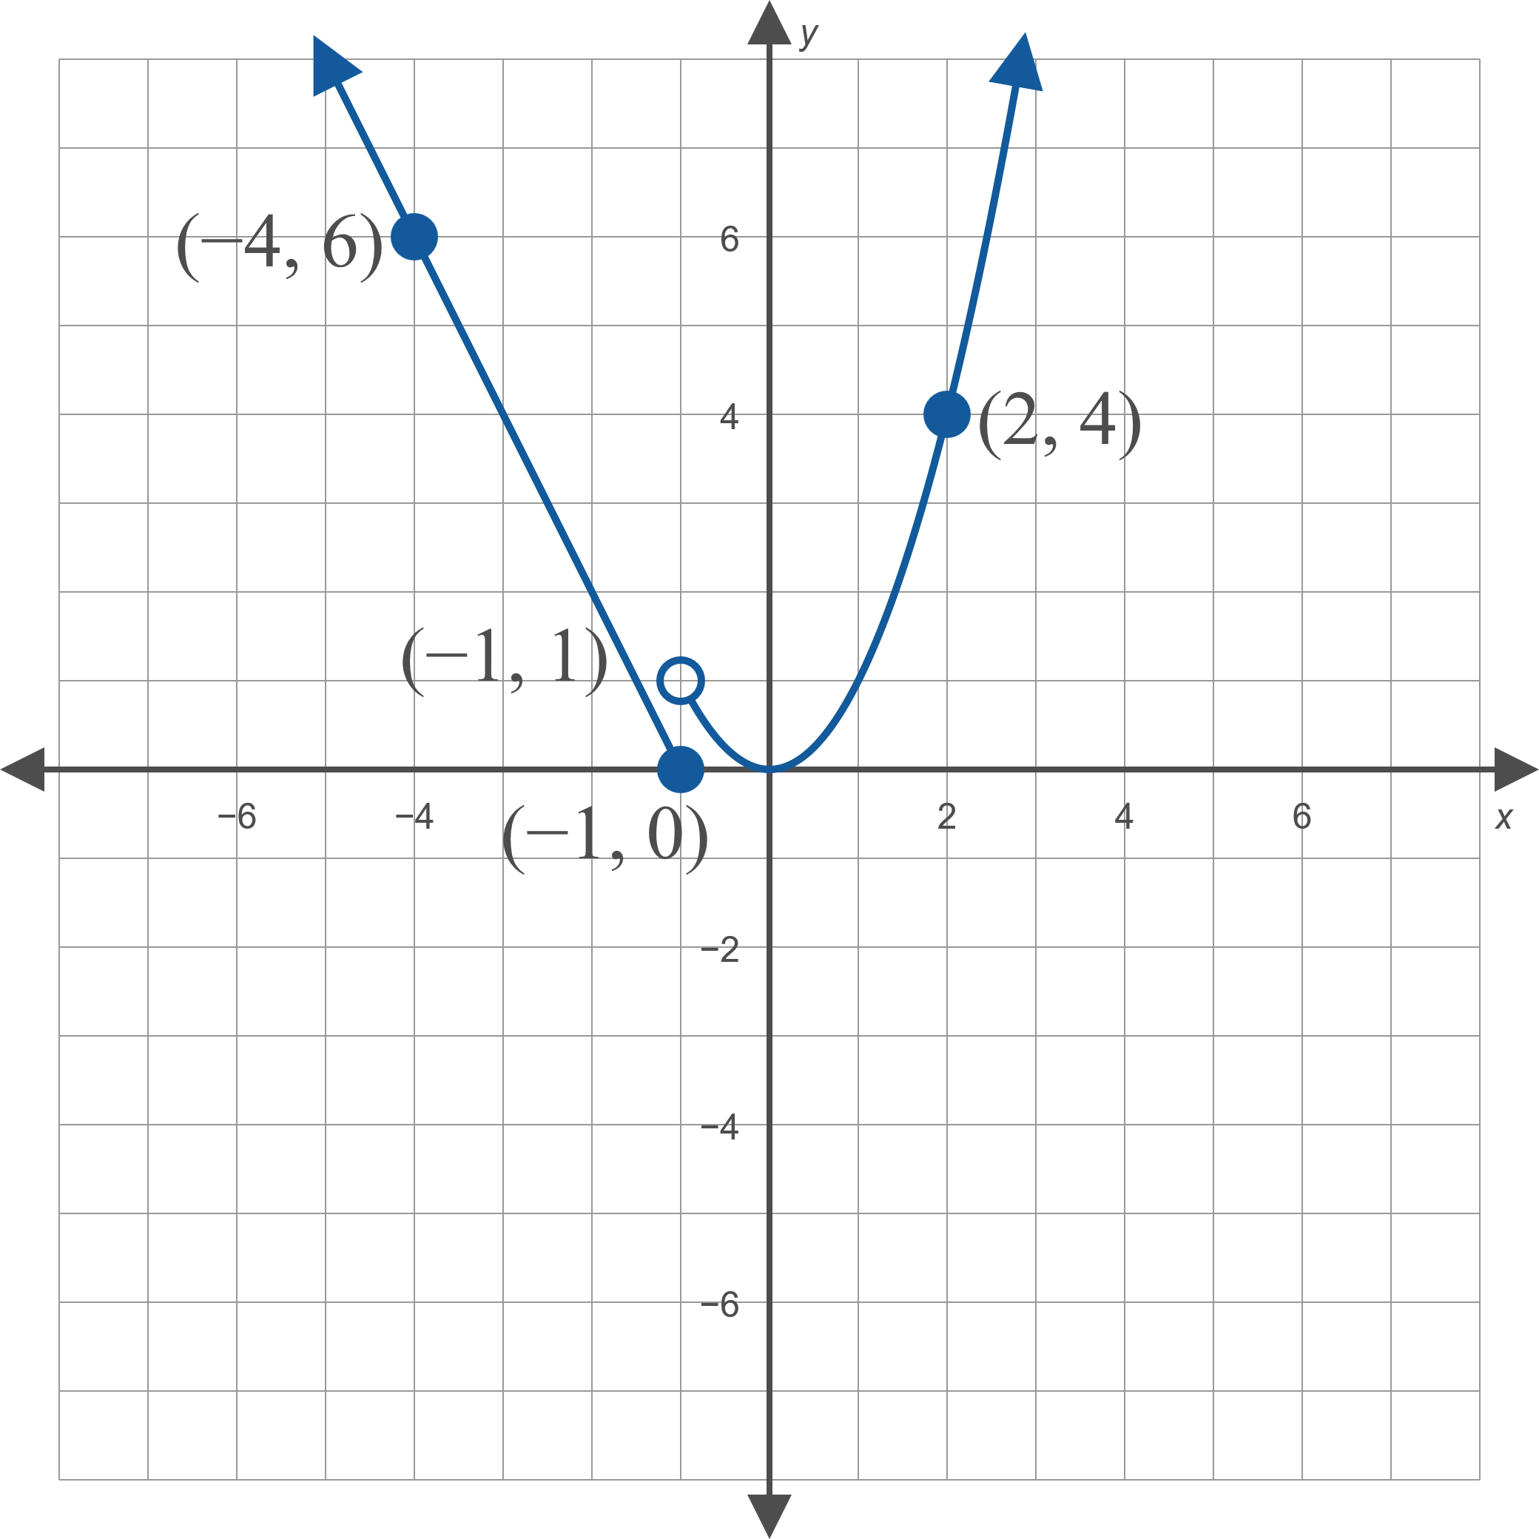
Example 4: Piecewise-Defined Function₃
Figure 13: y = f (x)

Slide 20
Example 4: Piecewise-Defined Function₄
to emphasize
Note the use of a closed circle at
that this point is part of the graph and the use of an open circle at
to indicate that this point is not part
of the graph. That is the value of

