Slide 1
Section 4.3
Quadratic Functions

Slide 2
Definition: Quadratic Functions
A quadratic function f in the variable x, also known as a second-degree polynomial function, is any function that can be written in the form
where a, b, and c are real numbers and

Slide 3
Definition: Vertex Form of a Quadratic Function
The graph of the function
where a, h, and k are real numbers and
is a
parabola whose vertex is at (h, k). The parabola is
narrower than
and is broader than
The parabola opens upward
if a is positive and downward if a is negative.

Slide 4
Example 1: Graphing Quadratic Functions₁
Sketch the graph of the function
f (x) = − x ² − 2x + 3.
Locate the vertex and the x-intercepts.

Slide 5
Note₁
Finding and plotting the x-intercepts is a great way to see the shape of the function.

Slide 6
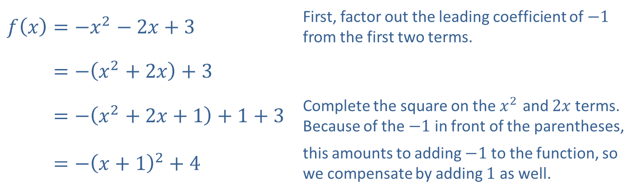
Example 1: Graphing Quadratic Functions₂
Solution
First, identify the vertex of the function by completing the square as follows.
​$f\left(x\right)=−x^{2}−2x+3$ | First, factor out the leading coefficient of $−1$ from the first two terms.
​𝑓⁡𝑥=−𝑥2+2𝑥+3
​𝑓⁡𝑥=−𝑥2+2𝑥+1+1+3 | Complete the square on the $x^{2}$ and $2x$ terms. Because of the $−1$ in front of the parentheses,
​𝑓⁡𝑥=−𝑥+12+4 | this amounts to adding $−1$ to the function, so we compensate by adding 1 as well.

Slide 7
Example 1: Graphing Quadratic Functions₃
Completing the square places the equation in vertex form, and we rewrite the expression
as
so the vertex is (−1, 4).

Slide 8
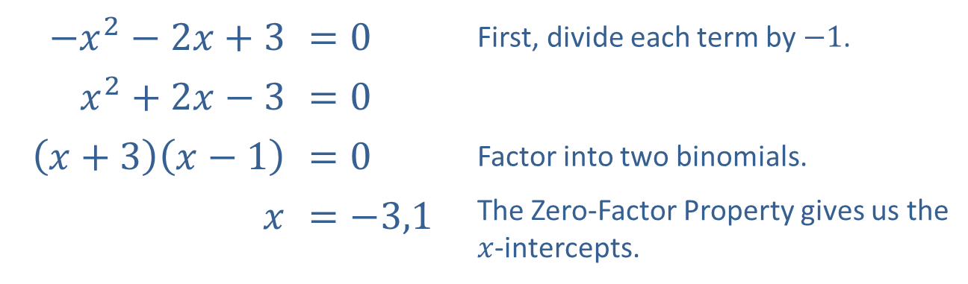
Example 1: Graphing Quadratic Functions₄
The instructions also ask us to identify the x-intercepts. An x-intercept of the function f is any point on the x-axis where f (x) = 0, so we need to solve the equation − x ² − 2x + 3. This can be done by factoring.
​$−x^{2}−2x+3$ | $$=0$$ | First, divide each term by $−1$.
​$x^{2}+2x−3$ | $$=0$$
​$\left(x+3\right)\left(x−1\right)$ | $$=0$$ | Factor into two binomials.
​$x$ | $$=−3,1$$ | The Zero-Factor Property gives us the $x$-intercepts.
Therefore, the x-intercepts are located at (−3, 0) and (1, 0).

Slide 9
Example 1: Graphing Quadratic Functions₅
The vertex form of the function,
tells us that this quadratic opens downward, has its vertex at (−1, 4), and is neither skinnier nor broader than the basic parabola. We now also know that it crosses the x-axis at −3 and 1. Putting this all together, we obtain the following graph.

Slide 10
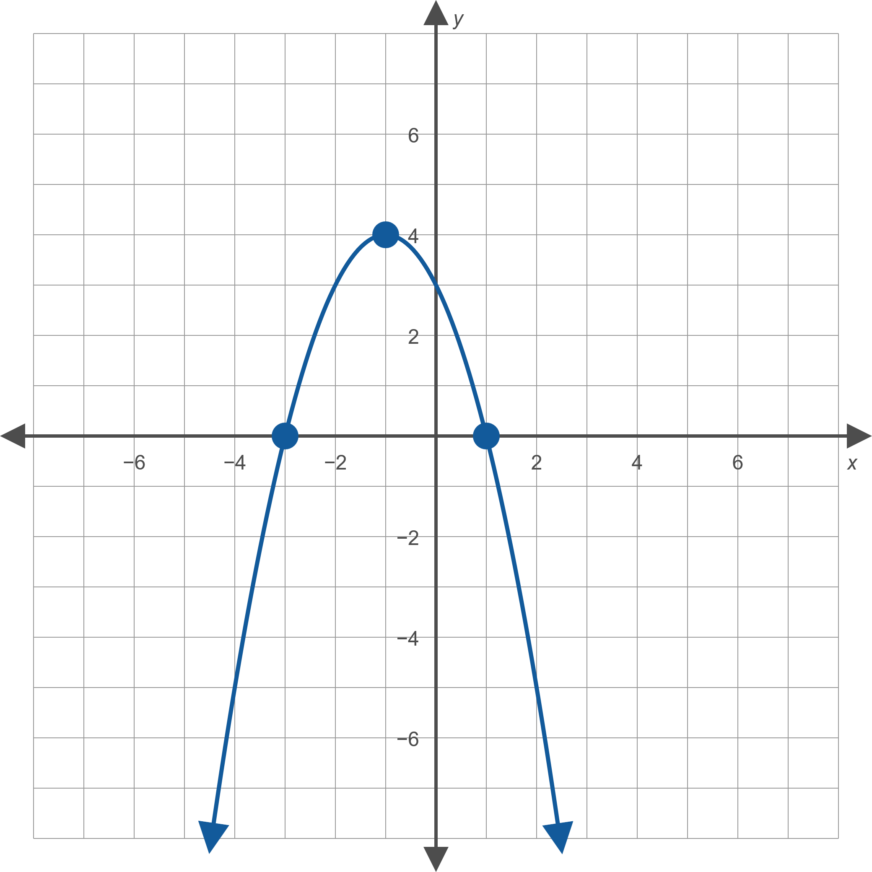
Example 1: Graphing Quadratic Functions₆
Figure 6: f (x) = − x² − 2x + 3.

Slide 11
Formula: Vertex of a Quadratic Function
Given a quadratic function
the graph of f is a parabola with a vertex given by

Slide 12
Example 2: Using the Vertex Formula₁
Find the vertex of the following quadratic functions using the vertex formula.​

Slide 13
Note₂
If the x-coordinate of the vertex is simple, use substitution to find the y-coordinate.
If the x-coordinate is complicated, use the explicit formula (the right-hand form in the vertex formula).

Slide 14
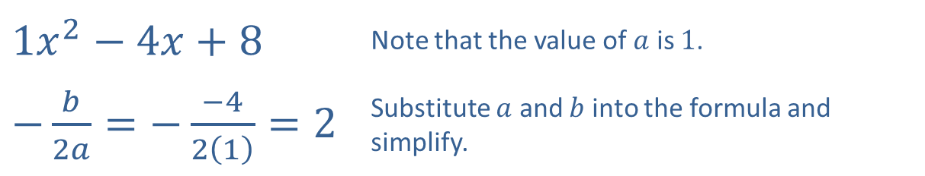
Example 2: Using the Vertex Formula₂
Solution
​Begin by using the formula to find the x-coordinate of the vertex.
​
​$1x^{2}−4x+8$ | Note that the value of $a$ is 1.
​$−\frac{b}{2a}=−\frac{−4}{2\left(1\right)}=2$ | Substitute $a$ and $b$ into the formula and simplify.

Slide 15
Example 2: Using the Vertex Formula₃
​At this point, we need to decide how to find the
y-coordinate. Since the x-coordinate is an integer, substitute it directly into the original equation, finding
Thus, the vertex of the graph of f (x) is (2, 4).

Slide 16
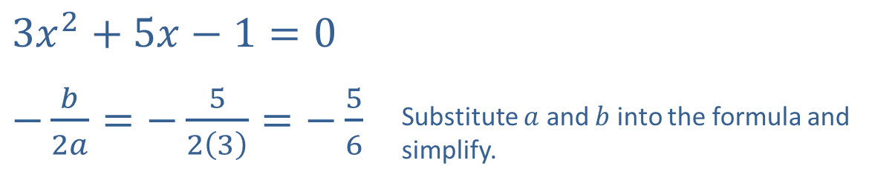
Example 2: Using the Vertex Formula₄
​Again, begin by finding the x-coordinate of the vertex.
​
​$3x^{2}+5x−1=0$
​$−\frac{b}{2a}=−\frac{5}{2\left(3\right)}=−\frac{5}{6}$ | Substitute $a$ and $b$ into the formula and simplify.

Slide 17
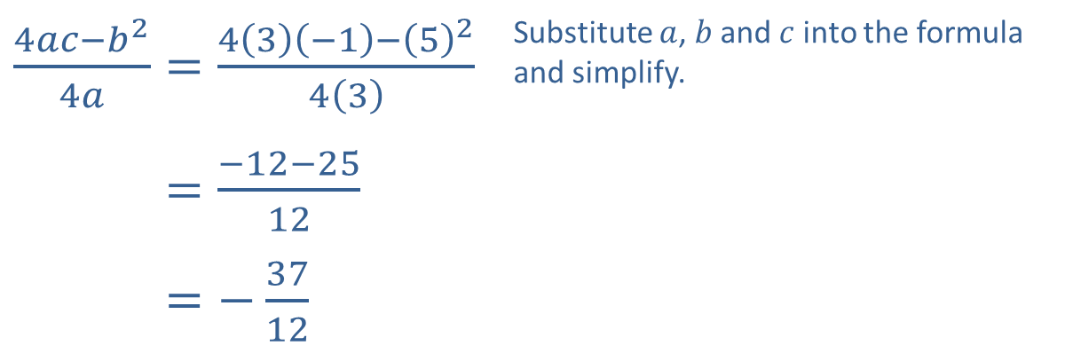
Example 2: Using the Vertex Formula₅
​Here, the x-coordinate is a fraction, so substituting it into the original equation leads to messy calculations. Instead, use the explicit formula to find the
y-coordinate.
​
​$\frac{4ac−b^{2}}{4a}=\frac{4\left(3\right)\left(−1\right)−{\left(5\right)}^{2}}{4\left(3\right)}$ | Substitute $a$, $b$ and $c$ into the formula and simplify.
​4𝑎𝑐−𝑏24𝑎=−12−2512
​4𝑎𝑐−𝑏24𝑎=−3712
Thus, the vertex of the graph of g(x) is

Slide 18
Example 3: Finding a Quadratic Function Given Its Graph₁
​Find a formula for the quadratic function whose graph is given in Figure 7.
​Use the formula to determine the coordinates of the parabola’s vertex.

Slide 19
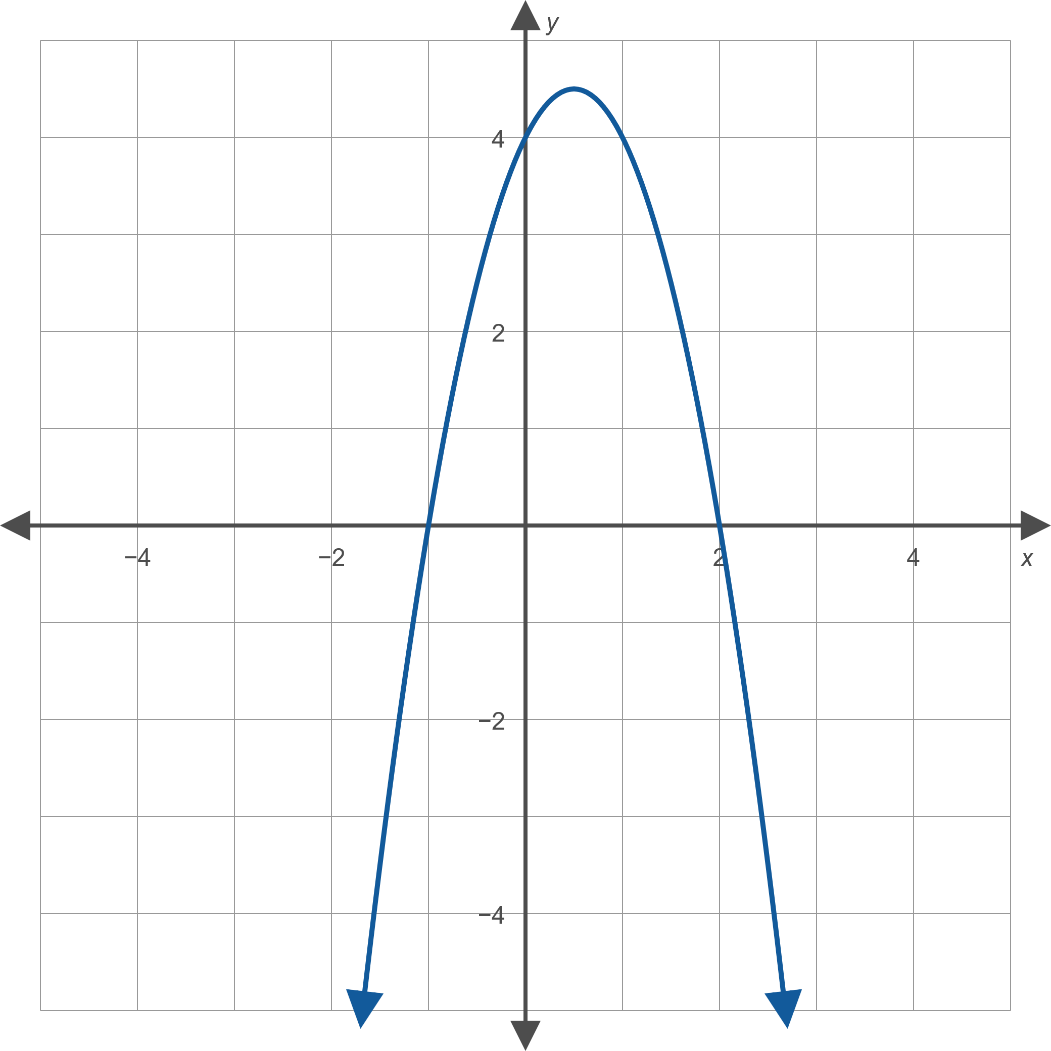
Example 3: Finding a Quadratic Function Given Its Graph₂
Figure 7

Slide 20
Example 3: Finding a Quadratic Function Given Its Graph₃
Solution
​The graph indicates that the parabola has
x-intercepts of − 1 and 2, so we know that the quadratic function corresponding to this graph can be factored as follows.

Slide 21
Example 3: Finding a Quadratic Function Given Its Graph₄
​The fact that the parabola opens downward tells us that a, must be negative, but we can determine it exactly by noting that f (0) = 4. Substituting this into the
can solve for a.
Hence,

Slide 22
Example 3: Finding a Quadratic Function Given its Graph₅
​Given the quadratic function f (x) = − 2x ² + 2x + 4, we know the coefficients are a = − 2, b = 2, and c = 4. We can now determine the coordinates of the vertex of the parabola as follows.

Slide 23
Example 4: Quadratic Regression₁
Given the points graphed in Figure 8, use quadratic regression to find and graph the quadratic function of best fit.

Slide 24
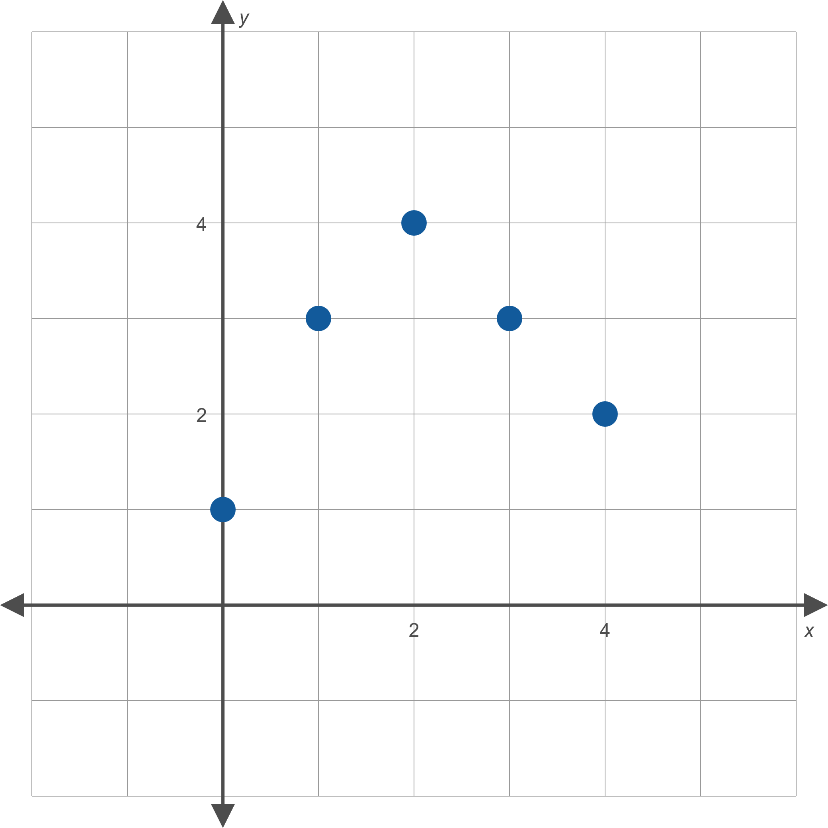
Example 4: Quadratic Regression₂
Figure 8

Slide 25
Example 4: Quadratic Regression₃
Solution
The coordinates of the five graphed points are
{(0,1), (1,3), (2,4), (3,3), (4,2)}.
Using the least-squares method to find a quadratic function that best fits the points results in the following function.
Figure 11 shows the graph of this function along with the given five points.

Slide 26
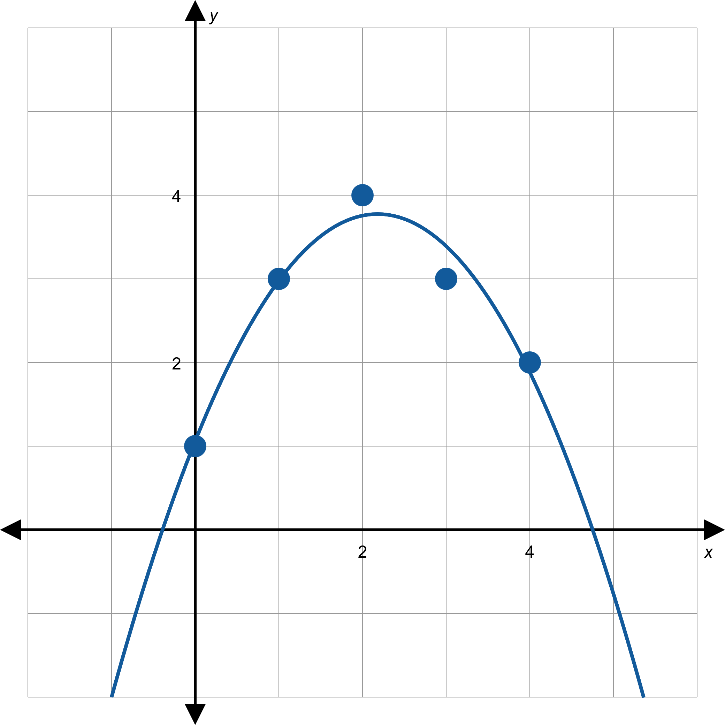
Example 4: Quadratic Regression₄
Figure 11

Slide 27
Example 5: Quadratic Regression₁
​Find the quadratic function that best fits the points shown in Figure 12.
​Use your result to determine the coordinates of the vertex of the best-fitting parabola.

Slide 28
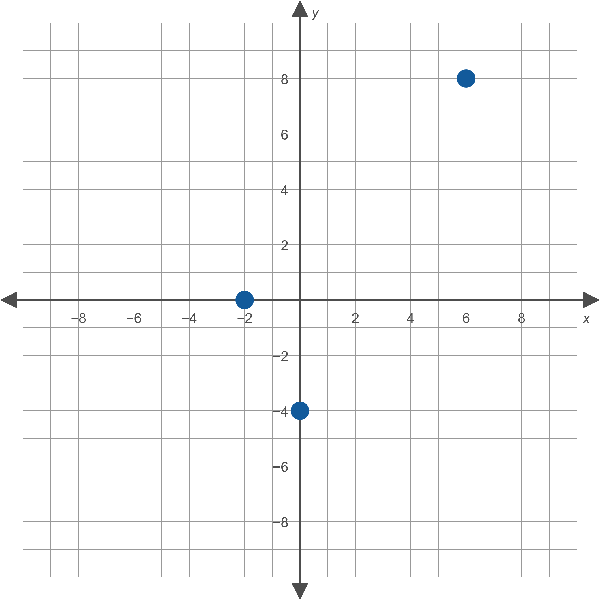
Example 5: Quadratic Regression₂
Figure 12

Slide 29
Example 5: Quadratic Regression₃
Solution
​The coordinates of the three graphed points are
{(− 2,0), (0,− 4), (6,8)}.
​Using the least-squares method to find a quadratic function that best fits the points results in the function
f (x) = 0.5x ² − x − 4.
​Figure 15 shows the graph of this function along with the given three points.

Slide 30
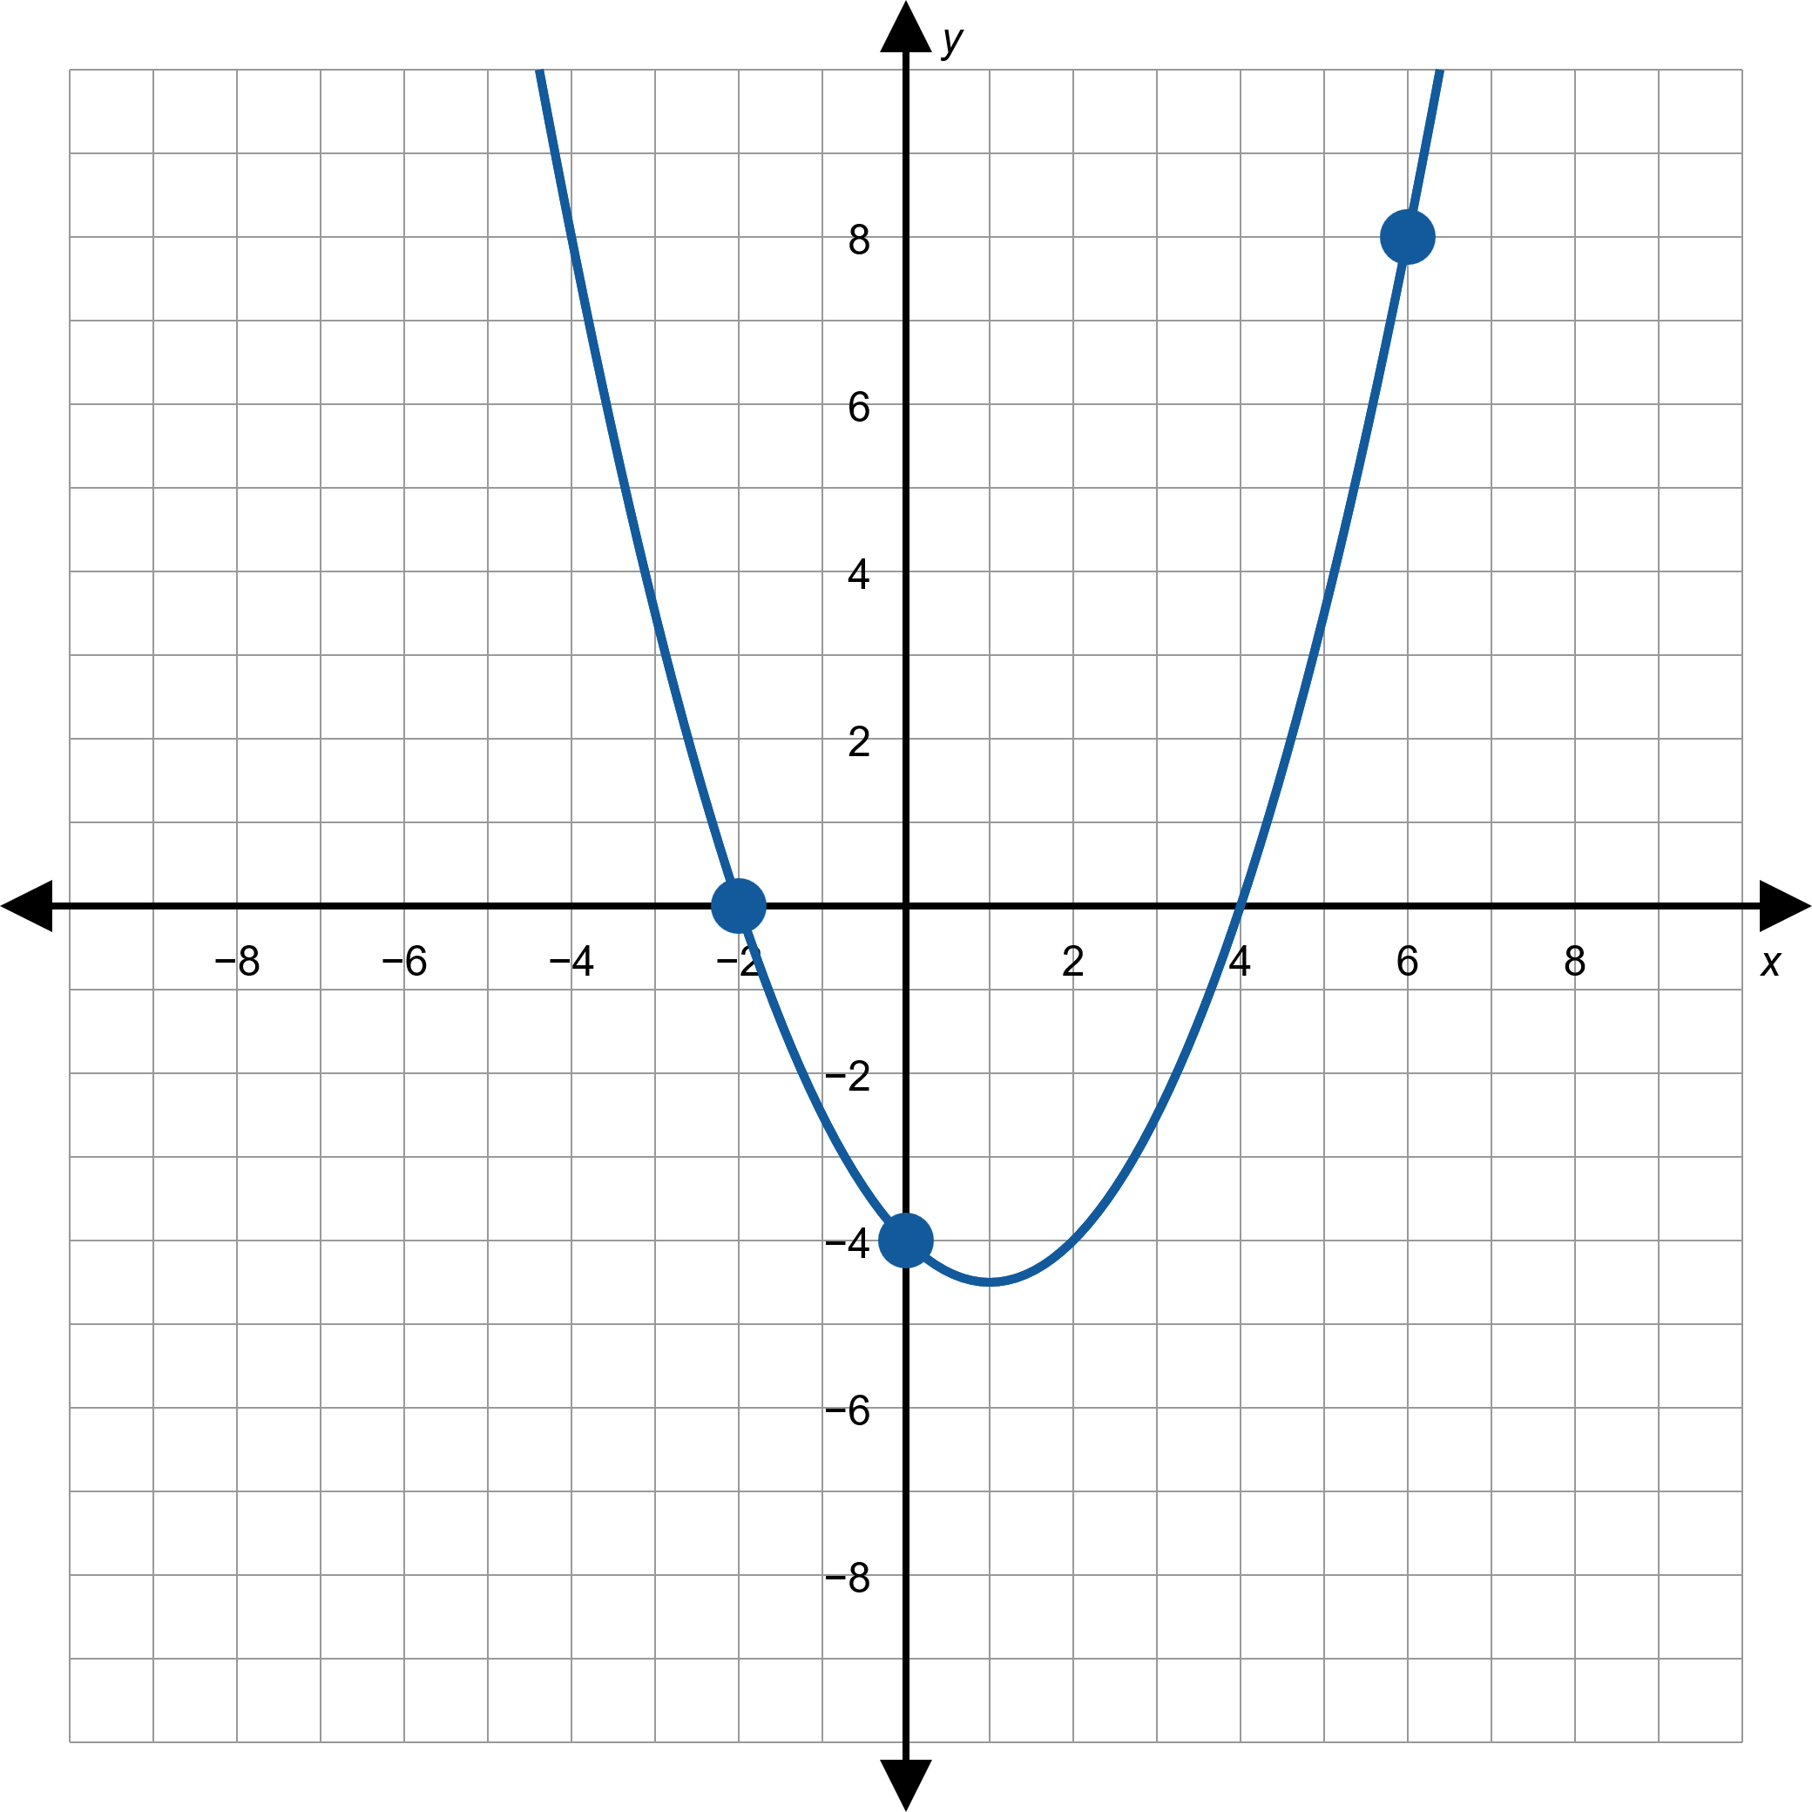
Example 5: Quadratic Regression₄
Figure 15

Slide 31
Example 5: Quadratic Regression₅
​Given the quadratic function f (x) = 0.5x ² − x − 4, we know the coefficients are a = 0.5, b = − 1, and c = − 1. We can now determine the coordinates of the vertex of the parabola as follows.

Slide 32
Example 6: Fencing a Garden₁
A farmer plans to use 100 feet of spare fencing material to form a rectangular garden plot against the side of a long barn, using the barn as one side of the plot. How should he split up the fencing among the other three sides in order to maximize the area of the garden plot?

Slide 33
Example 6: Fencing a Garden₂
Solution
If we let x represent the length of one side of the plot, as shown in Figure 17, then the dimensions of the plot are x feet by 100 − 2x feet. A function representing the area of the plot is
If we multiply out the formula for A, we recognize it as a quadratic function A(x) = − 2x ² + 100x. This is a parabola opening downward, so the vertex will be the maximum point on the graph of A.

Slide 34
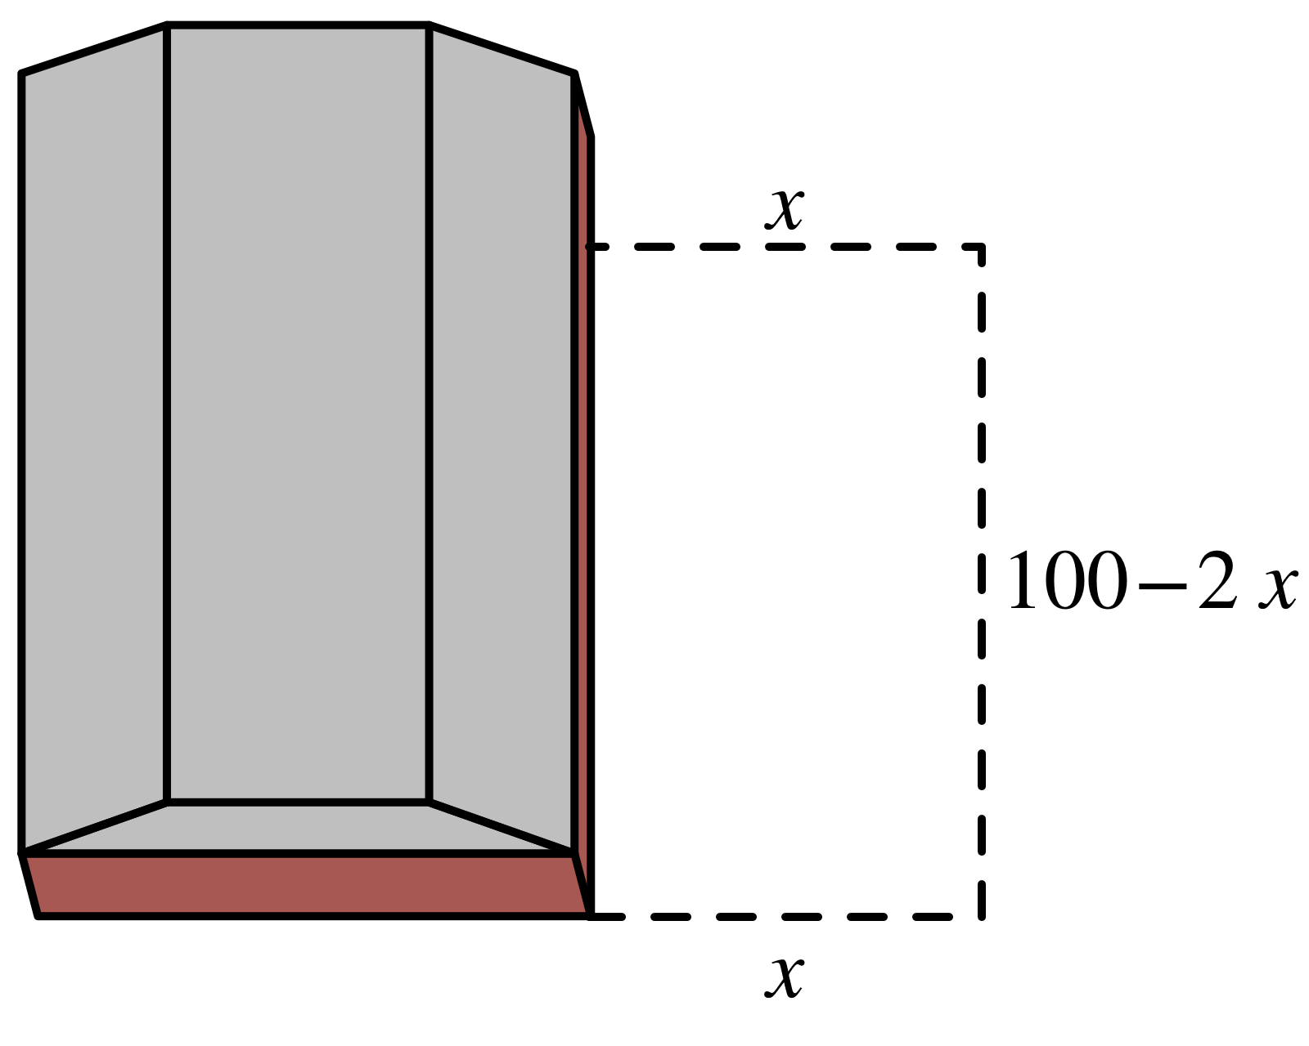
Example 6: Fencing a Garden₃
Figure 17

Slide 35
Example 6: Fencing a Garden₄
Using the vertex formula we know that the vertex of A
is the ordered pair
, or
Thus, to maximize area, we should let x = 25, and so 100 − 2x = 50. The resulting maximum possible area,
or 1250 square feet, is also the value A(25).

Slide 36
Example 7: Quadratic Regression and Maximization₁
Suzanne occasionally plays guitar in a coffee shop and sells CDs of her music when she does. She’s been experimenting with the price to charge per CD and has noted the relationship between price and number of CDs sold shown in Table 1, where the corresponding revenue (the product of price and number sold) is also shown. If she assumes the dependence of revenue on number of CDs sold is quadratic in nature, what number of CDs sold will maximize her revenue? What is the corresponding price per CD?

Slide 37
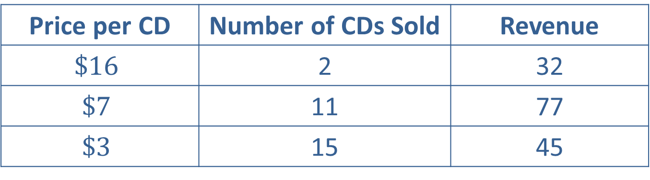
Example 7: Quadratic Regression and Maximization₂
Price per CD | Number of CDs Sold | Revenue
$$\$16$$ | 2 | 32
$$\$7$$ | 11 | 77
$$\$3$$ | 15 | 45
Table 1

Slide 38
Example 7: Quadratic Regression and Maximization₃
Solution
If we think of Revenue as a function of Number of CDs Sold, the coordinates of the three data points Suzanne has collected are
Using the least-squares method to find a quadratic function R that best fits the points results in the function
R(x) = − x ² + 18x.
Figure 18 shows the graph of this function along with the three data points.

Slide 39
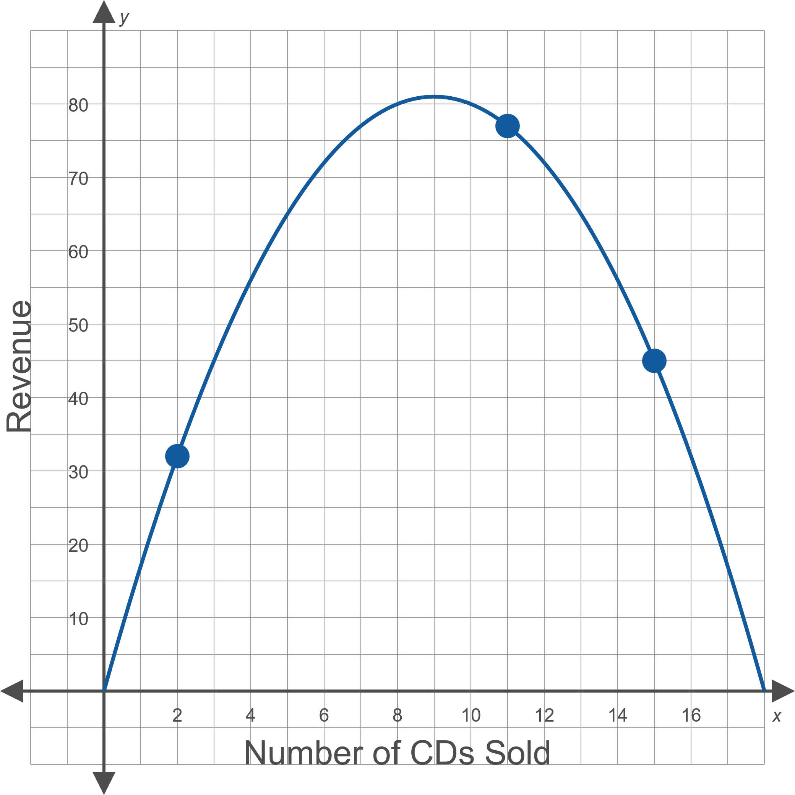
Example 7: Quadratic Regression and Maximization₄
Figure 18

Slide 40
Example 7: Quadratic Regression and Maximization₅
Given the formula R(x) = − x² + 18x, we know that so
a = −1, b = 18, and c = 0. the vertex of the parabola has the following coordinates.
So Suzanne should aim to sell 9 CDs to maximize her revenue at $81, and the corresponding price per CD
will be

