Slide 1
Section 4.2
Linear Functions

Slide 2
Definition: Linear Functions
A linear function f in the variable x is any function that can be written in the form f (x) = m x + b, where m and b are real numbers. If m ≠ 0, f (x) = m x + b is also called a first-degree polynomial function.

Slide 3
Note
A function cannot represent a vertical line (since it fails the vertical line test). Vertical lines can represent the graphs of equations, but not functions.

Slide 4
Example 1: Graphing Linear Functions₁
Graph the following linear functions.

Slide 5
Example 1: Graphing Linear Functions ₂
Solution
a. The function f (x) = 3x + 2 is a line with a slope of 3 and a y-intercept of 2. To graph the function, plot the ordered pair (0,2) and locate another point on the line by moving up 3 units and over to the right 1 unit, giving the ordered pair (1,5). Once these two points have been plotted, connecting them with a straight line completes the process.

Slide 6
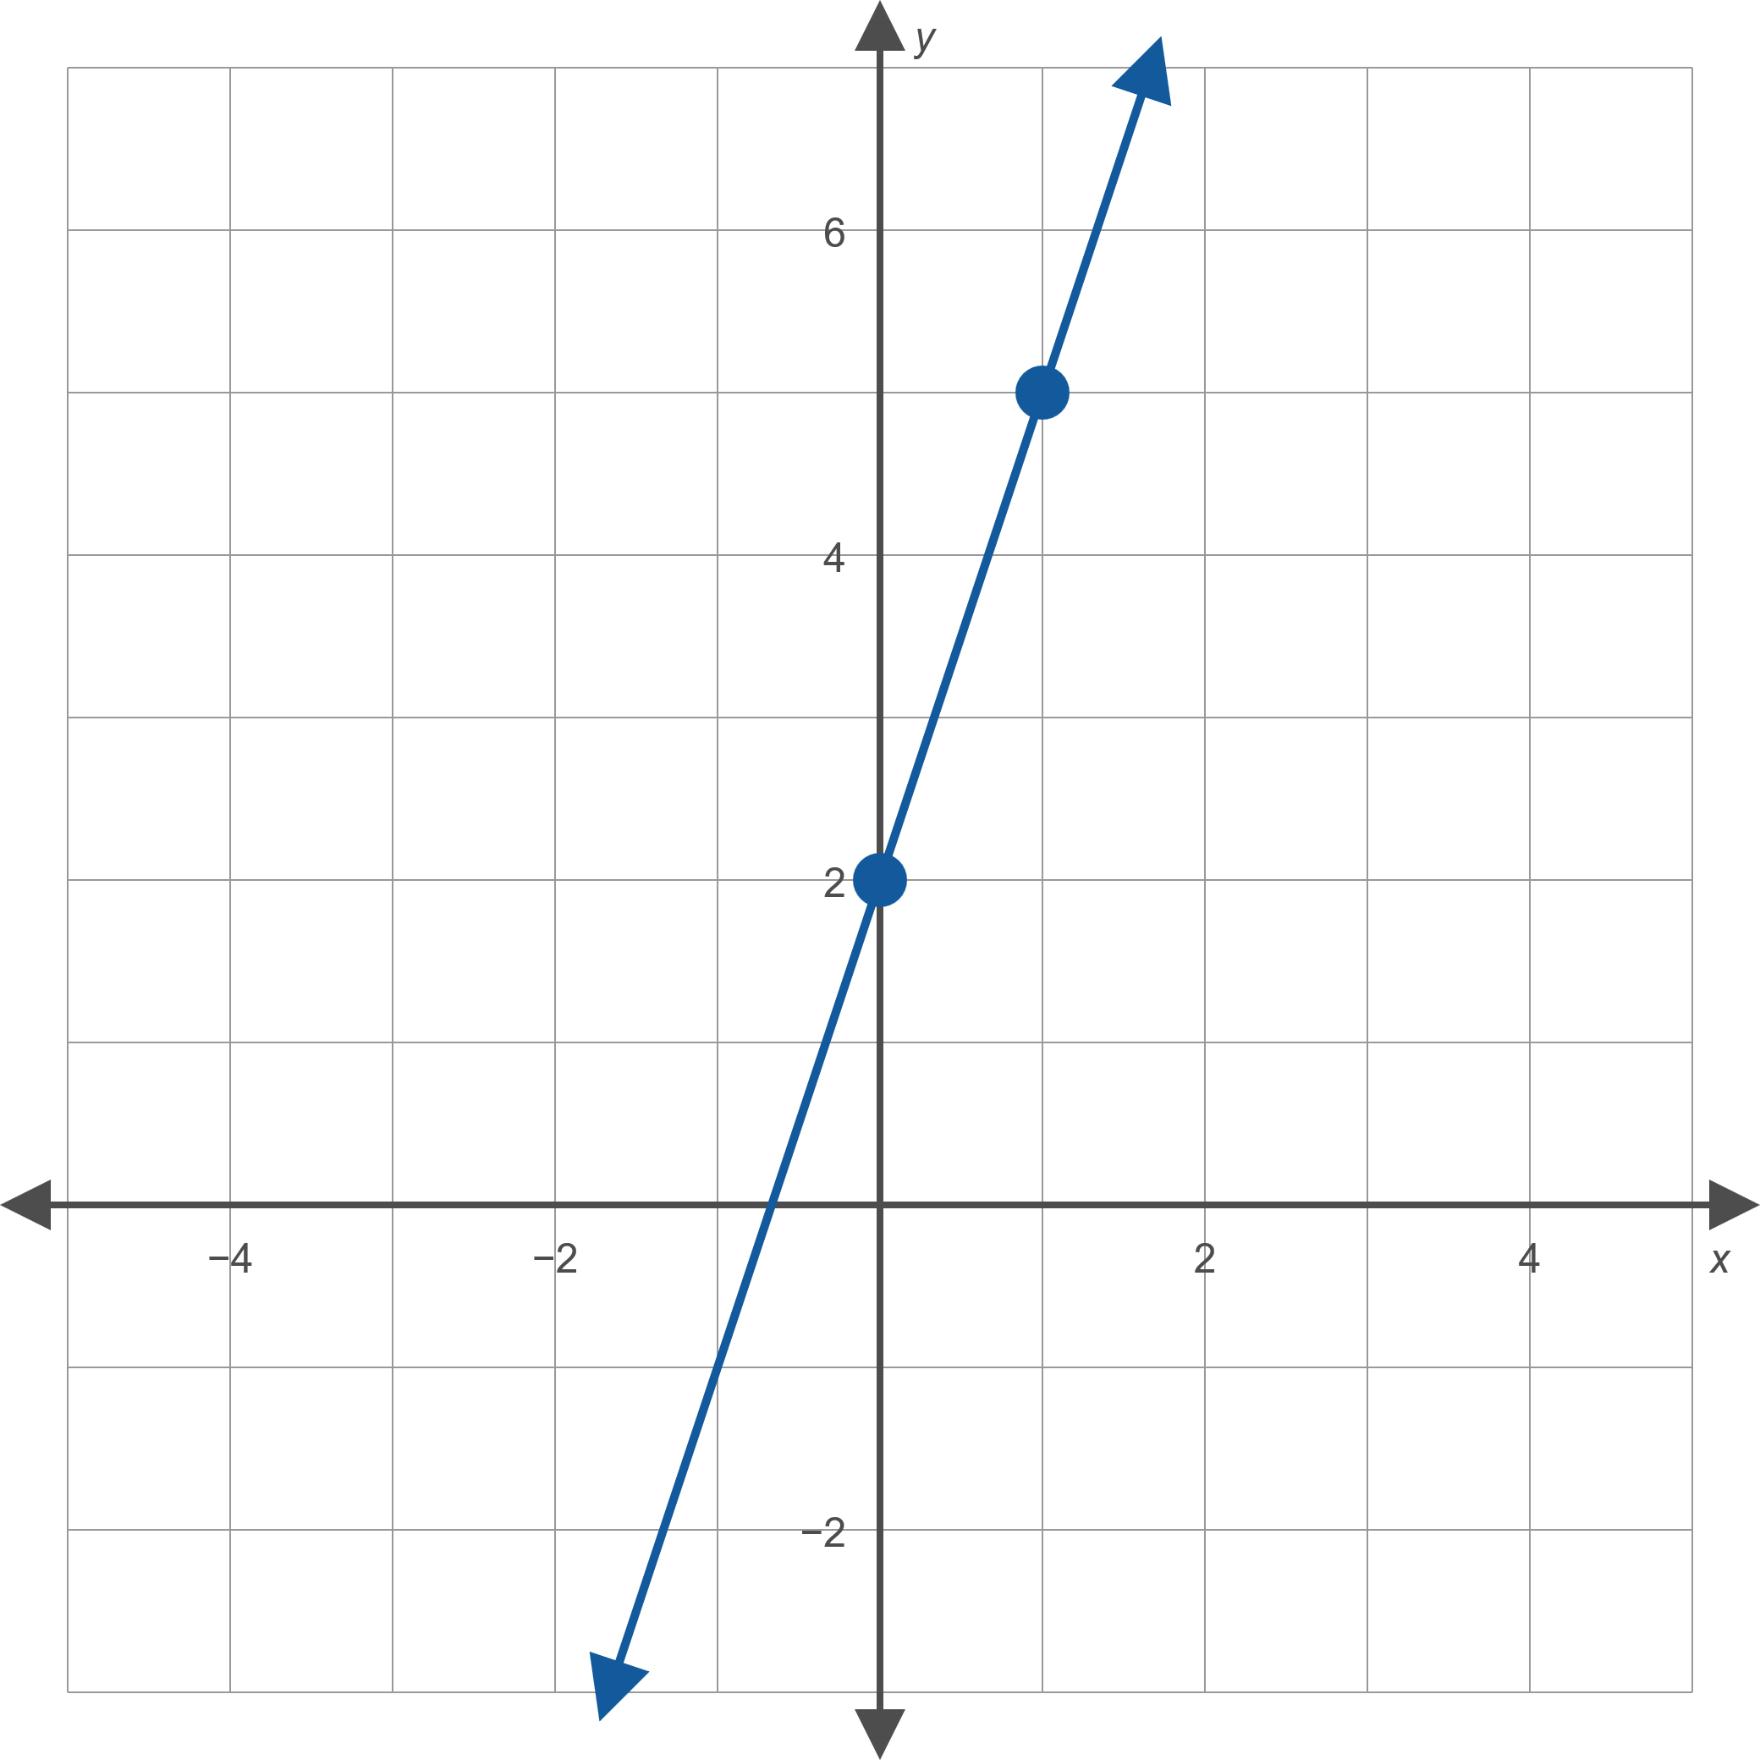

Example 1: Graphing Linear Functions ₃
​

Slide 7
Example 1: Graphing Linear Functions ₄
b. The graph of the function g(x) = 3 is a straight line with a slope of 0 and a y-intercept of 3. A linear function with a slope of 0 is also called a constant function, as it turns any input into one fixed constant—in this case the number 3. The graph of a constant function is always a horizontal line.
​

Slide 8
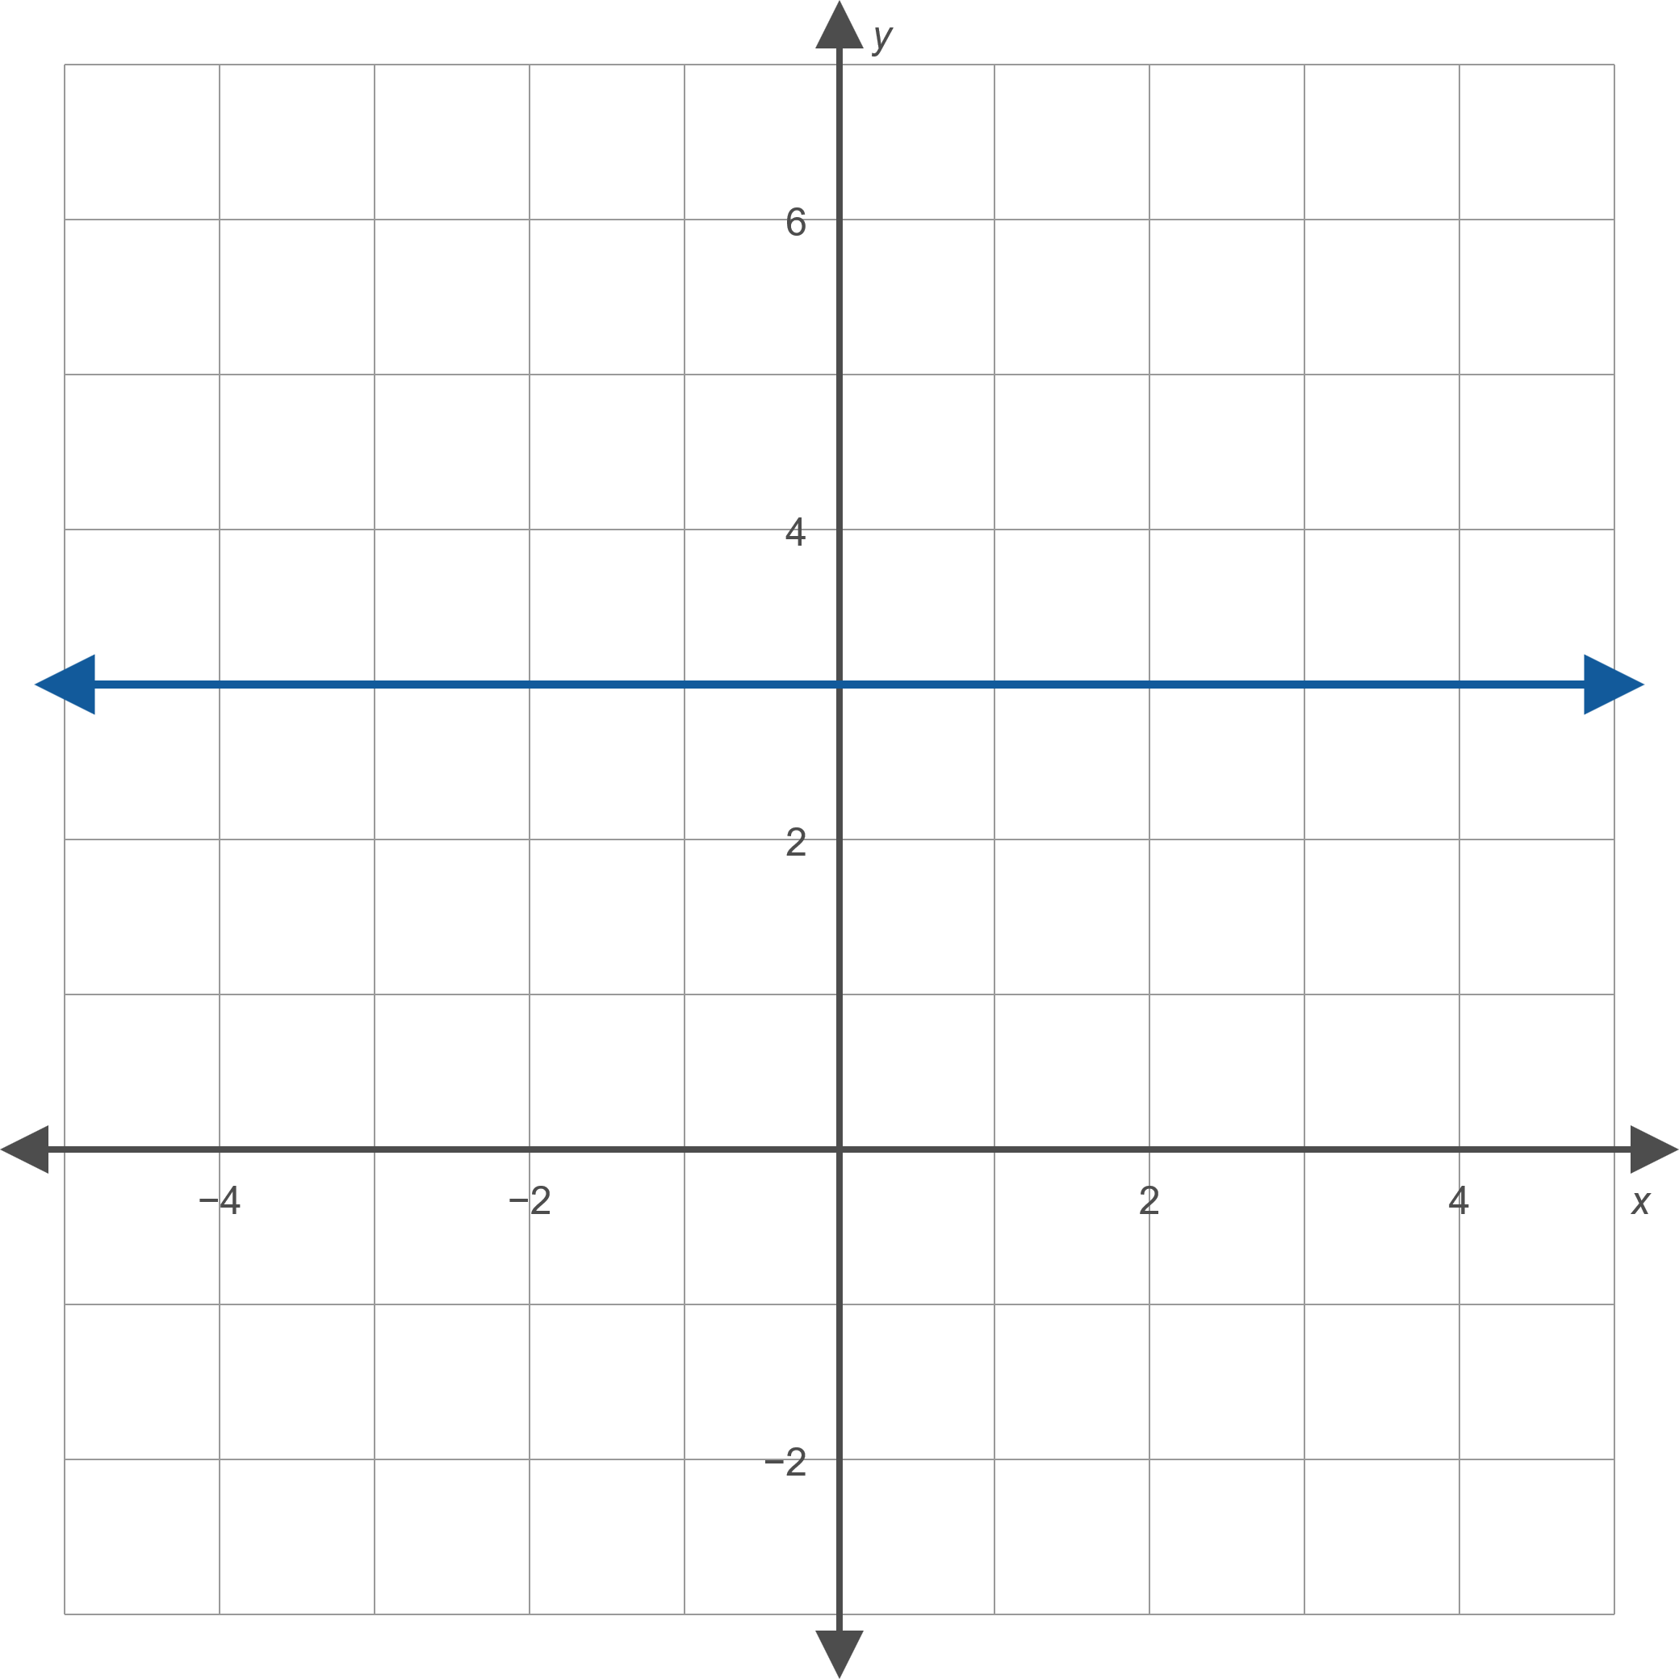
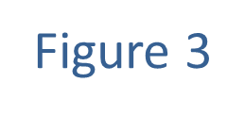
Example 1: Graphing Linear Functions ₅

Slide 9
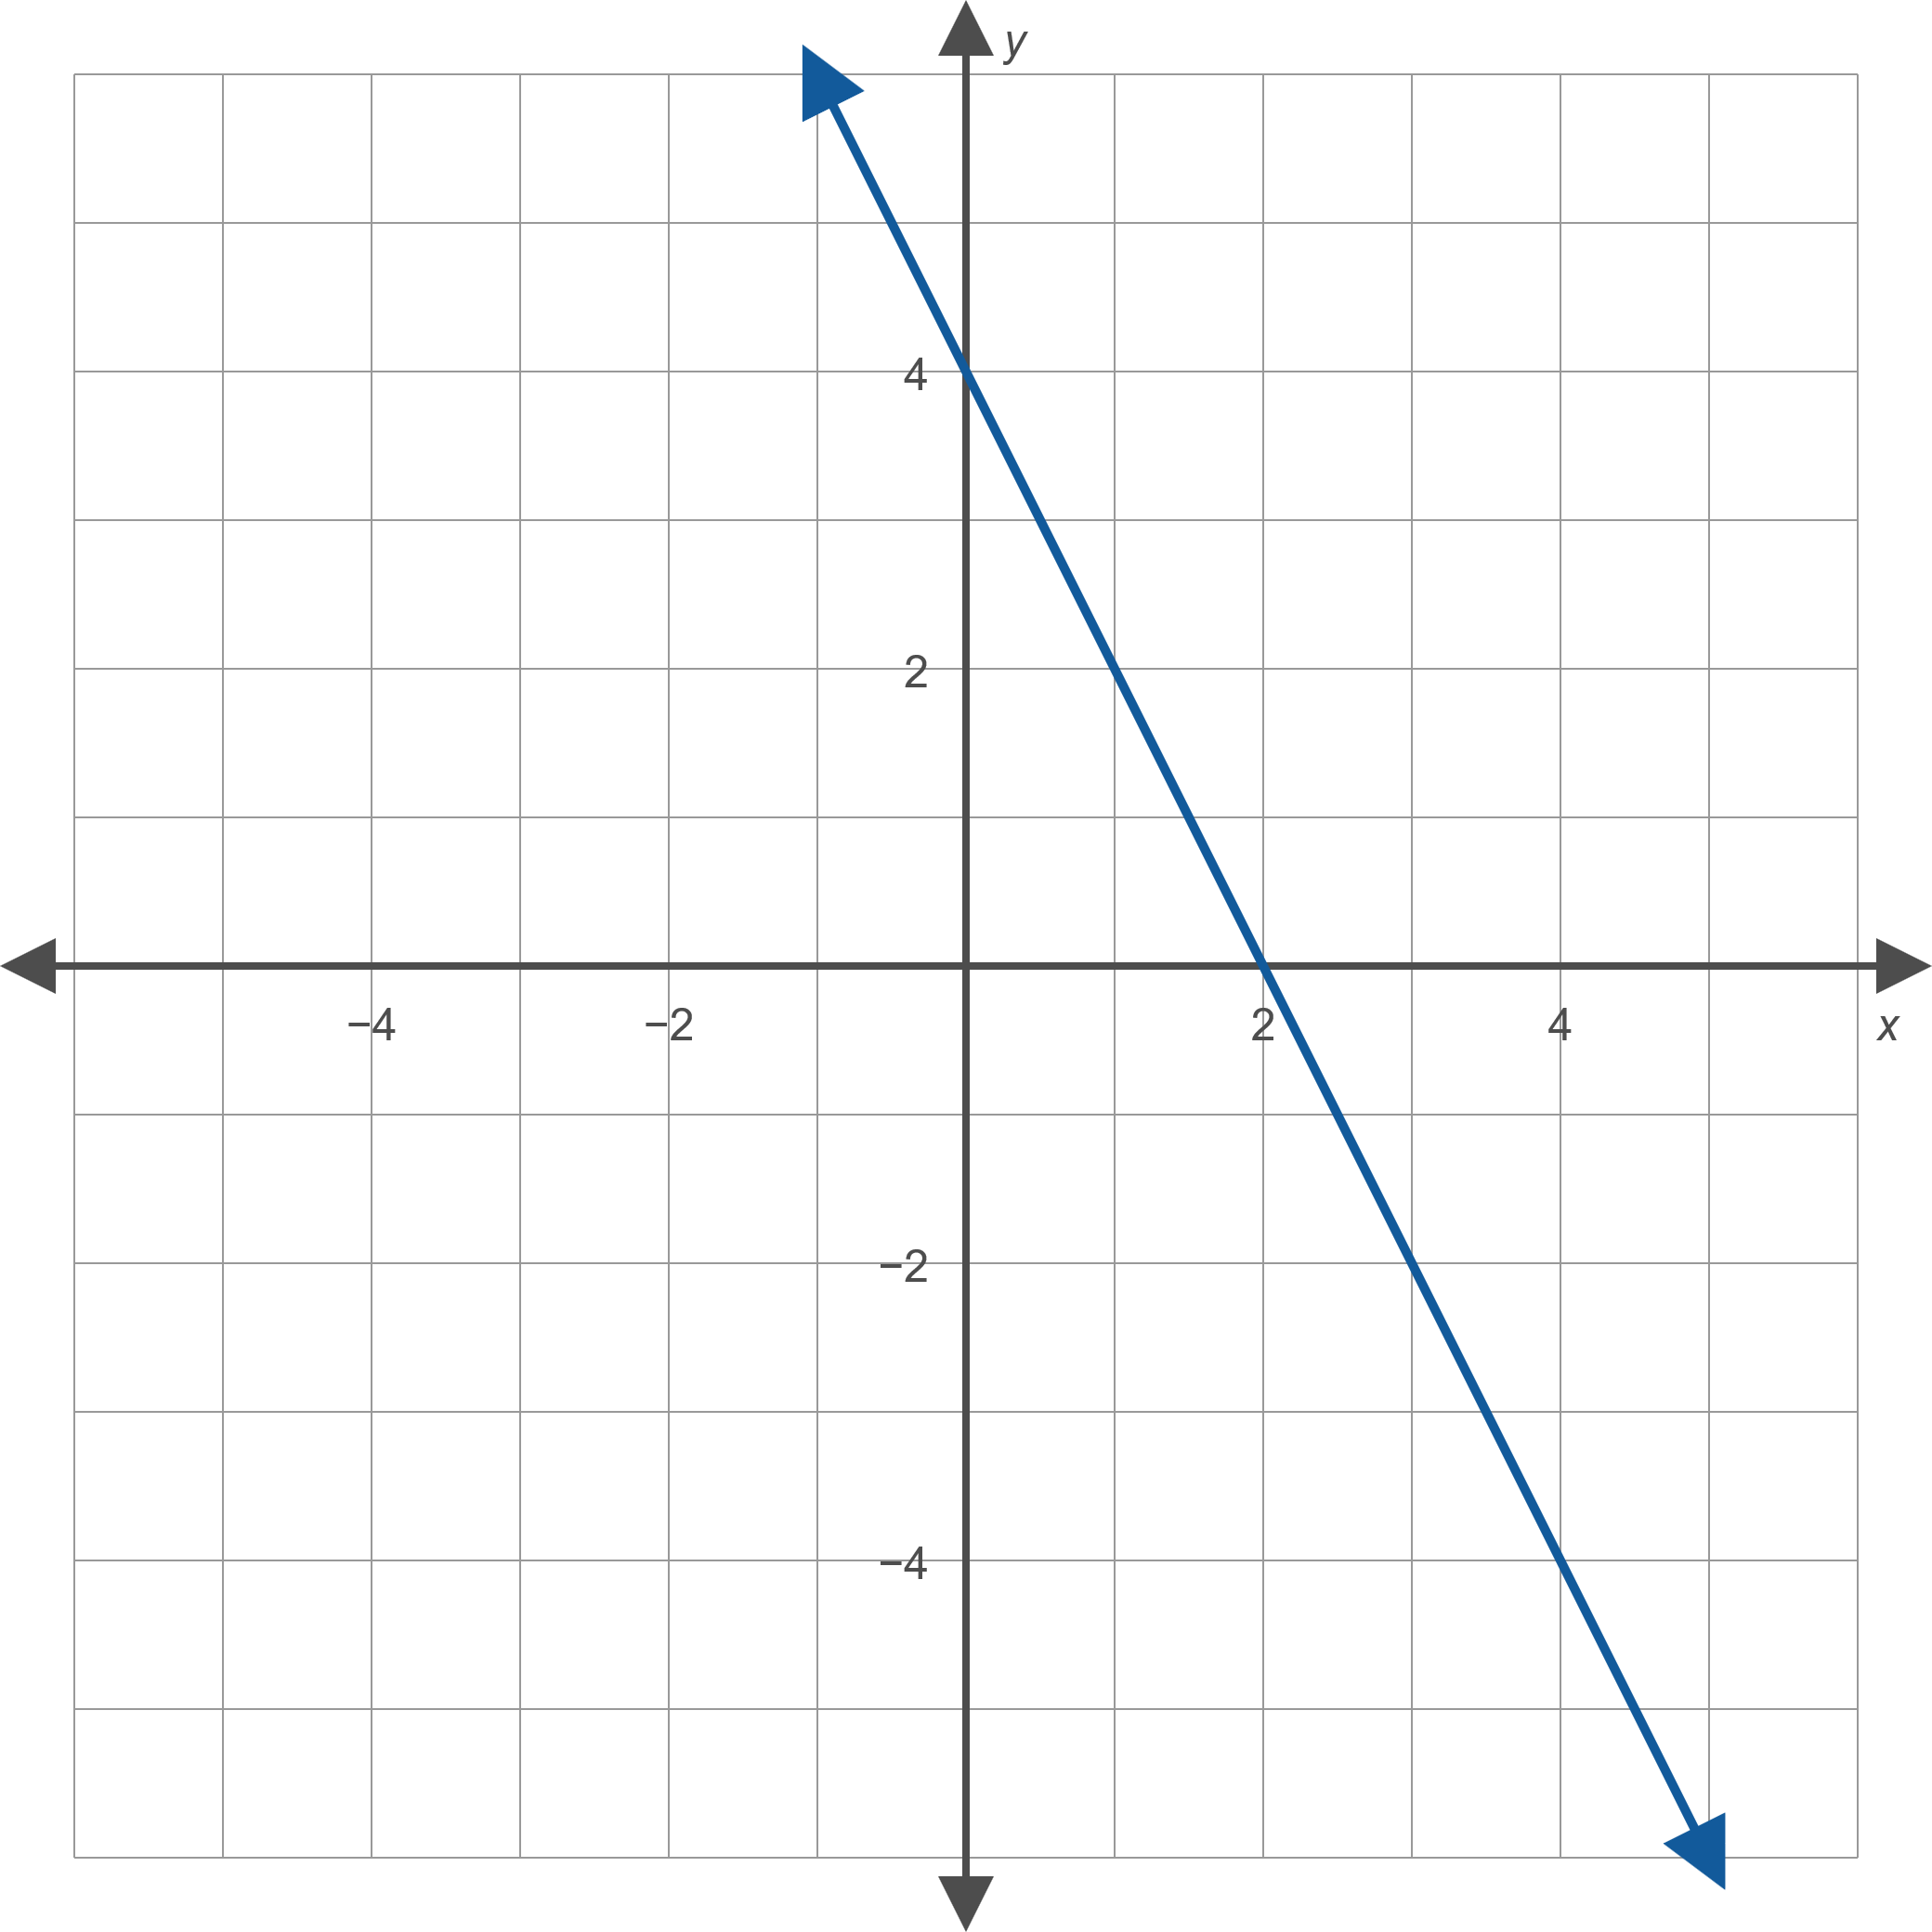
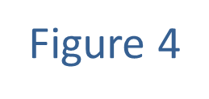
Example 2: Finding a Linear Function Given its Graph ₁
Find a formula for the linear function whose graph is given.

Slide 10
Example 2: Finding a Linear Function Given its Graph ₂
Solution
The graph shows a y-intercept of 4, giving us one of the two constants necessary to define a linear function. To determine the slope, we can use the fact that (0, 4) and (2,0) both lie on the graph and hence
If we name the function f, the formula for this function is thus
f (x) = −2x + 4.

Slide 11
Example 3: Finding the Line of Best Fit and Correlation Coefficient ₁
Given the points graphed in Figure 7,
a. ​use linear regression to find and graph the line of best fit, and
b. find the Pearson correlation coefficient r.

Slide 12
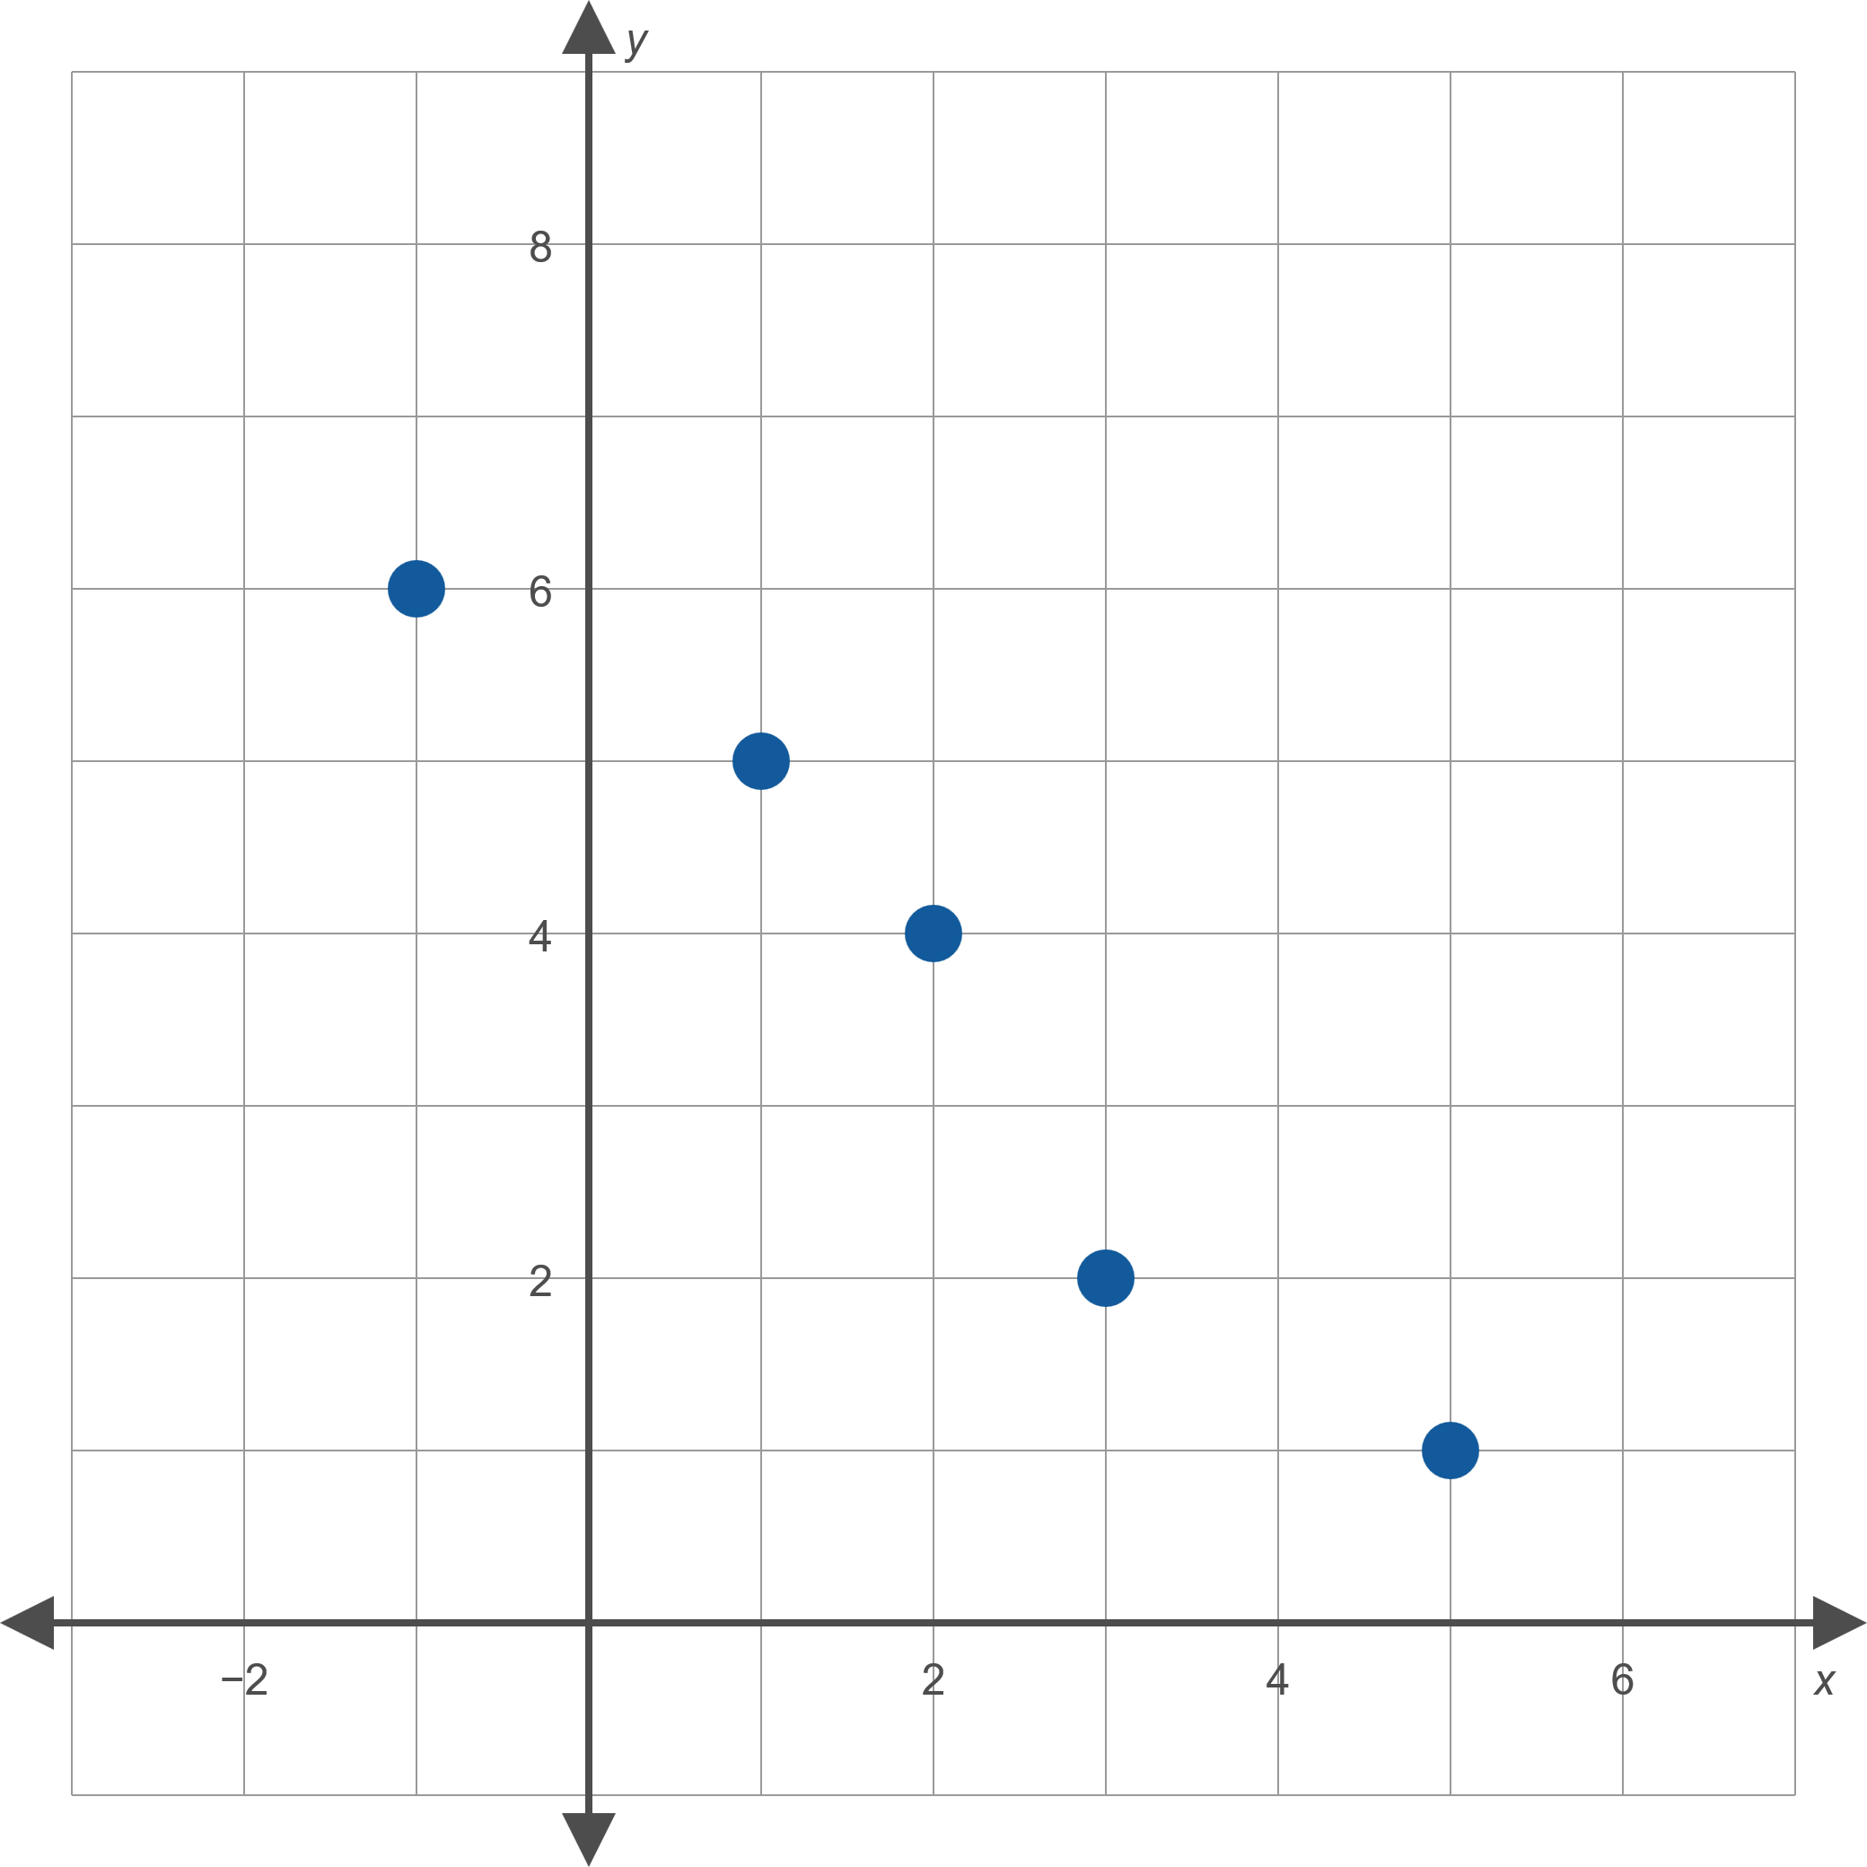

Example 3: Finding the Line of Best Fit and Correlation Coefficient ₂

Slide 13
Example 3: Finding the Line of Best Fit and Correlation Coefficient ₃
Solution
The coordinates of the five graphed points are
{ (−1,6), (1,5), (2,4), (3,2), (5,1) }.
The averages of the x- and y-values are thus
which we use to construct tables of the values of Δx and Δy.

Slide 14
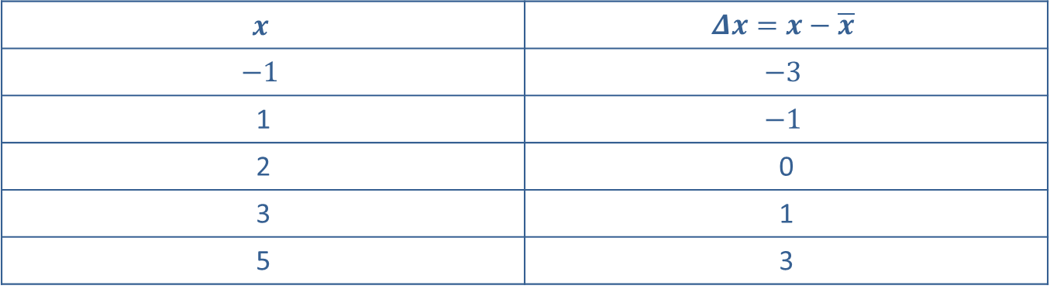
Example 3: Finding the Line of Best Fit and Correlation Coefficient ₄
Table 6
$$x$$ | $$Δx=x−\overline{x}$$
$$−1$$ | $$−3$$
1 | $$−1$$
2 | 0
3 | 1
5 | 3

Slide 15
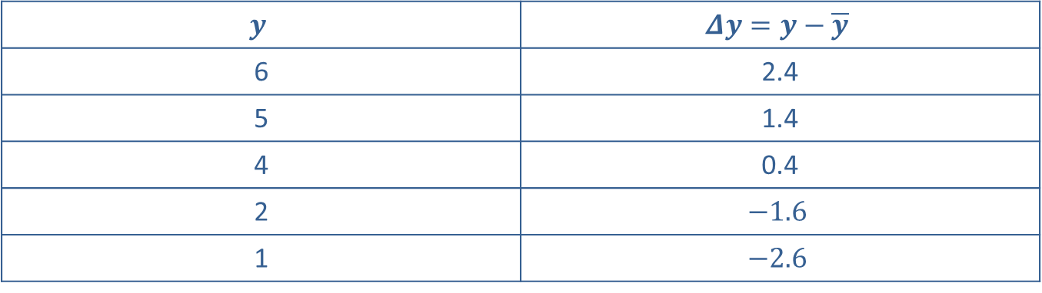
Example 3: Finding the Line of Best Fit and Correlation Coefficient ₅
Table 7
$$y$$ | $$Δy=y−\overline{y}$$
6 | 2.4
5 | 1.4
4 | 0.4
2 | $$−1.6$$
1 | $$−2.6$$

Slide 16
Example 3: Finding the Line of Best Fit and Correlation Coefficient ₆
We will need to know
so we make a third table leading to these sums.

Slide 17
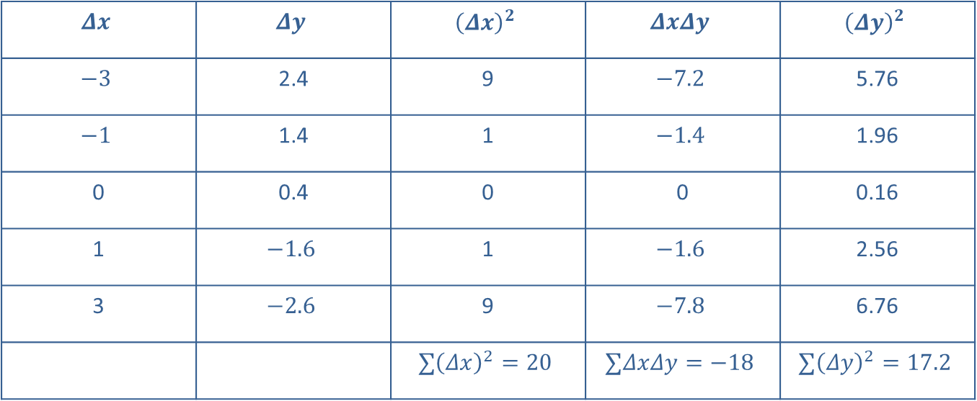
Example 3: Finding the Line of Best Fit and Correlation Coefficient ₇
Table 8
$$Δx$$ | $$Δy$$ | $${\left(Δx\right)}^{2}$$ | $$ΔxΔy$$ | $${\left(Δy\right)}^{2}$$
$$−3$$ | 2.4 | 9 | $$−7.2$$ | 5.76
$$−1$$ | 1.4 | 1 | $$−1.4$$ | 1.96
0 | 0.4 | 0 | 0 | 0.16
1 | $$−1.6$$ | 1 | $$−1.6$$ | 2.56
3 | $$−2.6$$ | 9 | $$−7.8$$ | 6.76
 |  | $$∑{\left(Δx\right)}^{2}=20$$ | $$∑ΔxΔy=−18$$ | $$∑{\left(Δy\right)}^{2}=17.2$$

Slide 18
Example 3: Finding the Line of Best Fit and Correlation Coefficient ₈
a. We have all we need now to determine that
​and
So, the line of best fit is y = −0.9x + 5.4. Figure 8 shows the graph of this line along with the given points.

Slide 19
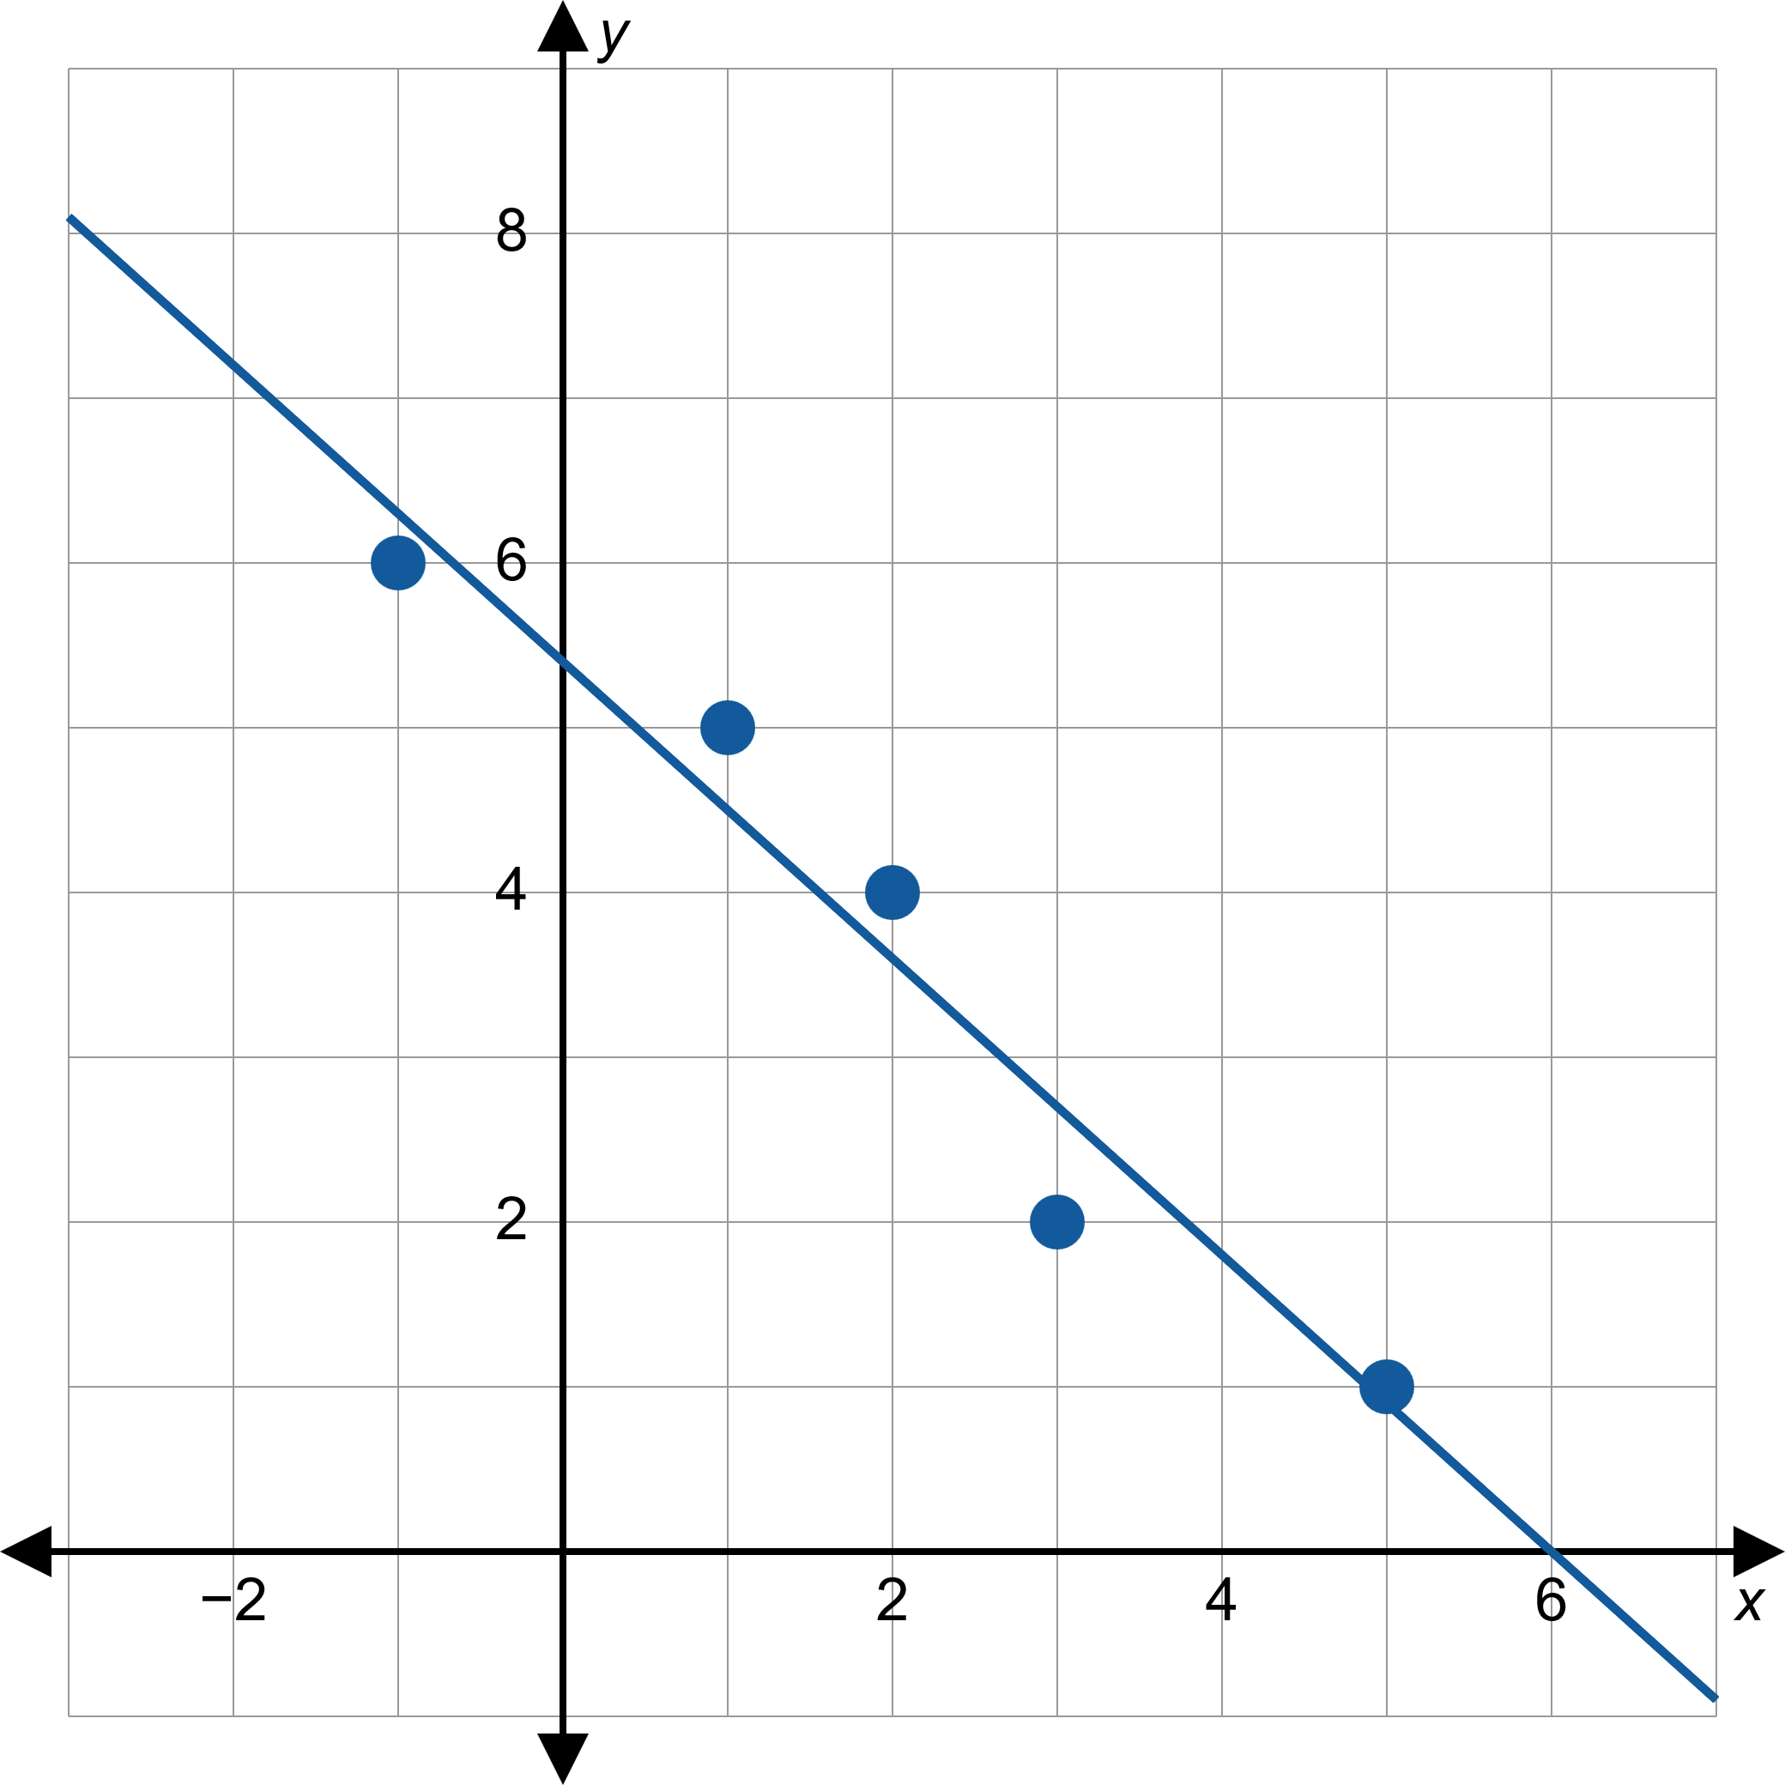

Example 3: Finding the Line of Best Fit and Correlation Coefficient ₉

Slide 20
Example 3: Finding the Line of Best Fit and Correlation Coefficient ₁₀
​We also have all we need to determine the Pearson correlation coefficient r.
The fact that r is negative reflects the fact that the slope of the best-fitting line is negative, and the fact that r is relatively close to 1 in magnitude means that this line of best fit is a reasonably good model of the behavior of the points.

Slide 21
Example 4: Finding the Line of Best Fit and Correlation Coefficient ₁
Given the points graphed in Figure 9,
a. ​use linear regression to find and graph the line of best fit, and
b. ​find the Pearson correlation coefficient r.

Slide 22
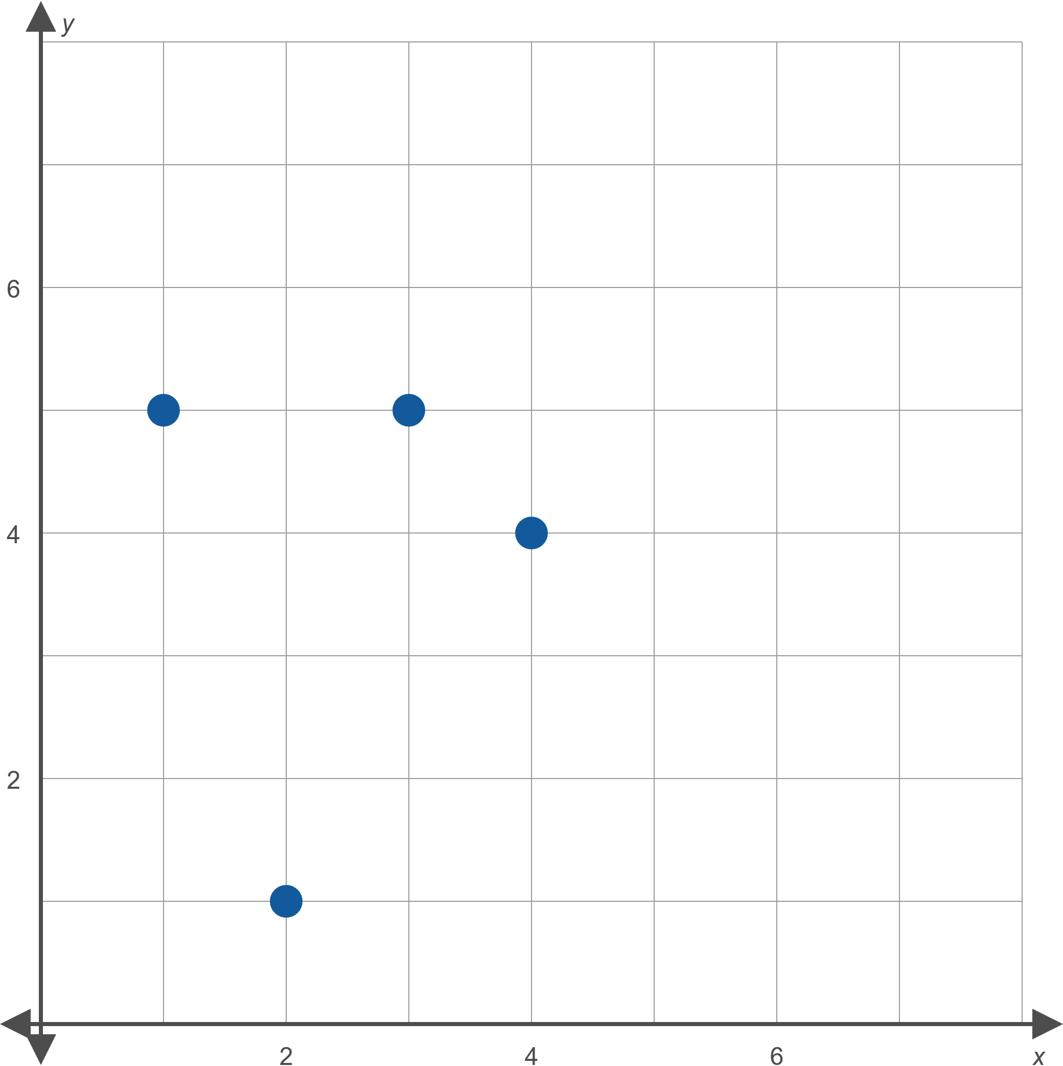
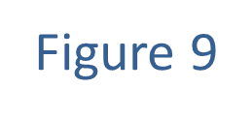
Example 4: Finding the Line of Best Fit and Correlation Coefficient ₂

Slide 23
Example 4: Finding the Line of Best Fit and Correlation Coefficient ₃
Solution
The coordinates of the four graphed points are
{ (1,5), (2,1), (3,5), (4,4) }.
The averages of the x- and y-values are thus
which we use to construct tables of the values of Δx and Δy.

Slide 24
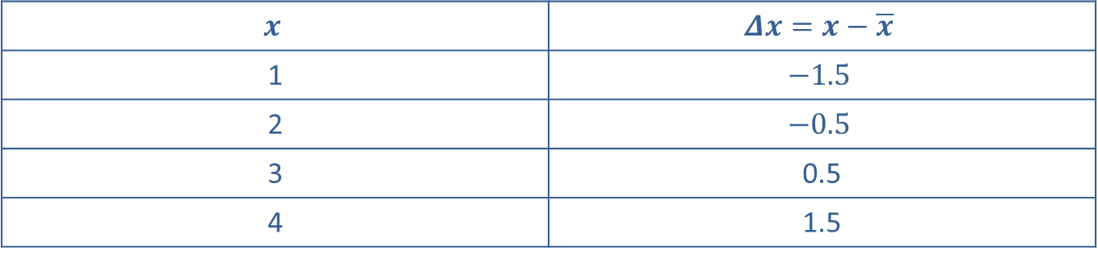
Example 4: Finding the Line of Best Fit and Correlation Coefficient ₄
Table 9
$$x$$ | $$Δx=x−\overline{x}$$
1 | $$−1.5$$
2 | $$−0.5$$
3 | 0.5
4 | 1.5

Slide 25
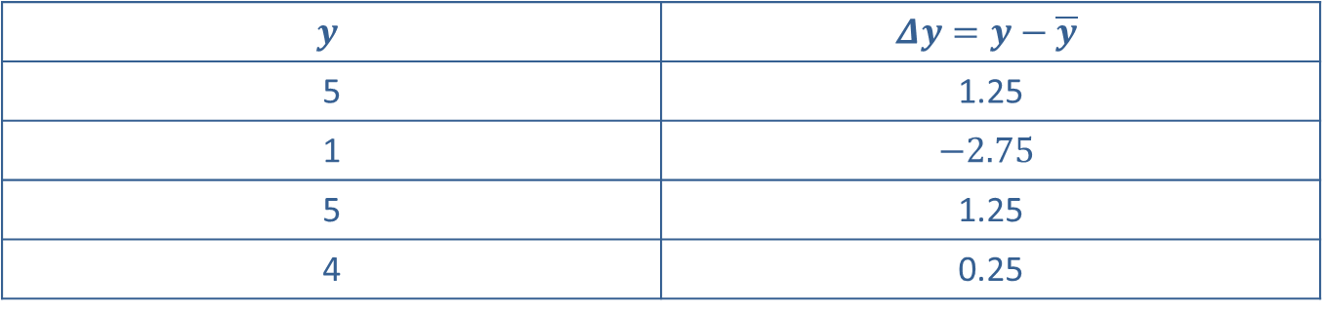
Example 4: Finding the Line of Best Fit and Correlation Coefficient ₅
Table 10
$$y$$ | $$Δy=y−\overline{y}$$
5 | 1.25
1 | $$−2.75$$
5 | 1.25
4 | 0.25

Slide 26
Example 4: Finding the Line of Best Fit and Correlation Coefficient ₆
We will need to know
so we make a third table leading to these sums.

Slide 27
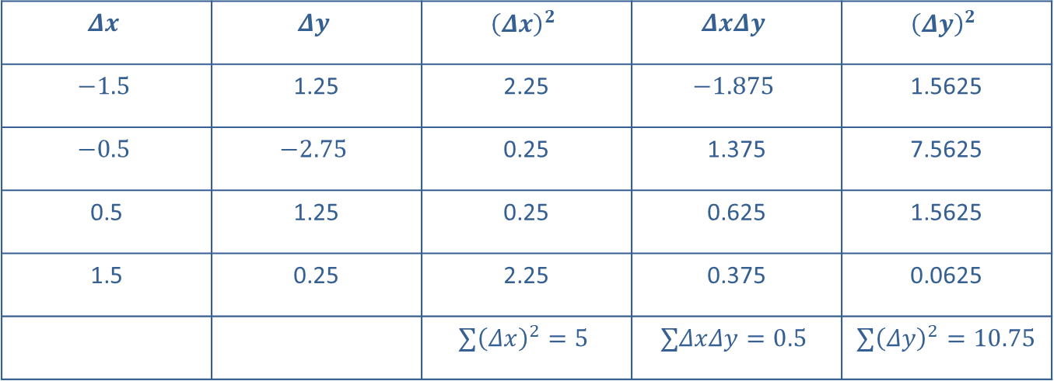
Example 4: Finding the Line of Best Fit and Correlation Coefficient ₇
Table 11
$$Δx$$ | $$Δy$$ | $${\left(Δx\right)}^{2}$$ | $$ΔxΔy$$ | $${\left(Δy\right)}^{2}$$
$$−1.5$$ | 1.25 | 2.25 | $$−1.875$$ | 1.5625
$$−0.5$$ | $$−2.75$$ | 0.25 | 1.375 | 7.5625
0.5 | 1.25 | 0.25 | 0.625 | 1.5625
1.5 | 0.25 | 2.25 | 0.375 | 0.0625
 |  | $$∑{\left(Δx\right)}^{2}=5$$ | $$∑ΔxΔy=0.5$$ | $∑{\left(Δy\right)}^{2}=10.75$

Slide 28
Example 4: Finding the Line of Best Fit and Correlation Coefficient ₈
​We have all we need now to determine that
and
So, the line of best fit is y = 0.1x + 3.5. Figure 10 shows the graph of this line along with the given points.

Slide 29
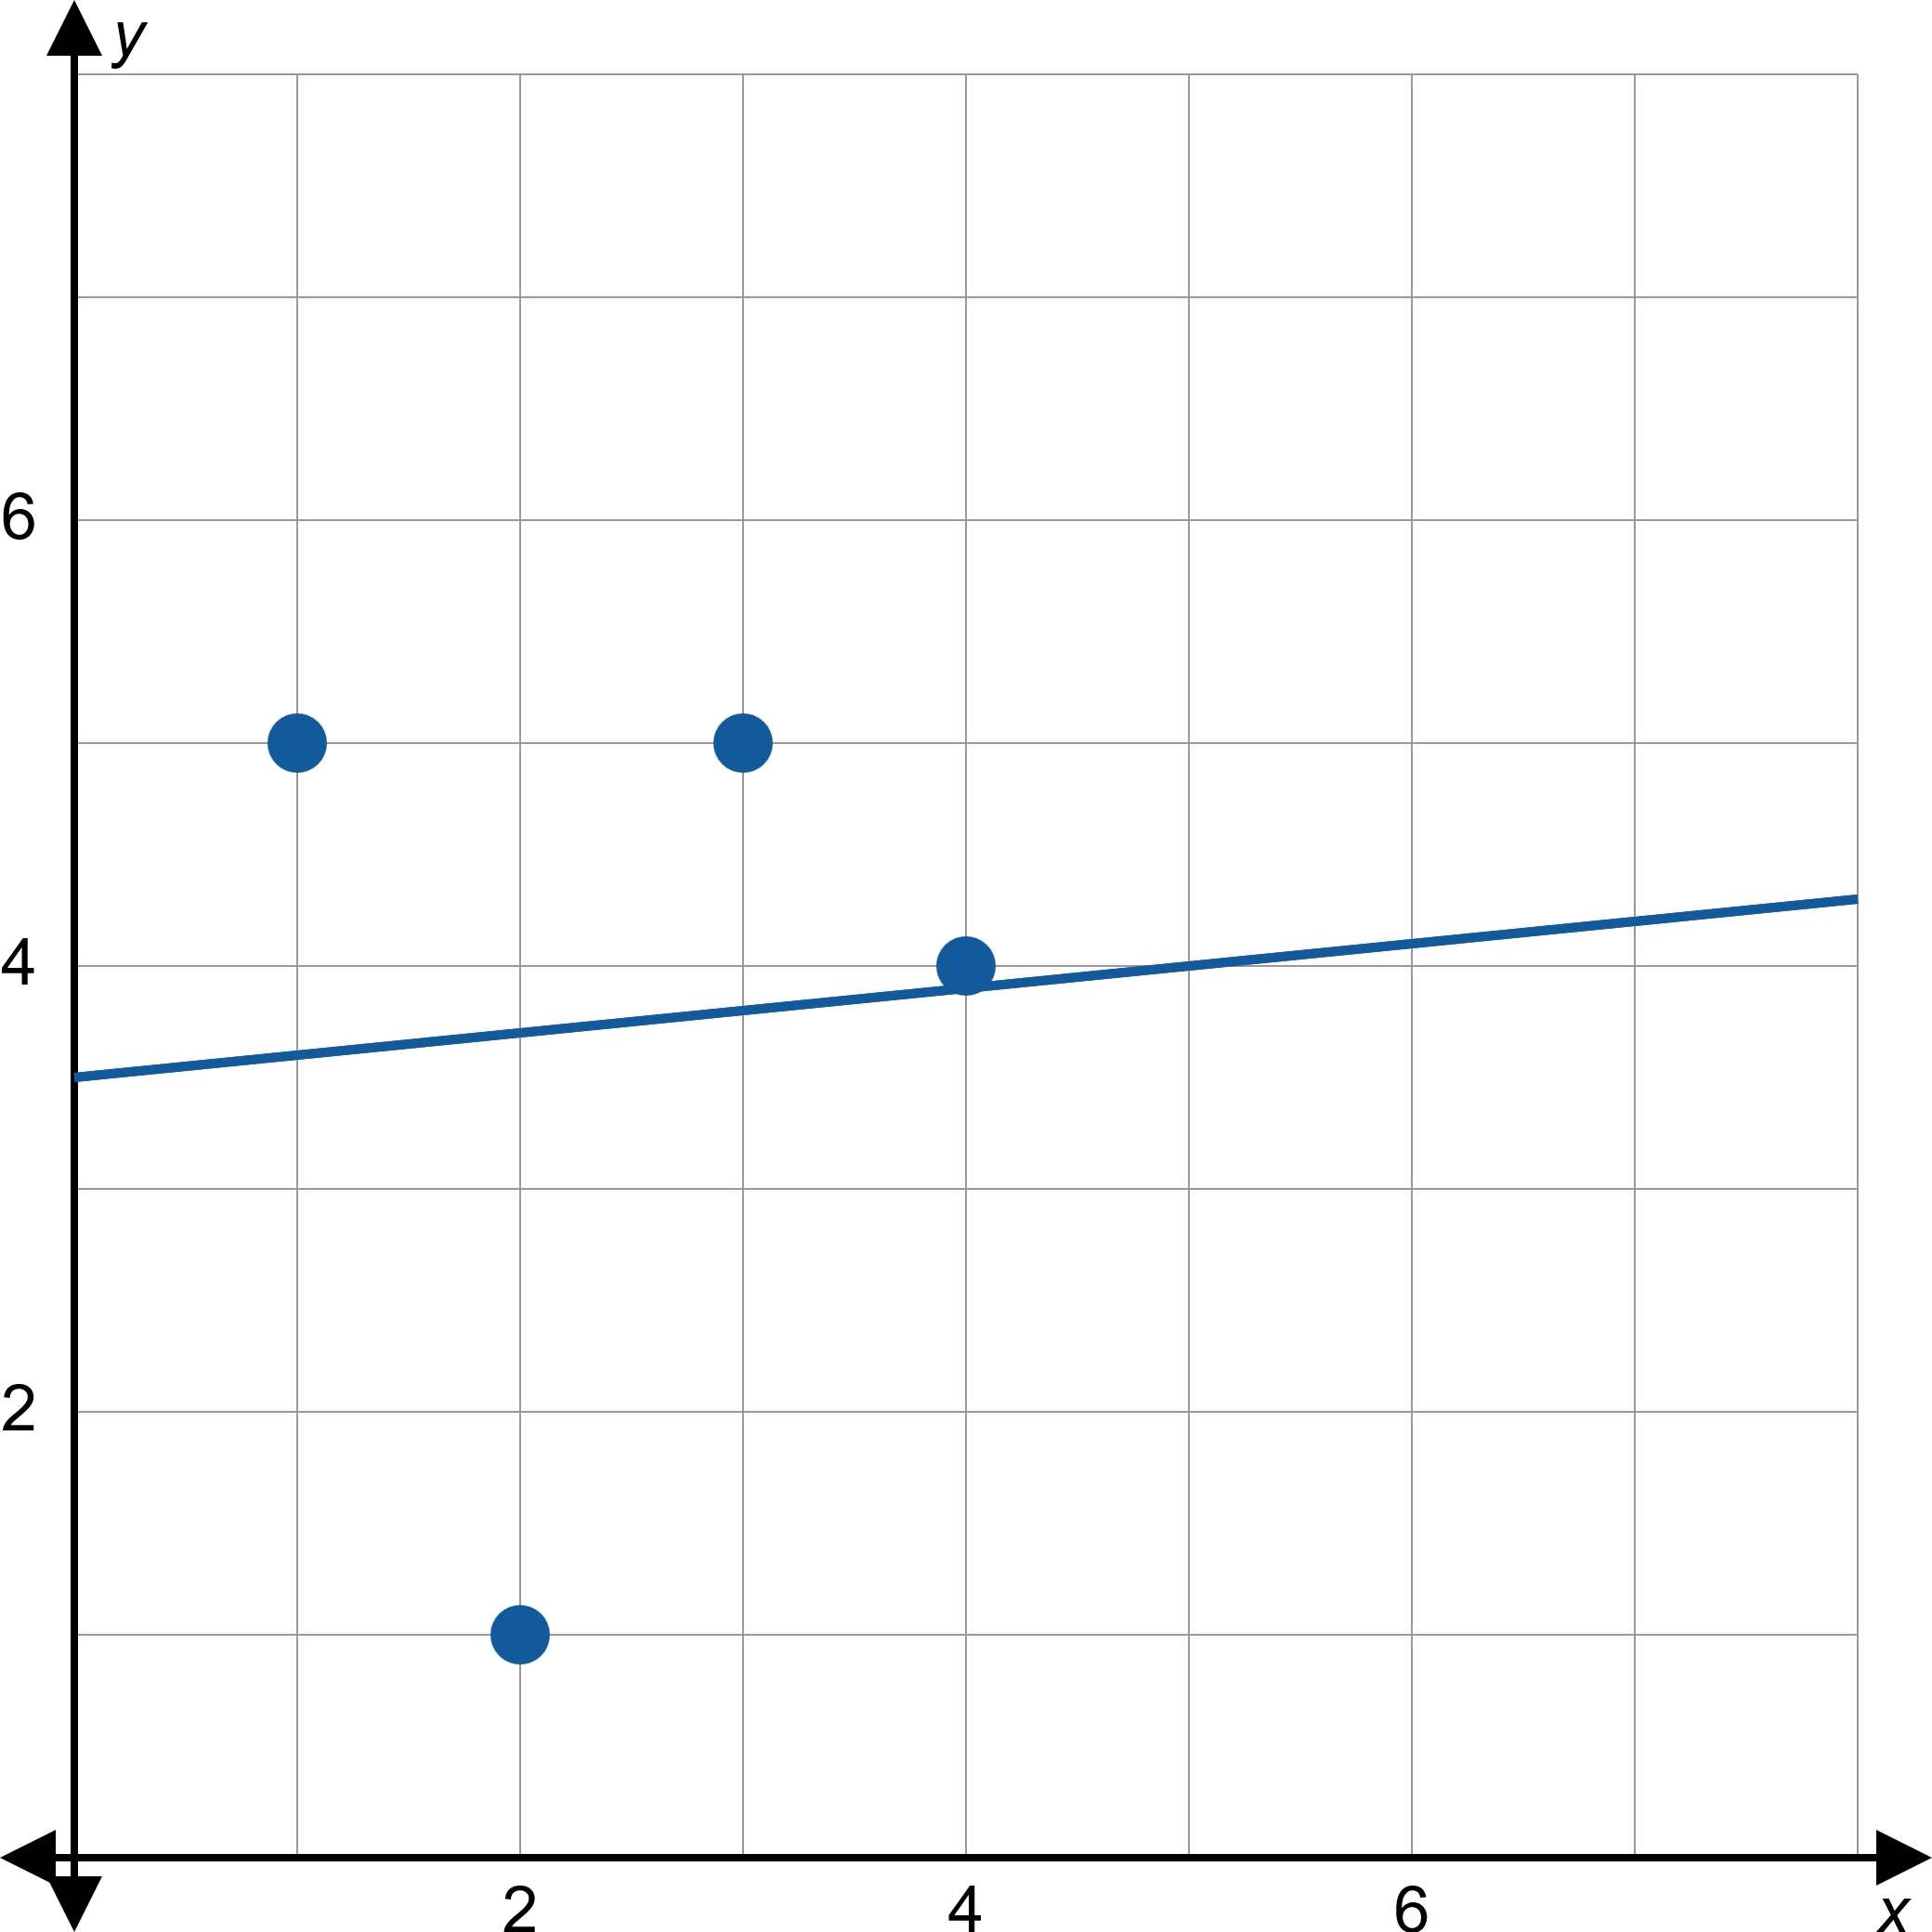
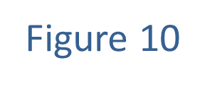
Example 4: Finding the Line of Best Fit and Correlation Coefficient ₉

Slide 30
Example 4: Finding the Line of Best Fit and Correlation Coefficient ₁₀
b. ​We also have all we need to determine the Pearson correlation coefficient r.
The fact that r is positive reflects the fact that the slope of the best-fitting line is positive, but the fact that r is relatively close to 0 in magnitude means that this line is a poor model of the behavior of the data.

