Slide 1
Section 3.5
Parallel and Perpendicular Lines

Slide 2
Theorem: Slopes of Parallel Lines
Two nonvertical lines with slopes m₁ and m₂ are parallel if and only if m₁ = m₂. Also, two vertical lines (with undefined slopes) are always parallel to each other.

Slide 3
Example 1: Finding Equations of Parallel Lines₁
Find equations for two lines parallel to each of the given lines.
a.
b.

Slide 4
Note:
When given a line in standard form, it is usually easiest to find its slope by rewriting it in slope-intercept form than to find two points on the line and calculate the slope directly.

Slide 5
Example 1: Finding Equations of Parallel Lines₂
Solution
​This line is already in slope-intercept form, so we immediately know the slope of the line is
Any
line parallel to this one must also have a slope of
To find two parallel lines, we can simply change
the value of the y-intercept.
Two such examples are

Slide 6
Example 1: Finding Equations of Parallel Lines₃
​This line is in standard form. Our first step is to rewrite it in slope-intercept form. ​
Subtract 10x from both sides.
Divide each term by −2.

Slide 7
Example 1: Finding Equations of Parallel Lines₄
​Again, once the line is in slope-intercept form, we can change the y-intercept to find two lines parallel to the original line.
​Two such examples are y = 5x and y = 5x + 8.

Slide 8
Example 2: Finding Equations of Parallel Lines₁
Find the equation, in slope-intercept form, for the line that is parallel to the line 3x + 5y = 23 and which passes through the point (−2, 1).

Slide 9
Example 2: Finding Equations of Parallel Lines₂
Solution
Again, our first step is to write the initial equation in slope-intercept form.
This tells us that the slope of the line whose equation
we seek is
We also know that the line is to pass
through (−2, 1), so we can use the point-slope form to
obtain the desired equation.

Slide 10
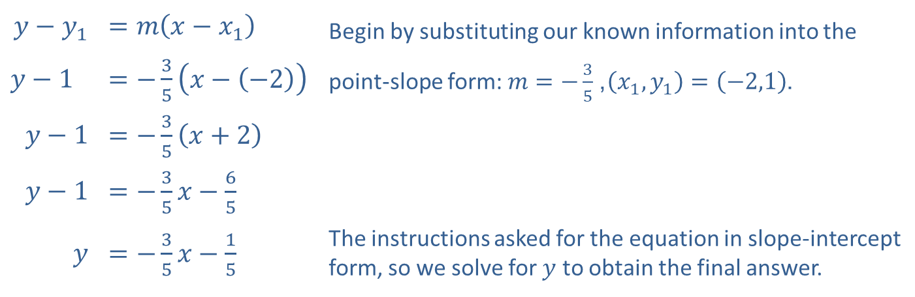
Example 2: Finding Equations of Parallel Lines₃
​$y−y_{1}$ | ​$=m\left(x−x_{1}\right)$ | Begin by substituting our known information into the
​$y−1$ | ​$=−\frac{3}{5}\left(x−\left(−2\right)\right)$ | point-slope form: $m=−\frac{3}{5}$, $\left(x_{1},y_{1}\right)=\left(−2,1\right)$.
​$y−1$ | ​$=−\frac{3}{5}\left(x+2\right)$
​$y−1$ | ​$=−\frac{3}{5}x−\frac{6}{5}$
$$y$$ | ​$=−\frac{3}{5}x−\frac{1}{5}$ | The instructions asked for the equation in slope-intercept form, so we solve for $y$ to obtain the final answer.

Slide 11
Example 3: Identifying a Quadrilateral₁
Determine if the quadrilateral (four-sided figure) in Figure 2 is a parallelogram (a quadrilateral in which both pairs of opposite sides are parallel).

Slide 12
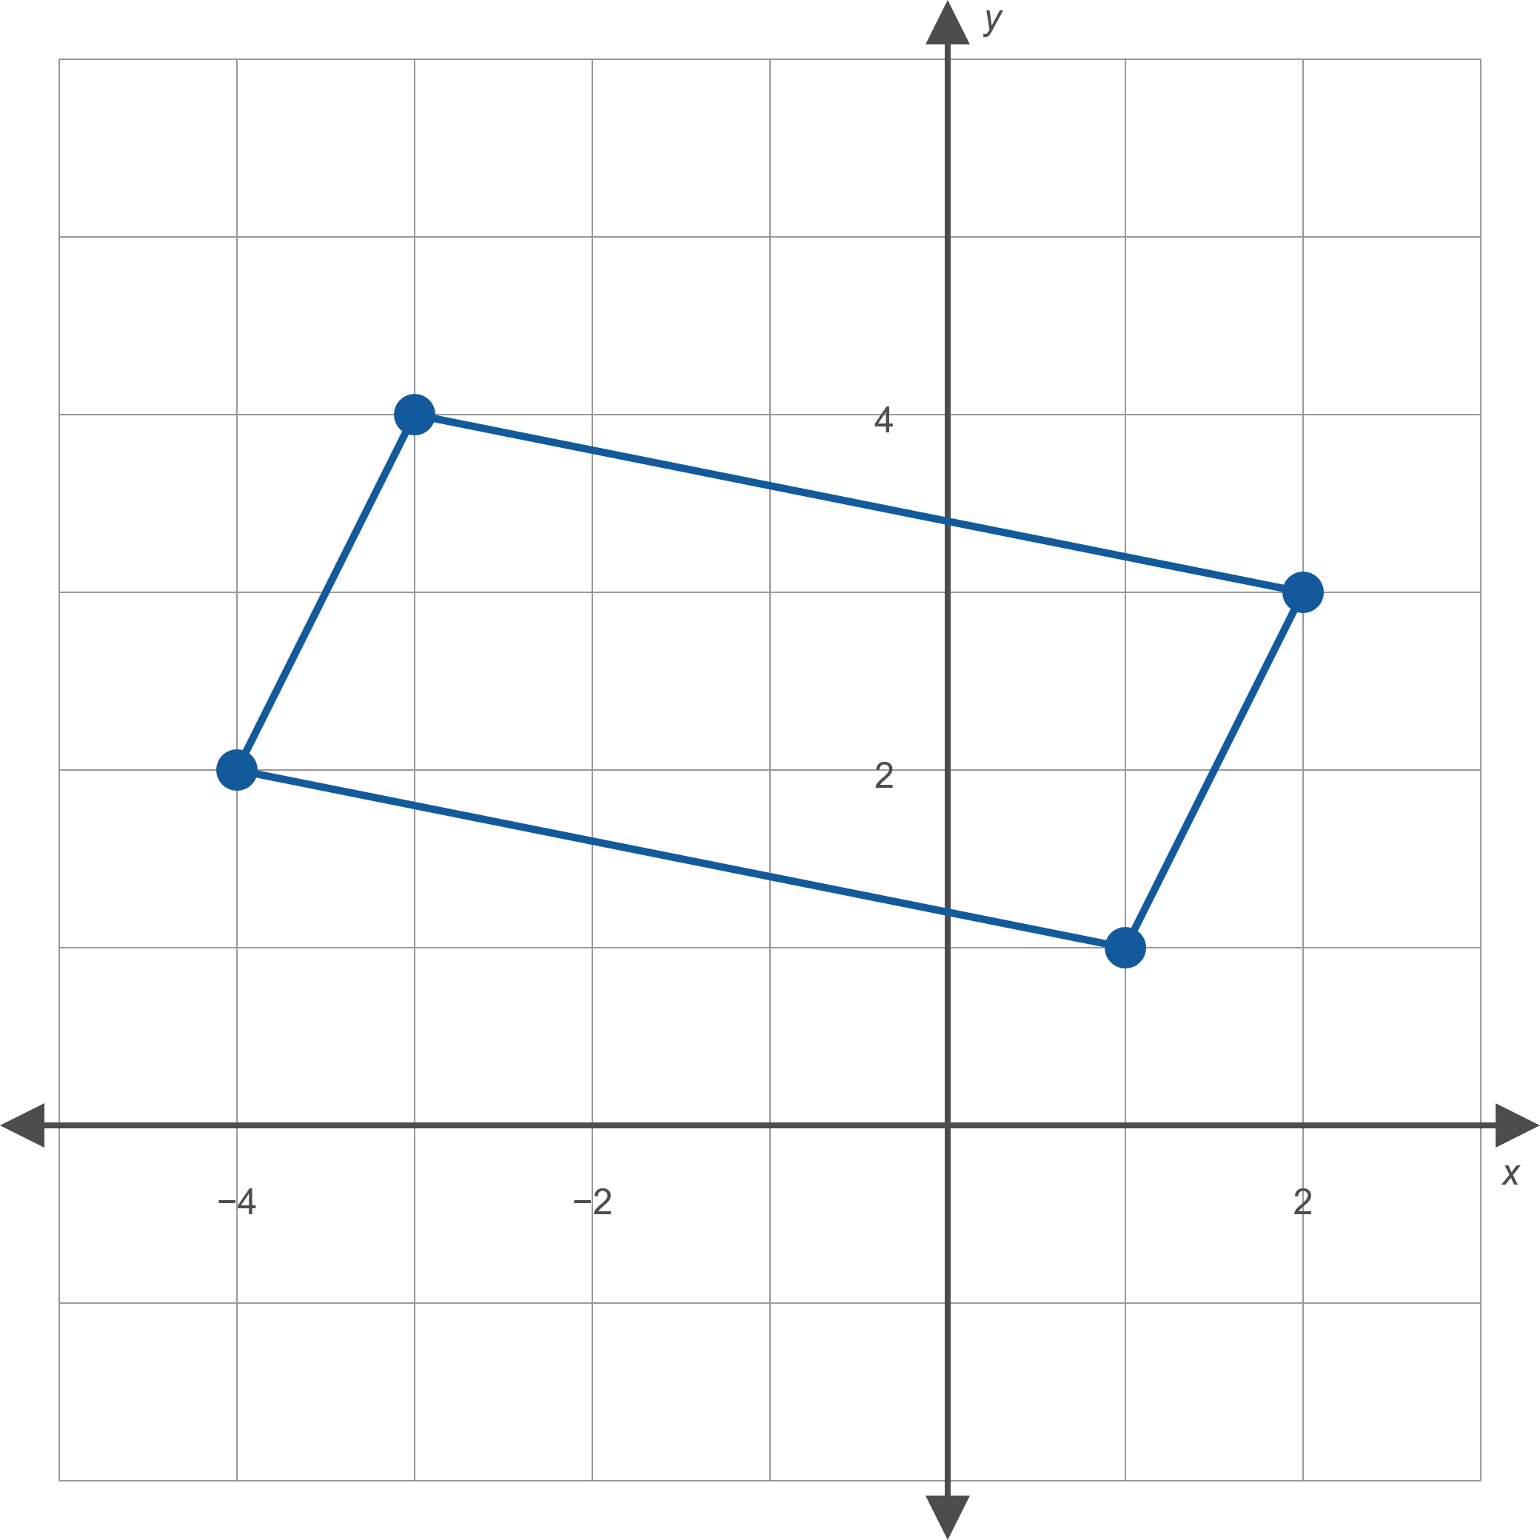
Example 3: Identifying a Quadrilateral₂
Figure 2

Slide 13
Example 3: Identifying a Quadrilateral₃
Solution
The four vertices are plotted in Figure 2, and the sides of the quadrilateral drawn. The figure is a parallelogram if the left and right sides are parallel and the top and bottom sides are parallel.

Slide 14
Example 3: Identifying a Quadrilateral₄
The slopes of the left and right sides are, respectively,
and the slopes of the top and bottom sides are, respectively,
Thus, the figure is indeed a parallelogram.

Slide 15
Theorem: Slopes of Perpendicular Lines
Suppose m₁ and m₂ represent the slopes of two lines, neither of which is vertical. The two lines are perpendicular if and only if
(equivalently,
and m₁ m₂ = −1). If one of two
perpendicular lines is vertical, the other is horizontal, and the slopes are, respectively, undefined and zero.

Slide 16
Example 4: Finding Equations of Perpendicular Lines₁
For each line given, find the equation of a perpendicular line.
a.
b.
The line passing through the points (−1, 3) and
(4, 1).

Slide 17
Example 4: Finding Equations of Perpendicular Lines₂
Solution
​This line is in slope-intercept form, so we can immediately identify the slope as
The slope of any perpendicular line must equal
the
negative reciprocal of the original slope. Thus, one solution is
​Since we only need the slope of the original line, there is no need to find its equation; we can calculate the slope directly from the given points.
Again, the slope of a line perpendicular to the line through the given
points must have a slope equal to the negative reciprocal of
which is
One perpendicular line is

Slide 18
Example 5: Finding Equations of Perpendicular Lines₁
Find the equation, in standard form, of the line that passes through the point (−3, 13) and is perpendicular to the line y = −7.

Slide 19
Note₁
Remember that if you encounter a horizontal or vertical line, you cannot use the slope formulas to find a perpendicular line.

Slide 20
Example 5: Finding Equations of Perpendicular Lines₂
Solution
The line y = −7 is a horizontal line, and hence any line perpendicular to it must be a vertical line, having the form x = c. Since the perpendicular line must pass through the point (−3, 13), the desired solution is
x = −3.

Slide 21
Example 6: Identifying Parallel and Perpendicular Lines₁
For each pair of lines, determine if the lines are parallel, perpendicular, or neither.
​3x − 7y = 12 and 14x + 6y = −5
b.
and the line passing through
the points (0, 4) and (2, 22)
c.

Slide 22
Note₂
A pair of lines cannot be both parallel and perpendicular.

Slide 23
Example 6: Identifying Parallel and Perpendicular Lines₂
Solution
​Both equations are in standard form, so our first step is to rewrite them in slope-intercept form to identify the slopes.
Are the lines parallel?
​No, the slopes are not equal.
​Are the lines perpendicular?
​Yes, the slopes are negative reciprocals of each other.
​Thus, the lines are perpendicular.

Slide 24
Example 6: Identifying Parallel and Perpendicular Lines₃
​One line is in point-slope form, so we can see its slope is 9. We calculate the slope of the other line using the two points given.
Are the lines parallel?
​Yes, the slopes are equal.
​
Thus, the lines are parallel. (Note that we didn’t need to find the equation of the second line.)

Slide 25
Example 6: Identifying Parallel and Perpendicular Lines₄
​Both lines are in slope-intercept form, so we can read off the slopes:
Are the lines parallel?
​ No, the slopes are not equal.
​Are the lines perpendicular?
​No, the slopes are reciprocals, not negative reciprocals.
​
Thus, the lines are neither parallel nor perpendicular.

