Slide 1
Section 3.4
Slope and Forms of Linear Equations

Slide 2
Definition: The Slope of a Line
Let L stand for a given line in the Cartesian plane, and let (x₁, y₁) and (x₂, y₂) be the coordinates of any two distinct points on L. The slope of the line L is the ratio
which can be described in words as "change in y
over change in x" or "rise over run."

Slide 3
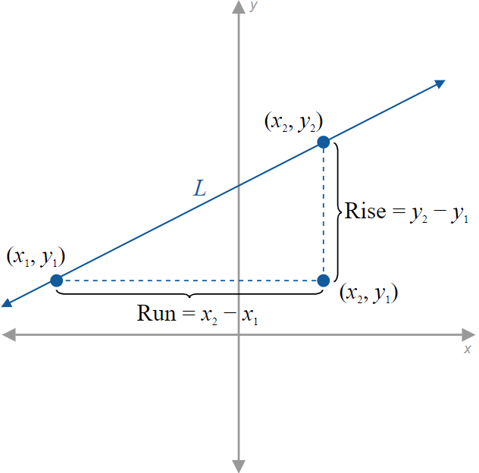
Figure 1: Rise and Run between Two Points

Slide 4
CAUTION!₁
It doesn't matter how you assign the labels (x₁, y₁) and (x₂, y₂) to the two points you are using to calculate slope, but it is important that you are consistent as you apply the formula. You cannot change the order in which you are subtracting as you determine the numerator and denominator in the slope formula.

Slide 5
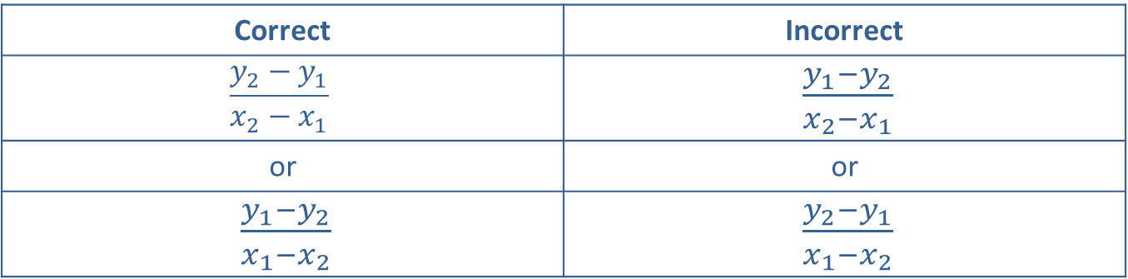
CAUTION!₂
Correct | Incorrect
$$\frac{y_{2}−y_{1}}{x_{2}−x_{1}}$$ | $\frac{y_{1}−y_{2}}{x_{2}−x_{1}}$
or | or
$\frac{y_{1}−y_{2}}{x_{1}−x_{2}}$ | $\frac{y_{2}−y_{1}}{x_{1}−x_{2}}$

Slide 6
Example 1: Calculating the Slope of a Line₁
Determine the slopes of the lines passing through the following pairs of points in ℝ ².

Slide 7
Example 1: Calculating the Slope of a Line₂
Solution
a.
We calculate the slope in two ways; first set
We get the same result using

Slide 8
Example 1: Calculating the Slope of a Line₃
The final answer tells us that the line through the two points rises 14 units for every run of 3 units horizontally.
b.

Slide 9
Example 1: Calculating the Slope of a Line₄
These two points have the same y-coordinate and thus lie on a horizontal line.
c.

Slide 10
Properties: Slopes of Horizontal and Vertical Lines
Horizontal lines, which can be written in the form y = c, have a slope of 0.
Vertical lines, which can be written in the form x = c, have an undefined slope.

Slide 11
Example 2: Calculating the Slope of a Line₁
Determine the slopes of the lines defined by the following equations.

Slide 12
Note₁
Intercepts are often good points to use in calculating the slope, since they have at least one coordinate equal to zero.

Slide 13
Example 2: Calculating the Slope of a Line₂
Solution
a. ​First, we find two points on the line by calculating the intercepts.​
Recall that the x-intercept is found by setting y equal to 0 and solving for x, and vice versa for the y-intercept.

Slide 14
Example 2: Calculating the Slope of a Line₃
​y-intercept: (0, −4)
x-intercept: (3, 0)
Once we have two points, we apply the slope formula.

Slide 15
Example 2: Calculating the Slope of a Line₄
b. x-intercept:
In this example, we have found the x-intercept. We do not have to find both intercepts; the point (1, 1) is on the line and is simple to use in calculation.
​second point on the line: (1, 1)
c. The equation is of the form x = c, and is a vertical line. Therefore, the slope is undefined.
d. This equation is of the form y = c, and is a horizontal line. Therefore, it has a slope of 0.

Slide 16
Definition: Slope-Intercept Form of a Line
If the equation of a nonvertical line in x and y is solved for y, the result is an equation in slope-intercept form.
y = mx + b
The constant m is the slope of the line, and the y-intercept of the line is (0, b).
If the variable x does not appear in the equation, the slope is 0 and the equation is simply of the form y = b and is a horizontal line.

Slide 17
Example 3: Slope-Intercept Form of a Line₁
Use the slope-intercept form of the line to graph the equation 4x − 3y = 6.

Slide 18
Example 3: Slope-Intercept Form of a Line₂
Solution
Solving the equation for y puts it in slope-intercept form.
Once we have done this, we know that the line has a slope
of
and crosses the y-axis at −2.

Slide 19
Example 3: Slope-Intercept Form of a Line₃
Immediately, we can plot the y-intercept.
A second point can now be found by using the fact that slope is "rise over run." This means a second point must lie 4 units up and 3 units to the right, i.e. at (3, 2).
Alternatively, we could locate a second point by moving down 4 units and moving to the left 3 units.

Slide 20
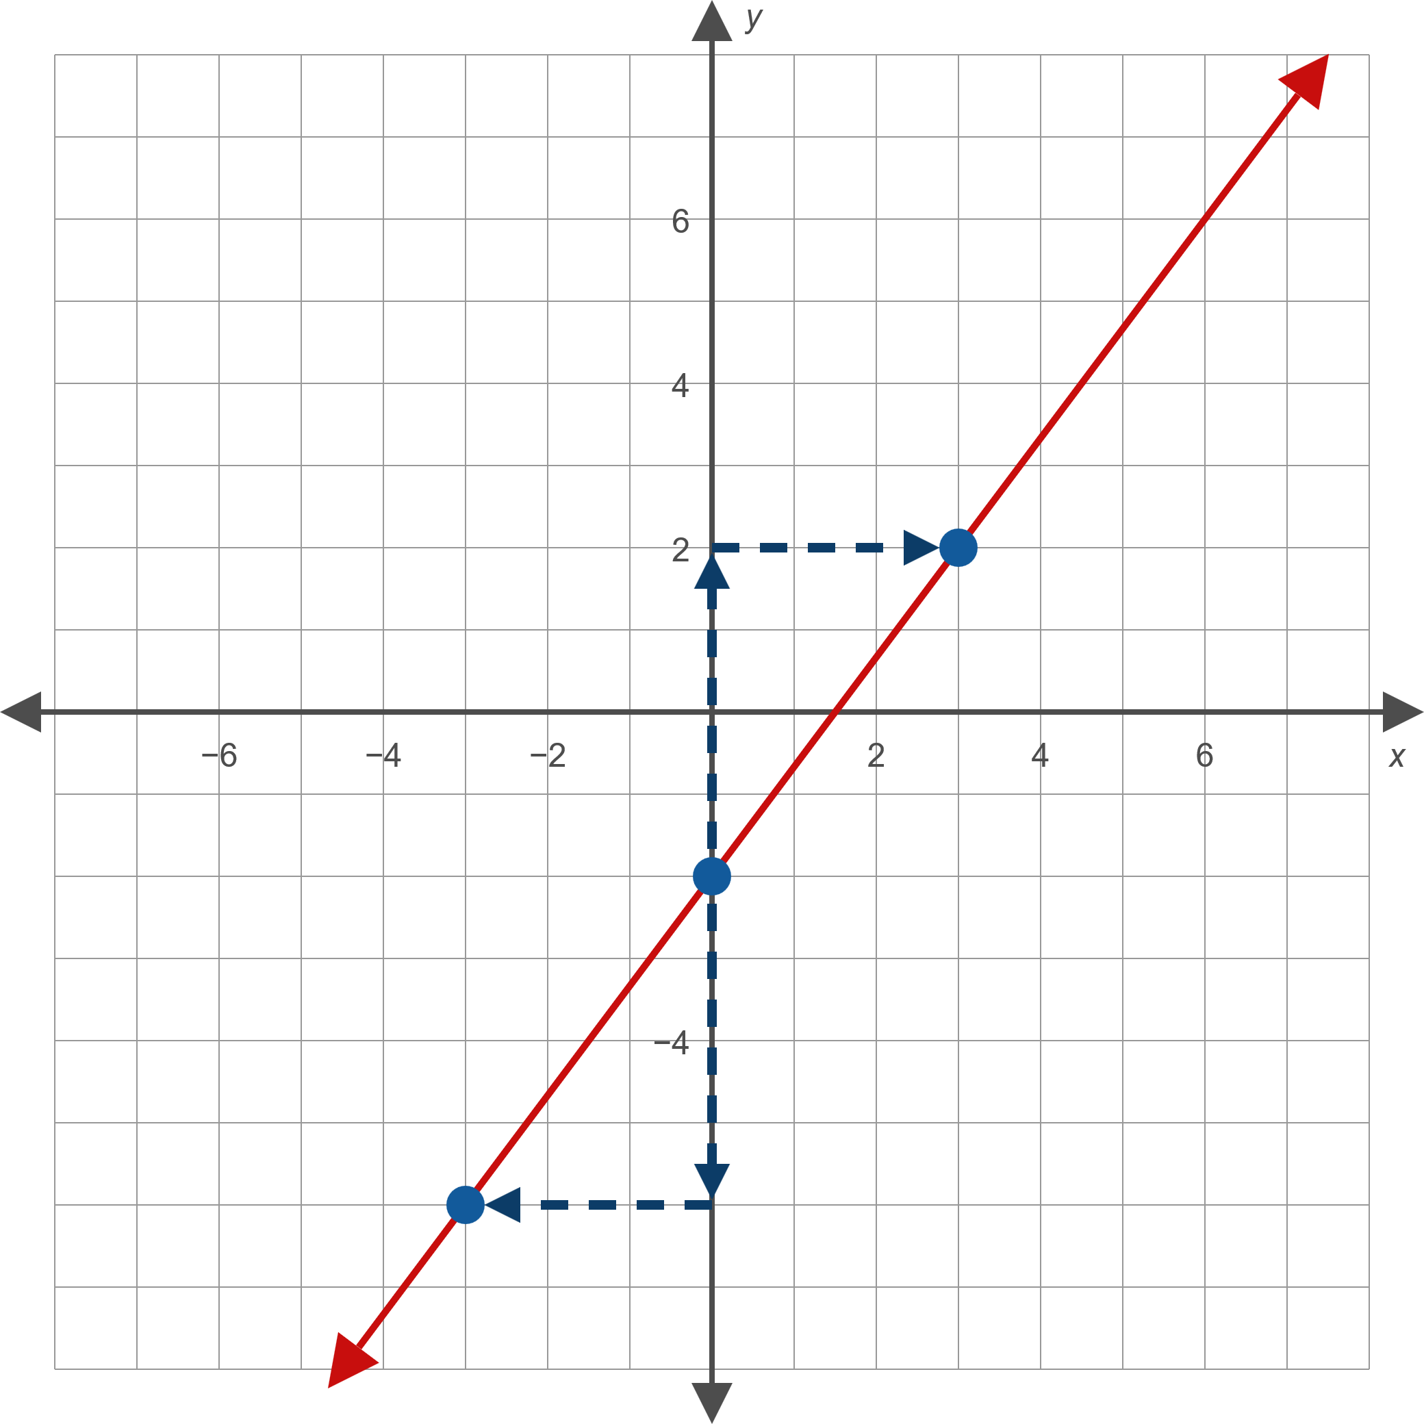

Example 3: Slope-Intercept Form of a Line₄

Slide 21
Example 4: Slope-Intercept Form of a Line₁
Find the equation of the line that passes through the point (0, 3) and has a slope of
Then graph the line.

Slide 22
Note₂
If a line is already in slope-intercept form, it's usually easiest to graph the line by plotting the y-intercept and then using the slope to find a second point.

Slide 23
Example 4: Slope-Intercept Form of a Line₂
Solution
First, we write the equation of this line in slope-intercept form. We are given the y-intercept of (0, 3) and the slope of
We can immediately write down the equation since the only information we need is the y-intercept and the slope.
We first plot the y-intercept, then move down 3 units and to the right 5 units to find a second point.
Or, we could have plotted a second point by moving up 3 units and to the left 5 units. Both methods make use of the fact that the slope is

Slide 24
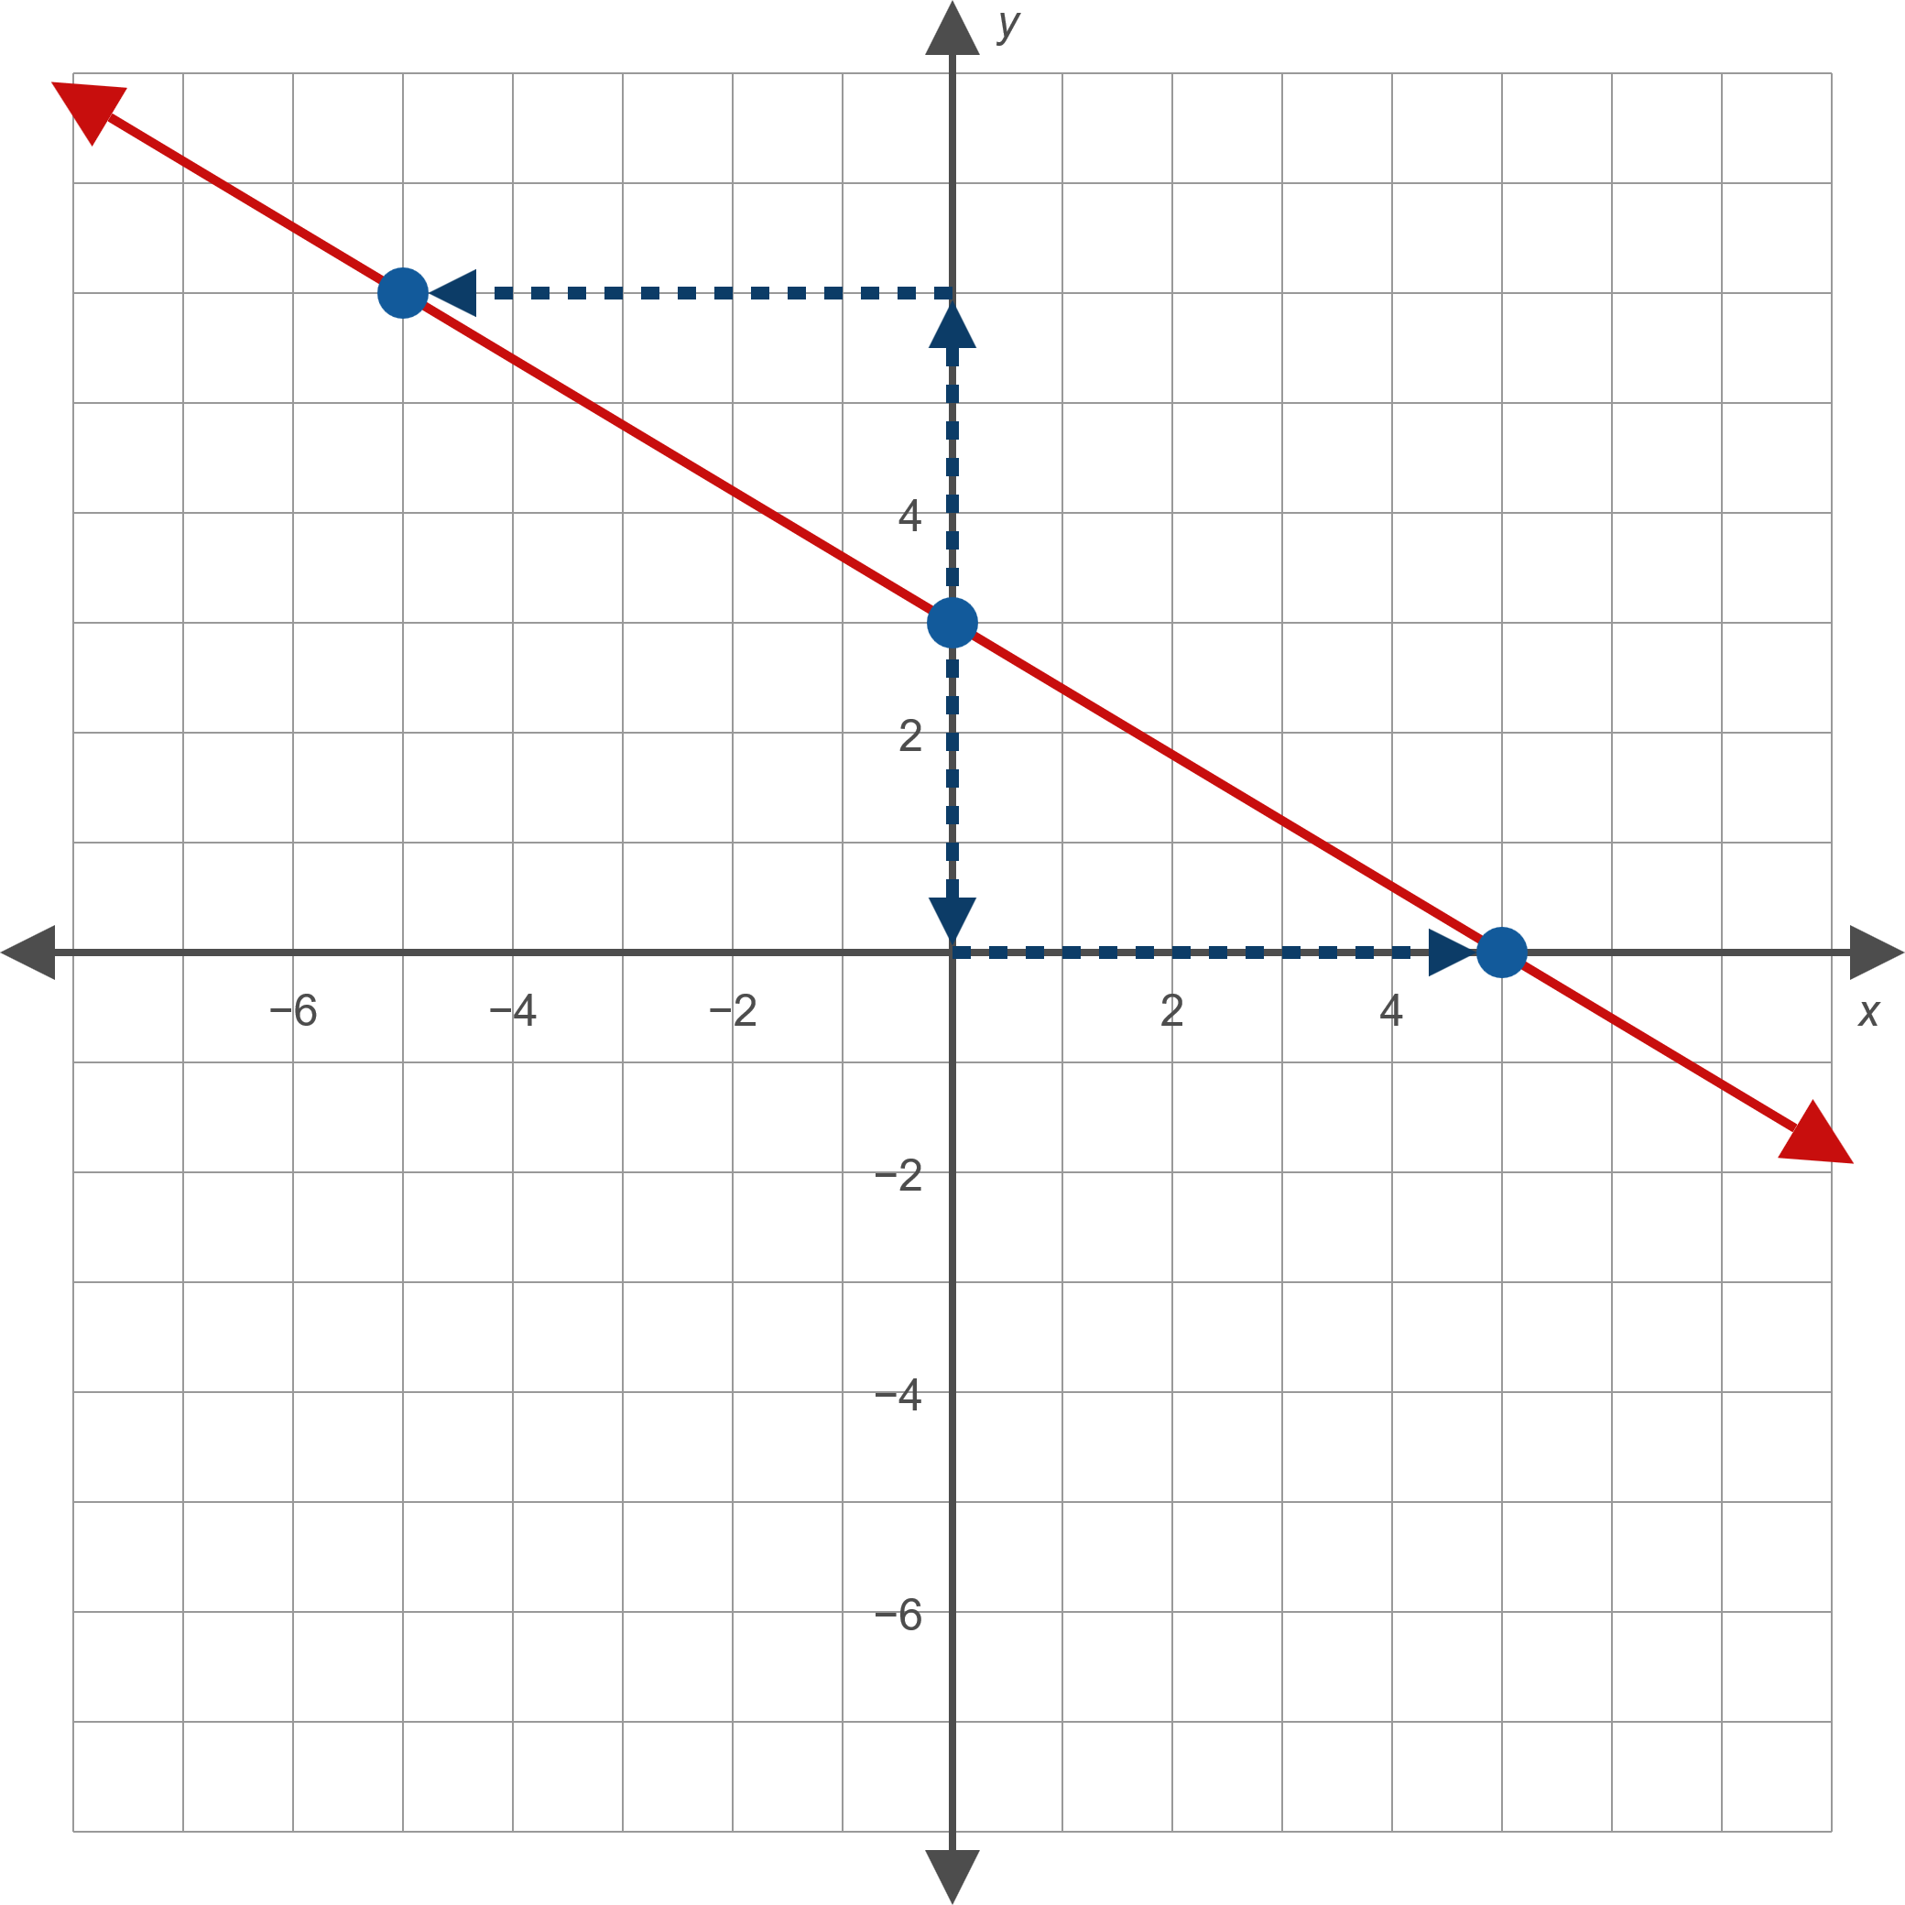
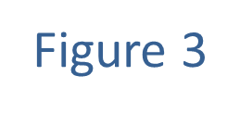
Example 4: Slope-Intercept Form of a Line₃

Slide 25
Definition: Point-Slope Form of a Line
The point-slope form of the equation for the line passing through the point (x₁, y₁) with slope m is
y − y₁ = m(x − x₁).
Note that m, x₁, and y₁ are all constants, while x and y are variables. Note also that since a line, by definition, has slope m, vertical lines cannot be described in this form.

Slide 26
Example 5: Using the Point-Slope Form of a Line₁
Find the equation, in slope-intercept form, of the line that passes through the point (−2, 5) with slope 3.

Slide 27
Note₃
When asked for an equation in either standard form or slope-intercept form, it's frequently easiest to write the point-slope form and then convert the equation to the desired form.

Slide 28
Example 5: Using the Point-Slope Form of a Line₂
Solution
Since we are given the slope of the line and a point on the line, we can substitute directly into the point-slope form, then solve for y to obtain the slope-intercept form.

Slide 29
Example 5: Using the Point-Slope Form of a Line₃
The point-slope form
The slope-intercept form

Slide 30
Example 6: Using the Point-Slope Form of a Line₁
Find the equation, in slope-intercept form, of the line that passes through the two points (−3, −2) and (1, 6).

Slide 31
Example 6: Using the Point-Slope Form of a Line₂
Solution
We already have a point (actually, two) on the line, but we still need the slope to use the point-slope form. We can calculate this using the two points and the slope formula.
Now we can substitute into the point-slope form, then solve for y to obtain the desired slope-intercept equation.

Slide 32
Example 6: Using the Point-Slope Form of a Line₃
Note that no matter which point we substitute into the point-slope form, the resulting slope-intercept equation is the same.

Slide 33
Standard Form:
Information Required: Typically, we arrive at the standard form when given a linear equation in another form.
Potential Uses: The standard form is most useful for easily calculating the x-and y-intercepts.

Slide 34
Slope-Intercept Form: y = mx + b
Information Required: The slope m and the y-intercept (0, b).
Potential Uses: The slope-intercept form makes it very easy to find the y-intercept and slope, and therefore to graph the line.

Slide 35
Point-Slope Form: y − y₁ = m (x − x₁)
Information Required: The slope m and a point on the line (x₁, y₁) or two points on the line (x₁, y₁) and (x₂, y₂).
Potential Uses: The point-slope form allows us to find the equation for a line when the y-intercept is unknown.

