Slide 1
Section 3.3
Linear Equations in Two Variables

Slide 2
Definitions: Linear Equations in Two Variables
A linear equation in two variables, say the variables x and y, is an equation that can be written in the form
ax + by = c, where a, b, and c are constants and a and b are not both zero. This form of such an equation is called the standard form.

Slide 3
Example 1: Linear Equations in Two Variables₁
Determine if the following equations are linear.

Slide 4
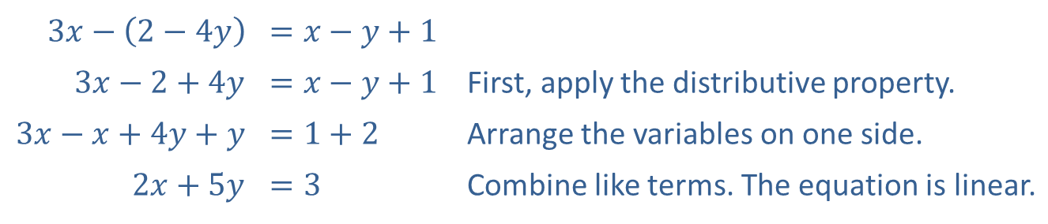
Example 1: Linear Equations in Two Variables₂
Solution
a.
​$3x−\left(2−4y\right)$ | ​$=x−y+1$
​$3x−2+4y$ | ​$=x−y+1$ | First, apply the distributive property.
​$3x−x+4y+y$ | ​$=1+2$ | Arrange the variables on one side.
​$2x+5y$ | ​$=3$ | Combine like terms. The equation is linear.

Slide 5
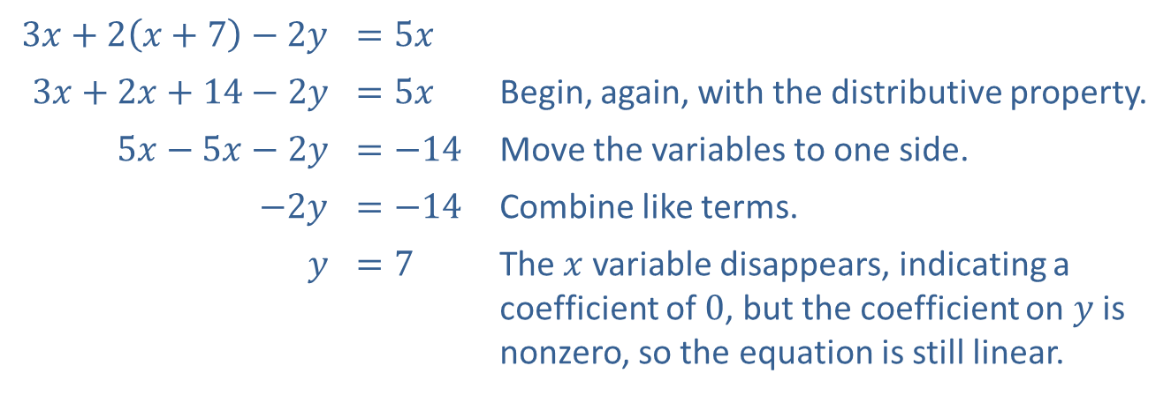
Example 1: Linear Equations in Two Variables₃
​
​$3x+2\left(x+7\right)−2y$ | ​$=5x$
​$3x+2x+14−2y$ | ​$=5x$ | Begin, again, with the distributive property.
​$5x−5x−2y$ | ​$=−14$ | Move the variables to one side.
​$−2y$ | ​$=−14$ | Combine like terms.
$$y$$ | ​$=7$ | The $x$ variable disappears, indicating a coefficient of 0, but the coefficient on $y$ is nonzero, so the equation is still linear.

Slide 6
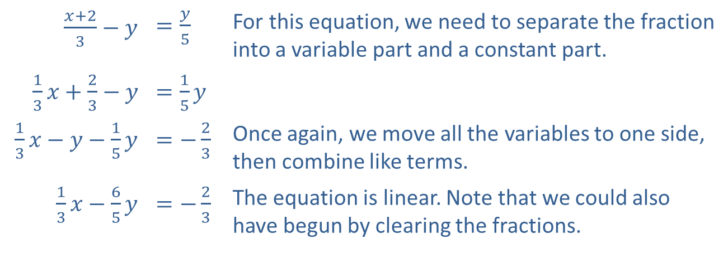
Example 1: Linear Equations in Two Variables₄
c.
​$\frac{x+2}{3}−y$ | ​$=\frac{y}{5}$ | For this equation, we need to separate the fraction into a variable part and a constant part.
​$\frac{1}{3}x+\frac{2}{3}−y$ | ​$=\frac{1}{5}y$
​$\frac{1}{3}x−y−\frac{1}{5}y$ | ​$=−\frac{2}{3}$ | Once again, we move all the variables to one side, then combine like terms.
​$\frac{1}{3}x−\frac{6}{5}y$ | ​$=−\frac{2}{3}$ | The equation is linear. Note that we could also have begun by clearing the fractions.

Slide 7
Example 1: Linear Equations in Two Variables₅
​
After simplifying this equation, we see that the coefficients on both x and y are 0. Thus, the equation is not linear.
Further, the equation simplifies to a false statement, so it actually has no solutions!

Slide 8
Example 1: Linear Equations in Two Variables₆
e.
The presence of the cubed term in this already simplified equation makes it not linear.

Slide 9
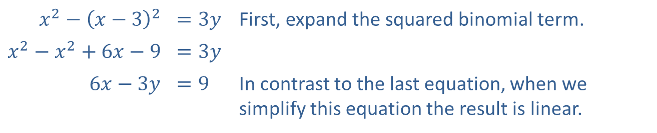
Example 1: Linear Equations in Two Variables₇
​
​$x^{2}−{\left(x−3\right)}^{2}$ | ​$=3y$ | First, expand the squared binomial term.
​$x^{2}−x^{2}+6x−9$ | ​$=3y$
​$6x−3y$ | ​$=9$ | In contrast to the last equation, when we simplify this equation the result is linear.

Slide 10
Definitions: The x- and y-Intercepts
Given a graph in the Cartesian plane, any point where the graph intersects the x-axis is called an x-intercept and any point where the graph intersects the y-axis is called a y-intercept.
All x-intercepts are of the form (c, 0) and all
y-intercepts are of the form (0, c).

Slide 11
Example 2: Finding Intercepts and Graphing Linear Equations₁
Find the x- and y-intercepts of the given equations, and sketch their graphs.

Slide 12
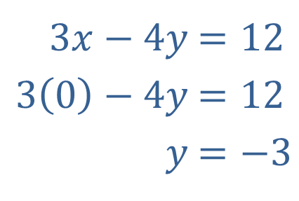
Example 2: Finding Intercepts and Graphing Linear Equations₂
Solution
To find the two intercepts, first set x equal to 0 and solve for y.
​
​
​​
​$3x−4y$ | ​$=12$
​$3\left(0\right)−4y$ | ​$=12$
​$y$ | ​$=−3$

Slide 13
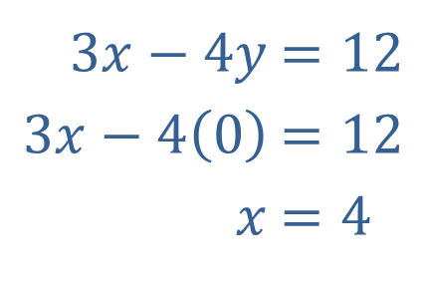
Example 2: Finding Intercepts and Graphing Linear Equations₃
Then set y equal to 0 and solve for x.
​$3x−4y$ | ​$=12$
​$3x−4\left(0\right)$ | ​$=12$
​$x$ | ​$=4$
This gives us the coordinates of the two intercepts,
y-intercept: (0, −3) and x-intercept: (4, 0), which we plot in Figure 1. Once we have plotted the intercepts, drawing a straight line through them gives us the graph of the equation.

Slide 14
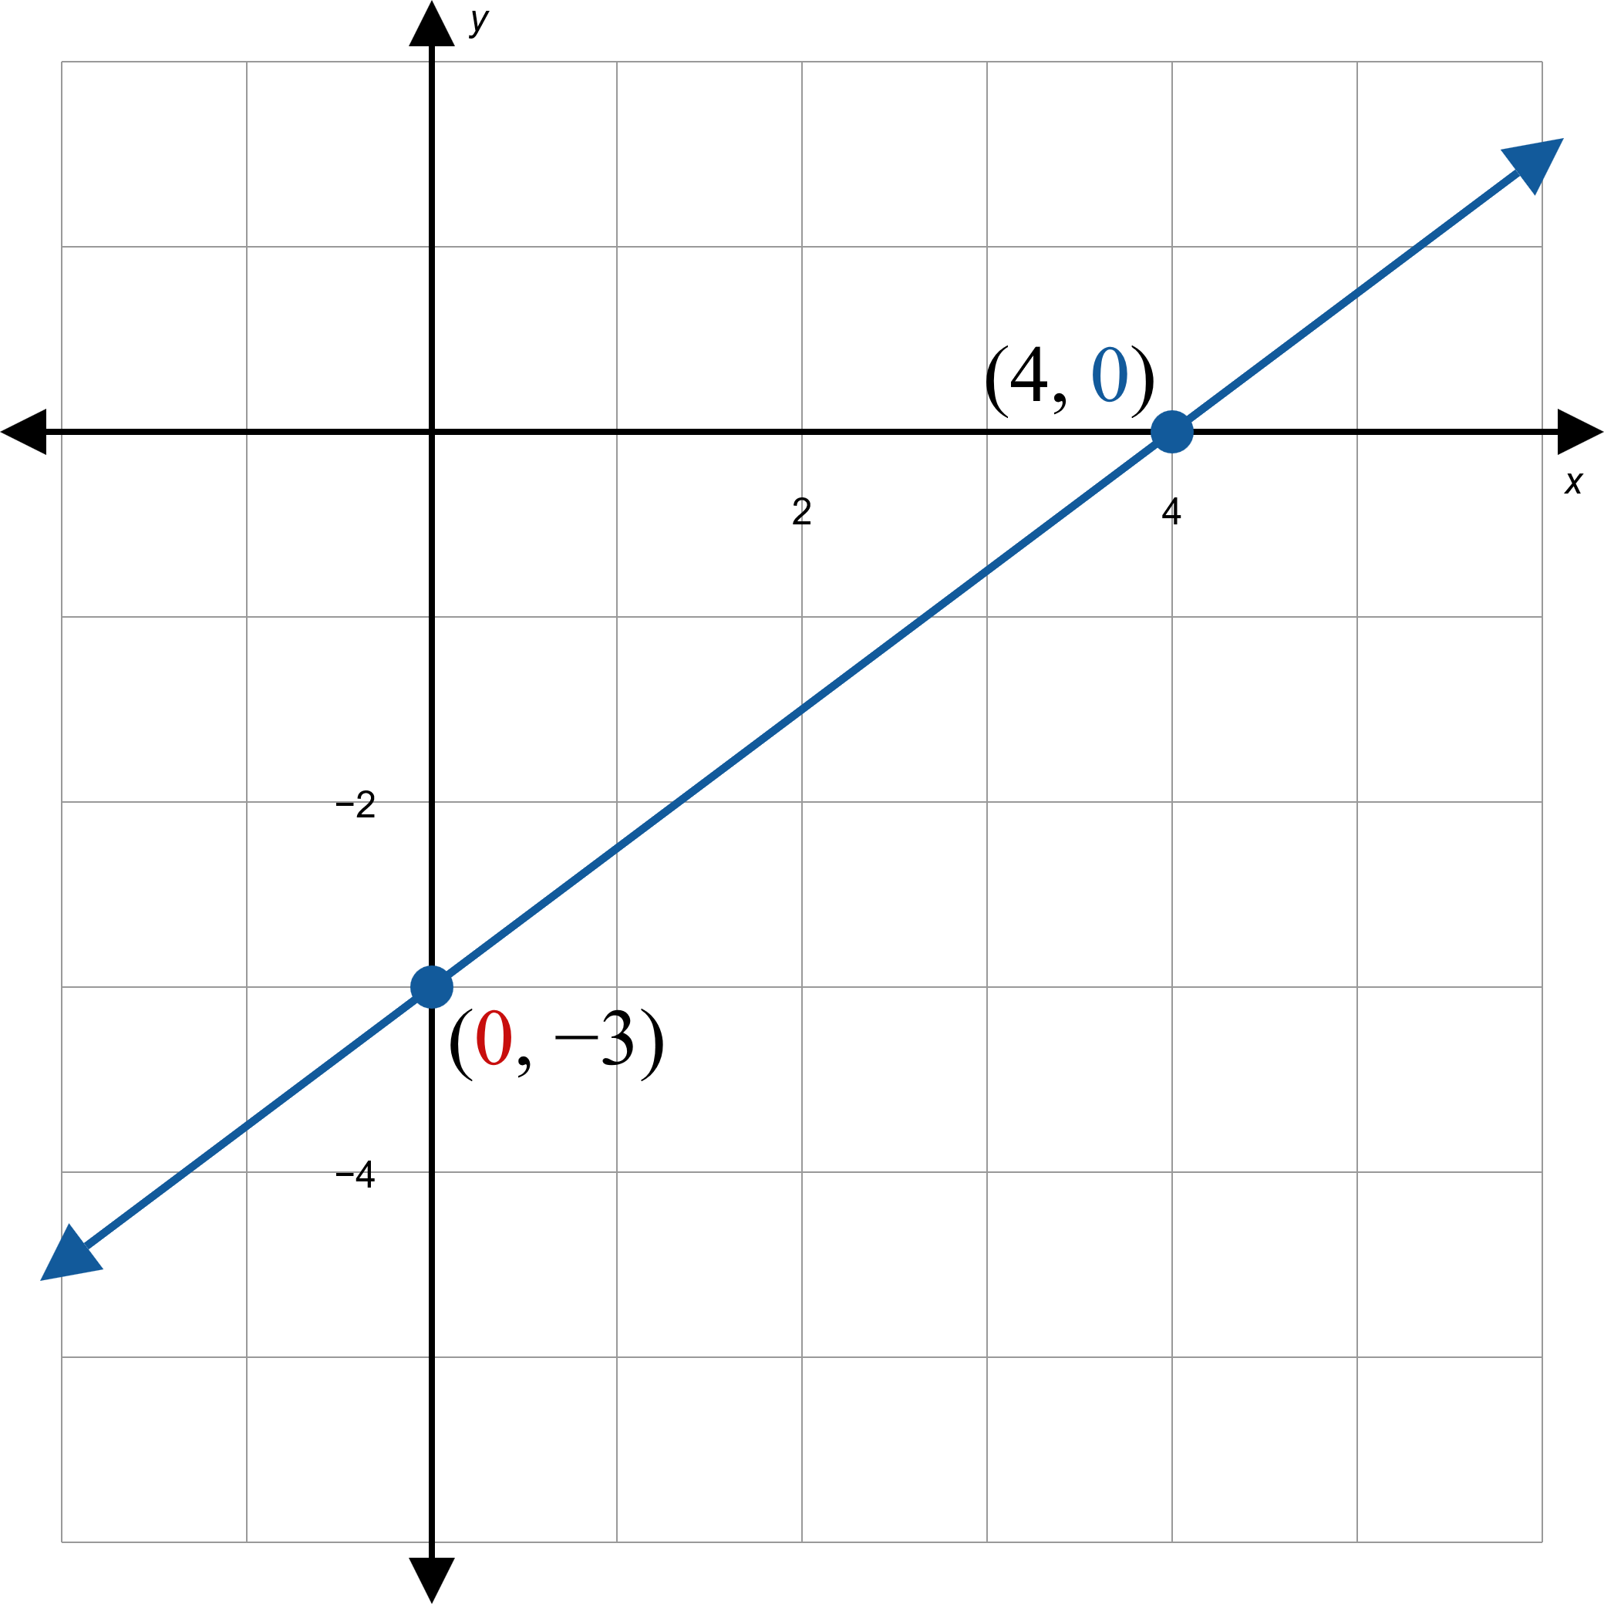
Example 2: Finding Intercepts and Graphing Linear Equations₄
Figure 1

Slide 15
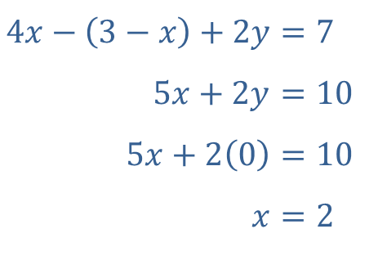
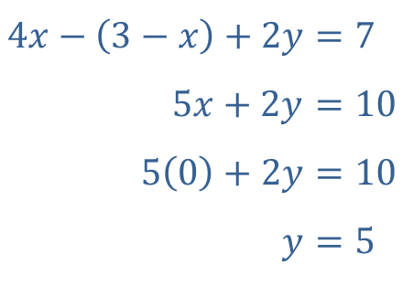
Example 2: Finding Intercepts and Graphing Linear Equations₅
​Again, find the two intercepts by setting the appropriate variables equal to 0.
​$4x−\left(3−x\right)+2y$ | ​$=7$
​$5x+2y$ | ​$=10$
​$5\left(0\right)+2y$ | ​$=10$
​$y$ | ​$=5$
​$4x−\left(3−x\right)+2y$ | ​$=7$
​$5x+2y$ | ​$=10$
​$5x+2\left(0\right)$ | ​$=10$
​$x$ | ​$=2$
Solving the resulting equations in one variable yields the intercept solutions, y-intercept: (0, 5) and
x-intercept: (2, 0). Plot the two intercepts, then draw the line passing through these two points.

Slide 16
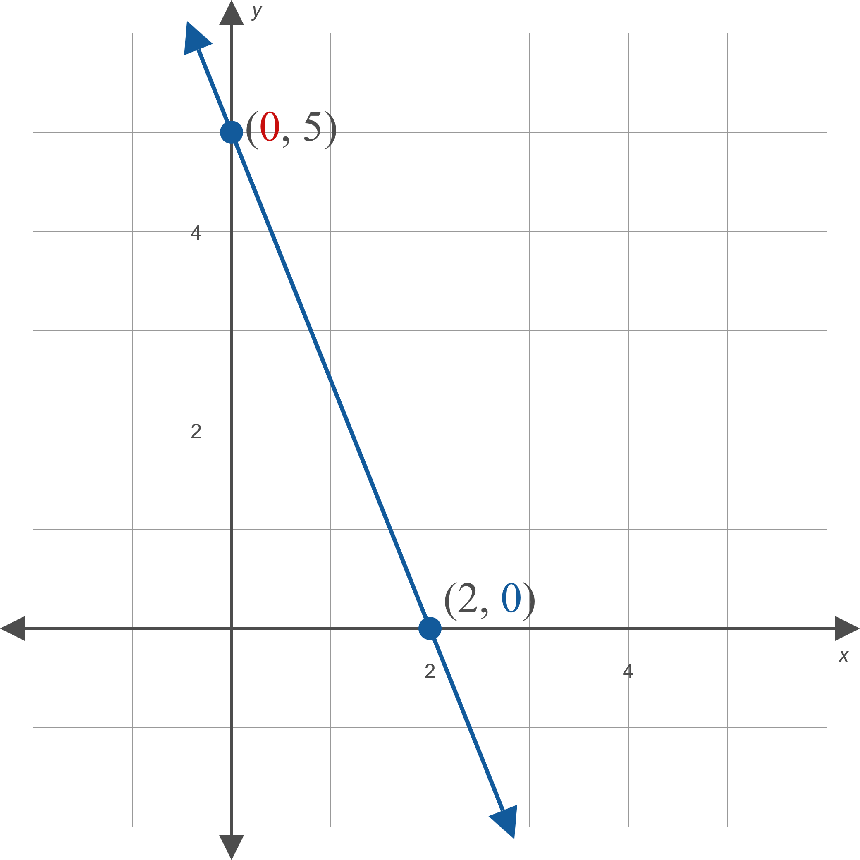
Example 2: Finding Intercepts and Graphing Linear Equations₆
Figure 2

Slide 17
Example 3: Graphing Horizontal and Vertical Lines₁
Graph the following equations.

Slide 18
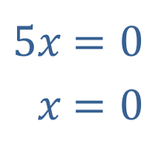
Example 3: Graphing Horizontal and Vertical Lines₂
Solution
​The first step is to divide both sides by 5, leaving the simple equation x = 0.
​
​$5x$ | ​$=0$
​$x$ | ​$=0$
The graph of this equation is the y-axis, as all ordered pairs on the y-axis have an x-coordinate of 0.

Slide 19
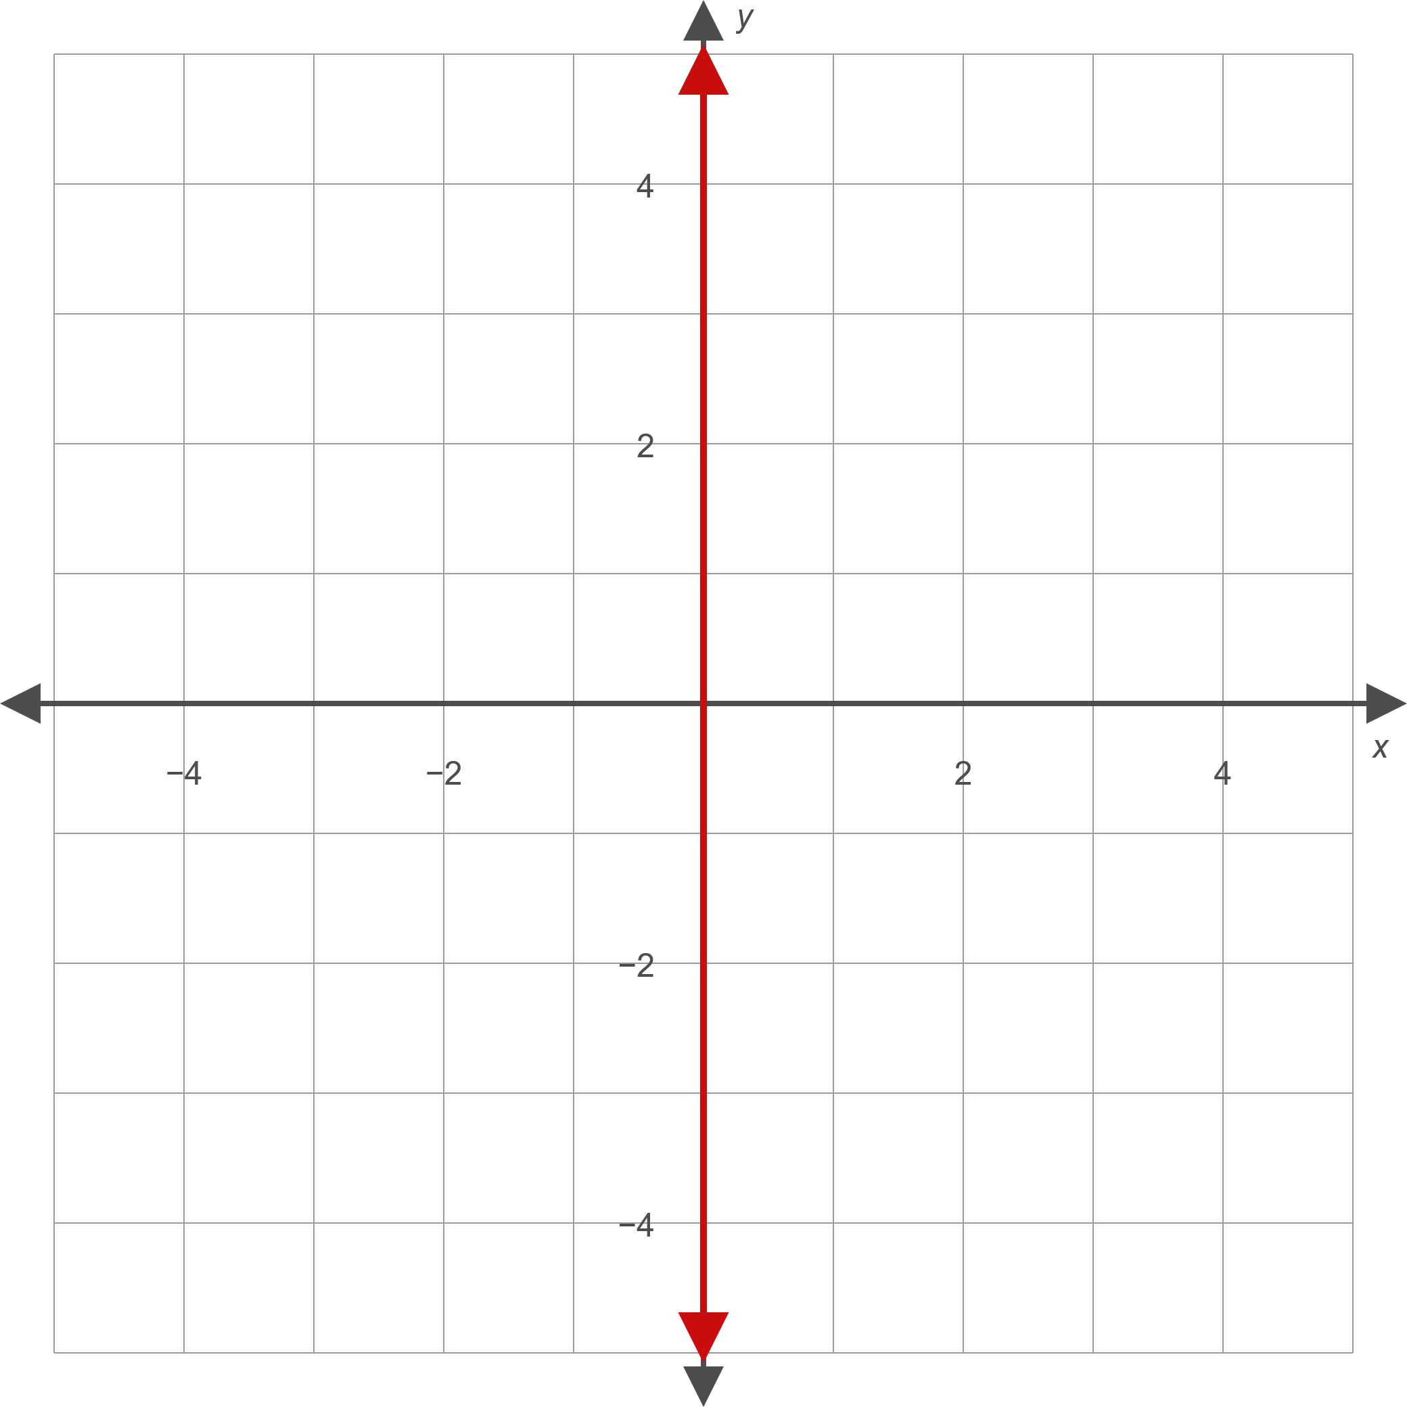
Example 3: Graphing Horizontal and Vertical Lines₃
Figure 8

Slide 20
Example 3: Graphing Horizontal and Vertical Lines₄
​The equation x = 0 is unique in that it has an infinite number of y-intercepts (since each point on the graph is on the y-axis) and one x-intercept (the origin).
​Similarly, the equation y = 0 has an infinite number of x-intercepts and one y-intercept.

Slide 21
Example 3: Graphing Horizontal and Vertical Lines₅
​Upon simplifying, note that this equation also represents a vertical line, this time passing through
on the x-axis.

Slide 22
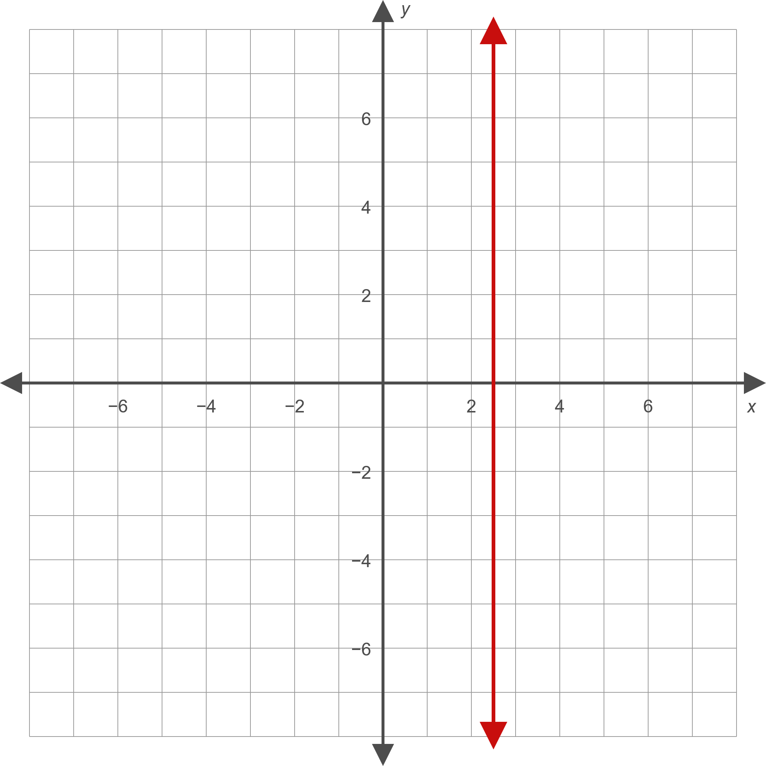
Example 3: Graphing Horizontal and Vertical Lines₆
Figure 9

Slide 23
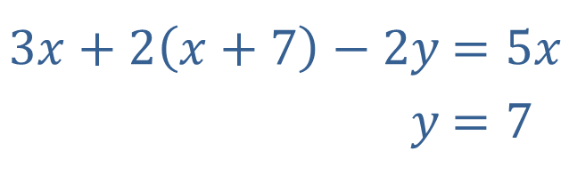
Example 3: Graphing Horizontal and Vertical Lines₇
​We encountered this equation in Example 1b and have already written it in standard form as shown.
​$3x+2\left(x+7\right)−2y$ | ​$=5x$
​$y$ | ​$=7$
The graph of this equation is the horizontal line consisting of all those ordered pairs whose
y-coordinate is 7.

Slide 24
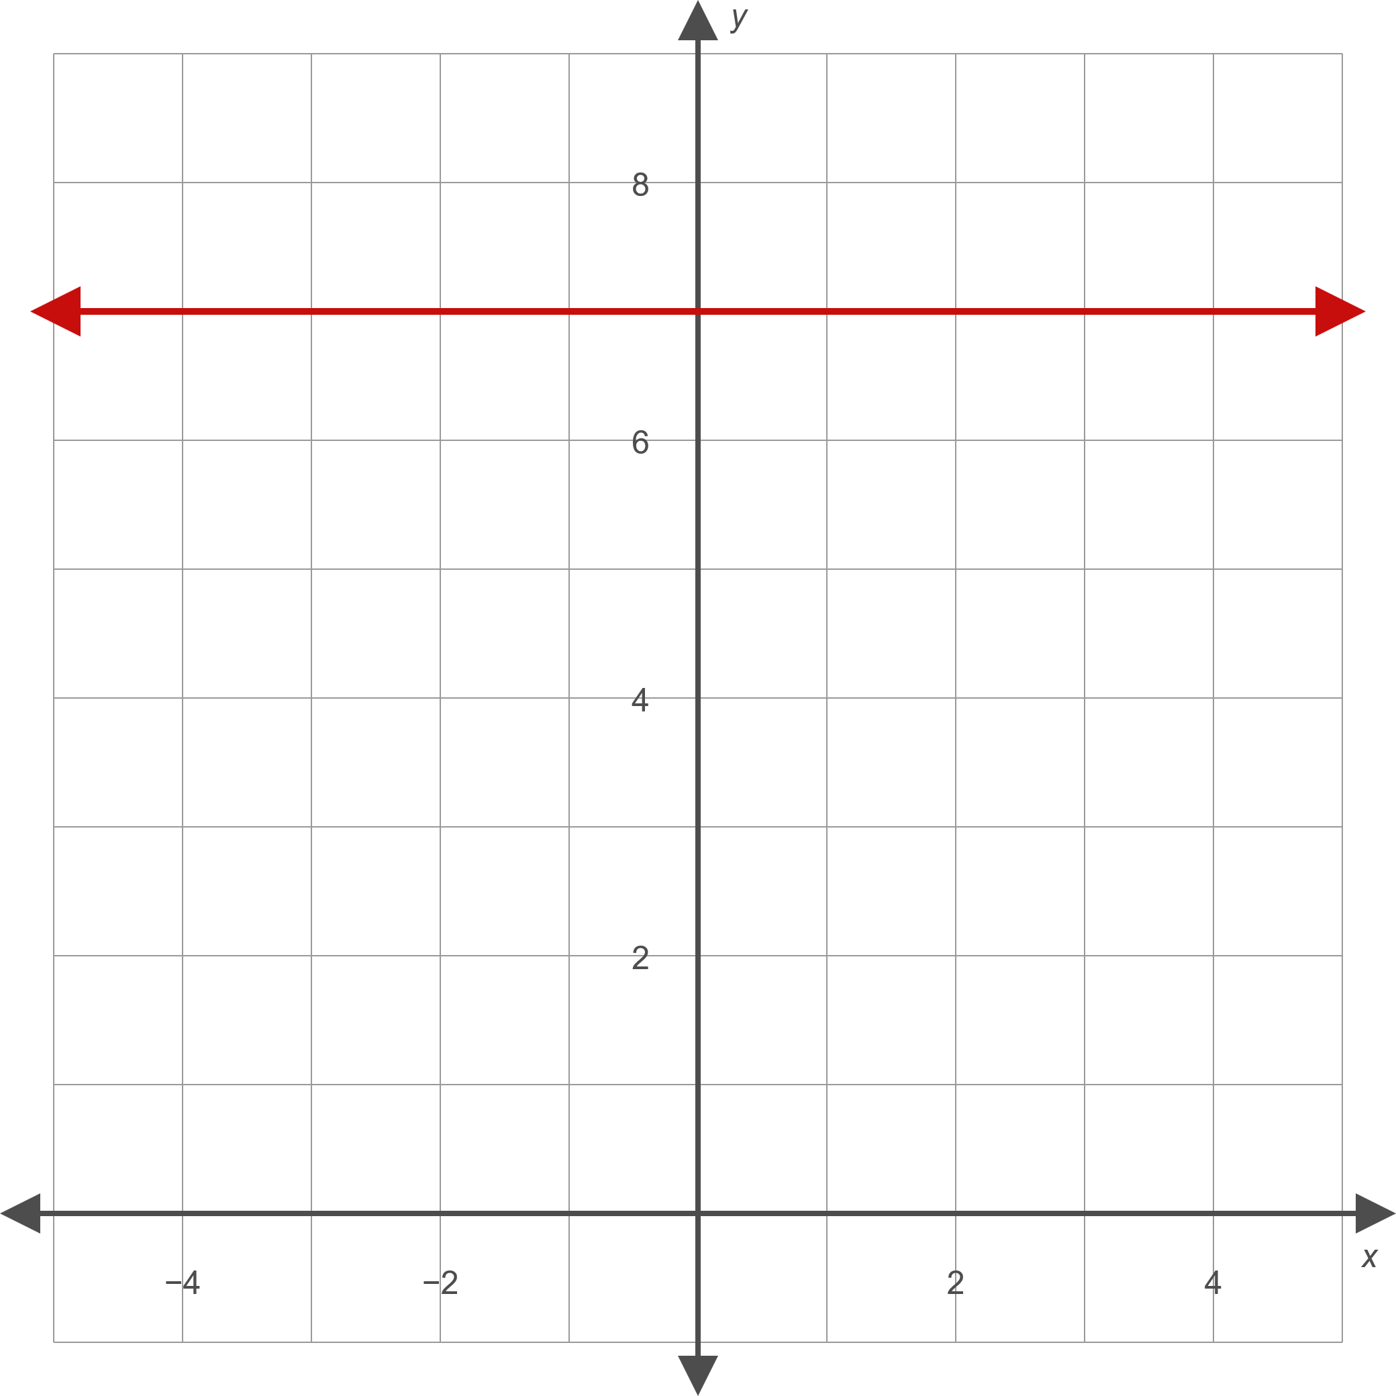
Example 3: Graphing Horizontal and Vertical Lines₈
Figure 10

