Slide 1
Section 3.2
Circles

Slide 2
Definition: Standard Form of a Circle
The standard form of the equation for a circle of radius r and center (h, k) is

Slide 3
Example 1: Standard Form of a Circle₁
Find the standard form of the equation for the circle with radius 3 and center (−2, 7).

Slide 4
Example 1: Standard Form of a Circle₂
Solution
We are given h = −2, k = 7, and r = 3, so we substitute these values into the standard form.
This can be simplified as follows.

Slide 5
Example 2: Standard Form of a Circle₁
Find the standard form of the equation for the circle with a diameter whose endpoints are (−4, −1) and (2, 5).

Slide 6
Example 2: Standard Form of a Circle₂
Solution
The midpoint of a diameter of a circle is the circle's center, so we can use the midpoint formula to find the center (h, k).
The distance from either diameter endpoint to the center gives us the circle's radius. Since we ultimately will want r², we can use a slight variation of the distance formula to find it.
Thus, the equation of the circle is

Slide 7
Example 3: Standard Form of a Circle₁
Find the standard form of the equation for the circle shown in Figure 2.

Slide 8
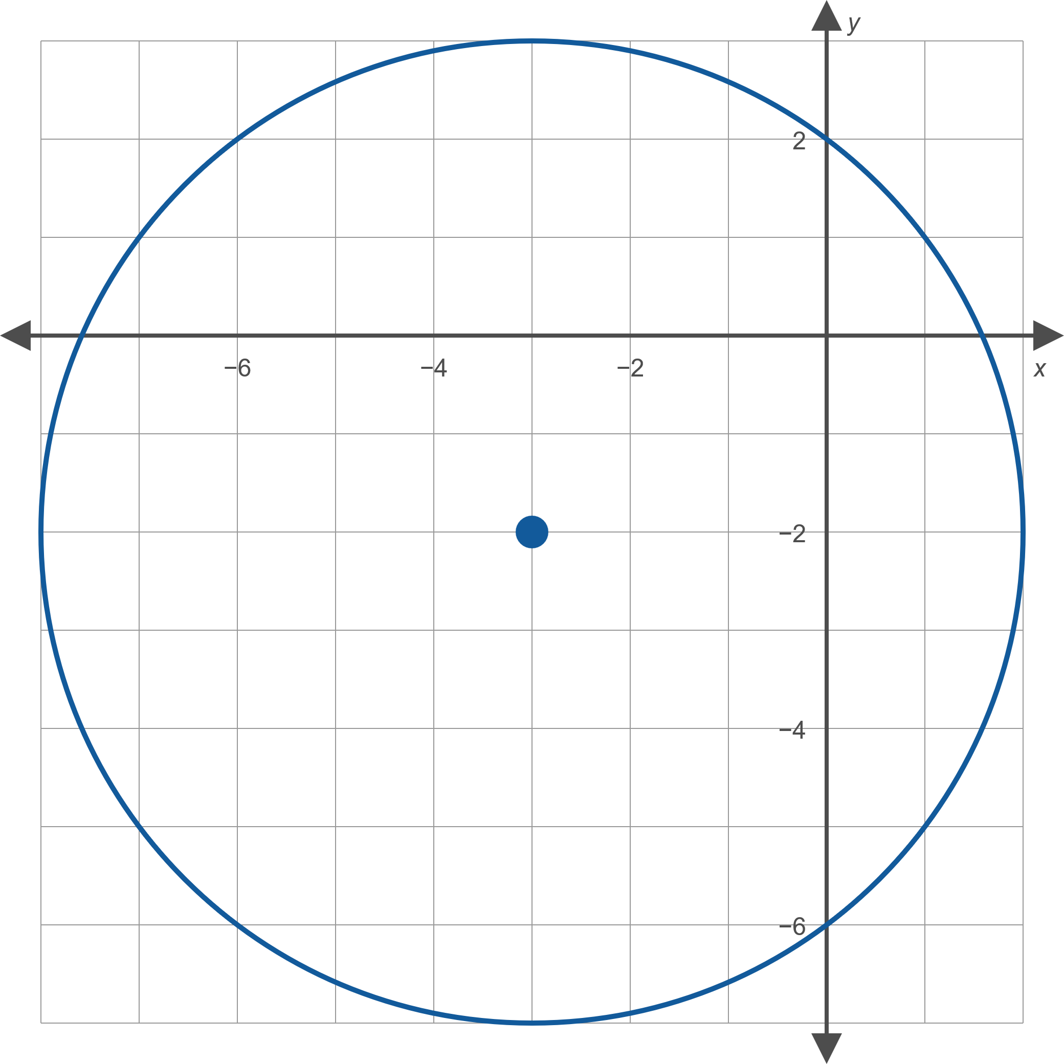
Example 3: Standard Form of a Circle₂
Figure 2

Slide 9
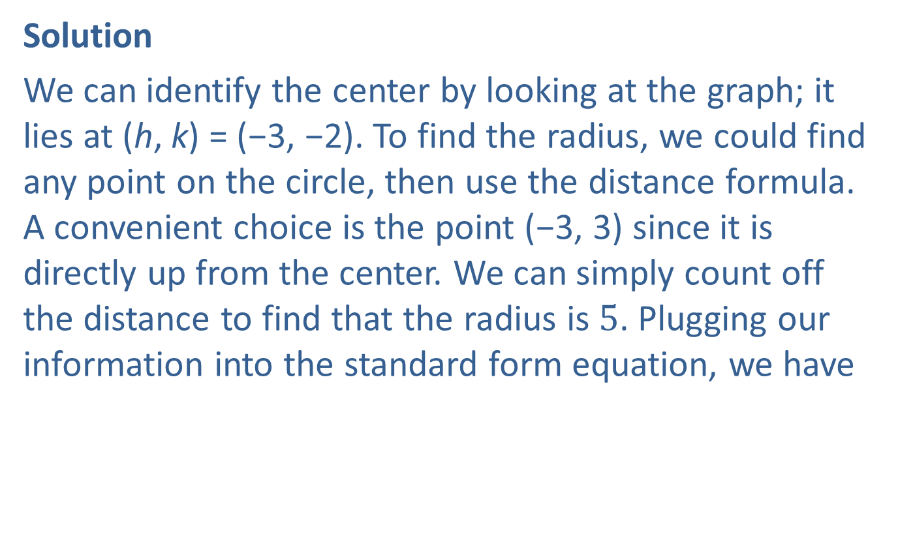
Example 3: Standard Form of a Circle₃
Solution
We can identify the center by looking at the graph; it lies at (h, k) = (−3, −2). To find the radius, we could find any point on the circle, then use the distance formula. A convenient choice is the point (−3, 3) since it is directly up from the center. We can simply count off the distance to find that the radius is $5$. Plugging our information into the standard form equation, we have
​

Slide 10
Example 4: Graphing Circles₁
Sketch the graph of the circle defined by

Slide 11
Example 4: Graphing Circles₂
Solution
The only preliminary step is to slightly rewrite the equation in the form
From this, we see that (h, k) = (2, −3) and that r = 2. The graph of the equation is shown in Figure 3.

Slide 12
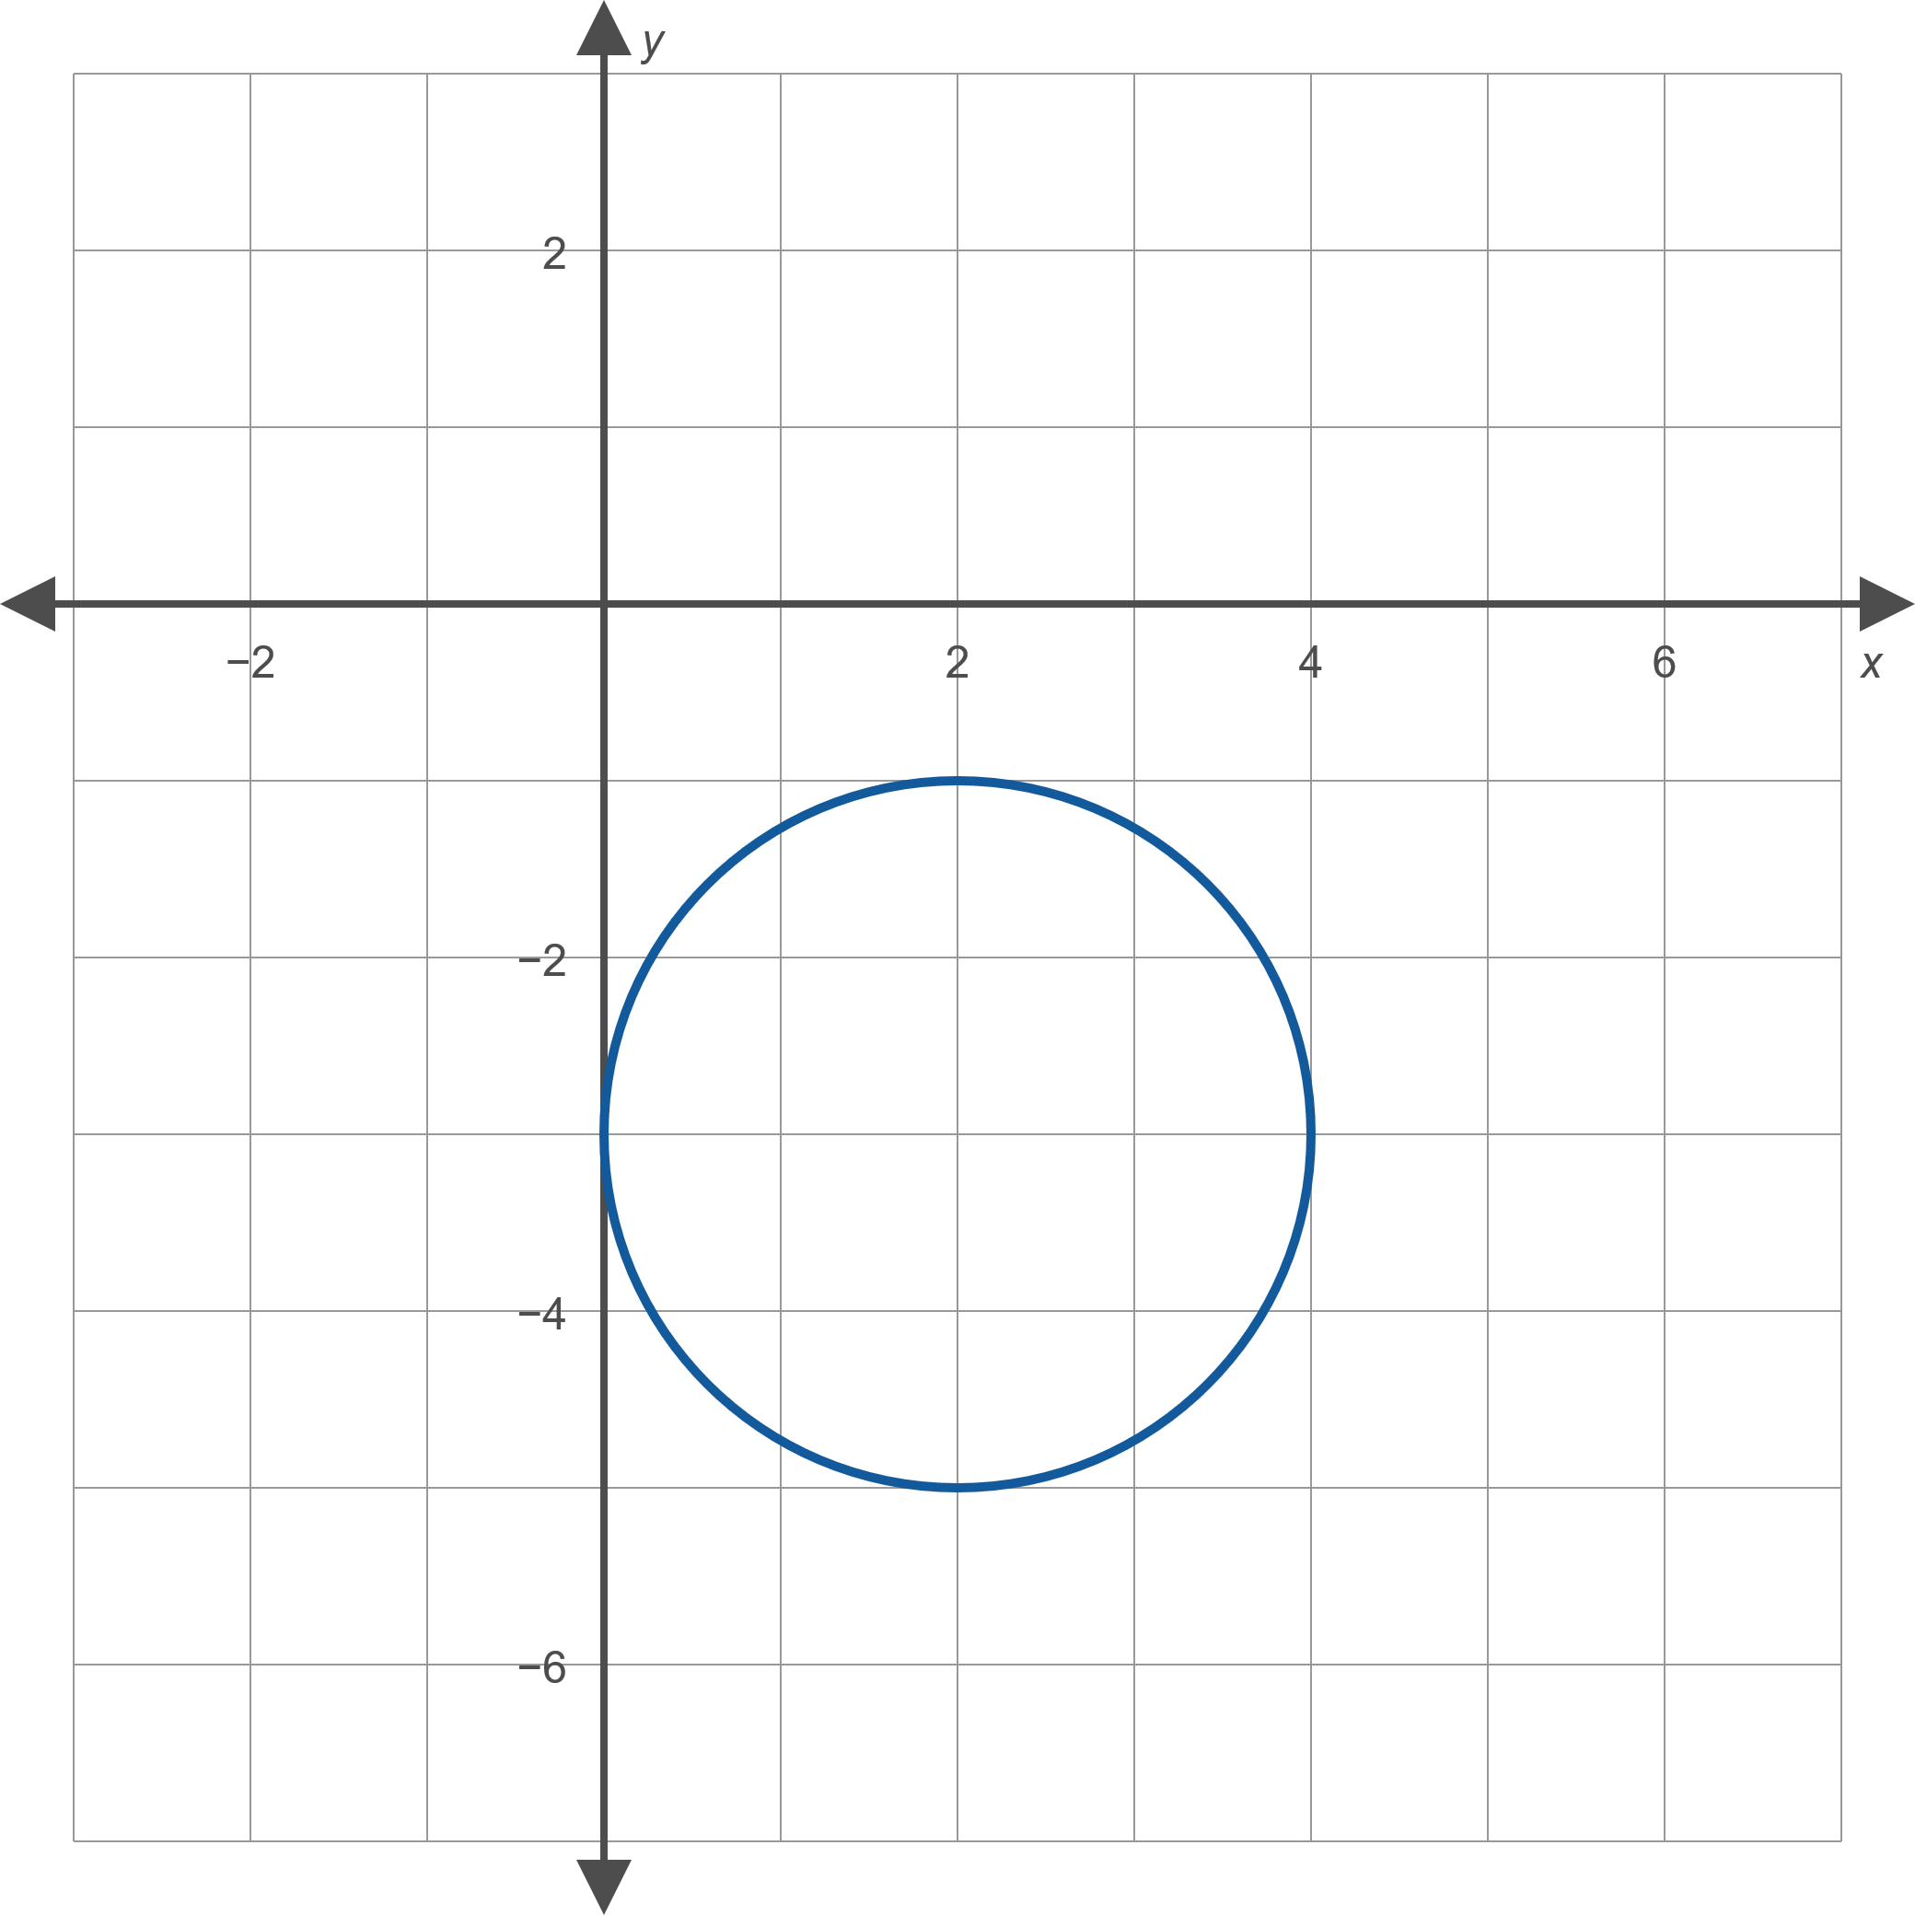
Example 4: Graphing Circles₃
Figure 3

Slide 13
Example 5: Graphing Circles and Completing the Square₁
Sketch the graph of the equation

Slide 14
Example 5: Graphing Circles and Completing the Square₂
Solution
We need to complete the square in the variable x and the variable y, and we do so as follows.

Slide 15
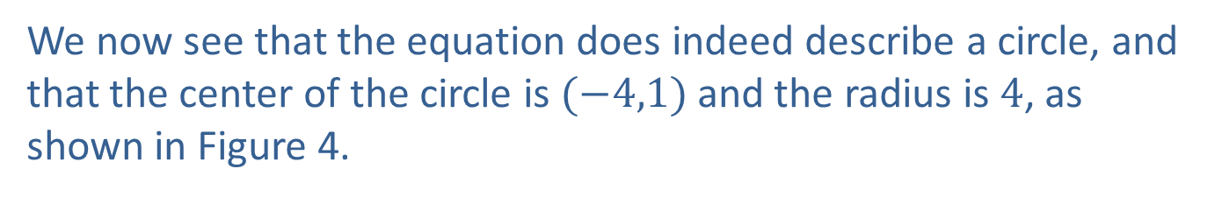
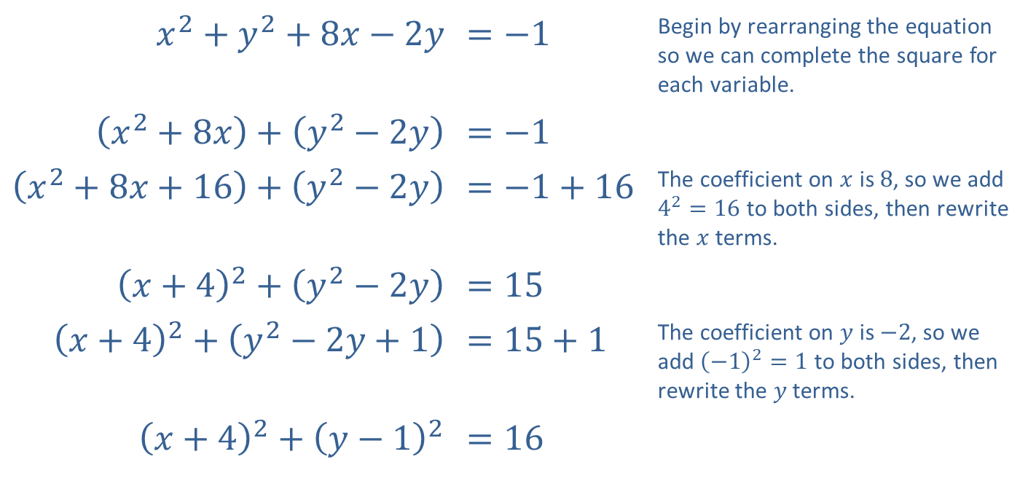
Example 5: Graphing Circles and Completing the Square₃
​$x^{2}+y^{2}+8x−2y$ | ​$=−1$ | Begin by rearranging the equation so we can complete the square for each variable.
​$\left(x^{2}+8x\right)+\left(y^{2}−2y\right)$ | ​$=−1$
​$\left(x^{2}+8x+16\right)+\left(y^{2}−2y\right)$ | ​$=−1+16$ | The coefficient on $x$ is 8, so we add $4^{2}=16$ to both sides, then rewrite the $x$ terms.
​${\left(x+4\right)}^{2}+\left(y^{2}−2y\right)$ | ​$=15$
​${\left(x+4\right)}^{2}+\left(y^{2}−2y+1\right)$ | ​$=15+1$ | The coefficient on $y$ is $−2$, so we add ${\left(−1\right)}^{2}=1$ to both sides, then rewrite the $y$ terms.
​${\left(x+4\right)}^{2}+{\left(y−1\right)}^{2}$ | ​$=16$
We now see that the equation does indeed describe a circle, and that the center of the circle is $(−4,1)$ and the radius is 4, as shown in Figure 4.

Slide 16
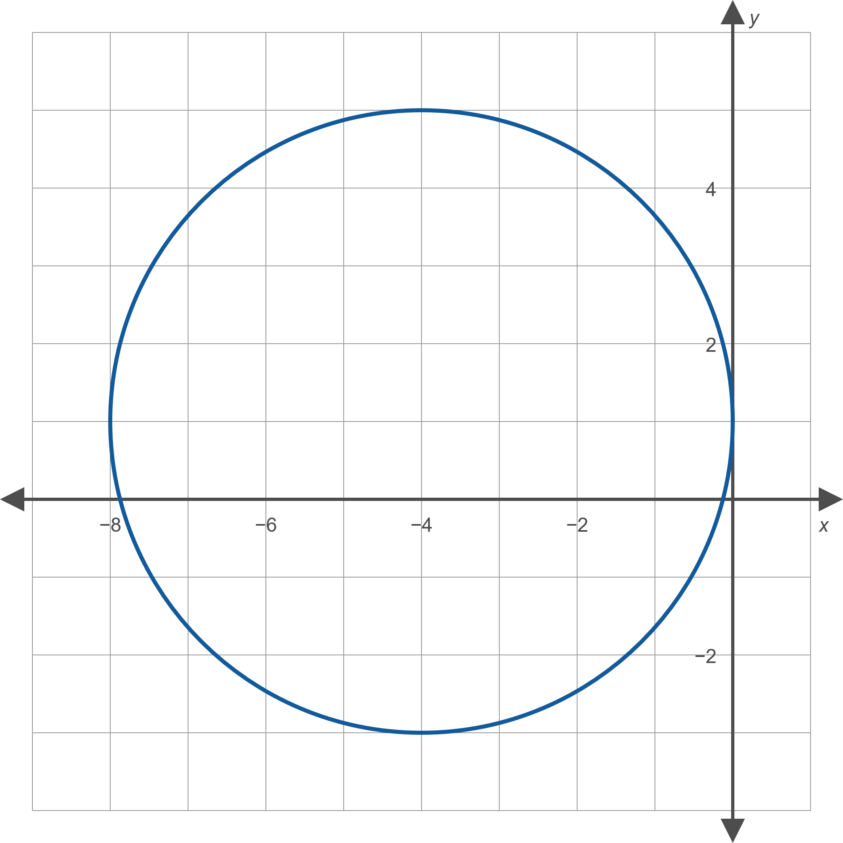
Example 5: Graphing Circles and Completing the Square₄
Figure 4

