Slide 1
Section 10.6
Probability

Slide 2
Definition: Terminology of Probability
An experiment is any activity that results in well-defined outcomes. In a given problem, we are usually concerned with finding the probability that one or more of the outcomes will occur, and we use the word event to refer to a set of outcomes.
The set of all possible outcomes of a given experiment is called the sample space of the experiment. This means that in the language of sets, an event is any subset of the sample space, including the empty set and the entire sample space.

Slide 3
Formula: Probabilities When Outcomes Are Equally Likely
We say that the outcomes of an experiment are equally likely if they all have the same probability of occurring. If E is an event of such an experiment, and if S is the sample space of the experiment, then the probability of E is given by
where n(E) and n(S) are, respectively, the cardinalities of the sets E and S.

Slide 4
CAUTION!₁
This formula has two important restrictions. First, it only applies in equally likely situations, so we can’t use it to analyze weighted coins, crooked roulette tables, tampered decks of cards, and so on. Secondly, and more subtly, it assumes that the size of the sample space is finite (otherwise, the formula makes no sense), so we can’t use it to analyze experiments based on, say, choosing a real number at random.

Slide 5
Example 1: Probabilities When Outcomes Are Equally Likely₁
A (fair) die is rolled once. Find the probability that the number rolled is
a. ​prime,
b. ​divisible by 5,
c. 7.

Slide 6
Example 1: Probabilities When Outcomes Are Equally Likely₂
Solution
The sample space S = {1,2,3,4,5,6} is the same for all three questions, and we can see that n(S) = 6.
a. Let E be the event that the number is prime. Then E = {2,3,5} since these are the prime numbers between 1 and 6, so n(E) = 3.
​Then,

Slide 7
Example 1: Probabilities When Outcomes Are Equally Likely₃
b. Let F be the event that the number is divisible by 5. Then F = {5}, as this is the only integer from 1 to 6 that is divisible by 5.
So
​
c. Let G be the event that the number is 7. In this case,
the empty set, as there is no way
for the top face to show a 7. This means P(G) = 0.

Slide 8
Example 2: Computing Probabilities₁
A pair of dice is rolled, and the sum of the top faces noted. What is the probability that the sum is
​a. 2,
b. 5,
c. 7 or 11?

Slide 9
Example 2: Computing Probabilities₂
Solution
The size of the sample space is the same for all three questions, so it makes sense to determine this first. In order to use the one probability formula we have, we need to make sure that all outcomes of the sample space are equally likely.

Slide 10
Example 2: Computing Probabilities₃
For this reason, we do not want to define the sample space to be all integers between 2 and 12. This is because these sums are not all equally likely. For instance, there is only one way for the sum to be 2: both top faces must show a 1. But there are two ways for the sum to be 3: one die (call it die A) shows a 1 and the other (die B) shows a 2, or else die A shows a 2 and die B shows a 1. Similarly, there are three ways for the sum of the top faces to be 4.
In order to define the sample space properly, we create a table of ordered pairs. In Table 1, the first number in each pair corresponds to the number showing on die A and the second number corresponds to the number showing on die B.

Slide 11
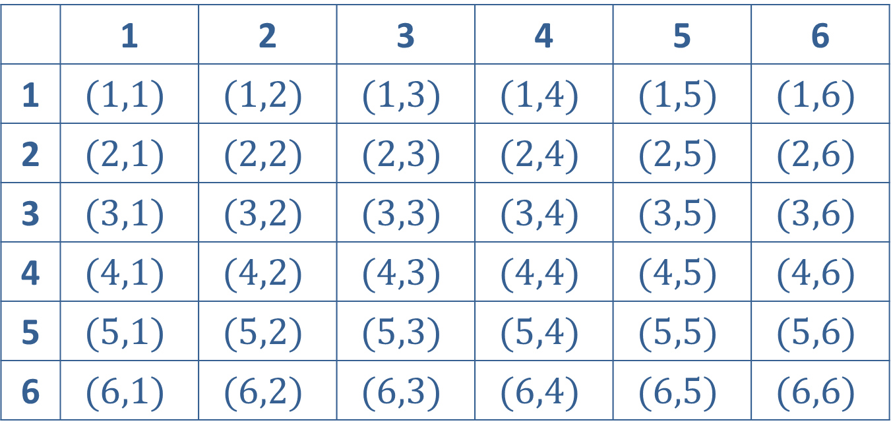
Example 2: Computing Probabilities₄
 | 1 | 2 | 3 | 4 | 5 | 6
1 | $$(1,1)$$ | $$(1,2)$$ | $$(1,3)$$ | $$(1,4)$$ | $$(1,5)$$ | $$(1,6)$$
2 | $$(2,1)$$ | $$(2,2)$$ | $$(2,3)$$ | $$(2,4)$$ | $$(2,5)$$ | $$(2,6)$$
3 | $$(3,1)$$ | $$(3,2)$$ | $$(3,3)$$ | $$(3,4)$$ | $$(3,5)$$ | $$(3,6)$$
4 | $$(4,1)$$ | $$(4,2)$$ | $$(4,3)$$ | $$(4,4)$$ | $$(4,5)$$ | $$(4,6)$$
5 | $$(5,1)$$ | $$(5,2)$$ | $$(5,3)$$ | $$(5,4)$$ | $$(5,5)$$ | $$(5,6)$$
6 | $$(6,1)$$ | $$(6,2)$$ | $$(6,3)$$ | $$(6,4)$$ | $$(6,5)$$ | $$(6,6)$$
Table 1: Sample Space for Rolling a Pair of Dice

Slide 12
Example 2: Computing Probabilities₅
Each of these ordered pairs is equally likely to come up, as any of the numbers 1 through 6 are equally likely for the first slot (die A) and similarly for the second slot (die B). Referring to the positions in the ordered pairs as “slots” points to a quick way of determining the size of the sample space. Since there are 6 choices for each slot, the Multiplication Principle of Counting tells us there are 36 possible outcomes of this experiment.

Slide 13
Example 2: Computing Probabilities₆
We can now proceed to answer the three specific questions.
a. There is only one ordered pair corresponding to a sum of 2, namely (1,1), so the probability of this event is
​
​
b. There are four ordered pairs corresponding to a sum of 5:
so the probability of this event is

Slide 14
Example 2: Computing Probabilities₇
c. ​A sum of 7 or 11 comes from any of the following ordered pairs.
​
​
Since there are eight elements in this event, the probability of rolling a sum of 7 or 11 is

Slide 15
Example 3: Computing Probabilities₁
Suppose you are taking a 10-question True-False test, and you are completely unprepared for it. If you decide to guess on each question, what is the probability of getting 8 or more questions right?

Slide 16
Example 3: Computing Probabilities₂
Solution
The sample space for this problem consists of all the possible sequences of 10 answers, each of which is True or False. Combinatorics tells us that there are
such sequences (2 choices for each of
10 “slots”), and these 1024 possible sequences are equally likely if your choice of True or False on each question is random.

Slide 17
Example 3: Computing Probabilities₃
The probability of getting 8 or more questions right can be broken up into three possibilities; getting 8 right, 9 right, or all 10 right.
There is only one sequence of 10 answers that are all correct. There are more ways of correctly answering exactly 9 questions, and we can use another tool from combinatorics to find out exactly how many ways.

Slide 18
Example 3: Computing Probabilities₄
We need to select 9 “objects” from a set of 10 to be correctly answered questions, and the number of ways to do this is
Similarly, there are
ways of selecting 8 of the 10
questions, so there are
ways of getting exactly 8 questions right.

Slide 19
Example 3: Computing Probabilities₅
Altogether, there are 45 + 10 + 1 = 56 ways of getting 8, 9, or 10 questions right, so the probability of this happening is
This means you only have a 5.5% chance of scoring 80% or better by guessing, so studying ahead of time is clearly advantageous!

Slide 20
Theorem: Cardinality of a Union of Sets
Let E and F be two finite sets. Then
Note that if E and F are disjoint, meaning they have no elements in common, then
so

Slide 21
Theorem: Probability of a Union of Two Events
Let E and F be two subsets of the same sample space. Then the probability of the event “E or F,” denoted
is given by the formula
The term
represents the probability of both
events E and F happening. If, as sets, events E and F are disjoint (so E ∩ F = ∅), then E and F are said to be mutually exclusive. In this case, E ∩ F = ∅ and

Slide 22
Example 4: Probability of a Union of Two Events₁
Assume a single die has been rolled and the number showing on top noted. Let E be the event “the number is divisible by 2” and let F be the event “the number is divisible by 3.” Find the following probabilities.

Slide 23
Example 4: Probability of a Union of Two Events₂
Solution
For this small experiment, we can list the elements of each of the four events we are interested in, and then determine each event’s cardinality:

Slide 24
Example 4: Probability of a Union of Two Events₃
Now we are ready to apply the appropriate formulas.
a. Since
and since the sample space
has six elements altogether,
b. ​Since n(E) = 3 and n(F) = 2,

Slide 25
Theorem: Unions of Mutually Exclusive Events
are pairwise disjoint (that is,
If
whenever i ≠ j), then

Slide 26
Example 5: Unions of Mutually Exclusive Events₁
Suppose Jim has chosen a PIN of 8 7 3 6 for his bank’s ATM, and that all PINS at the bank consist of four digits from 0 to 9. Using the ATM one day, he senses someone looking over his shoulder as he enters the first two digits, and he decides to cancel the operation and leave. The next day Jim discovers his ATM card is missing. In the worst-case scenario, a stranger now has Jim’s ATM card and the first two digits of his PIN. As he calls the bank to cancel the card, he wonders what the chances are the unknown someone can guess the remaining digits in the three tries the ATM allows. What is the probability of this event?

Slide 27

Example 5: Unions of Mutually Exclusive Events₂
Solution
If the first two digits are indeed known, the stranger has the task of filling in the last two digits, and there are 10 choices for each:
The size of the sample space is thus 100, and any guess at completing the PIN correctly has a probability equal to
of being correct.

Slide 28
Example 5: Unions of Mutually Exclusive Events₃
Assuming the stranger tries three different ways of completing the PIN (so that the three events are pairwise disjoint), the probability of Jim’s account being broken into is

Slide 29
CAUTION!₂
A common error often made in finding the answer to Example 5 gives an answer of
This is often due to confusion about an area of statistics called conditional probability. The probability of guessing right on the second guess is not
but is actually
where
is the probability
that the first guess is wrong. Note that

Slide 30
Definition: Independent Events
Given two events E ₁ and E ₂ in the same sample space, we say E ₁ and E ₂ are independent if
More generally, a collection of events
is independent if for any subcollection
of
it is true that

Slide 31
Example 6: Independent Events₁
If a coin is flipped three times, what is the probability of it coming up tails all three times?

Slide 32
Example 6: Independent Events₂
Solution
We actually have two good ways of answering this question, one using the notion of independence and one not.
Let E_{i} be the event “the coin comes up tails on the i^{th} flip.” We are interested, then, in the probability of E₁ ∩ E₂ ∩ E₃, the probability that we get tails each time.

Slide 33
Example 6: Independent Events₃
Since
for each i = 1, 2, 3
(remember, the coin is assumed to be fair), then

Slide 34
Example 6: Independent Events₄
The other way of obtaining the same answer is to consider the sample space made up of all possible three-toss sequences. Since each flip of the coin results in one of two possibilities, the Multiplication Principle of Counting tells us that there are 2³ = 8 possible sequences. Only one of these is the sequence consisting of three tails, so the probability of this event is

