Slide 1
Section 10.4
Mathematical Induction

Slide 2
Theorem: Principle of Mathematical Induction
Assume that P(n) is a statement about each natural number n. Suppose that the following two conditions hold:
1. P(1) is true.
2. ​For each natural number k, if P(k) is true, then
Then the statement P(n) is true for every natural number n.

Slide 3
Example 1: Proof by Mathematical Induction₁
Prove that for each natural number n,

Slide 4
Example 1: Proof by Mathematical Induction₂
Solution
Basic Step: The statement P(1) is the equation
1 = 1², which is clearly true.
Induction Step: As always, we begin this step with the assumption that P(k) is true.
That is,
We want to prove
that
is true, so we need to show that
To do this, we rewrite the left-hand side using the inductive assumption.

Slide 5
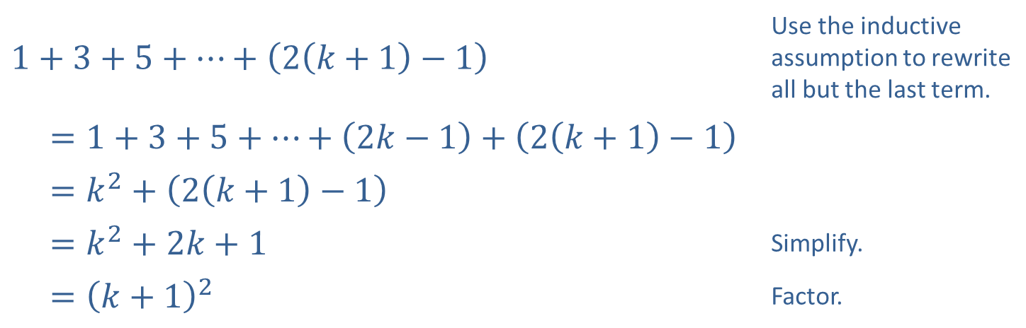
Example 1: Proof by Mathematical Induction₃
$$1+3+5+…+\left(2\left(k+1\right)−1\right)$$ | Use the inductive assumption to rewrite all but the last term.
$=1+3+5+…+\left(2k−1\right)+\left(2\left(k+1\right)−1\right)$
$=k^{2}+\left(2\left(k+1\right)−1\right)$
$=k^{2}+2k+1$ | Simplify.
$={\left(k+1\right)}^{2}$ | Factor.
Since we’ve completed the basic step and the induction step, the proof is complete.

Slide 6
Example 2: Proof by Mathematical Induction₁
Prove that for each natural number n,

Slide 7
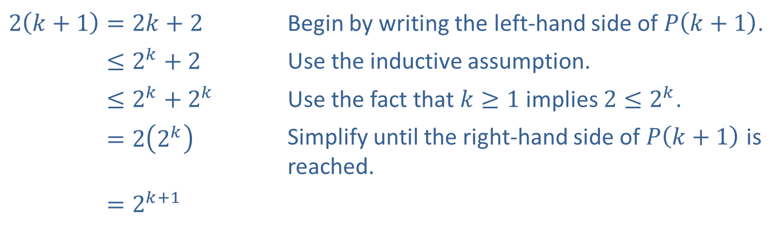
Example 2: Proof by Mathematical Induction₂
Solution
Basic Step: The statement P(1) is the inequality
This is true.
Induction Step: Assume that
Then we have the following.
​$2\left(k+1\right)=2k+2$ | Begin by writing the left-hand side of $P⁡\left(k+1\right)$.
​2𝑘+1≤2𝑘+2 | Use the inductive assumption.
​2𝑘+1≤2𝑘+2𝑘 | Use the fact that $k≥1$ implies $2≤2^{k}$.
​2𝑘+1=22𝑘 | Simplify until the right-hand side of $P⁡\left(k+1\right)$ is reached.
​2𝑘+1=2𝑘+1

Slide 8
Example 3: Proof by Mathematical Induction₁
Prove that for each natural number n,
is divisible by 5.

Slide 9
Example 3: Proof by Mathematical Induction₂
Solution
Basic Step: Since
is divisible by 5, P(1) is true.
Induction Step: Assume that
is divisible by 5.
Then there is some integer P for which

Slide 10
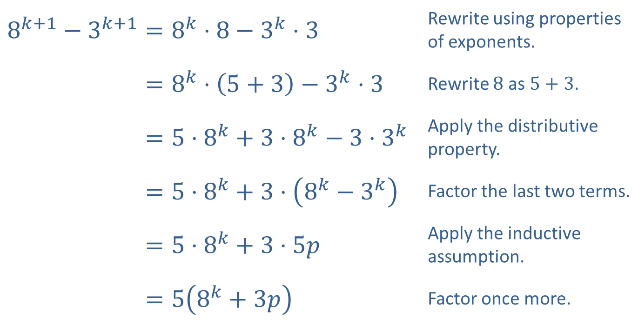
Example 3: Proof by Mathematical Induction₃
​$8^{k+1}−3^{k+1}=8^{k}⋅8−3^{k}⋅3$ | Rewrite using properties of exponents.
​8𝑘+1−3𝑘+1=8𝑘⋅5+3−3𝑘⋅3 | Rewrite 8 as $5+3$.
​8𝑘+1−3𝑘+1=5⋅8𝑘+3⋅8𝑘−3⋅3𝑘 | Apply the distributive property.
​8𝑘+1−3𝑘+1=5⋅8𝑘+3⋅8𝑘−3𝑘 | Factor the last two terms.
​8𝑘+1−3𝑘+1=5⋅8𝑘+3⋅5𝑝 | Apply the inductive assumption.
8𝑘+1−3𝑘+1=58𝑘+3𝑝 | Factor once more.

Slide 11
Example 3: Proof by Mathematical Induction₄
This shows that
is a product of 5 and the
integer
so we have shown that
is divisible by 5, completing the inductive step, and thus the proof.

Slide 12
Example 4: Proof by Mathematical Induction₁
Prove that for each natural number n,

Slide 13
Example 4: Proof by Mathematical Induction₂
Solution
Basic Step: Note that P(1) is the statement
which is true.
Induction Step: The inductive assumption is

Slide 14
Example 4: Proof by Mathematical Induction₃
Consider the left-hand side of
To show that
is true we need to demonstrate
That this sum is equal to the right-hand side of
namely
better written as
We use the inductive assumption to rewrite all but the last term of the left-hand side; some algebraic manipulation then leads to the desired result.

Slide 15
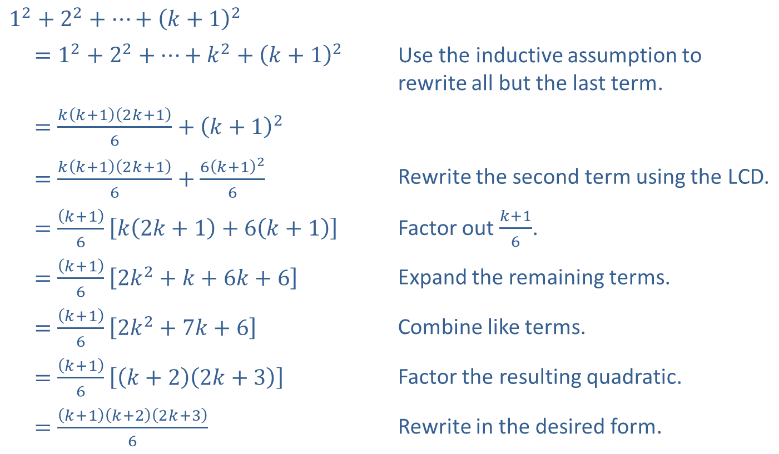
Example 4: Proof by Mathematical Induction₄
$$1^{2}+2^{2}+…+{\left(k+1\right)}^{2}$$
$$=1^{2}+2^{2}+…+k^{2}+{\left(k+1\right)}^{2}$$ | Use the inductive assumption to rewrite all but the last term.
​$=\frac{k\left(k+1\right)\left(2k+1\right)}{6}+{\left(k+1\right)}^{2}$
​$=\frac{k\left(k+1\right)\left(2k+1\right)}{6}+\frac{6{\left(k+1\right)}^{2}}{6}$ | Rewrite the second term using the LCD.
​$=\frac{\left(k+1\right)}{6}\left[k\left(2k+1\right)+6\left(k+1\right)\right]$ | Factor out $\frac{k+1}{6}$.
​$=\frac{\left(k+1\right)}{6}\left[2k^{2}+k+6k+6\right]$ | Expand the remaining terms.
​$=\frac{\left(k+1\right)}{6}\left[2k^{2}+7k+6\right]$ | Combine like terms.
​$=\frac{\left(k+1\right)}{6}\left[\left(k+2\right)\left(2k+3\right)\right]$ | Factor the resulting quadratic.
​$=\frac{\left(k+1\right)\left(k+2\right)\left(2k+3\right)}{6}$ | Rewrite in the desired form.

Slide 16
Example 4: Proof by Mathematical Induction₅
This completes the induction step, and thus the entire proof.

