Slide 1
Section 10.3
Geometric Sequences and Series

Slide 2
Definition: Geometric Sequences
A sequence
is a geometric sequence (also called a
geometric progression) if there is a constant r ≠ 0 so that
for each
The constant r is called the common ratio of the sequence.

Slide 3
Formula: General Term of a Geometric Sequence
The explicit formula for the general n^{th} term of a geometric sequence is
where r is the common ratio for the sequence.

Slide 4
Example 1: General Term of a Geometric Sequence₁
Find the formula for the general n^{th} term of each geometric sequence.

Slide 5
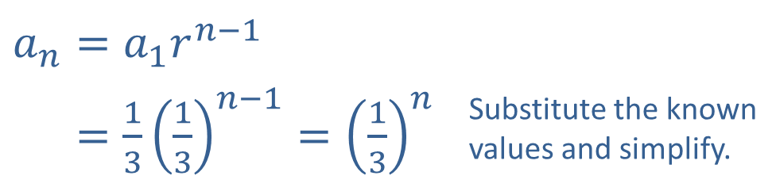
Example 1: General Term of a Geometric Sequence₂
Solution
​First, use any two consecutive terms to determine the common ratio r.
​
Since we know that
the explicit formula is as follows.
​$a_{n}=a_{1}r^{n−1}$
​𝑎𝑛=1313𝑛−1=13𝑛 | Substitute the known values and simplify.

Slide 6

Example 1: General Term of a Geometric Sequence₃
​Using the same process as before, we know a ₁$=3$ and can calculate r.
​
​
​Applying the formula, we have the following.

Slide 7
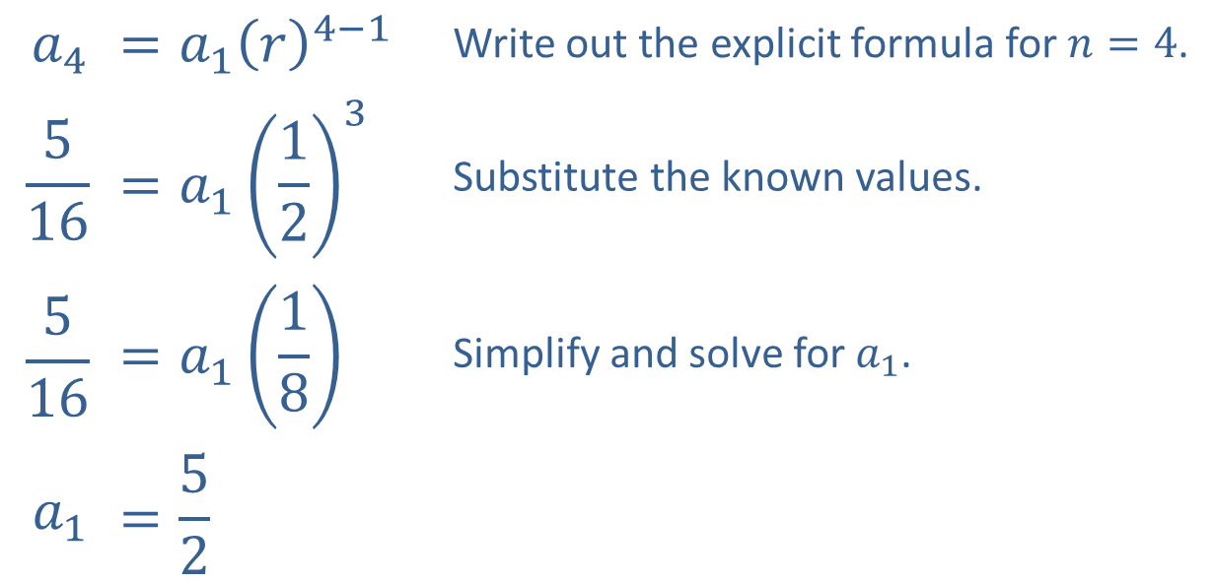
Example 1: General Term of a Geometric Sequence₄
​Here we are given r and another term. We can use the formula to find a ₁.
​
$$a_{4}$$ | $$=a_{1}{\left(r\right)}^{4−1}$$ | Write out the explicit formula for $n=4$.
$$\frac{5}{16}$$ | $$=a_{1}{\left(\frac{1}{2}\right)}^{3}$$ | Substitute the known values.
$$\frac{5}{16}$$ | $$=a_{1}\left(\frac{1}{8}\right)$$ | Simplify and solve for $a_{1}$.
$$a_{1}$$ | $$=\frac{5}{2}$$

Slide 8
Example 1: General Term of a Geometric Sequence₅
​We then substitute a ₁ and r to find the explicit formula.

Slide 9
Example 2: General Term of a Geometric Sequence₁
Given that the second term of a geometric sequence is −6 and the fifth term is 162, what is the fourth term?

Slide 10
Example 2: General Term of a Geometric Sequence₂
Solution
Given that the sequence is geometric, we know that
We can eliminate a ₁ from this pair of equations by dividing.

Slide 11
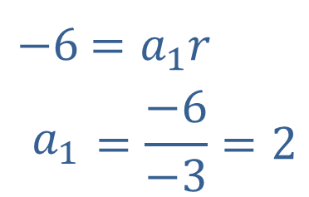
Example 2: General Term of a Geometric Sequence₃
Given r, we can find a ₁ using one of the previous equations.
​
​$−6$ | ​$=a_{1}r$
​$a_{1}$ | $$=\frac{−6}{−3}=2$$
So the general term is given by
and we find the fourth term by plugging in n = 4.

Slide 12
Formula: Partial Sum of a Geometric Sequence
be a geometric sequence with common ratio r,
Let
and assume r is neither 0 nor 1. Then the n^{th} partial sum of the sequence,
is given by

Slide 13
Example 3: Comparing Salary Offers₁
Marilyn has the option of taking a job with Employer A, who offers a yearly salary increase of $1250, or Employer B, who offers a yearly salary increase of 3%. Given that the starting salary is $40,000 for both, in what year does the accumulated salary paid by Employer B overtake the accumulated salary paid by Employer A?

Slide 14
Example 3: Comparing Salary Offers₂
Solution
We need to compare the partial sums of the salaries paid by the two employers up through year n to answer the question. The sequence of yearly salaries paid by Employer A is an arithmetic progression with a common difference of $1250, defined by
The geometric sequence of yearly salaries paid by Employer B is defined by

Slide 15
Example 3: Comparing Salary Offers₃
Recall that one partial sum formula for an arithmetic sequence is
where d is the common difference for the sequence.
In order to keep the partial sums straight, let A _{n} denote the sum of the salaries paid by Employer A through year n, and let B _{n} be the same for Employer B. Then
and

Slide 16
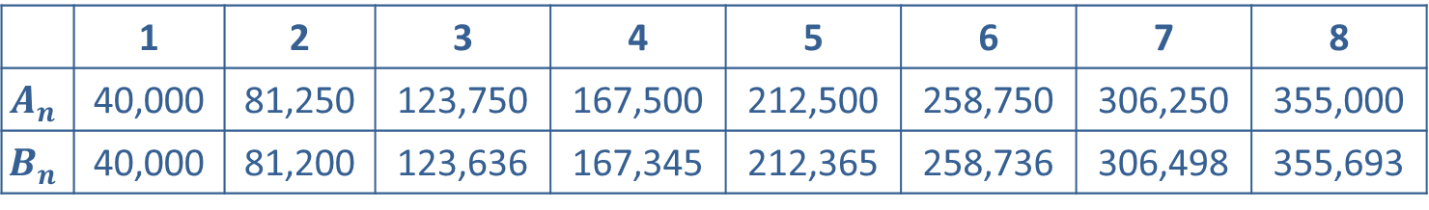
Example 3: Comparing Salary Offers₄
We can now use the formulas to compute the accumulated salaries paid by the two employers up through year n, as shown in Table 2.
 | 1 | 2 | 3 | 4 | 5 | 6 | 7 | 8
$$A_{n}$$ | 40,000 | 81,250 | 123,750 | 167,500 | 212,500 | 258,750 | 306,250 | 355,000
$$B_{n}$$ | 40,000 | 81,200 | 123,636 | 167,345 | 212,365 | 258,736 | 306,498 | 355,693
Table 2: Accumulated Salaries through Year 8
Comparing values in the table indicates that the accumulated salary paid by Employer B overtakes that of Employer A in the seventh year.

Slide 17
Example 4: Partial Sum of a Geometric Sequence₁
Evaluate

Slide 18
Example 4: Partial Sum of a Geometric Sequence₂
Solution
This is a partial sum of a geometric sequence, but as it is written the first term and the common ratio of the sequence are not apparent. A good way to begin is to write the sum in expanded form.
We can see that
and that the common ratio is
Since there are six terms in the sum, we let n = 6 in the partial sum formula. Putting this all together, we have the following.

Slide 19
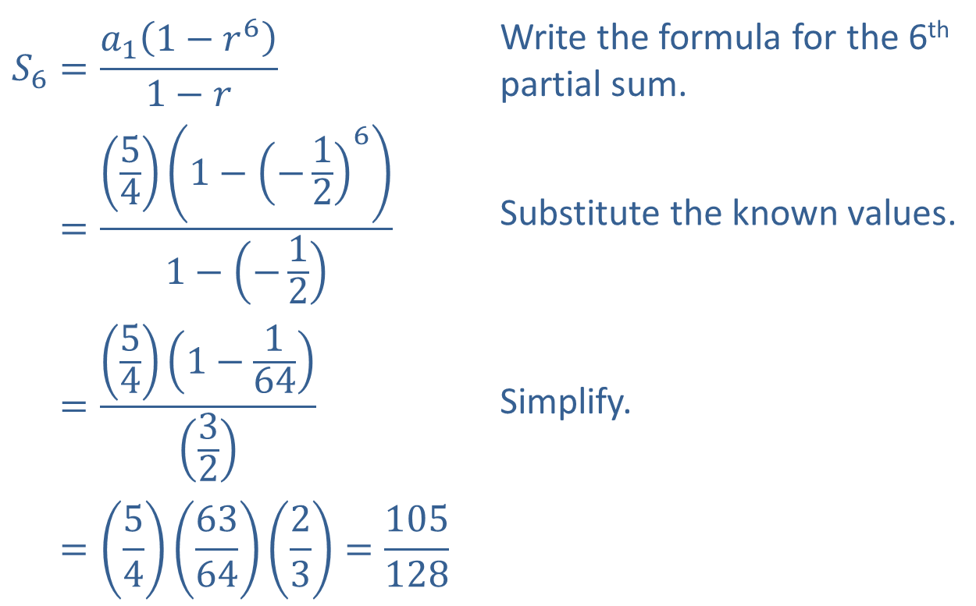
Example 4: Partial Sum of a Geometric Sequence₃
$$S_{6}=\frac{a_{1}\left(1−r^{6}\right)}{1−r}$$ | Write the formula for the 6th partial sum.
𝑆6=541−−1261−−12 | Substitute the known values.
𝑆6=541−16432 | Simplify.
𝑆6=54636423=105128

Slide 20
Formula: Sum of an Infinite Geometric Series
the infinite geometric series
If
converges, and the sum of the series is given by
We can use sigma notation with the index beginning at 0 to write the same series; in this form,

Slide 21
Example 5: Infinite Geometric Series₁
Find the sums of the following series.

Slide 22
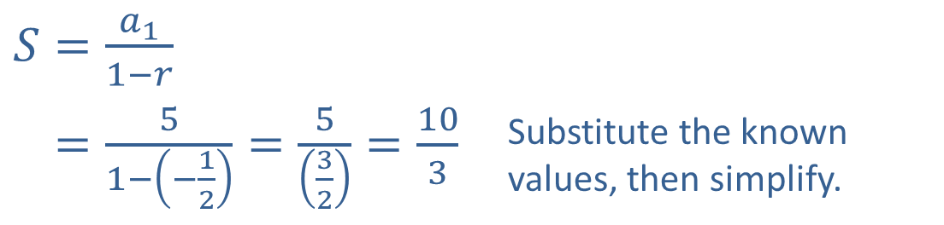
Example 5: Infinite Geometric Series₂
Solution
​First, we identify the values of a ₁ and r. Plugging in n = 1, we see that a ₁ = 5, and from the summation formula, we know
​​
Since the common ratio r is less than 1 in magnitude, we can apply the formula.
​$S=\frac{a_{1}}{1−r}$
​𝑆=51−−12=532=103 | Substitute the known values, then simplify.

Slide 23
Example 5: Infinite Geometric Series₃
​It is important to note exactly how a series is written. The formula
applies directly to two forms of summation notation:

Slide 24
Example 5: Infinite Geometric Series₄
​In this case, the form of the series doesn’t quite match either of these forms, so we write out the first few terms to identify the first term of the series and the common ratio.
From this, we can see that

Slide 25
Example 5: Infinite Geometric Series₅
​Plugging these values in, we have the following.

