Slide 1
Section 10.1
Sequences and Series

Slide 2
Definition: Sequences
An infinite sequence (or just sequence) is a function whose domain is the set of natural numbers
Instead of giving the function a name such as f and referring to the values of the sequence as
we commonly use subscripts and
refer to the terms of the sequence as
In other words, a_{n} stands for the n^{th} term in the sequence.
Finite sequences are defined similarly, but the domain of a finite sequence is a set of the form
for some positive integer k.

Slide 3
Example 1: Sequences₁
Determine the first five terms of the following sequences.

Slide 4
Note₁
Sequences often have distinct patterns. As you write out the terms for each sequence, see if you can predict the next term before calculating it.

Slide 5
Example 1: Sequences₂
Solution
​Replacing n in the formula for the general term with the first f ive positive integers, we obtain
​
so the sequence starts out as

Slide 6
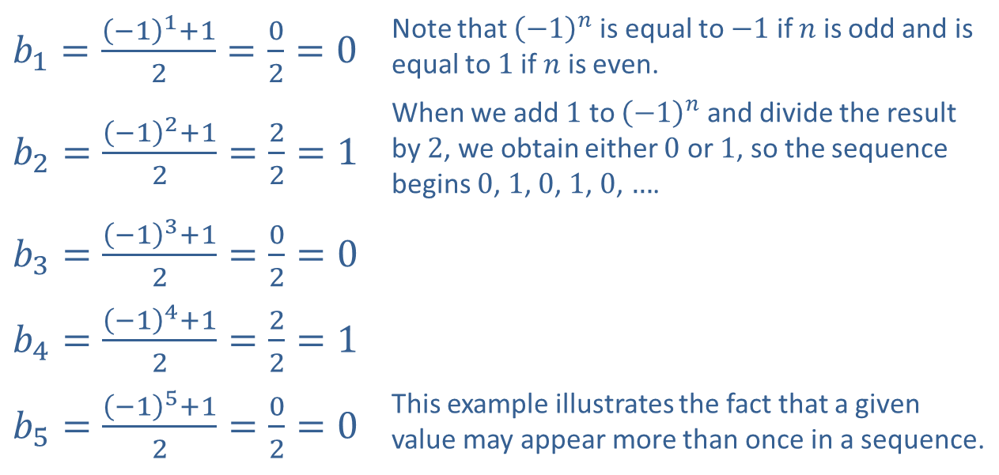
Example 1: Sequences₃
​Again, we replace n with the first five positive integers to determine the first five terms of the sequence.
​
​$b_{1}=\frac{{\left(−1\right)}^{1}+1}{2}=\frac{0}{2}=0$ | Note that ${\left(−1\right)}^{n}$ is equal to $−1$ if $n$ is odd and is equal to 1 if $n$ is even.
​$b_{2}=\frac{{\left(−1\right)}^{2}+1}{2}=\frac{2}{2}=1$ | When we add 1 to ${\left(−1\right)}^{n}$ and divide the result by 2, we obtain either 0 or 1, so the sequence begins 0, 1, 0, 1, 0, $…$.
​$b_{3}=\frac{{\left(−1\right)}^{3}+1}{2}=\frac{0}{2}=0$
​$b_{4}=\frac{{\left(−1\right)}^{4}+1}{2}=\frac{2}{2}=1$
​$b_{5}=\frac{{\left(−1\right)}^{5}+1}{2}=\frac{0}{2}=0$ | This example illustrates the fact that a given value may appear more than once in a sequence.

Slide 7
Example 1: Sequences₄
​Replacing n in the formula for the general term with the first five positive integers, we obtain
​
so the sequence starts out as

Slide 8
Example 2: Recursively Defined Sequences₁
Determine the first five terms of the following recursively defined sequences.

Slide 9
Example 2: Recursively Defined Sequences₂
Solution
We find the first five terms by replacing n with the first five positive integers, just as in Example 1. Note that in using the recursive definition we must determine the elements of the sequence in order; that is, to determine a₅, we need to first know a₄. And to determine a₄, we need to first know a₃, and so on back to a₁.
​Thus, the first five terms of the sequence are

Slide 10
Example 2: Recursively Defined Sequences₃
​The sequence defined by this recursive definition appears to be the same as the first sequence in Example 1, defined explicitly by a _{n} = 5n − 2. This illustrates the fact that a given sequence can often be defined several different ways.

Slide 11
Example 2: Recursively Defined Sequences₄
​Using the recursive formula
we obtain
​Thus, the first five terms of the sequence are

Slide 12
Example 3: Finding the Formula for a Sequence₁
Find a possible formula for the general n^{th} term of the sequences that begin as follows.

Slide 13
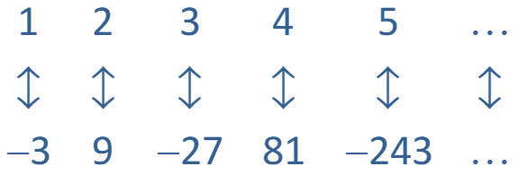
Example 3: Finding the Formula for a Sequence₂
Solution
​There is no general method to find a formula for the terms of a sequence. Observation is usually the best tool. If a formula for a given sequence does not come to mind quickly, it may help to associate each term of the sequence with its place in the sequence, as shown below.
​

Slide 14
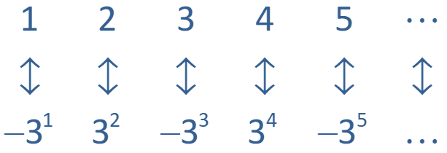
Example 3: Finding the Formula for a Sequence₃
​If a pattern is still not apparent, try rewriting the terms of the sequence in different ways. In this case, factoring the terms leads to the following.
​

Slide 15
Example 3: Finding the Formula for a Sequence₄
​The n^{th} term of the sequence is the n^{th} power of 3, multiplied by −1 if n is odd. One way to express alternating signs in a sequence is to multiply the n^{th} term by
​
(if the odd terms are negative) or by
(if the even terms are negative). In this case,
a possible formula for the general n^{th} term is
Note that we might also have come up with the recursive formula

Slide 16
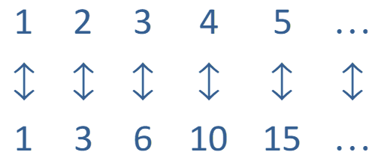
Example 3: Finding the Formula for a Sequence₅
​Associate each term with its place in the sequence, as follows.
​

Slide 17
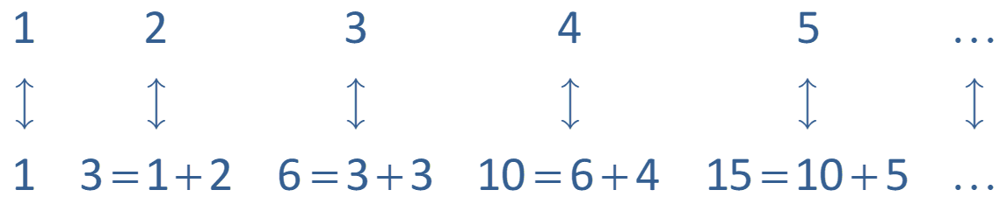
Example 3: Finding the Formula for a Sequence₆
​In this case, factoring the terms does not seem to help in identifying a pattern, but thinking about the difference between successive terms does.
​
This observation leads to the recursive formula

Slide 18
Definition: Summation Notation
The sum
is expressed in summation notation as
When this notation is used, the letter i is called the index of summation, and a_{i} often appears as the formula for the i^{th} term of a sequence. In the sum above, all the terms of the sequence beginning with a₁ and ending with a _{n} are to be added. The notation can be modified to indicate a different first or last term of the sum.

Slide 19
Example 4: Evaluating Sums₁
Rewrite the following sums in expanded form, then evaluate them.

Slide 20
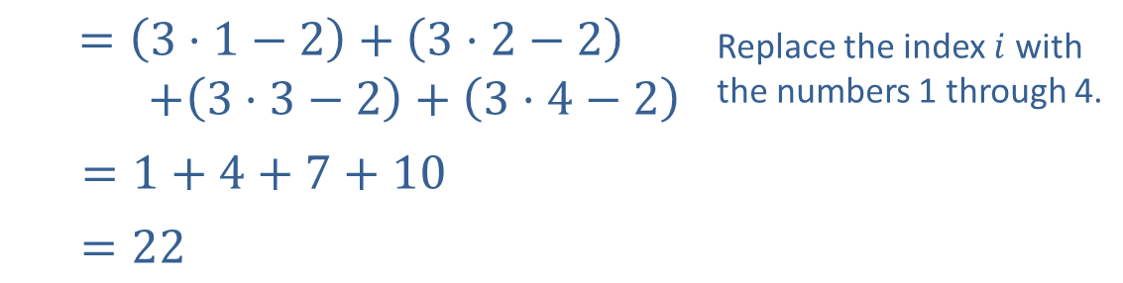
Example 4: Evaluating Sums₂
Solution
​
$$=\left(3⋅1−2\right)+\left(3⋅2−2\right)$$ $+\left(3⋅3−2\right)+\left(3⋅4−2\right)$ | Replace the index $i$ with the numbers 1 through 4.
$=1+4+7+10$
$=22$

Slide 21
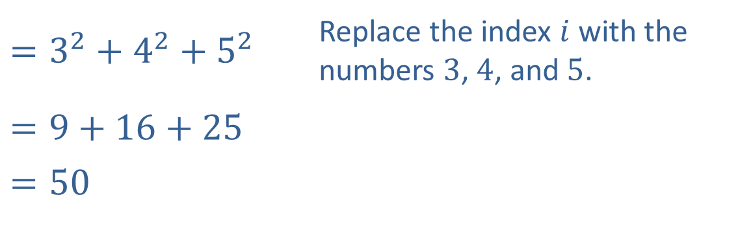
Example 4: Evaluating Sums₃
​
​$=3^{2}+4^{2}+5^{2}$ | Replace the index $i$ with the numbers 3, 4, and 5.
$$=9+16+25$$
​$=50$

Slide 22
Properties: Properties of Sigma Notation
Let
be two sequences, and let c be a constant.
1.
(the terms of a sum can be rearranged)
2.
(constants can be factored out of a sum)
3.
(a sum can be broken apart into two smaller sums)

Slide 23
CAUTION!
There are many statements that look similar to the properties of sigma notation but are not true. For instance, it is not generally true that

Slide 24
Formula: Four Summation Formulas

Slide 25
Example 5: Evaluating Sums₁
Use the above properties and formulas to evaluate the following sums.

Slide 26
Note₂
A good strategy is to break the sum into the simplest parts possible using the properties of sigma notation, then apply the known formulas.

Slide 27
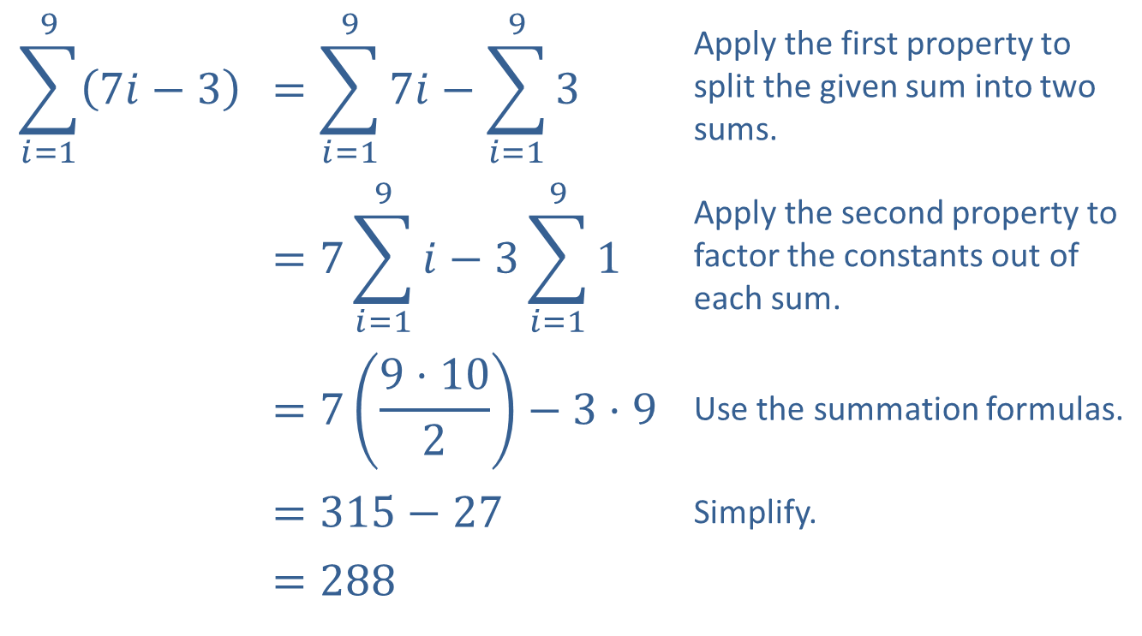
Example 5: Evaluating Sums₂
Solution
​
$$\sum_{i=1}^{9}{\left(7i−3\right)}$$ | $$=\sum_{i=1}^{9}{7i}−\sum_{i=1}^{9}{3}$$ | Apply the first property to split the given sum into two sums.
 | $$=7\sum_{i=1}^{9}{i}−3\sum_{i=1}^{9}{1}$$ | Apply the second property to factor the constants out of each sum.
 | $$=7\left(\frac{9⋅10}{2}\right)−3⋅9$$ | Use the summation formulas.
 | ​$=315−27$ | Simplify.
 | ​$=288$

Slide 28
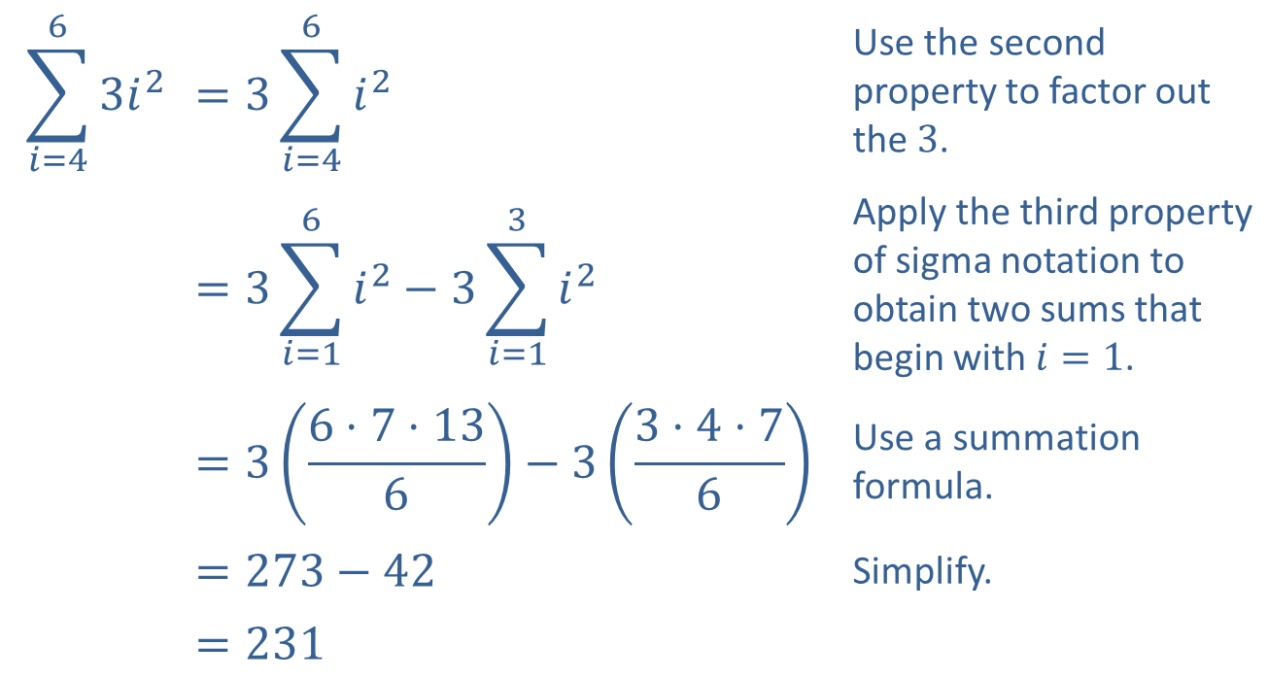
Example 5: Evaluating Sums₄
$$\sum_{i=4}^{6}{3i^{2}}$$ | $$=3\sum_{i=4}^{6}{i^{2}}$$ | Use the second property to factor out the 3.
 | $$=3\sum_{i=1}^{6}{i^{2}}−3\sum_{i=1}^{3}{i^{2}}$$ | Apply the third property of sigma notation to obtain two sums that begin with $i=1$.
 | $$=3\left(\frac{6⋅7⋅13}{6}\right)−3\left(\frac{3⋅4⋅7}{6}\right)$$ | Use a summation formula.
 | $$=273−42$$ | Simplify.
 | $$=231$$
​

Slide 29
Definition: Partial Sums and Series
the n^{th} partial sum is
Given an infinite sequence
S_{n} is an example of a finite series.
The infinite series associated with
is the sum
Note that the adjective infinite refers to the infinite number of terms that appear in the sum and does not imply that the sum itself is infinite.

Slide 30
Example 6: Evaluating Partial Sums and Series₁
Examine the partial sums associated with each infinite series to determine if the series converges or diverges.

Slide 31
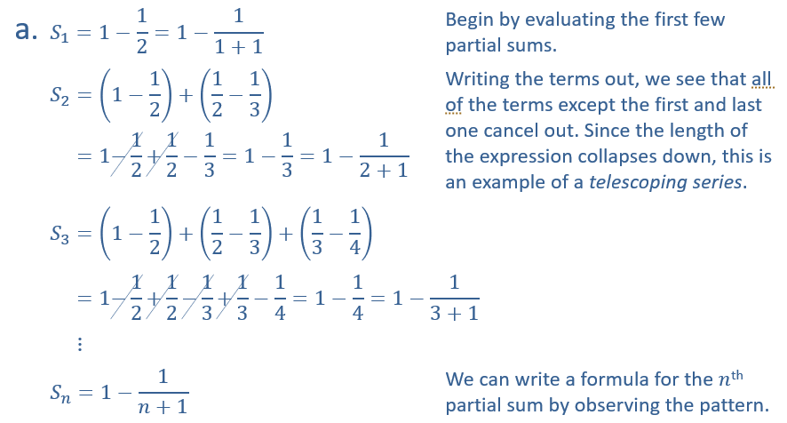
Example 6: Evaluating Partial Sums and Series₂
Solution
​

Slide 32
Example 6: Evaluating Partial Sums and Series₃
​The partial sums approach 1 as n gets larger and larger, therefore the series converges. In fact,

Slide 33
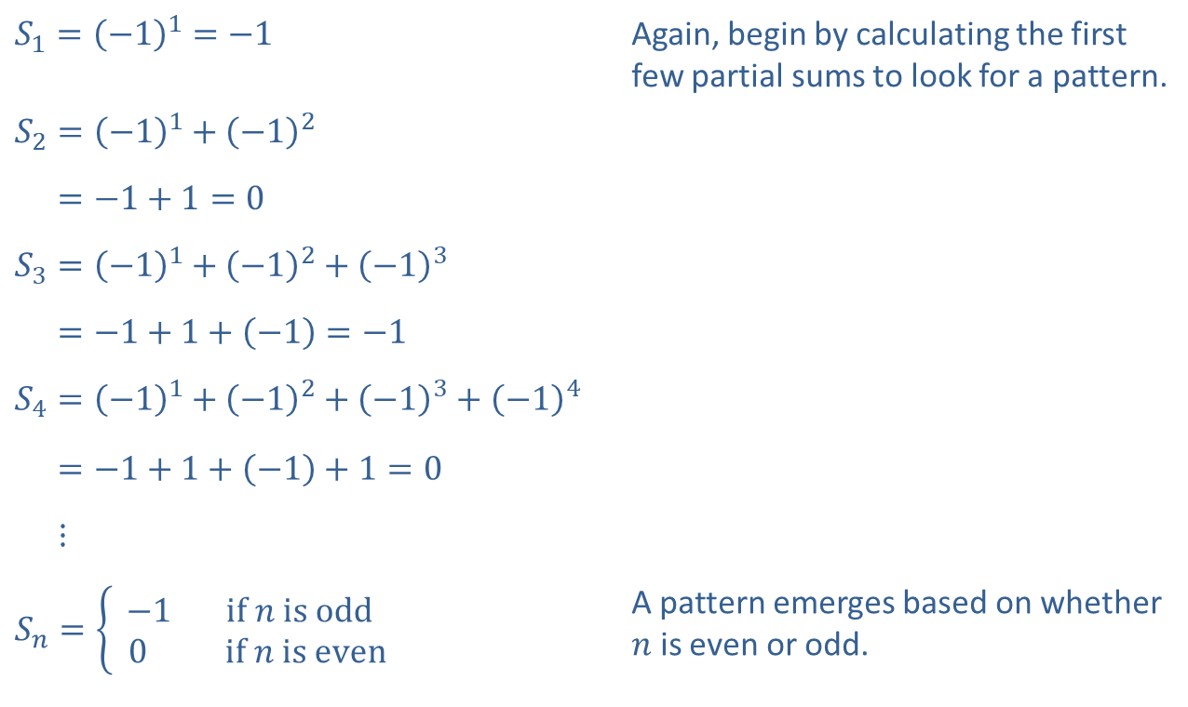
Example 6: Evaluating Partial Sums and Series₄
​
​$S_{1}={\left(−1\right)}^{1}=−1$ | Again, begin by calculating the first few partial sums to look for a pattern.
​$S_{2}={\left(−1\right)}^{1}+{\left(−1\right)}^{2}$
​𝑆2=−1+1=0
​$S_{3}={\left(−1\right)}^{1}+{\left(−1\right)}^{2}+{\left(−1\right)}^{3}$
​𝑆3=−1+1+−1=−1
​$S_{4}={\left(−1\right)}^{1}+{\left(−1\right)}^{2}+{\left(−1\right)}^{3}+{\left(−1\right)}^{4}$
​𝑆4=−1+1+−1+1=0
​𝑆4⋮
​$S_{n}=\left\{\begin{aligned}−1 if n is odd \\ 0 if n is even\end{aligned}\right.$ | A pattern emerges based on whether $n$ is even or odd.

Slide 34
Example 6: Evaluating Partial Sums and Series₅
​The partial sums of this series oscillate between −1 and 0 and do not approach a fixed number as n gets large. Therefore, this series diverges.

