Slide 1
Section 1.7
Rational Expressions

Slide 2
Definition: Rational Expressions
A rational expression is an expression that can be
written as a ratio of two polynomials
Such a fraction
is undefined for any value(s) of the variable(s) for which Q = 0. A given rational expression is simplified or reduced when P and Q contain no common factors (other than 1 and −1).

Slide 3
Example 1: Simplifying Rational Expressions₁
Simplify the following rational expressions, and indicate values of the variable that must be excluded.

Slide 4

Example 1: Simplifying Rational Expressions₂
Solution
​$\frac{x^{3}−8}{x^{2}−2x}$ | ​$=\frac{\left(x−2\right)\left(x^{2}+2x+4\right)}{x\left(x−2\right)}$ | After factoring both polynomials, we cancel the common factor of $x−2$.
 | ​$=\frac{x^{2}+2x+4}{x}\text{,} x≠0, 2$ | Note that even though the final expression is defined when $x=2$, the first and last expressions are equal only where both are defined.

Slide 5
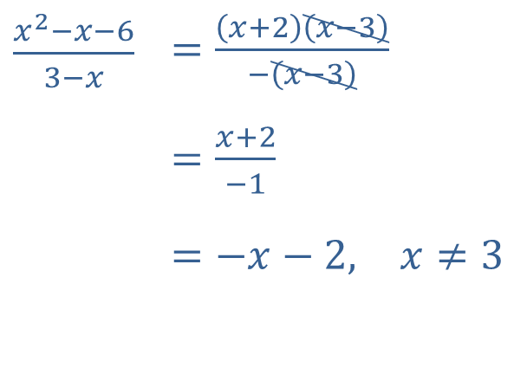

Example 1: Simplifying Rational Expressions₃
​$\frac{x^{2}−x−6}{3−x}$ | ​$=\frac{\left(x+2\right)\left(x−3\right)}{−\left(x−3\right)}$
 | ​$=\frac{x+2}{−1}$
 | ​$=−x−2\text{,} x≠3$
​
The denominator is already factored, but we bring out a factor of $−1$ from the denominator in order to cancel a common factor of x $−3$. Note that the original and simplified versions are only equal for values of $x$ not equal to 3.

Slide 6
CAUTION!
Remember that only common factors can be canceled! A very common error is to think that common terms from the numerator and denominator can be canceled.
For instance, the statement
is incorrect. The
expression x + 4 is completely factored, so the x that appears in the numerator is not a factor that can be canceled with one of the x’s in the denominator. The
expression
is already simplified as far as possible.

Slide 7
Example 2: Combining Rational Expressions₁
Add or subtract the rational expressions, as indicated.

Slide 8
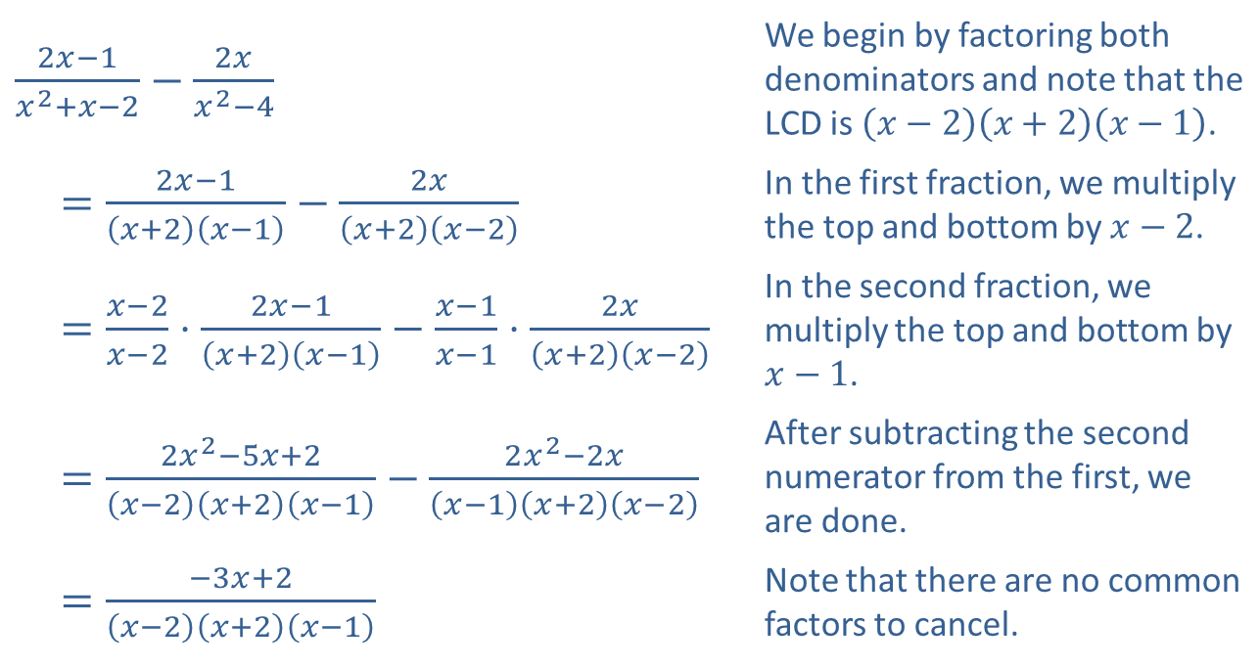
Example 2: Combining Rational Expressions₂
Solution
​
​$\frac{2x−1}{x^{2}+x−2}−\frac{2x}{x^{2}−4}$ | We begin by factoring both denominators and note that the LCD is $\left(x−2\right)\left(x+2\right)\left(x−1\right)$.
​$=\frac{2x−1}{\left(x+2\right)\left(x−1\right)}−\frac{2x}{\left(x+2\right)\left(x−2\right)}$ | In the first fraction, we multiply the top and bottom by $x−2$.
​$=\frac{x−2}{x−2}⋅\frac{2x−1}{\left(x+2\right)\left(x−1\right)}−\frac{x−1}{x−1}⋅\frac{2x}{\left(x+2\right)\left(x−2\right)}$ | In the second fraction, we multiply the top and bottom by $x−1$.
​$=\frac{2x^{2}−5x+2}{\left(x−2\right)\left(x+2\right)\left(x−1\right)}−\frac{2x^{2}−2x}{\left(x−1\right)\left(x+2\right)\left(x−2\right)}$ | After subtracting the second numerator from the first, we are done.
​$=\frac{−3x+2}{\left(x−2\right)\left(x+2\right)\left(x−1\right)}$ | Note that there are no common factors to cancel.

Slide 9
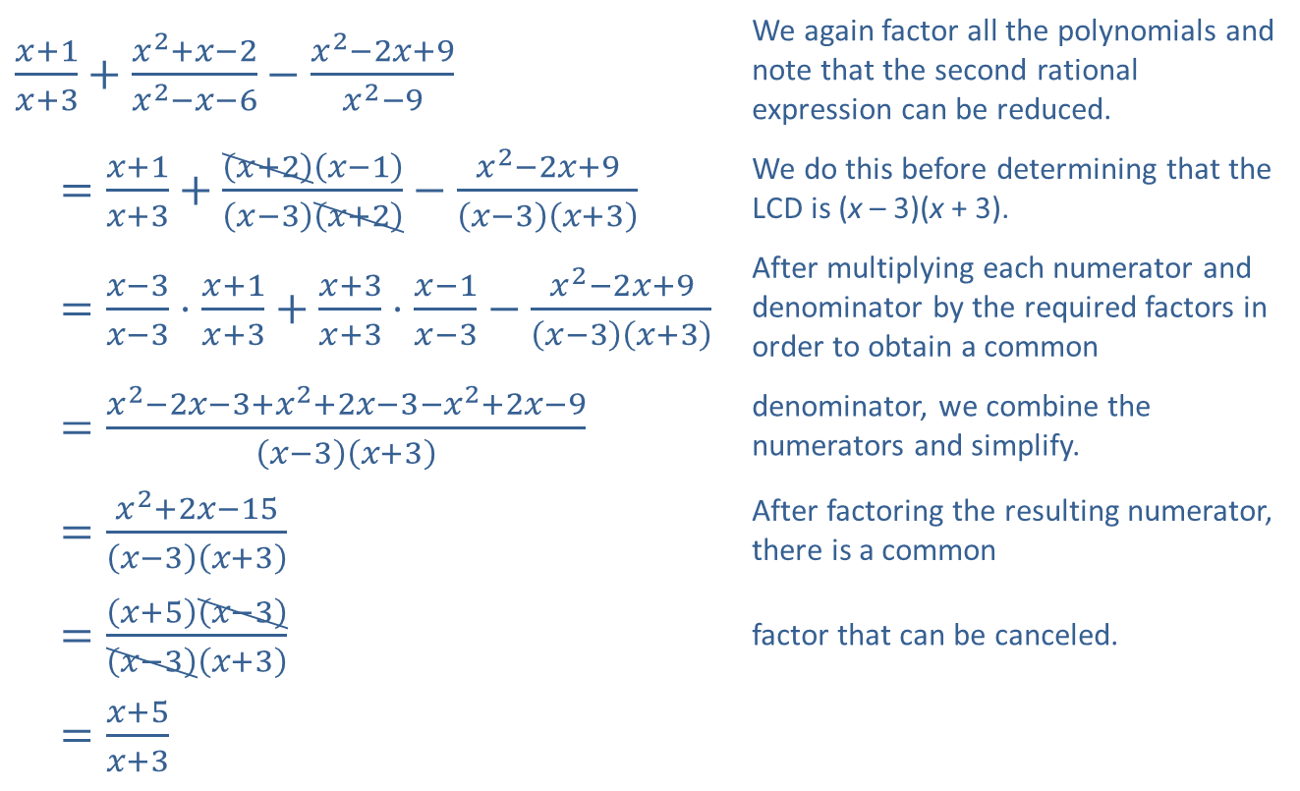
Example 2: Combining Rational Expressions₃
​$\frac{x+1}{x+3}+\frac{x^{2}+x−2}{x^{2}−x−6}−\frac{x^{2}−2x+9}{x^{2}−9}$ | We again factor all the polynomials and note that the second rational expression can be reduced.
​$=\frac{x+1}{x+3}+\frac{\left(x+2\right)\left(x−1\right)}{\left(x−3\right)\left(x+2\right)}−\frac{x^{2}−2x+9}{\left(x−3\right)\left(x+3\right)}$ | We do this before determining that the LCD is (x – 3)(x + 3).
​$=\frac{x−3}{x−3}⋅\frac{x+1}{x+3}+\frac{x+3}{x+3}⋅\frac{x−1}{x−3}−\frac{x^{2}−2x+9}{\left(x−3\right)\left(x+3\right)}$ | After multiplying each numerator and denominator by the required factors in order to obtain a common
​$=\frac{x^{2}−2x−3+x^{2}+2x−3−x^{2}+2x−9}{\left(x−3\right)\left(x+3\right)}$ | denominator, we combine the numerators and simplify.
​$=\frac{x^{2}+2x−15}{\left(x−3\right)\left(x+3\right)}$ | After factoring the resulting numerator, there is a common
​$=\frac{\left(x+5\right)\left(x−3\right)}{\left(x−3\right)\left(x+3\right)}$ | factor that can be canceled.
​$=\frac{x+5}{x+3}$
​

Slide 10
Example 3: Combining Rational Expressions₁
Multiply or divide the rational expressions, as indicated.

Slide 11
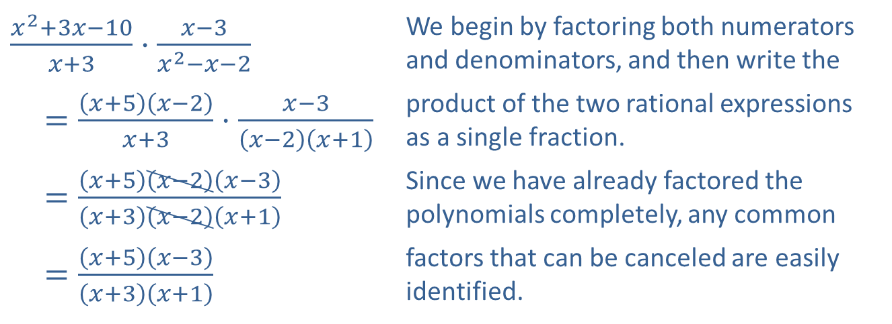
Example 3: Combining Rational Expressions₂
Solution
​
​$\frac{x^{2}+3x−10}{x+3}⋅\frac{x−3}{x^{2}−x−2}$ | We begin by factoring both numerators and denominators, and then write the
​$=\frac{\left(x+5\right)\left(x−2\right)}{x+3}⋅\frac{x−3}{\left(x−2\right)\left(x+1\right)}$ | product of the two rational expressions as a single fraction.
​$=\frac{\left(x+5\right)\left(x−2\right)\left(x−3\right)}{\left(x+3\right)\left(x−2\right)\left(x+1\right)}$ | Since we have already factored the polynomials completely, any common
​$=\frac{\left(x+5\right)\left(x−3\right)}{\left(x+3\right)\left(x+1\right)}$ | factors that can be canceled are easily identified.

Slide 12
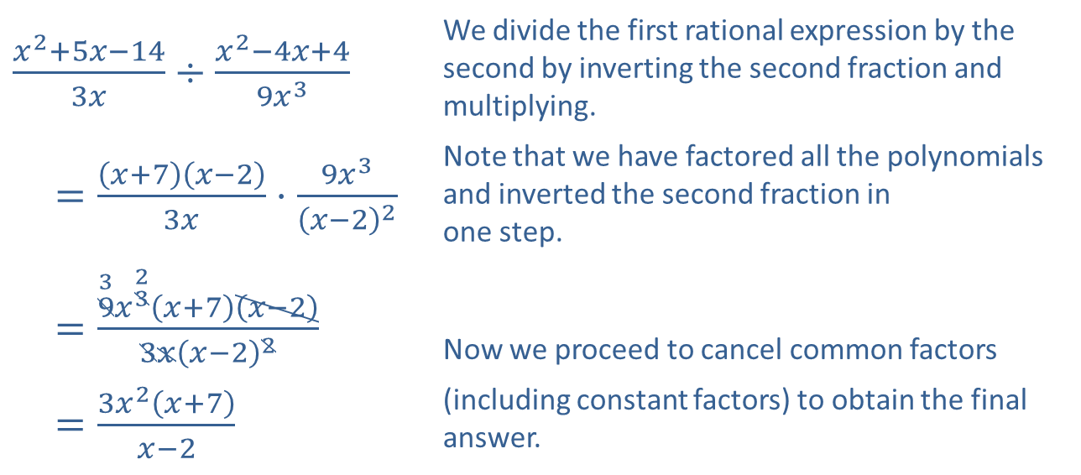
Example 3: Combining Rational Expressions₃
​$\frac{x^{2}+5x−14}{3x}÷\frac{x^{2}−4x+4}{9x^{3}}$ | We divide the first rational expression by the second by inverting the second fraction and multiplying.
​$=\frac{\left(x+7\right)\left(x−2\right)}{3x}⋅\frac{9x^{3}}{{\left(x−2\right)}^{2}}$ | Note that we have factored all the polynomials and inverted the second fraction in one step.
​$=\frac{\overset{3}{9}x^{\overset{2}{3}}\left(x+7\right)\left(x−2\right)}{3x{\left(x−2\right)}^{2}}$ | Now we proceed to cancel common factors
​$=\frac{3x^{2}\left(x+7\right)}{x−2}$ | (including constant factors) to obtain the final answer.
​

Slide 13
Example 4: Simplifying Complex Rational Expressions₁
Simplify the complex rational expressions.

Slide 14
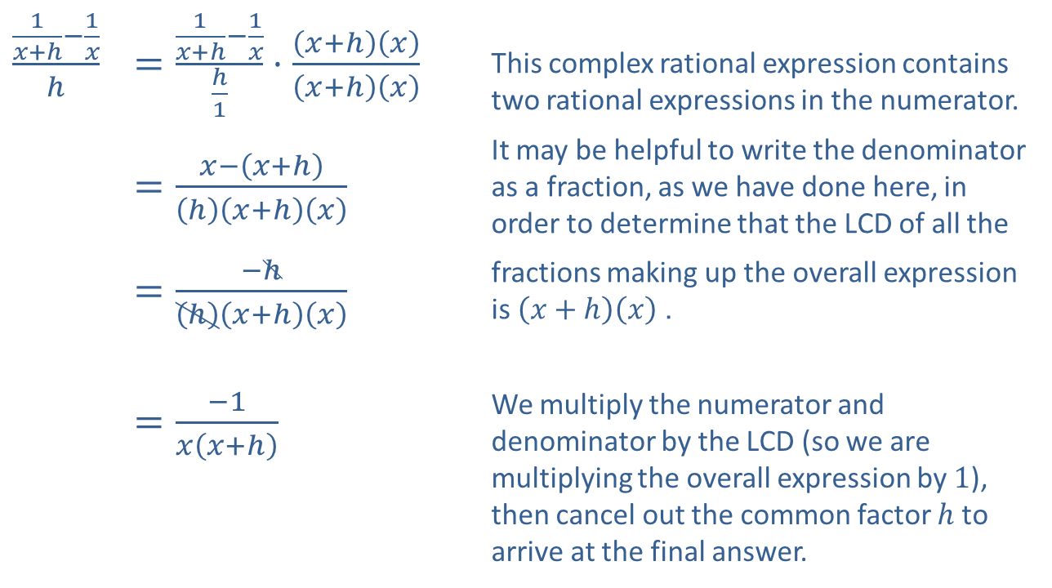
Example 4: Simplifying Complex Rational Expressions₂
Solution
​
​$\frac{\frac{1}{x+h}−\frac{1}{x}}{h}$ | ​$=\frac{\frac{1}{x+h}−\frac{1}{x}}{\frac{h}{1}}⋅\frac{\left(x+h\right)\left(x\right)}{\left(x+h\right)\left(x\right)}$ | This complex rational expression contains two rational expressions in the numerator.
 | ​$=\frac{x−\left(x+h\right)}{\left(h\right)\left(x+h\right)\left(x\right)}$ | It may be helpful to write the denominator as a fraction, as we have done here, in order to determine that the LCD of all the
 | ​$=\frac{−h}{\left(h\right)\left(x+h\right)\left(x\right)}$ | fractions making up the overall expression is $\left(x+h\right)\left(x\right)$.
 | ​$=\frac{−1}{x\left(x+h\right)}$ | We multiply the numerator and denominator by the LCD (so we are multiplying the overall expression by 1), then cancel out the common factor $h$ to arrive at the final answer.

Slide 15
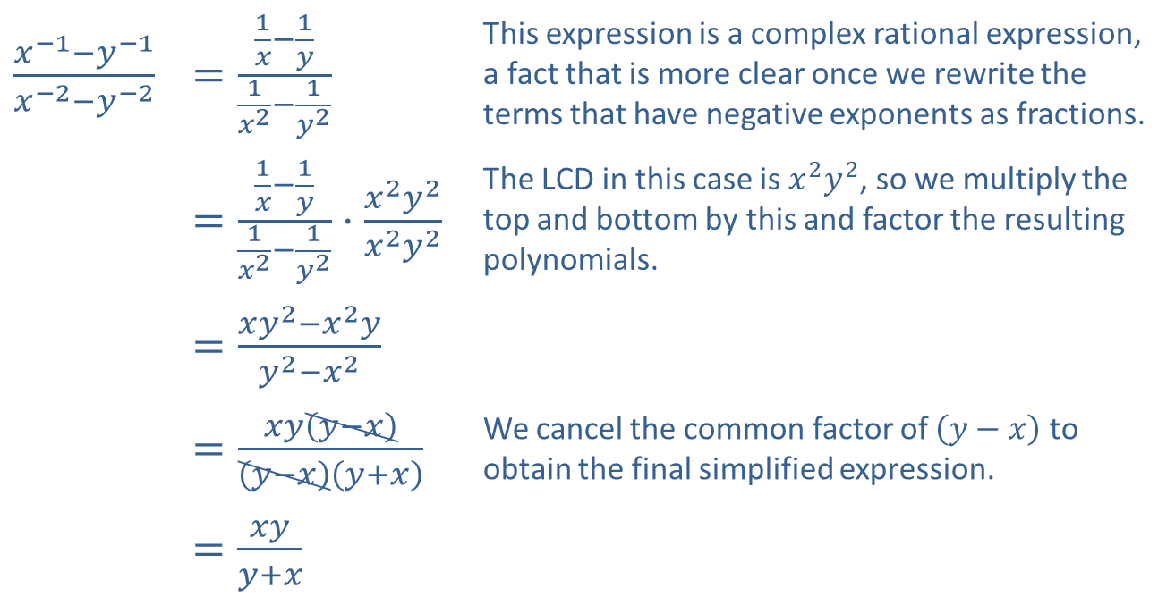
Example 4: Simplifying Complex Rational Expressions₃
​$\frac{x^{−1}−y^{−1}}{x^{−2}−y^{−2}}$ | ​$=\frac{\frac{1}{x}−\frac{1}{y}}{\frac{1}{x^{2}}−\frac{1}{y^{2}}}$ | This expression is a complex rational expression, a fact that is more clear once we rewrite the terms that have negative exponents as fractions.
 | ​$=\frac{\frac{1}{x}−\frac{1}{y}}{\frac{1}{x^{2}}−\frac{1}{y^{2}}}⋅\frac{x^{2}y^{2}}{x^{2}y^{2}}$ | The LCD in this case is $x^{2}y^{2}$, so we multiply the top and bottom by this and factor the resulting polynomials.
 | ​$=\frac{xy^{2}−x^{2}y}{y^{2}−x^{2}}$
 | ​$=\frac{xy\left(y−x\right)}{\left(y−x\right)\left(y+x\right)}$ | We cancel the common factor of $\left(y−x\right)$ to obtain the final simplified expression.
 | ​$=\frac{xy}{y+x}$
​

