Slide 1
Section 1.6
Factoring Polynomials

Slide 2
Example 1: Factoring Out the Greatest Common Factor₁
Factor each polynomial by factoring out the greatest common factor.

Slide 3
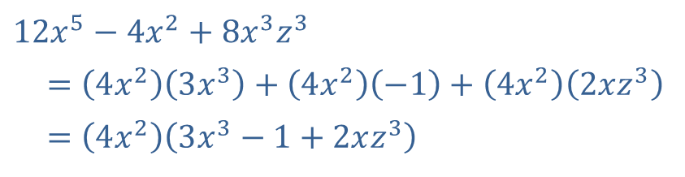
Example 1: Factoring Out the Greatest Common Factor₂
Solution
​
​$12x^{5}−4x^{2}+8x^{3}z^{3}$
​ $=\left(4x^{2}\right)\left(3x^{3}\right)+\left(4x^{2}\right)\left(−1\right)+\left(4x^{2}\right)\left(2xz^{3}\right)$
​ $=\left(4x^{2}\right)\left(3x^{3}−1+2xz^{3}\right)$
The greatest common factor is 4x ². Applying the distributive property in reverse leads to the factored form of this degree 6 trinomial.

Slide 4
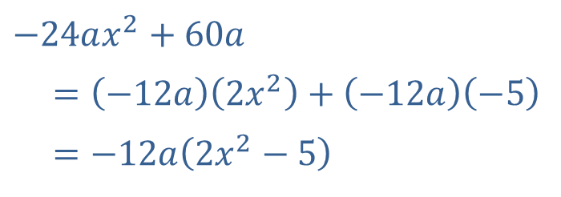
Example 1: Factoring Out the Greatest Common Factor₃
​
​$−24ax^{2}+60a$
​ $=\left(−12a\right)\left(2x^{2}\right)+\left(−12a\right)\left(−5\right)$
​ $=−12a\left(2x^{2}−5\right)$
An alternative form of the final
would have obtained this answer if we had factored out 12a initially. These two answers are equivalent.

Slide 5
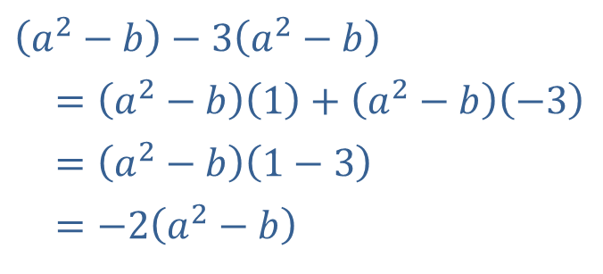
Example 1: Factoring Out the Greatest Common Factor₄
​
​$\left(a^{2}−b\right)−3\left(a^{2}−b\right)$
​ $=\left(a^{2}−b\right)\left(1\right)+\left(a^{2}−b\right)\left(−3\right)$
​ $=\left(a^{2}−b\right)\left(1−3\right)$
​ $=−2\left(a^{2}−b\right)$
In factoring out the greatest common factor a² − b, remember that it is being multiplied first by 1 and then by −3. One common source of error in factoring is to forget factors of 1.

Slide 6
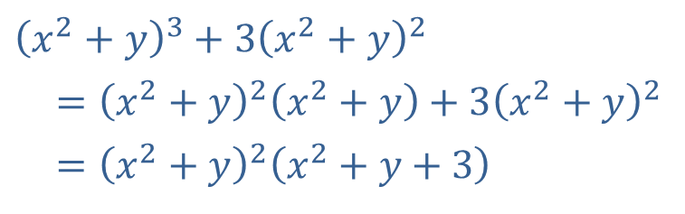
Example 1: Factoring Out the Greatest Common Factor₅
​
​${\left(x^{2}+y\right)}^{3}+{3\left(x^{2}+y\right)}^{2}$
​ $={\left(x^{2}+y\right)}^{2}\left(x^{2}+y\right)+3{\left(x^{2}+y\right)}^{2}$
​ $={\left(x^{2}+y\right)}^{2}\left(x^{2}+y+3\right)$
The greatest common

Slide 7
Example 2: Factoring by Grouping₁
Factor each polynomial by grouping.

Slide 8
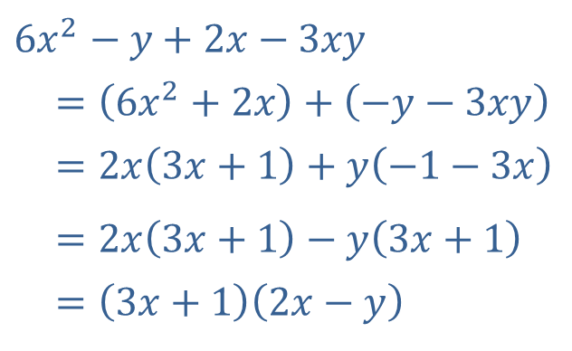
Example 2: Factoring by Grouping₂
Solution
​
​$6x^{2}−y+2x−3xy$
​$=\left(6x^{2}+2x\right)+\left(−y−3xy\right)$
​ $=2x\left(3x+1\right)+y\left(−1−3x\right)$
​ $=2x\left(3x+1\right)−y\left(3x+1\right)$
​ $=\left(3x+1\right)\left(2x−y\right)$
The GCF of the four terms in the polynomial is 1, so the Greatest Common Factor method doesn't directly apply. The first and third terms have a GCF of 2x, while the second and fourth have a GCF of y, so we group accordingly. After factoring the two groups, we notice that 3x + 1 and − 1−3x differ only by a minus sign (and the order). This means 3x + 1can be factored out.

Slide 9
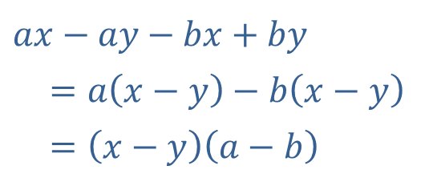
Example 2: Factoring by Grouping₃
​
​$ax−ay−bx+by$
​ $=a\left(x−y\right)−b\left(x−y\right)$
​ $=\left(x−y\right)\left(a−b\right)$
The first two terms have a common factor, as do the last two, so we proceed accordingly. In this problem, we could also have grouped the first and third terms, and the second and fourth terms, and obtained the same result.

Slide 10
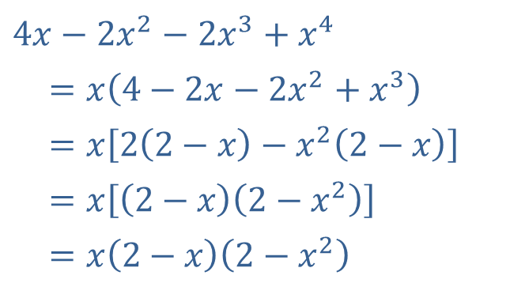
Example 2: Factoring by Grouping₄
​
​$4x−2x^{2}−2x^{3}+x^{4}$
​ $=x\left(4−2x−2x^{2}+x^{3}\right)$
​ $=x\left[2\left(2−x\right)−x^{2}\left(2−x\right)\right]$
​ $=x\left[\left(2−x\right)\left(2−x^{2}\right)\right]$
​ $=x\left(2−x\right)\left(2−x^{2}\right)$
We can begin by factoring out x from each of the four terms. The first two terms of the result then have a common factor of 2, and the second two terms have a common factor of −x ². This allows us to factor out (2 − x) from the two groups.

Slide 11
CAUTION!
One common error in factoring is to stop after groups within the original polynomial have been factored. For instance, while we have done some factoring to achieve the expression
in Example
2a, this is not in factored form. An expression is only factored if it is written as a product of two or more
factors. The expression
is a
sum of two smaller expressions.

Slide 12
Formula: Factoring Special Binomials
In the following equations, A and B represent algebraic expressions.
Difference of Two Squares:
Difference of Two Cubes:
Sum of Two Cubes:
Note that there is no similar pattern for factoring
A ² + B ².

Slide 13
Example 3: Factoring Special Binomials₁
Use the special factoring patterns to factor the following binomials.

Slide 14
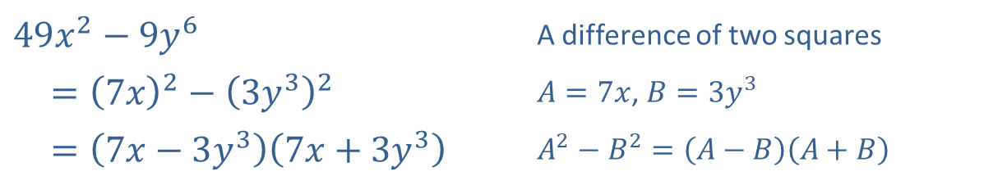
Example 3: Factoring Special Binomials₂
Solution
​
​$49x^{2}−9y^{6}$ | A difference of two squares
​$={\left(7x\right)}^{2}−{\left(3y^{3}\right)}^{2}$ | $A=7x$, $B=3y^{3}$
​ $=\left(7x−3y^{3}\right)\left(7x+3y^{3}\right)$ | $A^{2}−B^{2}=\left(A−B\right)\left(A+B\right)$

Slide 15
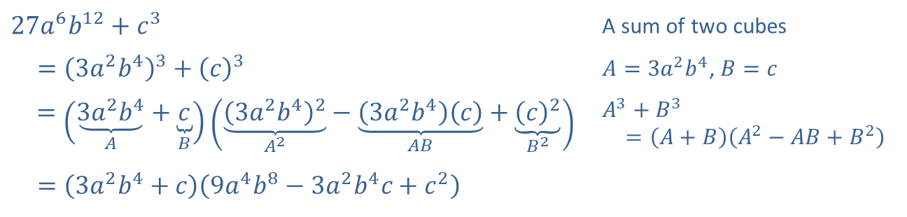
Example 3: Factoring Special Binomials₃
​
​$27a^{6}b^{12}+c^{3}$ | A sum of two cubes
​ $={\left(3a^{2}b^{4}\right)}^{3}+{\left(c\right)}^{3}$ | $A=3a^{2}b^{4}$, $B=c$
$=\left(\underset{A}{\underbrace{3a^{2}b^{4}}}+\underset{B}{\underbrace{c}}\right)\left(\underset{A^{2}}{\underbrace{{\left(3a^{2}b^{4}\right)}^{2}}}−\underset{AB}{\underbrace{\left(3a^{2}b^{4}\right)\left(c\right)}}+\underset{B^{2}}{\underbrace{{\left(c\right)}^{2}}}\right)$ | $A^{3}+B^{3}$ $=\left(A+B\right)\left(A^{2}−AB+B^{2}\right)$
​ $=\left(3a^{2}b^{4}+c\right)\left(9a^{4}b^{8}−3a^{2}b^{4}c+c^{2}\right)$

Slide 16
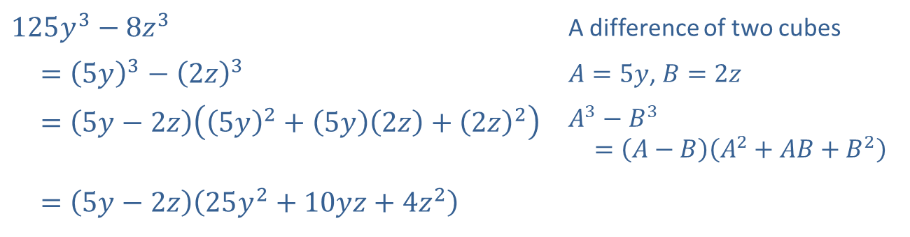
Example 3: Factoring Special Binomials₄
​
​$125y^{3}−8z^{3}$ | A difference of two cubes
​ $={\left(5y\right)}^{3}−{\left(2z\right)}^{3}$ | $A=5y$, $B=2z$
​ $=\left(5y−2z\right)\left({\left(5y\right)}^{2}+\left(5y\right)\left(2z\right)+{\left(2z\right)}^{2}\right)$ | $A^{3}−B^{3}$ $=\left(A−B\right)\left(A^{2}+AB+B^{2}\right)$
​ $=\left(5y−2z\right)\left(25y^{2}+10yz+4z^{2}\right)$

Slide 17
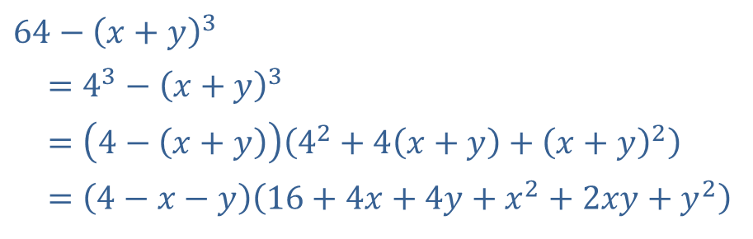
Example 3: Factoring Special Binomials₅
​
​$64−{\left(x+y\right)}^{3}$
​$=4^{3}−{\left(x+y\right)}^{3}$
​ $=\left(4−\left(x+y\right)\right)\left(4^{2}+4\left(x+y\right)+{\left(x+y\right)}^{2}\right)$
​ $=\left(4−x−y\right)\left(16+4x+4y+x^{2}+2xy+y^{2}\right)$
In this difference of two cubes, the second cube is itself a binomial. But the factoring pattern still applies, leading to the final factored form of the original binomial.

Slide 18
Example 4: Factoring a Trinomial₁
To factor x ² + x −12 we can begin by writing
and then try to find
two integers to replace the question marks. The two integers we seek must have a product of −12, and the fact that the product is negative means that one integer must be positive and one negative. The only possibilities are {1, −12}, {− 1, 12}, {2, −6}, {− 2, 6},
{3, −4} and {− 3, 4}, and when we add the requirement that the sum must be 1, we are left with
{− 3, 4}, Thus

Slide 19
Procedure: Factoring a Trinomial by Grouping
To factor the trinomial a x ² + b x + c, perform the following steps.
Step 1: Multiply a and c.
Step 2: Factor ac into two integers whose sum is b. If no such factors exist, the trinomial is irreducible over the integers.
Step 3: Rewrite b in the trinomial with the sum found in Step 2, and distribute. The resulting polynomial of four terms may now be factored by grouping.

Slide 20
Example 5: Factoring a Trinomial by Grouping₁
To factor the trinomial 6x ² − x −12 by trial and error, we would begin by noting that if it can be factored, the factors must be of the form
or
If we use the grouping method,
factor − 72 into two integers whose sum is − 1. The two numbers − 9 and 8 work, so we write
Now proceed by grouping.

Slide 21
Formula: Perfect Square Trinomials
In the following equations, A and B represent algebraic expressions.

Slide 22
Example 6: Perfect Square Trinomials₁
Factor the algebraic expression x ² + 10x + 25.

Slide 23
Example 6: Perfect Square Trinomials₂
Solution
The expression appears to be in the form of a perfect square trinomial, but we need to check that the value of the middle term follows the above pattern. Taking
A = x and B = 5, we see that 2AB = 10x, so the expression does match the form of a perfect square trinomial.
Thus, the factored form of
and x ² + 10x + 25 is a perfect square trinomial.

Slide 24
Example 7: Factoring Expressions with Noninteger Rational Exponents₁
Factor each of the following algebraic expressions.

Slide 25
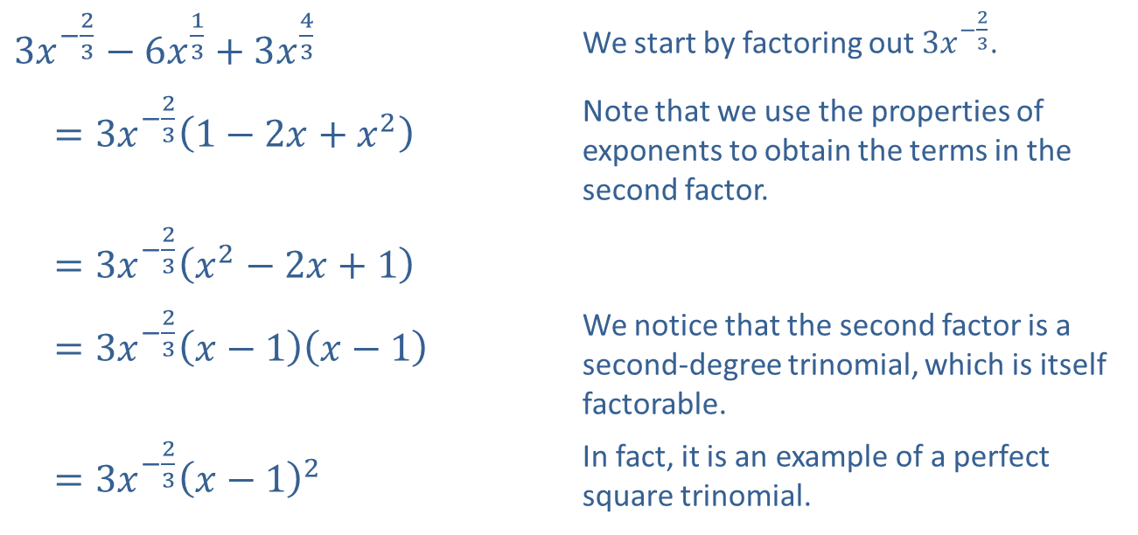
Example 7: Factoring Expressions with Noninteger Rational Exponents₂
Solution
​
​$3x^{−\frac{2}{3}}−6x^{\frac{1}{3}}+3x^{\frac{4}{3}}$ | We start by factoring out $3x^{−\frac{2}{3}}$.
​ $=3x^{−\frac{2}{3}}\left(1−2x+x^{2}\right)$ | Note that we use the properties of exponents to obtain the terms in the second factor.
​ $=3x^{−\frac{2}{3}}\left(x^{2}−2x+1\right)$
​ $=3x^{−\frac{2}{3}}\left(x−1\right)\left(x−1\right)$ | We notice that the second factor is a second-degree trinomial, which is itself factorable.
​ $=3x^{−\frac{2}{3}}{\left(x−1\right)}^{2}$ | In fact, it is an example of a perfect square trinomial.

Slide 26
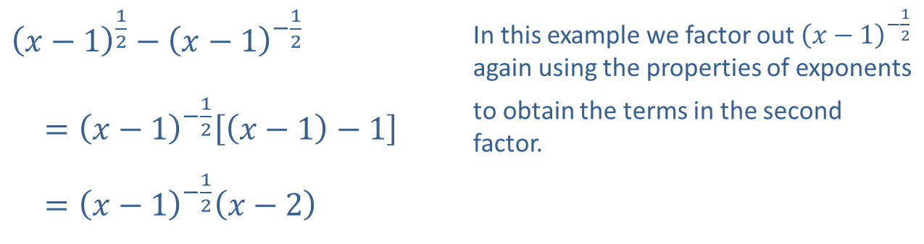
Example 7: Factoring Expressions with Noninteger Rational Exponents₃
​${\left(x−1\right)}^{\frac{1}{2}}−{\left(x−1\right)}^{−\frac{1}{2}}$ | In this example we factor out ${\left(x−1\right)}^{−\frac{1}{2}}$ again using the properties of exponents
​ $={\left(x−1\right)}^{−\frac{1}{2}}\left[\left(x−1\right)−1\right]$ | to obtain the terms in the second factor.
​ $={\left(x−1\right)}^{−\frac{1}{2}}\left(x−2\right)$
​

