Slide 1
Section 1.3
Properties of Exponents

Slide 2
Definition: Natural Number Exponents
If a is any real number and if n is any natural number, then
That is,
is merely a shorter, and more precise, way of
denoting the product of n factors of a. In the expression
a is called the base, and n is the exponent. The
process of multiplying n factors of a is called "raising a to the n^{th} power," and the expression
may be referred to as "the n^{th} power of a" or "a to the n^{th} power." Note that

Slide 3
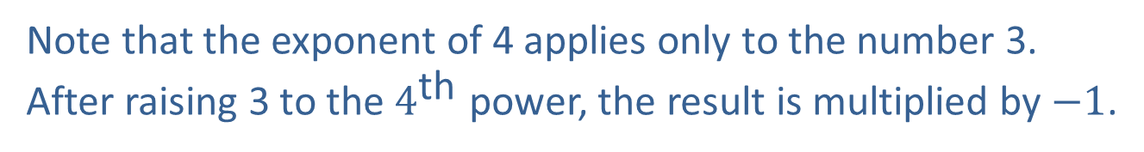
Example 1: Using Natural Number Exponents₁
Thus, “four cubed is sixty-four.”
Thus, “negative three squared is nine.”
Note that the exponent of 4 applies only to the number 3. After raising 3 to the $4^{\text{th}}$ power, the result is multiplied by $−1$.

Slide 4
Example 1: Using Natural Number Exponents₂
Even though x is a variable, preventing us from writing the expression as simply a number, we can use the definition of natural number exponents to write the product in a simpler way.
  We can cancel four factors of 7 from the numerator and denominator of the original fraction, leaving us with 7², or 49.

Slide 5
Definition: 0 as an Exponent
For any real number a ≠ 0, we define
The expression
is undefined, just as division by 0 is
undefined.

Slide 6
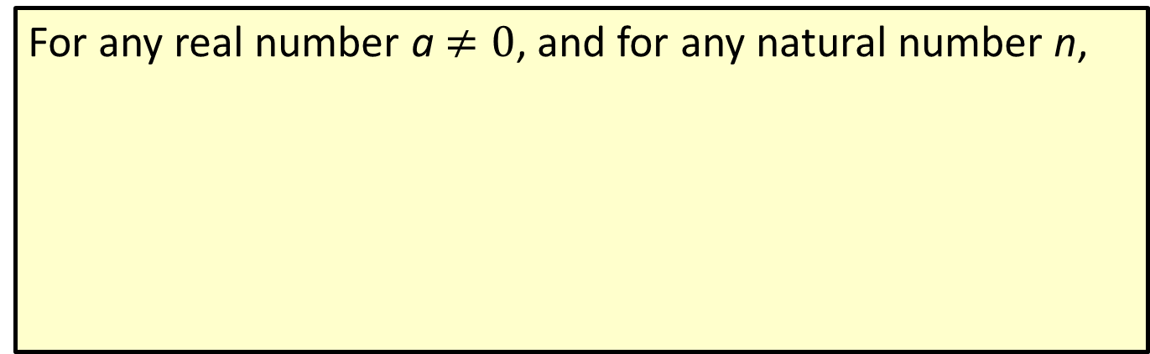
Definition: Negative Integer Exponents
For any real number a$≠0$, and for any natural number n,
(We don't allow a to be 0 simply to avoid the
possibility of division by 0.) Since any negative integer is the negative of a natural number, this defines exponentiation by negative integers.

Slide 7
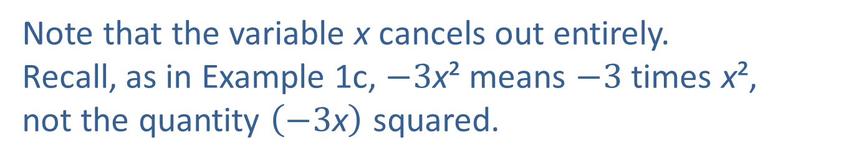
Example 2: Simplifying Exponents₁
Note that the variable x cancels out entirely.
Recall, as in Example 1c, $−3\text{x}\text{²}$ means $−3$ times x²,
not the quantity $\left(−3\text{x}\right)$ squared.

Slide 8
Example 2: Simplifying Exponents₂

Slide 9
Properties: Properties of Exponents₁
In the following properties, a and b may be taken to represent constants, variables, or more complicated algebraic expressions. The letters n and m represent integers.

Slide 10
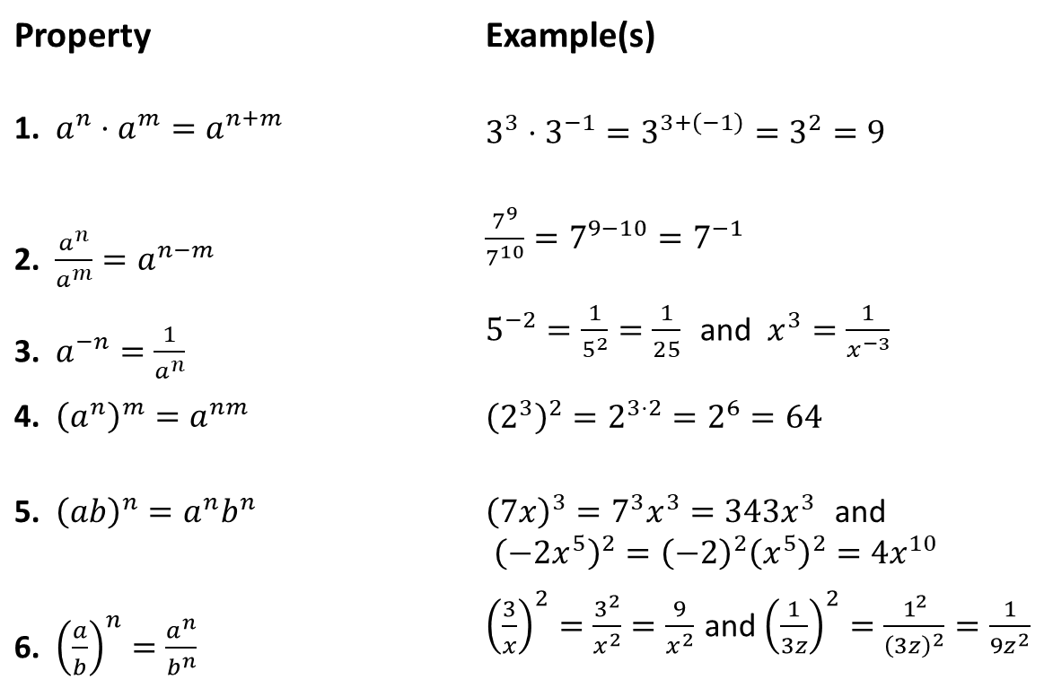
Properties: Properties of Exponents₂
Property | Example(s)
1. ​$a^{n}⋅a^{m}=a^{n+m}$ | ​$3^{3}⋅3^{−1}=3^{3+\left(−1\right)}=3^{2}=9$
2. ​$\frac{a^{n}}{a^{m}}=a^{n−m}$ | ​$\frac{7^{9}}{7^{10}}=7^{9−10}=7^{−1}$
3. ​$a^{−n}=\frac{1}{a^{n}}$ | ​$5^{−2}=\frac{1}{5^{2}}=\frac{1}{25}$ and $x^{3}=\frac{1}{x^{−3}}$
4. ​${\left(a^{n}\right)}^{m}=a^{nm}$ | ​${\left(2^{3}\right)}^{2}=2^{3⋅2}=2^{6}=64$
5. ​${\left(ab\right)}^{n}=a^{n}b^{n}$ | ​${\left(7x\right)}^{3}=7^{3}x^{3}=343x^{3}$ and ${\left(−2x^{5}\right)}^{2}={\left(−2\right)}^{2}{\left(x^{5}\right)}^{2}=4x^{10}$
6. ​${\left(\frac{a}{b}\right)}^{n}=\frac{a^{n}}{b^{n}}$ | ​${\left(\frac{3}{x}\right)}^{2}=\frac{3^{2}}{x^{2}}=\frac{9}{x^{2}}$ and ${\left(\frac{1}{3z}\right)}^{2}=\frac{1^{2}}{{\left(3z\right)}^{2}}=\frac{1}{9z^{2}}$

Slide 11
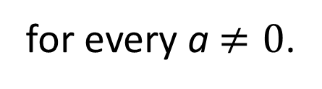
Properties: Properties of Exponents₃
Here and throughout this lesson, assume that every expression is defined. That is, if an exponent is 0, then the base is nonzero, and if an expression appears in the denominator of a fraction, then that expression is nonzero. Remember that
for every a$≠0$.

Slide 12
Example 3: Using Properties of Exponents₁
Simplify the following expressions by using the properties of exponents. Write the final answers with only positive exponents.

Slide 13
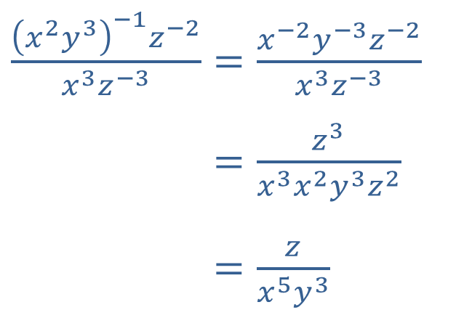
Example 3: Using Properties of Exponents₂
Solution
​
Any nonzero expression with an exponent of 0 is 1.
b.
​$\frac{{\left(x^{2}y^{3}\right)}^{−1}z^{−2}}{x^{3}z^{−3}}=\frac{x^{−2}y^{−3}z^{−2}}{x^{3}z^{−3}}$
​𝑥2𝑦3−1𝑧−2𝑥3𝑧−3=𝑧3𝑥3𝑥2𝑦3𝑧2
​𝑥2𝑦3−1𝑧−2𝑥3𝑧−3=𝑧𝑥5𝑦3
Note that we have used several properties in this example. We could have used the applicable properties in many different orders to achieve the same result. Also note that the final answer contains only positive exponents. If we had not been told to write the answer in this way, we could have written the result as

Slide 14
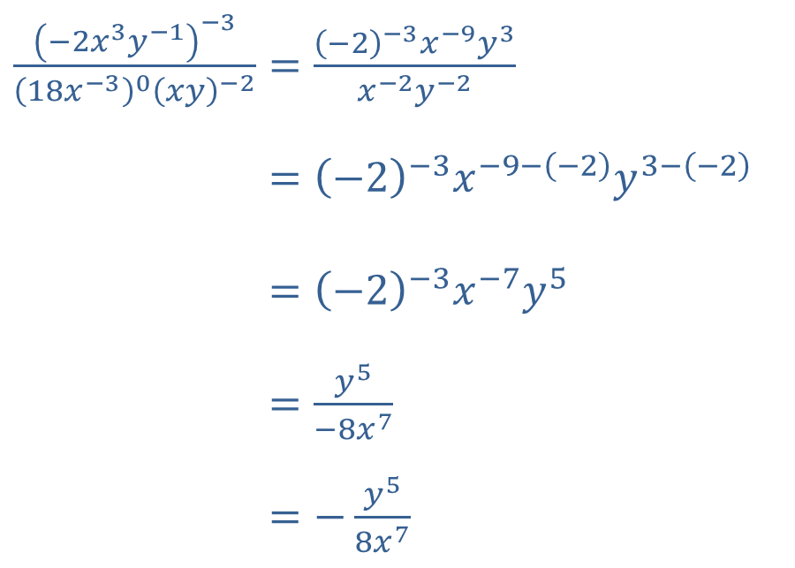
Example 3: Using Properties of Exponents₃
​$\frac{{\left(−2x^{3}y^{−1}\right)}^{−3}}{{\left(18x^{−3}\right)}^{0}{\left(xy\right)}^{−2}}=\frac{{\left(−2\right)}^{−3}x^{−9}y^{3}}{x^{−2}y^{−2}}$
​−2𝑥3𝑦−1−318𝑥−30𝑥𝑦−2=−2−3𝑥−9−−2𝑦3−−2
​−2𝑥3𝑦−1−318𝑥−30𝑥𝑦−2=−2−3𝑥−7𝑦5
​−2𝑥3𝑦−1−318𝑥−30𝑥𝑦−2=𝑦5−8𝑥7
​−2𝑥3𝑦−1−318𝑥−30𝑥𝑦−2=−𝑦58𝑥7
c. ​
We have chosen to apply the appropriate properties in a slightly different order than in the previous example, just to illustrate an alternative way to go about the task of simplifying such an expression.

Slide 15
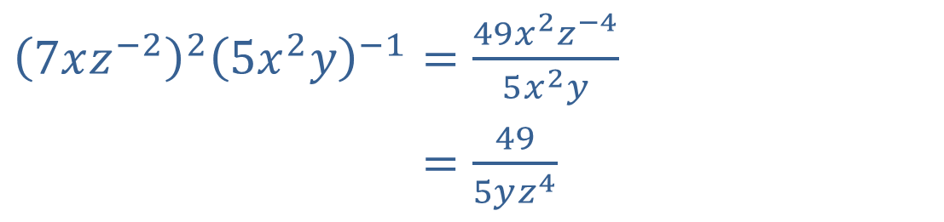
Example 3: Using Properties of Exponents₄
​${\left(7xz^{−2}\right)}^{2}{\left(5x^{2}y\right)}^{−1}=\frac{49x^{2}z^{−4}}{5x^{2}y}$
​7𝑥𝑧−225𝑥2𝑦−1=495𝑦𝑧4
d.
​
Note that the variable x disappeared entirely from the expression. If we had simplified the expression in a slightly different order, we would have obtained a factor of
  which is 1.

Slide 16
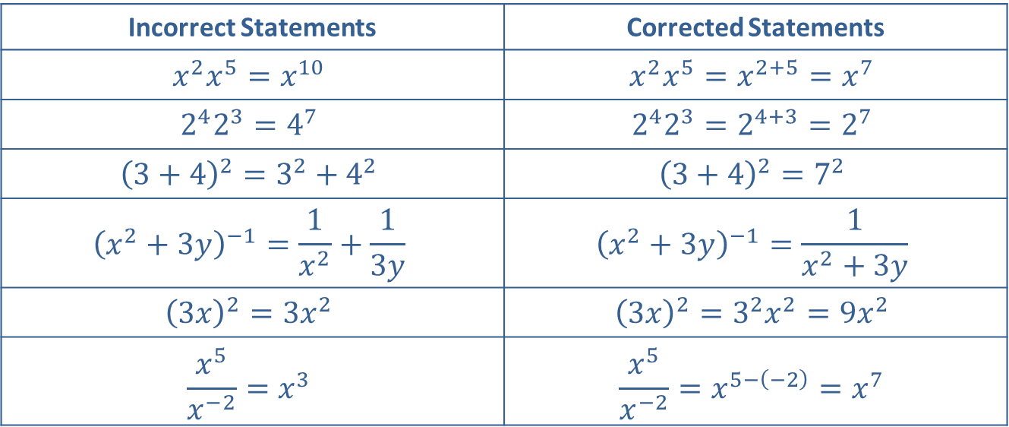
CAUTION!₁
Many common errors result from forgetting the exact forms of the properties of exponents, as shown below.
Incorrect Statements | Corrected Statements
$$x^{2}x^{5}=x^{10}$$ | $$x^{2}x^{5}=x^{2+5}=x^{7}$$
$$2^{4}2^{3}=4^{7}$$ | $$2^{4}2^{3}=2^{4+3}=2^{7}$$
$${\left(3+4\right)}^{2}=3^{2}+4^{2}$$ | $${\left(3+4\right)}^{2}=7^{2}$$
$${\left(x^{2}+3y\right)}^{−1}=\frac{1}{x^{2}}+\frac{1}{3y}$$ | $${\left(x^{2}+3y\right)}^{−1}=\frac{1}{x^{2}+3y}$$
$${\left(3x\right)}^{2}=3x^{2}$$ | $${\left(3x\right)}^{2}=3^{2}x^{2}=9x^{2}$$
$$\frac{x^{5}}{x^{−2}}=x^{3}$$ | $$\frac{x^{5}}{x^{−2}}=x^{5−\left(−2\right)}=x^{7}$$

Slide 17
Definition: Scientific Notation
A number is in scientific notation when it is written in the form
If n is a positive integer, the number is large in magnitude; if n is a negative integer, the number is small in magnitude (close to 0). The number a itself can be either positive or negative, and the sign of a determines the sign of the number as a whole.

Slide 18
CAUTION!₂
The sign of the exponent n in scientific notation does not determine the sign of the number as a whole. The sign of n only determines if the number is large (positive n) or small (negative n) in magnitude.

Slide 19
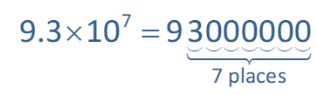
Example 4: Using Scientific Notation₁
​The distance from Earth to the sun is approximately 93,000,000 miles. Scientific notation takes advantage of the observation that multiplication of a number by 10 moves the decimal point one place to the right, and we can repeat this process as many times as necessary. Thus ​
is equal to
93,000,000, as 93,000,000 is obtained from 9.3 by moving the decimal point 7 places to the right.

Slide 20
Example 4: Using Scientific Notation₂
​The mass of an electron, in kilograms, is approximately
​0.000000000000000000000000000000911,
  clearly not a convenient number to work with. Scientific notation takes advantage of the observation that multiplication of a number by
(which is equivalent
to division by 10) moves the decimal point one place to the left. Again, we can repeat this process as many times as necessary. Thus in scientific notation,

Slide 21
Example 4: Using Scientific Notation₃
​The speed of light in a vacuum is approximately
In standard (nonscientific) notation, this number is written as 300,000,000.

Slide 22
Example 5: Simplifying Expressions with Scientific Notation₁
Simplify the following expressions, writing your answer either in scientific or standard notation, as appropriate.

Slide 23
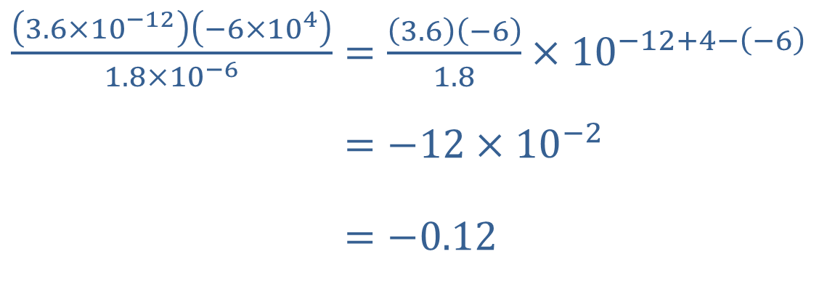
Example 5: Simplifying Expressions with Scientific Notation₂
Solution
​
​$\frac{\left(3.6×{10}^{−12}\right)\left(−6×{10}^{4}\right)}{1.8×{10}^{−6}}=\frac{\left(3.6\right)\left(−6\right)}{1.8}×{10}^{−12+4−\left(−6\right)}$
​3.6×10−12−6×1041.8×10−6=−12×10−2
​3.6×10−12−6×1041.8×10−6=−0.12
We have written the final answer in standard notation (as it is not inconvenient to do so). Note that in scientific notation, it would be written as

Slide 24
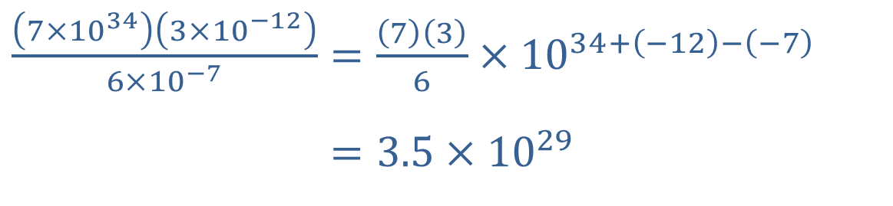
Example 5: Simplifying Expressions with Scientific Notation₃
​$\frac{\left(7×{10}^{34}\right)\left(3×{10}^{−12}\right)}{6×{10}^{−7}}=\frac{\left(7\right)\left(3\right)}{6}×{10}^{34+\left(−12\right)−\left(−7\right)}$
​7×10343×10−126×10−7=3.5×1029
​
This answer is best written in scientific notation.

Slide 25
Example 6: Using Geometric Formulas₁
Find formulas for each of the following:
​The surface area of a box
​The surface area of a soup can
​The volume of a birdbath in the shape of half of a sphere
​The volume of a gold ingot whose shape is a right trapezoidal cylinder

Slide 26
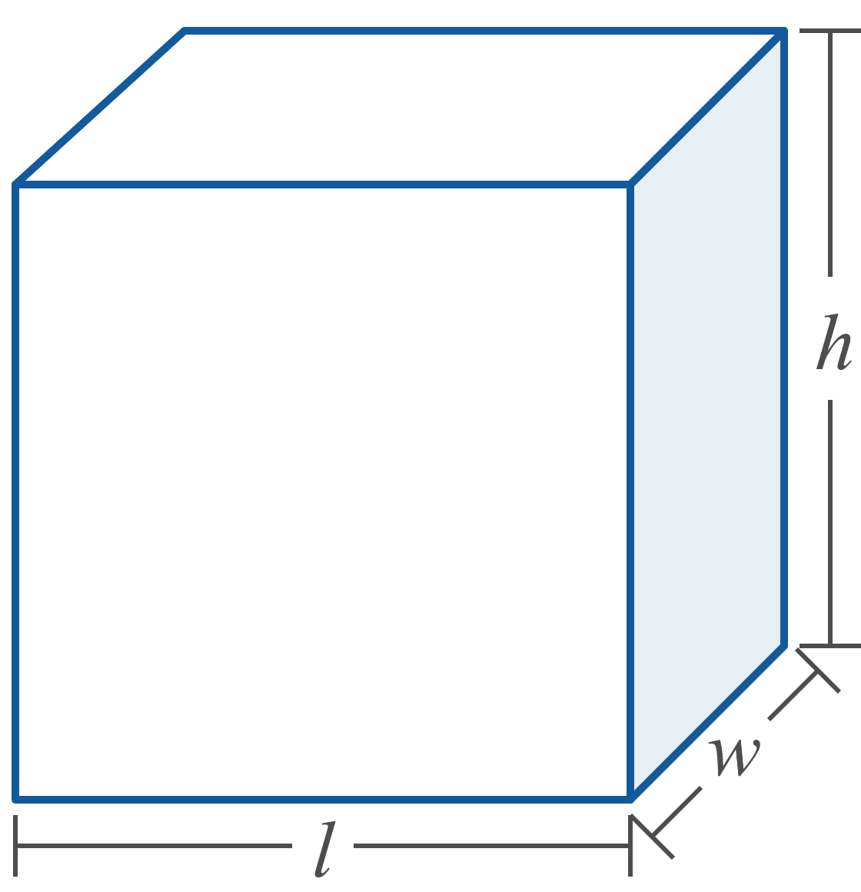
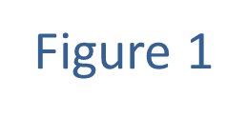
Example 6: Using Geometric Formulas₂

Slide 27
Example 6: Using Geometric Formulas₃
Solution
​A box whose six faces are all rectangular is characterized by its length l, its width w, and its height h. The area of a rectangle is one of the basic formulas that you should be familiar with. The formula for the surface area of a box, then, is just the sum of the areas of the six rectangular sides. If we let S stand for the total surface area, we obtain the formula S = lw + lw + lh + lh + hw + hw or
S = 2lw + 2lh + 2hw.​

Slide 28
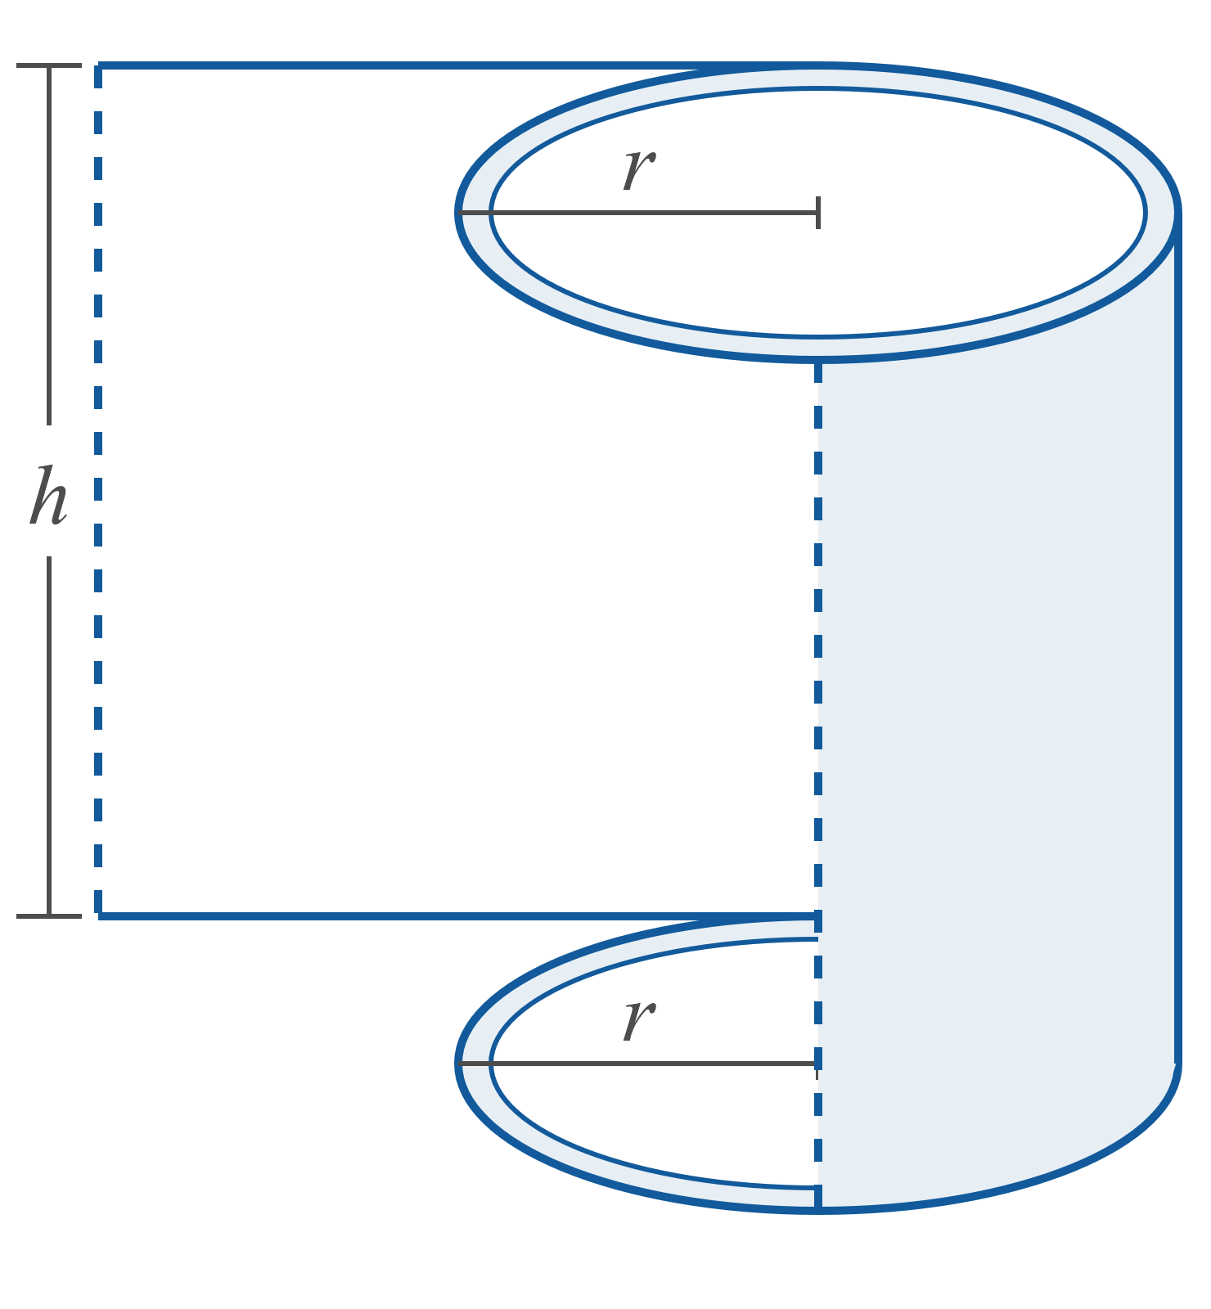
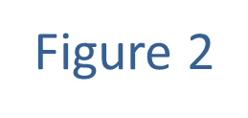
Example 6: Using Geometric Formulas₄

Slide 29
Example 6: Using Geometric Formulas₅
​A soup can, an example of a right circular cylinder, is characterized by its height h and the radius r of the circle that makes up the base (or the top).
  To determine the surface area of such a shape, imagine removing the top and bottom surfaces, cutting the soup can as shown in Figure 2, and flattening out the curved piece of metal making up the side.

Slide 30
Example 6: Using Geometric Formulas₆
The flattened piece of metal would be a rectangle with height h and width 2πr. Do you see why? The width of the rectangle is the same as the circumference of the circular top and base, and the circumference of a circle is 2πr. So the surface area of the curved side is 2πrh. We also know that the area of a circle is πr², so if we let S stand for the surface area of the entire can, we have

Slide 31
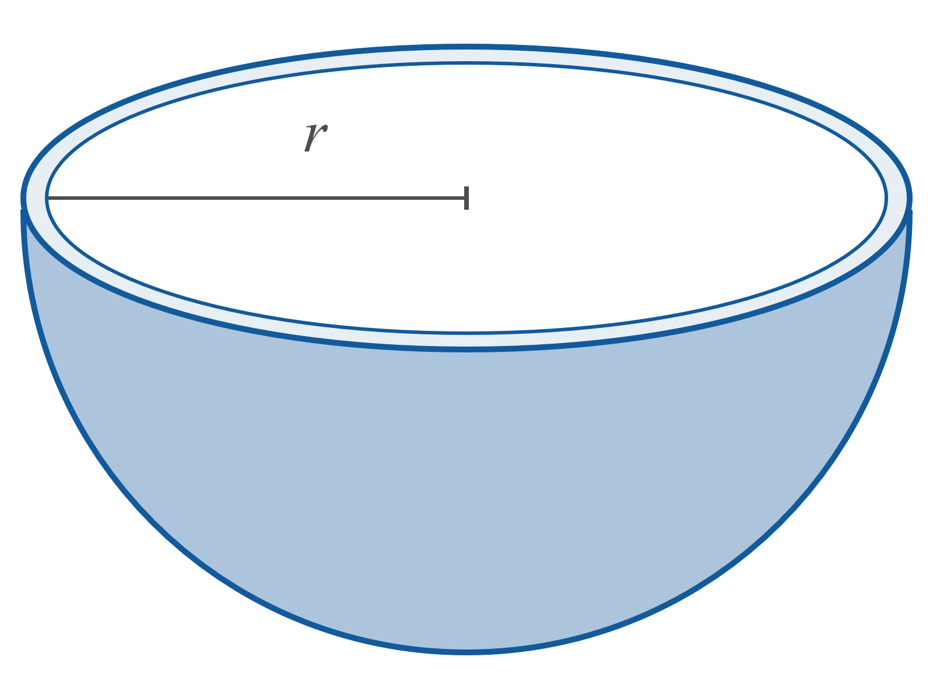
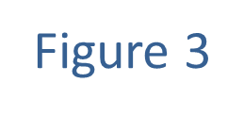
Example 6: Using Geometric Formulas₇

Slide 32
Example 6: Using Geometric Formulas₈
​The volume of a sphere of radius r is
​
and the birdbath of which we are to find the volume has the shape of half a sphere. So if we let V stand for the birdbath's volume,

Slide 33
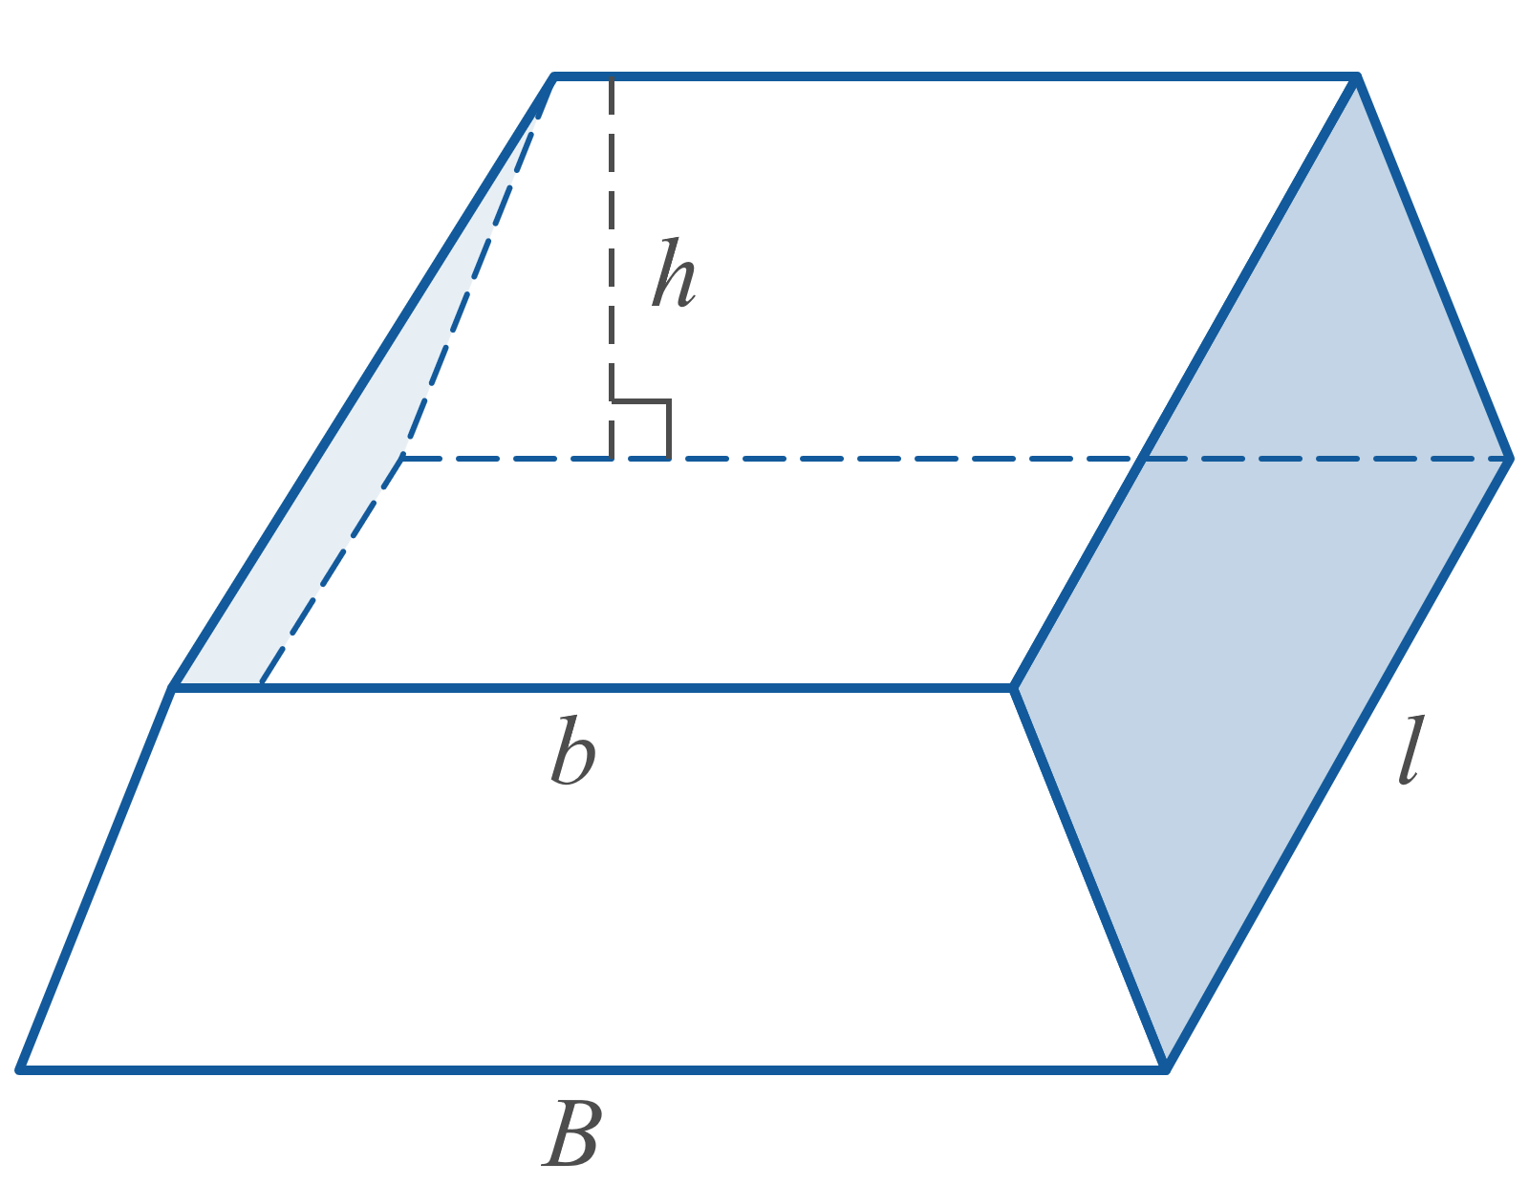
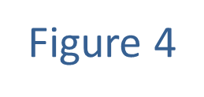
Example 6: Using Geometric Formulas₉

Slide 34
Example 6: Using Geometric Formulas₁₀
​A right cylinder is the three-dimensional object generated by extending a plane region along an axis perpendicular to itself for a certain distance. (Such objects are often called prisms when the plane region is a polygon.) The volume of any right cylinder is the product of the area of the plane region and the distance that region has been extended perpendicular to itself.

Slide 35
Example 6: Using Geometric Formulas₁₁
The gold ingot under consideration in this example is a right cylinder based on a trapezoid, as shown in
Figure 4. The area of the trapezoid is ​
and the ingot has length l, so its volume is
This could also be written as

