Slide 1
Section 1.1
Real Numbers

Slide 2

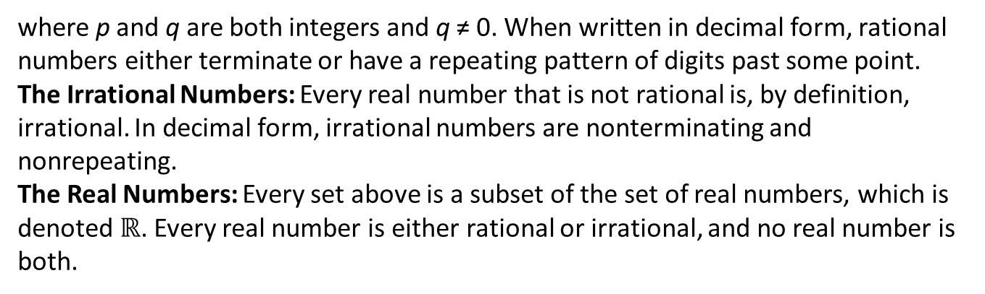
Definition: Types of Real Numbers
The Natural (or Counting) Numbers: This is the set of numbers
The Whole Numbers: This is the set of natural numbers and 0:
The Integers: This is the set of natural numbers, their negatives, and 0. As a list, this
The Rational Numbers: This is the set, with symbol $ℚ$ (for quotient), of ratios of
integers (hence the name). That is, any rational number can be written in the form
where p and q are both integers and q ≠ 0. When written in decimal form, rational numbers either terminate or have a repeating pattern of digits past some point.
The Irrational Numbers: Every real number that is not rational is, by definition, irrational. In decimal form, irrational numbers are nonterminating and nonrepeating.
The Real Numbers: Every set above is a subset of the set of real numbers, which is denoted $ℝ$. Every real number is either rational or irrational, and no real number is both.

Slide 3
Note:
Any integer p is also a rational number, since it can be written as

Slide 4
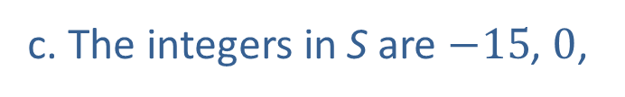

Example 1: Types of Real Numbers
Consider the set
a. The natural numbers in S are
Note that √9
is a natural number since √9 = 3.
b. The whole numbers in S are 0,
​c. The integers in S are $−15$, 0,
​d. The rational numbers in S are
The numbers $−7.5$ and
are both rational numbers since
(the bar over the last digit indicates that
the digit repeats indefinitely).
​e. The only irrational numbers in S are √2 and π.

Slide 5
Example 2: Drawing the Real Number Line₁
We choose which portion of the real number line to show and the physical length that represents one unit based on the numbers that we wish to plot.
​If we want to plot the numbers 101, 106, and 107, we might construct the graph.
​
Figure 3

Slide 6
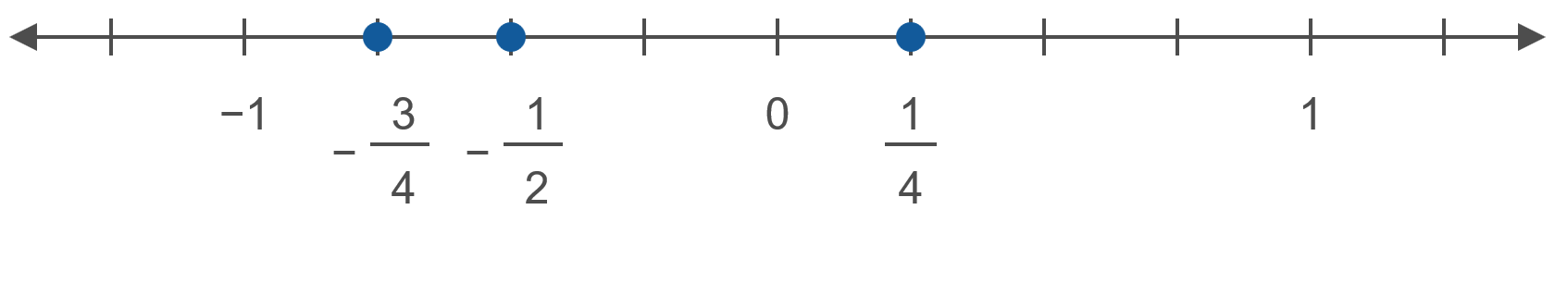
Example 2: Drawing the Real Number Line₂
​If we want to plot the numbers
​
we might make the unit interval longer.
Figure 4

Slide 7
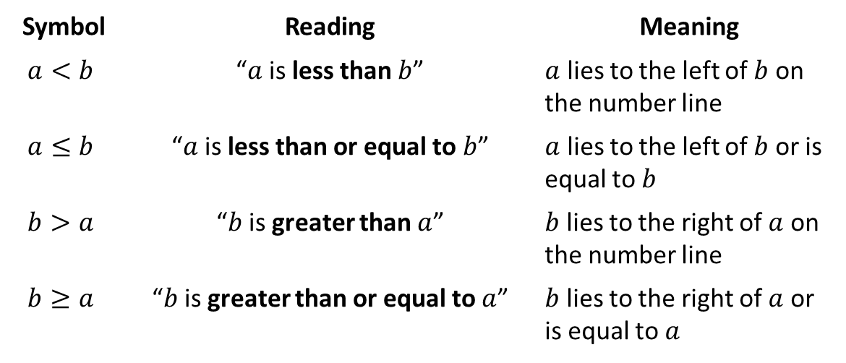
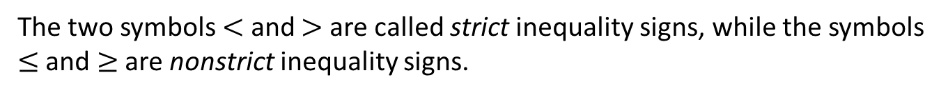
Definition: Inequality Symbols (Order)
Symbol | Reading | Meaning
$$a<b$$ | “$a$ is less than $b$” | $a$ lies to the left of $b$ on the number line
$$a≤b$$ | “$a$ is less than or equal to $b$” | $a$ lies to the left of $b$ or is equal to $b$
$$b>a$$ | “$b$ is greater than $a$” | $b$ lies to the right of $a$ on the number line
$$b≥a$$ | “$b$ is greater than or equal to $a$” | $b$ lies to the right of $a$ or is equal to $a$
The two symbols $<$ and $>$ are called strict inequality signs, while the symbols $≤$ and $≥$ are nonstrict inequality signs.

Slide 8
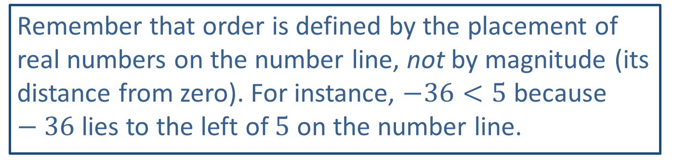
CAUTION!₁
Remember that order is defined by the placement of real numbers on the number line, not by magnitude (its distance from zero). For instance, $−36<5$ because $−36$ lies to the left of 5 on the number line.

Slide 9
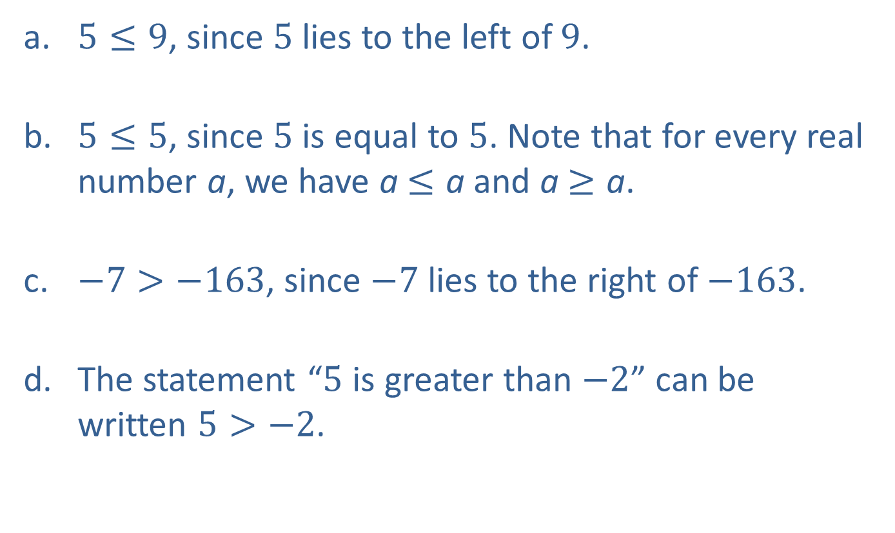
Example 3: Working with Order₁
​$5≤9$, since 5 lies to the left of 9.
​$5≤5$, since 5 is equal to 5. Note that for every real number a, we have a$≤\text{a}$ and a$≥\text{a}$.
​$−7>−163$, since $−7$ lies to the right of $−163$.
​The statement “5 is greater than $−2$” can be written $5>−2$.​

Slide 10
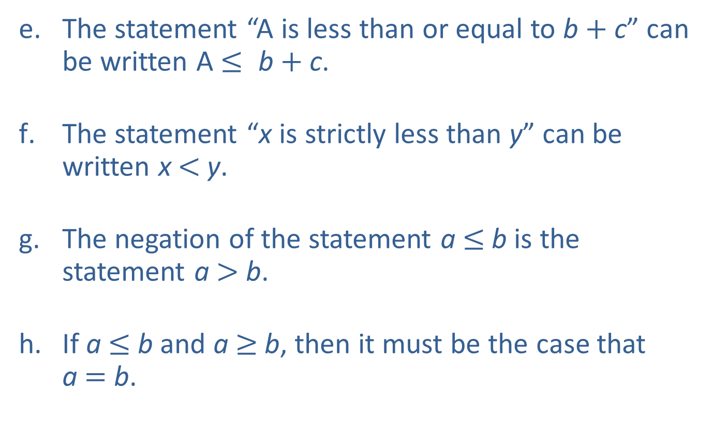
Example 3: Working with Order₂
​The statement “A is less than or equal to b$+$c” can be written A $≤$b$+$c.
​The statement “x is strictly less than y” can be written x$<$y.
​The negation of the statement a$≤$b is the statement a $>$b.
​If a $≤$ b and a$≥$b, then it must be the case that
a $=$ b.

Slide 11
Definition: Set-Builder Notation
The notation
is used to describe a set of real numbers, all of which have the property P. This can be read “the set of all real numbers x having property P.”
The symbol |(vertical bar) is also read as “such that,” so the above notation can also be read “the set of all real numbers x, such that x has property P.”

Slide 12
Example 4: Set-Builder Notation
is another way of describing the set
We could also describe this set as
since every even integer is a multiple of 2.
describes the set

Slide 13

Definition: The Empty Set
A set with no elements is called the empty set or the null set, and is denoted by the symbol $∅$ or
The empty set can arise from a set defined using
set-builder notation; for example, the set
is equivalent to the empty set, since no real number y satisfies the stated property.

Slide 14
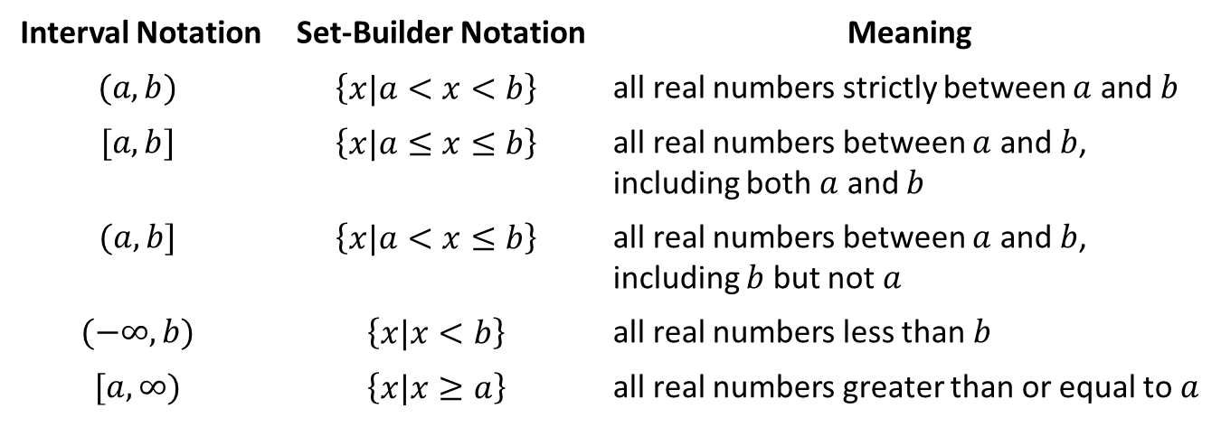
Definition: Interval Notation₁
Interval Notation | Set-Builder Notation | Meaning
$$(a,b)$$ | $$\left\{x|a<x<b\right\}$$ | all real numbers strictly between $a$ and $b$
$$[a,b]$$ | $$\left\{x|a≤x≤b\right\}$$ | all real numbers between $a$ and $b$, including both $a$ and $b$
$$(a,b]$$ | $$\left\{x|a<x≤b\right\}$$ | all real numbers between $a$ and $b$, including $b$ but not $a$
$$(−∞,b)$$ | $$\left\{x|x<b\right\}$$ | all real numbers less than $b$
$$[a,∞)$$ | $$\left\{x|x≥a\right\}$$ | all real numbers greater than or equal to $a$

Slide 15
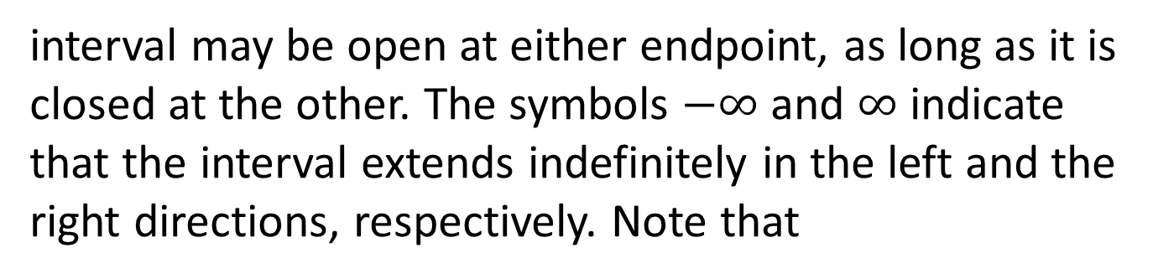
Definition: Interval Notation₂
are called open intervals,
Intervals of the form
while those of the form
are closed intervals. The
interval
is half-open (or half-closed). A half-open
interval may be open at either endpoint, as long as it is closed at the other. The symbols $−∞$ and $∞$ indicate that the interval extends indefinitely in the left and the right directions, respectively. Note that
excludes the endpoint b, while
includes the
endpoint a.

Slide 16
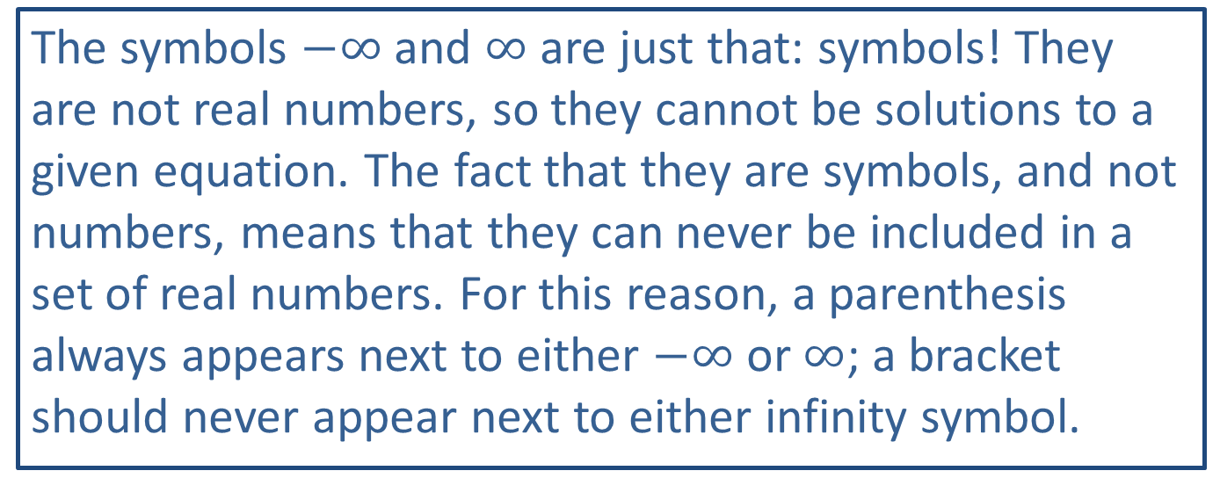
CAUTION!₂
The symbols $−∞$ and $∞$ are just that: symbols! They are not real numbers, so they cannot be solutions to a given equation. The fact that they are symbols, and not numbers, means that they can never be included in a set of real numbers. For this reason, a parenthesis always appears next to either $−∞$ or $∞$; a bracket should never appear next to either infinity symbol.

Slide 17
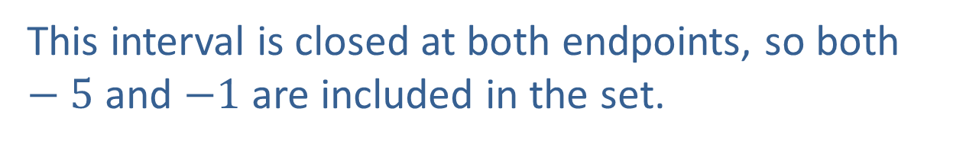
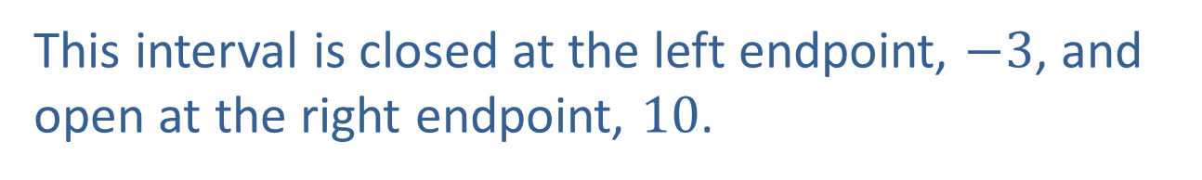
Example 5: Intervals of Real Numbers₁
​The interval
represents the set
This interval is open at both endpoints, so neither 2 nor 8 is included in the set.
b. The interval
is another way to write the set
This interval is closed at both endpoints, so both $−5$ and $−1$ are included in the set.
c. The interval
stands for the set
This interval is closed at the left endpoint, $−3$, and open at the right endpoint, 10.

Slide 18
Example 5: Intervals of Real Numbers₂
stands for the set
​The interval
Since the interval is open on the left endpoint, it is the set of numbers greater than (but not equal to) 4.
​e. The interval
is just another way of
describing the entire set of real numbers.

Slide 19
Definition: Absolute Value
The absolute value of a real number a, denoted as
is defined as follows.
The absolute value of a number is also referred to as its magnitude; it is the nonnegative number corresponding to its distance from the origin.

Slide 20
Definition: Distance on the Real Number Line
Given two real numbers a and b, the distance between them is defined to be
In particular, the distance between a and 0 is
or just

Slide 21
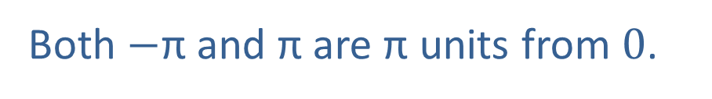

Example 6: Absolute Value₁
$17$ and 3 are 14 units apart.
Both $−\text{π}$ and π are π units from 0.

Slide 22
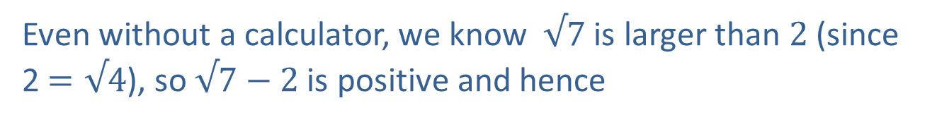
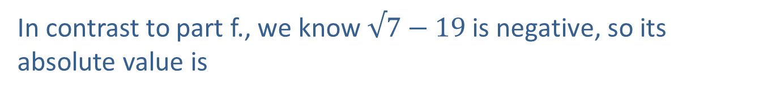
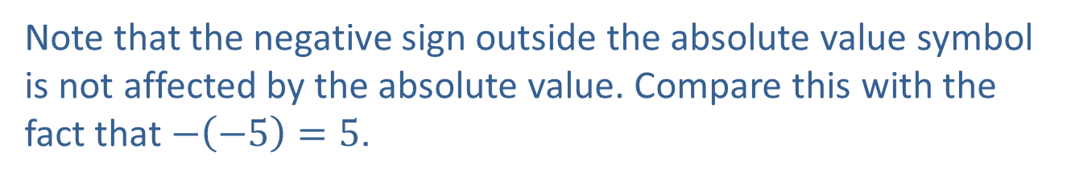
Example 6: Absolute Value₂
Note that the negative sign outside the absolute value symbol is not affected by the absolute value. Compare this with the fact that $−\left(−5\right)=5$.
Even without a calculator, we know √7 is larger than 2 (since 2 $=\text{√}\text{4}$), so √7 $−$ 2 is positive and hence
In contrast to part f., we know √7 $−$ 19 is negative, so its absolute value is

Slide 23
Properties: Properties of Absolute Value
In the following properties, a and b represent arbitrary real numbers.
(This is called the triangle inequality, as it is a reflection of the fact that one side of a triangle is never longer than the sum of the other two sides.)

Slide 24
Example 7: Using Absolute Value Properties

Slide 25
Example 8: Working With Repeating Digits
As a sum, the decimal number
The first two terms pose no problem, but we will have to work to write the third term as a ratio of integers.
Solving for x, we have
(We have just solved a linear equation; we will study these in detail later.) Altogether, we have the following result.

