Slide 1
Section 7.R.1
Rules for Exponents

Slide 2
Objectives
Use the product rule for exponents.
Simplify expressions that contain the exponent 0.
Use the quotient rule for exponents.
Simplify expressions that contain negative exponents.
Use a graphing calculator to evaluate exponential expressions.

Slide 3
Properties: The Product Rule for Exponents
If a is a nonzero real number and m and n are integers, then
In words, to multiply powers with the same base, keep the base and add the exponents.

Slide 4
Notes: The Product Rule
Reminder about the exponent 1: if a variable or constant has no exponent written, the exponent is understood to be 1.
For example,
In general, for any real number a,

Slide 5
Example 1: Using the Product Rule for Exponents₁
Use the product rule for exponents to simplify the following expressions.

Slide 6
Example 1: Using the Product Rule for Exponents₂
Solution

Slide 7
Example 2: Using the Product Rule for Exponents₁
Use the product rule for exponents when simplifying the following expressions.
Solution

Slide 8
Example 2: Using the Product Rule for Exponents₂

Slide 9
Definition: The Exponent 0₁
If a is a nonzero real number, then
The expression
is undefined.

Slide 10
Attention! The Exponent 0₂
Throughout this text, unless specifically stated otherwise, we will assume that the bases of exponents are nonzero.

Slide 11
Example 3: Evaluating The Exponent 0
Simplify the following expressions using the rule for 0 as an exponent.
Solution

Slide 12
Properties: Quotient Rule for Exponents
If a is a nonzero real number and m and n are integers, then
In words, to divide two powers with the same base, keep the base and subtract the exponents. (Subtract the denominator exponent from the numerator exponent.)

Slide 13
Example 4: Using the Quotient Rule for Exponents₁
Use the quotient rule for exponents to simplify the following expressions.
Solution

Slide 14
Example 4: Using the Quotient Rule for Exponents₂

Slide 15
Example 5: Dividing Terms with Coefficients₁
Use the quotient rule for exponents when simplifying the following expressions.
Solution

Slide 16
Example 5: Dividing Terms with Coefficients₂

Slide 17
Properties: Rule for Negative Exponents
If a is a nonzero real number and n is an integer, then

Slide 18
Example 6: Negative Exponents₁
Use the rule for negative exponents to simplify each expression so that it contains only positive exponents.
Solution

Slide 19
Example 6: Negative Exponents₂
Here we use the product rule first and then the rule
for negative exponents.

Slide 20
Notes: Negative Exponents₁
There is nothing wrong with negative exponents. In fact, negative exponents are preferred in some courses in mathematics and science. However, so that all answers are the same, in this course we will consider expressions to be simplified if:
all exponents are positive and
each base appears only once.

Slide 21
Example 7: Combining Rules for Exponents₁
Simplify each expression so that it contains only positive exponents.
Solution

Slide 22
Example 7: Combining Rules for
Exponents₂

Slide 23
Example 7: Combining Rules for
Exponents₃

Slide 24
Example 7: Combining Rules for
Exponents₄
(Note: Notice that the negative exponent relates only to the variable x, not to the number 10.)

Slide 25
Attention! Negative Exponents₂
Using the Quotient Rule
Regardless of the size of the exponents or whether they are positive or negative, the following single subtraction rule can be used with the quotient rule.
(numerator exponent − denominator exponent)
This subtraction will always lead to the correct answer.

Slide 26
Properties: Summary of the Rules for Exponents
For any nonzero real number a and integers m and n:
1. The exponent 1:
2. The exponent 0:
3. The product rule:
4. The quotient rule:
5. Negative exponents:

Slide 27
Example 8: Evaluating Exponential Expressions₁
Use a graphing calculator to evaluate each expression.

Slide 28


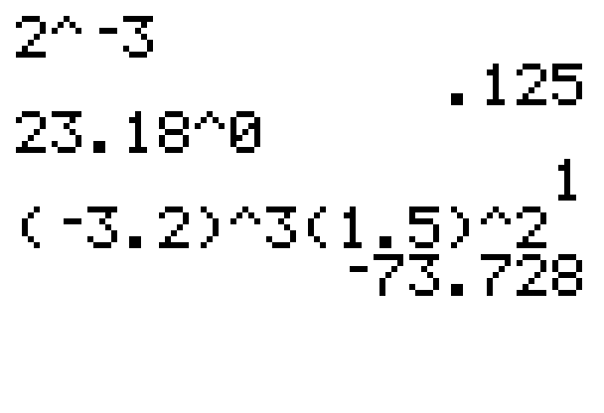
Example 8: Evaluating Exponential Expressions₂
Solution
The following solution show how the caret key
is used to indicate exponents.
Be careful to use the negative sign key
(and not the minus sign key) for negative numbers and negative exponents. Use parentheses as they are given in the expression being evaluated.

