Slide 1
Section 5.R.5
Introduction to Rational Expressions

Slide 2
Objectives
Determine any restrictions on the variable in a rational expression.
Evaluate rational expressions for given values of the variable.
Reduce rational expressions to lowest terms.

Slide 3
Rational Expressions : Introduction to Rational Expressions
A rational expression is an algebraic expression that can be written in the form
where P and Q are polynomials and Q ≠ 0.

Slide 4
Note₁
Remember, the denominator of a rational expression can never be 0. Division by 0 is undefined.

Slide 5
Example 1: Finding Restrictions on the Variable₁
Determine what values of the variable, if any, will make the rational expression undefined.
Solution

Slide 6
Example 1: Finding Restrictions on the Variable₂
Thus the expression
is undefined for
Any other real number may be substituted for x in the
expression. We write
to indicate the restriction
on the variable.

Slide 7
Example 1: Finding Restrictions on the Variable₃
Solution
Thus there are two restrictions on the variable:
6 and −1. We write x ≠ −1, 6.

Slide 8
Example 1: Finding Restrictions on the Variable₄
Solution
However there is no real number whose square is −36. Thus there are no restrictions on the variable.

Slide 9
Attention!
When the Numerator is 0
If the numerator of a rational expression has a value of 0 and the denominator is not 0 for that value of the variable, then the expression is defined and has a value of 0. If both numerator and denominator are 0, then the expression is undefined just as in the case where only the denominator is 0.

Slide 10
Example 2: Evaluating Rational Expressions₁
Find the value of each rational expression for the given value of the variable.
Solution
Note that any real number may be substituted for
since the denominator is never 0 for any real number.

Slide 11
Example 2: Evaluating Rational Expressions₂
Solution
Note that a numerator may be 0.

Slide 12
Properties: Summary of Arithmetic Rules for Rational Numbers (or Fractions)₁
A fraction (or rational number) is a number that can
be written in the form
where a and b are integers
and b ≠ 0. (Remember, no denominator can be 0.)
The Fundamental Principle:
where b, k ≠ 0
The reciprocal of
where a, b ≠ 0.

Slide 13
Properties: Summary of Arithmetic Rules for Rational Numbers (or Fractions)₂

Slide 14
Definition: The Fundamental Principle of Rational Expressions

Slide 15
Example 3: Reducing Rational Expressions₁
Use the fundamental principle to reduce each expression to lowest terms. State any restrictions on the variable by using the fact that no denominator can be 0. This restriction applies to denominators before and after a rational expression is reduced.
Solution
Note that x − 5 is a common factor. The key word here is factor. We reduce using factors only.

Slide 16
Example 3: Reducing Rational Expressions₂
Solution

Slide 17
Note₂
Note that the restrictions on the variable are determined before reducing.

Slide 18
Example 3: Reducing Rational Expressions₃
Solution
Note that the expression 10 − y is the opposite of y − 10. When nonzero opposites are divided, the quotient is always −1.

Slide 19
Reducing (or Simplifying) Rational Expressions
Opposites in Rational Expressions
For a polynomial P,
where P ≠ 0.
In particular,
where x ≠ a.

Slide 20
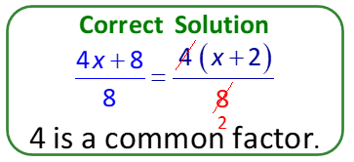
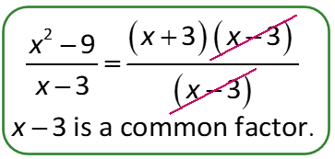
Caution!
“Divide out” only common factors.

