Slide 1
Section 5.R.4
Division with Polynomials

Slide 2
Objectives
Divide a polynomial by a monomial.
Divide polynomials by using the division algorithm.

Slide 3
Example 1: Dividing by a Monomial₁
Divide each polynomial by the monomial denominator by writing each fraction as the sum (or difference) of fractions. Simplify each fraction, if possible.
Solution

Slide 4
Example 1: Dividing by a Monomial₂

Slide 5
Theorem: The Division Algorithm
For polynomials P and D, the division algorithm gives
where Q and R are polynomials and the
degree of R < degree of D.

Slide 6
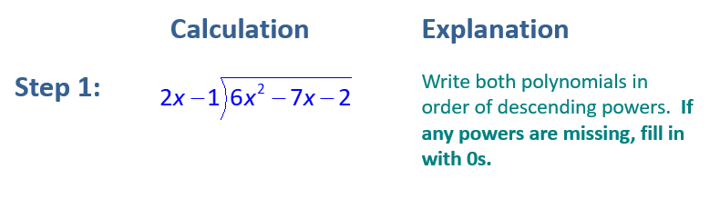
Example 2: Using The Division Algorithm₁
Simplify
by using long division.
Solution

Slide 7
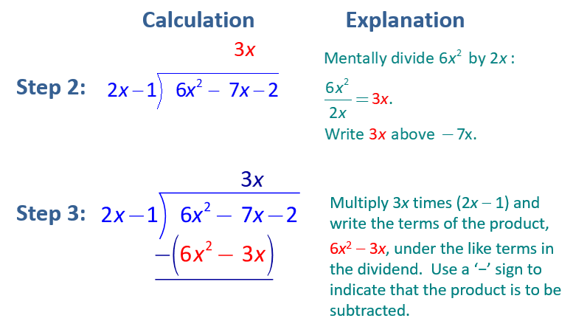
Example 2: The Division Algorithm₂

Slide 8
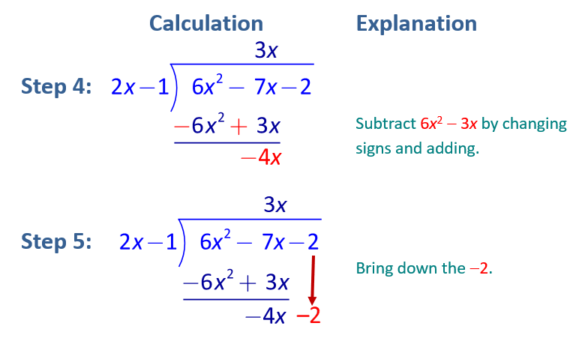
Example 2: The Division Algorithm₃

Slide 9
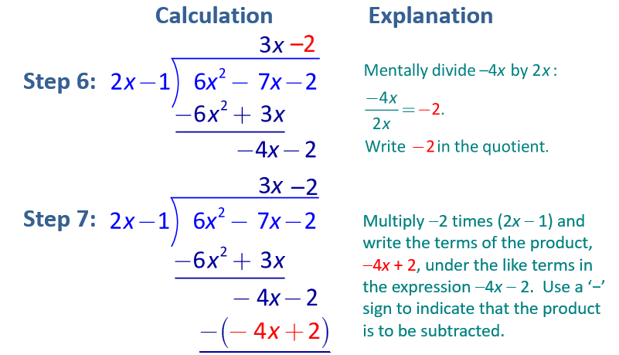
Example 2: The Division Algorithm₄

Slide 10
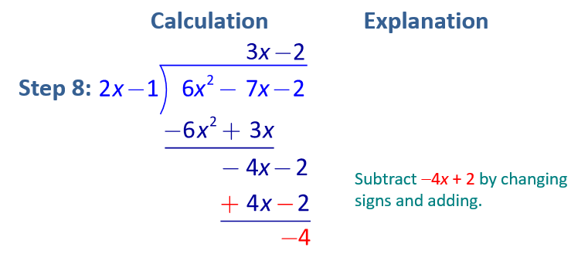
Example 2: The Division Algorithm₅
Thus the quotient is 3x − 2 and the remainder is −4.

Slide 11
Example 2: The Division Algorithm₆
we can write
In the form
Check:
Show

Slide 12
Example 3: Using Long Division (Remainder 0)
by using long division.
Divide
Solution
There is no remainder, thus the quotient is simply 5x ² − 2x + 1.

Slide 13
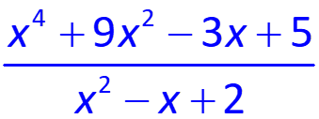
Example 4: Using Long Division₁
by using long division.
Simplify
Solution
Note that 0 is written as a placeholder for any missing powers of the variable. In this way, like terms are easily aligned vertically.

Slide 14
Example 4: Using Long Division (Terms Missing)₂

Slide 15
Example 4: Using Long Division (Terms Missing)₃
Thus, the quotient is x ² + x + 8 and the remainder is 3x − 11.
In the form
we can write

