Slide 1
Section 5.R.3
Multiplication with Polynomials

Slide 2
Objectives
Multiply a polynomial by a monomial.
Multiply two polynomials.
Use the FOIL method to multiply two binomials.

Slide 3
Example 1: Multiplying Polynomials and Monomials
Multiply:
Solution

Slide 4
Example 2: Multiplying Polynomials and Monomials
Multiply:
Solution

Slide 5
Example 3: Multiplying Two Binomials
Multiply:
Solution

Slide 6
Example 4: Multiplying Two Binomials
Multiply:
Solution

Slide 7
Example 5: Multiplying Polynomials
Multiply:
Solution

Slide 8
Example 6: Multiplying Polynomials
Multiply:
Solution

Slide 9
Example 7: Multiplying Polynomials₁
Multiply:
Solution
First multiply
, then multiply this result by

Slide 10
Example 7: Multiplying Polynomials₂

Slide 11
Example 8: Multiplying Polynomials
Multiply:
Solution
First multiply
, then multiply this result by

Slide 12
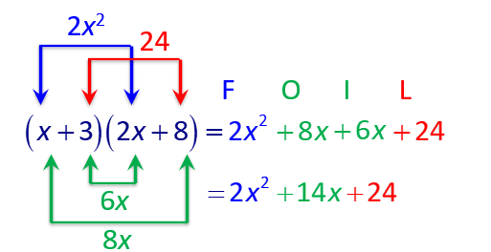
Example 9: Using the FOIL Method to Multiply Binomials
Use the FOIL method to multiply the binomials:
Solution

Slide 13
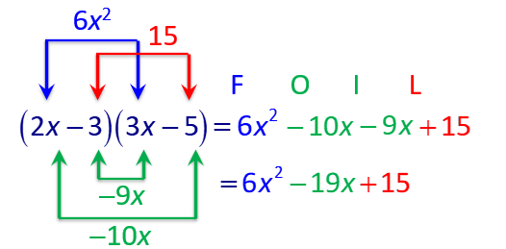
Example 10: Using the FOIL Method to Multiply Binomials
Use the FOIL method to multiply the binomials:
Solution

Slide 14
Example 11: Using the FOIL Method
Use the FOIL method to multiply the binomials:
Solution

