Slide 1
Section 4.R.9
Multiplication and Division with Complex Numbers

Slide 2
Objectives
Multiply with complex numbers.
Divide with complex numbers.
Simplify powers of i.

Slide 3
Example 1: Multiplying with Complex Numbers₁
Find the following products.
(3i)(2 − 7i)
Solution

Slide 4
Example 1: Multiplying with Complex Numbers₂
(5 + i)(2 + 6i)
Solution

Slide 5
Example 1: Multiplying with Complex Numbers₃
Solution

Slide 6
Example 1: Multiplying with Complex Numbers₄
(−1+ i)(2 − i)
Solution

Slide 7
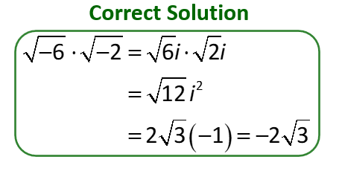
Caution!
Remember that
only if a and b are nonnegative
real numbers.
Applying this rule to negative real numbers can lead to an error. The error can be avoided by first changing the radicals to imaginary form.

Slide 8
Procedure: Writing Fractions with Complex Numbers in Standard Form
Multiply both the numerator and denominator by the complex conjugate of the denominator.
Simplify the resulting products in both the numerator and denominator.
Write the simplified result in standard form.

Slide 9
Example 2: Division with Complex Numbers₁
Write the following fractions in standard form.
Solution

Slide 10
Example 2: Division with Complex Numbers₂
Solution

Slide 11
Example 2: Division with Complex Numbers₃
Solution

Slide 12
Example 2: Division with Complex Numbers₄
Solution

Slide 13
Example 3: Simplifying Powers of i
Simplify each power of i.

