Slide 1
Section 3.R.1
Perimeter

Slide 2
Objectives
Recognize various types of polygons.
Calculate the perimeters of polygons.
Calculate the areas of polygons.
Know the terms circle, center, radius, and diameter.
Calculate the circumference and area of a circle.
Calculate the volumes of solids.
Calculate the surface areas of solids.

Slide 3
Definition: Polygon
A polygon is a closed plane figure, with three or more sides, in which each side is a line segment.
Each point where two sides meet is called a vertex.
Note: A closed figure begins and ends at the same point.

Slide 4
Definition: Perimeter
The perimeter P of a polygon is the sum of the lengths of its sides.

Slide 5
Finding the Perimeter of a Polygon
From the Metric System | From the US Customary System
millimeter (mm) | inch (in.)
centimeter (cm) | foot (ft)
meter (m) | yard (yd)
kilometer (km) | mile (mi)
Table 1

Slide 6
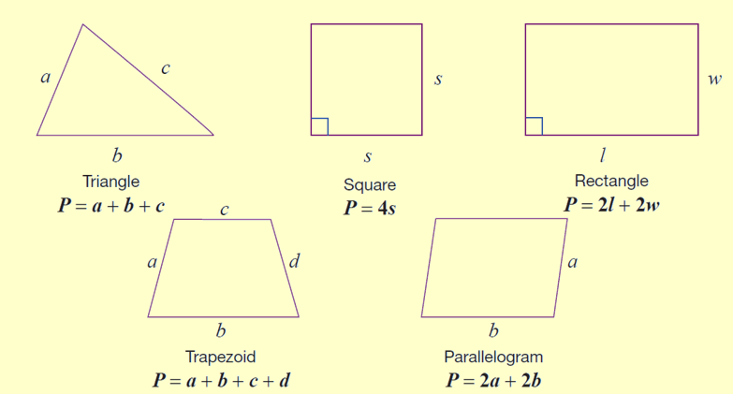
Formula: Perimeter Formulas for Five Polygons
Note that each formula represents the sum of the lengths of the sides.

Slide 7
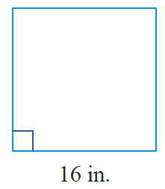
Example 1: Calculating the Perimeter of a Square
Calculate the perimeter of a square with sides of length 16 in.
Solution
Using the formula for the perimeter of a square, we have the following.
The perimeter of the square is 64 inches.

Slide 8
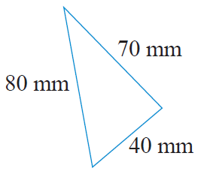
Example 2: Calculating the Perimeter of a Triangle
Calculate the perimeter of a triangle with sides of length 40 mm, 70 mm, and 80 mm.
Solution
First draw a figure and label the lengths
of the sides.
Now, using the formula for the perimeter of a triangle, we have the following.
The perimeter of the triangle is 190 mm.

Slide 9
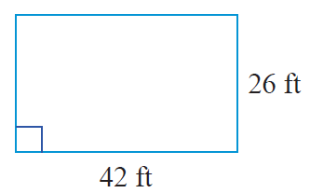
Example 3: Calculating the Perimeter of a Rectangle
Calculate the perimeter of the rectangle.
Solution
Using the formula for the perimeter of a rectangle, we have the following.
The perimeter of the rectangle is 136 ft.

Slide 10
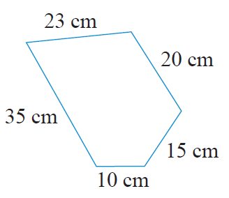
Example 4: Calculating the Perimeter of a Polygon₁
Calculate the perimeter of the polygon.
(Note: A 5-sided polygon is called a pentagon.)

Slide 11
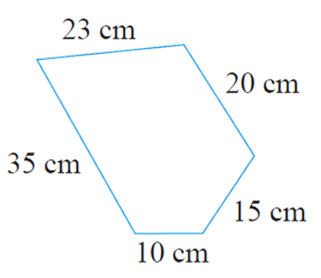
Example 4: Calculating the Perimeter of a Polygon₂
Solution
The perimeter of any polygon is found by adding the lengths of the sides. Thus, for this pentagon we have the following.
The perimeter of the polygon is 103 cm.

Slide 12
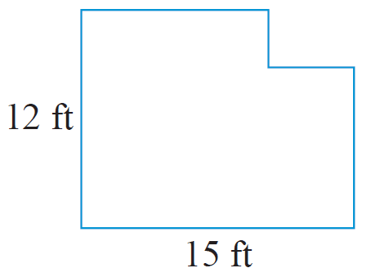
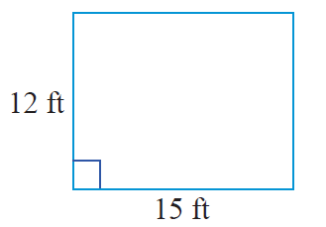
Example 5: Calculating the Perimeter of a Polygon₁
Calculate the perimeter of the polygon.
Solution
If a rectangle has length 15 ft and width 12 ft, then its perimeter is:

Slide 13
Example 5: Calculating the Perimeter of a Polygon₂
Now, if a small rectangle is cut from one corner of the original rectangle, then a new shape is formed. An interesting fact is that, regardless of the size of the cut out rectangle, this new shape will have the same perimeter as the original rectangle. This is because the length and width of the segments of the indented corner are the same as those of the cut out.

Slide 14
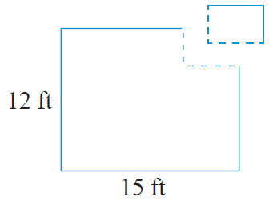
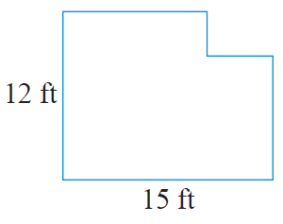
Example 5: Calculating the Perimeter of a Polygon₃
Thus, the perimeter of the polygon is 54 ft.

Slide 15
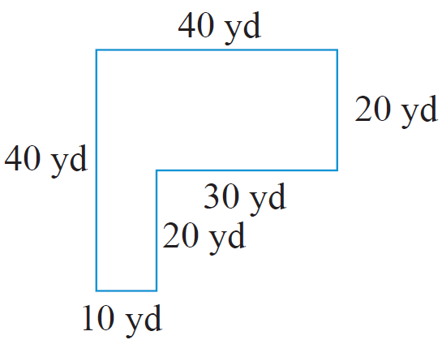
Example 6: Application: Calculating the Perimeter of a Polygon₁
For security, a chain link fence is to be built on the edge of a property surrounding a new warehouse. The property is L-shaped as shown.
How many yards of fencing will be needed?
What will be the cost of the entire fencing project if the price is $12.50 per yard?

Slide 16
Example 6: Application: Calculating the Perimeter of a Polygon₂
Solution
As the fence is to be put up along the edge of the property, the amount of fencing needed is equivalent to the perimeter of the property.
They will need 160 yards of fencing.

Slide 17
Example 6: Application: Calculating the Perimeter of a Polygon₃
The cost of the fencing will be $2000.

Slide 18
Finding the Area of a Polygon
From the Metric System | From the US Customary System
square millimeters (mm²) | square inches (in.²)
square centimeters (cm²) | square feet (ft²)
square meters (m²) | square yards (yd²)
square kilometers (km²) | square miles (mi²)
Table 2

Slide 19
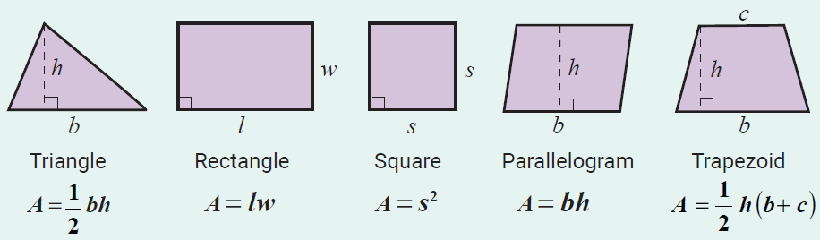
Formula: Area Formulas for Five Polygons
Note: The letter h is used to represent the height of the figure. The height is also called the altitude and is perpendicular to the base.

Slide 20
Example 7: Calculating the Area of a Triangle Using a Formula
Calculate the area of a triangle with height 4 in. and base 10 in. (Be sure to label the answer in square inches.)
Solution
Now, using the formula for the area of a triangle, we have the following.
The area of the triangle is 20 in. ²

Slide 21
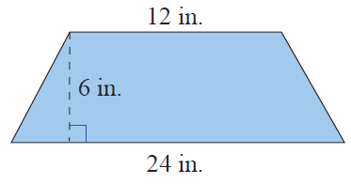
Example 8: Calculating the Area of a Trapezoid Using a Formula₁
Calculate the area of a trapezoid with altitude 6 in. and parallel sides of length 12 in. and 24 in.
Solution
First draw a figure and label the lengths of the known parts.

Slide 22
Example 8: Calculating the Area of a Trapezoid Using a Formula₂
Now, using the formula for the area of a trapezoid, we have the following.
The area of the trapezoid is 108 in. ²

Slide 23
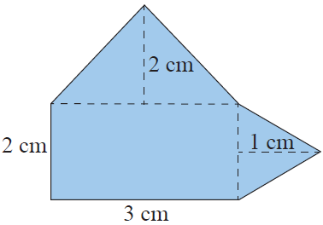
Example 9: Calculating the Area of a Composite Figure₁
Calculate the area of the composite figure made up of a rectangle and two triangles.
Solution
To find the area of this figure, calculate the area of each part and then add the three areas. The figure is made up of two triangles and one rectangle.

Slide 24

Example 9: Calculating the Area of a Composite Figure₂

Slide 25
Example 9: Calculating the Area of a Composite Figure₃
The area of the composite figure is 10 cm².

Slide 26
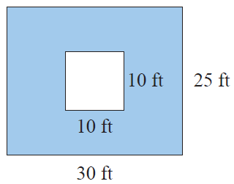
Example 10: Calculating Area₁
A square is cut out of a rectangle as shown. Calculate the area of the blue-shaded region.
Solution
There are three steps in calculating the area of the shaded region. First, calculate the area of the outer figure. Then, calculate the area of the inner figure. Finally,
calculate the difference between the areas.

Slide 27
Example 10: Calculating Area₂
Step 1: Calculate the area of the rectangle.
Step 2: Calculate the area of the square.
Step 3: Find the difference between the two areas.
The area of the shaded region is 650 ft².

Slide 28
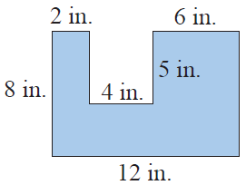
Example 11: Calculating Area₁
The polygon shown here is a rectangle with a rectangular piece missing. Find the area of the polygon.
Solution
There are several ways of finding the area of this figure. One way is to find the area of each of the three parts as illustrated here and then adding the three areas.

Slide 29
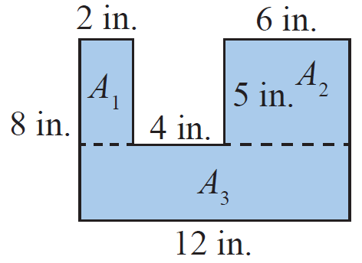
Example 11: Calculating Area₂
The area of the polygon is 76 in. ².

Slide 30
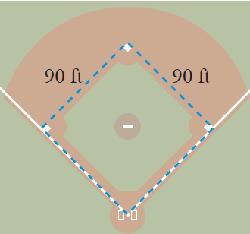
Example 12: Application: Calculating Perimeter and Area₁
A baseball infield is in the shape of a square 90 feet on each side.
What is the perimeter of the infield?
What is the area of the infield?

Slide 31
Example 12: Application: Calculating Perimeter and Area₂
Solution
The perimeter of the infield is 360 feet and the area is 8100 ft².

Slide 32
Definition: Circles₁
Circle: The set of all points in a plane that are
equidistant from a fixed point called the center of the
circle.
Radius: The distance from the center of a circle to any
point on the circle. (The letter r is used to represent
the radius of a circle.)

Slide 33
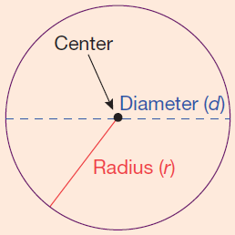
Definition: Circles₂
Diameter: The distance from one point on a circle to another point on the circle measured through the center. (The letter d is used to represent the diameter of a circle and d = 2r.)
Circumference: Perimeter of (or
distance around) a circle.

Slide 34
Formula: Formulas for Circles
Circumference: C = 2π r and C = π d.
Area: A = π r ²

Slide 35
Formulas for Circumference and Area of a Circle
Notes
The Greek letter π (Pi) is the symbol used for the
constant 3.1415926535…. This number is an infinite
nonrepeating decimal number. For our purposes, we
will use π = 3.14 (accurate to hundredths). However,
You should always be aware that 3.14 is only an
approximation for π and that related answers are only
approximations.

Slide 36
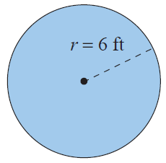
Example 13: Calculating the Circumference and Area of a Circle₁
Calculate
the circumference
the area of a circle with a radius of 6 ft.
Solution
Using the formula for circumference:
The circumference is 37.68 ft.

Slide 37
Example 13: Calculating the Circumference and Area of a Circle₂
Using the formula for area:
The area is 113.04 ft².

Slide 38
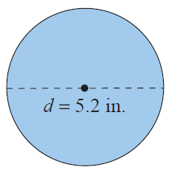
Example 14: Calculating the Circumference and Area of a Circle₁
Calculate a. the circumference and b. the area of a circle with a diameter of 5.2 in.
Solution
Using the formula for circumference:
The circumference is 16.328 in.

Slide 39
Example 14: Calculating the Circumference and Area of a Circle₂
Using the formula for area:
The area is 21.2264 in. ².

Slide 40
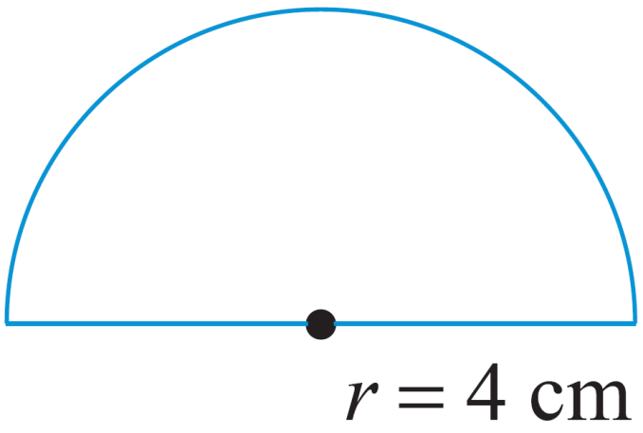
Example 15: Calculating the Perimeter₁
Calculate the perimeter of the figure shown: a semicircle (half of a circle) and a diameter. The radius is 4 ft long.
Solution
In order to find the perimeter of the figure, find the perimeter of the semicircle and then add the
diameter.

Slide 41
Example 15: Calculating the Perimeter₂
Length of semicircle
Diameter
Perimeter = semicircle + diameter
= 12.56 cm + 8 cm = 20.56 cm
The perimeter is 20.56 cm.

Slide 42
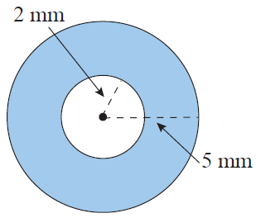
Example 16: Calculating the Area of a Washer₁
Calculate the area of the washer (shaded portion) with dimensions as shown in the figure.
Solution
Subtract the area of the inside (smaller) circle from the area of the outside (larger) circle.

Slide 43
Example 16: Calculating the Area of a Washer₂
The area of the washer is 65.94 mm².

Slide 44
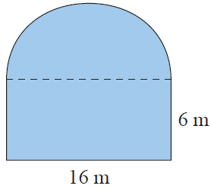
Example 17: Calculating Perimeter and Area₁
Calculate a. the perimeter and b. the area of the figure shown here with a square base and a semicircle attached to the top. The rectangle has a length of 16 m and a width of 6 m.

Slide 45
Example 17: Calculating Perimeter and Area₂
Solution
The perimeter of the figure is the sum of the lengths of three sides of the rectangle and the length of the semicircle. (Note: The diameter of the semicircle is 16 m.)
Sum of the lengths of three sides of the rectangle
= 6 m + 16 m + 6 m = 28 m
Length of semicircle =
Perimeter of the figure = 28 m + 25.12 m = 53.12 m

Slide 46
Example 17: Calculating Perimeter and Area₃
Calculate the area of the square then subtract the area of the semicircle.
Area of square
Area of semicircle

Slide 47
Example 17: Calculating Perimeter and Area₄
Area of the figure = 96 m + 100.48 m = 196.48 m².
The perimeter of the figure is 53.12 m and the area of the figure is 196.48 m².

Slide 48
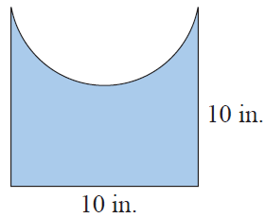
Example 18: Calculating Perimeter and Area₁
Calculate a. the perimeter and b. the area of the figure shown here with a square base and a semicircle cut out of one side. One side of the square is 10 in. long.

Slide 49
Example 18: Calculating Perimeter and Area₂
Solution
The perimeter of the figure is the sum of the lengths of three sides of the square and the length of the semicircle. (Note: The diameter of the semicircle is 10 in.)
Sum of the lengths of three sides of the square
= 10 in. + 10 in. + 10 in. = 30 in.
Length of semicircle
Perimeter of the figure = 30 in. + 15.7 in. = 45.7 in.

Slide 50
Example 18: Calculating Perimeter and Area₃
Calculate the area of the square then subtract the area of the semicircle.
Area of square
Area of semicircle

Slide 51
Example 18: Calculating Perimeter and Area₄
Area of the figure
The perimeter of the figure is 45.7 in. and the area of the figure is 60.75 in. ²

Slide 52
Volume
From the Metric System | From the US Customary System
cubic millimeters (mm³) | cubic inches (in.³)
cubic centimeters (cm³) | cubic feet (ft³)
cubic meters (m³) | cubic yards (yd³)
Table 3

Slide 53
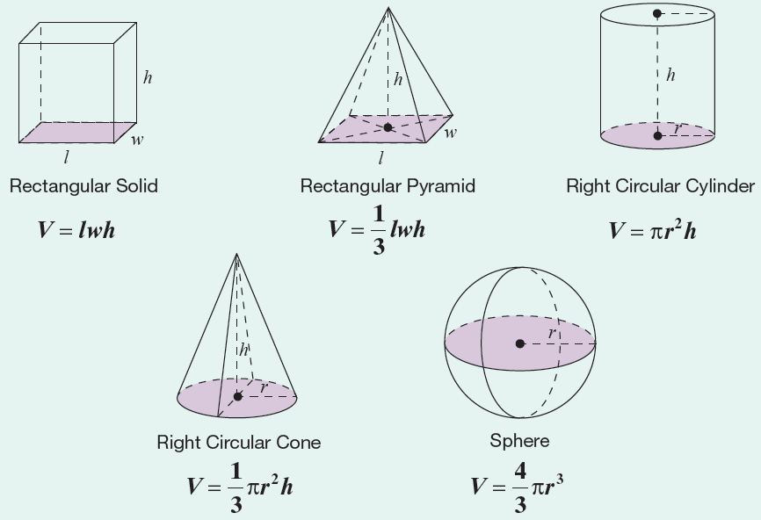
Formula: Volume Formulas for Five Geometric Solids

Slide 54
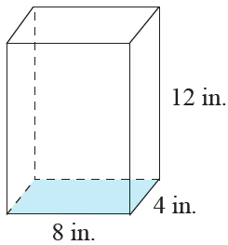
Example 19: Calculating the Volume of a Rectangular Solid₁
Calculate the volume of the rectangular solid with length 8 in. , width 4 in. , and height 12 in.
Solution
Using the formula for the volume of a
rectangular solid, we have the following.
The volume of the rectangular solid is 384 in. ³

Slide 55
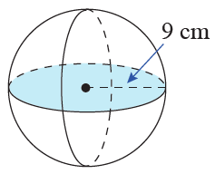
Example 20: Calculating the Volume of a Sphere
Calculate the volume of a sphere with radius 9 cm.
Use π = 3.14.
Solution
Using the formula for the volume of a sphere:
The volume of the sphere is 3052.08 cm³.

Slide 56
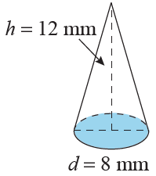
Example 21: Calculating the Volume of a Cone₁
What is the volume of a cone with a height of 12 mm and a circular base with a diameter of 8 mm?
Solution
We know the diameter of 8 mm, but we need the radius.
The radius is half of the diameter.

Slide 57
Example 21: Calculating the Volume of a Cone₂
So applying the formula for the volume of a cone, we have:
The volume of the cone is 200.96 mm³.

Slide 58
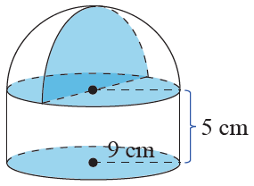
Example 22: Calculating the Volume of a Solid₁
Calculate the volume of a solid with the
indicated dimensions.
Solution
From the figure, we see that the
bottom portion of the solid is a
cylinder and on top of the cylinder is a hemisphere (one-half of a sphere). Thus, the volume of the solid will be the sum of the volumes of the cylinder and the hemisphere.

Slide 59
Example 22: Calculating the Volume of a Solid₂

Slide 60
Example 22: Calculating the Volume of a Solid₃
The volume of the solid is 2797.74 cm³.

Slide 61
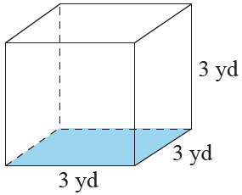
Example 23: Calculating the Volume of a Cube₁
Calculate the volume of the cube in both cubic yards and cubic feet. (Remember, 1 yd = 3 ft.)

Slide 62
Example 23: Calculating the Volume of a Cube₂
Solution
We apply the formula V = s³ twice; once by using s = 3 yards and once by using s = 9 feet.
The volume of the cube is 27 yd³ or 729 ft³
Notice that because feet are smaller than yards, there are many more cubic feet than cubic yards in the cube.

Slide 63
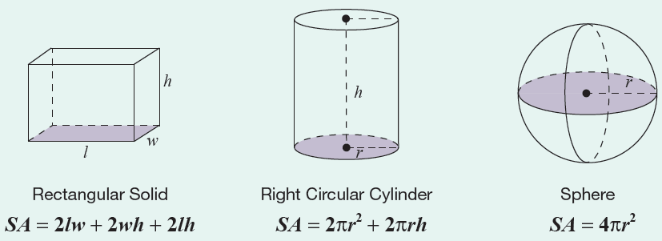
Formula: Surface Area Formulas for Three Geometric Solids

Slide 64
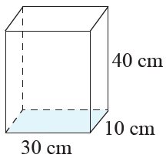
Example 24: Calculating the Surface Area of a Rectangular Solid
Calculate the surface area of a rectangular solid with length 30 cm, width 10 cm, and height 40 cm.
Solution
Using the formula for the surface area
of a rectangular solid, we have the following.
The surface area of the rectangular solid is 3800 cm²

Slide 65
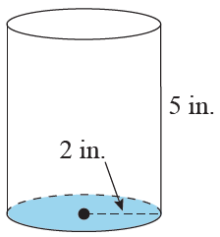
Example 25: Calculating the Surface Area of a Cylinder₁
Calculate the surface area of a coffee can in the shape of a cylinder with a height of 5 in. and a circular base with a radius of 2 in.

Slide 66
Example 25: Calculating the Surface Area of a Cylinder₂
Solution
Using the formula for the surface area of a
cylinder, we have the following.
The surface area of the cylinder is 87.92 in. ²

