Slide 1
Section 1.4
Properties of Radicals

Slide 2
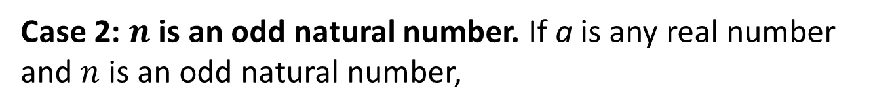
Definition: Radical Notation₁
Case 1: n is an even natural number. If a is a nonnegative real number and n is an even natural number,
is the nonnegative real number b with the property that
That is,
Note that
Case 2: $n$ is an odd natural number. If a is any real number and $n$ is an odd natural number,
is the real number b
(whose sign will be the same as the sign of a) with the property that
Again,

Slide 3
Definition: Radical Notation₂
gives the n^{th} root of a in radical
The expression
notation. The natural number n is called the index, a is the radicand, and √ is called a radical sign.
By convention,
is usually simply written as √ .

Slide 4
Definition: Perfect Powers
A perfect square is an integer equal to the square of another integer. The square root of a perfect square is always an integer.
A perfect cube is an integer equal to the cube of another integer. The cube root of a perfect cube is always an integer.

Slide 5
Example 1: Using Radical Notation₁
is not a real number, as no real number raised to the fourth power is –16.
Note that the fourth root of 16 is a real number, which is then multiplied by –1.
for any natural number n.
for any natural number n.
for any odd natural number n.

Slide 6
Example 1: Using Radical Notation₂
In general, if n is an even natural
number,
for any real number a. Remember,
though, that
if n is an odd natural number.

Slide 7
Example 2: Using Radical Notation₁
Given a right triangle with legs of length a and b, the Pythagorean Theorem states that the length of the hypotenuse c is given by
In this formula from the Pythagorean Theorem, find the following:
​The radicand
​The index
​The value of c if a = 5 and b = 12
​The value of c if a = 1 and b = 2

Slide 8
Example 2: Using Radical Notation₂
Solution
​The radicand is the quantity beneath the radical sign, a² + b².
​Because no index is indicated, the index is 2.
​

Slide 9
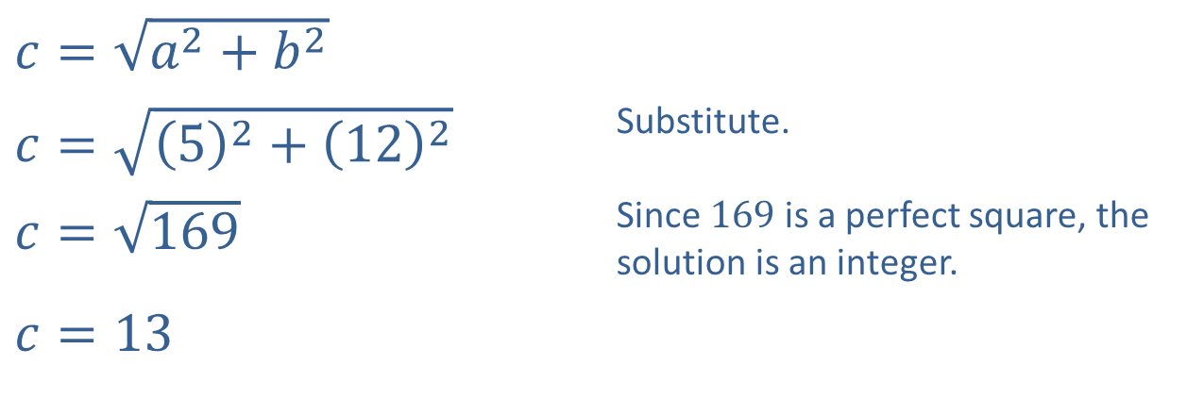
Example 2: Using Radical Notation₃
​$c=\sqrt{a^{2}+b^{2}}$
​$c=\sqrt{{\left(5\right)}^{2}+{\left(12\right)}^{2}}$ | Substitute.
​$c=\sqrt{169}$ | Since 169 is a perfect square, the solution is an integer.
​$c=13$
c. ​

Slide 10
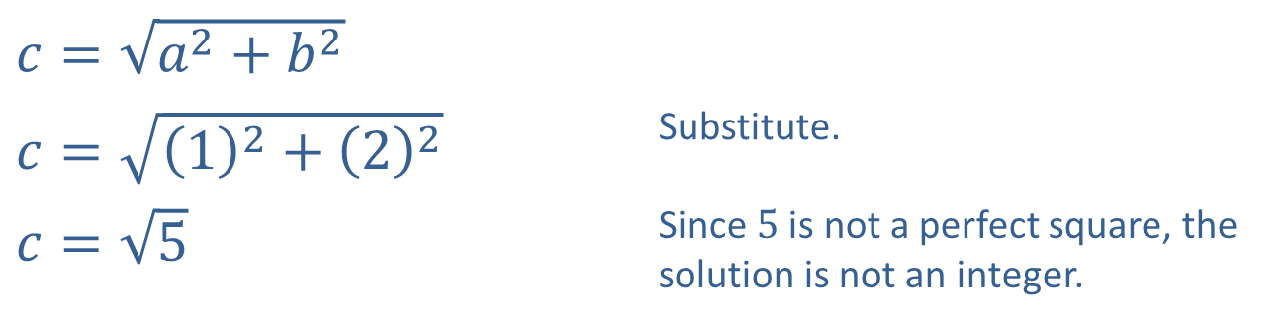
Example 2: Using Radical Notation₄
​$c=\sqrt{a^{2}+b^{2}}$
​$c=\sqrt{{\left(1\right)}^{2}+{\left(2\right)}^{2}}$ | Substitute.
​$c=\sqrt{5}$ | Since 5 is not a perfect square, the solution is not an integer.
​

Slide 11
Definition: Simplified Radical Form
A radical expression is in simplified form when the following conditions are met:
​The radicand contains no factor with an exponent greater than or equal to the index of the radical.
​The radicand contains no fractions.
​The denominator, if there is one, contains no radical.
​The greatest common factor of the index and any exponent occurring in the radicand is 1. That is, the index and any exponent in the radicand have no common factor other than 1.

Slide 12
Properties: Properties of Radicals₁
In the following properties, a and b may be taken to represent constants, variables, or more complicated algebraic expressions. The letters n and m represent natural numbers. It is assumed that all expressions are defined and are real numbers.

Slide 13
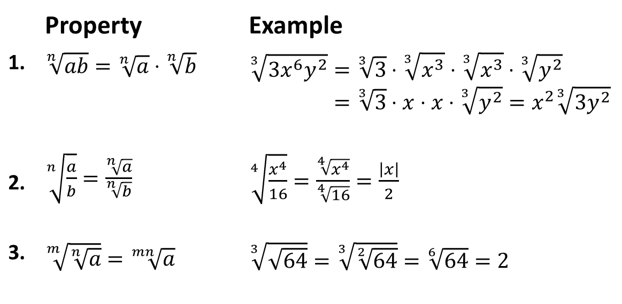
Properties: Properties of Radicals₂
 | Property | Example
1. | ​$\sqrt[n]{ab}=\sqrt[n]{a}⋅\sqrt[n]{b}$ | 33𝑥6𝑦2=33⋅3𝑥3⋅3𝑥3⋅3𝑦233𝑥6𝑦2=33⋅𝑥⋅𝑥⋅3𝑦2=𝑥233𝑦2
2. | ​$\sqrt[n]{\frac{a}{b}}=\frac{\sqrt[n]{a}}{\sqrt[n]{b}}$ | ​$\sqrt[4]{\frac{x^{4}}{16}}=\frac{\sqrt[4]{x^{4}}}{\sqrt[4]{16}}=\frac{\left|x\right|}{2}$
3. | ​$\sqrt[m]{\sqrt[n]{a}}=\sqrt[mn]{a}$ | ​$\sqrt[3]{\sqrt{64}}=\sqrt[3]{\sqrt[2]{64}}=\sqrt[6]{64}=2$

Slide 14
Example 3: Simplifying Radical Expressions₁
Simplify the following radical expressions.

Slide 15
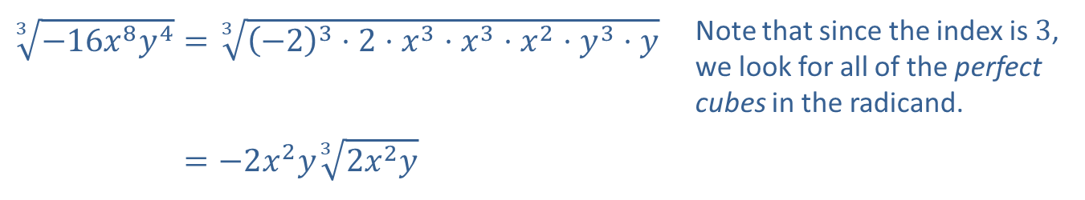
Example 3: Simplifying Radical Expressions₂
Solution
​
​$\sqrt[3]{−16x^{8}y^{4}}=\sqrt[3]{{\left(−2\right)}^{3}⋅2⋅x^{3}⋅x^{3}⋅x^{2}⋅y^{3}⋅y}$ | Note that since the index is 3, we look for all of the perfect cubes in the radicand.
​3−16𝑥8𝑦4=−2𝑥2𝑦32𝑥2𝑦

Slide 16
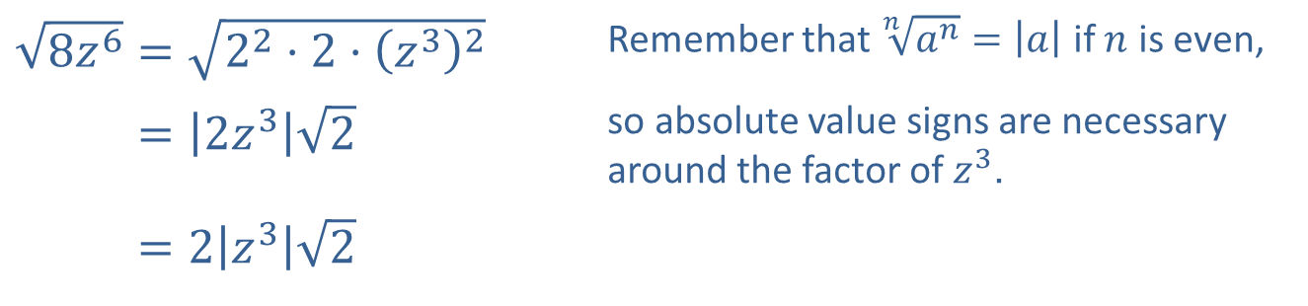
Example 3: Simplifying Radical Expressions₃
​$\sqrt{8z^{6}}=\sqrt{2^{2}⋅2⋅{\left(z^{3}\right)}^{2}}$ | Remember that $\sqrt[n]{a^{n}}=\left|a\right|$ if $n$ is even,
​8𝑧6=2𝑧32 | so absolute value signs are necessary around the factor of $z^{3}$.
​8𝑧6=2𝑧32
​

Slide 17
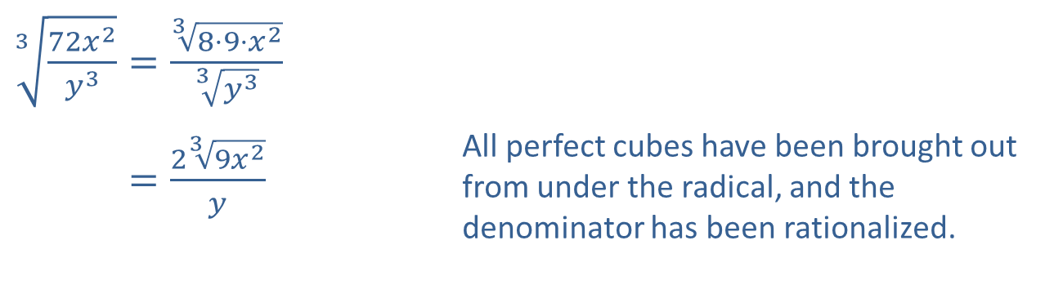
Example 3: Simplifying Radical Expressions₄
​$\sqrt[3]{\frac{72x^{2}}{y^{3}}}=\frac{\sqrt[3]{8⋅9⋅x^{2}}}{\sqrt[3]{y^{3}}}$
​372𝑥2𝑦3=239𝑥2𝑦 | All perfect cubes have been brought out from under the radical, and the denominator has been rationalized.
​

Slide 18
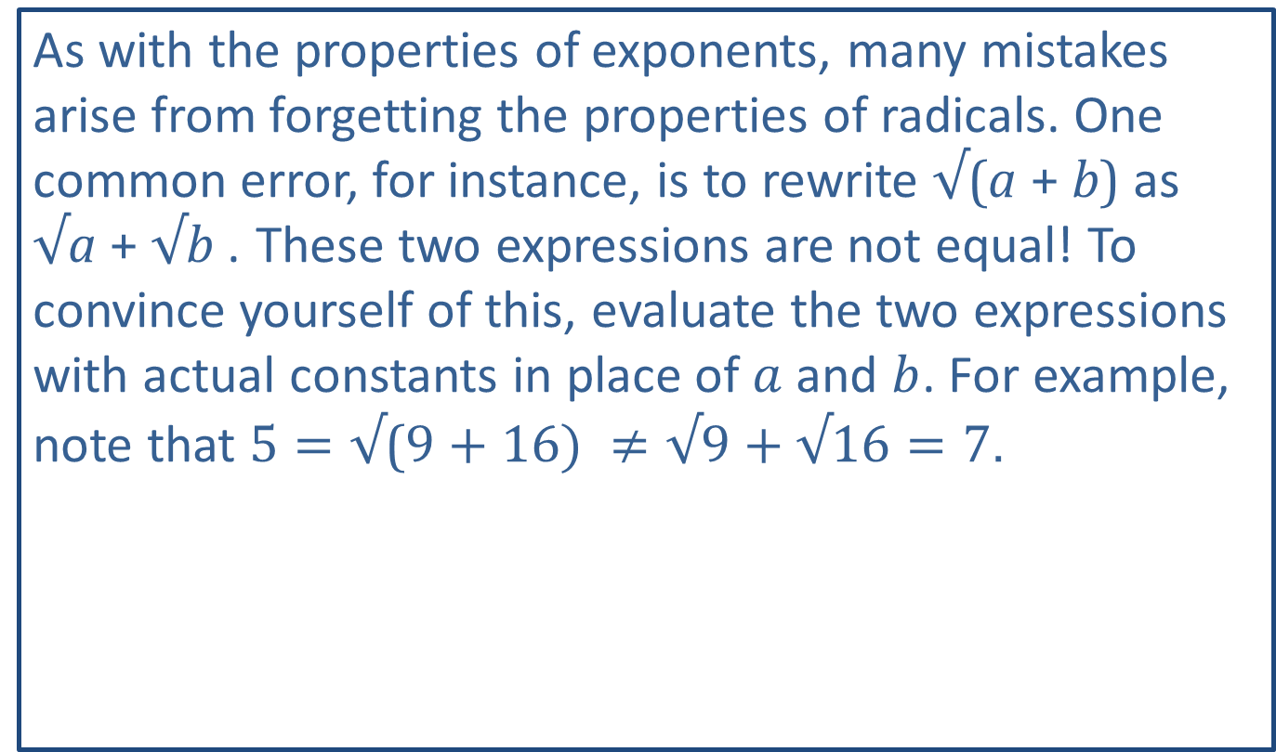
CAUTION!
As with the properties of exponents, many mistakes arise from forgetting the properties of radicals. One common error, for instance, is to rewrite √(a + b) as √a + √b . These two expressions are not equal! To convince yourself of this, evaluate the two expressions with actual constants in place of $a$ and $b$. For example, note that $5=\text{√}\text{(}9+16) ≠\text{√}9+\text{√}16=7$.

Slide 19
Example 4: Rationalizing the Denominator₁
Simplify the following radical expressions.

Slide 20
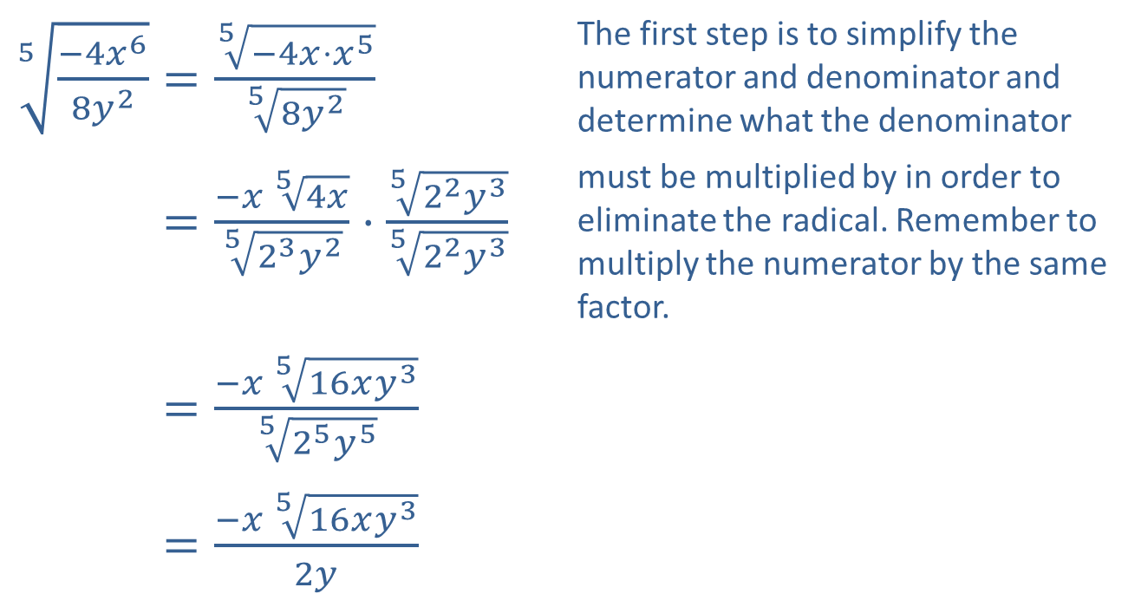
Example 4: Rationalizing the Denominator₂
Solution
​
​$\sqrt[5]{\frac{−4x^{6}}{8y^{2}}}=\frac{\sqrt[5]{−4x⋅x^{5}}}{\sqrt[5]{8y^{2}}}$ | The first step is to simplify the numerator and denominator and determine what the denominator
​5−4𝑥68𝑦2=−𝑥 54𝑥523𝑦2⋅522𝑦3522𝑦3 | must be multiplied by in order to eliminate the radical. Remember to multiply the numerator by the same factor.
​5−4𝑥68𝑦2=−𝑥 516𝑥𝑦3525𝑦5
​5−4𝑥68𝑦2=−𝑥 516𝑥𝑦32𝑦

Slide 21
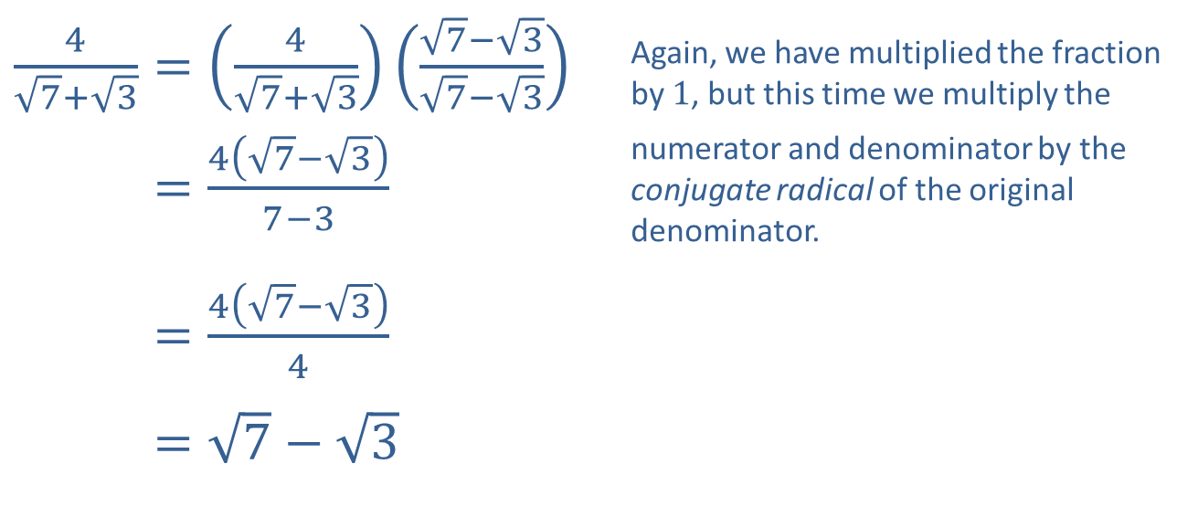
Example 4: Rationalizing the Denominator₃
​$\frac{4}{\sqrt{7}+\sqrt{3}}=\left(\frac{4}{\sqrt{7}+\sqrt{3}}\right)\left(\frac{\sqrt{7}−\sqrt{3}}{\sqrt{7}−\sqrt{3}}\right)$ | Again, we have multiplied the fraction by 1, but this time we multiply the
​47+3=47−37−3 | numerator and denominator by the conjugate radical of the original denominator.
​47+3=47−34
​47+3=7−3
​

Slide 22
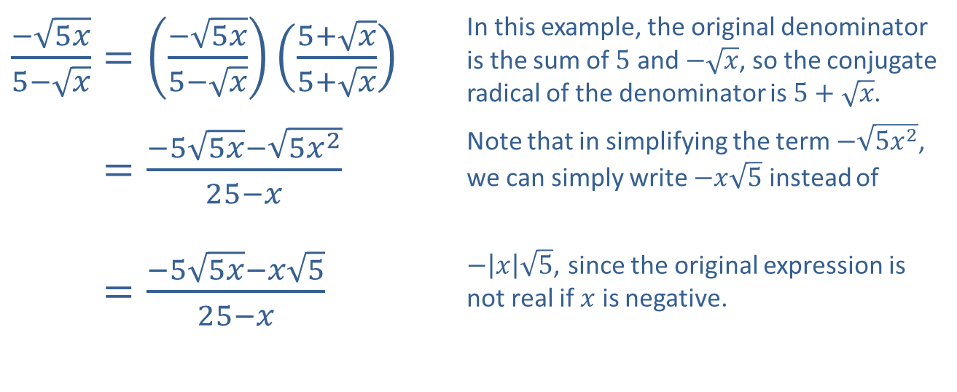
Example 4: Rationalizing the Denominator₄
​$\frac{−\sqrt{5x}}{5−\sqrt{x}}=\left(\frac{−\sqrt{5x}}{5−\sqrt{x}}\right)\left(\frac{5+\sqrt{x}}{5+\sqrt{x}}\right)$ | In this example, the original denominator is the sum of 5 and $−\sqrt{x}$, so the conjugate radical of the denominator is $5+\sqrt{x}$.
​−5𝑥5−𝑥=−55𝑥−5𝑥225−𝑥 | Note that in simplifying the term $−\sqrt{5x^{2}}$, we can simply write $−x\sqrt{5}$ instead of
​−5𝑥5−𝑥=−55𝑥−𝑥525−𝑥 | $−\left|x\right|\sqrt{5}$, since the original expression is not real if $x$ is negative.
​

Slide 23
Example 5: Rationalizing the Numerator₁
Rationalize the numerator of the fraction

Slide 24
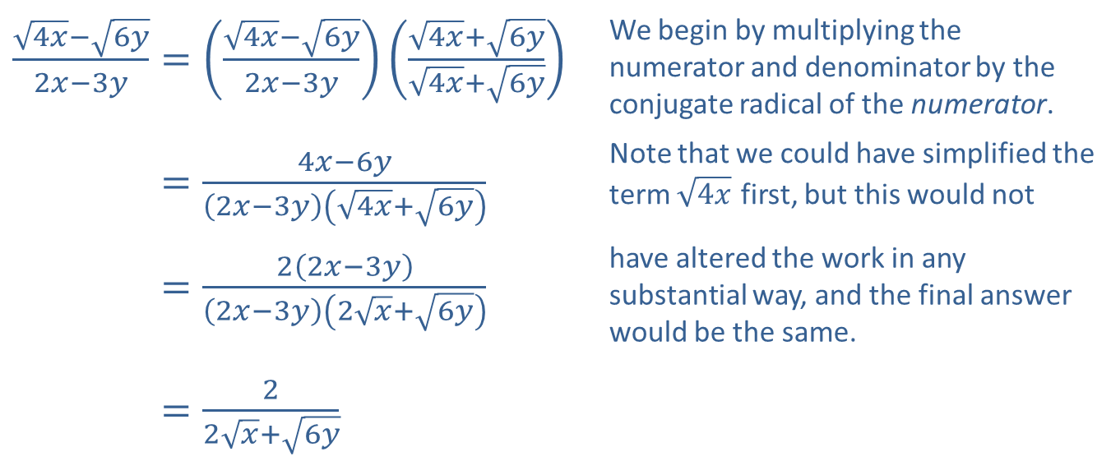
Example 5: Rationalizing the Numerator₂
Solution
​$\frac{\sqrt{4x}−\sqrt{6y}}{2x−3y}=\left(\frac{\sqrt{4x}−\sqrt{6y}}{2x−3y}\right)\left(\frac{\sqrt{4x}+\sqrt{6y}}{\sqrt{4x}+\sqrt{6y}}\right)$ | We begin by multiplying the numerator and denominator by the conjugate radical of the numerator.
​4𝑥−6𝑦2𝑥−3𝑦=4𝑥−6𝑦2𝑥−3𝑦4𝑥+6𝑦 | Note that we could have simplified the term $\sqrt{4x}$ first, but this would not
​4𝑥−6𝑦2𝑥−3𝑦=22𝑥−3𝑦2𝑥−3𝑦2𝑥+6𝑦 | have altered the work in any substantial way, and the final answer would be the same.
​4𝑥−6𝑦2𝑥−3𝑦=22𝑥+6𝑦

Slide 25
Example 6: Combining Radical Expressions₁
Combine the radical expressions, if possible.

Slide 26
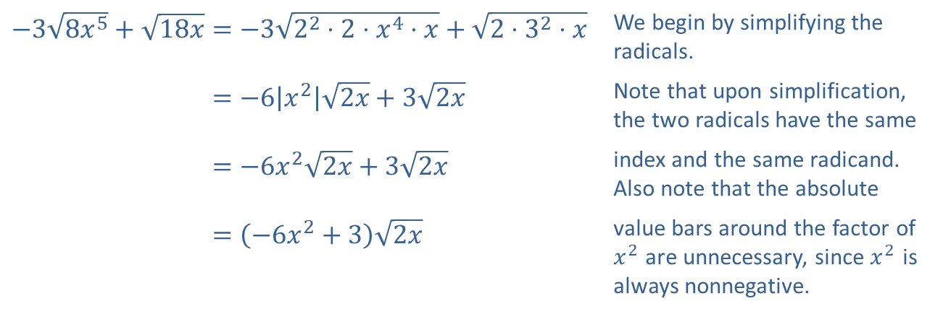
Example 6: Combining Radical Expressions₂
Solution
​
​$−3\sqrt{8x^{5}}+\sqrt{18x}=−3\sqrt{2^{2}⋅2⋅x^{4}⋅x}+\sqrt{2⋅3^{2}⋅x}$ | We begin by simplifying the radicals.
​−38𝑥5+18𝑥=−6𝑥22𝑥+32𝑥 | Note that upon simplification, the two radicals have the same
​−38𝑥5+18𝑥=−6𝑥22𝑥+32𝑥 | index and the same radicand. Also note that the absolute
​−38𝑥5+18𝑥=−6𝑥2+32𝑥 | value bars around the factor of $x^{2}$ are unnecessary, since $x^{2}$ is always nonnegative.

Slide 27
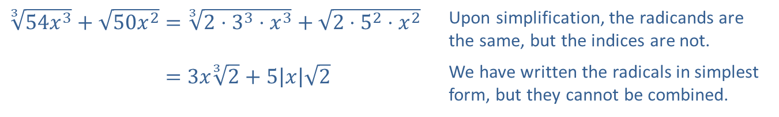
Example 6: Combining Radical Expressions₃
​
​$\sqrt[3]{54x^{3}}+\sqrt{50x^{2}}=\sqrt[3]{2⋅3^{3}⋅x^{3}}+\sqrt{2⋅5^{2}⋅x^{2}}$ | Upon simplification, the radicands are the same, but the indices are not.
​354𝑥3+50𝑥2=3𝑥32+5𝑥2 | We have written the radicals in simplest form, but they cannot be combined.

Slide 28
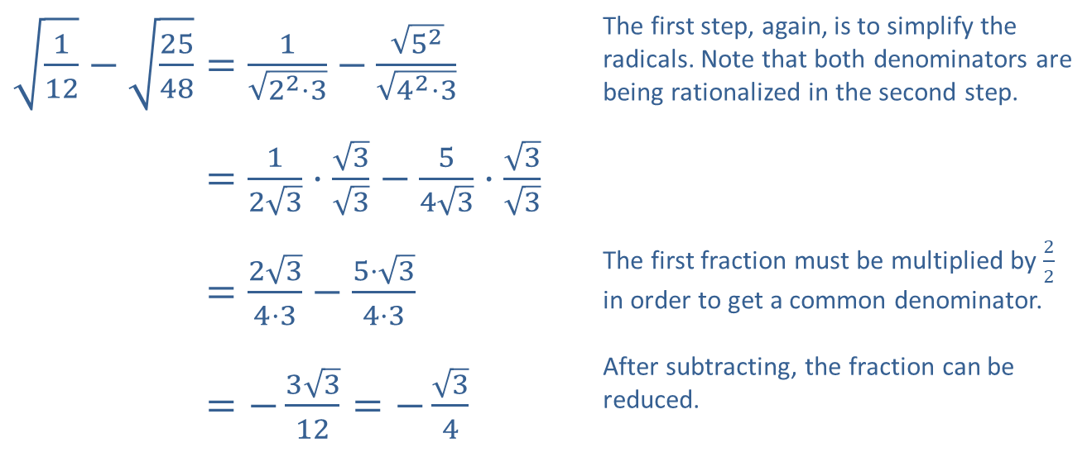
Example 6: Combining Radical Expressions₄
​$\sqrt{\frac{1}{12}}−\sqrt{\frac{25}{48}}=\frac{1}{\sqrt{2^{2}⋅3}}−\frac{\sqrt{5^{2}}}{\sqrt{4^{2}⋅3}}$ | The first step, again, is to simplify the radicals. Note that both denominators are being rationalized in the second step.
​112−2548=123⋅33−543⋅33
​112−2548=234⋅3−5⋅34⋅3 | The first fraction must be multiplied by $\frac{2}{2}$ in order to get a common denominator.
​112−2548=−3312=−34 | After subtracting, the fraction can be reduced.
​

Slide 29
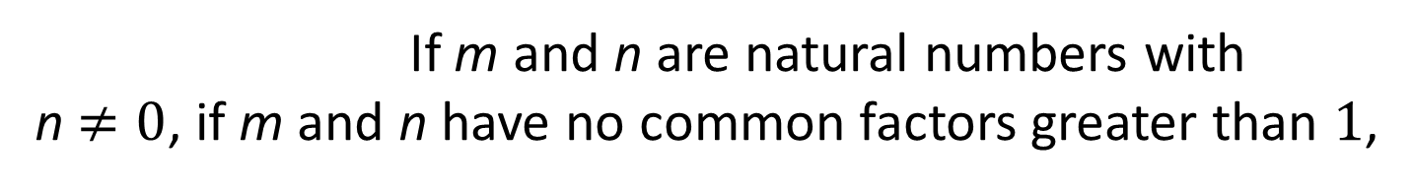
Definition: Rational Number Exponents
Meaning of
If n is a natural number and if
is a real number, then
If m and n are natural numbers with n$≠0$, if m and n have no common factors greater than 1,
and if
is a real number, then
Either
can be used to evaluate
as they are equal.
is defined to be

Slide 30
Example 7: Simplifying Expressions₁
Simplify each of the following expressions, writing your answer using the same notation as the original expression.

Slide 31
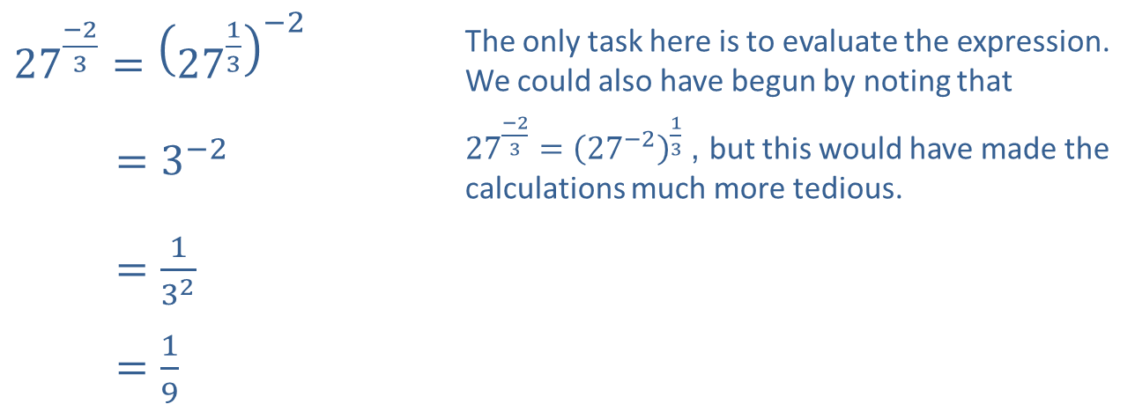
Example 7: Simplifying Expressions₂
Solution
​
​${27}^{\frac{−2}{3}}={\left({27}^{\frac{1}{3}}\right)}^{−2}$ | The only task here is to evaluate the expression. We could also have begun by noting that
​27−23=3−2 | ${27}^{\frac{−2}{3}}={\left({27}^{−2}\right)}^{\frac{1}{3}}$, but this would have made the calculations much more tedious.
​27−23=132
​27−23=19

Slide 32
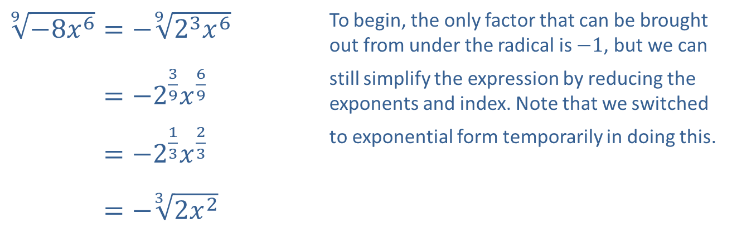
Example 7: Simplifying Expressions₃
b. ​
​$\sqrt[9]{−8x^{6}}=−\sqrt[9]{2^{3}x^{6}}$ | To begin, the only factor that can be brought out from under the radical is $−1$, but we can
​9−8𝑥6=−239𝑥69 | still simplify the expression by reducing the exponents and index. Note that we switched
​9−8𝑥6=−213𝑥23 | to exponential form temporarily in doing this.
​9−8𝑥6=−32𝑥2

Slide 33
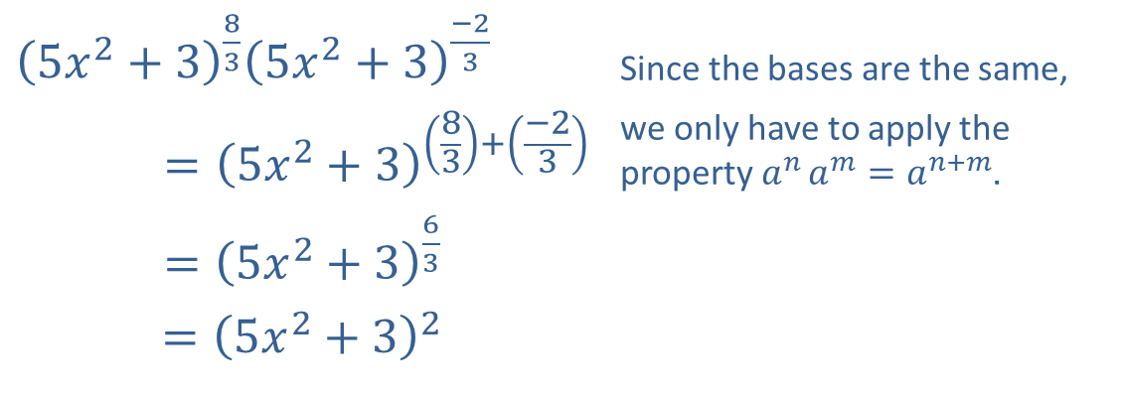
Example 7: Simplifying Expressions₄
​${\left(5x^{2}+3\right)}^{\frac{8}{3}}{\left(5x^{2}+3\right)}^{\frac{−2}{3}}$ | Since the bases are the same,
$$={\left(5x^{2}+3\right)}^{\left(\frac{8}{3}\right)+\left(\frac{−2}{3}\right)}$$ | we only have to apply the property $a^{n}{a^{m}}=a^{n+m}$.
​$={\left(5x^{2}+3\right)}^{\frac{6}{3}}$
​$={\left(5x^{2}+3\right)}^{2}$
c.

Slide 34
Example 7: Simplifying Expressions₅
d. ​Use the property stating
to simplify this expression.

Slide 35
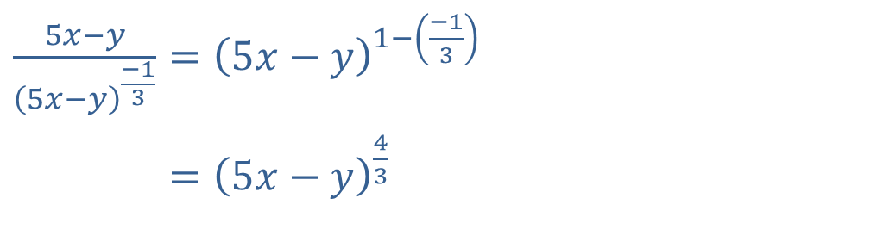
Example 7: Simplifying Expressions₆
e. We use the property
to simplify this expression.
​$\frac{5x−y}{{\left(5x−y\right)}^{\frac{−1}{3}}}={\left(5x−y\right)}^{1−\left(\frac{−1}{3}\right)}$
​5𝑥−𝑦5𝑥−𝑦−13=5𝑥−𝑦43

Slide 36
Example 8: Simplifying Radical Expressions₁
​Simplify the expression
​b. Write
as a single radical.

Slide 37
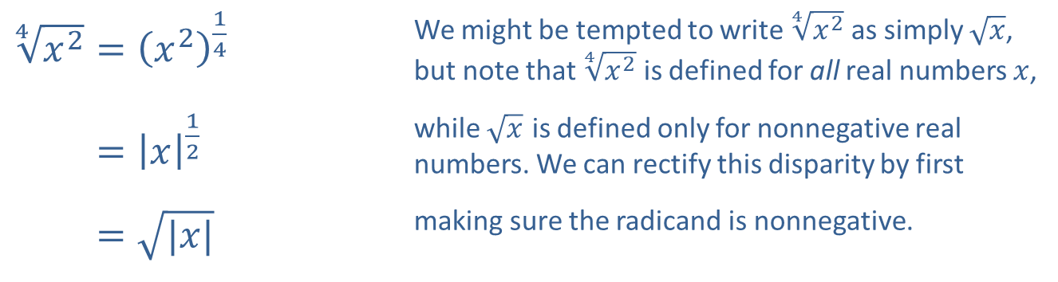
Example 8: Simplifying Radical Expressions₂
Solution
​
​$\sqrt[4]{x^{2}}={\left(x^{2}\right)}^{\frac{1}{4}}$ | We might be tempted to write $\sqrt[4]{x^{2}}$ as simply $\sqrt{x}$, but note that $\sqrt[4]{x^{2}}$ is defined for all real numbers $x$,
​4𝑥2=𝑥12 | while $\sqrt{x}$ is defined only for nonnegative real numbers. We can rectify this disparity by first
​4𝑥2=|𝑥| | making sure the radicand is nonnegative.

Slide 38
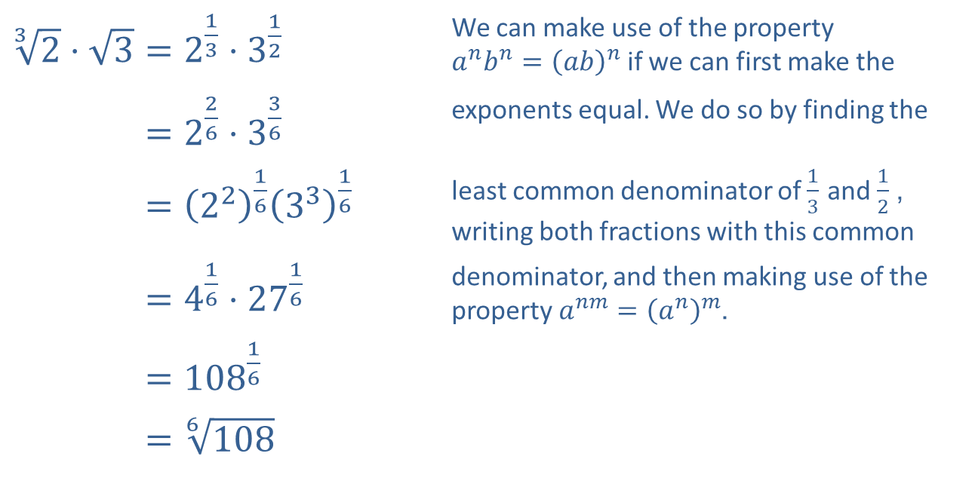
Example 8: Simplifying Radical Expressions₃
​$\sqrt[3]{2}⋅\sqrt{3}=2^{\frac{1}{3}}⋅3^{\frac{1}{2}}$ | We can make use of the property $a^{n}b^{n}={\left(ab\right)}^{n}$ if we can first make the
​32⋅3=226⋅336 | exponents equal. We do so by finding the
​32⋅3=22163316 | least common denominator of $\frac{1}{3}$ and $\frac{1}{2}$, writing both fractions with this common
​32⋅3=416⋅2716 | denominator, and then making use of the property $a^{nm}={\left(a^{n}\right)}^{m}$.
​32⋅3=10816
​32⋅3=6108
​

Slide 39
Example 9: Using Radical Notation₁
A regular hexagon is a six-sided plane figure whose sides are all the same length and whose interior angles are all the same. We can use Heron's formula to derive a formula for the area of a regular hexagon with side length d as follows.

Slide 40
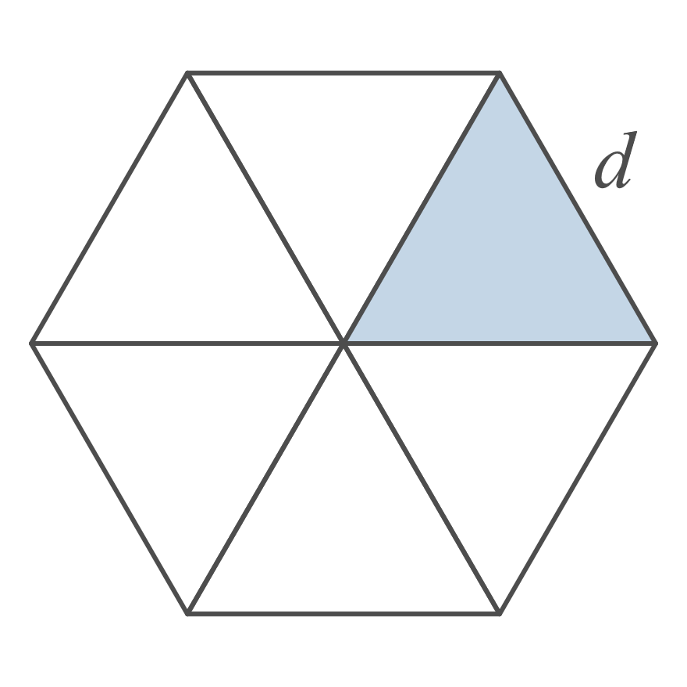
Example 9: Using Radical Notation₂
Solution
Begin by drawing three line segments joining each vertex to the vertex diagonally opposite it. The sum of the six angles meeting in the middle must be 360 degrees and all of the angles are equal, so each one must be a 60-degree angle. By symmetry, each of the six triangles making up the hexagon is isosceles, so each of the remaining two angles in any one triangle must measure 60 degrees as well. Thus each triangle is both equilateral and equiangular.

Slide 41
Example 9: Using Radical Notation₃
Heron’s formula tells us that the area of an equilateral
triangle of side length d is
Expressing this in terms of d alone, each triangle has
area
Simplifying this radical, we
obtain
Since the hexagon is made up of six of
these triangles, the total area A of the hexagon is

