Slide 1
Section 7.R.4
Logarithmic Functions

Slide 2
Objectives
Translate expressions between exponential and logarithmic form.
Evaluate logarithms by using their basic properties.
Use the definitions of exponential and logarithmic functions to solve equations.
Graph exponential and logarithmic functions on the same set of axes.

Slide 3
Definition: Definition of Logarithm (base b)
For b > 0 and b ≠ 1,
is read “y is the logarithm (base b) of x.”

Slide 4
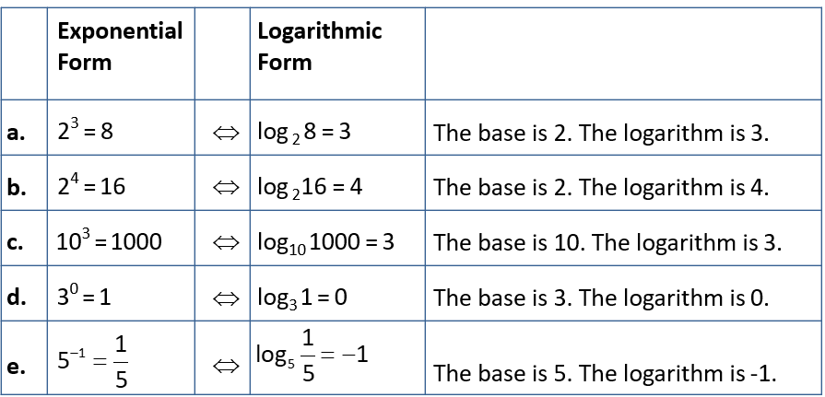
Example 1: Translating Between Exponential and Logarithmic Form
Note that in each case the base of the exponent is the base of the logarithm.

Slide 5
Properties: Basic Properties of Logarithms
For b > 0 and b ≠ 1,
Regardless of the base, the logarithm of 1 is 0.
The logarithm of the base is always 1.
For x > 0

Slide 6
Example 2: Evaluating Logarithms₁
Use the four basic properties of logarithms to evaluate each expression.
By property 1
By property 2
By property 3
Write 32 as 2⁵ , so the base is 2.
By property 4

Slide 7
Example 2: Evaluating Logarithms₂

Slide 8
Example 3: Solving Logarithmic Equations
Solve by first changing the equation to exponential
form:
Solution
Write the equation in exponential form
and solve for x.

Slide 9
Example 4: Solving Logarithmic Equations₁
Solve by first changing the equation to exponential form:
Solution

Slide 10
Example 4: Solving Logarithmic Equations₂

