Slide 1
Section 7.R.3
Rational Exponents

Slide 2
Objectives
Evaluate n^{th} roots.
Translate between radical expressions and expressions with rational exponents.
Use the properties of rational exponents to simplify expressions.
Use a graphing calculator to evaluate expressions with rational exponents.

Slide 3
n^{th} Roots
Type of Root | Radical Notation and Exponential Notation | Example
square roots
cube roots
fourth roots
n^{th} roots

Slide 4
Definition: Radical Notation
If n is an integer greater than 1, then
(assuming
is a real number).
The expression
is called a radical.
The symbol
is called a radical sign.
n is called the index.
a is called the radicand.
Note: If no index is given, it is understood to be 2. For
example,

Slide 5
Special Notes about the Index n: Note
For the expression
to be a real number
(assuming n is an integer greater than 1):
1. when a is nonnegative, n can be any index, and
2. when a is negative, n must be odd.
(If a is negative and n is even, then
is not a real number.)

Slide 6
Example 1: Evaluating n^{th} Roots
Any even root of a negative number is not a real number.

Slide 7
Properties: Summary of the Rules for Exponents₁
For nonzero real numbers a and b and rational numbers m and n,
1. The exponent 1:
(a is any real number.)
2. The exponent 0:
(a ≠ 0)
3. The product rule:
4. The quotient rule:

Slide 8
Properties: Summary of the Rules for Exponents₂
5. Negative exponents:
6. Power rule:
7. Power of a product:
8. Power of a quotient:

Slide 9
Definition: The General Form
If n is an integer greater than 1, m is any integer, and
is a real number, then
In radical notation:

Slide 10
Example 2: Converting from Exponential Notation to Radical Notation₁
Assume that each variable represents a positive real number. Each expression is changed to an equivalent expression in either radical or exponential notation.
The index, 3, is the denominator in the rational exponent.
The coefficient, 3, is not affected by the exponent.
−1 is the understood coefficient.

Slide 11
Example 2: Converting from Exponential Notation to Radical Notation₂
The index, 6, is the denominator of the rational exponent.
In a square root, the index is understood to be 2.
The coefficient, −1, is not affected by the exponent. We could also write

Slide 12
Attention! Rational Exponents
For the remainder of this chapter, we will assume that all variables represent positive real numbers, unless otherwise stated.

Slide 13
Example 3: Simplifying Expressions with Rational Exponents₁
Simplify each expression using one or more of the rules for exponents.

Slide 14
Example 3: Simplifying Expressions with Rational Exponents₂

Slide 15
Example 3: Simplifying Expressions with Rational Exponents₃
The exponent can be reduced as long as the expression is real.

Slide 16
Example 4: Simplifying Radical Notation by Changing to Exponential Notation₁
Simplify each expression by first changing it into an equivalent expression with rational exponents. Then rewrite the answer in simplified radical form.

Slide 17
Example 4: Simplifying Radical Notation by Changing to Exponential Notation₂

Slide 18
Example 4: Simplifying Radical Notation by Changing to Exponential Notation₃

Slide 19

Example 5: Evaluating Rational Exponents using a Calculator₁
Evaluate the following expressions using a TI-84 Plus graphing calculator.
Solution
To find
proceed as follows.
Step 1: Enter the base, 125.
Step 2: Press the caret key .

Slide 20

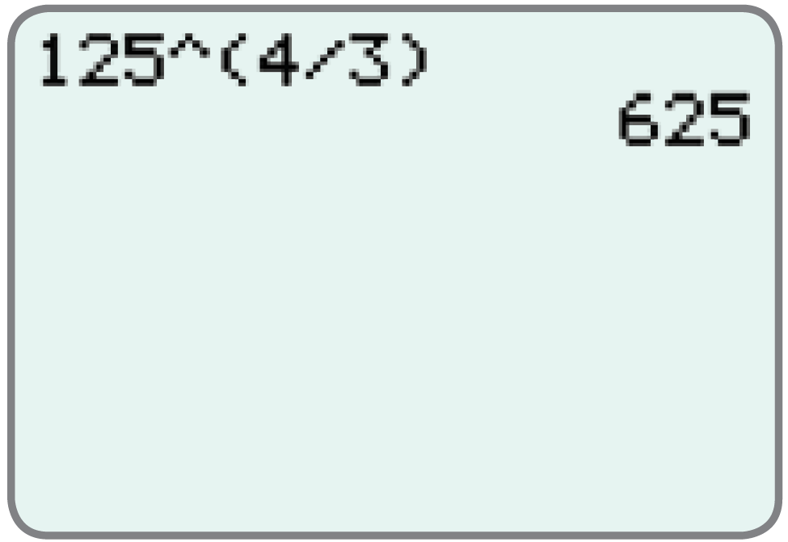
Example 5: Evaluating Rational Exponents using a Calculator₂
Step 3: Enter the exponent in parentheses,
.
Step 4: Press
The display should read as follows.

Slide 21
Example 5: Evaluating Rational Exponents using a Calculator₃
Solution
To find
proceed as follows.
Step 1: Enter the base, 36.
Step 2: Press the caret key .

Slide 22
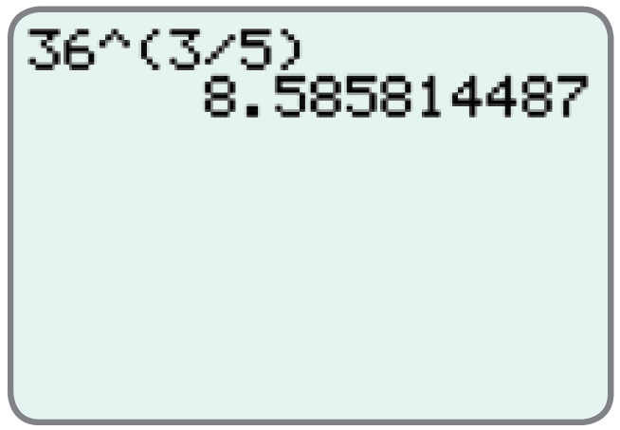
Example 5: Evaluating Rational Exponents using a Calculator₄
Step 3: Enter the exponent in parentheses,
Step 4: Press .
The display should read as follows.

