Slide 1
Section 5.R.7
Simplifying Complex Fractions

Slide 2
Objectives
Simplify complex fractions by simplifying the numerator and denominator and then dividing.
Simplify complex fractions by multiplying by the LCM of all denominators and then simplifying.
Simplify complex algebraic expressions.

Slide 3
Procedure: To Simplify Complex Fractions (First Method)
Simplify the numerator so that it is a single rational expression.
Simplify the denominator so that it is a single rational expression.
Divide the numerator by the denominator and reduce to lowest terms.

Slide 4
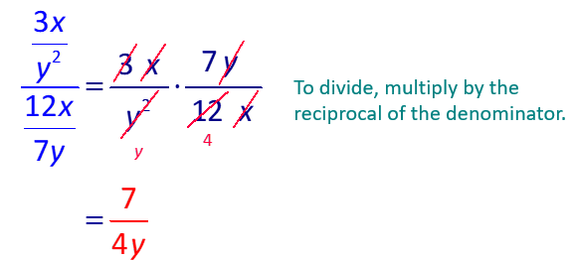
Example 1: First Method for Simplifying Complex Fractions
Simplify the complex fraction
Solution

Slide 5
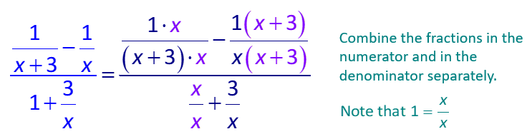
Example 2: First Method for Simplifying Complex Fractions₁
Simplify the following complex fraction.
Solution

Slide 6
Example 2: First Method for Simplifying Complex Fractions₂

Slide 7
Example 3: First Method for Simplifying Complex Fractions₁
Simplify the complex fraction.
Solution

Slide 8
Example 3: First Method for Simplifying Complex Fractions₂

Slide 9
Procedure: To Simplify Complex Fractions (Second Method)
Find the LCM of all the denominators in the numerator and denominator of the complex fraction.
Multiply both the numerator and denominator of the complex fraction by this LCM.
Simplify both the numerator and denominator and reduce to lowest terms.

Slide 10
Example 4: Second Method for Simplifying Complex Fractions₁
Simplify the following complex fractions.
Solution
Multiply by x(x + 3), the LCM of {x, x + 3}. This multiplication can be done because the net effect is that the fraction is multiplied by 1.

Slide 11
Example 4: Second Method for Simplifying Complex Fractions₂
Note that this matches the result found in Example 2 using Method 1.

Slide 12
Example 5: Second Method for Simplifying Complex Fractions
Simplify the complex fraction.
Solution
Multiply by xy, the LCM of {1, x, y}.

Slide 13
Example 6: Simplifying Complex Algebraic Expressions₁
Simplify the following expression.
Solution
The rules for order of operations indicate that the division is to be done first, followed by the addition.

Slide 14
Example 6: Simplifying Complex Algebraic Expressions₂

