Slide 1
Section 4.R.6
Factoring Trinomials:
a x² + bx + c

Slide 2
Objectives
Use the trial-and-error method to factor trinomials.
Use the ac-method to factor trinomials.

Slide 3
Guidelines for the Trial-and-Error Method
If the sign of the constant term is positive (+), the signs in both factors will be the same, either both positive or both negative.
If the sign of the constant term is negative (−), the signs in the factors will be different, one positive and one negative.

Slide 4
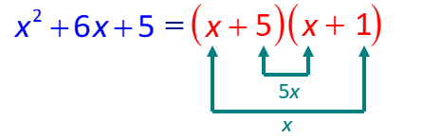
Example 1: Using the Trial-and-Error Method₁
Use the trial-and-error method to factor each polynomial.
a. x² + 6x + 5, b. 4x² −4x −15 , c. 6a² −31a + 5
Solution
a. Since the middle term is +6x and the constant is 5,
we know that the two factors of 5 must both be
positive, +5 and +1.

Slide 5
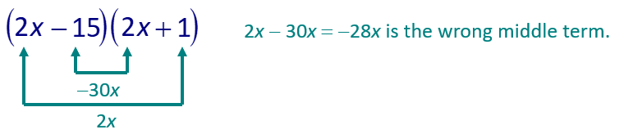
Example 1: Using the Trial-and-Error Method₂
b. 4x² − 4x − 15 ,
For F: 4x ² = 4x ⋅ x and 4x² = 2x ⋅ 2x.
For L: −15 = −15 ⋅ 1, −15 = −1 ⋅ 15, −15 = −3 ⋅ 5, and
−15 = −5 ⋅ 3.
Trials

Slide 6
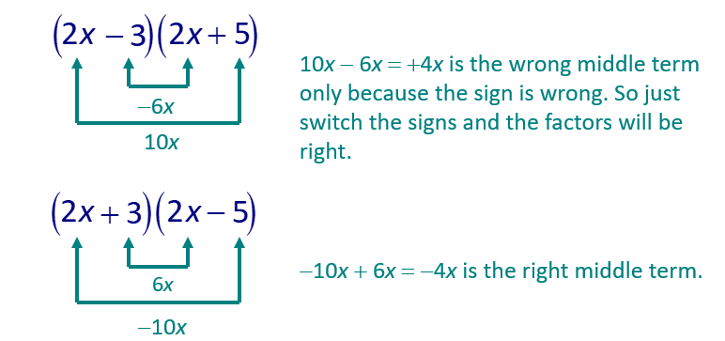
Example 1: Using the Trial-and-Error Method₃
Now that we have the answer, there is no need to try all the possibilities with (4x)(x).

Slide 7
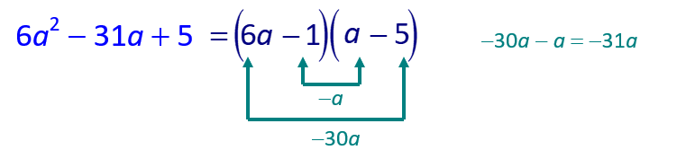
Example 1: Using the Trial-and-Error Method₄
c. 6 a² −31a + 5
Since the middle term is −31a and the constant is +5, we know that the two factors of 5 must both be negative, −5 and −1. We try F = 6 a² = 6a ⋅ a.
We found the correct factors on the first try.

Slide 8
Example 2: Factoring Trinomials₁
Completely factor each polynomial. Be sure to look first for the greatest common monomial factor.
Solution
To begin, factor out the common monomial 2x.

Slide 9
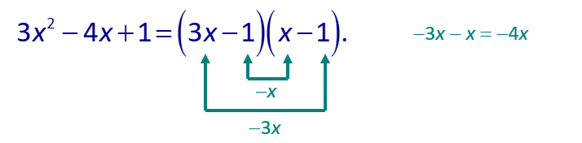
Example 2: Factoring Trinomials₂
Now, factor the trinomial 3x ² − 4x + 1. Since the middle term is −4x and the constant is +1, we know that the two factors of 1 must both be negative, −1 and −1. We also know that F = 3x ² = 3x ⋅ x. This gives
Thus,
Be careful to include the monomial term in the answer.

Slide 10
Example 2: Factoring Completely₃
Check:
Check the factorization by multiplying.

Slide 11
Example 2: Factoring Completely₄
c.
Now consider the trinomial:
The factors of +1 need to be +1 and +1, but
So there is no way to factor and get a middle term of +x for the product. This trinomial, 2x ² + x + 1, is not factorable.
Thus,

Slide 12
Notes: The Trial-and-Error Method of Factoring
Reminder: To factor completely means to find factors of the polynomial, none of which are themselves factorable. Thus
is not factored completely because
We could write
This problem can be avoided by first factoring out the GCF (in this case, 2).

Slide 13
Procedure: Analysis of Factoring by the ac-Method₁
 | General Method ax² + bx + c | Example 2x² + 9x + 10
Step 1: | Multiply a ∙ c. | Multiply 2 · 10 = 20.

Slide 14
Procedure: Analysis of Factoring by the ac-Method₂
Step 2: | Find two integers whose product is ac and whose sum is b. If this is not possible, then the trinomial is not factorable. | Find two integers whose product is 20 and whose sum is 9. In this case, 4 ⋅ 5 = 20 and 4 + 5 = 9.)

Slide 15
Procedure: Analysis of Factoring by the ac-Method₃
Step 3: | Rewrite the middle term (bx) using the two numbers found in Step 2 as coefficients. | Rewrite the middle term (+9x) using +4 and +5 as coefficients. 2x² + 9x + 10 = 2x² + 4x + 5x + 10

Slide 16
Procedure: Analysis of Factoring by the ac-Method₄
Step 4: | Factor by grouping the first two terms and the last two terms. | Factor by grouping the first two terms and the last two terms. 2x²+ 4x + 5x + 10 = (2x²+ 4x)+(5x + 10) = 2x(x + 2)+5(x + 2)

Slide 17
Procedure: Analysis of Factoring by the ac-Method₅
Step 5: | Factor out the common binomial factor. This will give two binomial factors of the trinomial ax² + bx + c. | Factor out the common binomial factor (x + 2). Thus 2x²+ 9x + 10 2x²+ 4x + 5x + 10 (2x² + 4x) + (5x + 10) = 2x(x + 2) + 5(x + 2) = (x + 2)(2x + 5).

Slide 18
Example 3: Using the ac-Method₁
Use the ac-method to factor 3x ² + 19x + 6.
Solution
a = 3, b = 19, c = 6
Step 1: Find the product ac: 3 ⋅ 6 = 18.
Step 2: Find two integers whose product is 18 and whose sum is 19.
1 and 18 are the desired coefficients.

Slide 19
Example 3: Using the ac-Method₂
Step 3: Rewrite the middle term (+19x) as + 1x + 18x.
3x ² + 19x + 6 = 3x ² + 1x + 18x + 6
Step 4: Factor by grouping.

Slide 20
Example 3: Using the ac-Method₃
Step 5: Factor out the common binomial factor
(3x + 1).
Note that in Step 3, we could have written +19x as +18x + 1x. Try this to convince yourself that the result will be the same two factors.

Slide 21
Example 4: Using the ac-Method₁
Use the ac-method to factor 12y ³ −26y ² + 12y
Solution
First factor out the greatest common factor 2y.
Now factor the trinomial 6y ² −13y + 6 with a = 6,
b = −13, and c = 6.

Slide 22
Example 4: Using the ac-Method₂
Step 1: Find the product ac:
Step 2: Find two integers whose product is 36 and whose sum is −13.
Note: This may take some time and experimentation. We do know that both numbers must be negative because the product is positive and the sum is negative. You might try prime factoring.
For example: 36 = 2 ⋅ 2 ⋅ 3 ⋅ 3

Slide 23
Example 4: Using the ac-Method₃
With combinations of these prime factors, we can write the following.
Negative Factors of 36 | Sum
−1 · −36 | −1 + (−36) = −37
−2· −18 | −2 + (−18) = −20
−3· −12 | −3 + (−12) = −15
−4· −9 | −4 + (−9) = −13 | We can stop here
−4 and −9 are the desired coefficients.

Slide 24
Example 4: Using the ac-Method₄
Steps 3 and 4: Rewrite the middle term (−13y) as
−9y −4y.
6y ² −13y + 6= 6y ² −9y −4y + 6
Note: −2 is factored from the last two terms so that there will be a common binomial factor (2y −3).
Step 5: Factor out the common binomial factor (2y −3).

Slide 25
Example 4: Using the ac-Method₅
Thus for the original expression,

Slide 26
Example 5: Using the ac-Method₁
Use the ac-method to factor 4x ² −5x −6.
Solution
a = 4, b = −5, c = −6
Step 1: Find the product ac:
Step 2: Find two integers whose product is −24 and whose sum is −5.
Note: We know that one number must be positive and the other negative because the product is negative.

Slide 27
Example 5: Using the ac-Method₂
Steps 3: Rewrite the middle term (−5x) as +3x −8x.
Step 4 and 5: Factor out the common binomial factor
(4x +3).

Slide 28
Tips to Keep in Mind while Factoring₁
When factoring polynomials, always look for the greatest common factor first. Then, if there is one, remember to include this common factor as part of the answer.
2. To factor completely means to find factors of the polynomial such that none of the factors are themselves factorable.

Slide 29
Tips to Keep in Mind while Factoring₂
Not all polynomials are factorable. (See 2x ² + x + 1 in Example 2c.) Any polynomial that cannot be factored as the product of polynomials with integer coefficients is not factorable.
Factoring can be checked by multiplying the factors. The product should be the original expression.

Slide 30
Example 6: Factoring Trinomials
Completely factor each trinomial. Be sure to begin by looking for the greatest common factor.
15x² + 38x + 7, b. 4y² + 6y −108.
Solution

Slide 31
Notes: The ac-Method of Factoring
No matter which method you use (the ac-method or the trial-and-error method), factoring trinomials takes time. With practice, you will become more efficient with either method. Make sure to be patient and observant.

