Slide 1
Section 4.R.5
Factoring Trinomials:
x² + bx + c

Slide 2
Objectives
Factor trinomials with leading coefficient 1 (of the form x² + bx + c).
Factor trinomials by first factoring out a common monomial factor.

Slide 3
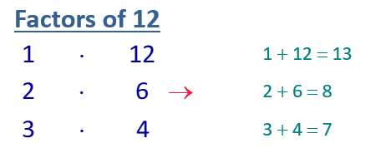
Example 1: Factoring Trinomials with Leading Coefficients of 1 ₁
Factor: x ² + 8x + 12
Solution
12 has three pairs of positive integer factors, as illustrated below.
Of these 3 pairs, only 2 + 6 is equal to 8.

Slide 4
Example 1: Factoring Trinomials with Leading Coefficients of 1 ₂
Note: If the middle term had been −8x, then we would have wanted pairs of negative integer factors to find a sum of −8. In other words, we would have found that

Slide 5
Example 2: Factoring Trinomials with Leading Coefficients of 1 ₁
Factor: y ²− 8y − 20
Solution
We want a pair of integer factors of −20 whose sum is −8. In this case, because the product is negative, one of the factors must be positive and the other negative.

Slide 6
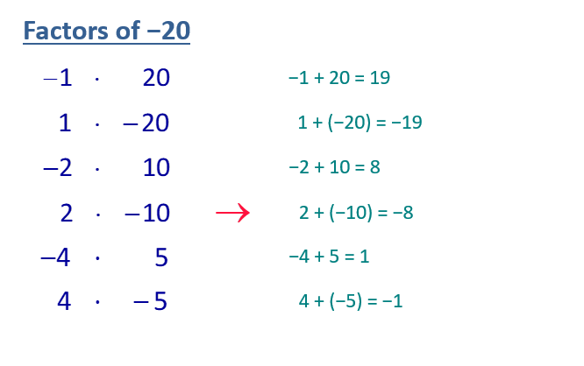
Example 2: Factoring Trinomials with Leading Coefficients of 1 ₂

Slide 7
Example 2: Factoring Trinomials with Leading Coefficients of 1 ₃
We have listed all the pairs of integer factors of −20. You can see that 2 and −10 are the only two whose sum is −8. Thus listing all the pairs is not necessary. This stage is called the trial-and-error stage. That is, you can try different pairs (mentally or by making a list) until you find the correct pair. If such a pair does not exist, the polynomial is not factorable.

Slide 8
Example 2: Factoring Trinomials with Leading Coefficients of 1 ₄
Note that, by the commutative property of multiplication, the order of the factors does not matter. That is, we can also write

Slide 9
Example 3: Factoring Trinomials
Solution

Slide 10
Procedure: To Factor Trinomials of the Form x² + bx + c₁
To factor x ²+ bx + c, if possible, find a pair of integer factors of c whose sum is b.
If c is positive, then both factors must have the same sign.

Slide 11
Procedure: To Factor Trinomials of the Form x² + bx + c₂
If c is negative, then one factor must be positive and the other negative.

Slide 12
Example 4: Finding a Common Monomial Factor₁
Completely factor each trinomial by first factoring out the GCF in the form of a common monomial factor.
Solution
a. First factor out the GCF, 5x.
Factored, but not completely factored

Slide 13
Example 4: Finding a Common Monomial Factor₂
Now factor the trinomial x² − 3x + 2. Look for factors of +2 that add up to −3. Because

Slide 14
Example 4: Finding a Common Monomial Factor₃
Check:
The factoring can be checked by multiplying the factors.

Slide 15
Example 4: Finding a Common Monomial Factor₄
First factor out the GCF, 10y³.
The factoring can be checked by multiplying the factors.

Slide 16
Example 5: Finding a Common Monomial Factor
Solution

Slide 17
Identifying Polynomials that are Not Factorable
When factoring polynomials, always look for a common monomial factor first. Then, if there is one, remember to include this common monomial factor as part of the answer. Not all polynomials are factorable. For example, no matter what combinations are tried,
x² + 3x + 4 does not have two binomial factors with integer coefficients. (There are no factors of +4 that will add to +3.) We say that the polynomial is not factorable. A polynomial is not factorable if it cannot be factored as a product of polynomials with integer coefficients.

